Slide 1
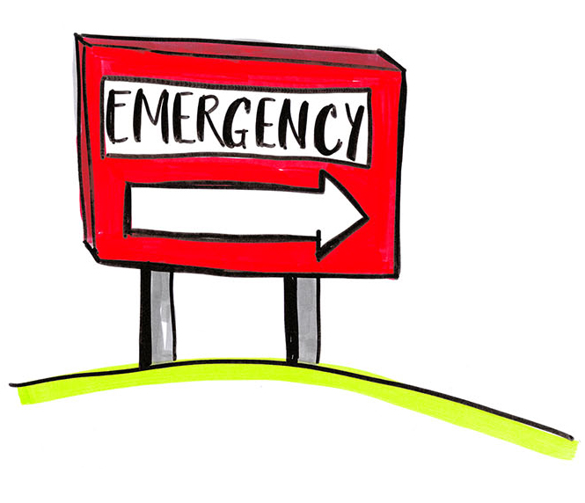
Organ Donation and the ED
A Strategy for Best Practice

Slide 2
UK Transplants and the Transplant Waiting List
2002 - 2016
Three people die in the UK
EVERYDAY waiting for a transplant
Organ Donation and the ED
Notes:
[CLICK advance]
There have been significant improvements in organ transplantation over the last decade…
[CLICK advance]
predominantly because of increased deceased donation.
ED staff have played an important part in this success.
[CLICK advance]
Yet despite improvements 3 people die in the UK everyday waiting for a transplant.

Slide 3
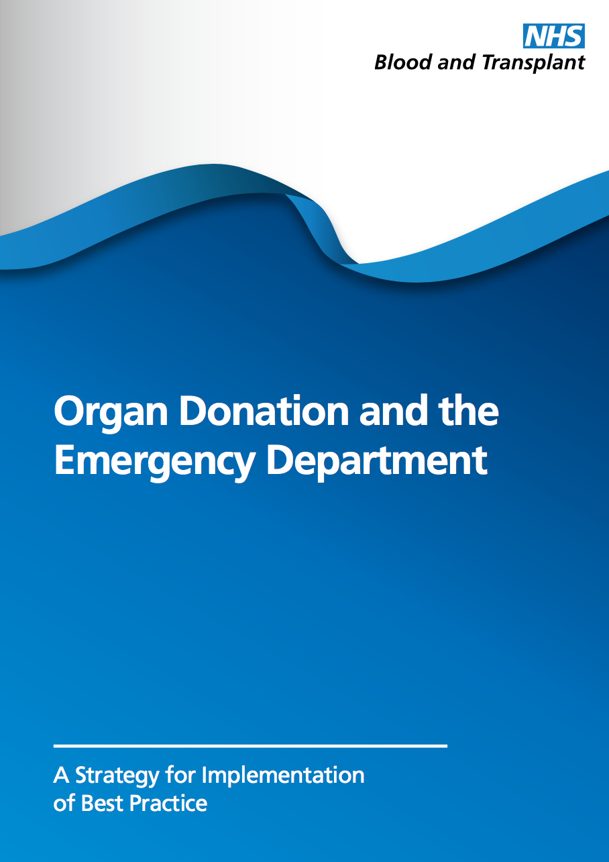

2016
Preface
Many critically ill patients enter the hospital through the Emergency Department. Emergency physicians and nurses are firstly concerned with resuscitation of these patients. We also recognise that some will have such severe illness or injury that they will not survive. The emergency department becomes the first stage of an emotional journey for the relatives. Clinicians working in the emergency department face many challenges as they help the family understand the unfolding tragedy.
Most patients who go on to become organ donors start their journey in the emergency department and the question of when to explore this opportunity for the patient can be difficult for clinicians and potentially cause conflict among them. Deceased donation is important, not just for those people waiting on the transplant list, but also because many people have made an express wish to become organ donors after their death. Nursing staff and emergency physicians must understand this and support their patients and families to explore this wish at the end of life.
This strategy guide presents best practice in how clinicians should make decisions about the withdrawal of treatment and describes the important legislation and ethical support for the identification and referral of the potential organ donor in the emergency department, building on the Royal College of Emergency Medicine, End of Life Care Best Practice Guide. Furthermore, it practically describes best practice in approaching the family of the potential donor.
Dr Tajek Hassan
President of the Royal College of Emergency Medicine
Organ Donation and the ED
Notes:
The ED strategy by NHS Blood and Transplant hopes to build on past success while we strive to do more and has been endorsed by the RCEM.
Most patients who go on to become organ donors start their journey in the emergency department. Deceased donation is important, not just for those people waiting on the transplant list, but also because many people in the UK have expressed a wish in life to become organ donors after their death.
This strategy guide presents best practice in how clinicians should make decisions about the withdrawal of life-sustaining treatment, identify and refer the potential organ donor in the emergency department and approach a family of a potential donor. It builds on the Royal College of Emergency Medicine, End of Life Care Best Practice Guide and other national guidance.

Slide 4
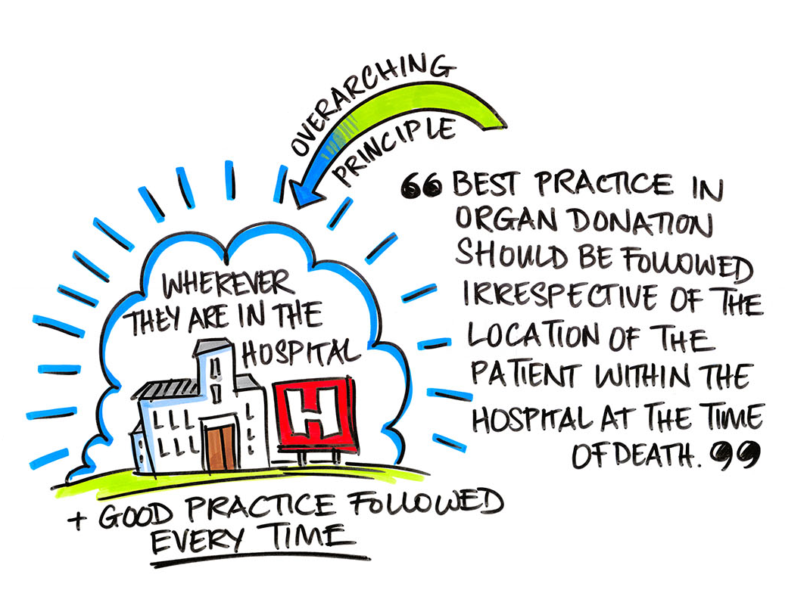
Organ Donation and the ED
Notes:
The overarching principle of the strategy is that best practice in organ donation should be followed irrespective of the location of the patient within the hospital at the time of death.

Slide 5
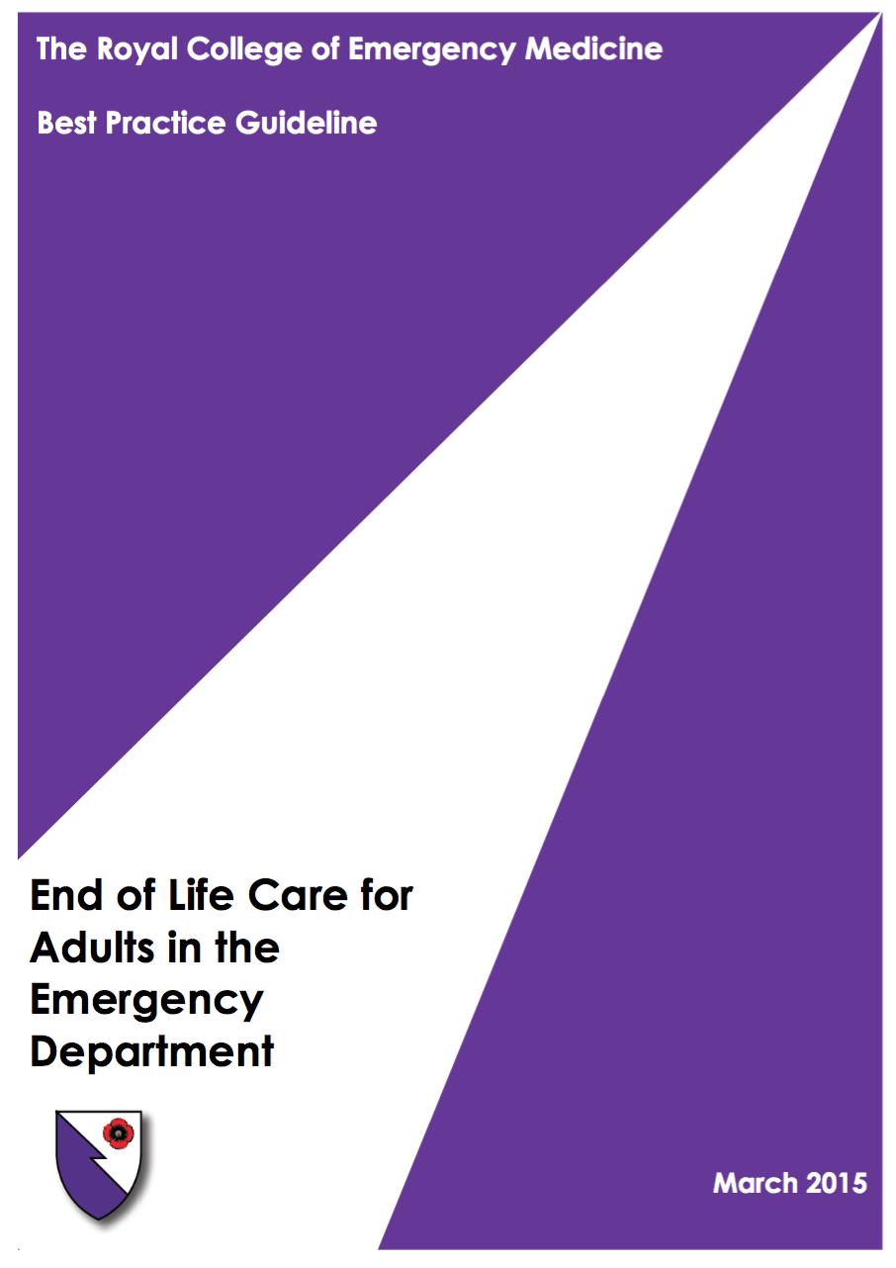


Royal College of EM
A senior named ED clinician should be involved with and responsible for every end of life care patient. This will usually be the ED Consultant but may be an ST4 or above out of hours, who should discuss such patients with their Consultant by phone as a minimum.
2015
Organ Donation and the ED
Notes:
Making the right decision regarding the withdrawal of life sustaining treatment in a critically ill ventilated patient in the ED can be difficult. Good communication by senior doctors is essential.

Slide 6
St Elsewhere
Young man, high speed traumatic head injury.
Within an hour of arrival in ED - declared non survivable by neurosurgery.
Family approached for donation by ED consultant whilst SNOD enroute.
Family very keen for donation
No ICU beds available in the hospital, but available in another hospital in the same trust.
SNOD confirmed donation with the family and also the coroner at ICUs request prior to transferring the patient to the sister hospital.
On arrival to ICU, patients GCS started improving, strong spontaneous cough.
ICU consultant felt best to pause process
GCS improved further overnight.
Decision to transfer him back to the neurocentre and treat.
Discharged home.
Family are okay with everything, very thankful donation delayed treatment withdrawal!
Organ Donation and the ED
Notes:
6
This is a case where the decision making proved especially difficult. The trouble is around the UK and around the world, everyone has had a case like this.
[Mention a local case if relevant]

Slide 7
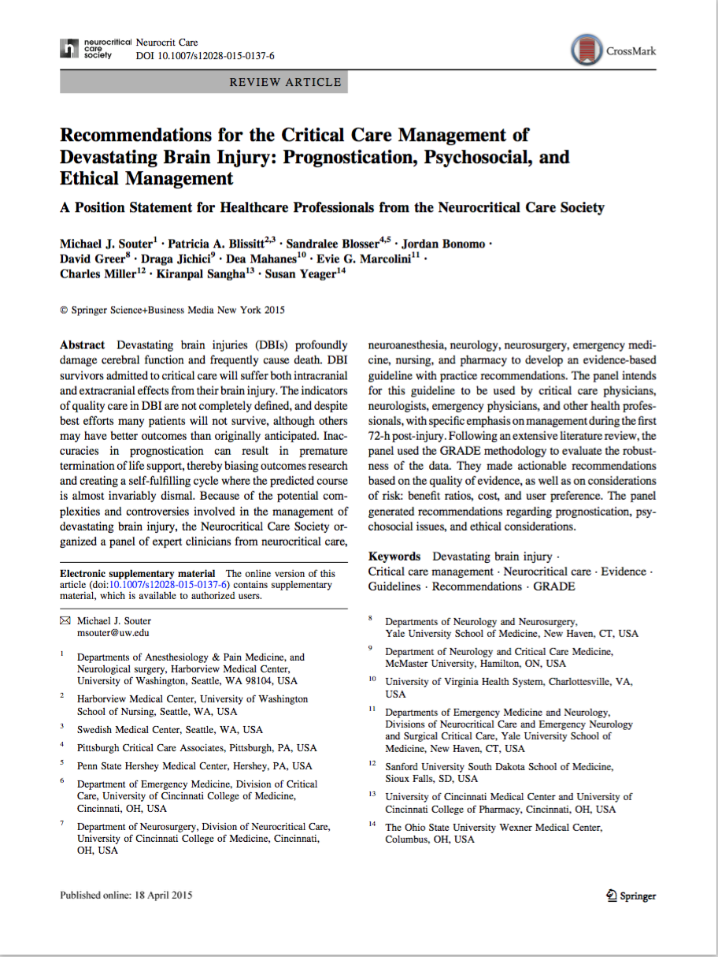
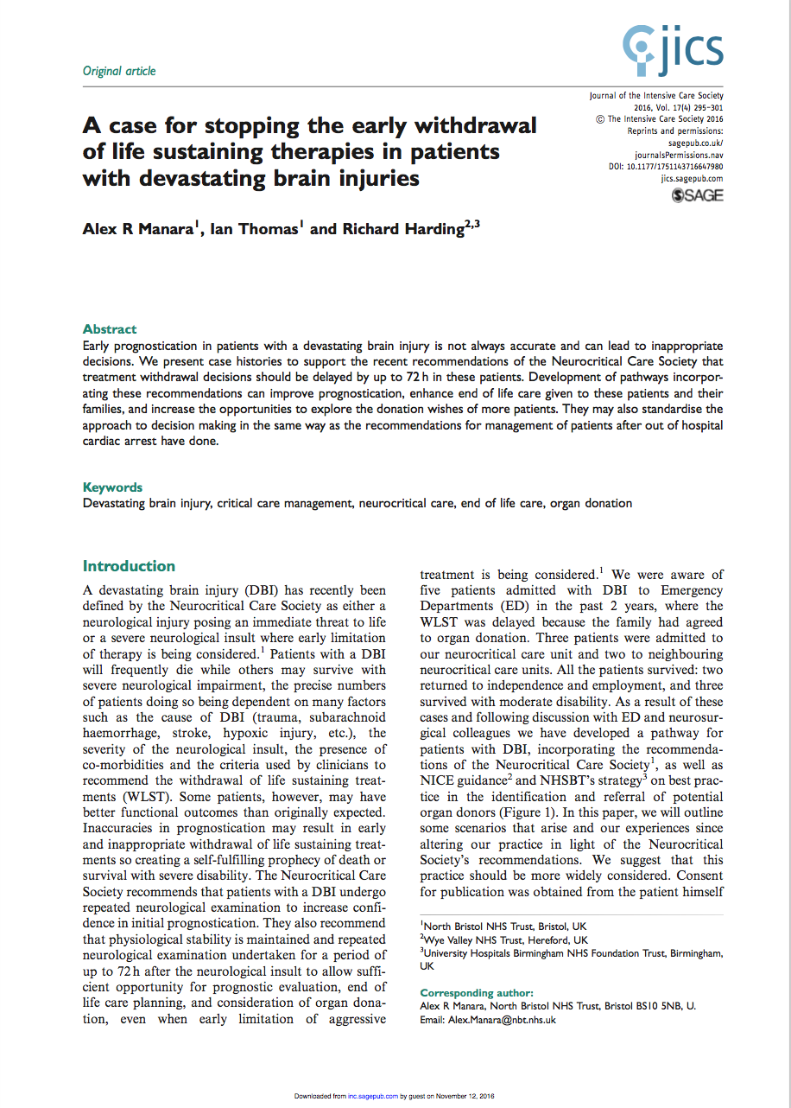
Neurocritical Care Society Guidance (USA)
We recommend determining prognosis from repeated examinations over time to establish greater confidence and accuracy.
2015
2016
“A case for stopping the early withdrawal of life sustaining therapies in patients with devastating brain injuries.”
Souter et al. (2015)
Neurocritical Care; 23: 4–13.
Manara A, Thomas I and Harding R. (2016)
JICS 14(4): 295-301.
Organ Donation and the ED
Notes:
In the USA they were so worried that the Neurocritical Care Society recommended admission of all patients with devastating brain injury to the ICU for a period of observed prognostication.
[CLICK advance]
In the UK Alex Manara and colleagues in Bristol have argued that there is a case for stopping the early withdrawal of life sustaining therapies in ED in patients with devastating brain injuries.

Slide 8
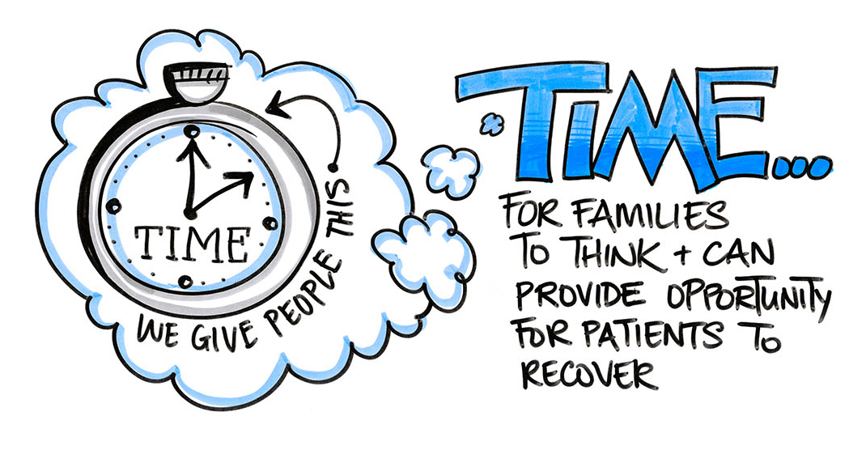

vs
Organ Donation and the ED
Notes:
Admission of patients with devastating brain injury to ICU can certainly give time for families to come to terms with the death of their relative and in rare cases may even provide the opportunity for patients to recover; but balancing against ICU resources will be an ongoing challenge in the UK.
Currently there is a draft consultation document led by the Faculty of Intensive Care Medicine but supported by the Royal College of Emergency Medicine which suggests that these patients receive a period of physiological stabilisation and observation on ICU to improve the quality of decision making.
[Note once this DBI statement is approved it will be added to the slide set but it is premature to do so currently].

Slide 9
2016
Before deceased donation becomes part of a patient’s end of life care in the ED, it must be robustly established that further life-sustaining treatment is not of overall benefit to the patient.
Any decision to withdraw life-sustaining treatment should be made by two senior doctors.
Organ Donation and the ED
Notes:
While we await this guidance the recommendation in the ED strategy is more conservative. It simply asks that any decision to withdraw life-sustaining treatment be made by two senior doctors.
That may or may not lead to admission to ICU for a period of observed prognostication.

Slide 10
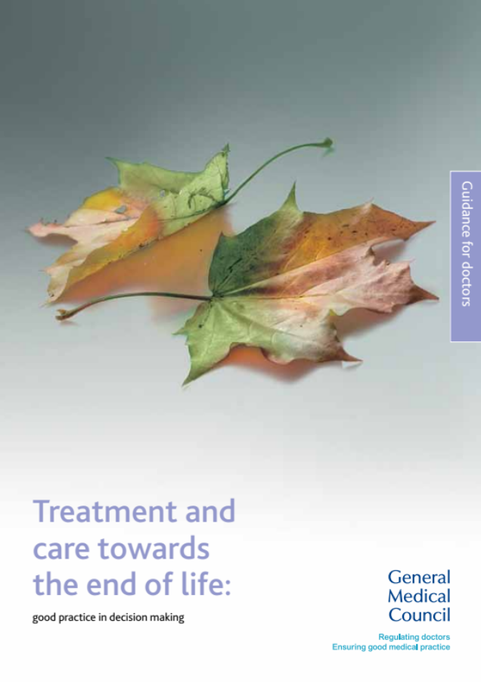

General Medical Council
Organ donation
81 If a patient is close to death and their views cannot be determined, you should be prepared to explore with those close to them whether they had expressed any views about organ or tissue donation, if donation is likely to be a possibility.
82 You should follow any national procedures for identifying potential organ donors and, in appropriate cases, for notifying the local transplant coordinator.
2010
Establishes a duty on doctors to explore donation and follow national procedures.
Organ Donation and the ED
Notes:
With regard to the identification and referral of potential organ donors you may not know that there is GMC duty on doctors to refer.
As established in the 2010 GMC Good Practice Guidance: Treatment and Care Towards the End of Life.

Slide 11
Royal College of EM
Opportunities for organ and tissue donation should be considered as a usual part of end of life care in the Emergency Department.
ED staff should refer all patients who are expected to die, and who are intubated and ventilated, to their local Specialist Nurse in Organ Donation (SNOD).
Referral to the SNOD should be as early as possible as they can offer valuable support and guidance for the team and family. The SNOD will assess patient suitability for organ donation and approach the patient’s next of kin for consent, if appropriate.
2015
Organ Donation and the ED
Notes:
Referring to the specialist nurse for organ donation (or SNOD as they are called) and referring early is strongly supported by the RCEM. Importantly suitability for donation is highlighted as best carried out by the SNOD and not to be prematurely declined by clinical staff.

Slide 12
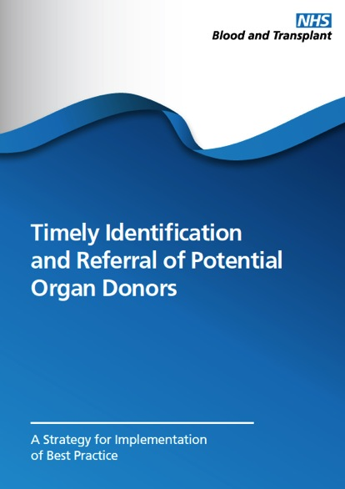
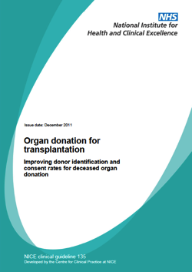
2012
Refer to SNOD
Plan to withdraw life-sustaining treatment in a mechanically ventilated patient.
2011
16% of the patients who died in ED and were NOT referred as potential donors were registered as donors on the NHS Organ Donor Register.
Organ Donation and the ED
1st April 2012 – 31st March 2016
Notes:
Additionally there is NICE Guidance telling us WHO to refer; and the message is simple. Refer to the SNOD any mechanically ventilated patient you are considering the withdrawal of life sustaining treatment in the ED.
[Click advance]
Sadly between 2012 and 2016 16% of patients who died in the ED meeting referral criteria but who were not referred, were subsequently found to have been on the NHS Organ Donor Register. This denied these patients the opportunity to have their end of life wishes respected.

Slide 13
Northern Ireland Referral
Notes:
13
The goal of the strategy is that for patients dying in the ED meeting referral criteria...

Slide 14
Strategy Goal: No one died in your ED meeting referral criteria and was not referred. (NO BLUE)
Northern Ireland Referral
Notes:
14
... they are either all referred, or there are no patients dying in your ED meeting referral criteria because they have all been admitted to ICU (eg South Eastern).

Slide 15
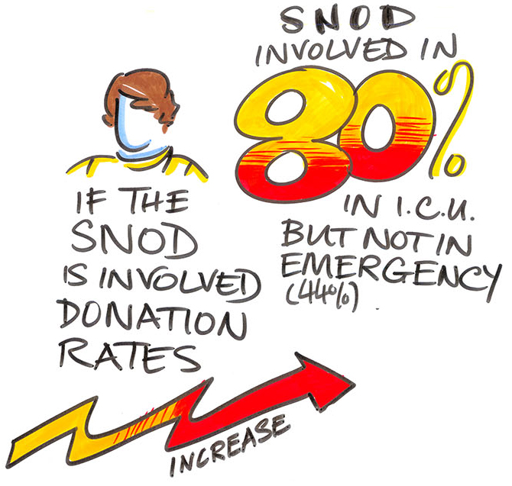
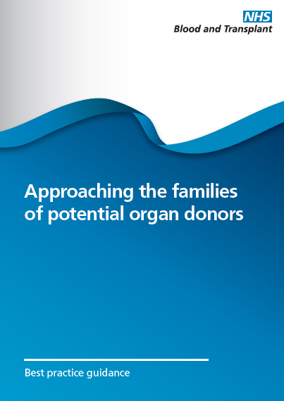
Donation is ONLY raised after confirming the families understanding and acceptance of loss.
Planning
2012
Confirming understanding and acceptance of loss
Discussing donation
Organ Donation and the ED
Notes:
We know that families are hardly likely to being willing to positively consider organ donation if they have not understood and accepted their impending loss. The presence of a SNOD in these conversations dramatically increases the consent and authorisation rate. The SNOD has the bereavement skills and time to help you deliver empathic, family first, end of life care.
So donation conversations need to be planned. And the option of donation should only be raised in the presence of a SNOD and after confirming the families understanding and acceptance of loss.
One way is that the doctor raises the option of organ donation as an end-of-life choice the family can make on the patient’s behalf and hands over the conversation to the SNOD.
Alternatively, in the planning conversation, it may have been decided that the SNOD be the person to raise donation.

Slide 16
Strategy Goal: No family approached in ED regarding organ donation without a SNOD. (NO RED)
Family Approaches – Northern Ireland
Notes:
16
No family approaches in the ED in Northern Ireland.

Slide 17

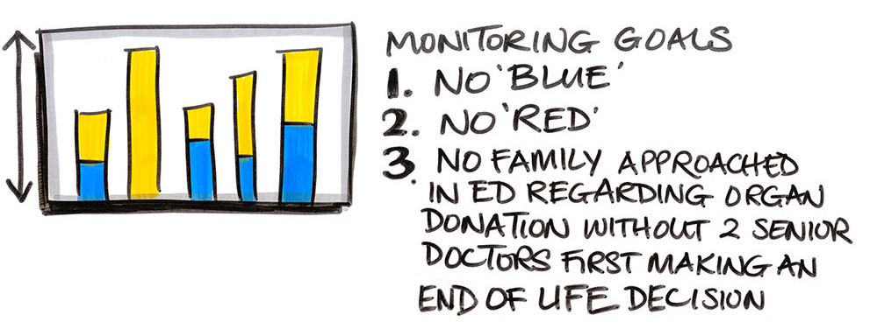
2016
Organ Donation and the ED
Notes:
The ED Strategy is a big ask and we need your help.
What we need from you in the ED is three things.
No blue. No one dies in your ED meeting referral criteria and is not referred.
No red. No family is approached in ED regarding organ donation without involving a SNOD.
And to ensure the right prognostic decision is always made and there are no mixed messages given – no family is approached in ED regarding organ donation without two senior doctors first confirming the end of life treatment decision.

Slide 18

Organ Donation and the ED
Notes:
The overarching principle of the strategy is clear:
Best practice in organ donation should be followed irrespective of the location of the patient within the hospital at the time of death.
It is a goal worth striving for.
[Click advance]
Thank you.

