Slide 1
Pathology
Professor Derek Manas
Professor of HPB and Transplant Surgery
Newcastle University
Medical Director OTDT

Slide 2
Introduction
Histopathological review is necessary when:
  A suspicion of malignancy identified in a donor
    ‘lump’ in a potentially transplantable organ
    Suspected ‘cancer’ in a hollow viscus
  Further assessment of organ quality is required
    Liver (fat)
    Kidney (glomerulosclerosis)
Urgent histopathological analysis can enable the utilisation of donor organs that would otherwise have been discarded

Slide 3
Case 1
42-year-old male
‘liked a drink’
RTA
  Head injury
  DBD donor
    LFTs – Normal
    U+E – Normal
6 Organs accepted:
  2 kidneys
  Heart and lungs
  Pancreas
  Liver
Creatinine | 73
Amylase | 40
Glucose | 8
Bilirubin | 18
ALT | 17
GGT | 78
PT | 12
U Output | 3400mls

Slide 4
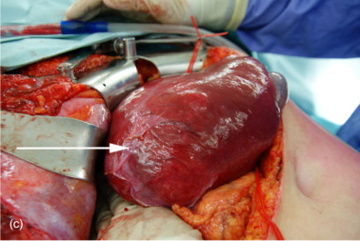
Case 1
Retrieval
  All organs retrieved
  Heart and Lungs – dispatched
  Abdominal organs were retrieved ‘En-bloc’
  On the back table – lesion was noted posteriorly in the Right lobe of the liver
  WHAT NEXT?

Slide 5

Case 1
Options:
  Ignore – surgeon says its benign
  Discard all organs
  Biopsy
  The pathologist on call that night could not decide if it was malignant or not

Slide 6

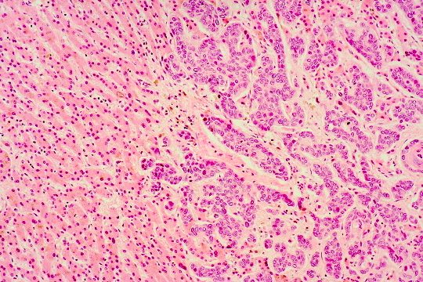
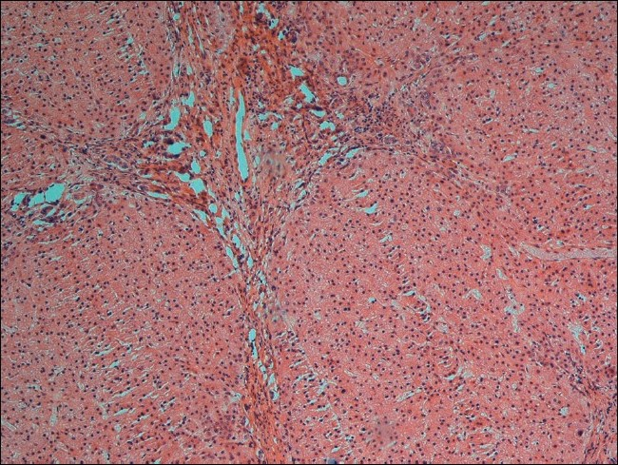
Case 1
normal hepatocytes
malignant cells
Hepatocellular Carcinoma
Focal Nodular Hyperplasia

Slide 7
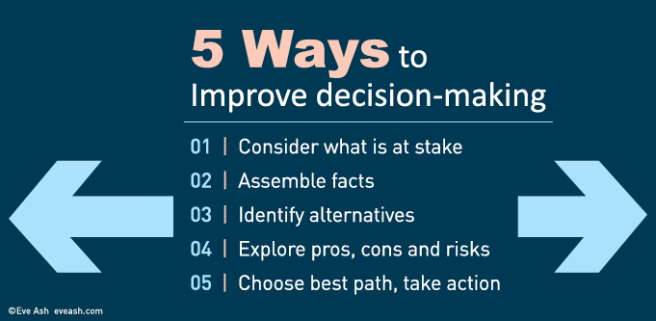
Case 1
Options:
  Ignore – surgeon says its benign
  Discard all organs
  Biopsy results awaited. . . .
  What about the heart and lungs – already dispatched?

Slide 8
Case 1: FNH (benign)
FNH is the second most common hepatic lesion and is found at autopsy
  prevalence of 0.3 – 3 %
Clinically relevant cases of FNH are rare
  reported prevalence in US studies of 0.03 %
Caused by an injury to the portal tract resulting in the formation and enlargement of arterial to venous shunts
  This causes hyper-perfusion in local arteries resulting in oxidative stress that triggers a response from hepatic stellate cells to produce the central scar typically seen in cases of FNH
Buscarini L et al, 1993; Wanless IR et al, 2006

Slide 9
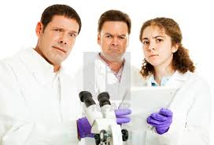
Types of FNH lesions
Traditional
  those containing abnormal nodular architecture, malformed appearing vessels and cholangiolar proliferation)
  most likely to be associated with symptoms.
Telangiectatic
Mixed
Atypical forms
  less likely to be associated with symptoms.
Hsee LC et al, 2005

Slide 10
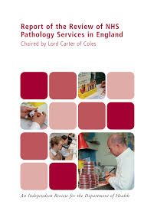
RC pathology guidelines
Specialist On-call Rota's

Slide 11
Case 2
42-year-old male
‘liked a drink’
BMI - 36
RTA
  Head injury
  DBD donor
    LFTs – Abnormal
    U+E – Normal
6 Organs accepted:
  2 kidneys
  Heart and lungs
  Pancreas
  Liver
Creatinine | 73
Amylase | 40
Glucose | 8
Bilirubin | 28
ALT | 17
GGT | 378
PT | 17
U Output | 3400mls

Slide 12
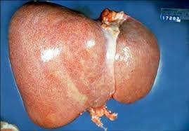
Case 2
At retrieval:
  Liver noted to be ’moderately fatty’
  What next:
    Ignore
    Biopsy
    Contact recipient Centre

Slide 13
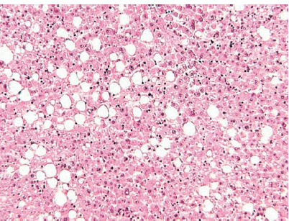
Case 2: 16% to 20% Macrovesicular steatosis

Slide 14
There are two forms of Liver ‘Graft–Steatosis’
Macrovesicular steatosis
  fat vacuoles occupy most of the hepatocytes cytoplasm and displaces the nucleus peripherally
    associated with excessive alcohol, obesity, diabetes and hyperlipidaemia
Microvesicular steatosis
  fat vacuoles are smaller and have a centrilobular distribution
    associated with mitochondrial injury such as acute viral or drug induced injury, sepsis and some metabolic disorders
Angele MK et al, Am J Surg 2008; 195: 214.

Slide 15
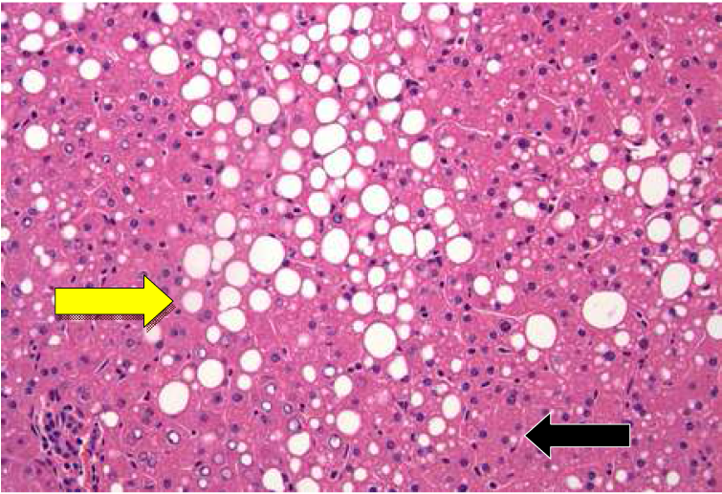
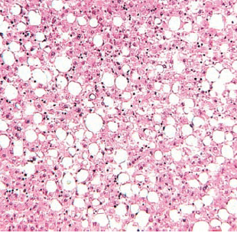

50% to 55% MacVS.
Large droplet Macro-VS, small droplet Macro-VS, Micro-VS

Slide 16
Hepatic Steatosis – Outcome after LT
Definition
Impact of a ‘fatty’ graft
< 30% Mild
30% - 60% Moderate
> 60% Severe
Primary non-function
  No steatosis: < 5%
  Mild steatosis: 5 %
  Moderate steatosis: 10-15%
  Severe steatosis: > 50%
D'Alessandro A. Transplantation 1991
Strasberg SM, Hepatology, 1994
Ploeg R, Transplantation, 1993
MORE SPECIFIC: LARGE DROPLET MacVS, SMALL DROPLET MacVS, MicVS, TOTAL STEATOSIS

Slide 17
Case 2: best utilisation?
Recipient
  40-year-old ALD
    Abstinent for 2 years
  5 cm HCC
    Previously 6.2 cm
    Down-sized with TACE and RFA
    Meeting the ‘new criteria’
  Been waiting 100 days
    First offer of a liver

Slide 18
Case 3
Female donor:
  63 years old
  SAH
  BMI - 32
  History of
    Hypertension and MODM
    Smoker for 20 years
    ‘liked a drink’
    Previous breast cancer – stage I – 10yrs before
        Given the ‘all clear’
  DBD
    Offer of liver and kidneys
Creatinine | 92
Amylase | 40
Glucose | 14
Bilirubin | 18
ALT | 47
GGT | 118
ICU stay | 3days
U Output | 1400mls
Po2 | 10

Slide 19
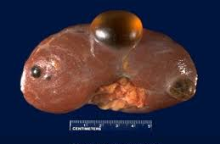
Case 3
At retrieval:
  L kidney was noted to have multiple cysts
  What next:
    Ignore
    Biopsy
    ‘De-roof’
    Contact the recipient Centre
Simple cysts

Slide 20
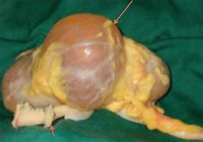
Case 3
What if the cyst was more complex
What next:
  Ignore
  Biopsy
  Contact the recipient Centre

Slide 21
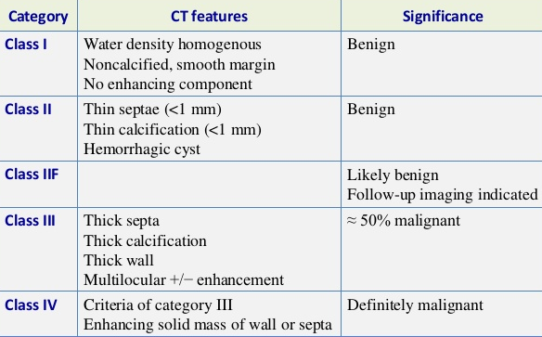
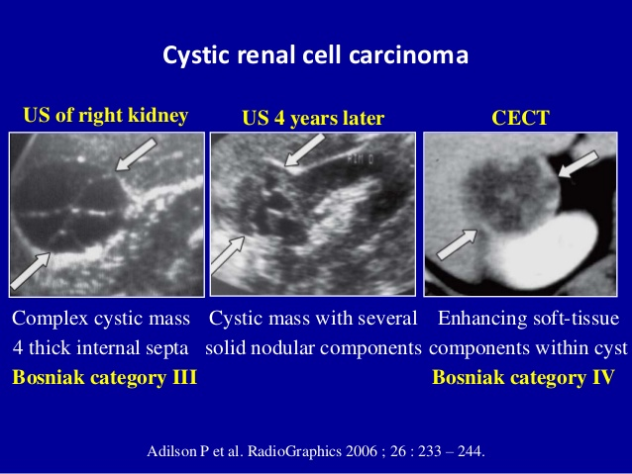
Renal cysts
Chapple et al, 2011

Slide 22
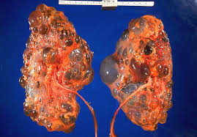
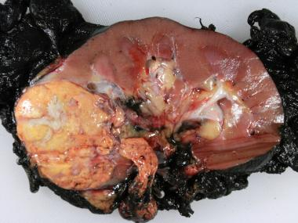
Which one should be biopsied?

Slide 23
Case 4
72 year old man
  Hypertension
  Diabetes
Sudden collapse
Plan to withdraw treatment
Offered kidneys as a DCD
NORS surgeon noted significant scarring
  Both kidneys
Creatinine | 102
Amylase | 24
Glucose | 14
Bilirubin | 18
ALT | 27
GGT | 78
ICU stay | 3days
U Output | 400mls
Po2 | 12

Slide 24
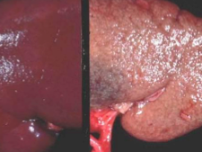
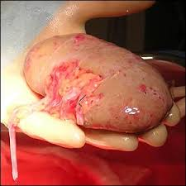
Case 4
At the implanting Centre there were concerns
Options:
  Ignore and implant
  NMP
  Discard
  Biopsy
REMUZZI SCORE: 8

Slide 25
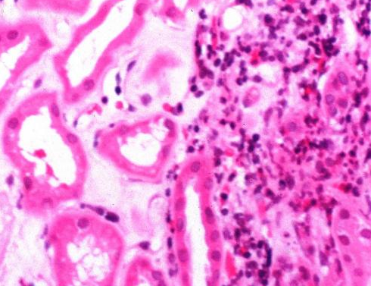
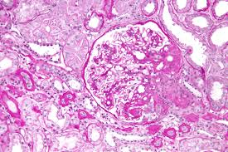
Case 4
Tubulointerstitial fibrosis
Glomerulosclerosis

Slide 26
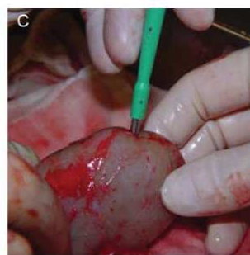
Scarred kidney. . .
With increasing age there is an increase in chronic vascular changes, tubulointerstitial scarring and glomerulosclerosis in kidneys
  The histological extent does not correlate with the serum creatinine
The only reliable way to determine the extent of scarring is by an adequately sized biopsy, that takes in the full thickness of the cortex:
  to prevent over representation of subcapsular accentuation of glomerulosclerosis
  includes arcuate arteries more likely to show hypertensive type intimal changes impacting the luminal area
The use of a biopsy has been shown to increase the utilization of elderly donors with good outcomes
Mallon DH et al, 2015; Remuzzi G et al, 2006

Slide 27
Remuzzi Score (Cambridge modification)

Slide 28
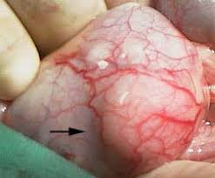
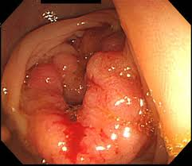
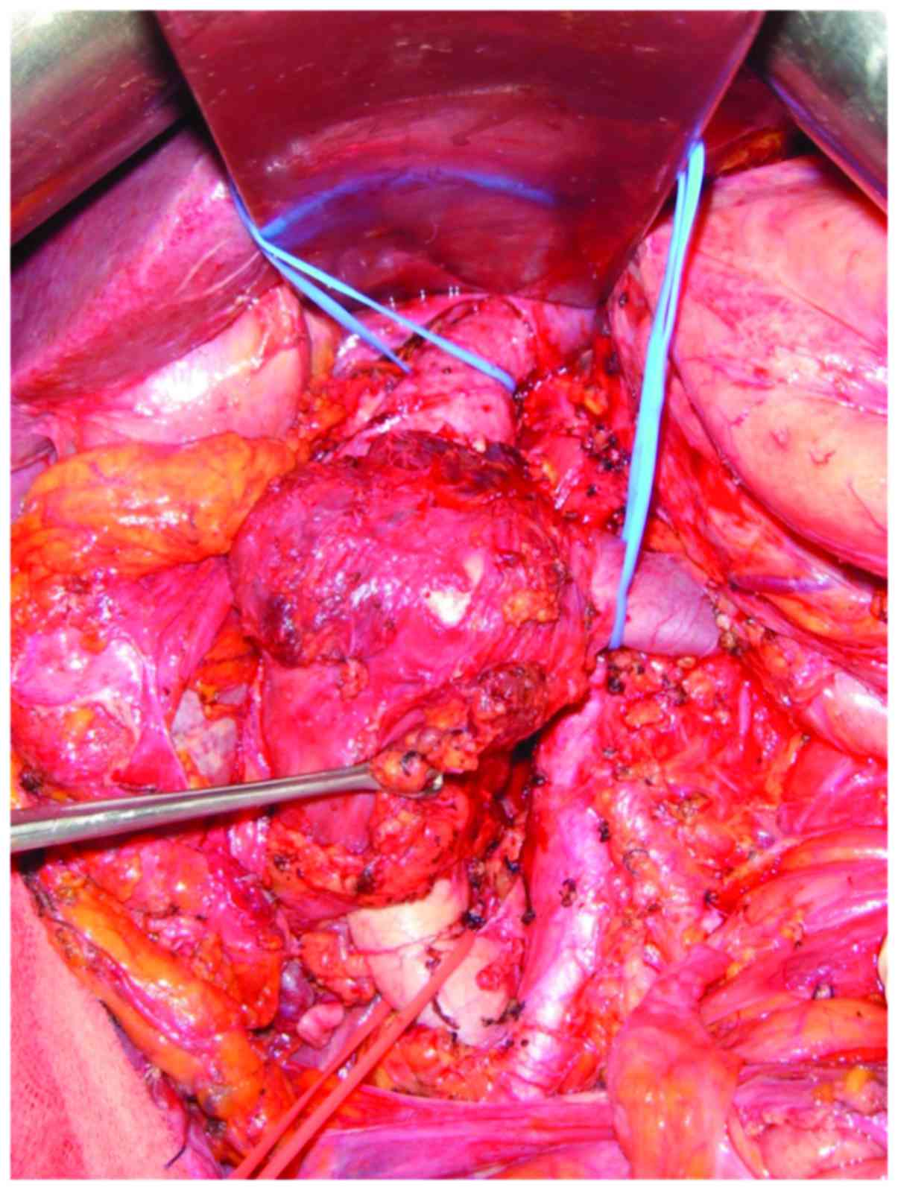
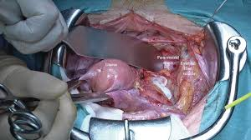
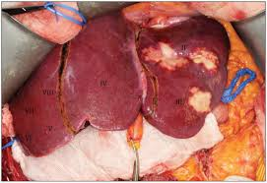
the need
For those unexpected lesions identified during organ retrieval or at the time of examination of the organ/s at the implanting centre.
  Histopathological analysis becomes necessary before safe transplantation can proceed.
    Once its biopsied all is put on hold until there is an outcome
  At present there is NO FORMAL ‘JOINED-UP’ process across TRANSPLANTING CENTRES IN THE UK for obtaining ‘out-of-hours’ histopathological review of retrieved organs
    Some centers have an on-call
    Some centers – ‘good-will’
    Some centers have no service

Slide 29
Why is pathological analysis important?
Risk of malignant lesions is increased with:
  Increasing age
  Obesity
  Excess alcohol
  Smoking
  History of previous malignancy (metastases to liver and lungs)
Further assessment of organ quality is required
  enable the better utilization of donor organs

Slide 30
Age and BMI
37% > 60
30% > 30

Slide 31
Case 5
Male donor:
  18yrs old
  Attempted suicide by hanging
  Was found by friends and cut down
    ‘hanging-time’ unknown
      ??? WIT
  Resuscitated by paramedics
  No past medical history
  All his organs offered as a DBD
Creatinine | 375 → 101
Amylase | 300 → 88
Glucose | 4
Bilirubin | 18
ALT | 702 → 204
Po2 | 18
ICU stay | 5days
U Output | 800mls

Slide 32
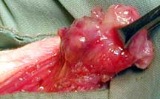
Case 5
At retrieval, a large para-aortic lymph node mass (2.5 cms) was found
SNOD attempted to get a histology assessment @ 2am
No pathologist was available
NORS surgeon assessed it as benign

Slide 33
Case 5
What next:
  Cardiac patient was asleep
  R kidney was allocated to a recipient for a beneficial match (waited 3 years)
  Liver was allocated to a Sero-negative hepatitis 27-year-old female
  Pancreas was allocated to an islet patient with severe hypoglycemic unawareness
  6 organs were discarded and 6 patients missed out
    2 died

Slide 34
History of cancer in a potential organ donor

Slide 35
History of cancer in a potential organ donor
61 donors donated 140 organs
133 recipients, comprising a total of
  86 Kidneys
  22 Livers
  10 Hearts
  8 Lungs
  7 multiple organs
    (4 kidney–pancreas, 2 heart–lung and 1 kidney–heart).
Comparison of the survival of recipients of single organs from donors with an unacceptable/high risk and standard/non-standard risk of cancer transmission revealed no signiﬁcant difference in unadjusted survival or risk-adjusted hazard of death
At 10 years after transplantation, the additional survival beneﬁt of transplanting the organs from donors with an unacceptable/high risk of cancer transmission was 944 (95 per cent C.I. 851 to 1037) life-years, with a mean survival of 7·1 (95 per cent C.I. 6·4to7·8) years per recipient.
8 of these recipients developed post-transplant cancers, but none had the same cancer type as their donor, indicating these were likely to be de novo cancers
Desai R et al, 2014

Slide 36
Donor Malignancy Transmission Risk Assessment
Nalesnik MA et al, 2011

Slide 37
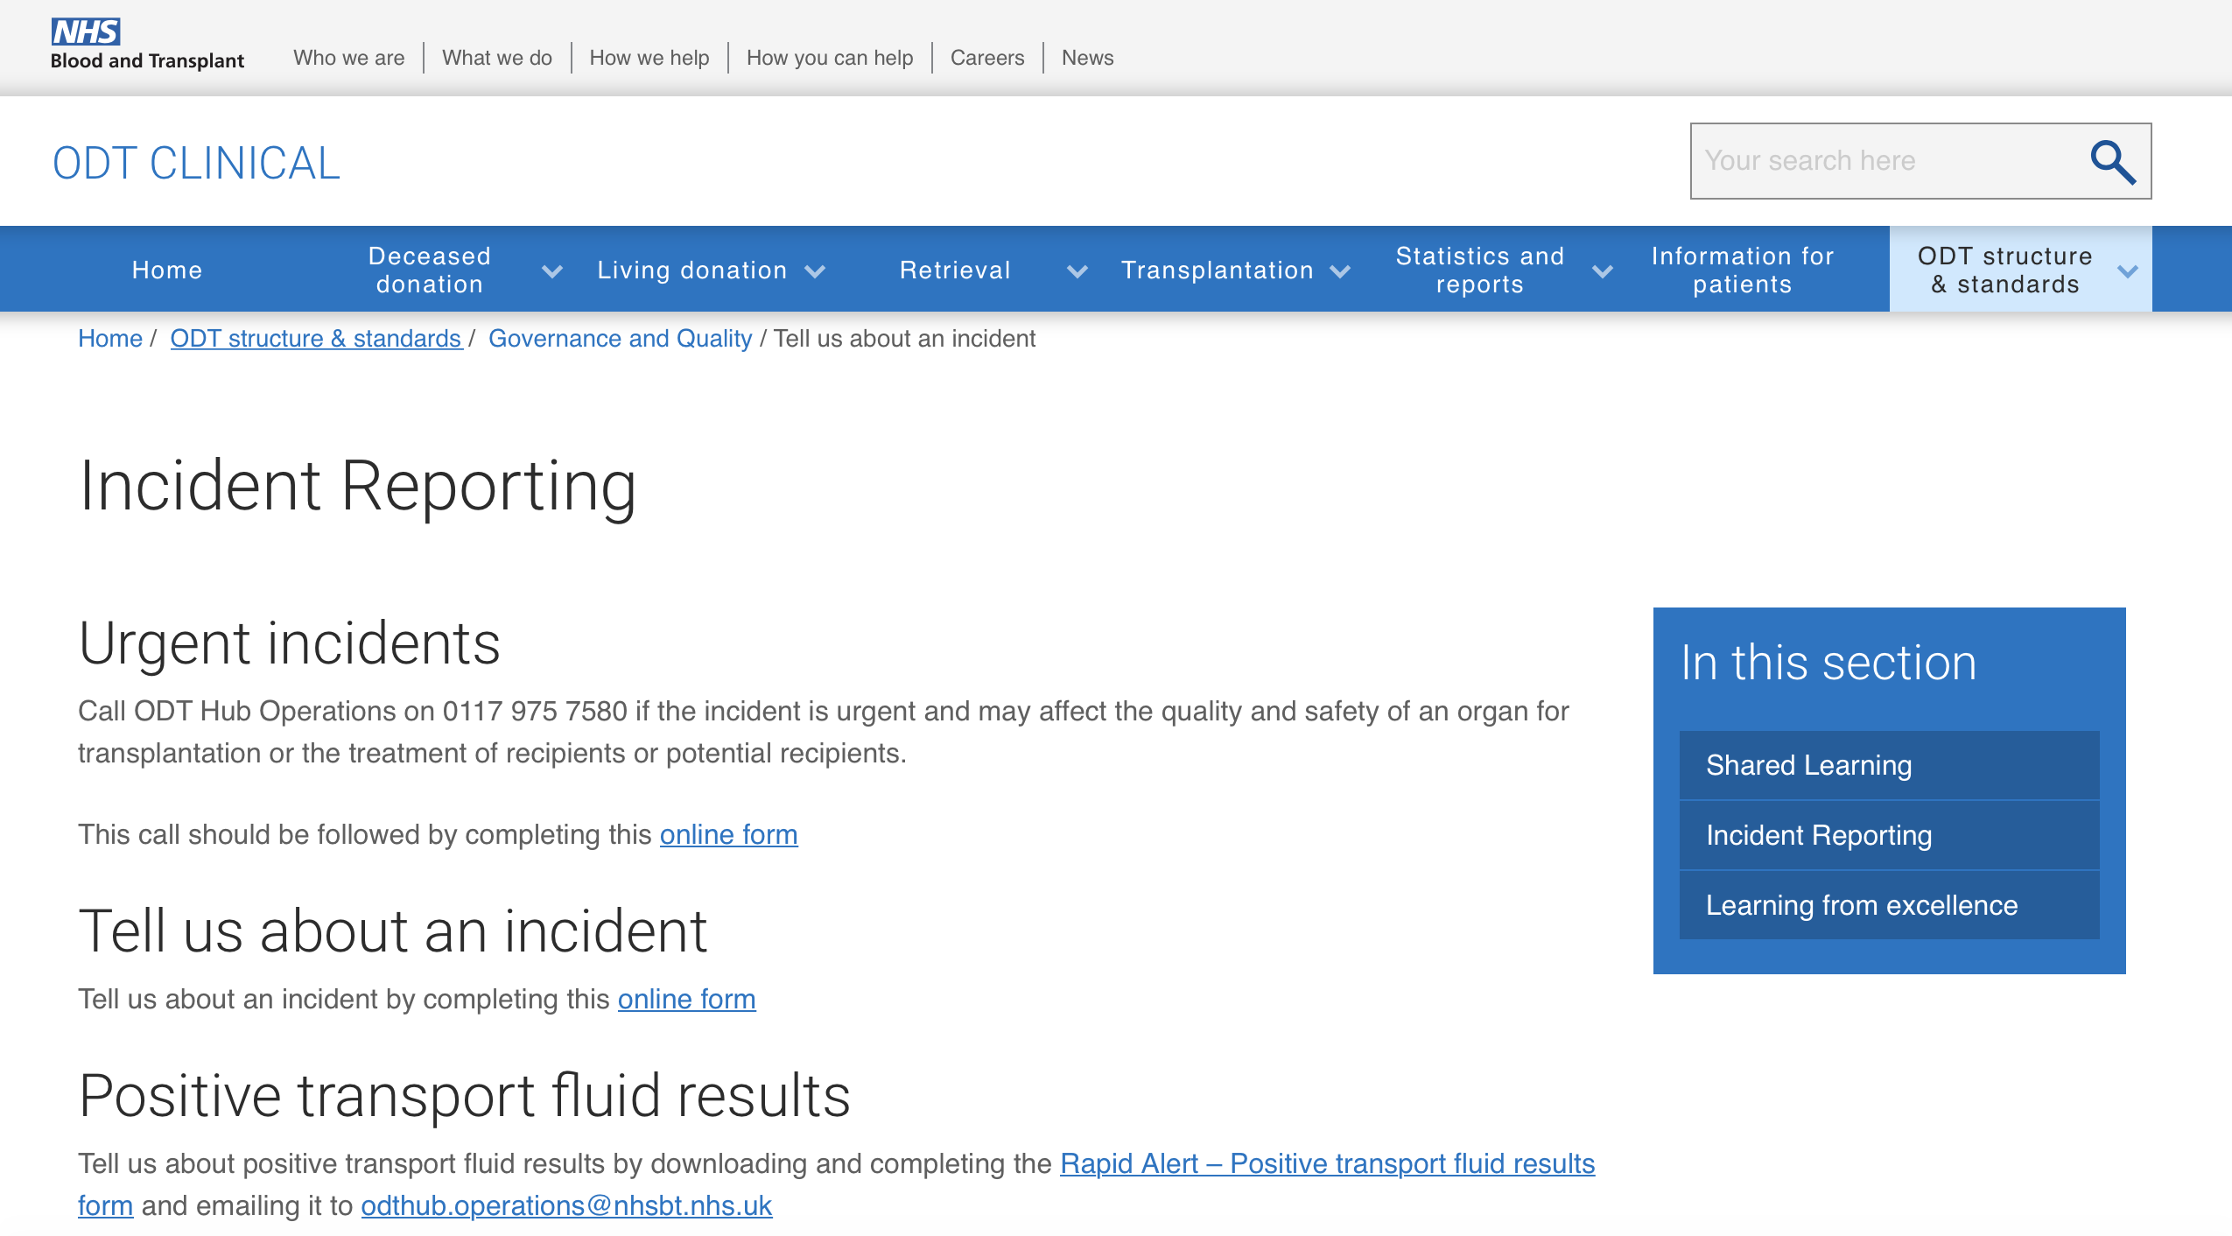
https://www.odt.nhs.uk/odt-structures-and-standards/governance-and-quality/tell-us-about-an-incident/

Slide 38
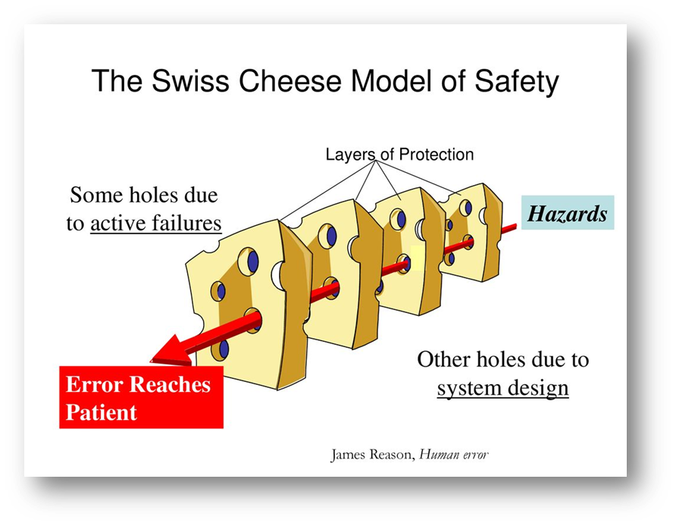
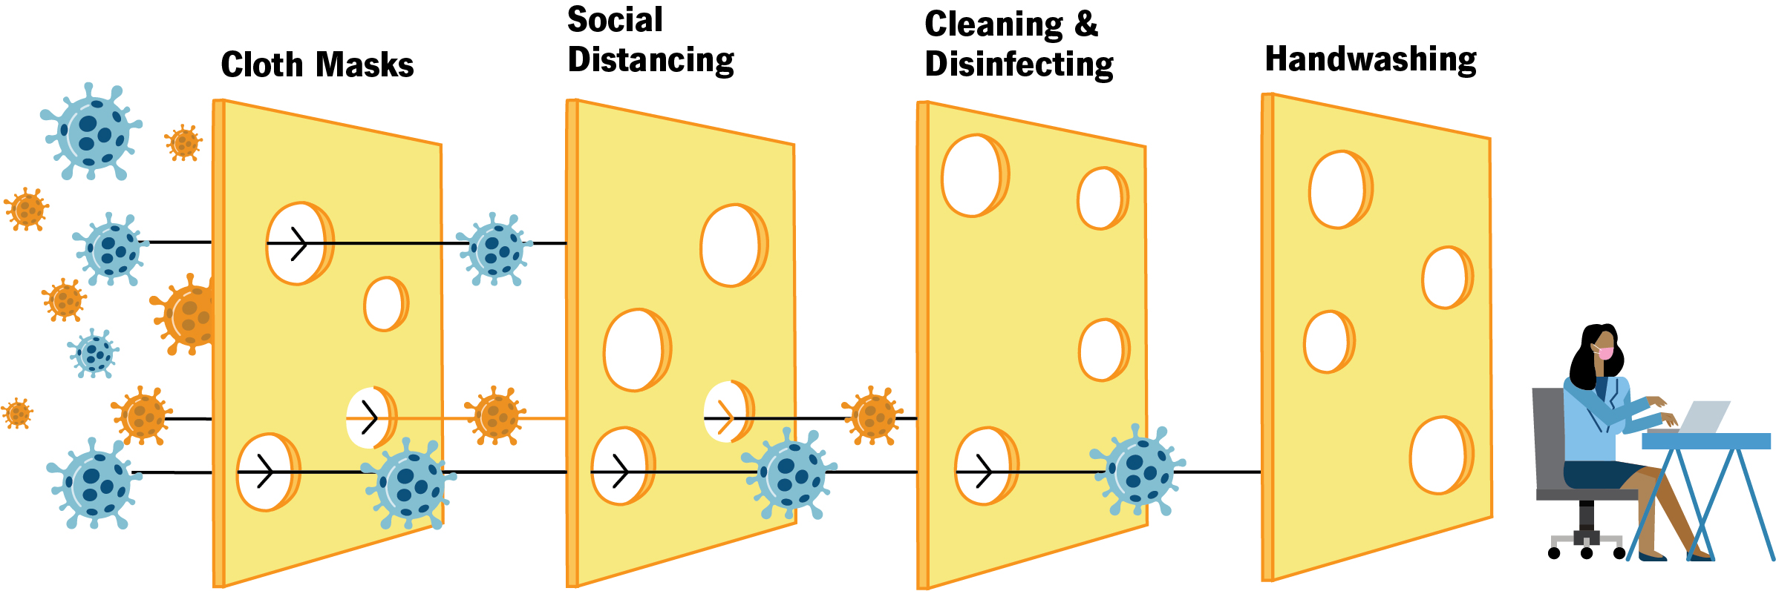

Slide 39
Bad for transplantation. . .

Slide 40

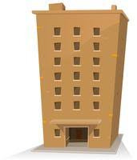
The current process: ‘vulnerable’
Specimen to Laboratory
Biomedical Scientist
Histopathology Processing
Frozen Section
Glass Slide
Pathologist
Histopathology Assessment
Glass slide
Provisional histopathology report emailed to HUB operations
Glass Slide - Histopathology Processing/ Histopathology Assessment

Slide 41
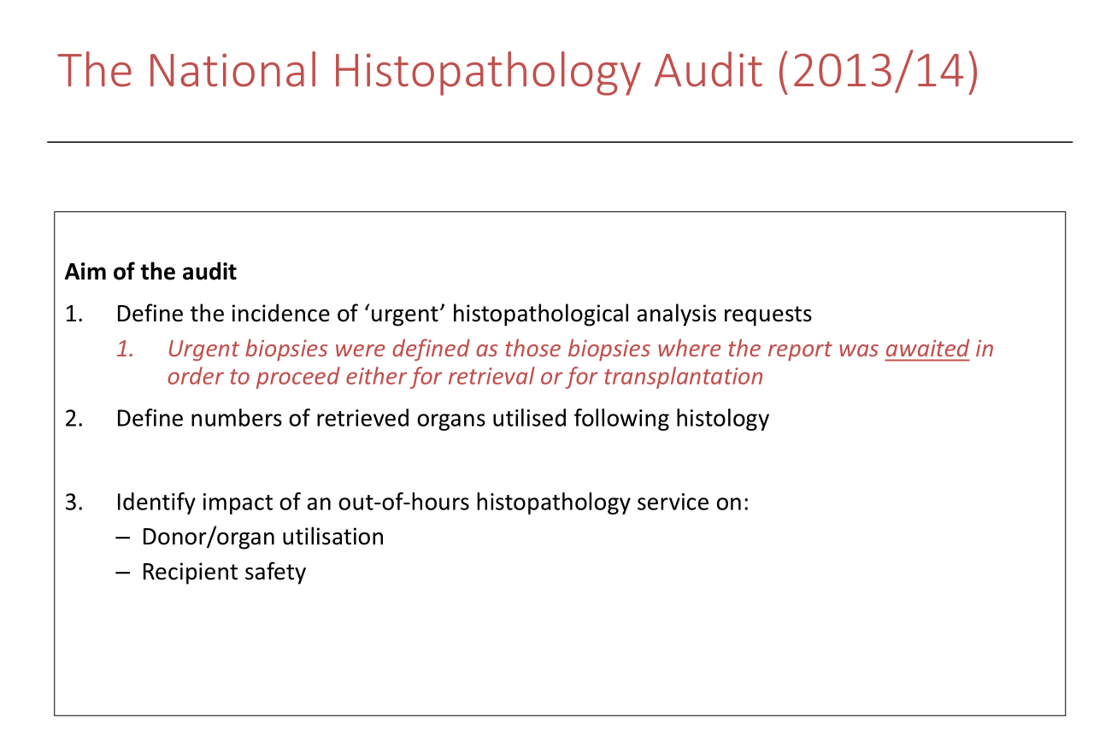
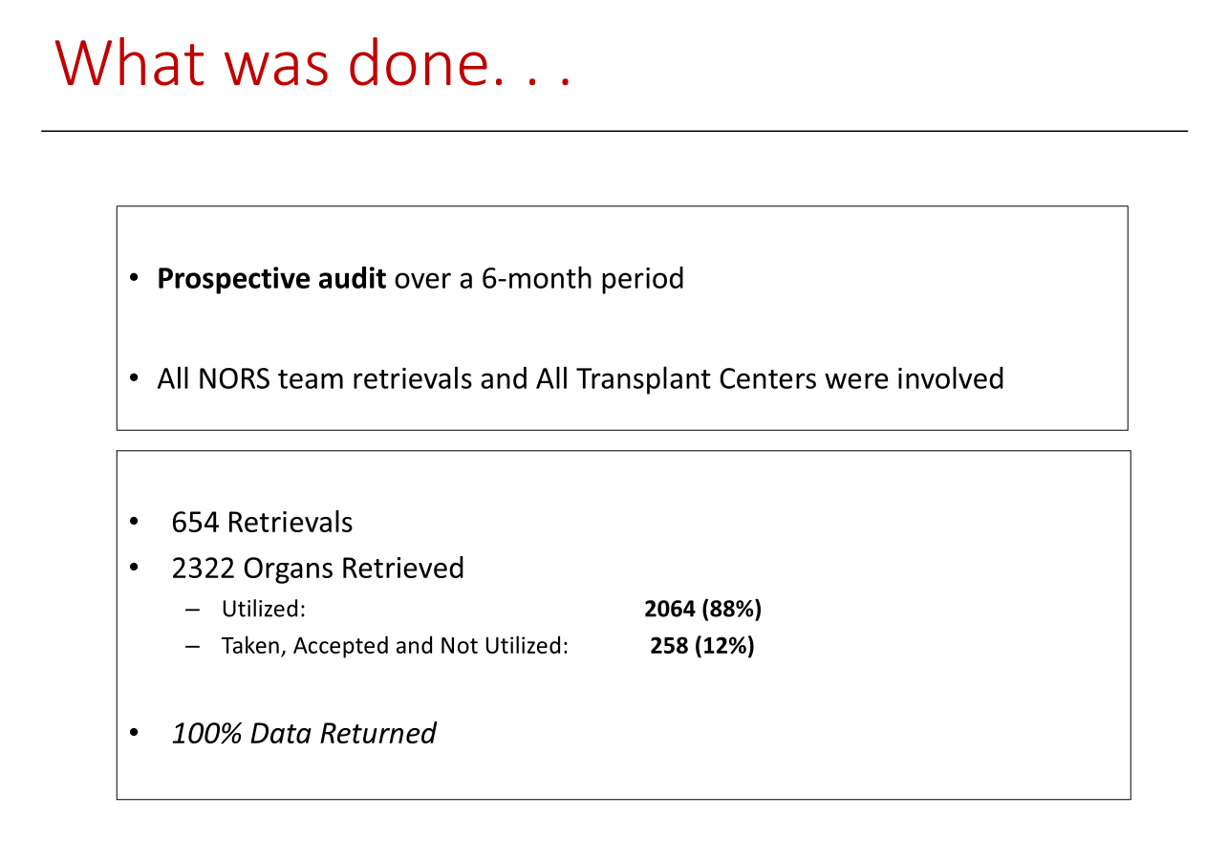
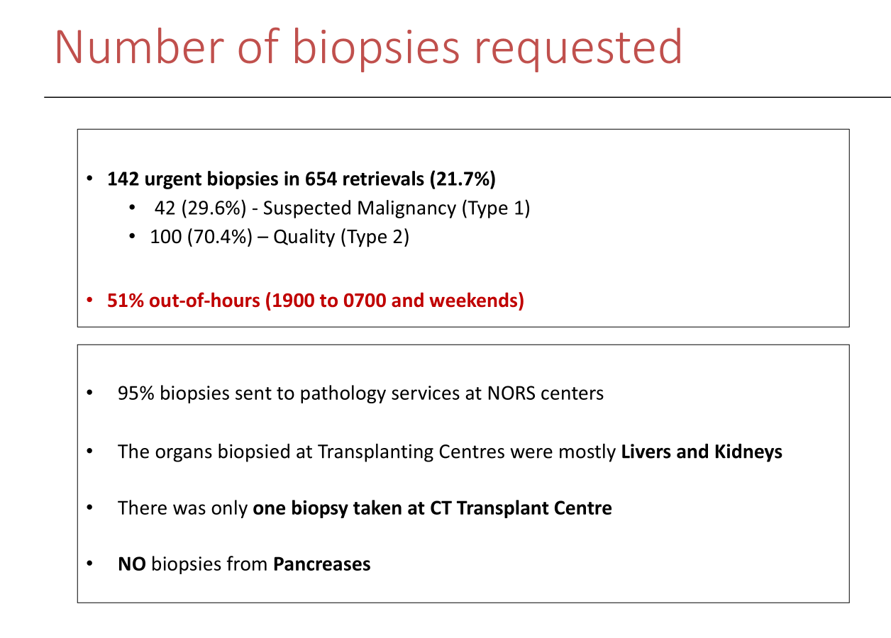
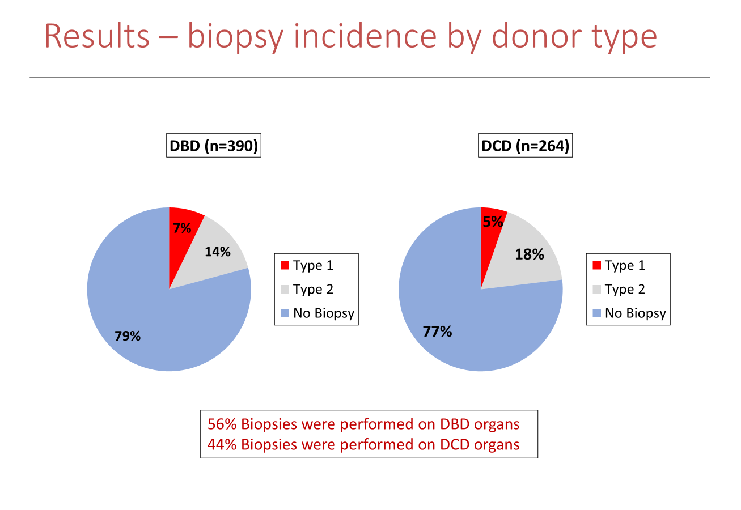

Slide 42
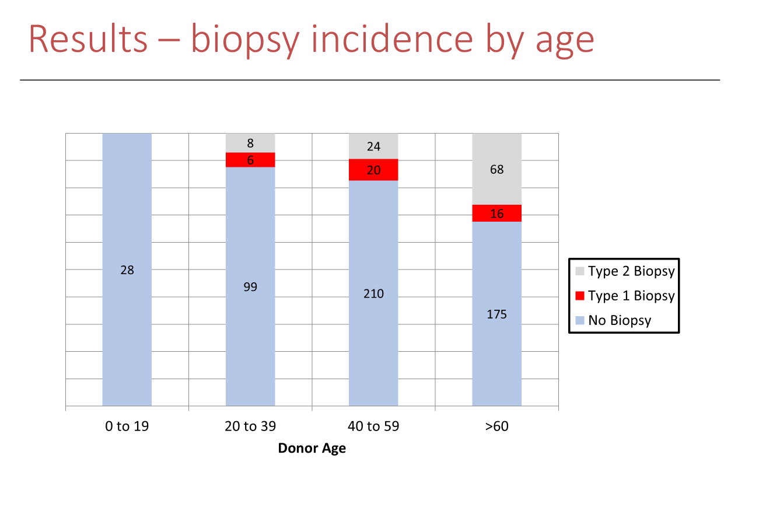
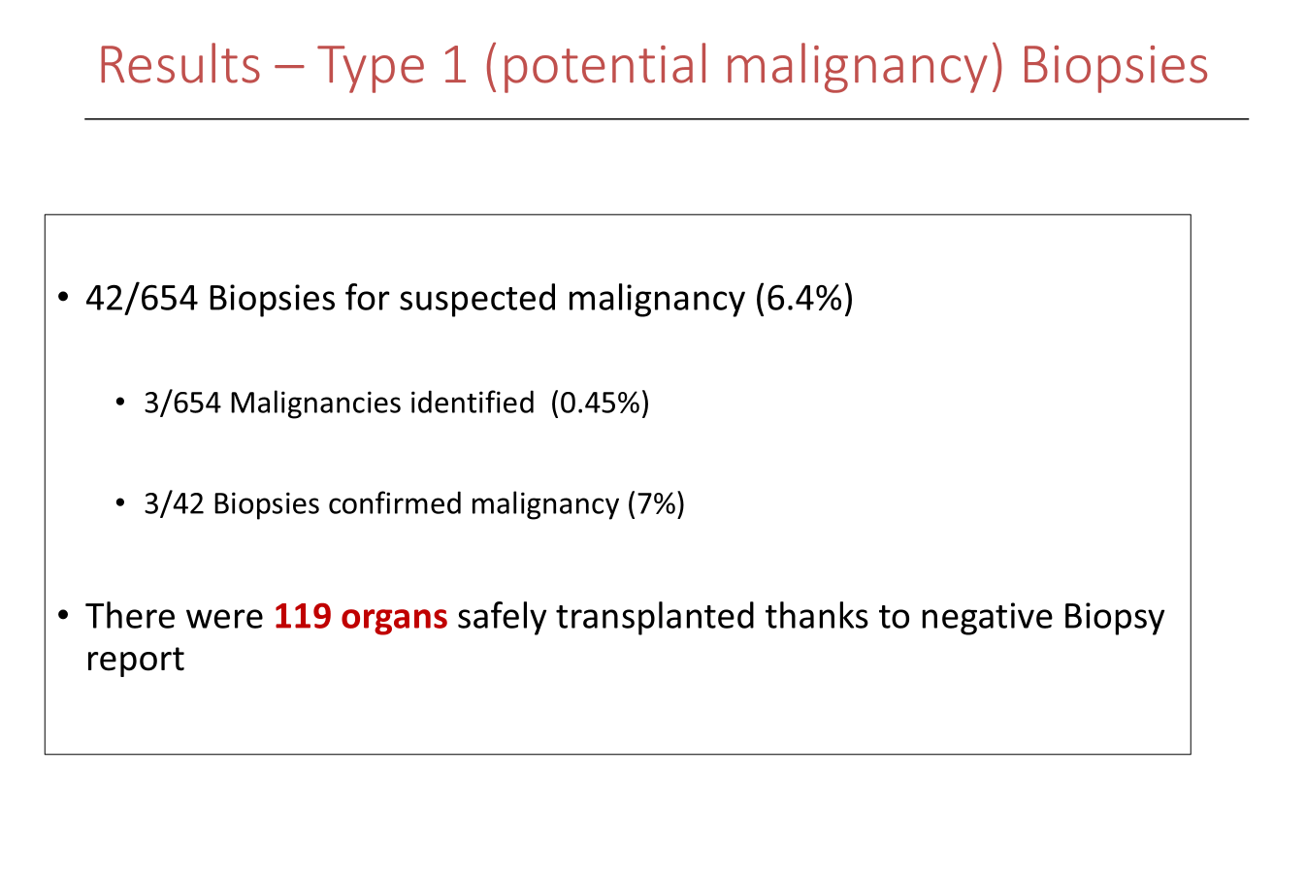
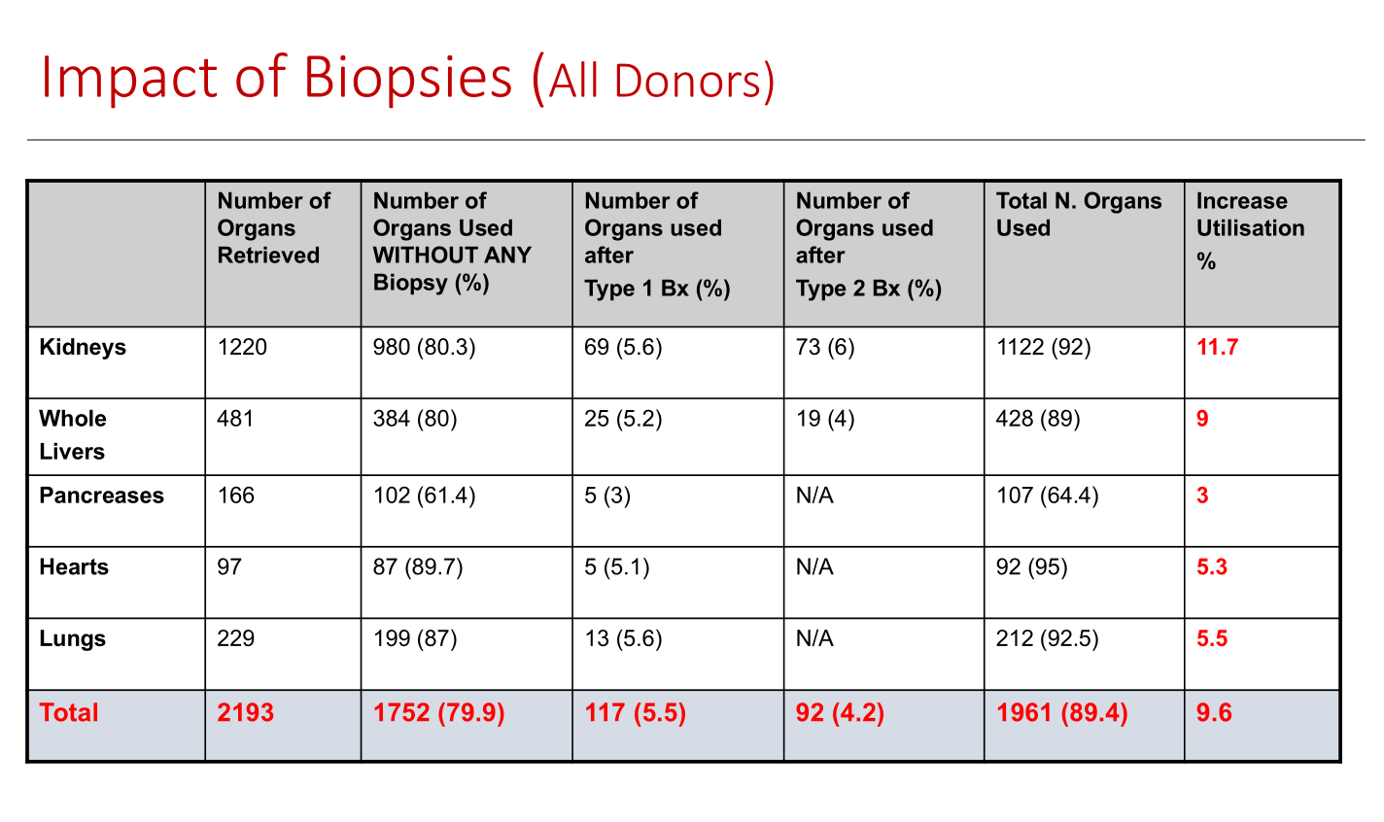
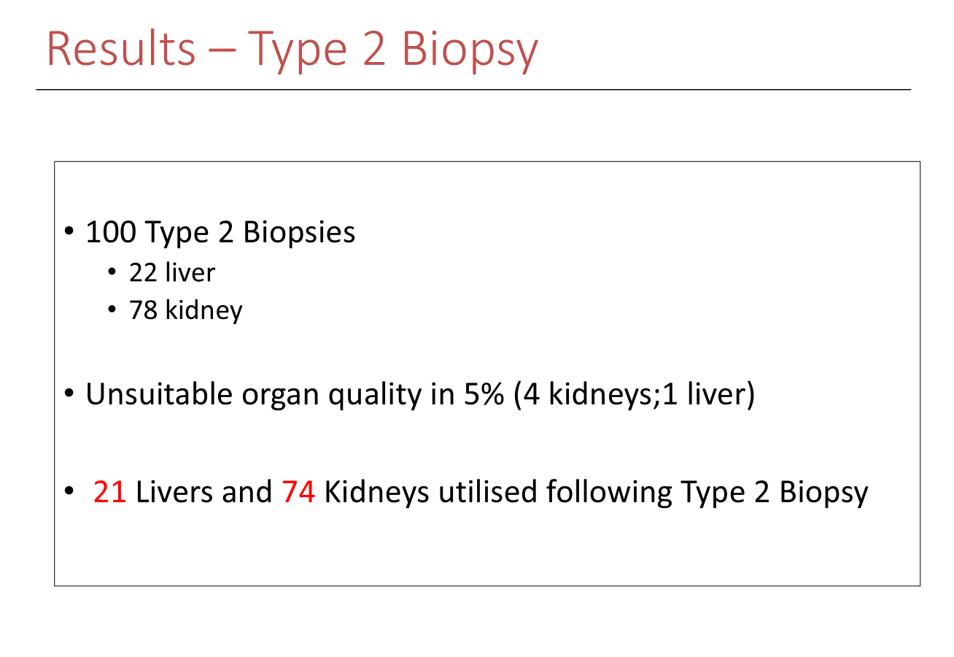

Slide 43
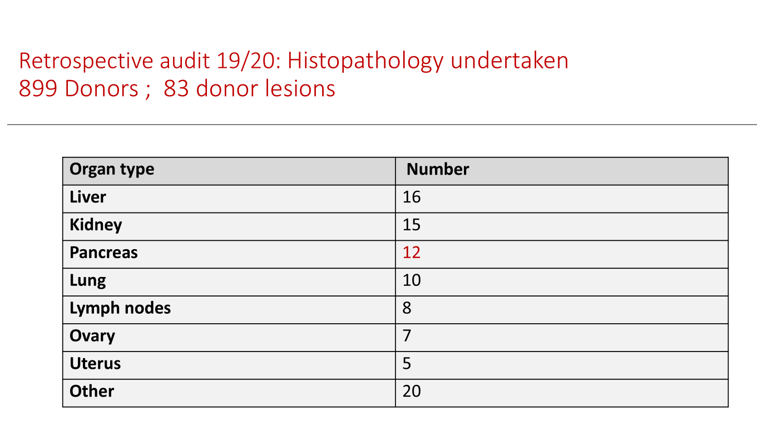
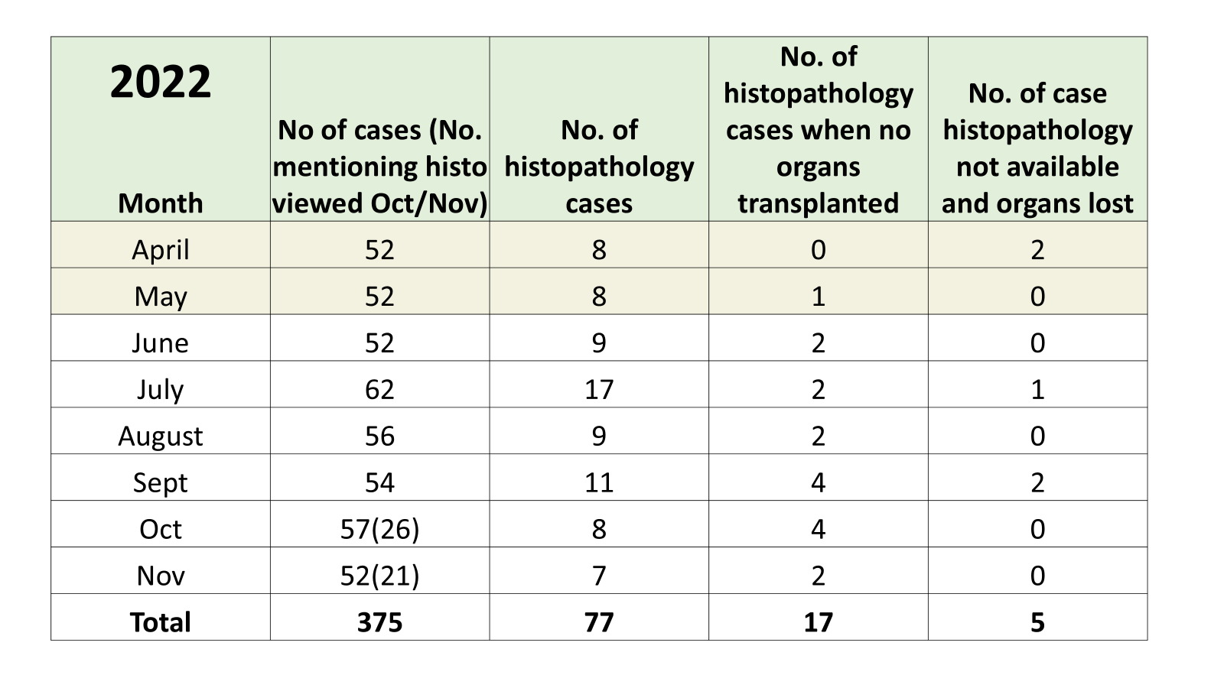
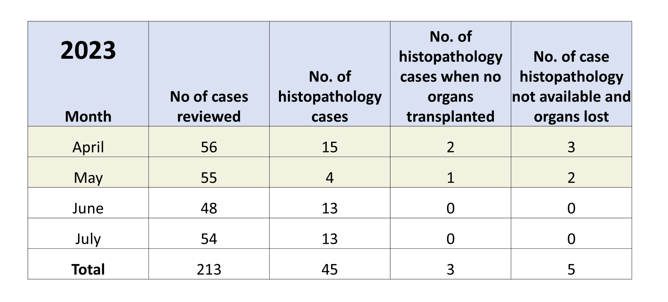

Slide 44
Audit 19/20: Where were they performed then and now (2024)
Abdominal NORS centres undertaking histopathology | Number
Leeds | 19
Cambridge | 15
Kings College | 14
Newcastle | 11
Royal Free | 8
Birmingham | 7
Edinburgh | 4
Cardiff | 2
Non NORS centres | 13
Abdominal NORS | 24/7 Histopathology Service- Current | Histopathology undertaken September 1st – February 28th | 24/7 Histopathology Service - October | Additional Info
Birmingham | Yes | 7 | Yes | No formal rota, 2 pathologists will undertake out of hours histopathology, not contracted or paid to do so
Cambridge | Yes | 15 | Yes | Will only process their own histopathology
Cardiff | Yes | 2 | Yes
Edinburgh | No | 4 | No | Stopped 2 years ago
King’s College | Yes | 14 | Yes | Only Liver and related specimens. No BMS/lab staff on call just Pathologists
Manchester | No | 0 | No
Leeds | Yes | 19 | No | Likely to cease in October 2020 although not confirmed
Newcastle | Yes | 11 | No | Will cease in October 2020
Royal Free | Yes | 8 | Yes
Oxford | No | 0 | No
Increased vulnerability of ‘out of hours’ Histopathology from October 2020
Notes:
Include donor hospitals and in particular Portsmouth and Belfast.
NB Manchester and Oxford have not undertaken any histopathology

Slide 45
Histopathology per organ / speciality
Notes:
Other: 1 mass behind patella, 6 skins
1 Liver biopsy to assess function in 22-23 but all other liver biopsies for lesions.
This data contains all requested biopsies. Some biopsies were not performed as unable to obtain histopathology service.
Also, some donors may have required biopsies on multiple organs ie: liver and kidney, jejunum and ovary, liver and lung …. (this would be noted in both columns)

Slide 46
Histopathology cases per centre
Notes:
Donor hospital :28% of all Histo cases
Accepting centres process 55% of all histo
12% at NORS centre
5% at other centres

Slide 47
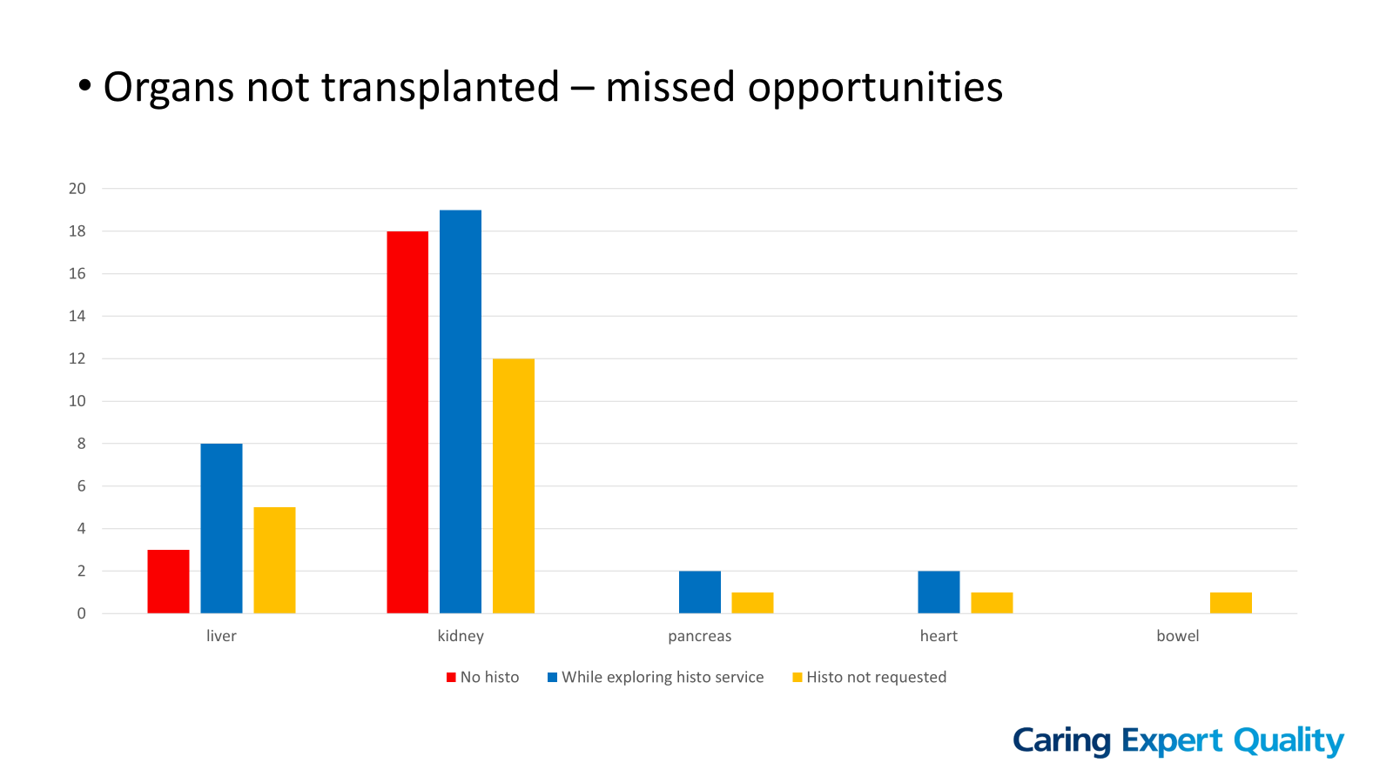
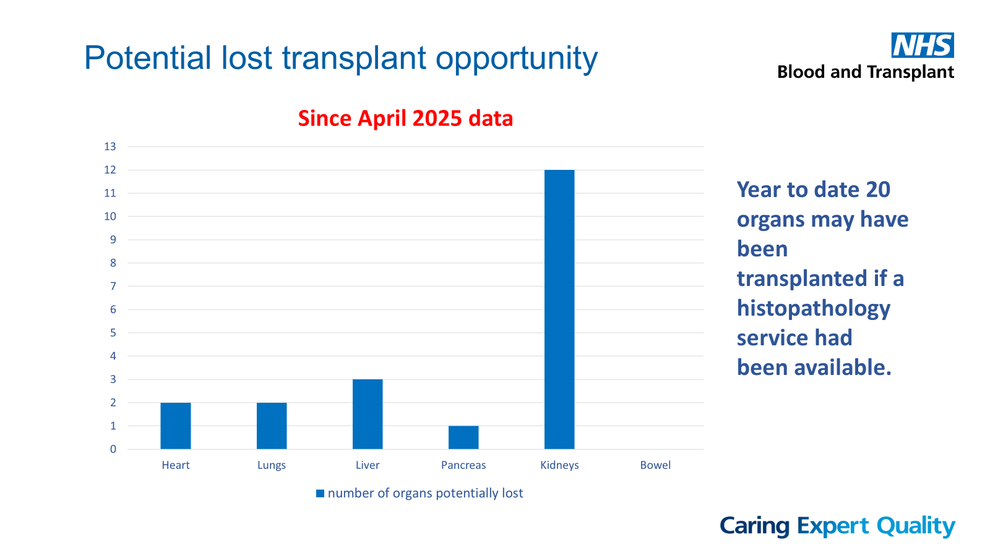
Missed Opportunities

Slide 48
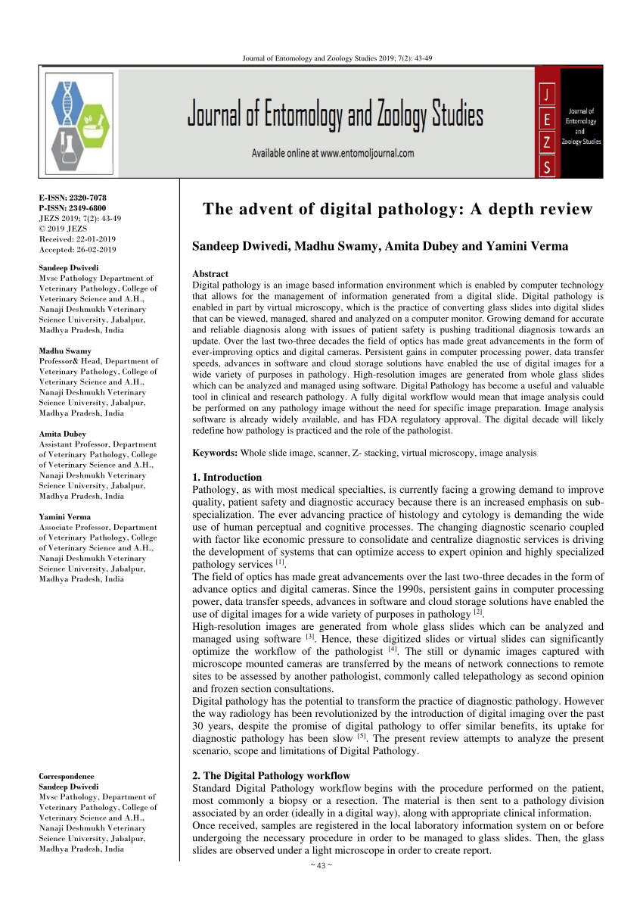
Advent of digital technology

Slide 49
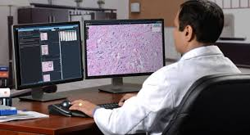
Digital Pathology

Slide 50
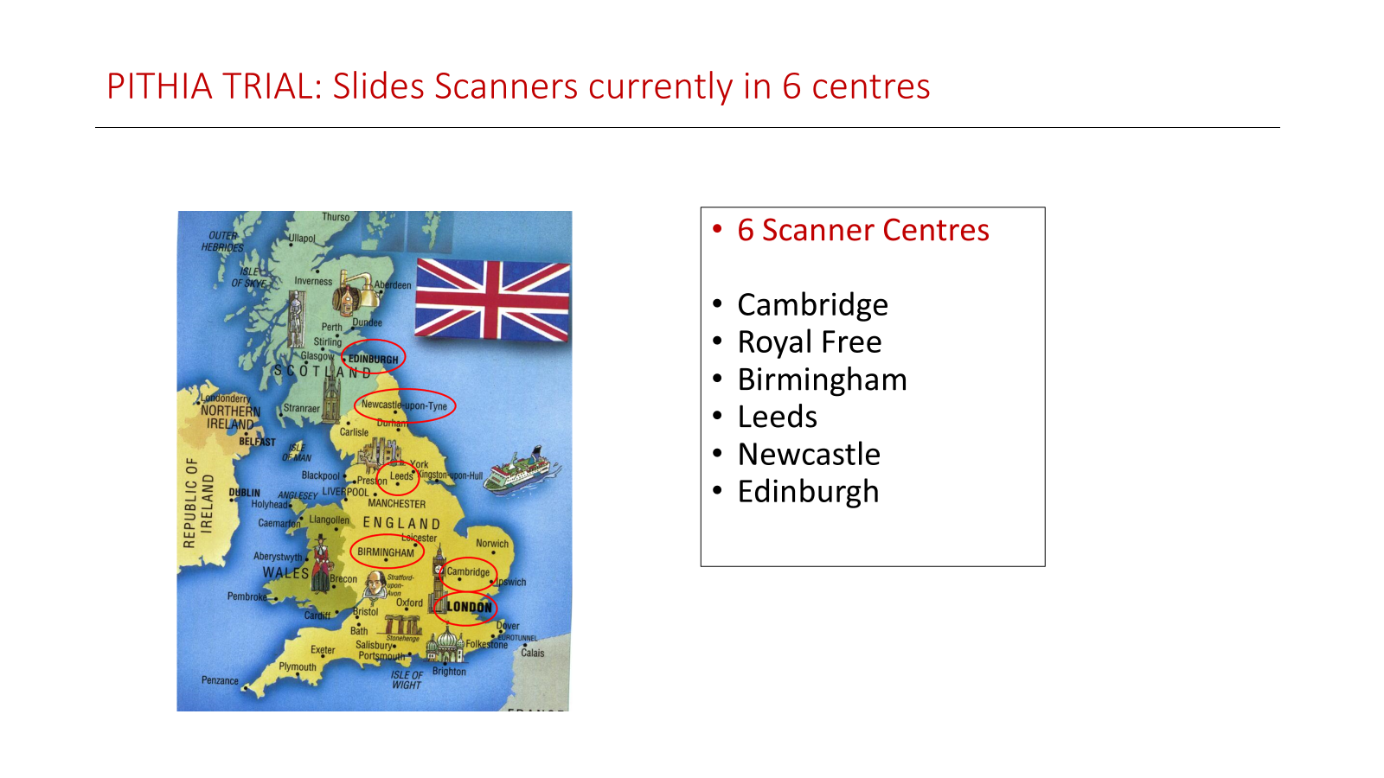


Slide Scanner - Histopathology Processing/ Histopathology Assessment
Specimen to Laboratory
Biomedical Scientist
Histopathology Processing
Frozen Section
Glass Slide
Biomedical Scientist
Scans Glass Slide
Glass Slide sent to ‘server’
Pathologist accesses image via Computer
Histopathology Assessment
Provisional histopathology report emailed to HUB operations

Slide 51
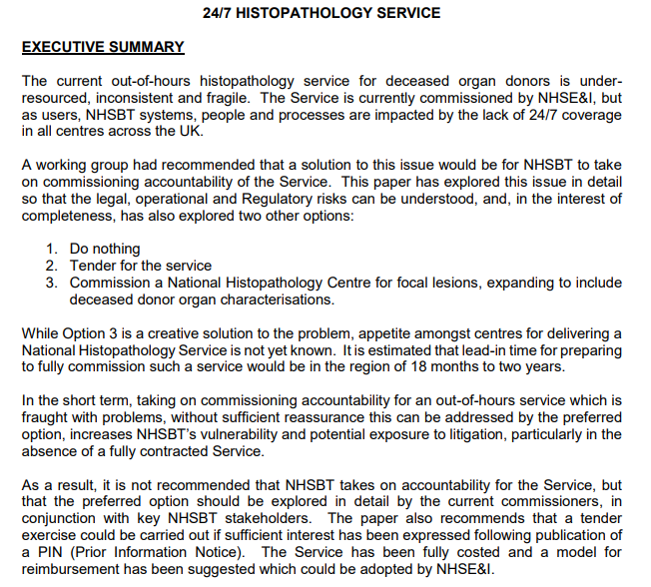
Developing a 24/7 service
Workforce (Staffing/ standby/ call out)
Transport requirements
Distance of travel for samples
Impact on SNODs/ HUB/ BMS/ Pathologists
Cost of equipment (initial, recurring)

Slide 52
Option 1. National Histopathology Assessment Centre/ NORS Histopathology Processing Centre (With Slide Scanner)
Single National Histopathology Assessment Centre
BMS on call at 6 Scanner Centres
6 subspecialty pathologist rotas on call
Urothelial Kidney
Liver and Hepatobiliary
Gynaecology
Lung
Gastrointestinal
Haematological
Notes:
Subspecialty to be confirmed 6/4 to be confirmed

Slide 53
Option 2. NORS Histopathology Assessment Centre/ NORS Histopathology Processing Centre (With Slide Scanner)
6 Histopathology Assessment Centres
BMS on call at 6 Scanner Centres
6 subspecialty pathologists on call
Urothelial Kidney
Liver and Hepatobiliary
Gynaecology
Lung
Gastrointestinal
Haematological

Slide 54
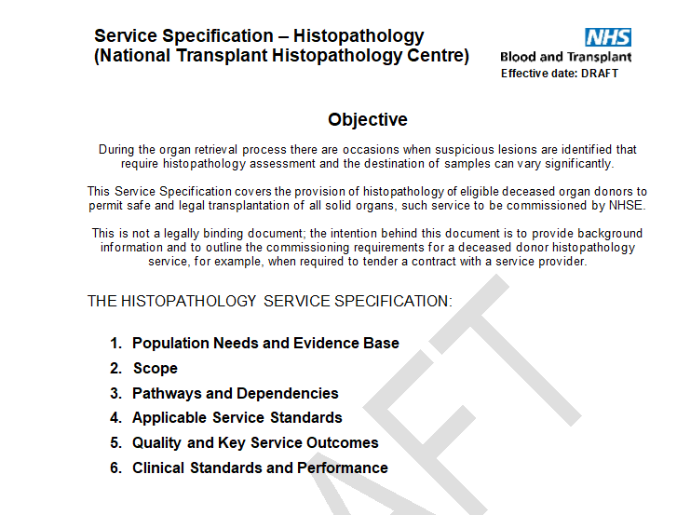
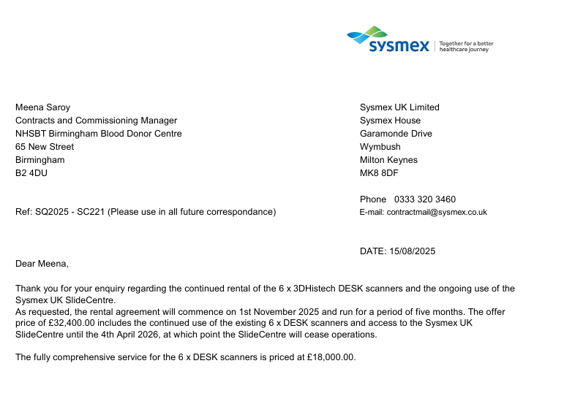

Slide 55
Discussion
Histopathology is vital to improve donor characterization
Donors are now much older, and the risk of malignancy is significantly higher
Risk averse practices can be reduced when histopathology analysis is available
Organ utilization can be improved
There is a recognition that there is a need for organ specific pathological analysis
Need for sustainability
Need for a robust service
Notes:
Steering group advise NHSBT via NRG on feasibility

