Slide 1

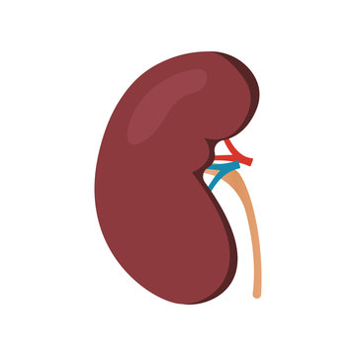

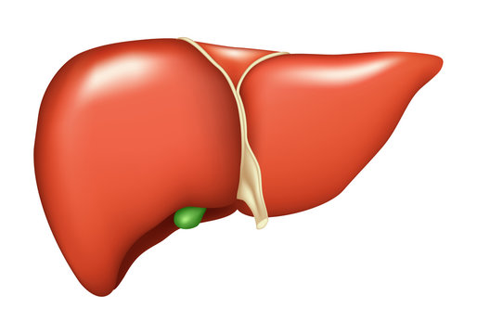
Travel for Transplantation
Lisa Burnapp
Consultant Nurse
Associate Medical Director - Living Donation and Transplantation
Recipient and Living Donor Coordinator Induction, October 2025

Slide 2
Context
Not all travel for transplantation is illicit or criminal (i.e. involving payment)
  People can and do travel legitimately for organ donation and transplantation
Low level of travel for transplantation in habitual residents from UK but reported activity has increased
  Mostly living kidney donation and transplantation
  Some deceased donor transplantation cases (returning to the UK)

Slide 3
What is Travel for Transplantation?*
Patients who travel for transplantation abroad and return to their country after the transplant
Resident recipients who receive an organ transplant from a non-resident living donor (e.g. NHS recipient)
Non-resident recipients who receive an organ transplant from a non-resident living donor (e.g. Private Sector)
Non-resident recipients who receive an organ transplant from a resident living donor (e.g. Private Sector)
Transnational living kidney exchange programmes where donors and/or recipient travels to participate in a KEP
* Registry of International Travel for Transplantation Activity (RITTA), Council of Europe
Notes:
What is travel for transplantation, NFP?
NRD difficult

Slide 4


Multiple Agencies - Roles and Responsibilities
Human Tissue Authority- Regulator
Department of Health - Policy setting; Ministerial liaison
NHS Blood and Transplant - National Focal Point*; clinical liaison and support
Other agencies
  Visas and Immigration
  National Crime Agency
  Police
*Network of National Focal Points on Travel for Transplantation (NETTA), Council of Europe

Slide 5

Relevant Legislation - Pre April 2024
Modern Slavery Act (2015)
  Human trafficking for the purposes of organ donation
Human Tissue Acts – (Amendments, July 2022)
  Jurisdiction within and outside the UK for transplantation associated with criminal activity*
Other considerations
  General Data Protection Regulations (GDPR)
  Consent law
*Except Northern Ireland

Slide 6
Amendment to Regulations – July 2022
1st July 2022
Amendment to Section 32 of the Human Tissue Act 2004 and Section 20 of the Human Tissue (Scotland) Act 2006
Extended the offences set out in these sections to extraterritorial jurisdiction relating to financial or commercial dealings in human material for transplant, such as buying or selling human organs
Any person resident in England, Wales or Scotland is committing an offence if they are involved in seeking, offering, or receiving payment or reward for donating organs for transplantation or initiating, negotiating, advertising or being involved in buying or selling human organs for transplantation, anywhere in the world.
*https://www.hta.gov.uk/news/supply-information-about-transplants-regulations-2024

Slide 7
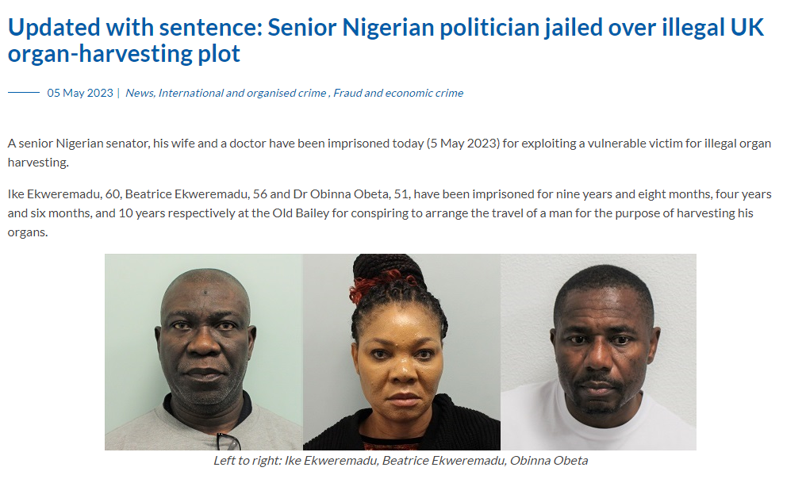
May 2023

Slide 8



Learning
Potential donor did not donate
‘Authorities’ unaware of concerns
Vulnerable person

Slide 9
Questions…..
Is it legitimate or not?
Whose responsibility is it to raise a concern?
Who decides and how?
How will it impact on relationships between clinical teams and their patients?
What are the consequences of doing nothing?
What are the consequences of doing something?
What if you are wrong?

Slide 10


Duty to Report
Human Tissue Act 2004 (Supply of Information about Transplants) Regulations 2024

Slide 11

2024 Regulations- the headlines*
Came into force on 1 April 2024
Introduced under section 34 of the Human Tissue Act 2004
Apply to England, Wales and Northern Ireland
Parallel legislation in Scotland (from 1st July)
Failing to report under the Regulations is an offence
Reporting is direct to the Human Tissue Authority (HTA)
*https://www.hta.gov.uk/news/supply-information-about-transplants-regulations-2024

Slide 12
The Human Tissue Act 2004 (Supply of Information about Transplants) Regulations 2024
1 April 2024
Human Tissue Act 2004 (Supply of Information about Transplants) Regulations 2024 came into force. These Regulations make it mandatory for ‘relevant clinicians’ in England, Wales and Northern Ireland to report:
  a reasonable suspicion that an organ donation and transplantation related offence may have been committed under the Human Tissue Act or Modern Slavery legislation
  a patient who has received an organ transplant outside the UK
*https://www.hta.gov.uk/news/supply-information-about-transplants-regulations-2024

Slide 13
Who is required to report?
Under regulation 2
‘Relevant clinicians’ have a statutory duty to report, whether they work in a transplant centre or non-transplant centre:
    a. a specialist nurse involved in living donor care
    b. a specialist nurse involved in recipient care
    c. a transplant surgeon
    d. a physician involved in living donor care
    e. a physician involved in recipient care
*https://www.hta.gov.uk/news/supply-information-about-transplants-regulations-2024

Slide 14
Reporting of a ‘Reasonable Suspicion’
When reporting a reasonable suspicion, the clinician must share certain information required by the Regulations – this includes:
  Information about the clinician submitting the report
  Information and a description about the reasonable suspicion
  The organ believed to have been transplanted
  The full name, date of birth and gender of the donor (or potential donor) and the recipient (or potential recipient) and any other person(s) believed to have been involved
  The relationship between the donor and recipient, if one exists
*https://www.hta.gov.uk/news/supply-information-about-transplants-regulations-2024

Slide 15
What constitutes ‘reasonable suspicion’?*
You can report even if you are not certain that an offence has been committed
When reporting a reasonable suspicion, clinicians must not alert the donor or recipient
Grounds for ‘reasonable suspicion’ may include:
  Where the work up of a living donor is not progressed for non-clinical reasons (e.g. due to suspicion that a donor has, or will be, rewarded for their donation)
  If the donor has a changing or conflicting account about their reasons for donating
  If a recipient states a clear intent to seek a transplant outside the UK in circumstances where there is concern that an offence may take place
*https://www.hta.gov.uk/news/supply-information-about-transplants-regulations-2024

Slide 16
What is the HTA’s role?
Report
The HTA considers all reports made by a clinician
Assess
Information within a report, and any subsequent
Escalate
A decision is made about whether a police referral is required
Information is shared with the police for further investigation if the HTA considers this necessary
under the Regulations
relevant information gathered by the HTA, is assessed
Adapted from a slide provided by Jess Porter, Head of Regulation, HTA

Slide 17
Failure to comply with the regulations
Failure to comply with the Regulations is an offence (section 34 of the HT Act) a person found guilty is liable on summary conviction to:
    a. a fine not exceeding level 3 on the standard scale (i.e., £1,000) for failing to comply without a reasonable excuse, or
    b. a fine not exceeding level 5 on the standard scale (i.e., an unlimited fine) for knowingly or recklessly supplying information that is false or misleading
*https://www.hta.gov.uk/news/supply-information-about-transplants-regulations-2024

Slide 18
Activity to date*
68 reports since 01 April 2024 – of these:
  19 cases - referred by HTA to police for further investigation
  4 cases – police investigation completed, no further action
  17 cases - not referred to police following HTA review of information / documentation to provide assurance the transplant was accessed legitimately
  32 cases - under review pending HTA decision
* Data provided by HTA, June 2025

Slide 19
Important to Know
The legislation does not apply retrospectively
Report cases (as soon as reasonably practicable) or contact the HTA at: report@hta.gov.uk
The Duty to Report applies to
  All cases where a patient receives an organ transplant outside the UK
  Any case within or outside the UK where there is concern that an offence may have been caused under the Human Tissue Act 2004 or Modern Slavery Act 2015
  Does not conflict with any professional advice (e.g.; General Medical Council/Nursing and Midwifery Council)
Vnxlkvnbnnb;n;mn;.
*https://www.hta.gov.uk/news/supply-information-about-transplants-regulations-2024

Slide 20
Useful to Know
Engage with your hospital information governance and safeguarding teams for additional support
The HTA cannot divulge information to clinicians that may compromise a police investigation
Early consultation with the HTA if in doubt
  There is little or no evidence of relationship
  You have any other concerns
*https://www.hta.gov.uk/news/supply-information-about-transplants-regulations-2024

Slide 21
What do patients need to know?*
Be clear in discussions with patients about
  The quality, safety and health issues that may be associated with unlawful organ donation and transplant activity
  That professionals are obliged to share information and personal data with the HTA if they travel outside the UK for an organ transplant
  The risk of opening themselves up to prosecution and being reported to the HTA for possible police referral where an offence may have been committed
  The requirement to notify the HTA of any transplant that has taken place outside the UK
Vnxlkvnbnnb;n;mn;.
*https://www.hta.gov.uk/news/supply-information-about-transplants-regulations-2024

Slide 22
NHSBT’s National Focal Point Role
Collaboration with Human Tissue Authority and National Focal Points
  Clinical support and liaison; data sharing agreement; embed legislation across the transplant community; update public and professional guidance
  Represent UK within the European Network of National Focal Points on Travel for Transplantation (NETTA)
Engagement with the transplant community (professionals and patients)
  Information webinars; presentations to clinical advisory group meetings/clinical networks/congresses/patient groups; clinical support and liaison
Monitoring and data collection – UK Transplant Registry and Registry for International Travel for Transplantation Activity (RITTA)

Slide 23
Further Resources
General information:
Supply of Information about Transplants Regulations 2024 | Events | Human Tissue Authority (hta.gov.uk)
The Regulations:
The Human Tissue Act 2004 (Supply of Information about Transplants) Regulations 2024 (legislation.gov.uk)
Guidance document for clinicians:
The Human Tissue Act 2004 (Supply of Information about Transplants) Regulations 2024.pdf (hta.gov.uk)

Slide 24
Other Resources
Declaration of Istanbul leaflet Leaflet on Declaration of Istanbul
In progress
Information for donors and recipients- NHSBT website

Slide 25

Acknowledgements
NHSBT
  Matthew Robb – NFP Representative (data)
  Derek Manas – OTDT Medical Director
Human Tissue Authority
  Jess Porter - Head of Regulation
  Sumrah Chohan, Anjeli Kara, Michelle Spencer-Williams
Clinical colleagues
  NHSBT Clinical Team
  In transplant and non-transplant centres
Others
  Patient representatives
  Dept. of Health and Social Care (DHSC)
  UK Visas and Immigration
  National Crime Agency
  Police

