Slide 1

Carrie Scuffell
Transplant development nurse,
NHS Blood and Transplant

Slide 2


Slide 3

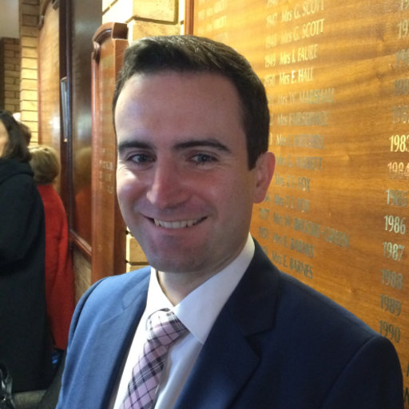
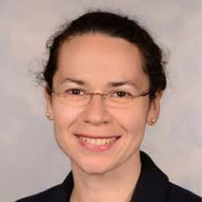
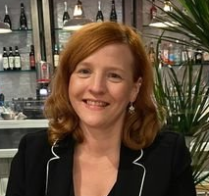
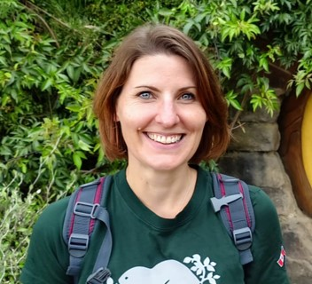
Who are ESIT?
Part of the OTDT Clinical Team within NHSBT
Wider group
      Transplant Medicine
      Transplant Surgery
      Transplant Coordinators
      AHP
      OTDT leadership
      NHSBT Statistics
      NHSBT Sustainability Dept
      Centre for Sustainable Healthcare
      British Transplant Society
Core group
Chair: Matt Welberry Smith
John O’Callaghan
Rosa Montero
  Carrie Scuffell
  Laura Barton

Slide 4

What is ESIT?
Vision
Enabling an environmentally sustainable future for transplant services in the UK
Mission
Providing the UK transplant community with the data, strategies and tools needed to improve environmental sustainability in the delivery of transplant services

Slide 5



Online launch April 1st
Network of ESIT champions
Introductory coffee hour (1pm on 26th June)
Free training programme in carbon literacy (July-Nov 2025)
ESIT Pledge
Funding for pathway mapping
Dashboard development
National Sustainable QI project
ESOT – ESIT collaboration
Multi-agency green task force

Slide 6
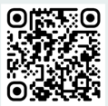


How can I get involved?
Become an ESIT champion
Attend the carbon literacy training
Sign the pledge
Think about practical ways you might improve ESIT in your area
Contact us….
ESIT@nhsbt.nhs.uk
@ESIT_NHSBT

Slide 7

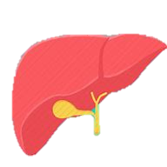
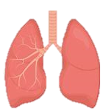
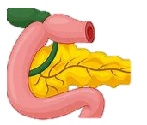
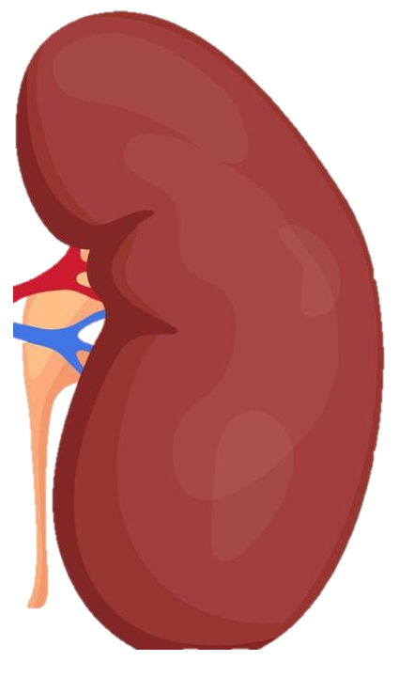
rgan
O
tilisation
U
evelopment
D
eam
T

Slide 8
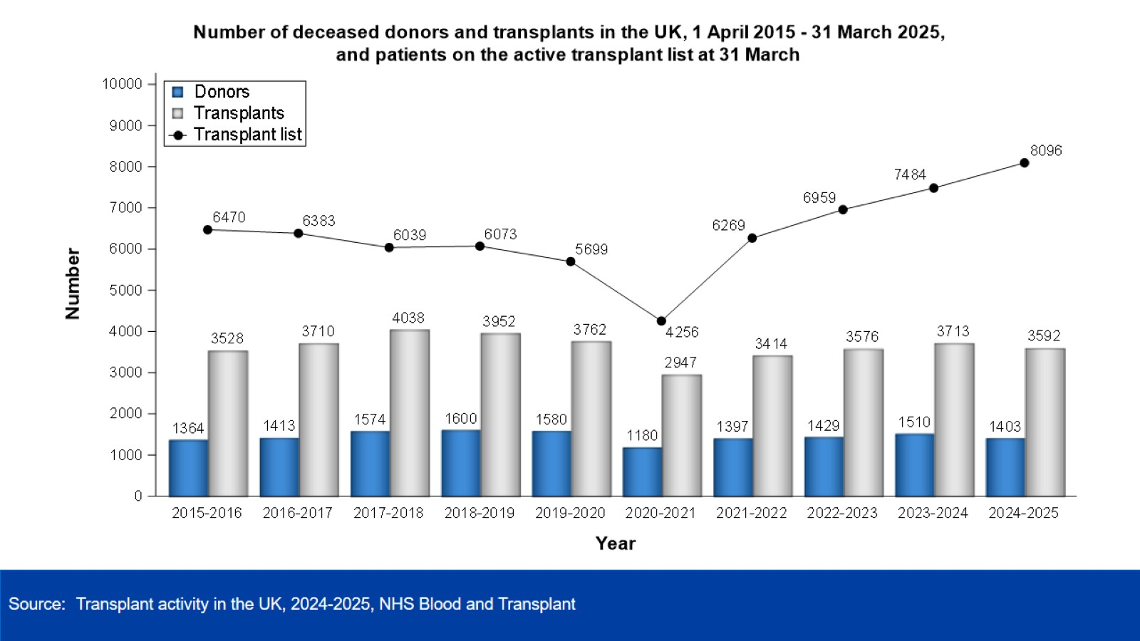

Slide 9
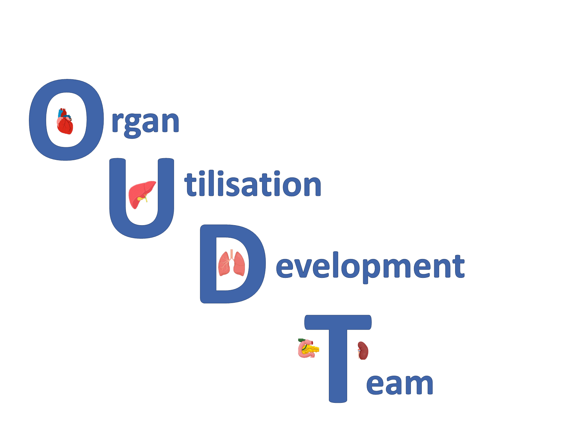
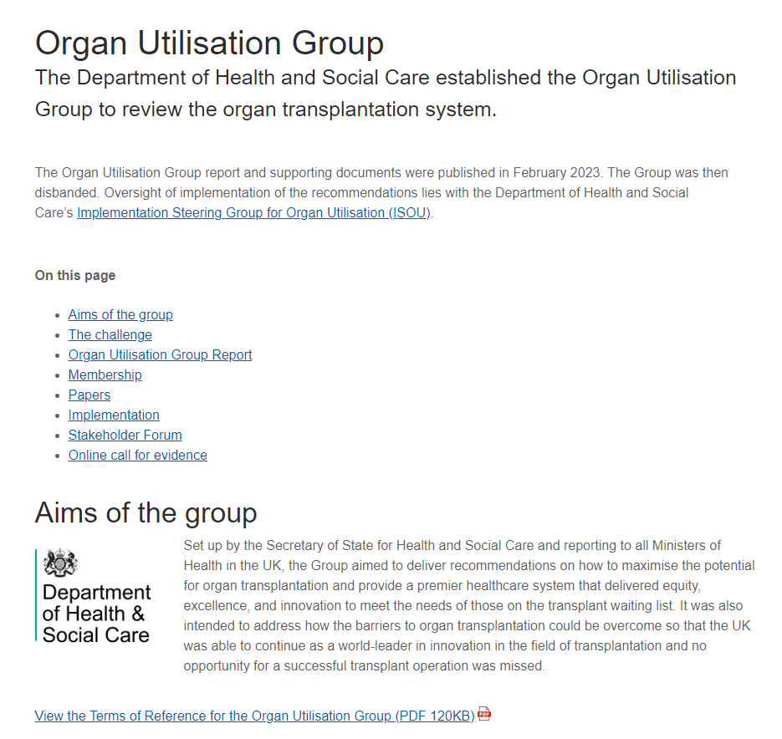
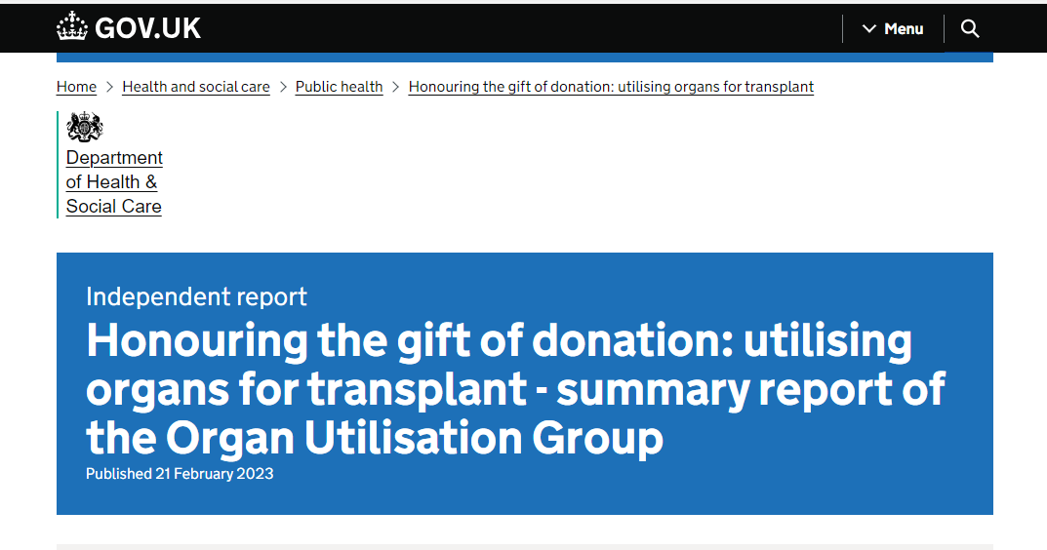
Honouring the gift of donation: utilising organs for transplant - summary report of the Organ Utilisation Group - GOV.UK
Recommendation themes
1. Placing the patients at the heart of the service.
2. An operational infrastructure that maximises transplant potential
3. Creating a sustainable workforce that is fit for the future.
4. Data provision that informs decisions and drives improvements.
5. Driving and supporting innovation.
6. Delivering improvements through new strategic and commissioning frameworks.

Slide 10
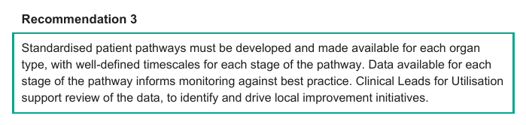
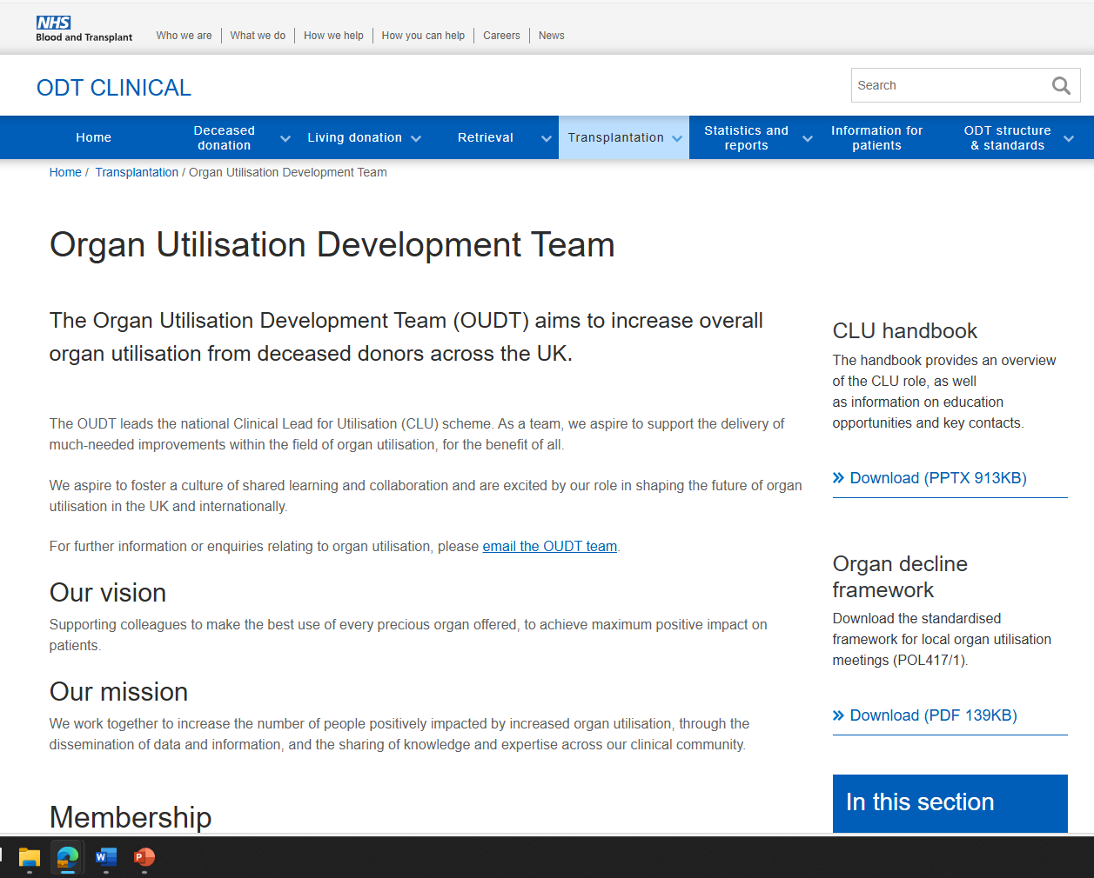
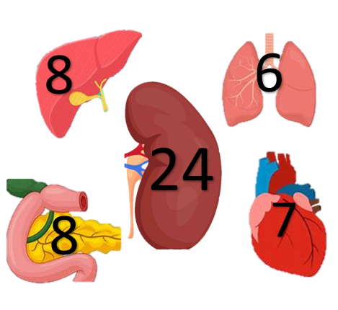
Every unit must have a Clinical Lead for Utilisation who is responsible for data oversight and monitoring within their unit and works with clinical and management colleagues to deliver improvements.
Clinical Leads for Utilisation (est. 2020)
53 local CLUs
5 National lead CLUs
Chris Callaghan
Associate Medical Director, Organ Utilisation
Nick Inston
National Lead CLU (abdominal)
Vicky Gerovasili
National Lead CLU (cardiothoracic)
Laura Barton
Programme Manager
Carrie Scuffell
Transplant Development Nurse
Lead CLUs
Andy Morley Smith, Anya Adair, David VanDellen.
Supported by
OU Stats team
Jenny Mehew Principal Statistician
Konstantina Soumilas, Paul Smith Statisticians
MDGS team
Sam Tomkings, Sarah Belgium,Temi Adams
Secretaries

Slide 11
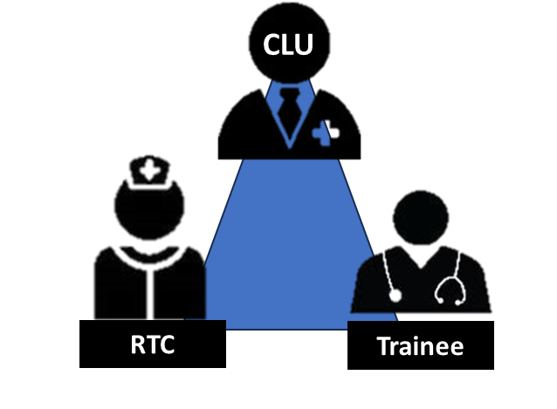
Our Mission
We work together to increase the number of people positively impacted by increased organ utilisation, through the dissemination of data and information, and the sharing of knowledge and expertise across our clinical community.
        Quarterly national organ specific CLU community calls
        Quarterly Lead CLU meetings
        Weekly OUDT meetings (Monthly with OD colleagues)
        Implementation of local OU(decline) meetings with standardised framework
        Offer review scheme
        CLU survey and focus group outcomes (structure and support, annual 121s,)
        National conference (NOUC) and CTU course
        Collaborating with OD, Collaboratives, NORS
        Established long-term funding
OrganUtilisationDevelopmentTeam@nhsbt.nhs.uk
Organ Utilisation Development Team - ODT Clinical - NHS Blood and Transplant
@OUDT-NHSBT

Slide 12
Enhanced Recovery After Surgery (ERAS) in transplantation
Carrie Scuffell
SME for ERAS in Transplantation,
NHS Blood and Transplant
Notes:
NHSBT strategy
Falls under Recipient and transplant outcomes

Slide 13
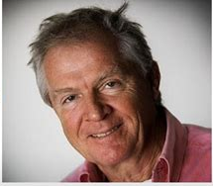
Background
Fast track programme 1997
  Shifted focus from individual changes in perioperative practice to combining multiple changes to improve outcomes.
  Combined interventions directly targeted at reducing surgical stress.
  Demonstrated reductions in length of hospital stay, fatigue and morbidity
Professor Henrik Kehlet
Kehlet H. Multimodal approach to control postoperative pathophysiology and rehabilitation. Br. J. Anaesth. 1997;78:606–617. doi: 10.1093/bja/78.5.606. - DOI - PubMed

Slide 14
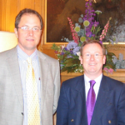

Background
2001
  Enhanced Recovery After Surgery (ERAS) Study Group.
  Group of six surgeons assembled by Professors Ken Fearon and Ollie Ljungqvist.
2010
  The ERAS Study Group registered as a new non-profit organization in Sweden under the title ‘the ERAS Society’, including Professor Kehlet,

Slide 15

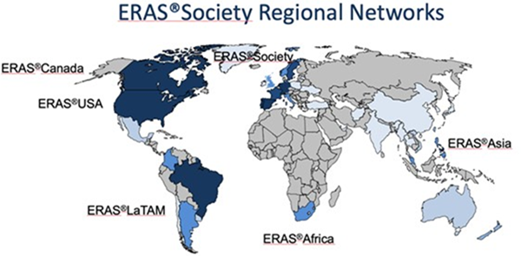
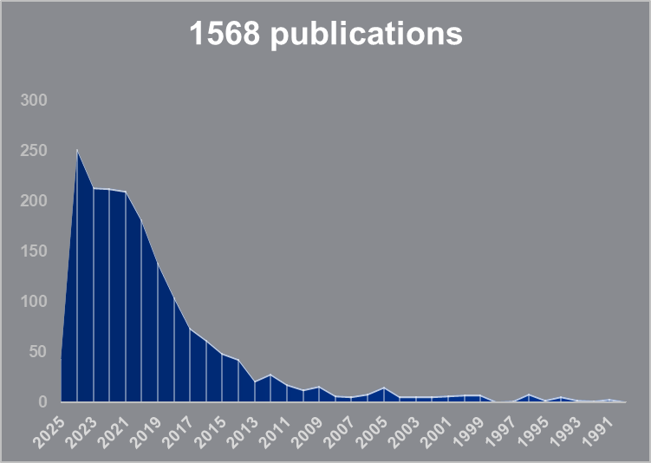
What is ERAS?
Multimodal, pathway to help improve recovery
  Reduce surgical stress
  Patent centred - encourages patient engagement and autonomy
  Reduces the risk of complications
  Better use of resources
  Reduced Length of Stay (LOS)
‘Business as usual’ in other realms of surgery

Slide 16

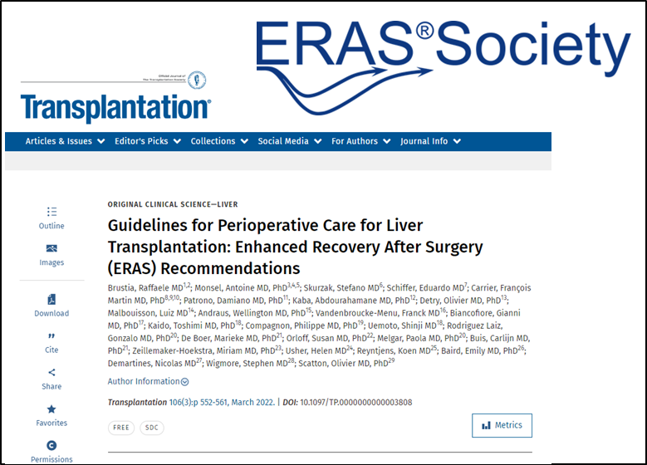
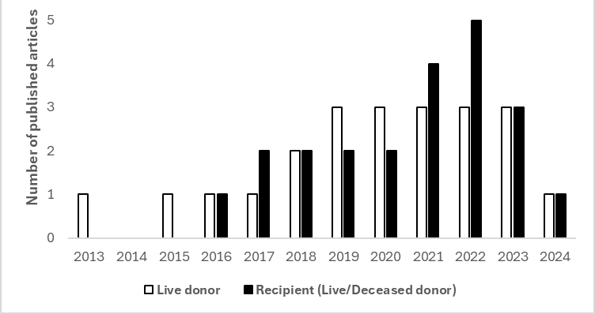
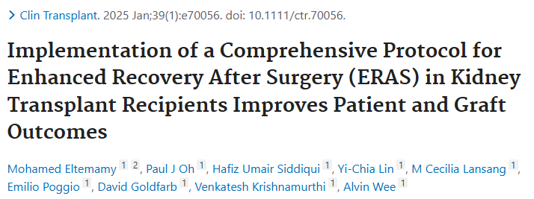
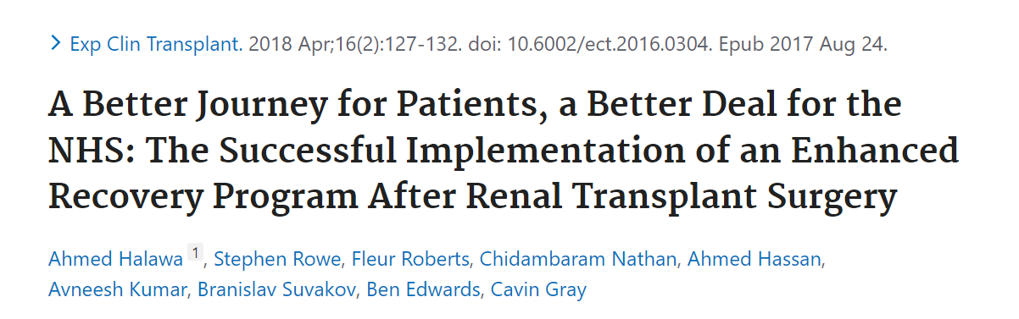
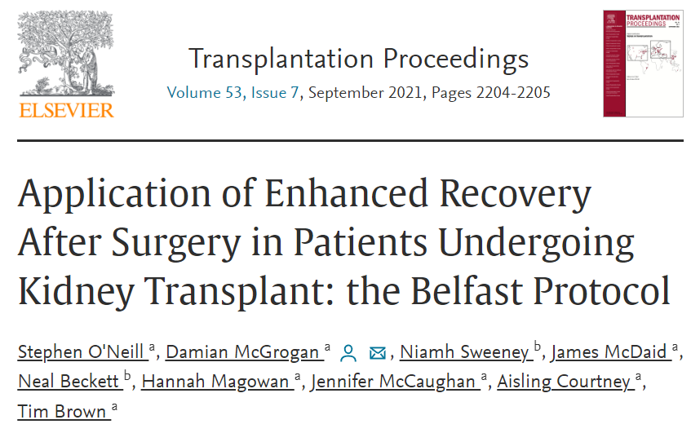
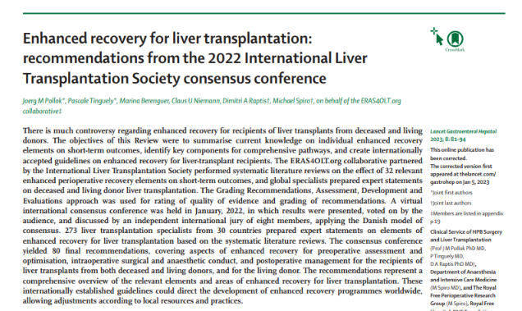
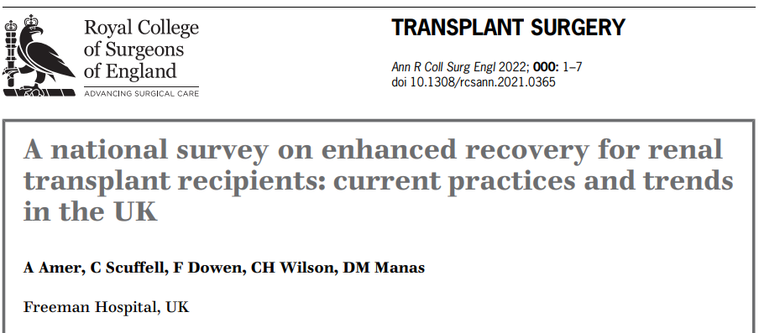
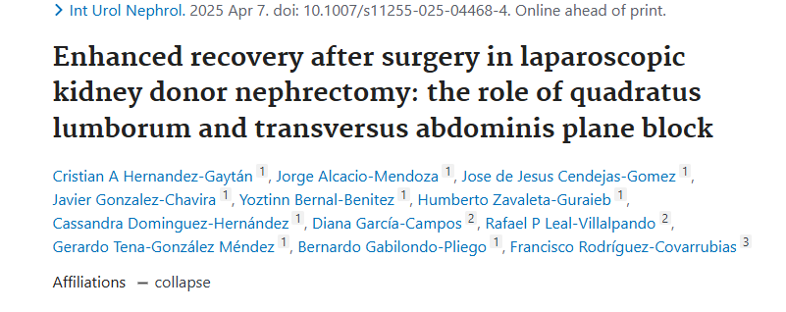
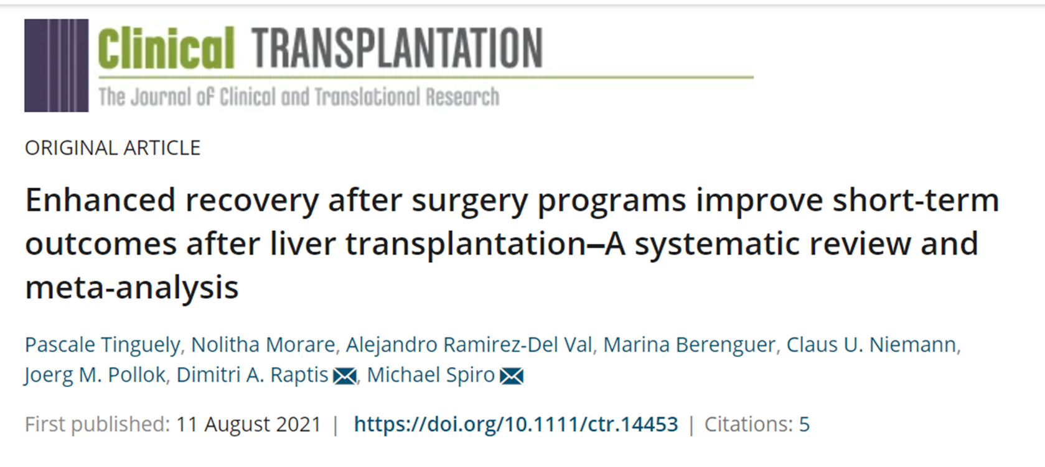
ERAS in transplantation

Slide 17

NHSBT ERAS project aims
To facilitate a UK-wide roll out of ERAS in Transplantation by*
Adult Liver
Paediatric
kidney
Drawing from evidence and existing best practice
Providing a repository of evidence-based resources to support adoption of ERAS in centres
Started with adult kidney transplant recipients
Scope to include other organs and living donors
Adult lung
Pancreas
Living kidney
donor
Adult Kidney
Key deliverable for the Implementation and Steering Organ Utilisation (ISOU) Group¹
Workstreams
¹https://www.gov.uk/government/publications/honouring-the-gift-of-donation-utilising-organs-for-transplant/honouring-the-gift-of-donation-utilising-organs-for-transplant-summary-report-of-the-organ-utilisation-group
*ERAS Steering Group ToR, May 2023
Steering group

Slide 18


NHSBT ERAS project structure
NHSBT
Derek Manas, Medical Director
Lisa Burnapp, ERAS Programme lead
Carrie Scuffell, ERAS Subject Matter Expert
Interested and participated centres
Geographically diverse
Variety of disciplines
Lay and recipient/donor representation
Multidisciplinary Steering group
Transplant recipients and living donors
Expert by experience panels
  Stage 1
    core and desirable ERAS components with supporting evidence
Stage 2
  Downloadable resources for centres
  Evaluation and measurement criteria
Stage 3
  Circulation and communication
  Patient facing content
Adult kidney transplant
Adult liver transplant
Living kidney donor
Pancreas transplant
Lung
transplant
?
Evaluation and measurements

Slide 19
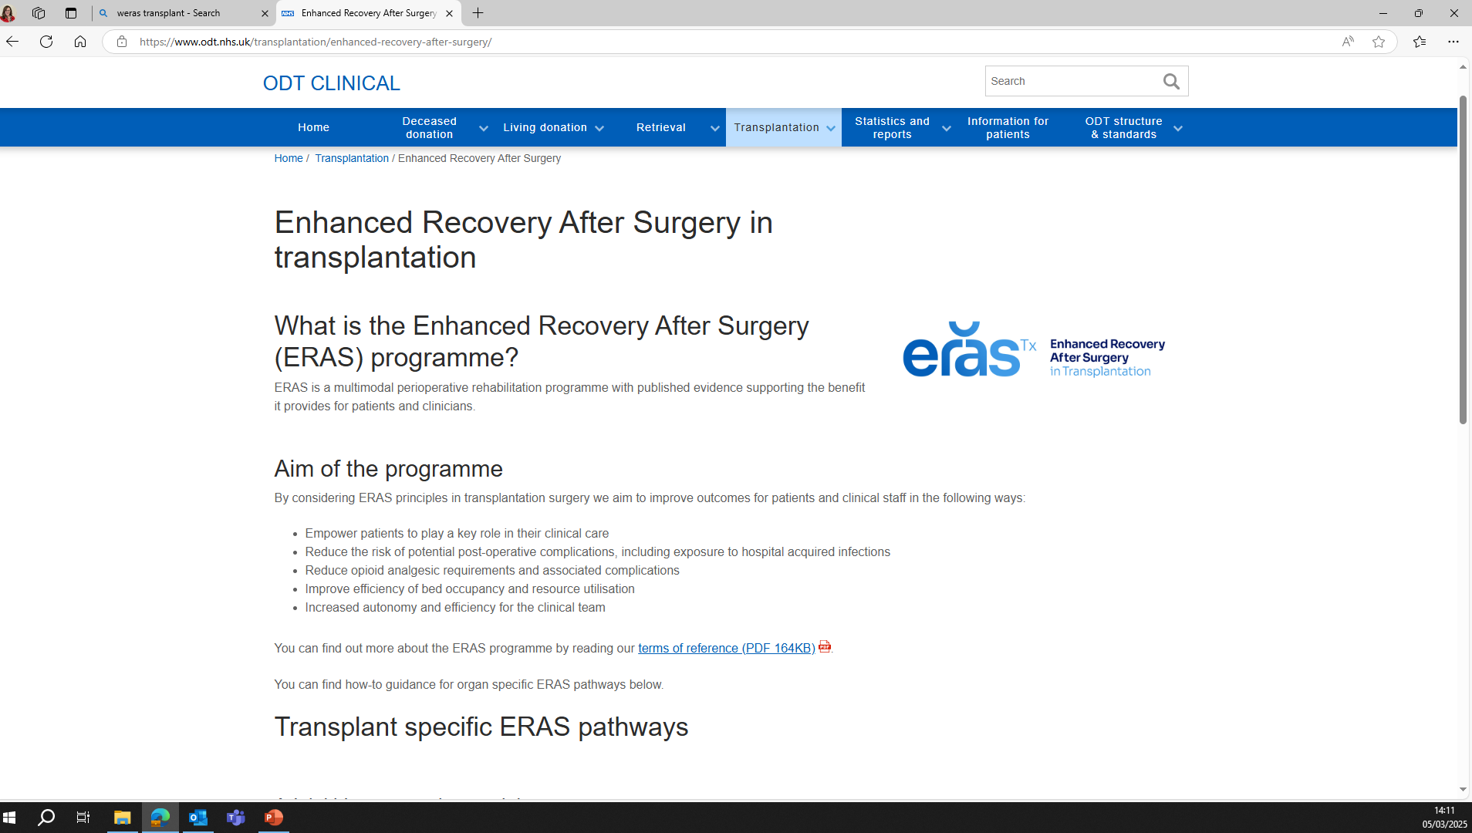
www.odt.nhs.uk

Slide 20
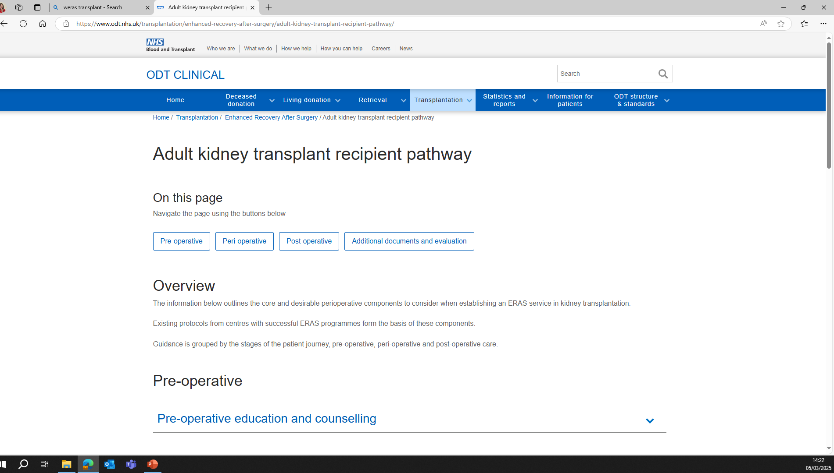
www.odt.nhs.uk

Slide 21
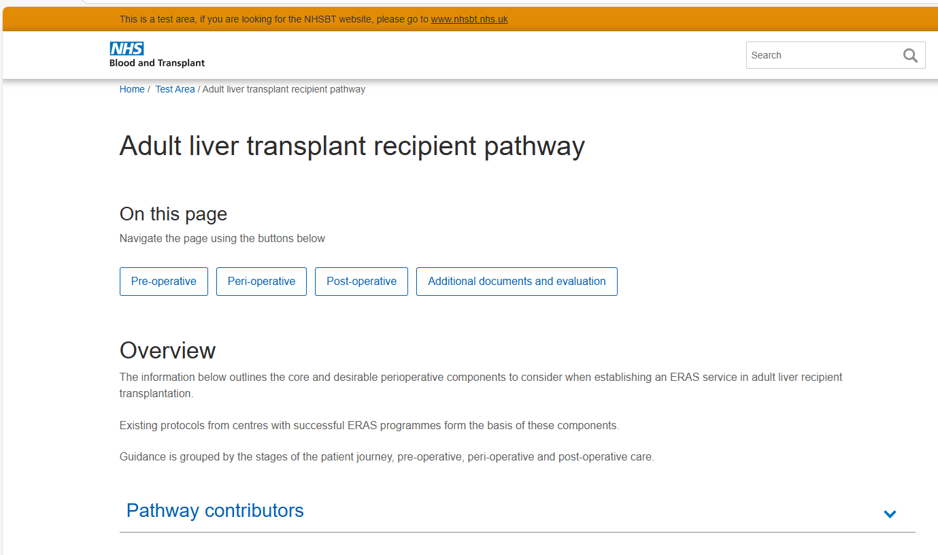
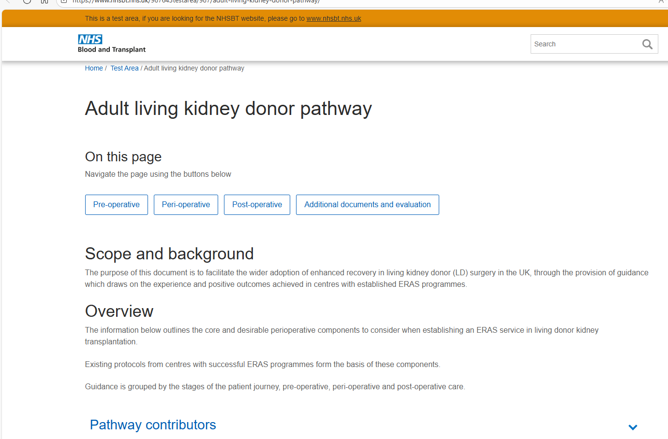
www.odt.nhs.uk

Slide 22
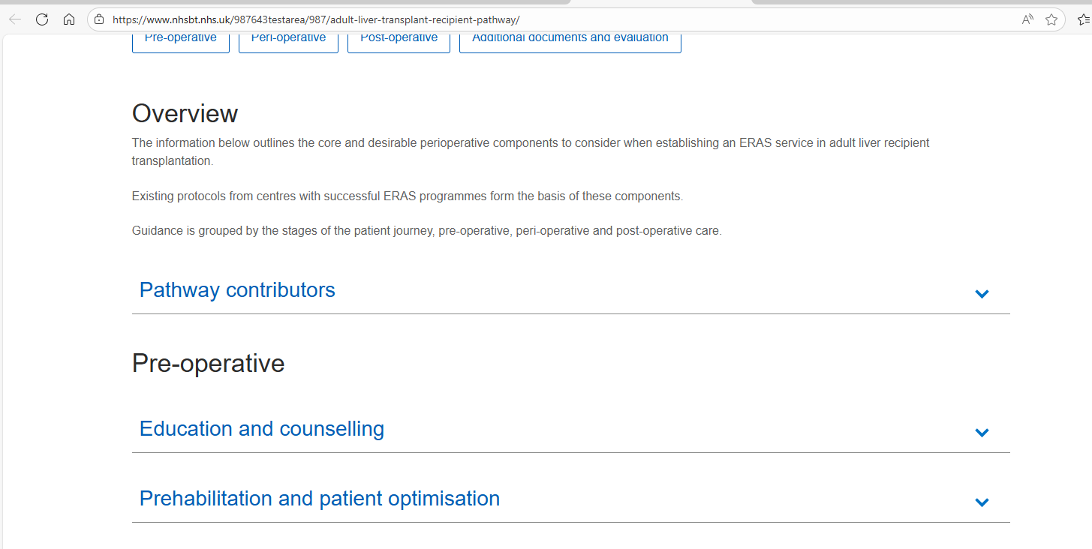
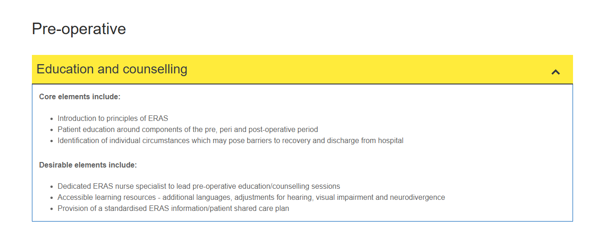
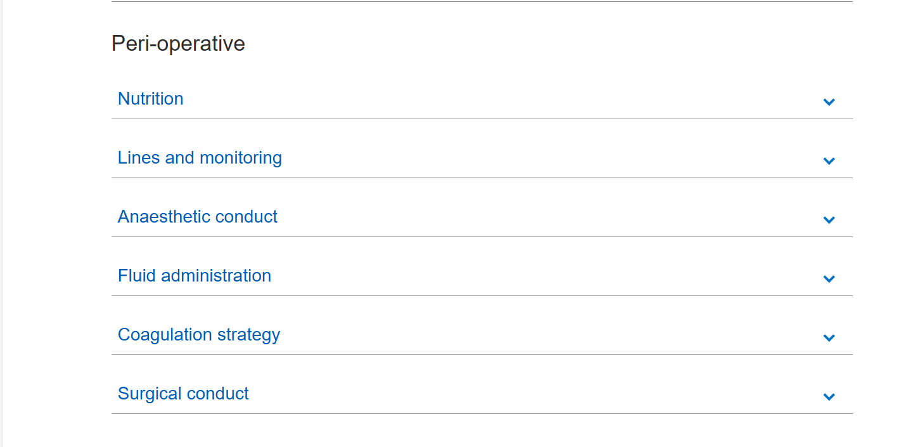
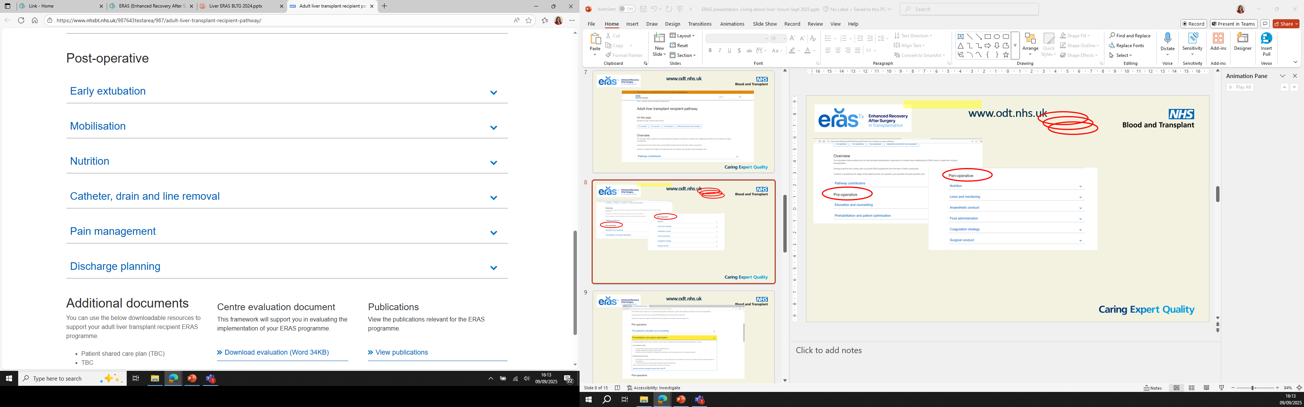
www.odt.nhs.uk
www. Link to supporting evidence….

Slide 23
www.odt.nhs.uk

Slide 24
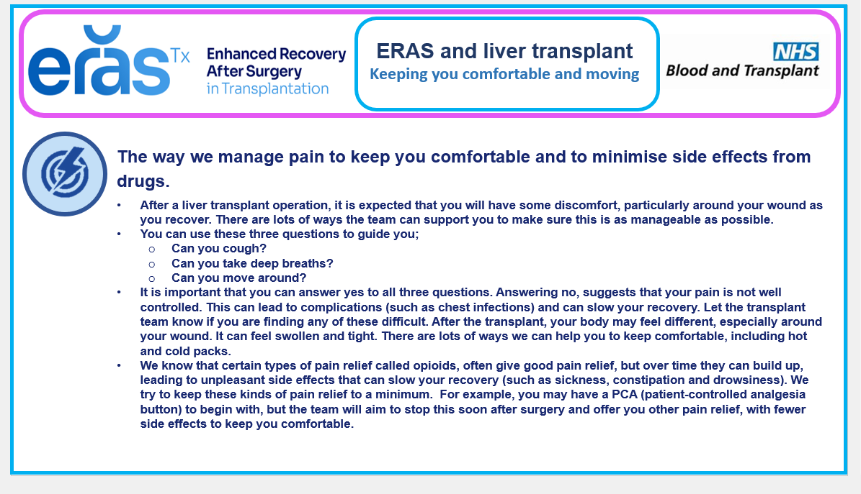
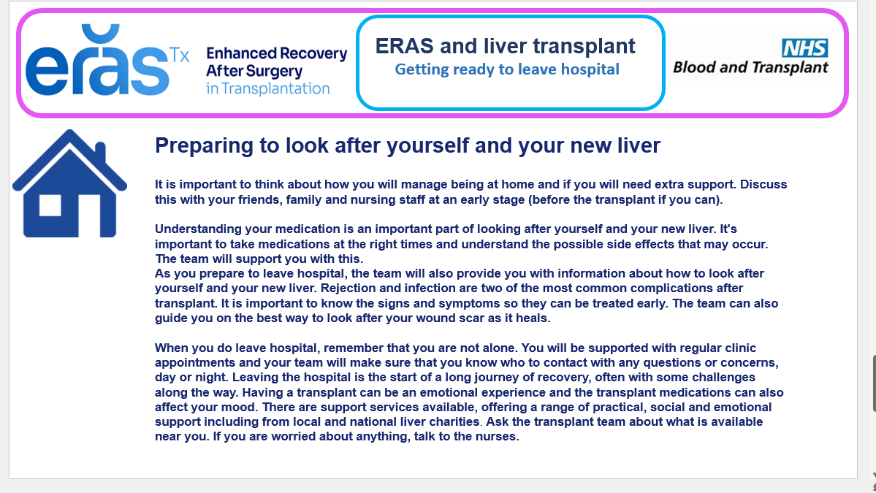
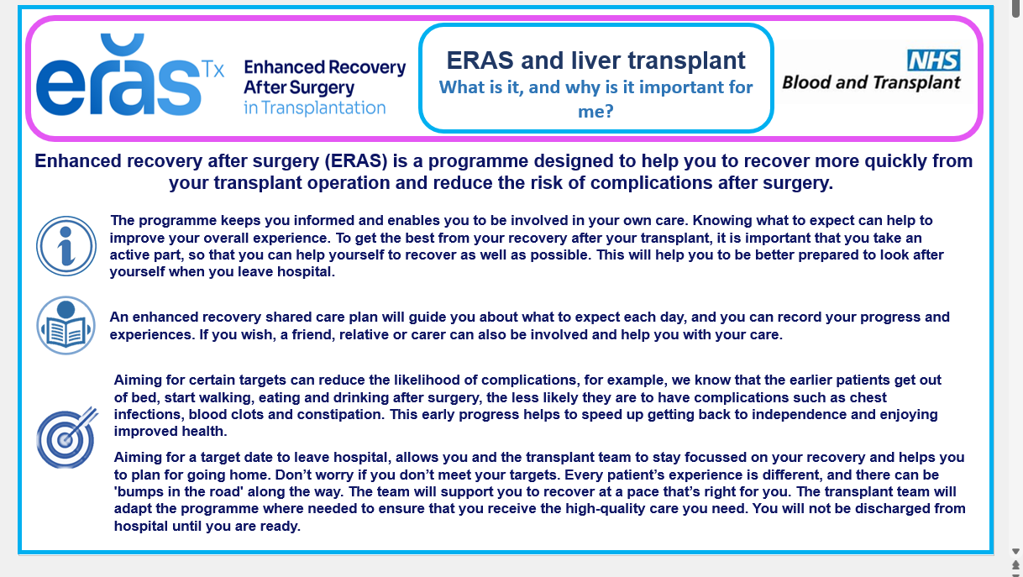
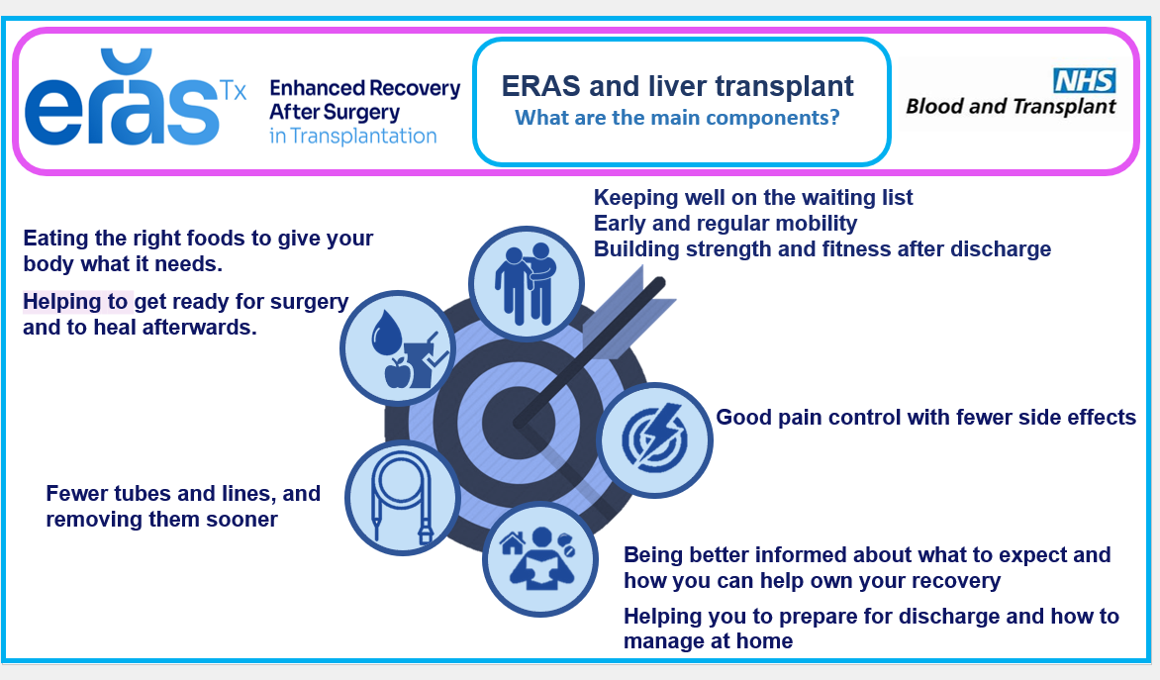
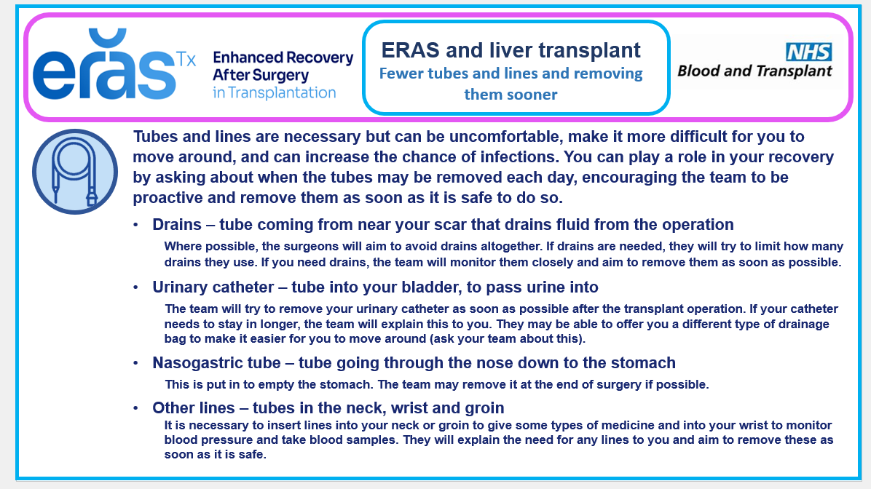
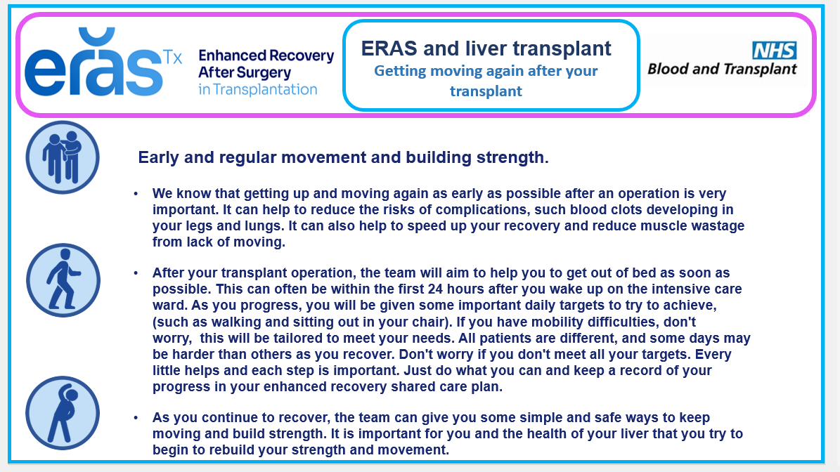
www.odt.nhs.uk
Got to here. Add liver stuff

Slide 25
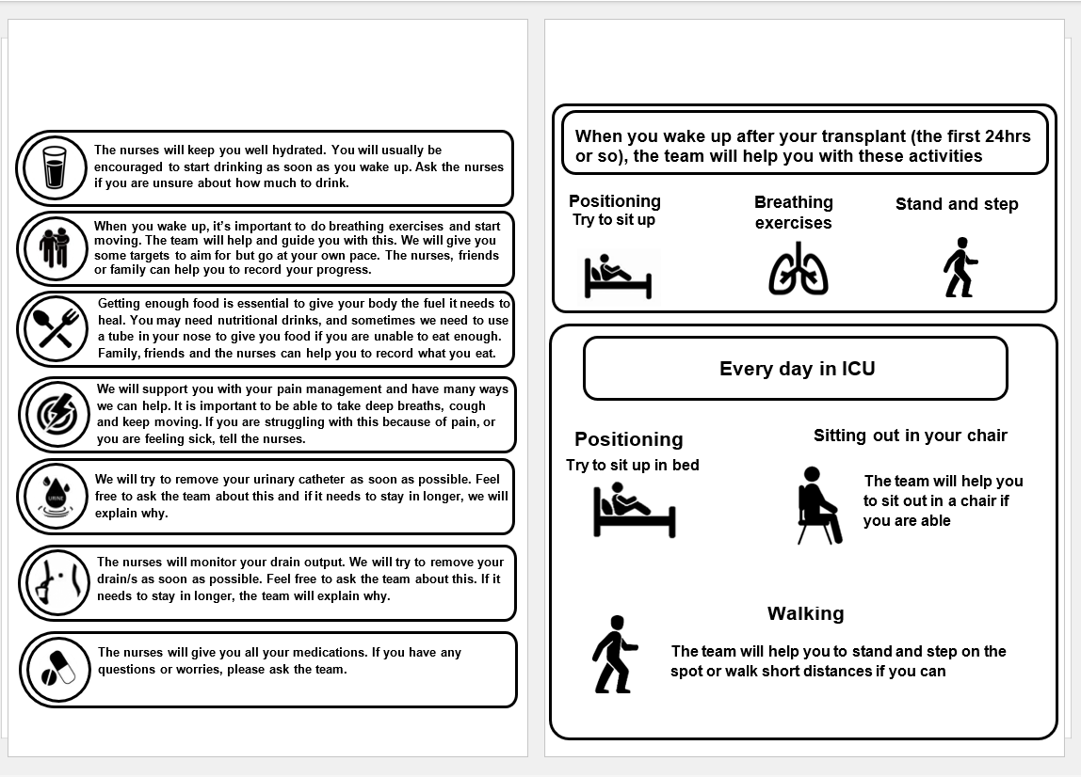
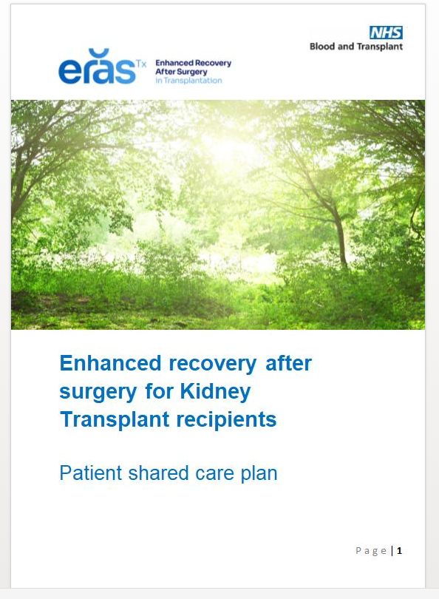
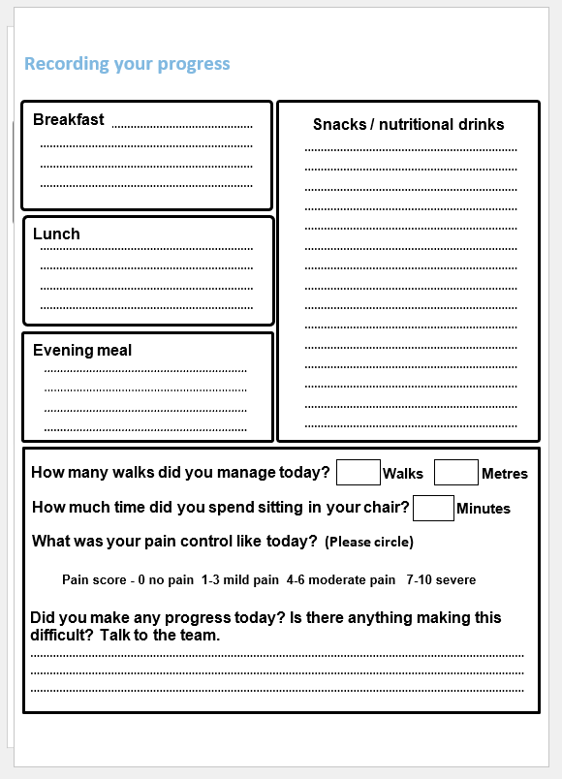
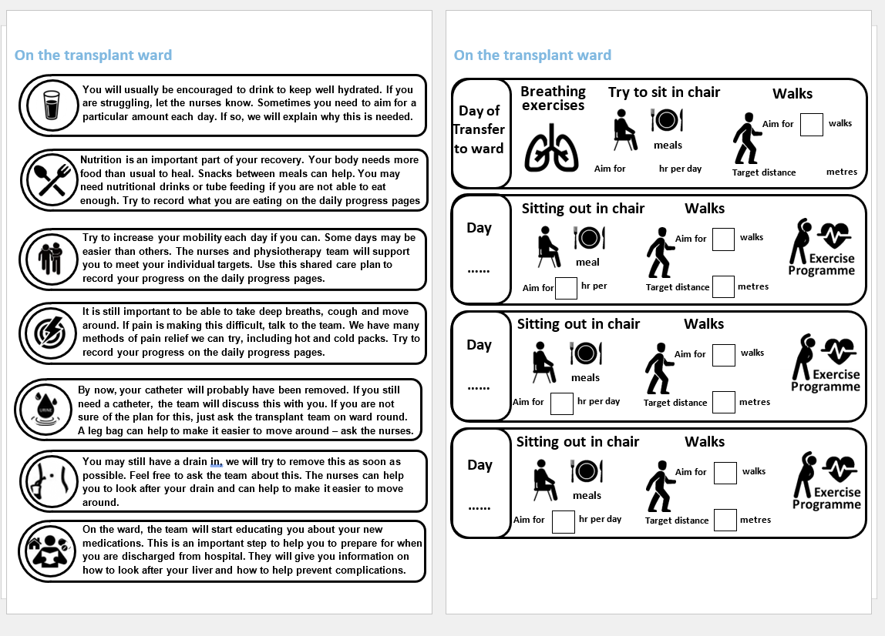
www.odt.nhs.uk
Shared care plan
Enhanced recovery after surgery for liver transplant recipients
Patient shared care plan

Slide 26
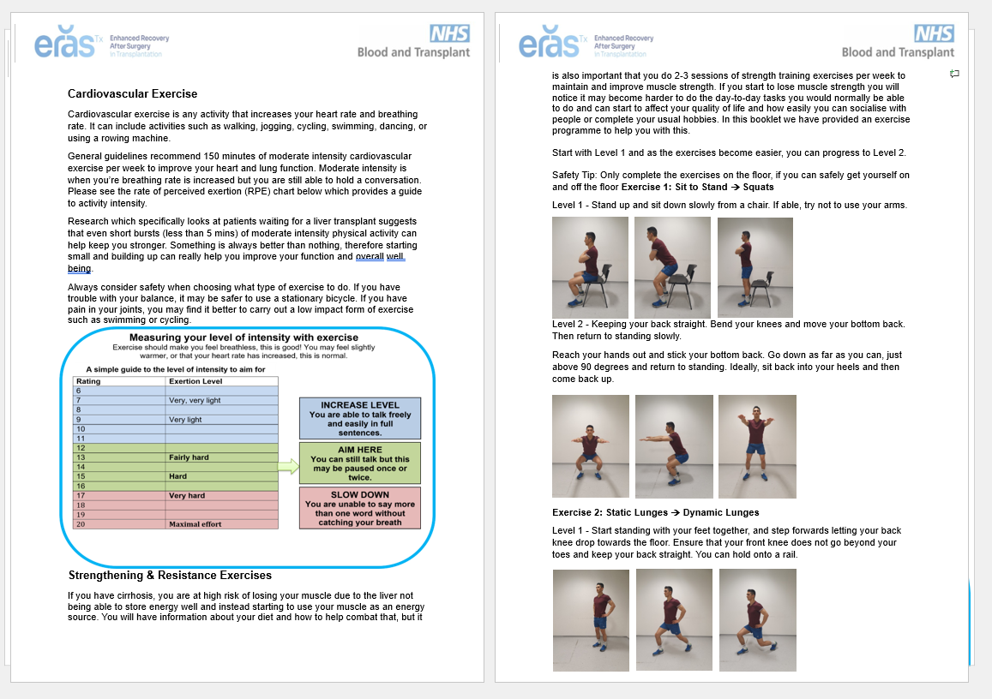
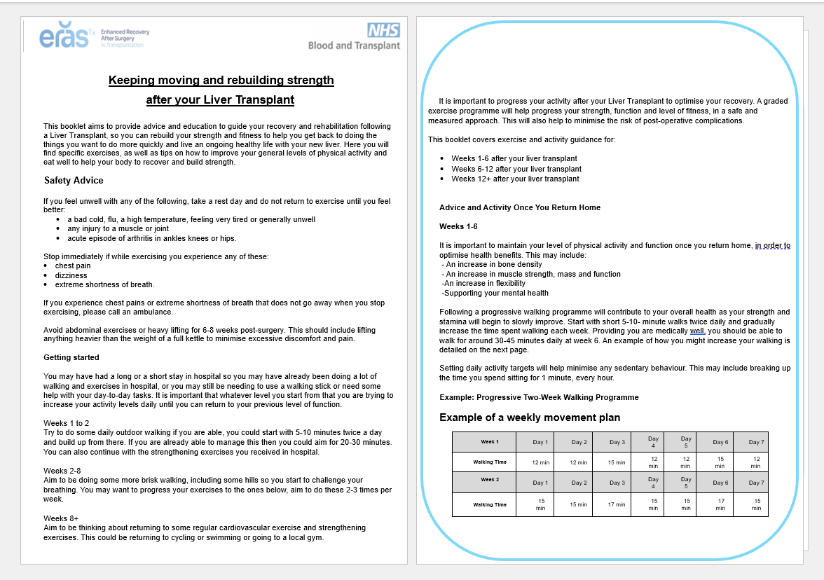



www.odt.nhs.uk
Prehab and Rehab documents
Prehab
Nutrition and exercise
Rehab
Nutrition and exercise

Slide 27
NHSBT ERAS project next steps
NHSBT
Derek Manas, Medical Director
Lisa Burnapp, ERAS Programme lead
Carrie Scuffell, ERAS Subject Matter Expert
  Stage 1
    core and desirable ERAS components with supporting evidence
Stage 2
  Downloadable resources for centres
  Evaluation and measurement criteria
Stage 3
  Circulation and communication
  Patient facing content
  Additional resources
Multidisciplinary Steering group
Expert by experience panels
Adult kidney transplant
Adult liver transplant
Living kidney donor
Pancreas transplant
Lung
transplant
???????
?Paediatric kidney
transplant
? Living donor liver
? Heart
transplant
Evaluation and measurements

Slide 28








Emily Bonner, Aimen Amer, Frankie Dowen
Freeman Hospital Newcastle
Suzan Yannis,
Kidney care UK
Jane Chappell
Addenbrookes, Cambridge
Paula Appleton, Stephen Bond
Addenbrooke’s Hospital, Cambridge
Lisa Donohoe,
Glasgow
Frank Dor,
London WLRTC
Alice Greenwood,
SJUH Leeds
Jess Hollingsworth
SJUH, Leeds
Ben Stutchfield, Aubrey McCallum, Catherine McAnenny
Royal Infirmary of Edinburgh
Sharlene Greenwood, Juliet Briggs,
Kings College Hospital, London
Experts by experience
panel
Ciaran Campbell
Nick Palmer KCUK
Mae Law (KRUK)
Stephen Emmerson
Alan Hancock
Ben Stokes
Fez Awan
Mark Smith
Sue Lyon
Keith Pennington
Pam Nye
Pete Revell (NKF)
Patricia Gooden
Experts by experience panel
Erica Fairburn
Jayne Pilkington
Nathen Raffle
Sarah Barker
Katherine Walcot
Thomas Crame, Emily Bonner
Freeman Hospital, Newcastle
Michael Spiro,
The Royal Free, London
Kiran Sran
Guy’s and St Thomas’, London
@ERAS4txnhsbt.bsky.social
Jeremy Fabes,
Plymouth
Felicity Williams,
Mathew Armstrong
QEH, Birmingham
Rachel Thomas, Ben Stutchfield
Royal Infirmary of Edinburgh
ERASforTransplant@nhsbt.nhs.uk
Michael Spiro, Ilya Kantsedikas, Gemma Wells,
Bryon O’Farrell, Abigail Greenwell,
Rebecca Bateman
The Royal Free, London
Aisling Courtney, Carla Erskine
Belfast Health and Social Care Trust
Derek Manas, Lisa Burnapp, Carrie Scuffell, Liz Armstrong, Jen Hobbs, Sapna Marwaha, Trudy Monday, Olivia Quinn, Emma Avery, Conner Sweet, Elaine Jolly
NHSBT

