Slide 1


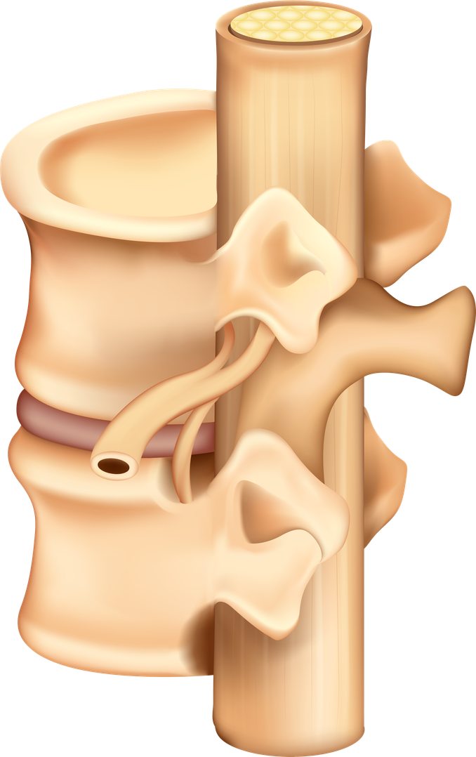




Prophylactic platelets are
NOT required
1
Prior to bone marrow aspirate and trephine
2
In stable patients with bone marrow failure
Version 2.0

