Slide 1


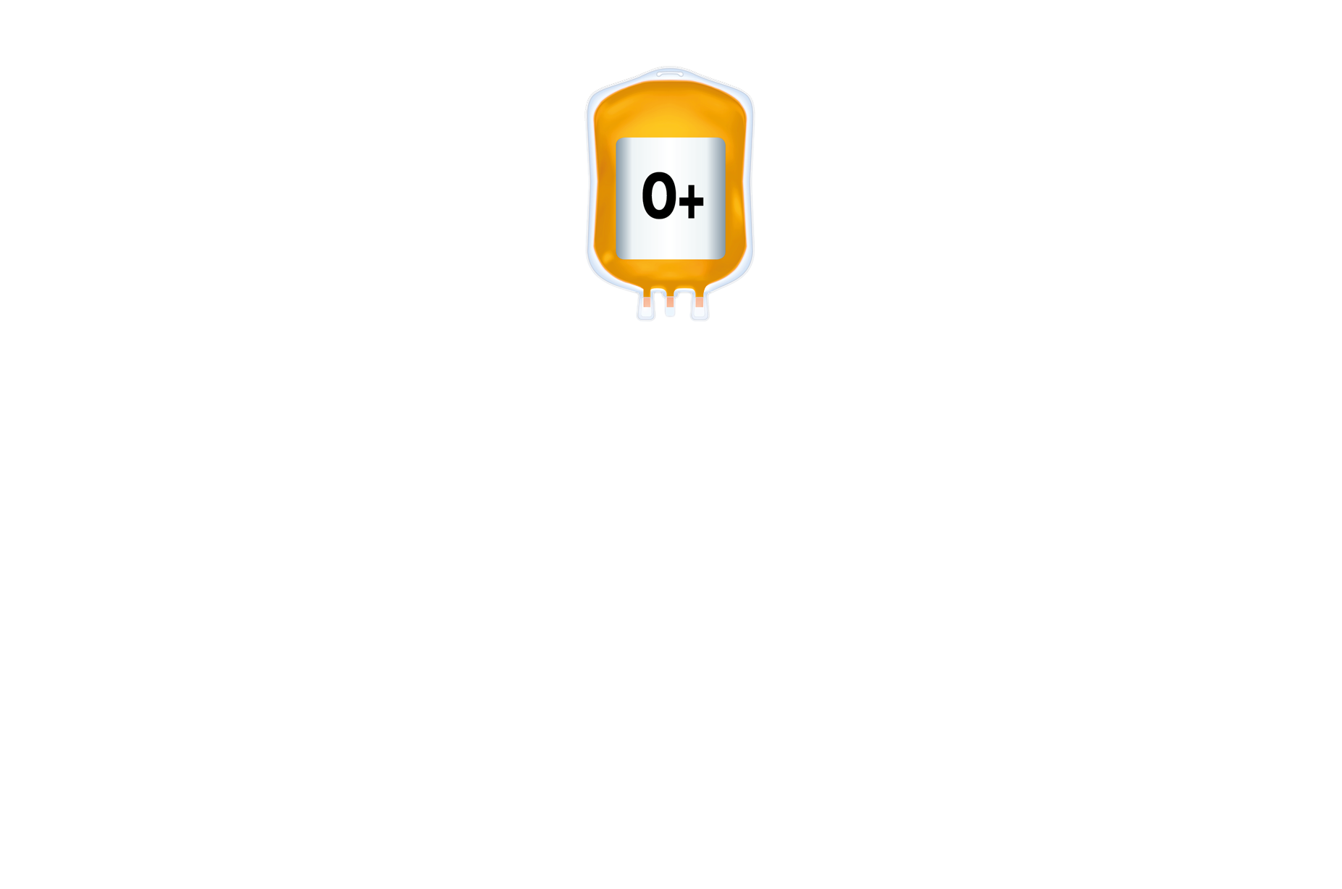

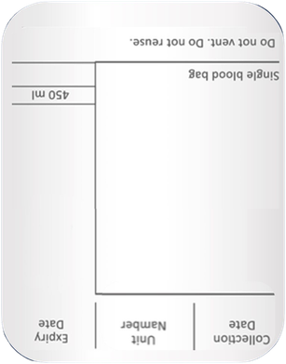


Don’t use two when
one will do
One adult therapeutic dose of
platelets is required for prophylaxis
Version 2.0

