Slide 1


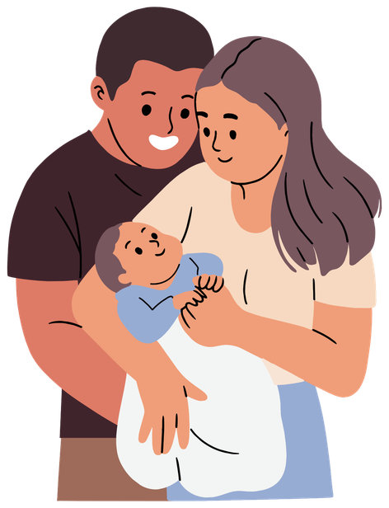
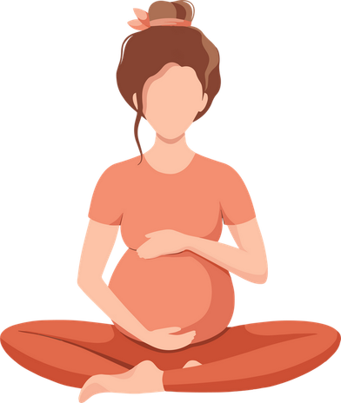
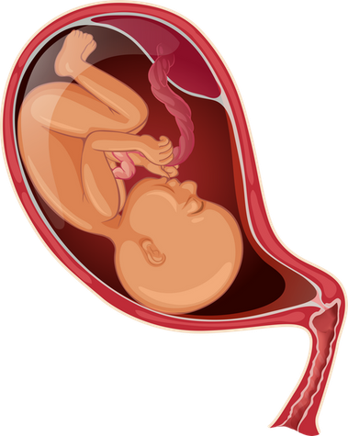

CMV negative components should only be considered for specific patient needs
Intrauterine transfusion (IUT)
Neonatal transfusion up to 28 days post estimated date of delivery
Elective transfusion during pregnancy NOT during labour and delivery
Version 2.0

