Slide 1







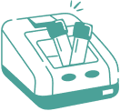
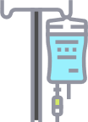



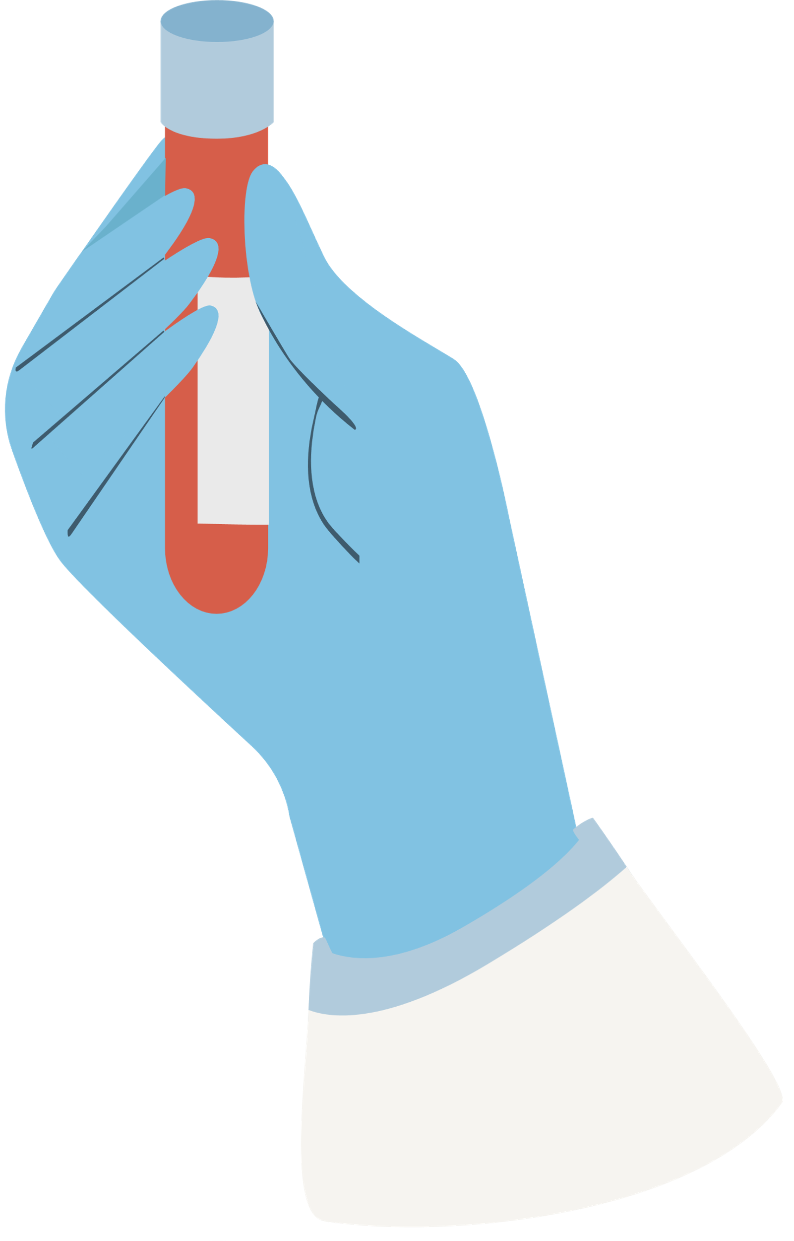
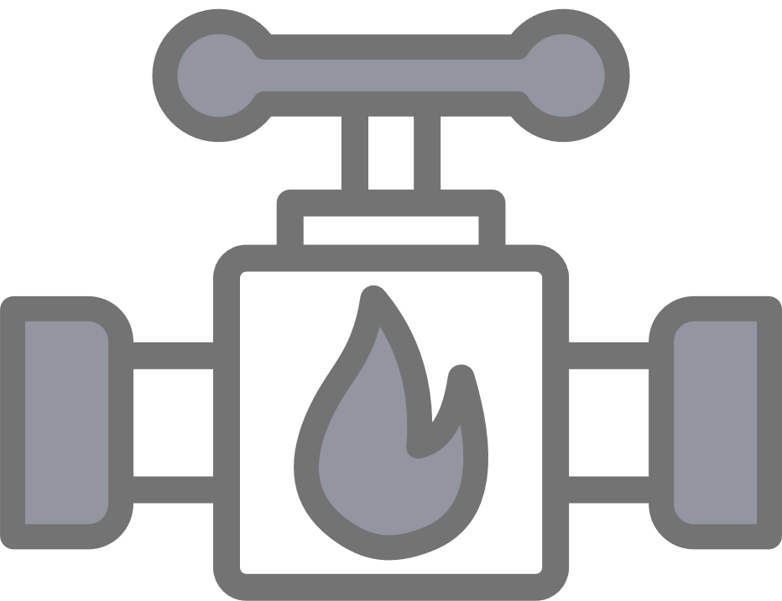

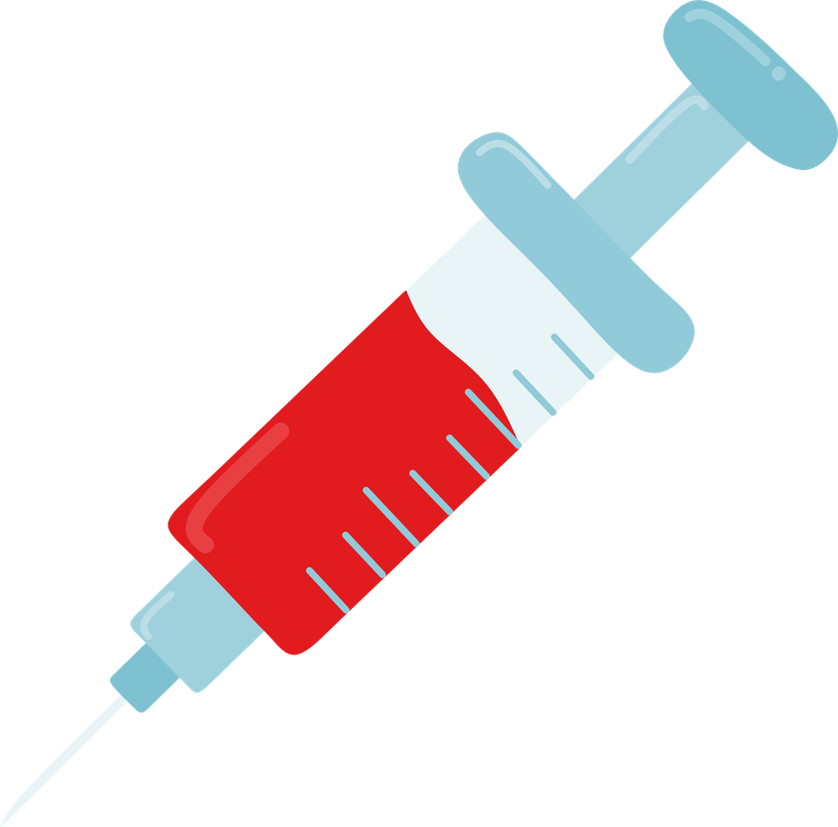


How can we prevent iatrogenic anaemia?
Introduce a minimum
retesting sample policy
Deliver training and education
Clinically assess the
need for sampling
Patient
Reduce sample rejection
Implement the use of
smaller sample tubes
Consider venous arterial blood management systems
Notes:
1. Policy on minimum testing standard
2. Training and education of staff when to take and the frequency
3. Assess patients - is the patient clinically stable? will the bloods change the patients care management? Does the patient have underlying risks of anaemia? Are these bloods being taking due to habit?
4. Has your Trust considered introducing smaller sample tubes?
5. Venous arterial blood management systems (VAMPS) help to reduce IA by preventing dilutional samples and too much blood from being drawn in to the syringe. Any unused blood can also be returned back to the patient. VAMPS are close systems so also reduce the risk of contamination.

