Slide 1

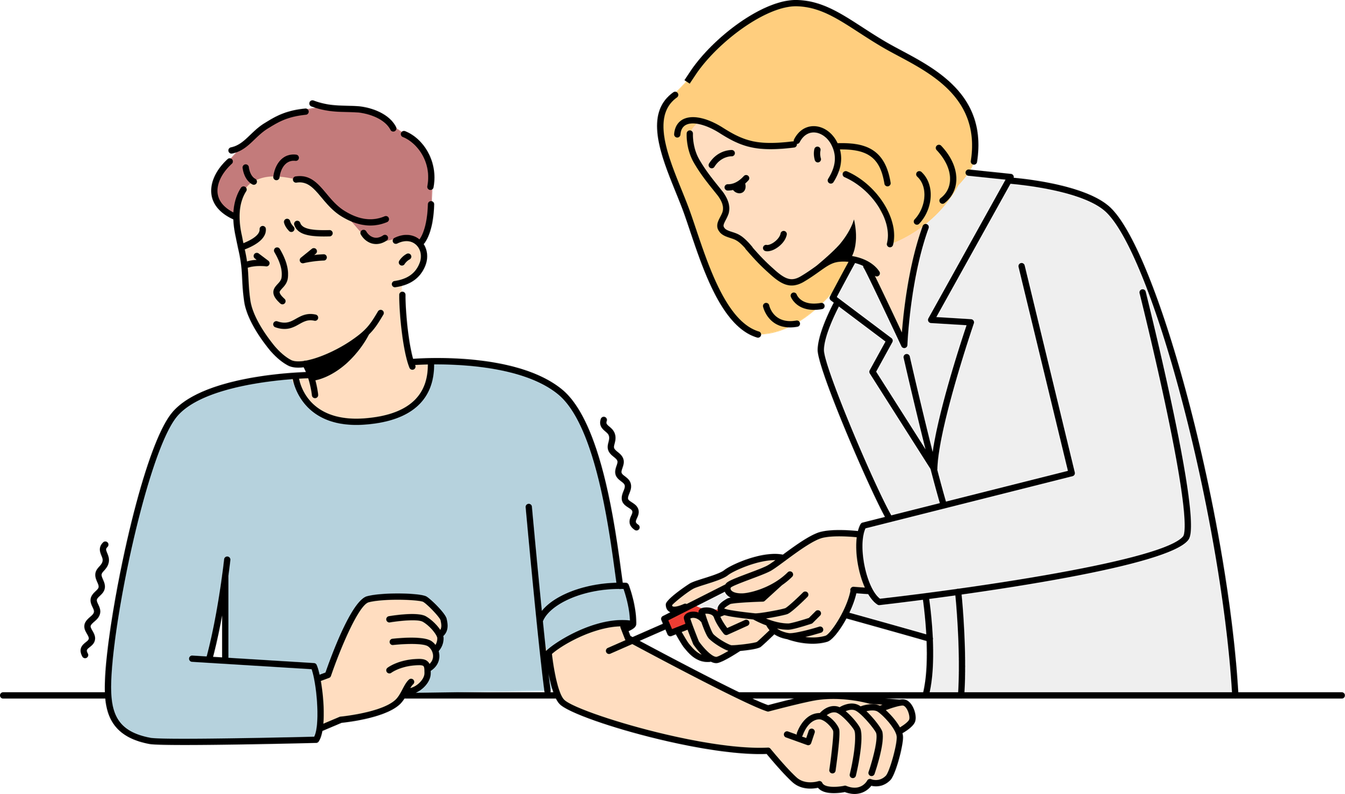


Unnecessary and rejected blood samples
Patient
Hospital
Potential risks:
  increase in underlying anaemia
  unnecessary rebleeding
  infection
  delay in treatment
Increase in patient safety risks
RISK
RISK
Patient dissatisfaction
SATISFACTION
Patient dissatisfaction from being rebled and reattendance
Increased costs - consumables, delays, staffing and workload
SATISFACTION
COST
Version 2.0

