Slide 1




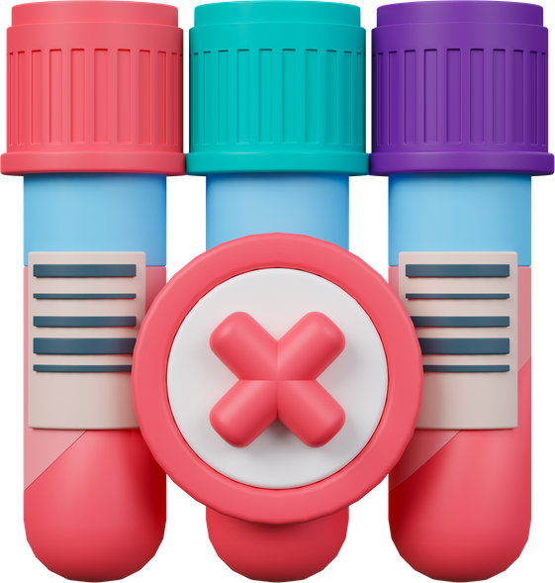

How to reduce blood sample rejection
Avoid duplicate or repeat samples
Are you bleeding
the correct patient?
Check volume required
for each sample
Have you labelled the
sample correctly?
Is your patient prepared?
Avoid taking samples from
a limb with IV fluids
Version 2.0

