Slide 1




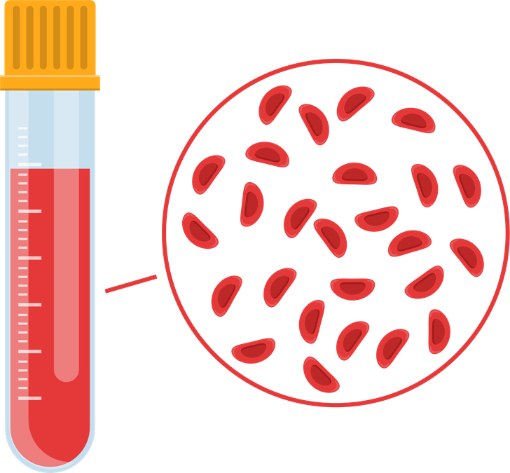


What is iatrogenic anaemia?
Hb
Iatrogenic anaemia occurs when medical interventions, particularly blood sampling lead to anaemia.
Version 2.0

