Slide 1


Donor infection and the impact on transplantation
Dr Emma Montgomery, Consultant Nephrologist,
Freeman Hospital, Newcastle Upon Tyne

Slide 2
Donor derived infection
Organ transplant is a low risk but an important route of transmission of infection from donor to recipient.

Slide 3
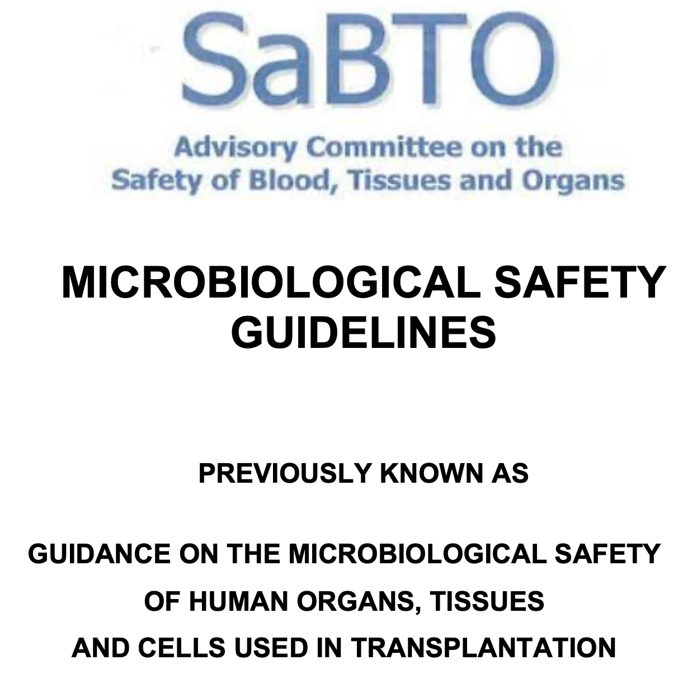
The most important resource for microbiology guidance in transplantation in the UK

Slide 4
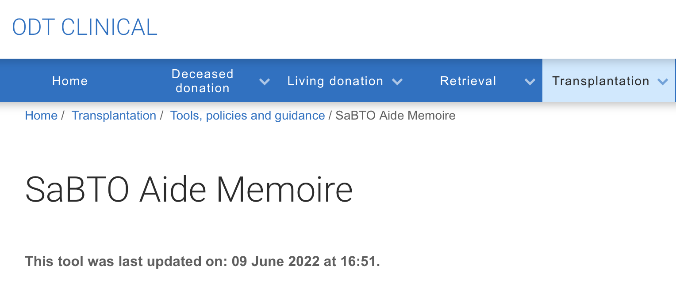
Aide Memoire

Slide 5
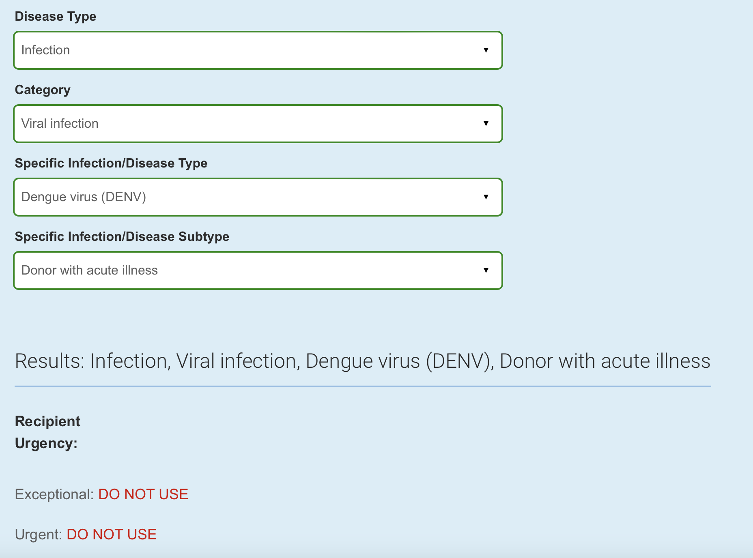
Aide Memoire

Slide 6
What are we dealing with ?
The degree of risk for transmission of infection carried with grafts, notably of viruses, is largely unknown and, for a specific organ, difficult to assess.

Slide 7
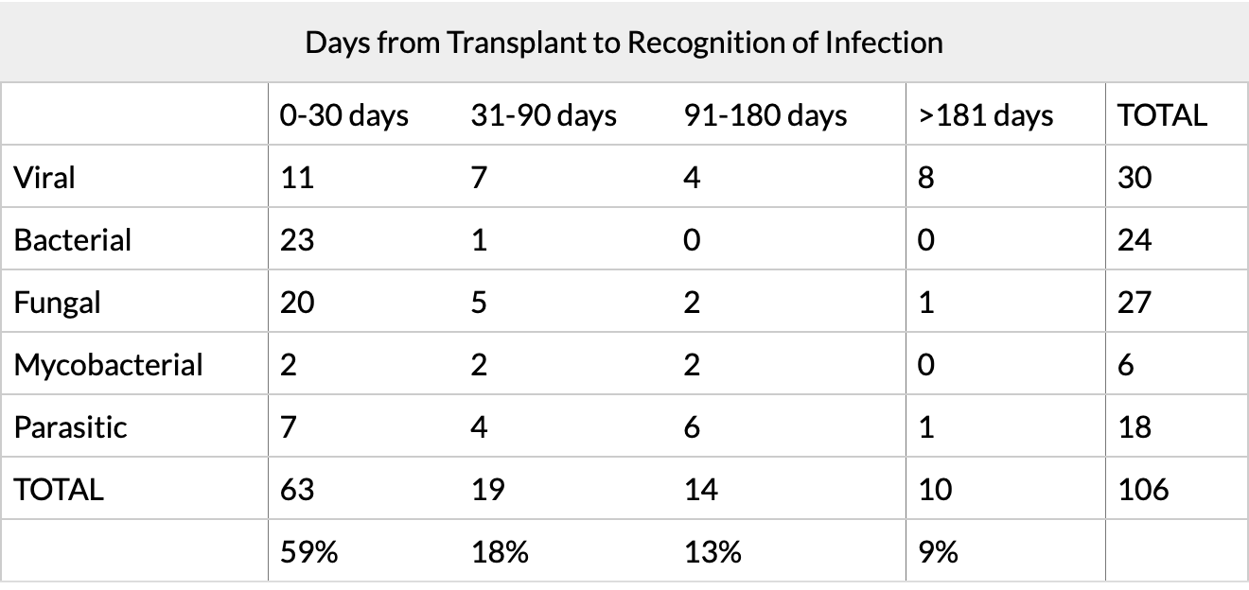
When will we see infection?

Slide 8
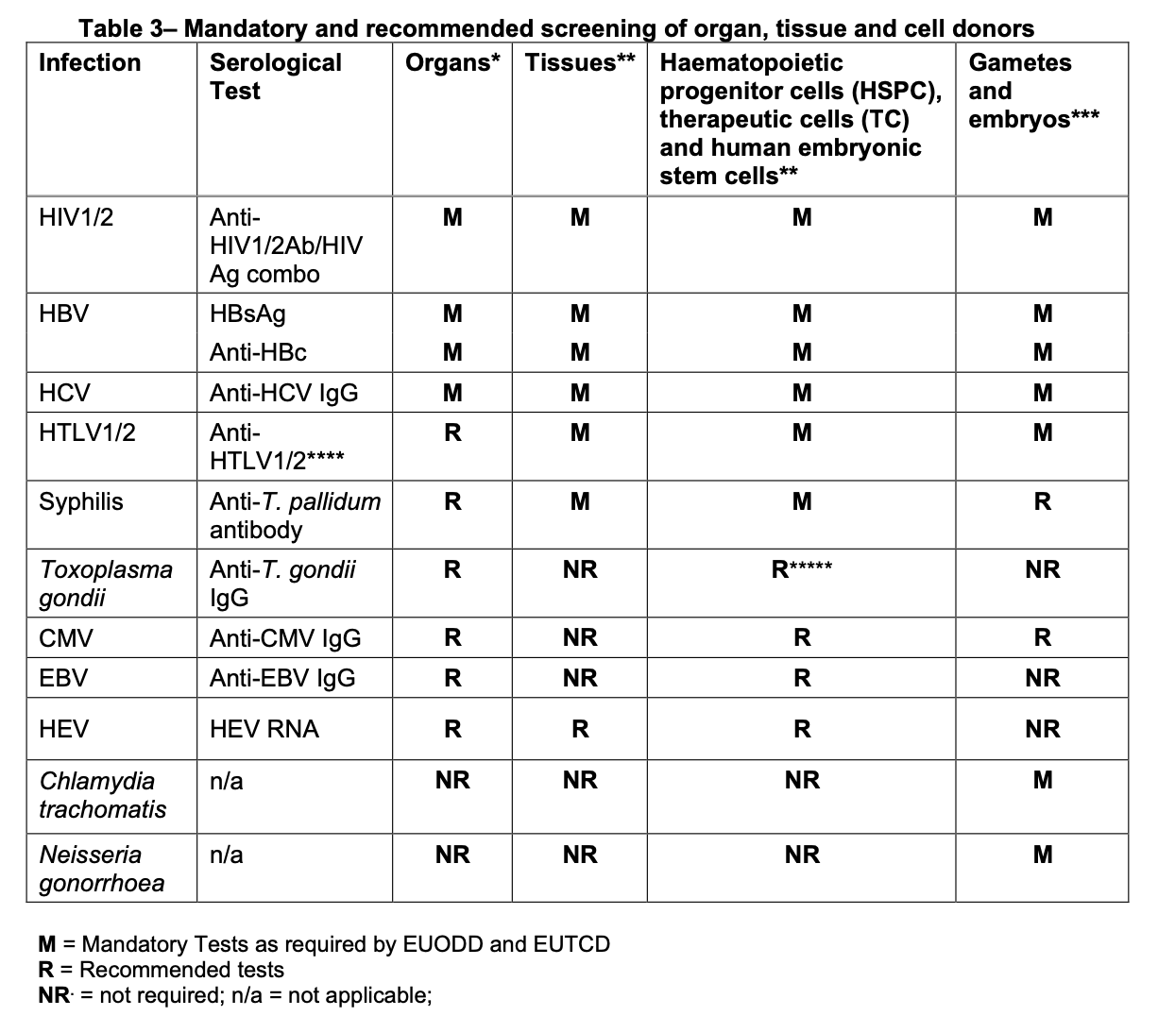
Mandatory screening

Slide 9
Required Donor Information
Treatment received in the illness before donation (including duration and dose of antimicrobial and other drug therapy)
Vaccination history and immunisation status
History of receipt of blood, blood components, blood products, tissue or organ graft.
Previous or current immunosuppression (by disease or drugs) as this may affect the interpretation of test results or the donor's suitability.
Travel History

Slide 10
Required Donor Information
History of contact with animals and other vectors. Transplantation may transmit zoonotic infections.
History that may have put the donor at increased risk of transmissible spongiform encephalopathies (TSEs).
History of malignancy, recent infectious disease or exposure to an infectious disease.
Behavioural history that could have put the donor at risk of transmissible pathogens This will include questions about risk behaviours such as recreational drug use, men who have sex with men (MSM), sex with commercial sex workers, sex with a partner know to have a sexually transmissible disease, acupuncture, tattooing and body piercing.
Results of any recent microbiological tests should be reviewed.

Slide 11
What do you think are the risks?
Donor :
a 33-year-old male, had a known history of polysubstance abuse and other high risk forensic history. The cause of death was a cardiac arrest and subsequent hypoxic brain injury shortly preceded by elicit IV substance abuse.
OOHCA – Overdose – Cocktail of methadone, cocaine ? Others.
Recent release from HMP – Overdosed in HMP ( Scotland )
Sofa surfing
Known active IVDU user since 2022.
Bitten from another human.
Infection – aspiration only .
Virology – EBV positive remaining virology negative at time of donation.
Had IVDU overdose earlier in the day – taken to ED , given Naloxone, self discharged and further IVDU overdose, found with needle in his arm

Slide 12
Transmission of Blood born virus
Human immunodeficiency virus (HIV)
Hepatitis C virus (HCV)
Hepatitis B virus (HBV)
CMV and EBV

Slide 13
Transmission rates
Hepatitis B 100 more transmissible than HIV
Hepatitis C 10 times more transmissible than HIV
HIV - often has the largest Stigma attached

Slide 14
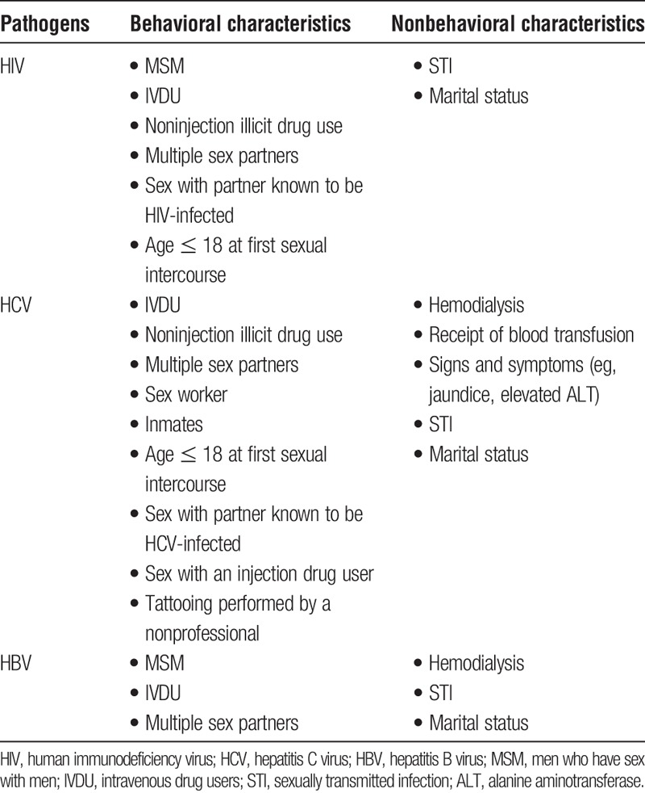
High Risk activity

Slide 15
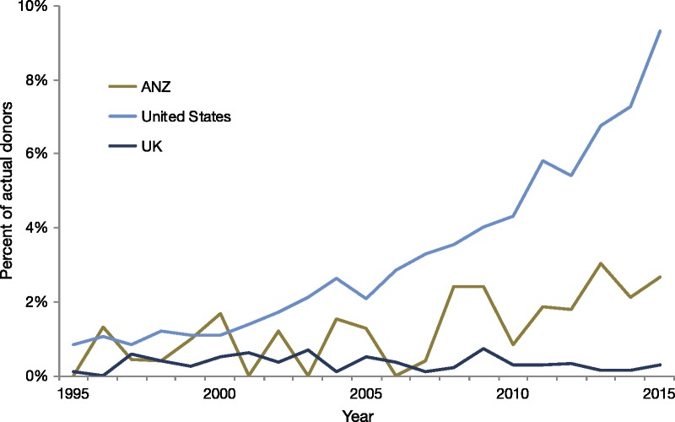
Twenty-year trends in the percentage of donors with drug overdose (intended or unintended) as a cause of death in Australia and New Zealand (ANZ) compared with the United Kingdom (UK) and United States (data sources: Australia and New Zealand Organ Donation Registry [ANZOD], Organ Procurement and Transplantation Network [OPTN], National Health Service Blood and Transplant [NHSBT]).

Slide 16
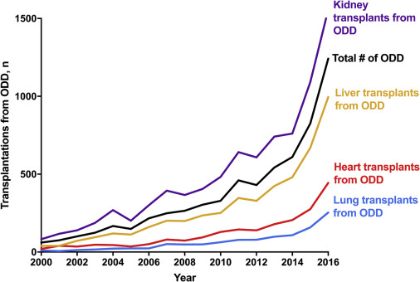
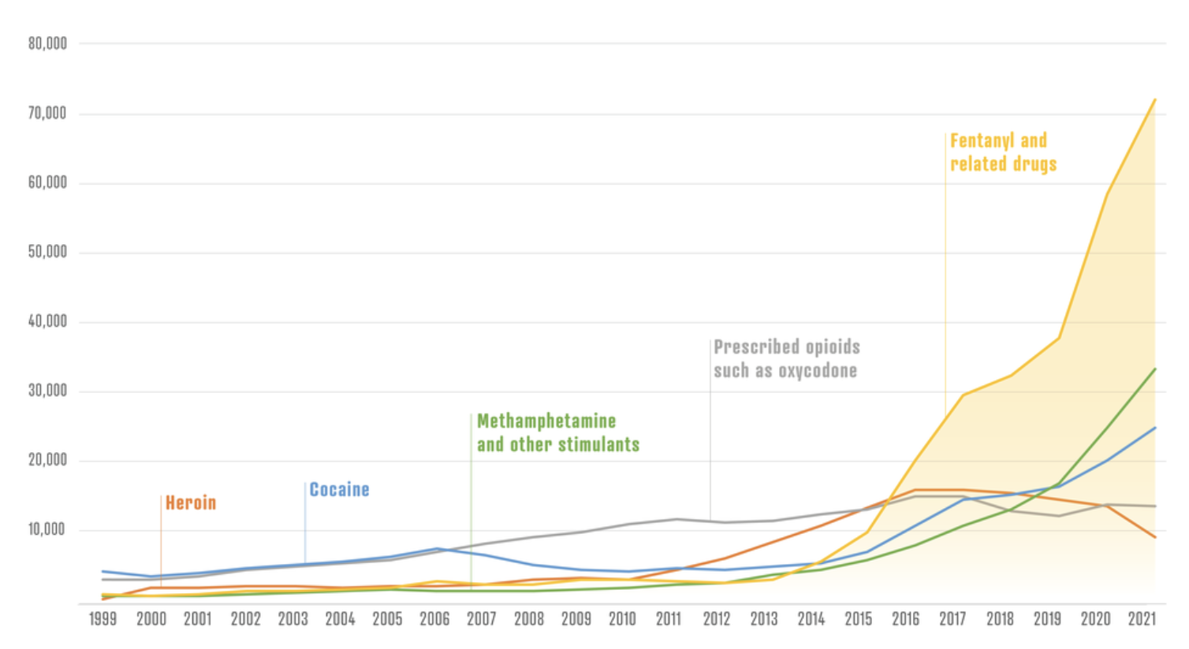
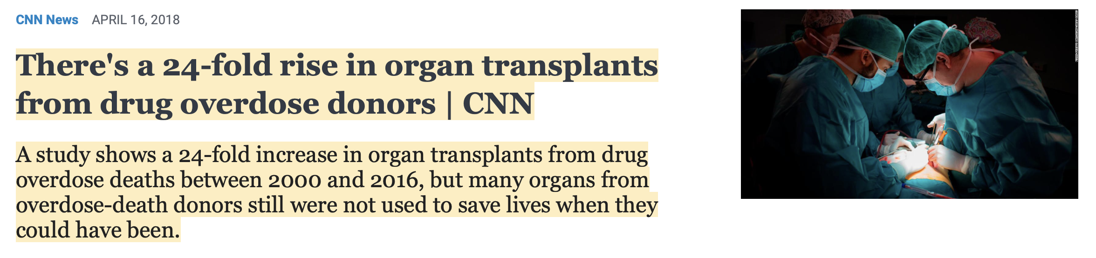
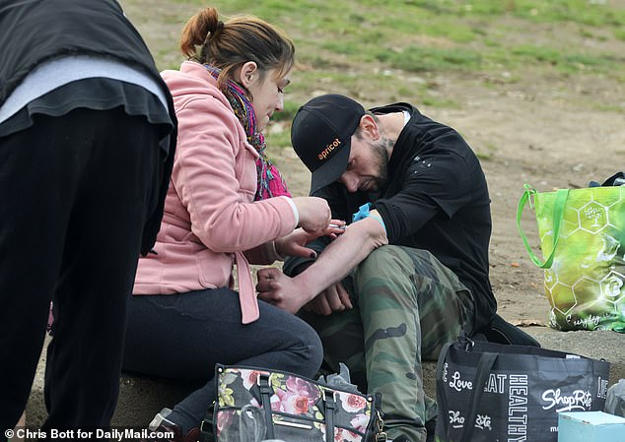
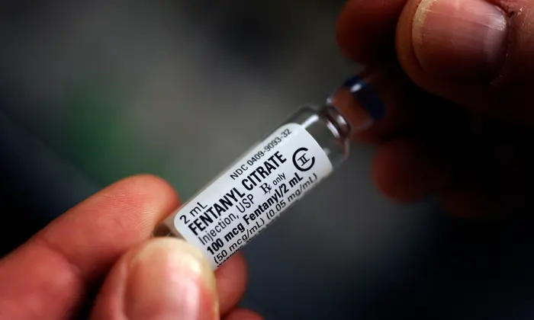


Slide 17
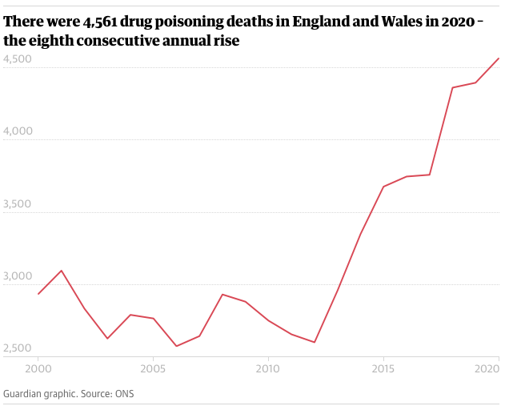
Drug poisonings in England and Wales
The rate of drug poisonings continues to increase
Rates of drug-related poisoning were 60.9% higher in 2020 (79.5 deaths per million) than they were in 2010 (49.4 per million).
The rate has increased every year since 2012
ONS:Deaths related to drug poisoning in England and Wales: 2020 registrations

Slide 18
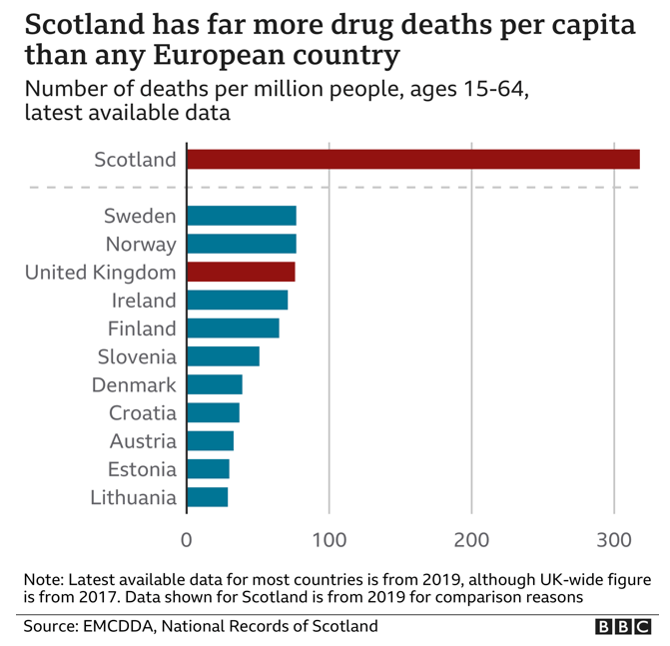
Scotland
It means Scotland continues to have by far the highest drug death rate recorded by any country in Europe.
And its rate is more than three-and-a-half times that of England and Wales.

Slide 19
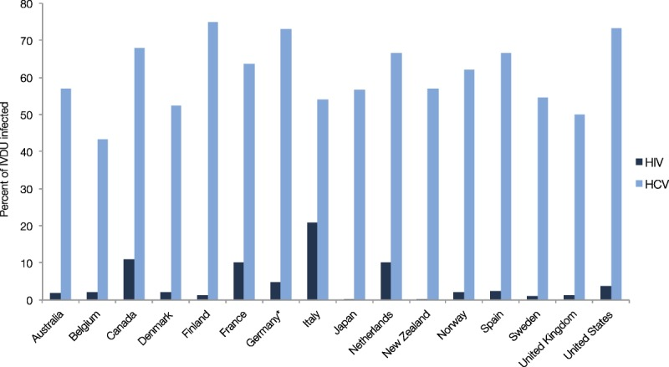
Estimated prevalence of human immunodeficiency virus (HIV) and hepatitis C virus (HCV) among people who inject drugs in selected high-income countries. HCV prevalence estimates represent mid-range estimates (source of HCV data: United Nations Office on Drugs and Crime http://unodc.org; source of HIV data: UNAIDS aidsinfo. unaids.org). *HCV estimate for Germany represents high range estimate for the year 2011. IVDU, intravenous drug users.

Slide 20
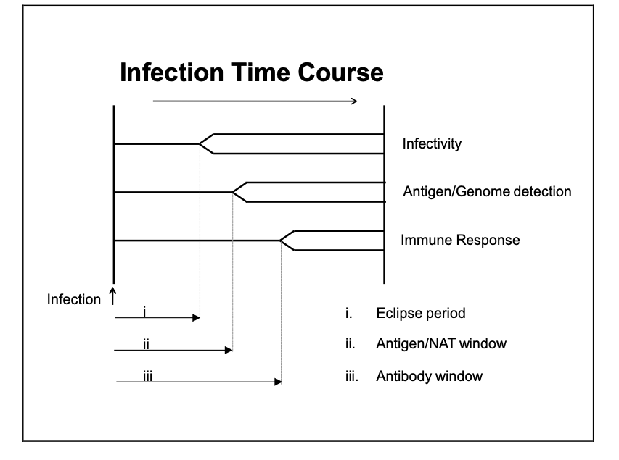
Interpreting donor test results
Following exposure to, and infection by, a microbiological agent there is a period of time during which no microbe can be readily recovered from the host; this is classically called the eclipse period.
Donations taken during this period are unlikely to be infectious but in practice this would not be safe and should be avoided.
** Not always correct

Slide 22
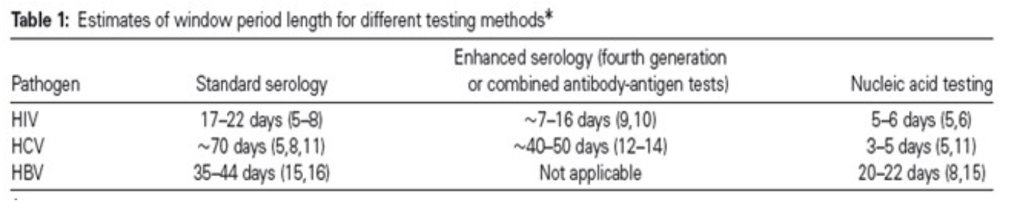
Window

Slide 23
Would you take the organ?

Slide 24
What do you think are the risks?
Donor :
a 33-year-old male, had a known history of polysubstance abuse and other high risk forensic history. The cause of death was a cardiac arrest and subsequent hypoxic brain injury shortly preceded by elicit IV substance abuse.
OOHCA – Overdose – Cocktail of methadone, cocaine ? Others.
Recent release from HMP – Overdosed in HMP ( Scotland )
Sofa surfing
Known active IVDU user since 2022.
Bitten from another human.
Infection – aspiration only .
Virology – EBV positive remaining virology negative at time of donation.
Had IVDU overdose earlier in the day – taken to ED , given Naloxone, self discharged and further IVDU overdose, found with needle in his arm

Slide 25
Interpreting donor test results
Following exposure to, and infection by, a microbiological agent there is a period of time during which no microbe can be readily recovered from the host; this is classically called the eclipse period.
Donations taken during this period are unlikely to be infectious but in practice this would not be safe and should be avoided.
** Not always correct

Slide 26
Case - What happened next?
Kidney implantation : uneventful
No damage to the kidney, 2 arteries one vein.
Long cold ischemic time - 23 hours
Delayed graft function

Slide 27
Named offer
Male 40 – (active on the TX list for 9 years).
Primary diagnosis IgA Nephropathy .
Previous renal transplant
No live donors.
HDX dependent, managing well no access issues.
Highly sensitised – tier score 9 – not suitable for imlifidase.

Slide 28
Day 3
Contact from NHSBT 3 days after implantation - extended provisional virology showing raised hepatitis C titres in donor.
Confirmation 24 hours later donor was now Hepatitis C positive at time of donation.
Screen the recipient

Slide 29
Hepatitis C transmission from donor to recipient

Slide 30
However
We had identified that the donor was very high risk
Hepatitis C was most likely infection to be transmitted but others could also be transmitted
Hep C- readily treatable
Hep B – lower risk, recipient vaccinated and good response
HIV- with treatment , provides almost normal life expectancy ( better than dialysis)
Possibility of other unknown infections
Discussed all of these with the donor prior to transplant. Discussed with virology, microbiology, Liver and Infectious diseases.

Slide 31
Consent – prior to transplant
Full written and verbal consent for high risk donor
Risk mediation considered
Patients' family informed
Screening pathway in place
Everyone fully aware prior to transplant
When transmission occurred - patient was very unbothered, much more excited to have a kidney

Slide 32
Outcome
Recipient became Hepatitis C POSITIVE almost immediately after transplantation .
Referred to liver specialist for treatment
- Maviret given (Glecaprevir 100mgs/Pibrentasvir 40mgs) once GFR was suitable.
HCV Converted from positive to negative within 8 weeks after treatment.
Genotype 3

Slide 33
Outcome
Creatinine 81
Current eGFR 88
On phased return to work at 8 weeks
He feels that it was the best decision ever made.

Slide 34
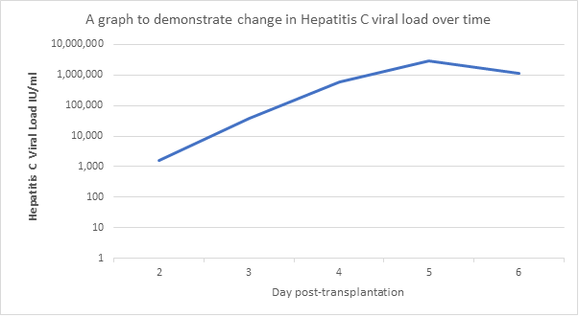
Viral transmission was much quicker than we expected
(pre transplant) - HCV RNA Not detected
d0, Transplant
d1 - 572 IU/ml
d2 - 1540 IU/ml
d3 - 38900 IU/ml
d4 - 467000 IU/ml (serum)
d4 - 581000 IU/ml (EDTA)
d5 - 2,910,000 IU/ml
d6 - 1,140,000 IU/ml

Slide 35
How does this impact transplantation?
Adult standard criteria DBD donor kidney offer decline rates
~50%

Slide 36
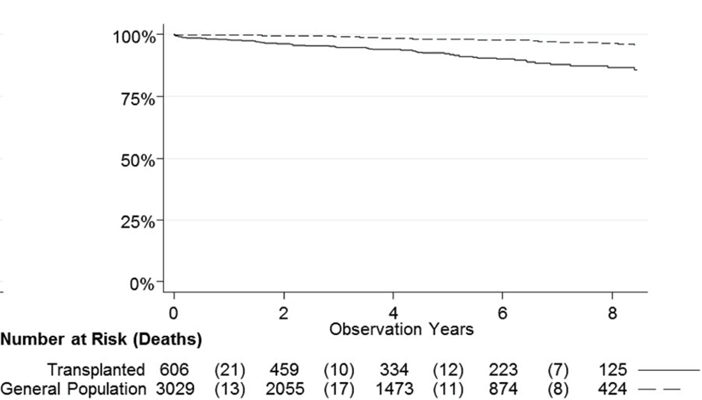
Survival
Dialysis
Transplant

Slide 37
We need more kidneys!
Notes:
BK virus was first discovered in a kidney transplant recipient who presented with a ureteral stricture in 1971 [2]. However, it was only in 1993 that the first definitive biopsy-proven case of BKVAN was described [2,3]. It is a matter of debate whether the increasing incidence of BK viremia over the subsequent years was as a result of the increasing availability of reliable testing methods versus a consequence of more potent immunosuppression regimes. During the period of its early description, BKVAN frequently resulted in graft loss with rates of 50–100% reported [3]. The ensuing increasing recognition and nuanced management have now resulted in a reduction in associated graft loss to under 15% within the last 2 decades

Slide 38
We need more kidneys!
to use kidneys better and think outside of the box
Notes:
BK virus was first discovered in a kidney transplant recipient who presented with a ureteral stricture in 1971 [2]. However, it was only in 1993 that the first definitive biopsy-proven case of BKVAN was described [2,3]. It is a matter of debate whether the increasing incidence of BK viremia over the subsequent years was as a result of the increasing availability of reliable testing methods versus a consequence of more potent immunosuppression regimes. During the period of its early description, BKVAN frequently resulted in graft loss with rates of 50–100% reported [3]. The ensuing increasing recognition and nuanced management have now resulted in a reduction in associated graft loss to under 15% within the last 2 decades

Slide 39
CMV and EBV
The majority of adult populations worldwide are latently infected with CMV and/or EBV,
CMV: 20% to 100%
EBV: 50% to 90%
of populations older than 18 years, respectively

Slide 40
CMV and EBV
CMV and EBV cause lifelong infection, and organs from seropositive donors may transmit infection, potentially causing severe disease in a seronegative recipient.
Latent CMV and EBV may also reactivate in immunosuppressed seropositive patients post transplantation.
No contraindications exist for organ donation in the case of donors with latent CMV infection, although recipient morbidity increases in the case of D+/R− combinations.

Slide 41
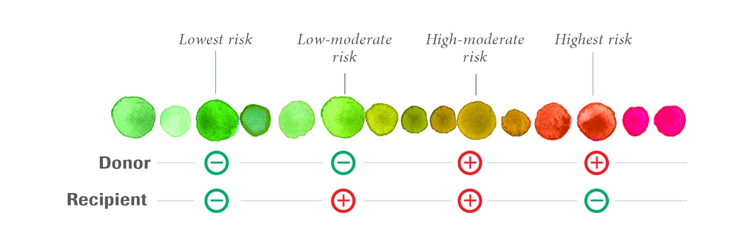
CMV

Slide 42
Human T cell Lymphotropic Virus (HTLV)
The Human T-cell lymphocytic virus-1 (HTLV-1) is an oncogenic retrovirus that preferentially infects CD4+ T-cells.
Transmission may occur as a result of breast feeding, IV drug use, sexual intercourse or blood transfusion.
Although infection is usually asymptomatic in most individuals, approximately 2% to 5% of infected individuals will subsequently develop acute T-cell leukaemia/lymphoma (ATL) around 20 to 30 years after infection. ( 10 to 20 years if transplant related)
Some studios show 40% risk of HTLV-1–associated myelopathy/tropical spastic paraparesis (HAM/TSP) in SOT ( compares to <0.4% in non transplant) ( +ve to +ve however is low risk)
Devastating Disease. Therefore generally don’t take organs

Slide 43
Toxoplasma gondii
Transmission of an infection with T. gondii occurs most commonly when a seronegative recipient receives an organ from a seropositive donor.
Whereas the occurrence of toxoplasmosis following non-cardiac organ transplantation is low, the reported prevalence in serologically mismatched (D+/R–) heart and heart-lung recipients in the absence of antimicrobial prophylaxis can be as high as 75% due to the transmission of T. gondii cysts present within cardiac tissue.
If positive
Donation permitted
Informs need for prophylaxis in heart recipients

Slide 44
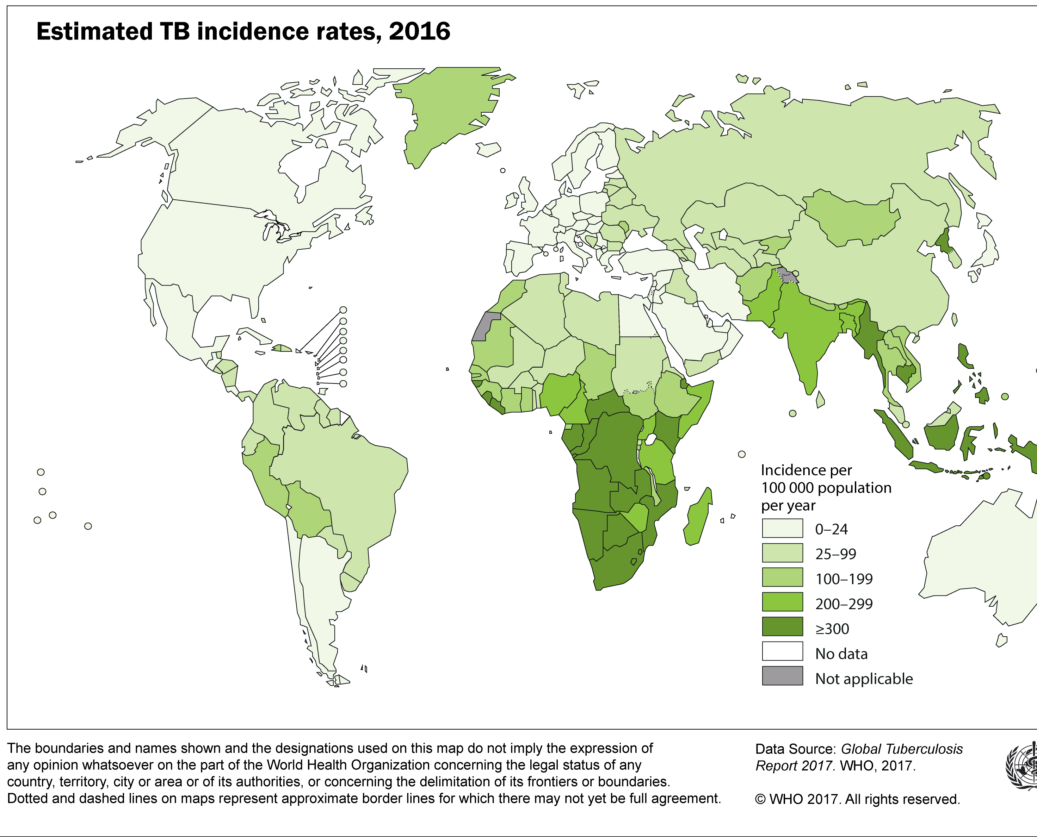
TB - Tuberculosis
Donation of organs and tissues is contraindicated from donors with active disease or within the first six months of anti-tuberculosis treatment.
Previous disease or from a risk area - requires donor prophylaxis.

Slide 45
Hepatitis E Virus
Hepatitis E virus (HEV) is overall the world's most common cause of acute viral hepatitis.
If positive
Donation permitted. Informs post transplant management

Slide 46
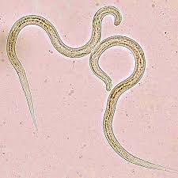
Strongyloides stercoralis
Asymptomatic carriage with strongyloides stercoralis has been reported most often in donors who were both born in and lived for some while in endemic areas which include most of the Tropics and Sub-tropics.
An Eosinophilia may or may not be present. Transmission to immuno-compromised recipients is often associated with significant morbidity and a high mortality rate.
Pre-donation identification from stool sampling and serology, most practicable for a live donor allows for effective recipient prophylaxis.

Slide 47
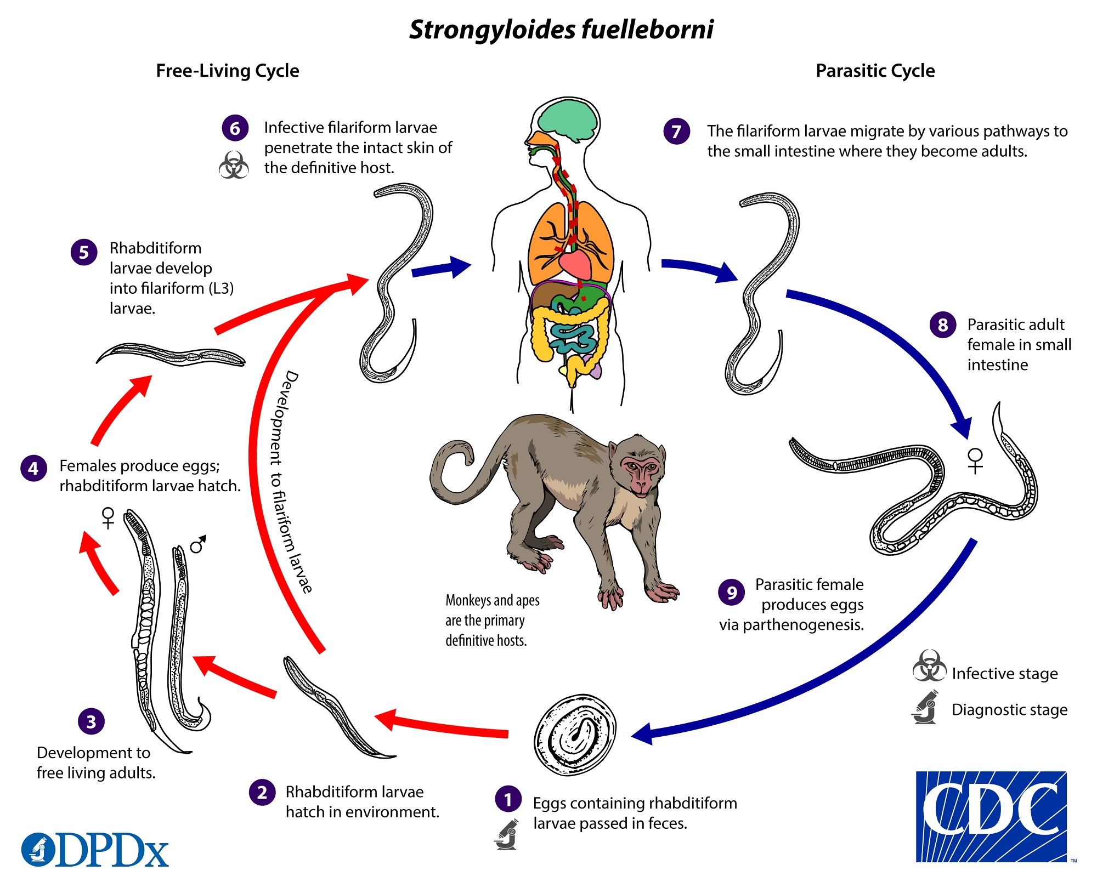

Slide 48
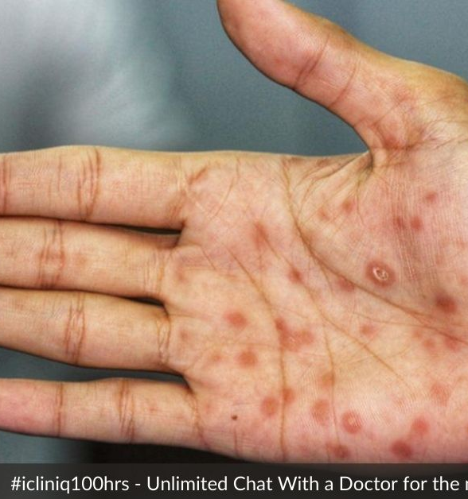
Treponema pallidum (Syphilis)
Syphilis is never a contraindication for using organs
Penicillin should be administered to recipients of serologically reactive donors.

Slide 49
Drug resistant bacteria e.g. methicillin resistant Staphylococcus aureus (MRSA), vancomycin resistant Enterococcus (VRE), carbapenemase-producing Enterobacteriaceae (CPE)
Drug resistant bacteria can be transmitted from donor to recipient. Transmitted infections are difficult to treat and are associated with poorer outcome in the recipient.
  The presence of drug resistant bacteria in the donor is a relative contraindication to solid organ transplantation.
  Specialist microbiological advice must be sought.
  Careful consideration of benefits from transplant is required.

Slide 50
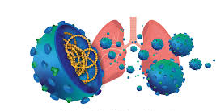
Yearly Epidemic Influenza
UK guidelines state that lungs and bowel should not be used from donors with confirmed influenza infection.
Other organs may be offered, and the final decision lies with the transplanting surgeon.

Slide 51
Meningoencephalitis of unknown cause
Donors with undiagnosed meningoencephalitis are an uncommon but potentially lethal source of donor-derived infection.
Transmission of rabies, LCMV, WNV, Mycobacterium tuberculosis, Cryptococcus, Coccidiodes immitis, Aspergillums, and Balamuthia have occurred when donors with meningitis or encephalitis of unknown cause have been used as organ donors.
For this reason, any meningitis or encephalitis without a proven cause should be an absolute contraindication to transplantation, according to the international guidelines

Slide 52
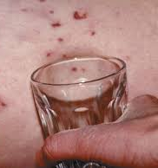
Bacterial meningitis
If bacterial meningitis has been confirmed, and there is no visible damage or local infection in the organ or tissues required at retrieval, the donation of the organs, tissues and cells are acceptable provided appropriate treatment has been administered to the donor.

Slide 53
Transmissible Spongiform Encephalopathies (TSEs) (Prion )
TSEs (otherwise known as prion diseases) are a group of fatal transmissible neurodegenerative disorders that in humans occur in sporadic, genetic and acquired forms.
The commonest human TSE, Creutzfeldt-Jakob disease, occurs in all three forms:
Genetic (gCJD),
Sporadic (sCJD)
Acquired (Variant CJD,vCJD, and iatrogenic CJD,iCJD).

Slide 54
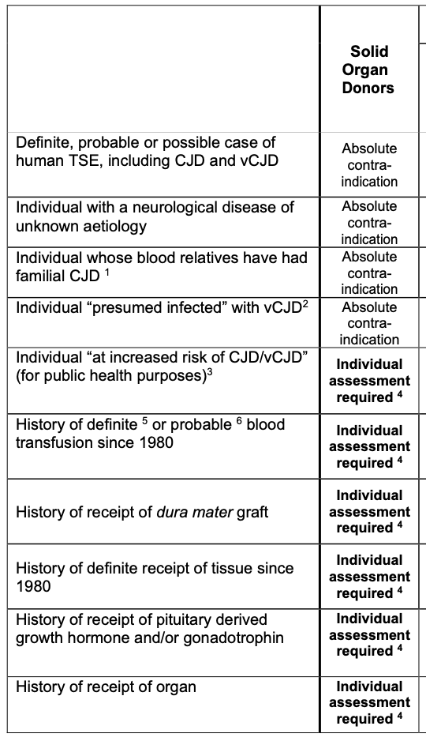
Exclusions from organ and/or tissue donation based on possible TSE exposure

Slide 55
Aide Memoire
https://www.odt.nhs.uk/transplantation/tools-policies-and-guidance/sabto-aide-memoire/

Slide 56
Thank you

