Slide 1
Communication
with
Collaboration
and
Compassion
Recipient & Living Donor Coordinators Induction
3rd October 2025

Slide 2

What Is Civility Saves Lives?
A Movement Backed by Research and Built by Healthcare Professionals
Civility Saves Lives is a clinician-led initiative that raises awareness of the profound impact that behaviour, including rudeness has on performance, wellbeing, and patient safety within a healthcare setting.
​
Our message is simple: how we treat each other at work matters. Even small acts of incivility can reduce diagnostic accuracy, worsen outcomes, and drive staff away. But respectful, compassionate communication creates safer, more effective teams.

Slide 3
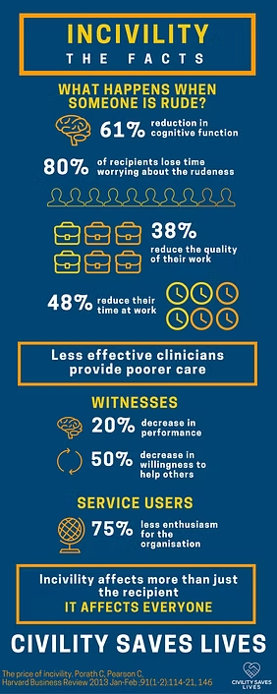
Impact of Incivility
61% reduction in Cognitive bandwidth
80% lost work time worrying about the incident
48% intentionally decreased the time spent at work
20% reduction in performance across the whole team

Slide 4
What is Communication?
‘A process involving a sender encoding a message, transmitting it through a channel, and a receiver decoding the message to understand its meaning’
Purpose:
Share Information
Build Understanding
Express Feelings
Achieve Goals
Channels:
Face to Face
Telephone
Video
Written
Effective communication is dependent of sender and receiver using the same code

Slide 5
Coded language in Healthcare
Healthcare professionals use coded language routinely. However, this can often be very specific to professional discipline or clinical speciality.
Coded language can be deadly if the ‘sender’ and the ‘receiver’ do not share the same code.
e.g.
LTx
LKT
PHT
Liver Transplant? Lung Transplant?
Liver & Kidney Transplant? Laparoscopic Kidney Transplant?
Portal Hypertension? Pulmonary Hypertension?

Slide 6
Coded language in Healthcare
Healthcare professionals use coded language routinely. However, this can often be very specific to professional discipline or clinical speciality.
Coded language can be deadly if the ‘sender’ and the ‘receiver’ do not share the same code.
e.g.
DOA
FBC
ERS
Dead on Arrival? Documented on Arrival?
Full Blood Count? Final Business Case?
Eye Retrieval Scheme? Early Morning Shift?
Coded language is often loaded with cultural biases and is particularly problematic for diverse teams or where not all team members are ‘clinical’

Slide 7
Why does incivility in communication manifest?
Incivility in the workplace communication arises out of systemic pressures on staff, such as:
Demanding workload
Patient Safety worries
Time Pressures
Focus on own priorities
The chance of incivility is increased when staff are hungry, tired or exposed to emotional distress
Incivility is borne out of frustration. Its about ‘Good People having a bad day (or moment)’
It’s rarely about bad people!

Slide 8
Civility in Organ Donation and Transplantation
Organ donation & Transplantation requires teamwork.
To achieve the best outcomes for donors, their families and recipients, our teams need to perform well at times of high emotional stress.
Good relationships between all staff involved help donation run smoothly and keep everyone involved safe.
There are many elements that contribute to good working relationships, and being civil, or respectful, is one of these. Rudeness can manifest easily within a team, and incivility can cause a breakdown in teamwork.
The negative effects of incivility include reduced performance that negatively impacts the clinical outcomes of our donors and recipients and on staff health and wellbeing.

Slide 9
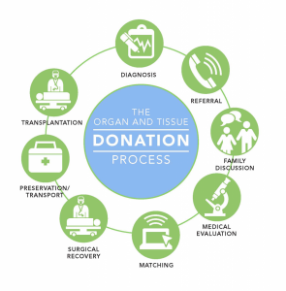
The complexity of the donation pathway
Organ donation and transplant pathway communication involves crucial interactions between multidisciplinary and multiprofessional clinical and non-clinical colleagues, patients and families at each stage, from the initial referral to post-transplant care.
Everyone will have differing, often competing, priorities that evolve and change based on new information.
The needs of individual recipients need to be viewed in balance and with regard to the needs of the donor, their family and the donating centre.

Slide 10
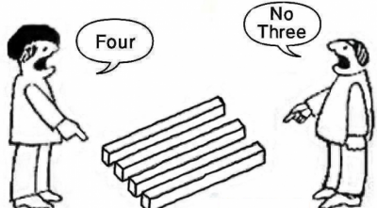
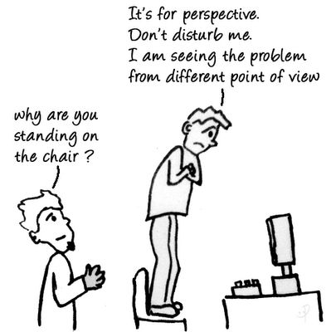
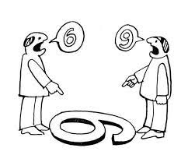

Slide 11
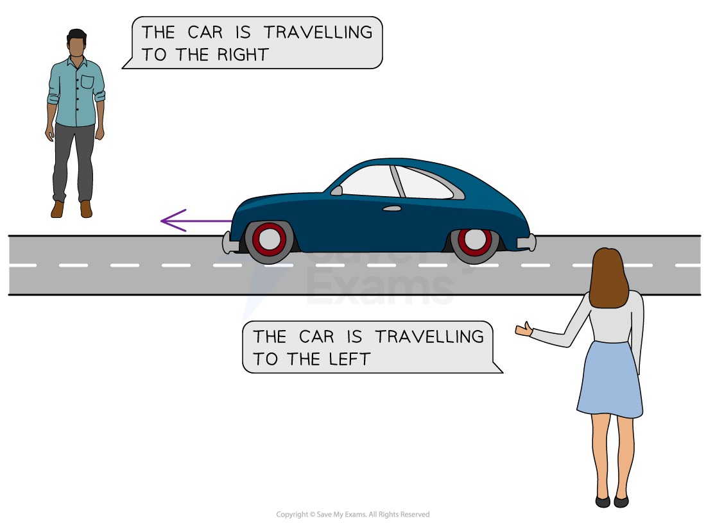
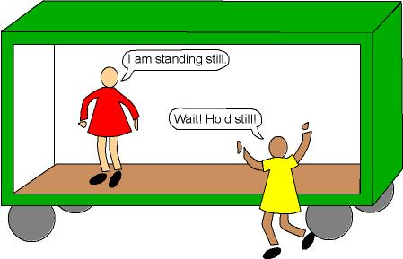

Slide 12
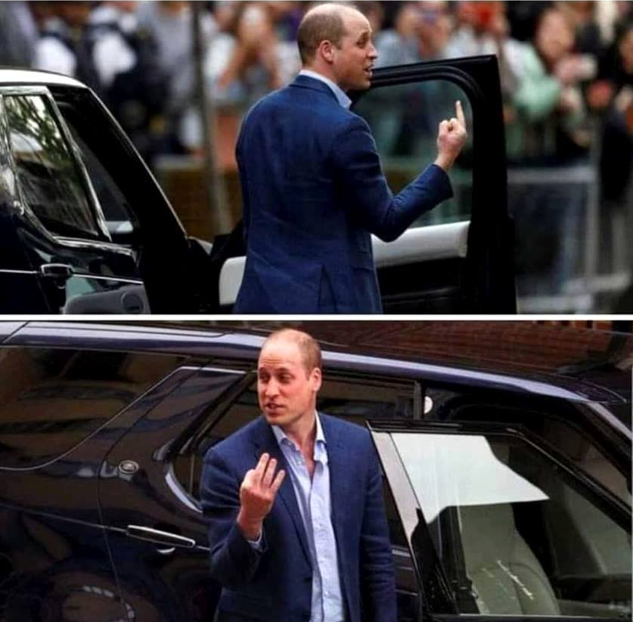


Slide 13
Takeaway Messages
Clarity – remember, not everyone speaks your code
Civility – how you say something is just as important as what you say
Compassion – for your patient, for the donor (and family), yourself and each other
Compromise - remember the bigger picture! We are all trying to achieve the best outcomes, and give and take is always necessary

