Slide 1
Patient Blood Management on Labour Ward
Patient blood management (PBM) is a multidisciplinary, evidence based approach to optimising a person's own blood to improve their outcomes.
The following slides demonstrate how this can be implemented, including in the labour ward setting.
There are three pillars to PBM
Pillar one: optimise red blood cell mass
Pillar two: minimise blood loss
Pillar three: manage anaemia
Version 2
Adapted from Royal Free London NHS Hospital Resource

Slide 2

Pillar one: optimise red blood cell mass
Iron deficiency anaemia (IDA) affects 1 in 4 women of childbearing age in the UK.
Commence oral iron therapy when the Hb is less than 110g/L regardless of gestation.
Consider if a haemoglobinopathy screen is indicated.
Hb <90, refer to obs ANC 2/52
If Hb <80 or symptomatic, refer for urgent obstetrician review
Request ferritin, if <100 mcg iron deficiency is confirmed
If ferritin>100mcg consider other causes, add on iron studies, B12, folate, U&Es and CRP
First line therapy - ferrous sulphate 200mg OD - do not wait for ferritin or other results before commencing oral iron.
Advise to take first thing in the morning, no other medications or food. Taking with vitamin C may improve absorption. Avoid tea and coffee for an hour before and after taking.
If unable to tolerate, reduce to OD on alternate days, or change to ferrous fumarate.
Recheck Hb 2-4 weeks after commencing iron to ensure appropriate incrementation (greater than 10g/L).
Version 2
Adapted from Royal Free London NHS Hospital Resource

Slide 3

Pillar one: optimise red blood cell mass
Consider intravenous iron in the following circumstances:
  Oral iron not tolerated after counselling regarding absorption, changing iron preparation, reducing dosing to alternate days
  Quick iron replacement required (ie within less than 4 weeks)
  Oral iron not adequately elevating Hb
Intravenous iron is contraindicated in gestations less than 13 weeks.
Use with caution before 34 weeks due to small risk of foetal bradycardia.
(Refer to the Anaemia Pathway and IV Iron Infusion in Pregnancy guideline in the resources section of the OB Anaemia Toolkit)
If anaemia is detected during pregnancy, ensure a full blood count is taken pre-delivery.
Version 2
Adapted from Royal Free London NHS Hospital Resource

Slide 4
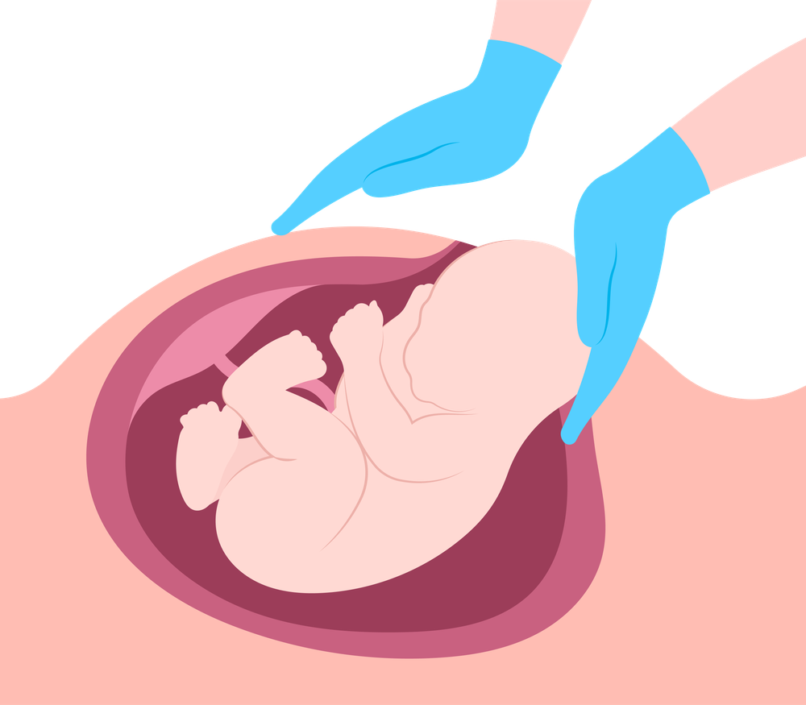
Pillar two: minimise blood loss
Meticulous haemostasis, surgical and anaesthetic techniques.
Consider the use of tranexamic acid.
Avoid coagulopathy.
Patient positioning/warming.
Use of pharmacological agents.
Consider the use of cell salvage at caesarean section.
Some Trusts set up cell salvage collection for all caesarean sections, regardless of expected blood loss.
Strongly recommended where blood loss is expected to exceed 500mls
Several Trusts in England have implemented vaginal cell salvage.
Verify the correct dose of anti-D required if cell salvage is used for D negative women who have a D positive baby.
Consider a hospital birth and active management of the third stage for those with anaemia in pregnancy.
Version 2
Adapted from Royal Free London NHS Hospital Resource

Slide 5
Pillar three: manage anaemia
Stable postpartum women rarely need a blood transfusion if the Hb is greater than 70g/L.
Giving iron to replenish stores and support sustained incrementation is more effective than a red blood cell (RBC) transfusion.
For stable adults, if clinically indicated, RBC should be given one unit at a time, followed with a clinical reassessment and check of Hb.
Document informed consent, including risks and ineligibility to donate blood in the future. Alternatives to transfusion should be discussed.
If unstable or actively bleeding blood components should not be withheld
Maximise oxygen delivery
Minimise oxygen requirements
Treat infections promptly
Consider individual tolerance of anaemia
Restrictive transfusion strategies
Version 2
Adapted from Royal Free London NHS Hospital Resource

