Slide 1


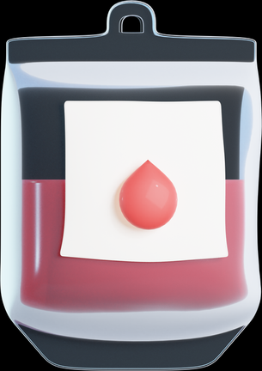

Don’t give two without review
Single unit transfusions reduce the risk of an adverse reaction and may be suitable for the following adults:
Clinically stable
Normovolaemic
No evidence of clinically significant active bleeding
Clinically reassess the person after each unit has been transfused:
Are there any signs or symptoms of transfusion reaction? Have their symptoms of anaemia improved? Re-check haemoglobin levels - is a further unit indicated?
Version 2

