Slide 1


The UK LiVING KIDNEY DONATION BUDDY SUPPORT SERVICE
Delivered in partnership by kidney research uk and give a kidney

Slide 2

About the PARTNERSHIP
Our aim is to raise awareness of living kidney donation and help more people understand what it means to be a living donor, as well as supporting and guiding them through their donation journey.
We raise awareness through the Make Your Mark campaign which is a celebration of people and extraordinary acts of kindness. It’s about the people who have already made the decision to step forward and the people who could be inspired to see if it’s inside them to save a life.
SOCIAL
MEDIA
COMMUNITY EVENTS
PUBLIC INSTALLATION
TRAIN PANEL ADVERTISING
ARTICLES WITH THE GUARDIAN
FILMS
NATIONAL PRESS COVERAGE
RADIO COVERAGE
REAL LIFE STORIES

Slide 3
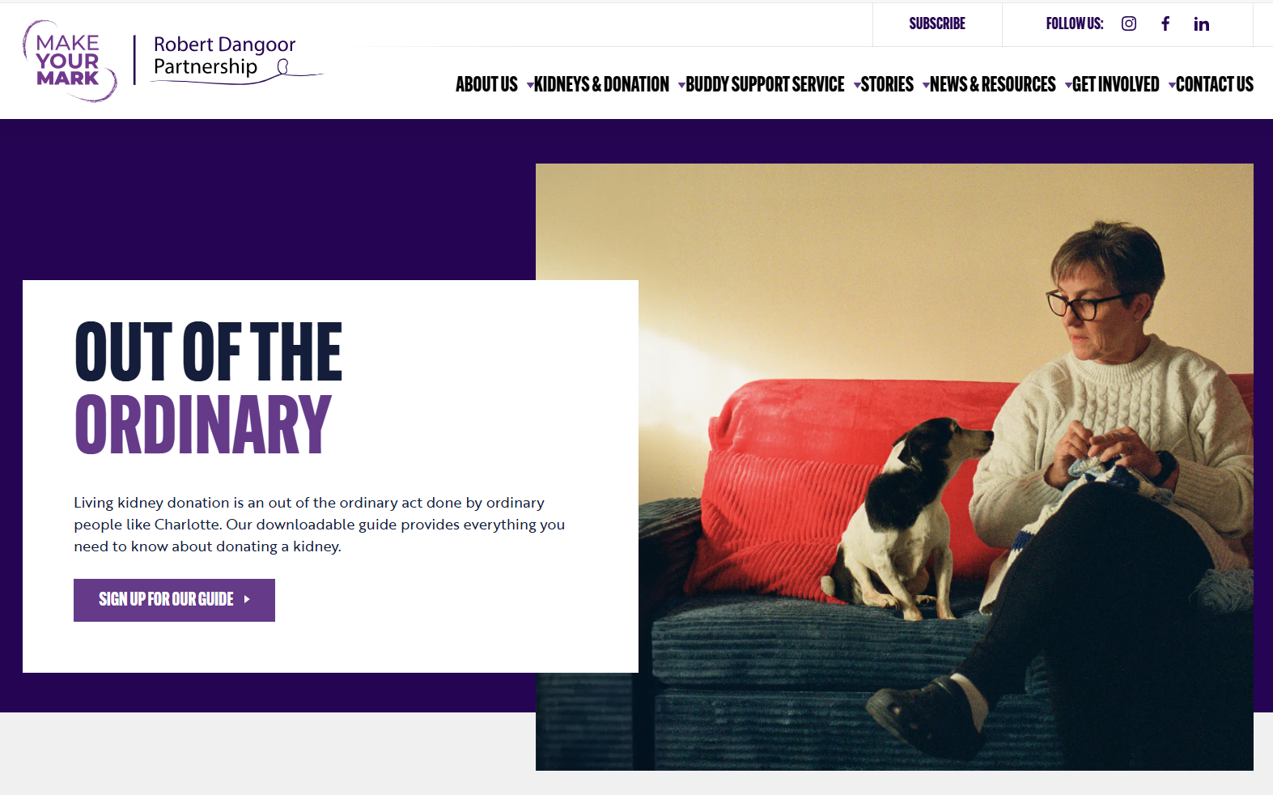
About our services
Information and resources about living kidney donation
Guidance on how to start the donation process
Interactive “Getting started” checklist
Real life stories
One to one support and information
Access to the UK Living Kidney Donation Buddy Support Service
www.donateakidney.co.uk

Slide 4

Our BUDDY support SERVICE
The UK Living Kidney Donation Buddy Support Service allows anyone interested in learning more about living kidney donation – whether they are considering donating themselves, or know someone else thinking about it – to speak with someone with lived experience.
We know that support is essential for donors and those around them during the kidney donation process, both before and after the donation.
This service offers a secure and safe place where they can chat with someone who has first hand experience and understands their journey.

Slide 5

HOW IT WORKS
The service is provided through an online platform where users can set up a profile and manage their own appointments.
They can select a buddy of their choice based on donation type, age, location, ethnicity, gender and religious beliefs.
Once the appointment is confirmed, the session will take place online. This service is not for in person meetings or discussions over the phone. All communication will be done through the online platform.
The meetings are 1-1 with a buddy. However, if users have family or friends who would like support then they can request a buddy themselves.

Slide 6
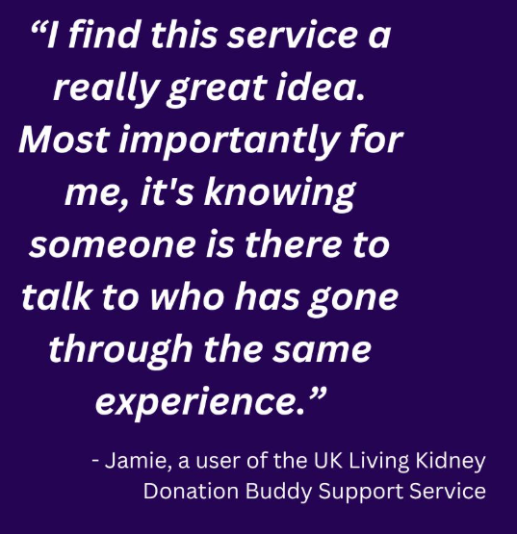
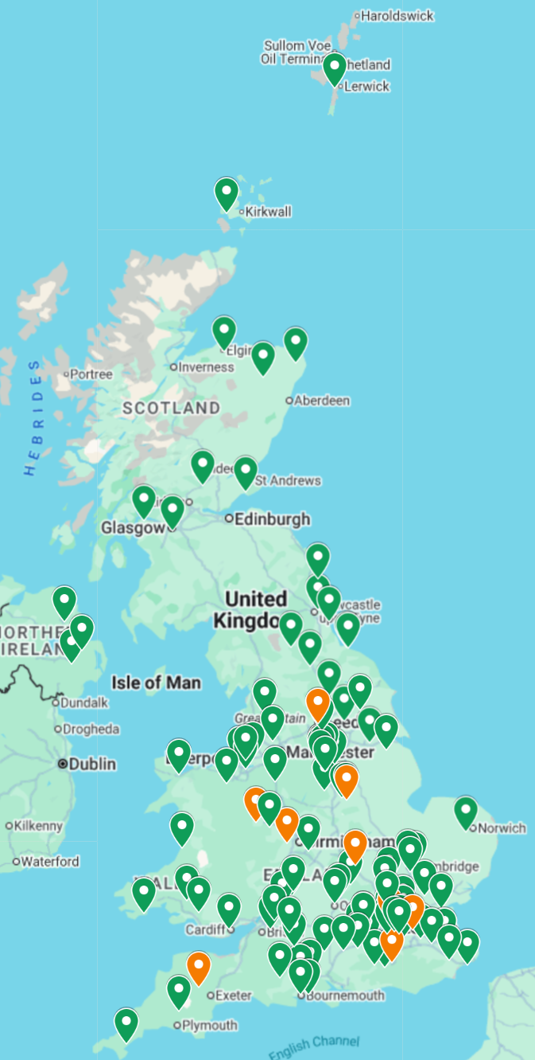

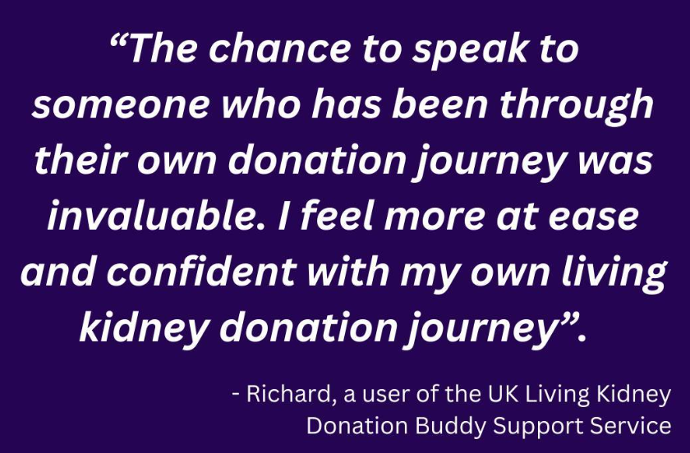
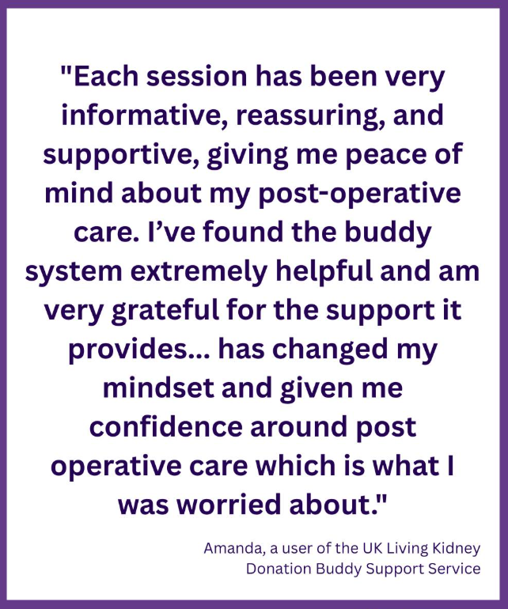
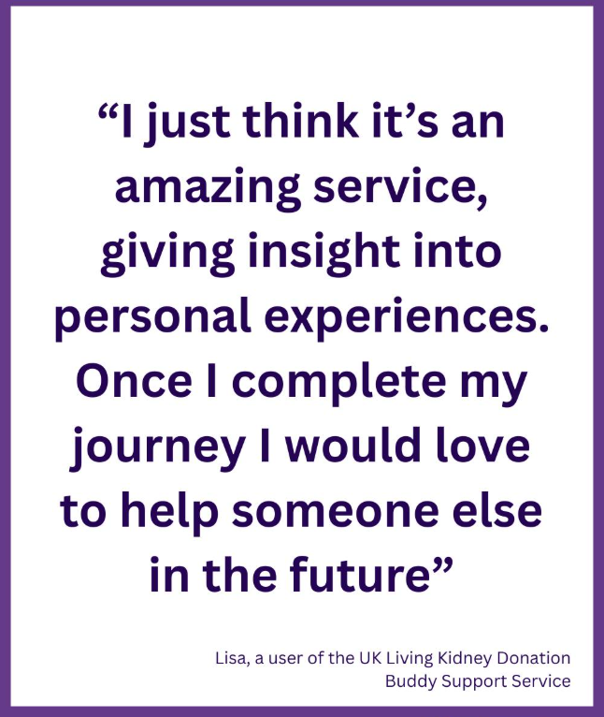
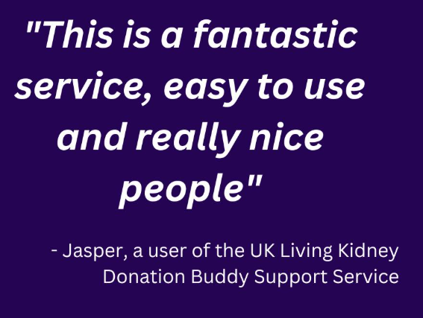
OUR BUDDIES
110
buddies available
UK wide coverage
Thorough onboarding process

Slide 7
Our ask to you
Request leaflets and posters for your unit
Refer people to the service throughout their donation journey
Help us recruit more buddies from diverse backgrounds
Thank you for your support!

