Slide 1
Higher BMI and living donation
Victoria Banwell, cons Transplant Surgeon
Royal Infirmary of Edinburgh

Slide 2
The size of the problem
Obesity (BMI >30) is growing problem in Western societies
It’s complex!
Major barrier to transplant
BMI is not a perfect measure but most commonly used index

Slide 3
Obesity and living donation
BMI >30 relative contraindication
Increased risk of peri-operative complications
Increased long term risks
  HTN
  DM
  Proteinuria
  ESRF
Notes:
18% donors had a BMI >30 in review practice 2007-2017

Slide 4
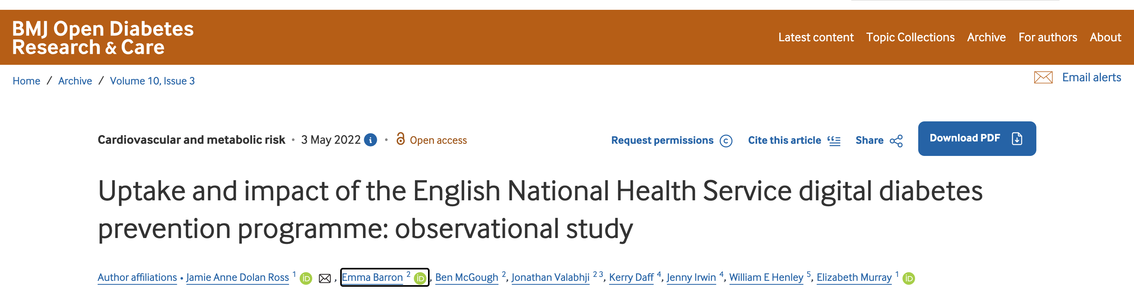
Used apps aimed to modify lifestyle in those at risk of developing DM
‘Second Nature’ was one of the providers
  Diet and exercise app with structured programme (initial 12 week programme)
  Compatible with wearable devices
  Provides peer support
  Mean reduction weight 7.5% at 6 months

Slide 5
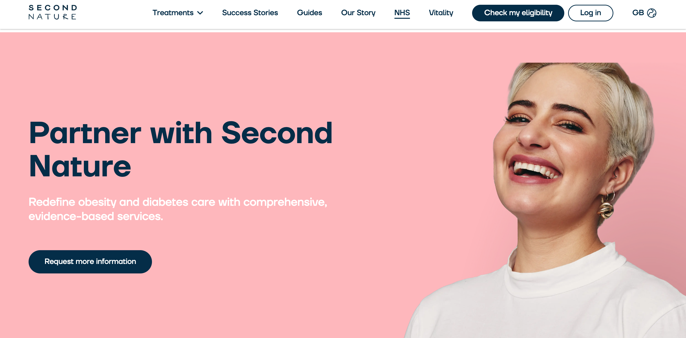
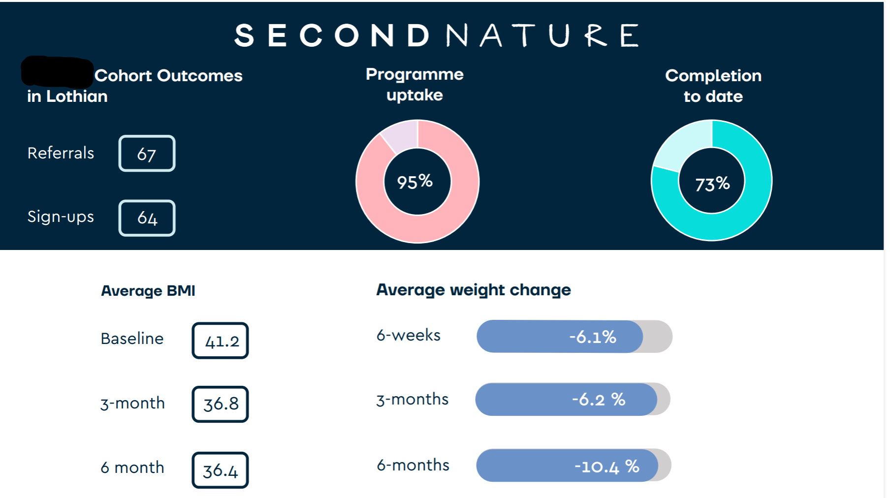
£5000 from transplant endowment funds
  Purchased 25 subscriptions at £150 each
  Use approx. £600 for a band 4 to administrate and review progress
Lifelong access for user, particularly important in trying to prevent rebound weight gain
For donors with BMI >30 who otherwise meet initial screening criteria

Slide 6
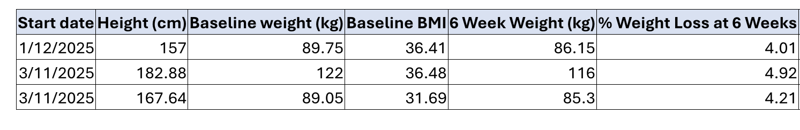

Slide 7
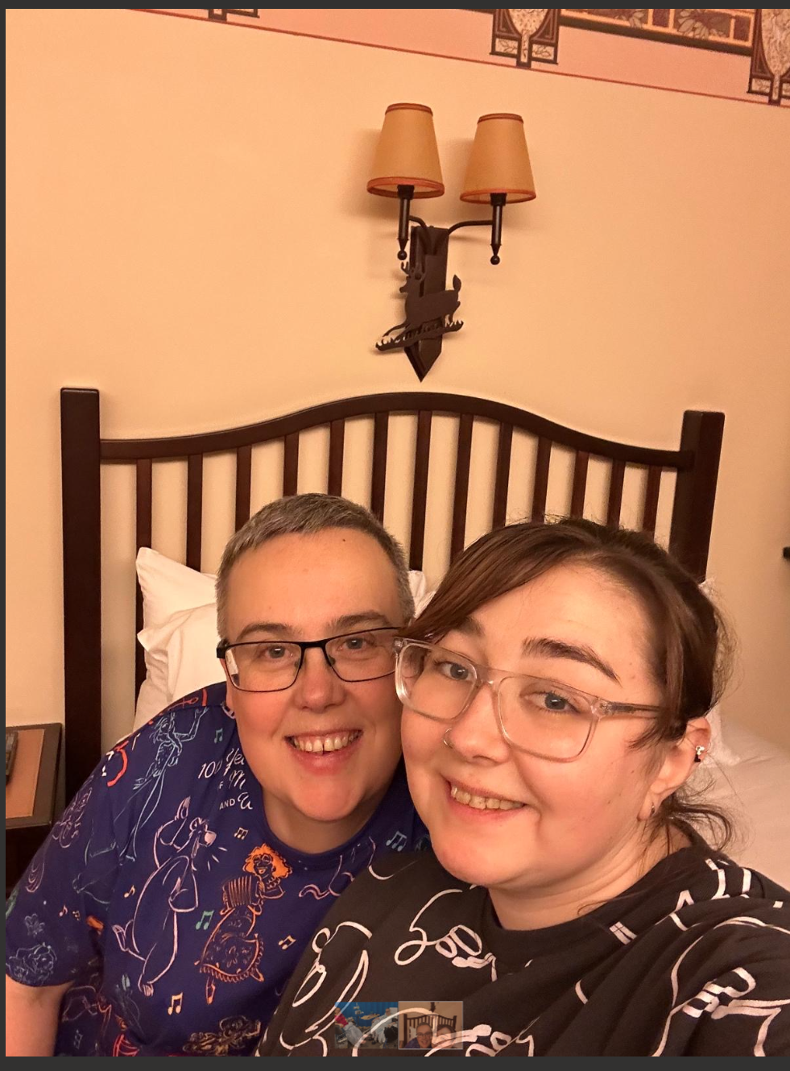
Living Donor story

Slide 8
Sara and Jessica
Initial REACH visit summer 2024 as part of tx referral process
Family have limited financial means and initially thought Sara wasn’t suitable as weight 100kg (BMI 37)
Visit a renal social work event in early 2025 and Sara was keen to come forward; now supported by Jess
At this point she was keen to lose weight

Slide 9
Sara’s Weight Loss Journey
Sept 24
June 25
Nov 25
Feb 26
Transplant assessment
Approached LD team
Medical and surgical assessment
Initial date of donation

Slide 10
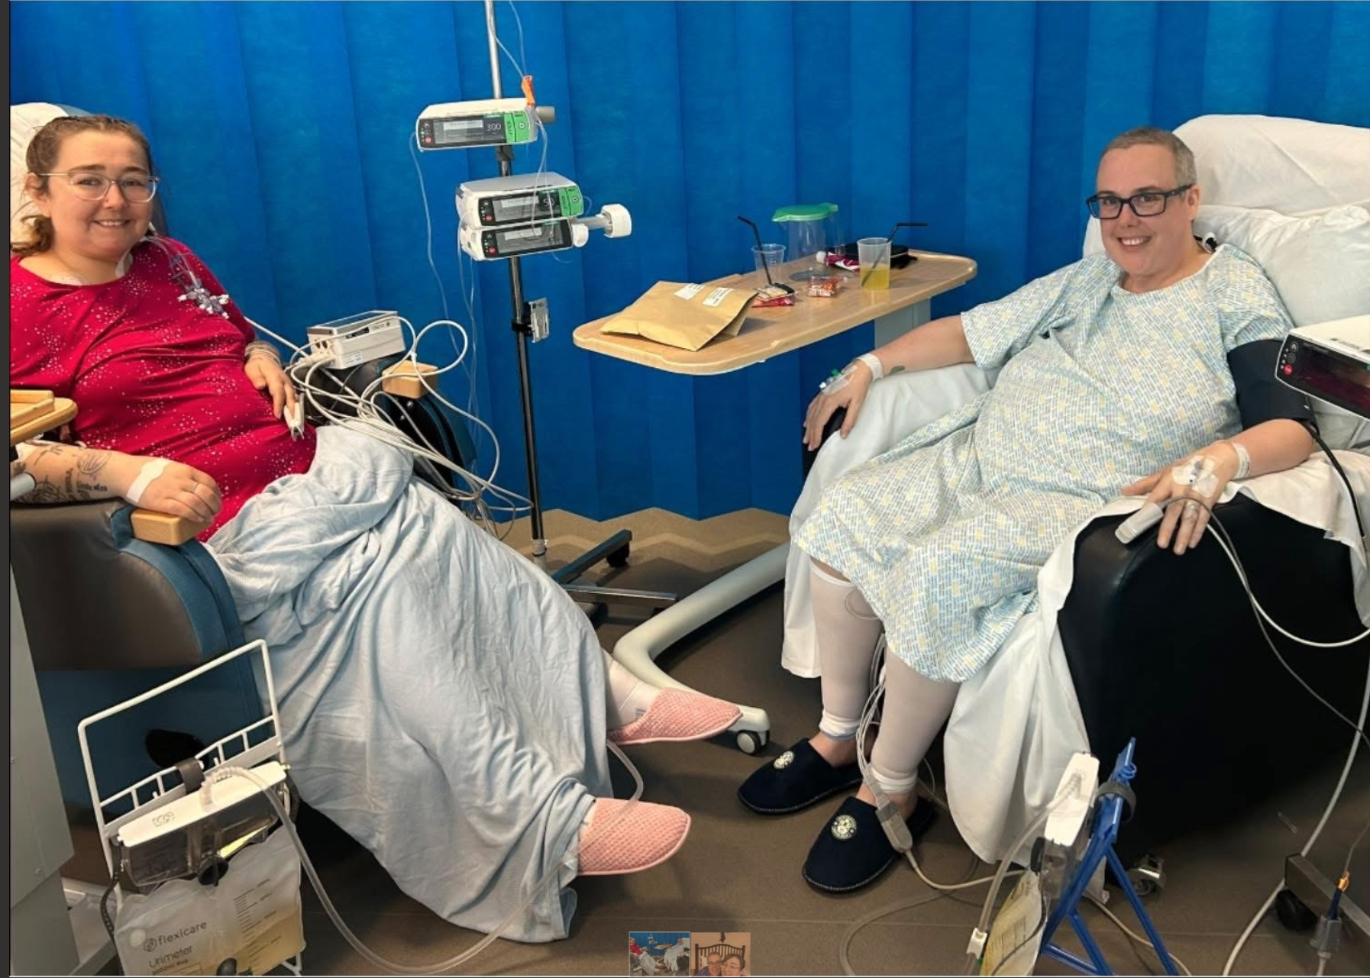

Slide 11
Thanks to…
Living donor co-ordinators
Jen Lumsdaine
Gillian Walker and our dieticians
Jess and Sara

