Slide 1


Living Donation Futures Programme
Lisa Burnapp
Associate Medical Director- Living Donation and Transplantation, NHSBT
UK LKD Network Meeting, 2026

Slide 2

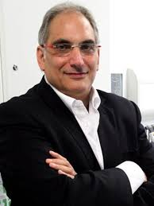
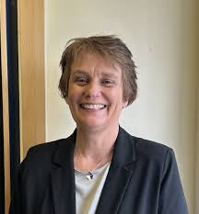
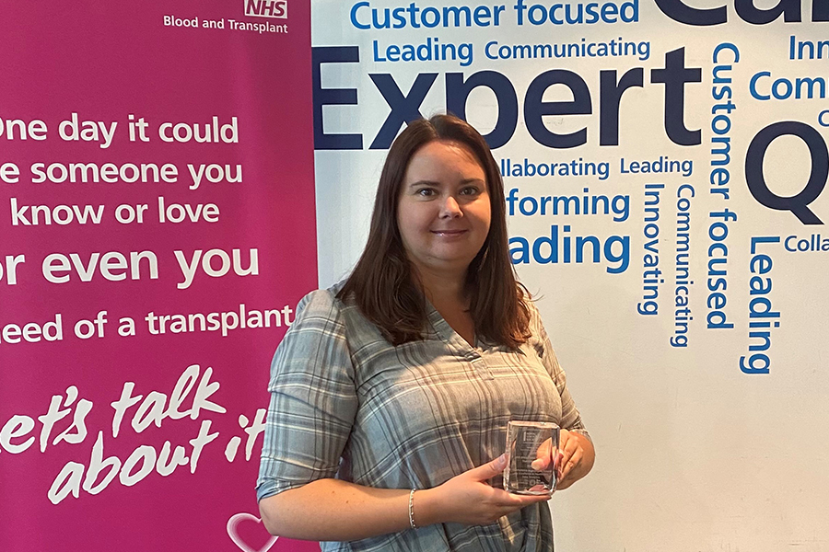
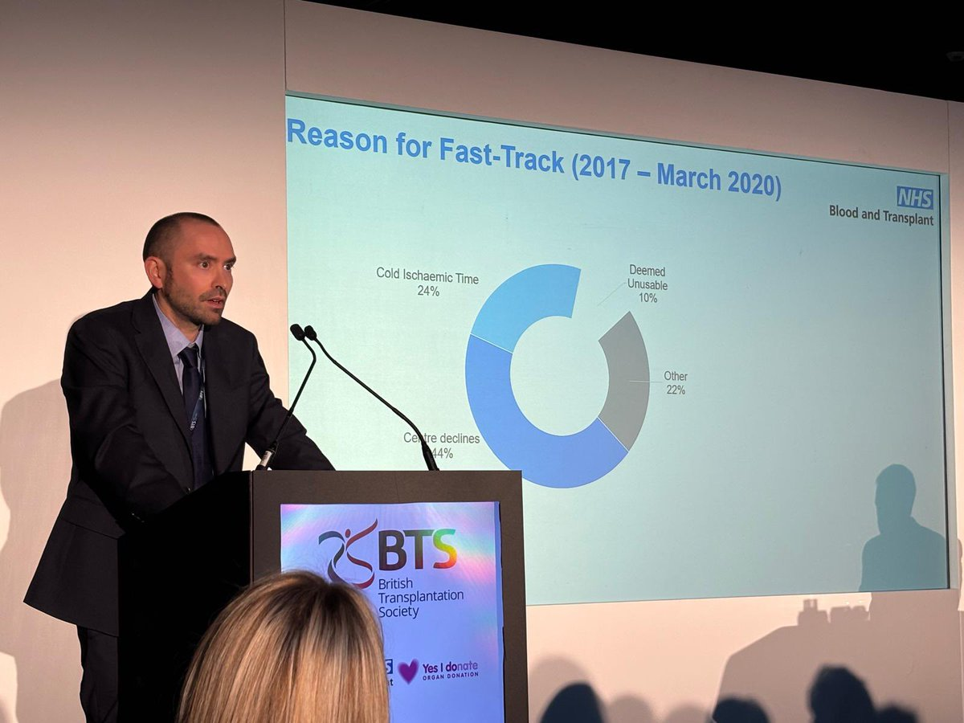
Thank You….
Derek Manas
  Medical Director- OTDT
Jen Lumsdaine
  Lead Nurse – Living Donation
Lisa Mumford
  Head of Statistics and Clinical Research, NHSBT
Matthew Robb
  Principal Statistician, NHSBT

Slide 3

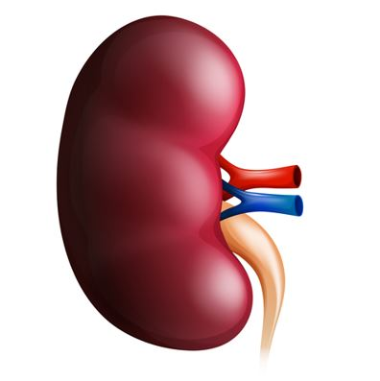
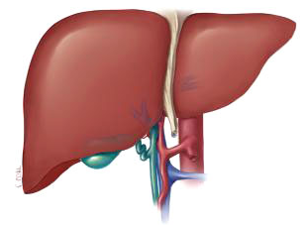
Thinking About the Future
‘Think tank’ style meeting
  What does NHSBT do to support living donation now? (As is)
  What more can NHSBT do to support living donation? (To Be)
  Representation across the transplant community
Scope
  Liver and kidney expansion/development
  Benefit to adults and children
  Think ‘where we would like to be’ rather than ‘where we are’ and what it would take

Slide 4
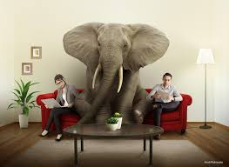
Thinking About the Future
Outputs
Identify priorities using SWOC
How do we take our priorities forward?
Who needs to take the lead?
Who else needs to be involved – wider engagement?
Identify resources (people/money/infrastructure) to support

Slide 5
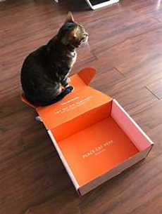
Think as if there is no box….
Warren Buffett ‘no box thinking’
Adopted by Derek Manas,
OTDT Medical Director

Slide 6

Context: Donors
Estimated 30-40 living liver donors in 25/26

Slide 7
Context: Key rates from the Potential Donor Audit
DBD donation
DCD donation
% of patients/families
ED data excluded
Referral rate - percentage of neurological death suspected (or imminent death anticipated) patients referred to SN-OD
Testing rate - percentage of neurological death suspected patients tested for brain death
Consent/authorisation rate - percentage of families approached where consent/authorisation for donation was ascertained

Slide 8
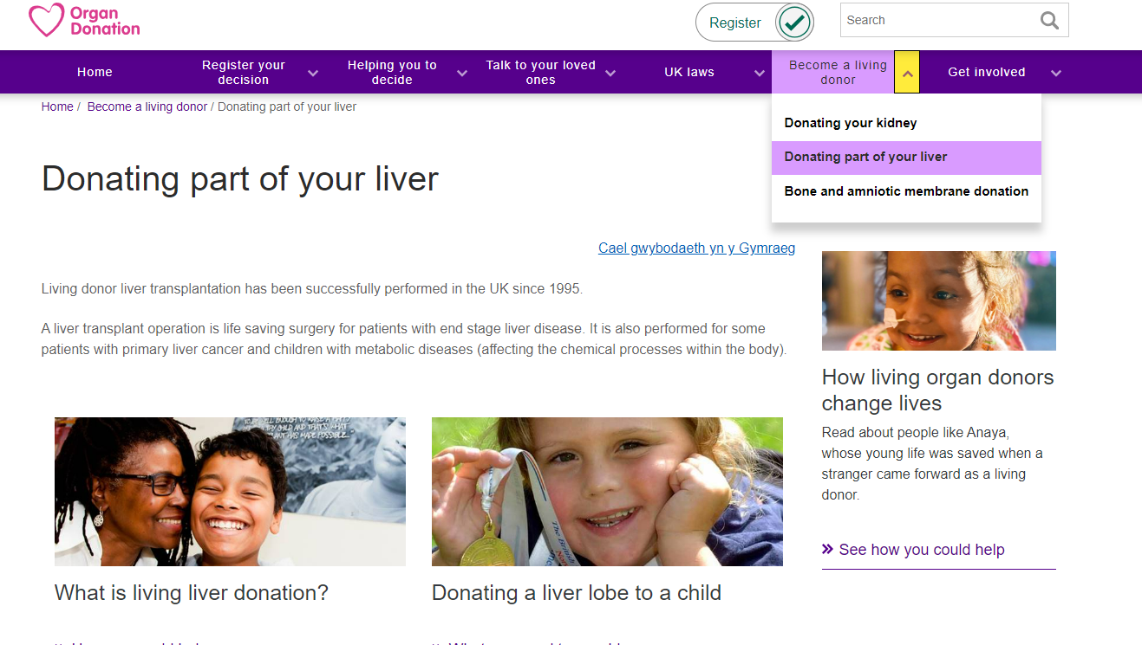

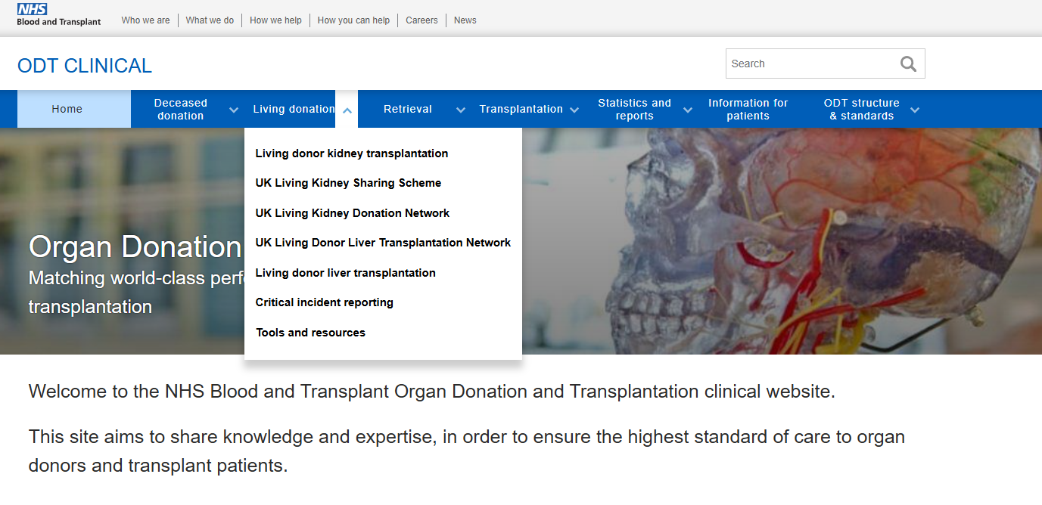



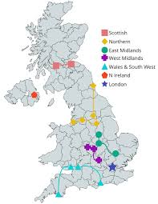



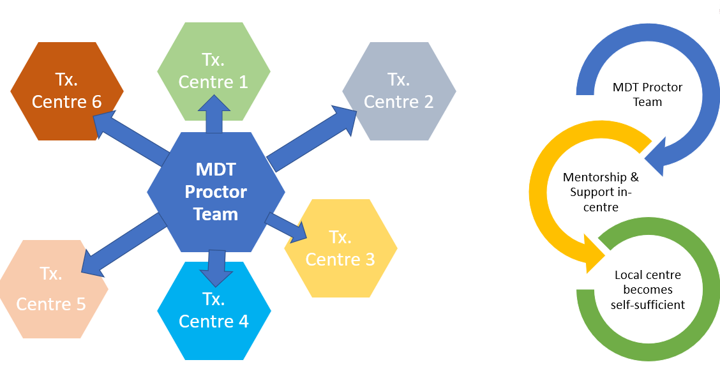
What does NHSBT do for living donation now?
Clinical Registries
Donor self-reported outcome and experience measures
UK Living Donor Networks -Kidney Liver

Slide 9
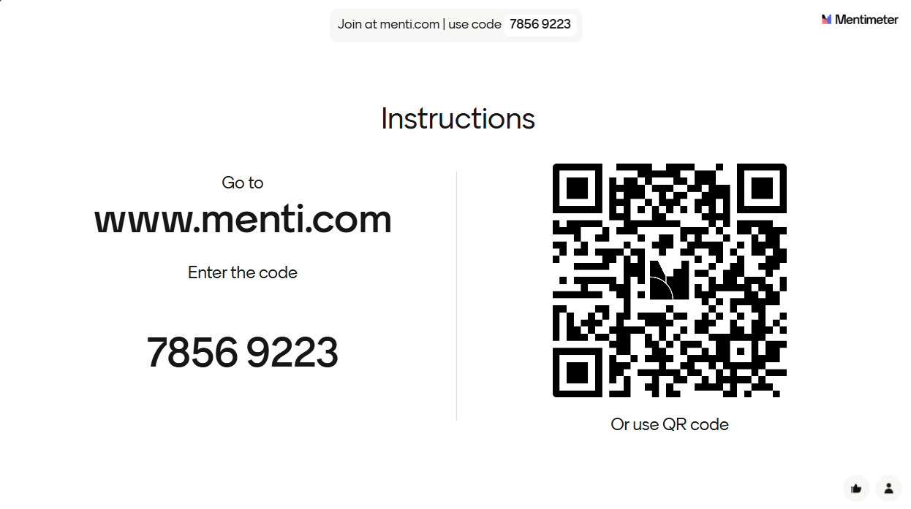
Think Tank Menti Exercises

Slide 10
Session 1: Strengths and Weaknesses (‘as is’)
Split into allocated liver and kidney groups
‘Free think’: 15 minutes strengths and 15 minutes weaknesses
Allocate ideas into following categories
  Awareness and promotion
  Education- donor-recipient-healthcare professionals
  Support and follow-up- donor-recipient-family
  Clinical considerations
  Logistics/organisational

Slide 11
Session 2: Opportunities and Challenges (‘to be’)
Split into allocated liver and kidney groups
‘Free think’: 15 minutes opportunities and 15 minutes challenges
Allocate ideas into following categories
  Awareness and promotion
  Education- donor-recipient-healthcare professionals
  Support and follow-up- donor-recipient-family
  Clinical considerations
  Logistics/organisational

Slide 12
Session 3: Priorities (‘How do we get there?’)
Review Challenges and Opportunities on Menti
Free discussion to identify/discuss priorities in each area
Menti vote: individually identify top priorities (in order) in each area
  Awareness and promotion
  Education- donor-recipient- healthcare professionals
  Support and follow-up- donor-recipient-family
  Clinical considerations
  Logistics/organisational
Review priorities output from Menti

Slide 13
Twelve Priorities
Priorities 1-6 | Priorities 6-12
Marketing and communications | Financial reimbursement
Maximising non-directed donation | Donor support; ODR for living donors
Capacity and capability | Disease prevention
National (UK) Living Donation Development Team | Other types of financial compensation
‘Spend to Save’ commissioning | Differential indications (LDT v DDT)
Digital transformation and data collection | UK-wide waiting list for liver

Slide 14
Five Workstreams
Workstream | Purpose | Co-Leads
Public Awareness, Engagement and Culture Change | Increase understanding, trust and acceptance of living donation Reduce stigma, misinformation and inequity | Holly Mason Jen Lumsdaine
Donor Experience, Support and Fairness | Ensure living donors are fully supported, protected and treated equitably throughout the pathway | Jorge Jesus-Silva Bob Wiggins
Clinical Pathways, Capacity and capability | Deliver living donation safely and consistently at scale across the UK | Gareth Jones Varuna Aluvihare
Data, Digital and System Intelligence | Use data and digital tools to enable transparency, improvement and confidence in living donation | Lisa Mumford Matthew Robb
Commissioning, Investment and System Alignment | Create the financial and policy conditions that sustain and grow living donation | Nick Earl Teresa Magirr

Slide 15


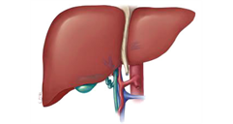
Programme Board
Derek Manas
OTDT Medical Director
Lisa Burnapp
Programme Lead
Workstream 1
Holly Mason
Jen Lumsdaine
Workstream 2
Jorge Jesus-Silva
Bob Wiggins
Workstream 3
Gareth Jones
Varuna Aluvihare
Workstream 4
Lisa Mumford
Matthew Robb
Workstream 5
Nick Earl
Teresa Magirr
Medical Director Group Support
Lay Representative
Workstream membership to be confirmed

Slide 16
Next Steps
First Project Board Meeting – 2nd July, Face to Face, London
To
  Consolidate the Board
  Agree scope of the programme and individual workstream activities
  Agree representation for each workstream and identify potential invitees
  Define Terms of Reference for the Project Board
Expressions of interest to be involved in workstreams to lisa.Burnapp@nhsbt.nhs.uk

Slide 17
Acknowledgements
Derek Manas
  Medical Director- OTDT
Jen Lumsdaine
  Lead Nurse – Living Donation
Lisa Mumford
  Head of Statistics and Clinical Research, NHSBT
Matthew Robb
  Principal Statistician, NHSBT
Abigail Horne and Temi Adams
  Medical Director Group Support
Think tank attendees
Workstream Leads
OTDT Senior Management Team
Those who have expressed interest in being involved

