Slide 1

Self-reported experience in living Kidney donor transplantation
Dr Nicola Anderson
Research Fellow, CPROR, of University of Birmingham
n.e.anderson.1@bham.ac.uk
Clinical Director, Lead Clinical Academic Nurse, RD & I,
University Hospitals Birmingham NHS Foundation Trust
Job Code: HANS-PR.GLO.25.020-001 Date of Creation: October 2025

Slide 2
Aims
Outline types of patient experience data (PED) – specific focus on PROMs and PREMs
Overview of kidney recipient and living donor PROM data
Key considerations for maximising the impact of using PROMs (DROMs) and PREMs (DREMs)

Slide 3

Types of Patient Experience Data
Health and functional status
Disease symptoms
Treatment adherence
Care/ treatment preferences
Quality of life
Care experience or satisfaction
Side effects/tolerability of treatment
Data can be collected using
Quantitative methods i.e, surveys, PROMs, PREMs
Qualitative methods i.e., interviews and focus groups
Complaints, social media

Slide 4
What are Patient-Reported Outcomes (PROs)?
  ‘A PRO is any report of the status of a patient’s health condition that comes directly from the patient, without interpretation of the patient’s response by a clinician or anyone else.’
  FDA guidance: Guidance for Industry, Patient-Reported Outcome Measures: Use in Medical Product Development to Support Labeling Claims. 2009 https://www.fda.gov/regulatory-information/search-fda-guidance-documents/patient-reported-outcome-measures-use-medical-product-development-support-labeling-claims
PROs may be collected using self-reported validated measures or questionnaires known as patient-reported outcome measures (PROMs)

Slide 5
PROMs data capture – common constructs
Symptoms inc overall burden
Psychosocial and physical functioning
Adverse events or tolerability
Health-related Quality of Life
Financial or social impacts
Notes:
PROMs are, by definition, subjective as they are usually generated as self-collected data. Therefore, to ensure they are standardised and valid, it is important to apply psychometric principles, methodological validation concepts and appropriate techniques for questionnaire development and translation.
own reports about their:
Physical health (fatigue, pain, recovery)
Mental health (anxiety, depression)
Quality of life
Financial or social impacts after donation
These go beyond clinical metrics like kidney function or surgical complications.

Slide 6
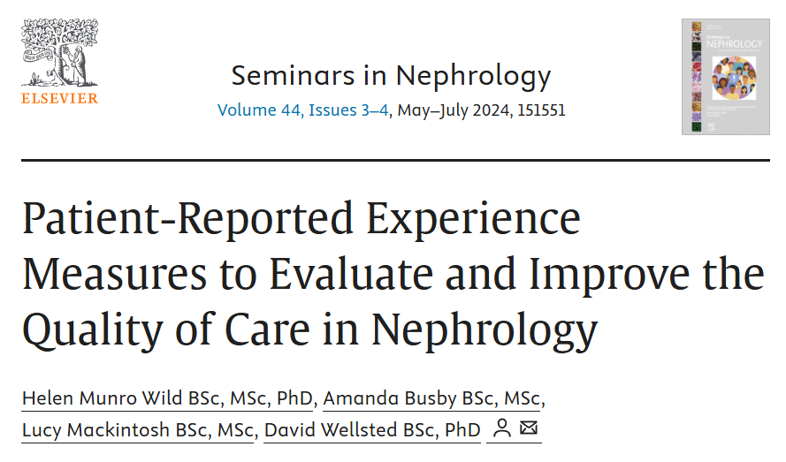
What are Patient-Reported Experience Measures (PREMs)?
  A PREM is designed to capture the patient's direct perspective on their interaction with the healthcare system: specifically the patient's perception of what happened during their care encounter and how it happened
The Kidney PREM is led by The UK Kidney Association in partnership with Kidney Care UK.
DISTIGUISH EXPERIENCE AND SATISFACTION
Munro Wild H, Busby A, Mackintosh L, Wellsted D, Patient-Reported Experience Measures to Evaluate and Improve the Quality of Care in Nephrology (2024) Seminars in Nephrology, 44 (3-4) https://doi.org/10.1016/j.semnephrol.2024.151551
Notes:
I want to also distinguish PROMs from PREMs – as can be seen from this definition – a PREM is ……and an example of a PREM developed specifically for nephrology, includes transplant patients but Liver Donor specific data not specified
In kidney transplantation, most evidence is PROM-heavy, while PREM evidence (especially specific to transplant recipients) is more limited.

Slide 7
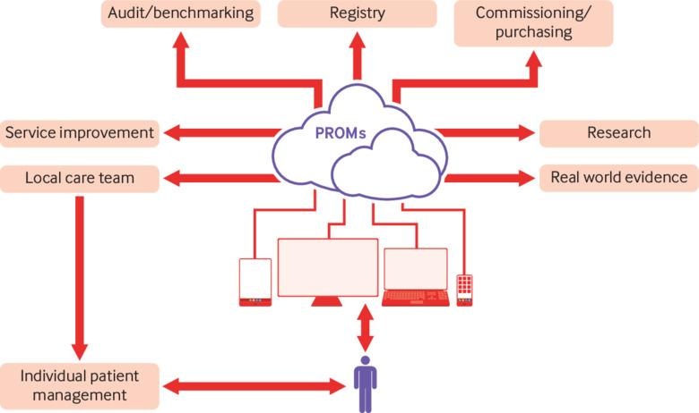
Multiple uses and why this data is important
Calvert et al BMJ 2019 ;364:k5267
Maximising the impact of patient reported outcome assessment for patients and society https://doi.org/10.1136/bmj.k5267
Notes:
Data from PREMs – QIP largely at local levels – improve patient experience (or satisfaction)
Individual patient management – support treatment decisions, monitor long term outcomes,
They help:
Identify unmet needs (e.g., fatigue, mental health)
Guide patient-centered care
Inform shared decision-making
Improve long-term follow-up strategies

Slide 8
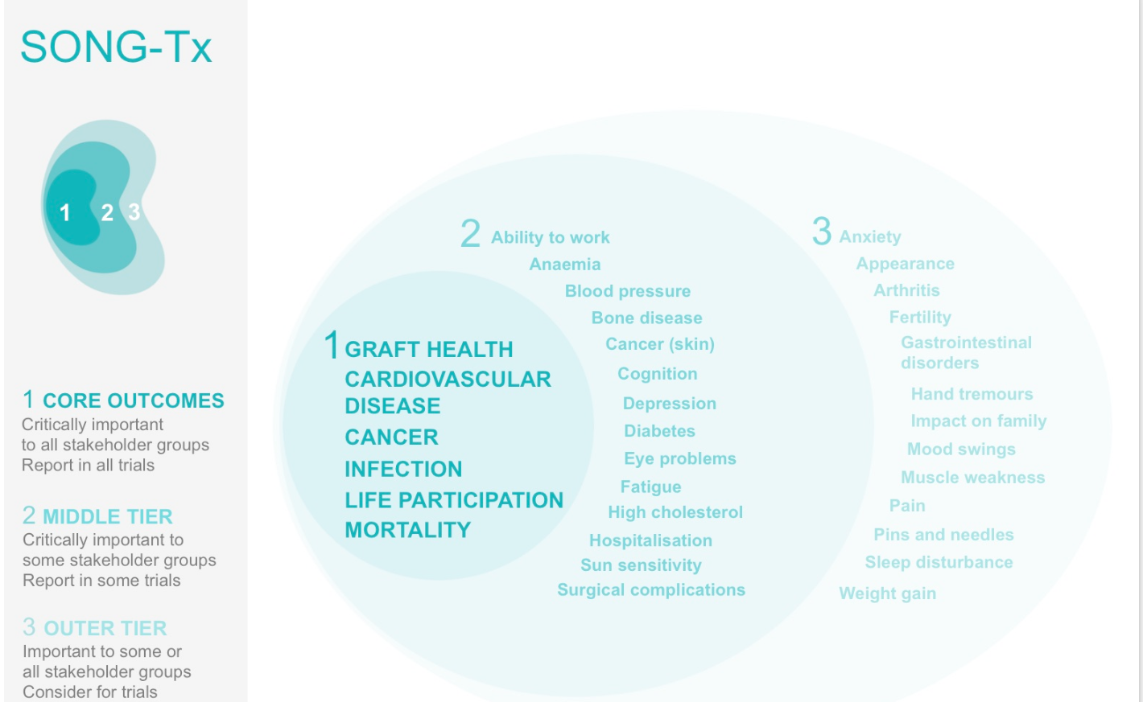
What outcomes (PROs)?
Core outcome set (+ recommendations for outcome measures)
  SONG Tx (for clinical research/clinical trials)
  International Consortium for Health Outcomes Measurement (ICHOM) – (for values -based health care)
Notes:
Core outcome sets are available to support decisions on outcomes to be measured – A core outcome set (COS) is an agreed standardised set of outcomes that should be measured and reported and the SONG and ICHOM groups have developed COS for use in CKD for research and values based care settings respectively.
The developers of these COS have also recommended or developed PROMs to use, which can be considered along side the findings from SR which can support measure choice
Core outcome sets are available to support decisions on outcomes to be measured – A core outcome set (COS) is an agreed standardised set of outcomes that should be measured and reported and the SONG and ICHOM groups have developed COS for use in CKD for research and values based care settings respectively.
The developers of these COS have also recommended or developed PROMs to use, which can be considered along side the findings from SR which can support measure choice

Slide 9
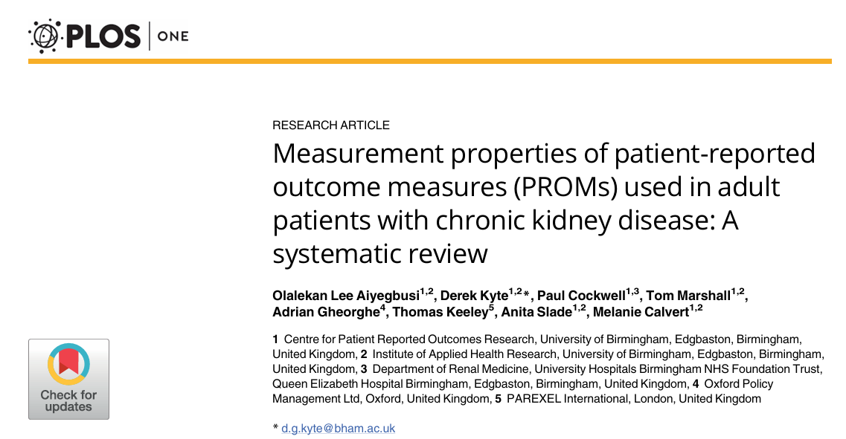
What measures (PROMs) and key considerations
Generic (e.g., EQ-5D, SF-36, PROMIS 29/57, GHQ, HADS)
Population, Disease or treatment specific
  Kidney Donor Quality of Life (KDQOL) It measures various dimensions, including physical health, emotional well-being, and social functioning.
  End Stage Renal Disease-Symptom Checklist Transplantation Module (ESRD-SCLTM) KDQOL 36, KTQ – for transplantation recipients
Culturally appropriate
Language availability
Cost and accessibility
Notes:
Donor Satisfaction Questionnaire - Evaluates the donor's satisfaction with the donation process, including pre-operative information, surgical experience, and post-operative care
Kidney Donor Quality of Life (KD-QOL)**: A specific tool developed to evaluate the quality of life of kidney donors. It measures various dimensions, including physical health, emotional well-being, and social functioning.
General Health Questionnaire (GHQ)**: Assesses psychological distress and mental health status. It helps identify any potential mental health issues post-donation.
Hospital Anxiety and Depression Scale (HADS)**: Measures anxiety and depression levels, which can be crucial for understanding the emotional impact of kidney donation
Short Form Health Survey (SF-36)**: Although generic, it can be used to assess the overall health status and functional ability of living donors before and after donation.
Symptom Checklists**: Tools that allow donors to report any physical symptoms or side effects experienced after the donation, such as pain, fatigue, or changes in health status.
Return to Work and Daily Life Questionnaire**: Measures how quickly and effectively donors return to their daily activities, work, and overall lifestyle post-surgery.
Donor Registry data

Slide 10
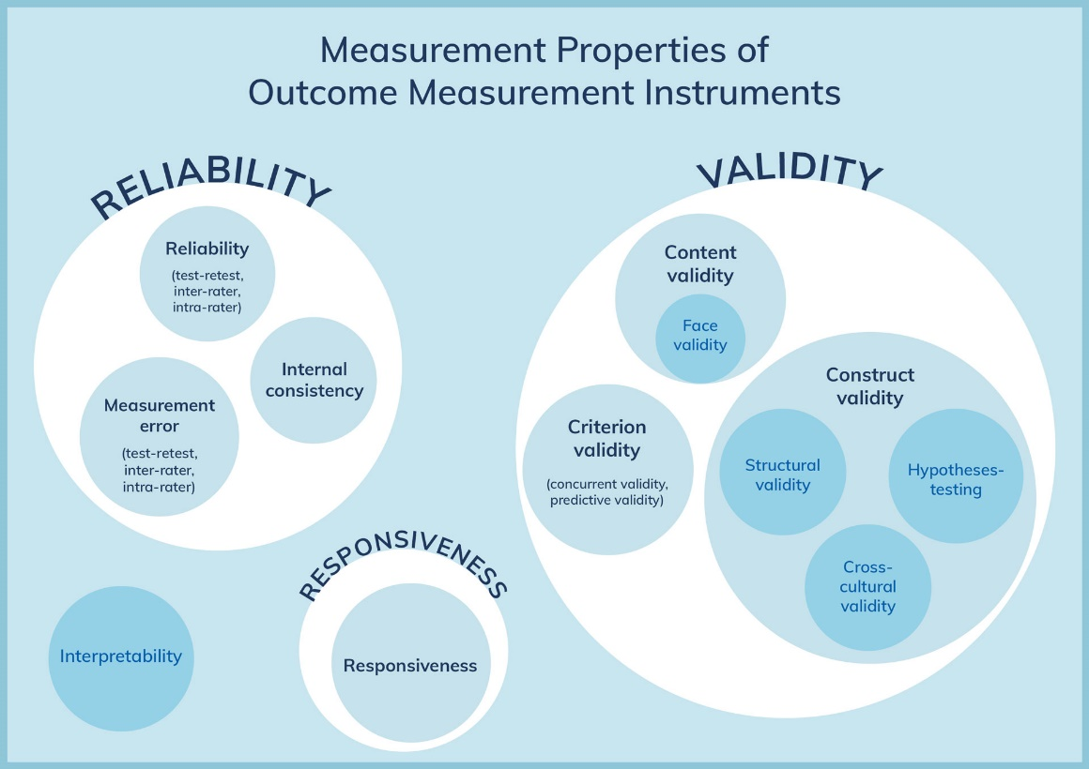
Measurement Properties
PROM qualities or attributes
Consider evidence of measurement properties
  Systematic reviews
  Databases like COSMIN, PROQOLID
Interpretable
  Qualitative meaning of PROM scores (i.e. what high scores vs low scores represent, and what degree of change is small vs large – Minimum clinically important difference MCID)
Mokkink et al. COSMIN Risk of Bias checklist for systematic reviews of Patient-Reported Outcome Measures. Quality of Life Research 2018; 27: 1171-1179.

Slide 11
PROMs data collection
United Kingdom
Decentralised for recipients – individual Tx Centres
The NHS Blood and Transplant collates donor follow-up data.
UK programs:
  Routinely track clinical outcomes
  Have participated in research using PRO measures
Reality: PROs are used in research and some clinical pathways but not consistently embedded everywhere yet.
Gaps in standardisation (follow up times and PROM usage)
Work is ongoing to establish PROMs and PREMs with recipients at a national level
Notes:
In US - Growing trend to include PROs in registry data i.e., USA
- Organ Procurement and Transplantation Network (OPTN)
Large research efforts (e.g., Living Donor Collective in USA) are expanding PRO tracking.
Bottom line
Yes, living kidney donors are followed using patient-reported outcomes
But:
It’s inconsistent
Often research-driven rather than routine care
Improving as healthcare systems recognize donor wellbeing beyond surgical success

Slide 12
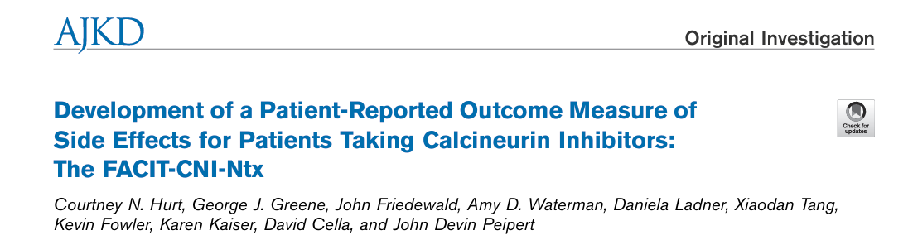
Recipient Experience Data
Key improvements post-transplant:
Better physical functioning vs dialysis
Increased independence
Improved overall QoL
Persistent challenges:
Medication side effects
Anxiety about graft failure
Infection risk concerns
Body image or weight changes
PROMs often show:
Big early improvement, then plateau
QoL still lower than general population in some domains
Notes:
Medication side effects - immunosupression

Slide 13
PRO data from Access to Transplantation and Transplant Outcome Measures (ATTOM) programme
poorer PROMs in kidney transplant patients were most strongly associated with:
  Older age (physical decline)
  Female sex
  Minority ethnicity
  Higher socioeconomic deprivation
  Unemployment and lower education
Quality of Life: Longitudinal data - significant and similar QOL improvements for both living-donor and deceased-donor transplant recipients compared to those remaining on the waiting list.
These findings reinforce that equity in transplantation is not just about access—but also about lived outcomes after treatment.
Notes:
The UK-based ATTOM programme represents a significant advancement in this field by linking PROMs with national registry, clinical, and economic data to evaluate both access to transplantation and post-transplant outcomes. Findings from ATTOM and related studies highlight persistent inequalities in both access and patient-reported outcomes, influenced by demographic and socioeconomic factors, and demonstrate that improvements in HRQoL are not universal. Despite their value, the integration of PROMs into transplant research and practice remains challenged by issues such as missing data, variability in measurement tools, and difficulties in interpreting clinically meaningful change. Collectively, the literature supports the use of PROMs as essential components of a more comprehensive, patient-centred assessment of kidney transplant success, while underscoring the need for standardisation and improved implementation in routine care.
Demographic factors
ATTOM findings consistently identify:
Age
Older patients tend to report lower physical HRQoL
Younger patients may report worse mental health outcomes (e.g., anxiety, adjustment issues)
Sex
Women often report lower PROM scores, particularly for:
Fatigue
Pain
Psychological wellbeing
Ethnicity
Patients from minority ethnic groups may report:
Lower HRQoL scores
Different symptom burdens
These differences are partly linked to access barriers and broader inequalities
💷 Socioeconomic factors
ATTOM highlights strong gradients in outcomes based on deprivation:
Socioeconomic deprivation (Index of Multiple Deprivation)
More deprived patients report:
Lower overall HRQoL (e.g., on EQ-5D)
Worse physical and mental health domains
Deprivation is also linked to:
Reduced access to transplantation
Higher comorbidity burden
Employment status
Being unemployed or unable to work is associated with:
Poorer PROM scores
Lower functional recovery post-transplant
Education level
Lower educational attainment is associated with:
Worse self-reported health
Potential differences in health literacy and self-management
🏥 Interaction with clinical pathway
ATTOM emphasises that these factors operate across the entire transplant pathway:
Pre-transplant:
Deprivation and ethnicity affect likelihood of being listed
Post-transplant:
The same groups often experience less improvement in PROMs
This suggests compound inequality, not just isolated effects
🧠 Key interpretation
A central insight from ATTOM is that:
Differences in PROMs are not purely biological—they reflect social determinants of health.
Even after adjusting for clinical variables:
Socioeconomic disadvantage remains a significant independent predictor
This implies that improving transplant outcomes requires:
Social and policy interventions
Not just medical optimisation

Slide 14
Donor specific - Quality of Life and vulnerability factors
Most donors report equal or better overall quality of life compared to the general population
Many describe a lasting sense of:
  Purpose
  Satisfaction from helping someone
  Improved self-esteem
This “boost” is sometimes called the “donor effect”
Vulnerability Factors - higher risk for poor psychological outcomes if: graft fails (leading to "donor grief"), donor is an "unrelated" or "altruistic" donor with lower social support, donor experiences unexpected financial strain or prolonged physical recovery.
Notes:
When outcomes are worse
PROs tend to be less favourable in certain situations:
If the recipient has poor outcomes or dies
If donation was emotionally complex (e.g., family pressure)
If donors had pre-existing mental health vulnerabilities
If follow-up care and support are limited
These factors matter more than the surgery itself in predicting long-term wellbeing.

Slide 15
Donor Experience – functional status
Physical Functioning
Most return to normal daily functioning
Long-term physical QOL is generally unchanged
But some report:
Persistent fatigue (a minority)
Occasional pain or discomfort around the surgical site
Reduced physical capacity in very active individuals
Clinical outcomes may look “perfect,” but PROs sometimes reveal subtle, ongoing symptoms that wouldn’t show up in lab tests
Mental Health
Low overall rates of depression and anxiety
High emotional wellbeing tied to donation meaning
However, a notable minority (~5–20%) report:
Anxiety about their own future health
Guilt or distress if the transplant fails
Strained relationships (rare, but documented)
This is why organisations like KDIGO emphasise psychosocial follow-up—not just medical checks

Slide 16
Donor Experiences – Financial and social impacts
Financial and social impacts often underestimated
Common donor-reported issues:
Lost wages during recovery
Travel and accommodation costs
Insurance or employment concerns (especially in the US)
In the UK (via Commissioning teams), reimbursement systems reduce this—but don’t eliminate indirect impacts..

Slide 17
NHSBT approach DROMs and DREMs
Digital collection model since 2025 (paper since 2020)
DROMs Core domains measured – physical recovery, psychological impact, financial toxicity
DREMs to identify the ‘pain points’ in process – Decision making support, post surgical care
Aims – to create risk prediction models for individual donors
Challenges: Donor drop out long term FU, lack of resources, no global standard for DROMs, ‘Closing the loop’ through red-flagging and annual reporting.
From 2026 data reporting in NHSBT Annual report
Notes:
1. The "Digital-First" Collection Model
NHSBT has moved away from paper-based surveys, which traditionally had low response rates.
Automated Triggers: Surveys are now often triggered automatically via the UK Living Donor Registry at specific intervals: pre-donation (baseline), 6 months, 12 months, and then annually for life.
Patient Portals: Donors can often access these surveys via patient-facing apps or portals, allowing them to report symptoms or psychological shifts in real-time rather than waiting for an annual appointment.
1. The "Digital-First" Collection Model
NHSBT has moved away from paper-based surveys, which traditionally had low response rates.
Automated Triggers: Surveys are now often triggered automatically via the UK Living Donor Registry at specific intervals: pre-donation (baseline), 6 months, 12 months, and then annually for life.
Patient Portals: Donors can often access these surveys via patient-facing apps or portals, allowing them to report symptoms or psychological shifts in real-time rather than waiting for an annual appointment.
2. Core Domains Measured (PROMs)
NHSBT focuses on specific "domains" that impact the life of a donor. Instead of just asking "How do you feel?", they use validated scales to measure:
Physical Recovery: Tracking the time it takes to return to work and pre-donation exercise levels.
Psychological Impact: Using tools like the PHQ-9 (Depression) and GAD-7 (Anxiety) to monitor the emotional "come down" that some donors experience after the initial euphoria of donation fades.
Financial Toxicity: A unique area of interest for NHSBT is measuring the "out-of-pocket" experience to ensure the Reimbursement of Expenses policy is actually working to prevent donor hardship.
3. Measuring the "Care Journey" (PREMs)
The NHSBT approach to PREMs is designed to identify "pain points" in the donor work-up process. They look for:
Decision-Making Support: Did the donor feel pressured? Was the information about long-term risks (like gestational hypertension for female donors) clear?
Post-Surgical Care: This is a major focus. PREMs often reveal that while the surgical care is excellent, the transitional care (going from a high-dependency ward to home) is where donors feel most vulnerable.
The "LKD Outcomes" Research Framework
NHSBT collaborates closely with the Living Kidney Donor (LKD) Outcomes Research Group. This group uses the data collected to create "Risk Prediction Models."
The Goal: By 2026, the aim is to use this data to provide prospective donors with "personalized risk profiles." For example, instead of saying "Most people feel fine," a coordinator can say, "Based on data from 5,000 donors like you, 15% experience significant fatigue at 3 months, but 98% are back to baseline by one year."
Challenges and "Closing the Loop"
The biggest hurdle NHSBT faces is "Closing the Loop." Historically, data was collected but not always acted upon immediately. The current strategy emphasizes:
Red-Flagging: If a PROM score indicates a significant drop in mental health, a notification is sent to the donor’s specific transplant center for immediate follow-up.
Annual Reporting: NHSBT now includes high-level PROM/PREM data in their annual Living Donation Report, making the "patient voice" as visible as the "graft survival" statistics.
The short answer is no, not consistently. While there is a strong national push for standardization, the actual collection of PROMs and PREMs currently varies significantly between the 23 transplant centers in the UK.
As of early 2026, the landscape is defined by a "standard of intent" vs. a "standard of practice." Here is the current reality of how these tools are deployed across the country:
1. The Gap in Standardization
A national survey of UK transplant centers (published in late 2025/early 2026) revealed that while clinical outcomes are excellent everywhere, the follow-up pathways are remarkably different:
Follow-up Duration: Only about 48% of centers currently guarantee lifelong monitoring for donors. Other centers stop active follow-up between 3 and 24 months. If a center isn't following a donor long-term, they aren't collecting long-term PROMs.
Data Silos: Some "pioneer" centers (like those in London or the West Midlands) have fully integrated digital PROM collection into their patient portals. Smaller centers may still rely on paper forms or informal "how are you feeling?" chats during clinic, which doesn't count as validated data collection.
2. The "Postcode Lottery" of Donor Experience
Because centers have different levels of funding and staffing, your experience with these tools depends on where you donate:
High-Volume Centers: Often have dedicated Living Donor Coordinators who use automated systems to send out the EQ-5D-5L or Kidney PREM.
Research-Active Centers: If your center is part of a specific NHSBT pilot (like the new Assessment and Recovery Centres (ARCs) launching in 2026), you are much more likely to be asked to complete detailed questionnaires as part of their data-gathering efforts.
3. The Move Toward the "National Registry"
NHSBT is currently working to fix this inconsistency. Their goal for 2026–2030 is to move PROM/PREM collection away from individual hospital "whims" and into the UK Living Donor Registry.
The Logic: If the data is collected by the national registry rather than the local hospital, it doesn't matter if you move house or if your local center changes its follow-up policy.
The Incentive: NHSBT is increasingly making "comprehensive data submission" (including psychosocial data) a key performance indicator for transplant units.
4. What this means for a Donor
If you are donating in 2026, you might find yourself in one of three categories:
The Digital Donor: You get app notifications at 6 months, 1 year, and 5 years asking you to rate your health and experience (standardized).
The Clinical Donor: You have your bloods taken every year, but nobody asks you to fill out a formal questionnaire about your "vitality" or "anxiety" (not yet standardized).
The Research Donor: You are enrolled in a specific study (like the LKD Outcomes study) and are asked very detailed questions using the SF-36.
Summary of Variation
FeatureIntegrated Centers (~50%)Traditional Centers (~50%)Collection MethodDigital/AutomatedPaper or "Face-to-Face"FrequencyLifelong (Annual)Short-term (1–2 years)Tools UsedEQ-5D, GAD-7, National PREMGeneral health check only
In short: While the tools exist and are endorsed by NHSBT, they are not yet a mandatory "tick-box" for every center. If you want to ensure your "voice" is part of the national data, you can ask your coordinator: "Are you recording my PROM data in the national registry, or just in my local hospital notes?"

Slide 18
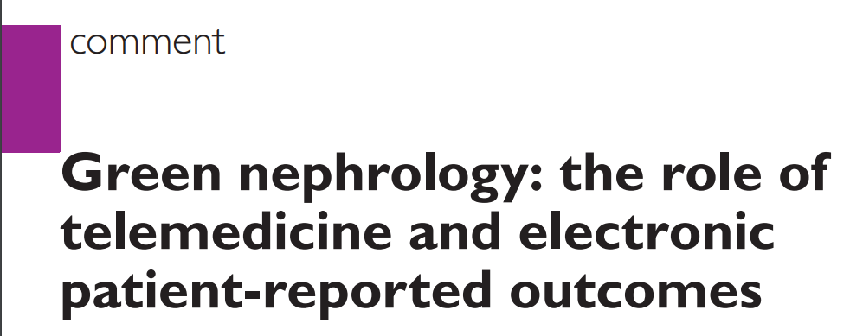
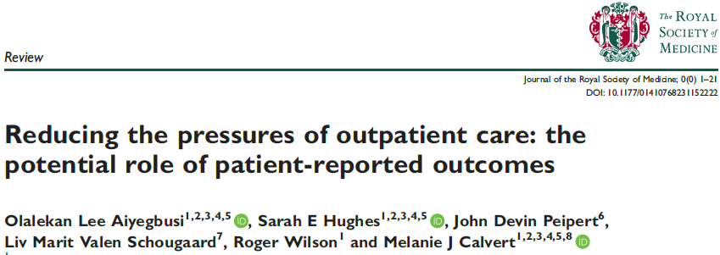
Potential benefits of using PROMs
Routine, longitudinal PROs
Get the ‘Big’ picture
Impact survival. Other outcomes
Efficient utilization of resources
Enhance MDT care
Notes:
Why PROs matter so much here
Without PROs, the story would look overly simple:
Clinical data says: “donation is safe”
PRO data adds:
→ “mostly—but not impact-free, and support matters”
That’s why systems like the Organ Procurement and Transplantation Network and international guidelines are pushing toward routine, long-term PRO collection.

Slide 19
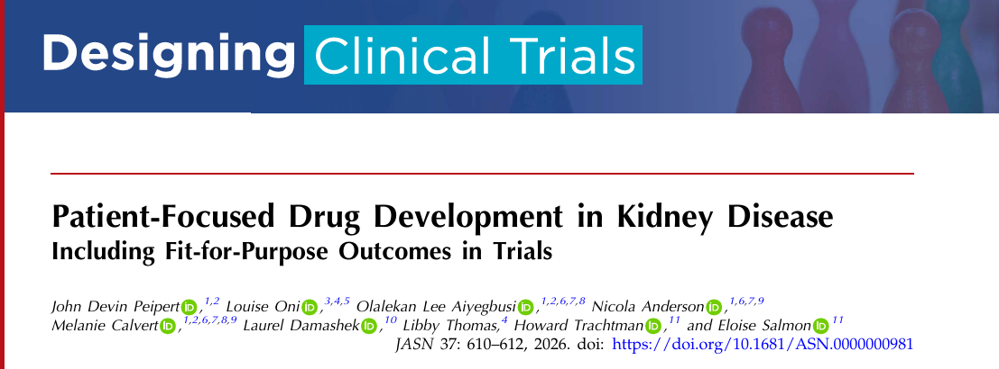
Value of PROMs in trials
Patient-centred data reflecting patient priorities and needsPatient-centred data reflecting patient priorities and needs
Holistic view on treatment efficacy
Identification of important symptoms
Improving health equity
Notes:
Crossnohere paper

Slide 20
Patient Focused Drug Development
What to Measure
Engage patients early
Justifying the Measure is Fit for Purpose
Generate evidence that the measure reflects patients’ experiences and is sensitive to clinically meaningful change
Creating Endpoints
Define how the measure will be used to make comparisons within the trial
Determine what is most important to patients
Determine how symptoms/ patient function should be captured
Determine how much change indicates treatment benefit or harms from the patient’s perspective
Figure adapted from FDA Patient-Focused Drug Development Guidance Series for Enhancing the Incorporation of the Patient’s Voice in Medical Product Development and Regulatory Decision Making
Notes:
Devin papers

Slide 21
Key considerations for maximising the benefits of using PROMs
‘the devil is in the detail of implementation’ Flythe 2022
DOI: 10.2215/CJN.10840922

Slide 22
Key considerations for implementation
Population i.e Donor or recipient
Stakeholder engagement
Co-design
Purpose
What outcomes?
Which measures?
Data Capture
Frequency and timing
Administering and scoring
System Evaluation
Reporting
Workflow
Interpretation, visualisation and response
EHR integration
Governance
Datapooling
Guidance - https://theproteusconsortium.org/about/
  PROTEUS-TRIALS
  PROTEUS-PRACTICE

Slide 23






Actions to promote representation and participation of under-served groups in PROs
Diversity
Include individuals from all relevant demographics
Diversity
Clinical
characteristics
Cultural needs and languages
Literacy and health literacy
Regulatory engagement
Digital inclusion
Involve individuals from all relevant demographics in the identification of key concepts, development/selection of PRO measures and data collection.
Consider range and severity of disease, symptoms and functional impact, comorbidities, physical and cognitive disabilities.
Include individuals from relevant culture and languages within the target population to ensure results are generalizable.
Engage early with regulators to seek advice on PRO and DEI strategy
Include individuals with all levels of reading, writing, problem solving abilities, if possible.
Consider participants needs, including access to and technological needs
Calvert, M.J., Cruz Rivera, S., Retzer, A. et al. Patient reported outcome assessment must be inclusive and equitable. Nat Med 28, 1120–1124 (2022). https://doi.org/10.1038/s41591-022-01781-8

Slide 24
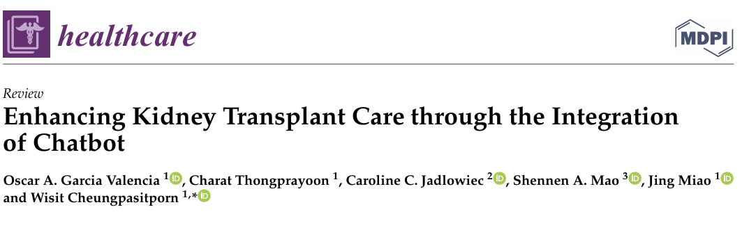
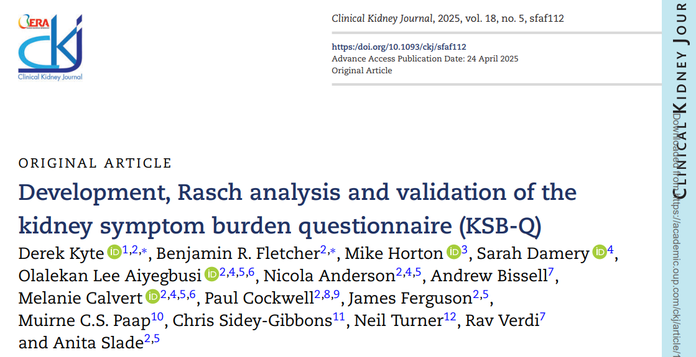
New approaches
Item banking, Computer Adaptive Testing and Artificial Intelligence
  Measure design
  Measure administration
  Measure interpretation
  Donation support
Live Donation story telling project - The Living Donation Storytelling Project – Hear real-life stories…and share your own!
Notes:
Refer Amy Waterman work
Human-Technology Co-Care Framework: A care model was created where AI tools assist with diagnostics, engagement, and decision-making. In the meantime, clinicians focus on empathy and individualized support.
Data Scraping Methodology to Understand Public Sentiment: Over 200,000 public comments were analyzed across platforms like Reddit, Twitter, and YouTube. By filtering threads for quotes, findings revealed that most comments focused on practical concerns, such as financial questions, time off work, and out-of-pocket costs.
AI-Driven Donor Profiling: 3 donor personas were developed by analyzing online behavior:
Caretakers: Motivated after being emotionally moved to help someone in need
Purpose Seekers: Motivated to act to express their sense of purpose
Pragmatists: Motivated to act from a life of abundance to give something back after personal impact
These profiles helped to build a national digital campaign, “How far would you go to save a life?” which reached over 121,000 people and prompted 1,400 individuals to begin the donor evaluation process.
Predictive Modeling to Support High-Risk Patients for Tailored Care: At Houston Methodist, only 40% of patients completed transplant evaluation within 12 months. AI models now identify high-risk individuals early in the process, allowing for tailored interventions and the development of patient-informed support programs. Additionally, programs are being developed to listen to patients at higher risk for dropout.
Empathetic AI Chatbots: A transplant AI mentor, capable of responding to emotionally complex questions about donation, was developed. Content is drawn only from trusted sources, such as the National Kidney Foundation, with ethical guidelines in place to ensure accuracy and respect.
Conclusions

Slide 25
Conclusions
PROMS
The routine and systematic use of DROMs/DREMs could support person-centred care in living donor transplant settings
However, various elements have to be addressed to maximise the benefits
PREMS
Clinical effectiveness
Experience of care
Safety

Slide 26
Disclaimer
.Funder
Nicola Anderson is funded by the National Institute for Health and Care Research (NIHR) Birmingham Biomedical Research Centre (BRC) and declares personal fees from GSK, Hansa Pharmaceuticals and Takeda UK.
The views expressed are those of the author(s) and not necessarily those of the NIHR or the Department of Health and Social Care.

Slide 27
Centre for Patient-reported Outcomes Research (CPROR) https://www.birmingham.ac.uk/research/centres-institutes/patient-reported-outcomes
Professor Melanie Calvert, Professor Devin Peipert
Professor Olalekan Lee Aiyegbusi
Contact: n.e.anderson.1@bham.ac.uk
Thank you and Acknowledgments

