Slide 1
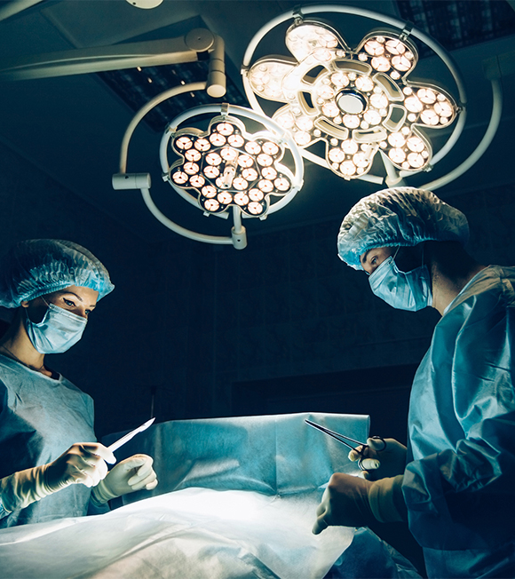
Sustainability and Certainty in Organ Retrieval (SCORE)
Shadow Modelling Summary
Phase 3: Aug – Dec 2025

Slide 2

Link to recorded version of this presentation
here

Slide 3
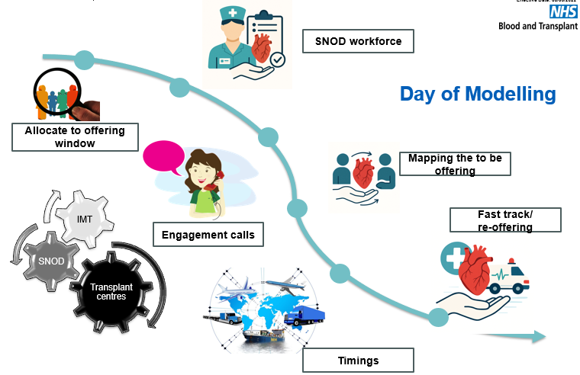
Planned Arrival Window (PAW)
Shadow modelling
Aims
Test viability of proposed PAW timings in real time
Understand the operational considerations across the pathway by involving operational colleagues
Identify barriers or issues which could impact implementation
Build confidence in the system’s readiness for change

Slide 4
Headlines – Phase 3 PAW modelling
Aug – Dec 2025
19 August – 18 December 2025
39 days
180 Donors
178 Abdo attendances
54 CT attendances
(2 CT team only)
500 organs accepted
433 abdominal
67 cardiothoracic
96% (176/180) NORS teams arrivals in the PAW between 2000-0300
Of the 37 occasions (21%) donor registered 0800-1600 in PAW+
26 occasions (70%) facilitated that night
Of the 11/37 PAW+ not able to be facilitated that night
7 CT (2 DCD H)
4 Abdo only
8% (14 donors) accelerated pathway donors
73% all organs arrive between 0600-1000
72% abdominal
83% cardiothoracic
3 occasions the family withdrew consent
2 occasions the coroner withdrew consent
Notes:
Deliberately targeted busy periods, this included Organ Donation Week, some of half term and the Drs strike days in England,
PAW+ donors – although for modelling considering those registered 0800-1600. when modelling it has become clear that if registering an abdo only donor at 1700 or 1800 on a day of moderate activity, it would be possible to include them as a PAW+ donor that evening. Modelling has shown an additional 7 donors registered 1600- 1830 who we could have facilitated that night.

Slide 5
Perfusion Technologies
DCD Heart teams attended 12 donors
(22% of all CT attendances)
DCD Heart family withdrew consent due to time frames on 3 occasions (abdominal organs proceeded)
NRP teams attended 31 donors
DCD Heart and NRP combined on 4 occasions

Slide 6
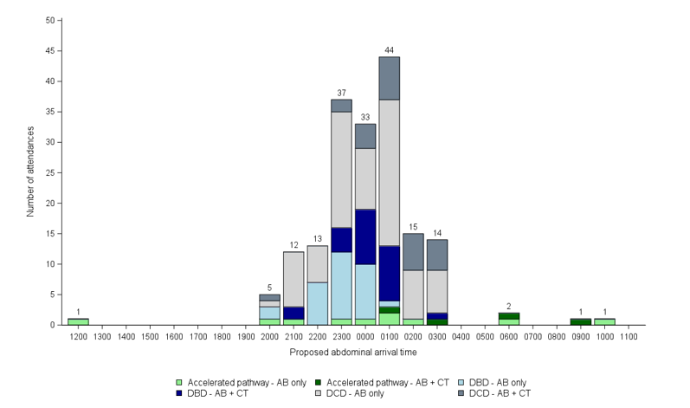
Simulated NORS team arrival time by donor and attendance type

Slide 7
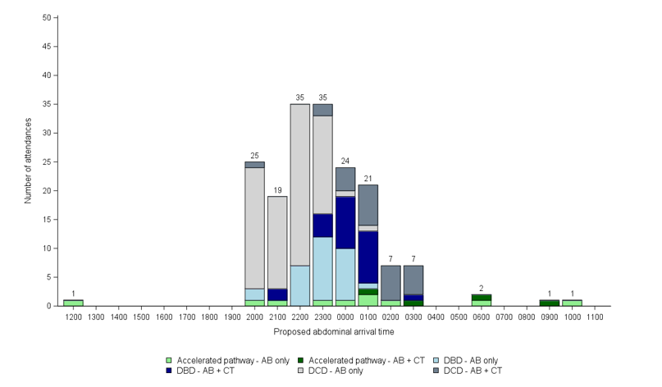
Simulated NORS team arrival time by donor and attendance type – 100% ANRP abdo only
Notes:
NRP adds on average 3 hours to the length of time NORS teams spend at a DCD abdo only donor

Slide 8
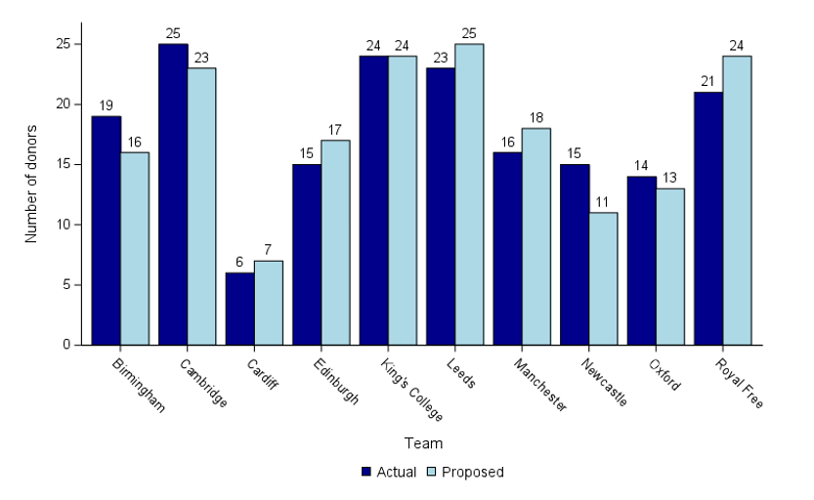
Actual and simulated abdominal NORS activity
Notes:
When comparing how the mobilisation of NORS teams differed under the proposed modelling, for the abdominal attendances the team would have been the same in 88 (49%) of cases – so a different team deployed 51% of the time.

Slide 9
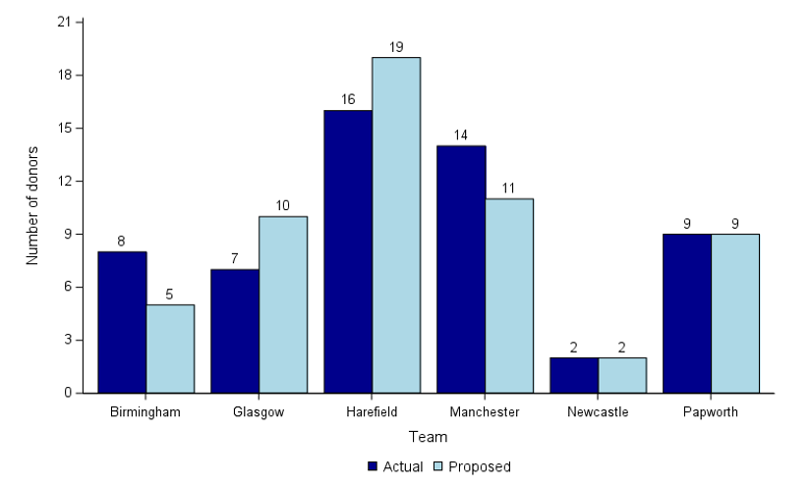
Actual and simulated cardiothoracic NORS activity
Notes:
When comparing how the mobilisation of NORS teams differed under the proposed modelling, for the cardiothoracic attendances the team would have been the same in 37 (66%) of cases (lower than last round of modelling at 89% the same)

Slide 10

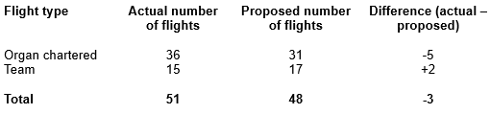
Example – NORS and organ travel requirements for 24hrs
Flight impact
LEGEND
ABDOMINAL TEAMS
CARDIOTHORACIC TEAMS
RENAL + PANCREATIC ORGANS
LIVER + BOWEL ORGANS
Aim - Better use of resources
7 donors over water
  Northern Ireland and Channel Islands
Overall an 6% reduction in flights
CARDIOTHORACIC ORGANS
NON-PROCEEDING DONORS
ABERDEEN
GLASGOW
EDINBURGH
NEWCASTLE UPON TYNE
BELFAST
LEEDS
BOLTON
OLDHAM
MANCHESTER
BIRMINGHAM
LEICESTER
CAMBRIDGE
CAMBRIDGE
PONTYPRIDD
OXFORD
BRISTOL
LONDON
PORTSMOUTH
Notes:
Extrapolated up to a year of data would suggest a saving of 28 flights over a year

Slide 11
NORS Heatmaps

Slide 12
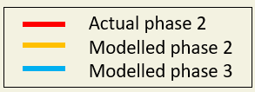
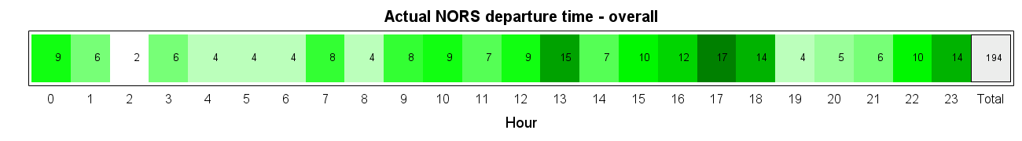
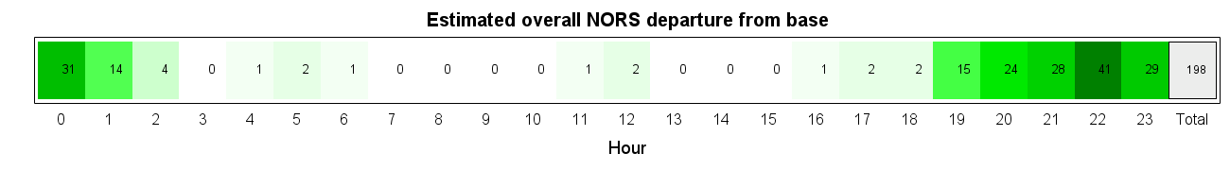
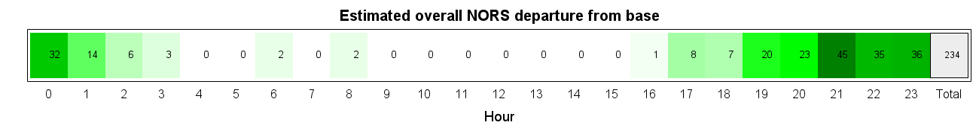
NORS departure time heatmaps
Actual v modelled
Notes:
Actual v modelled NORS departure from base times. – total is different due to not all RTI forms being returned at the point of running the report (4th Sept)

Slide 13
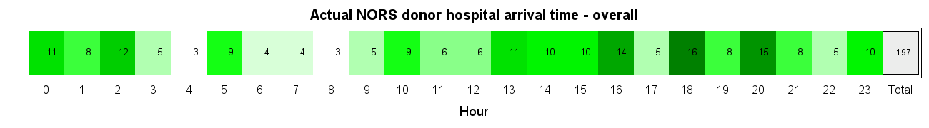
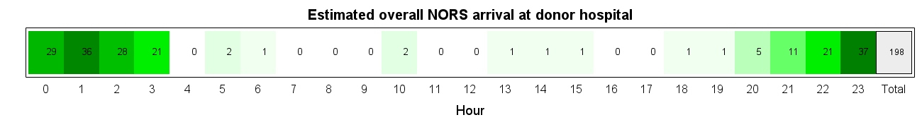
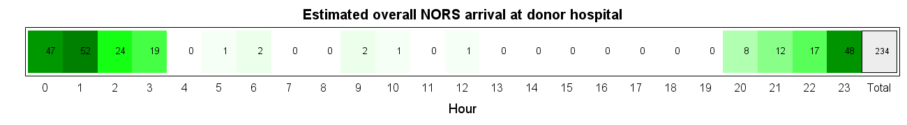
NORS arrival at donor hospital time heatmaps
Actual v modelled

Slide 14
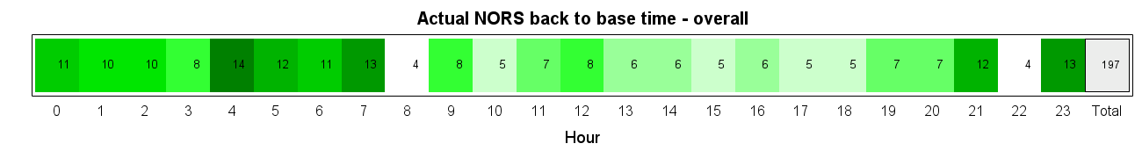
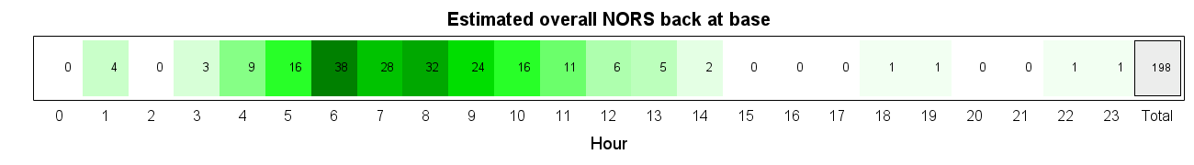

NORS arrival at donor hospital time heatmaps
Actual v modelled

Slide 15
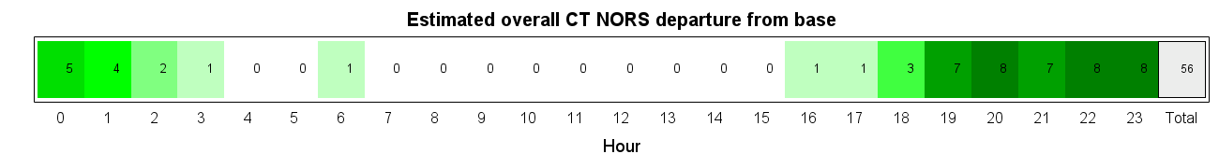
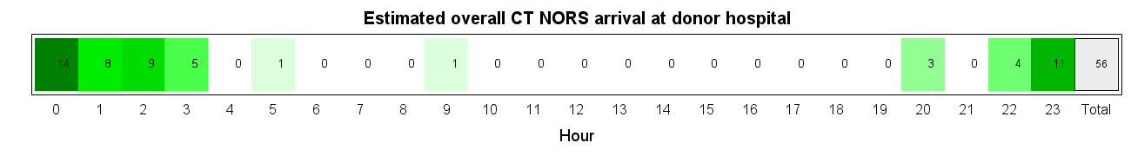
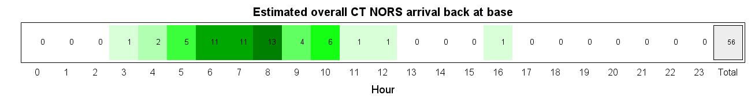
Phase 3 Modelling – NORS Heatmaps – Cardiothoracic Teams
Departure/Arrival/Return to Base

Slide 16
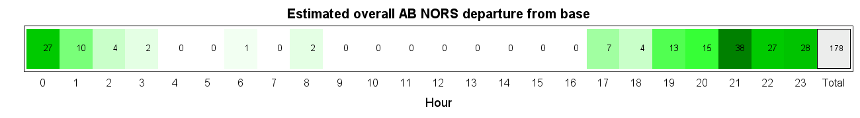
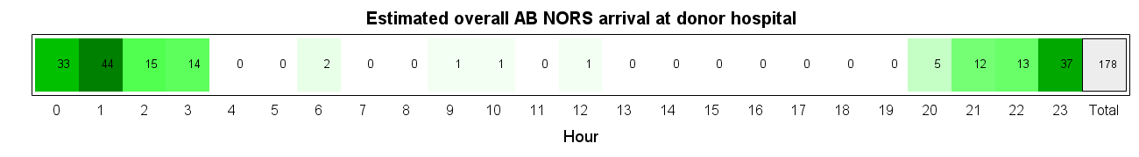

Phase 3 Modelling – NORS Heatmaps – Abdominal Teams
Departure/Arrival/Return to Base

Slide 17
Cambridge Abdo NORS Heatmaps

Slide 18
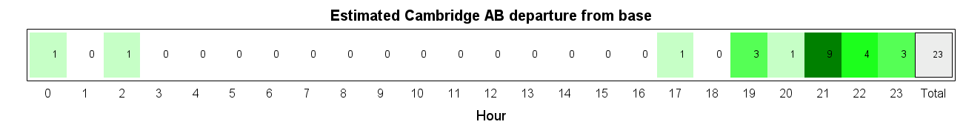
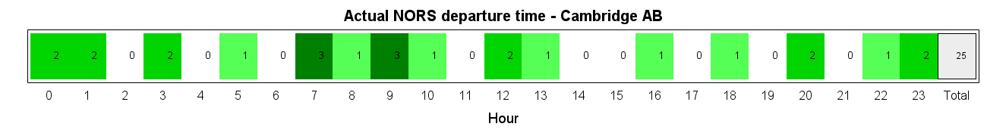
Modelling - NORS Heatmaps – Departure from base time
Cambridge

Slide 19
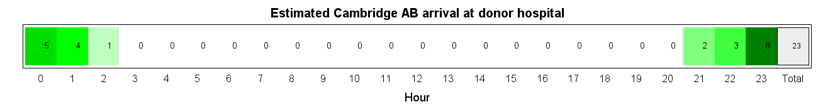
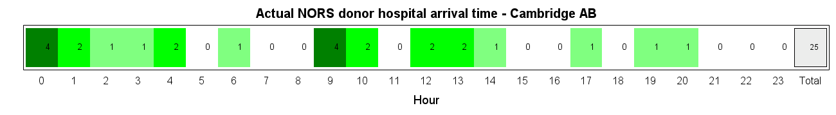
Modelling - NORS Heatmaps – Arrival at donor hospital time
Cambridge
Notes:
Actual number of attendances compared to simulated attendances may vary due to the differences in team allocation shown in slides 6 & 7

Slide 20

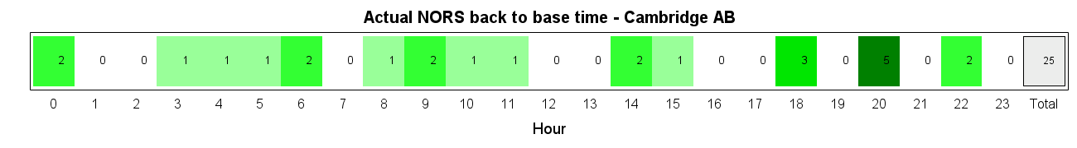
Modelling - NORS Heatmaps – Arrival back at base time
Cambridge
Notes:
Actual number of attendances compared to simulated attendances may vary due to the differences in team allocation shown in slides 6 & 7

Slide 21
Organ Arrival Heatmaps

Slide 22
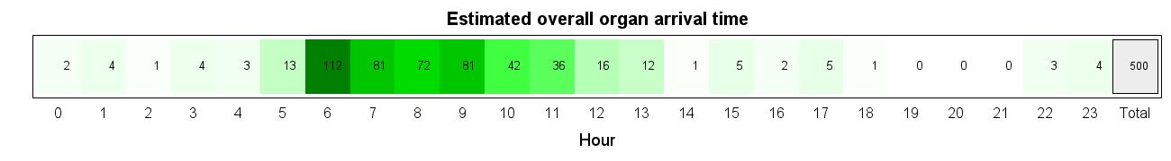
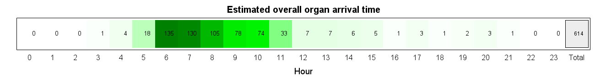
Phase 2 & Phase 3
Modelling - Organ Arrival Heatmaps
All Organs
Phase 2
Phase 3

Slide 23
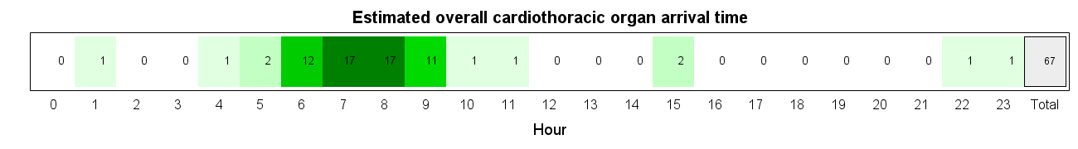
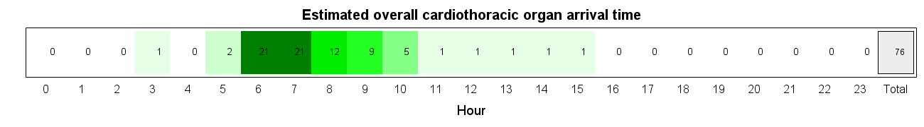
Phase 2 & Phase 3
Modelling - Organ Arrival Heatmaps
All Cardiothoracic Organs
Phase 2
Phase 3

Slide 24

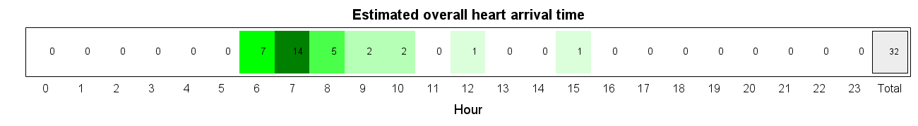
Phase 2 & Phase 3
Modelling - Organ Arrival Heatmaps
Cardiothoracic Organs - Heart
Phase 2
Phase 3

Slide 25
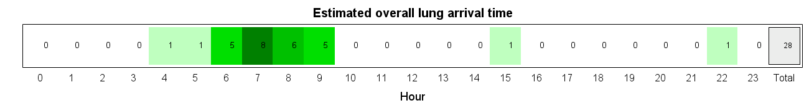

Phase 2 & Phase 3
Modelling - Organ Arrival Heatmaps
Cardiothoracic Organs - Lungs
Phase 2
Phase 3

Slide 26
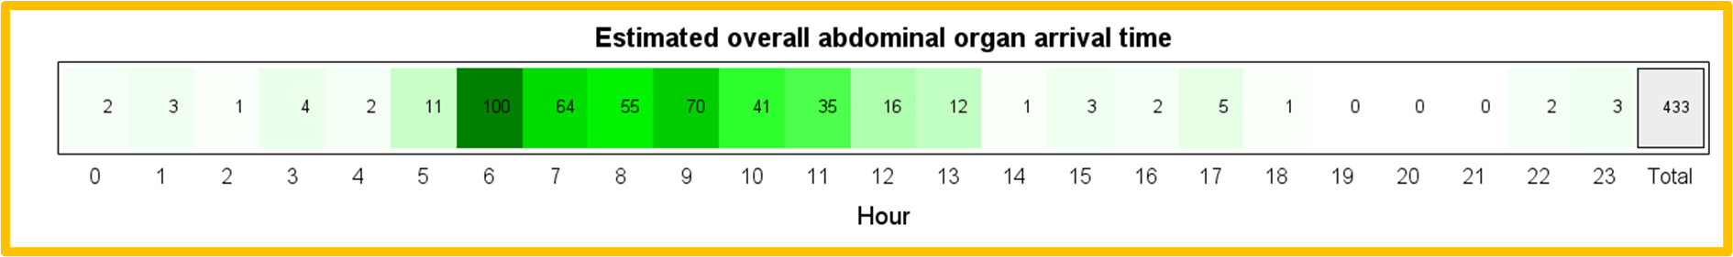

Phase 2 & Phase 3
Modelling - Organ Arrival Heatmaps
All Abdominal Organs
Phase 2
Phase 3

Slide 27
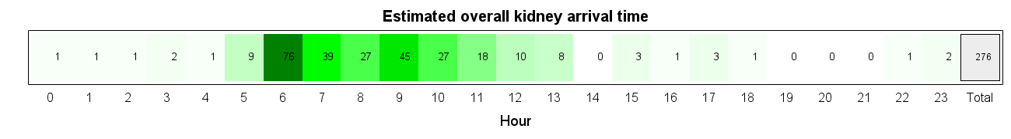

Phase 2 & Phase 3
Modelling - Organ Arrival Heatmaps
Abdominal Organs - Kidney
Phase 2
Phase 3

Slide 28
Royal Free Heatmaps

Slide 29

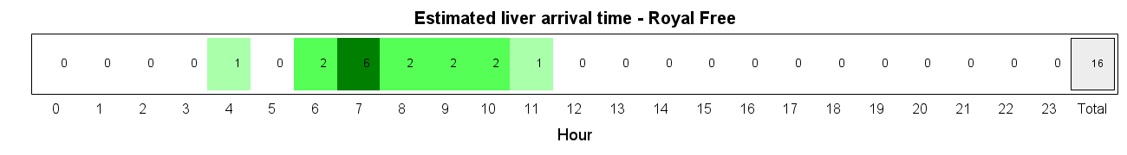
Modelling - Organ Arrival Heatmaps – Royal Free
By Organ Group - Liver

Slide 30
Feedback from Specialist Nurses
Themes
Donor family considerations
Donor Hospital considerations
Donor stability
NORS team resilience and logistics
Recipient Centre requests for delays
Multiple organs arriving at the same time at transplant centres
Summary
Strong support for predictability, clearer communication and structure across the pathway
A need to ensure capacity for accelerated pathway for exceptional cases
Current theatre variability could be stabilised by a PAW (donor and transplant theatres)
Some Transplant centres challenged for daytime theatre space
Donor families tolerate delays when anticipated but not when unexpected

Slide 31
Feedback from Recipient Coordinators
Summary
06:00-08:00 is the most preferred time of organ arrival
Spacing between organs is possible under a PAW but must be carefully managed
Machine perfusion helps but does not remove challenge
Variation by centre and organ type
Themes
Strong preference for arrivals 06:00-08:00 across all organ groups
  Enables daytime team to start implant
Centres cannot accept multiple organs without spacing between arrivals
  Consider perfusion technology to aid
Challenge to daytime theatre access to implant
  Especially for renal teams

Slide 32
Learning
Key to include SN and Recipient Coordinators in modelling
Multiple donor activity at the same hospital occurred twice in this modelling – one donor hospital able to support 2 retrievals simultaneously overnight
Modelling during the junior Drs strike in England – no adverse events seen
It is possible to consider donors registered later than 16:00 as a PAW+ donor
European organ offers arrive at all times in the 24hr clock.
For donors in extremities of UK, possible to fly NORS in before airport shuts, pause, and retrieve organs timed to catch flight when airport reopens in the morning.
Increase in NRP use for abdo only donors will add 3hrs to retrieval and bring more NORS arrival times 2000-2300
Potential DCD Heart donors lost if multiple DCD Heart activity
It was possible to facilitate 9 donors in one PAW as 1 CT organs only donor

Slide 33

Sustainability and Certainty in Organ Retrieval (SCORE) - ODT Clinical - NHS Blood and Transplant
Thank you
Scroll down for
NORS heatmaps by centre
Organ arrival time by centre
FAQs

Slide 34
Phase 3 Modelling
NORS CT Heatmaps A-Z

Slide 35
Birmingham CT NORS Heatmaps

Slide 36
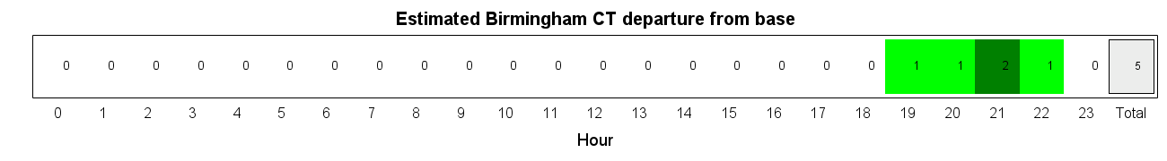
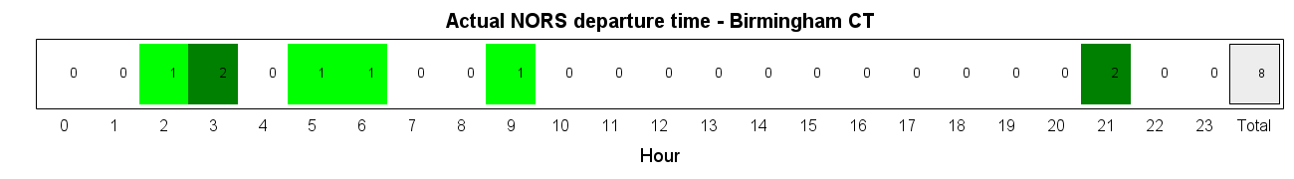
Phase 3 Modelling - NORS Heatmaps – Departure from base time
Birmingham
Notes:
Actual number of attendances compared to simulated attendances may vary due to the differences in team allocation shown in slides 6 & 7

Slide 37
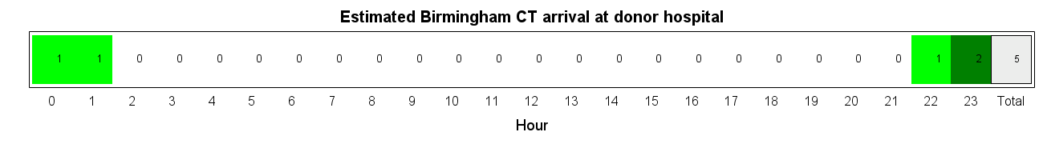
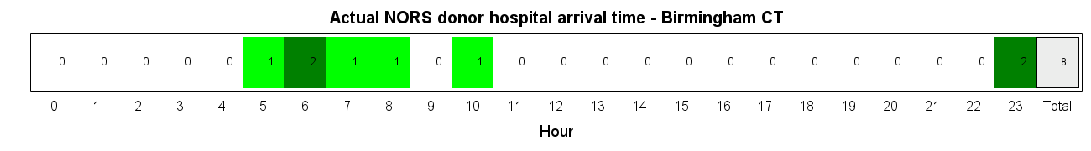
Phase 3 Modelling - NORS Heatmaps – Arrival at donor hospital time
Birmingham
Notes:
Actual number of attendances compared to simulated attendances may vary due to the differences in team allocation shown in slides 6 & 7

Slide 38
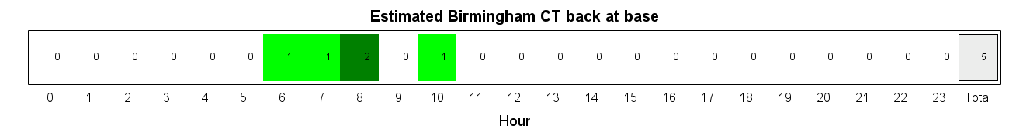
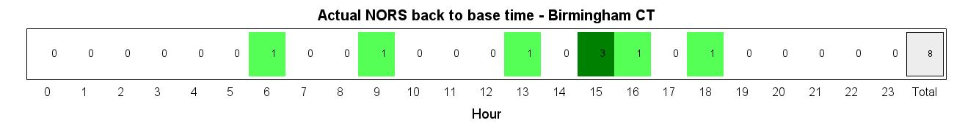
Phase 3 Modelling - NORS Heatmaps – Arrival back at base time
Birmingham
Notes:
Actual number of attendances compared to simulated attendances may vary due to the differences in team allocation shown in slides 6 & 7

Slide 39
Glasgow CT NORS Heatmaps

Slide 40
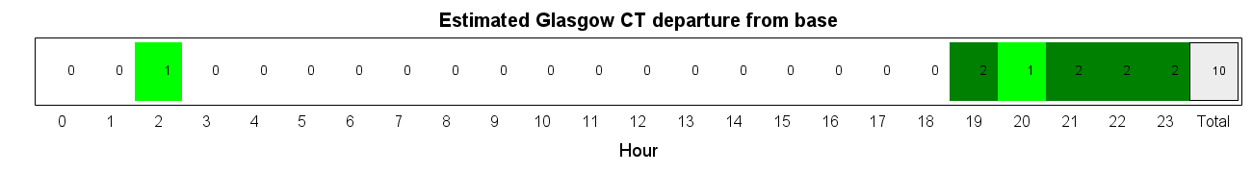
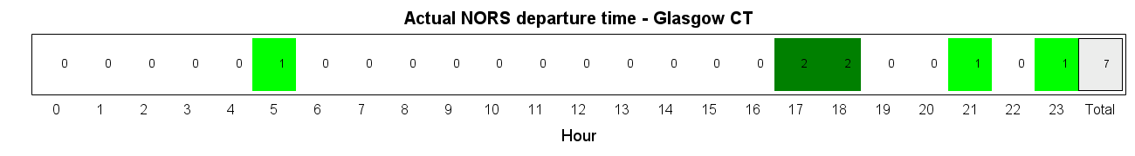
Phase 3 Modelling - NORS Heatmaps – Departure from base time
Glasgow
Notes:
Actual number of attendances compared to simulated attendances may vary due to the differences in team allocation shown in slides 6 & 7

Slide 41
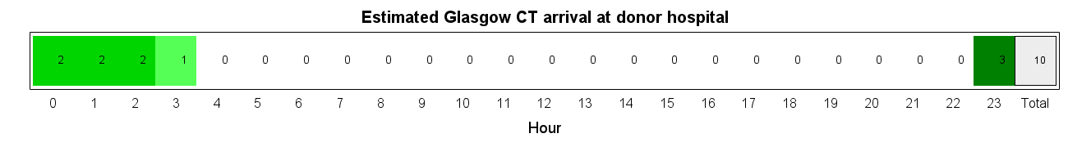
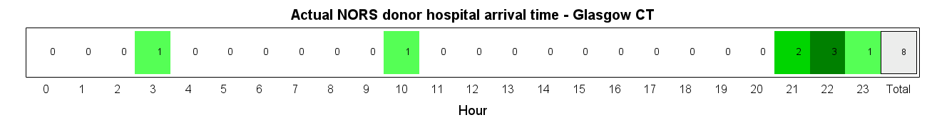
Phase 3 Modelling - NORS Heatmaps – Arrival at donor hospital time
Glasgow
Notes:
Actual number of attendances compared to simulated attendances may vary due to the differences in team allocation shown in slides 6 & 7

Slide 42
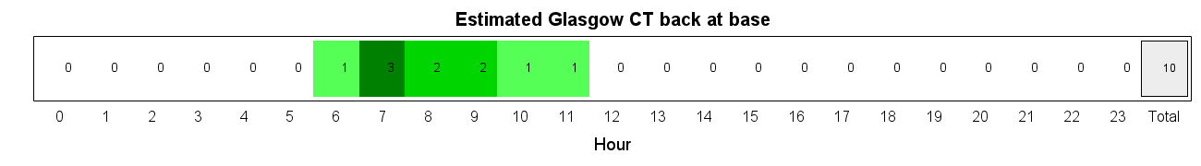
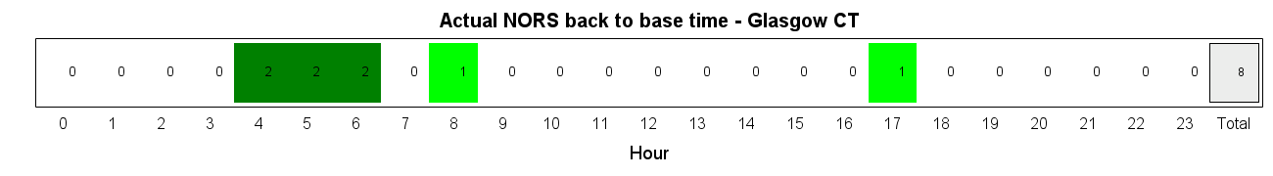
Phase 3 Modelling - NORS Heatmaps – Arrival back at base time
Glasgow
Notes:
Actual number of attendances compared to simulated attendances may vary due to the differences in team allocation shown in slides 6 & 7

Slide 43
Harefield CT NORS Heatmaps

Slide 44
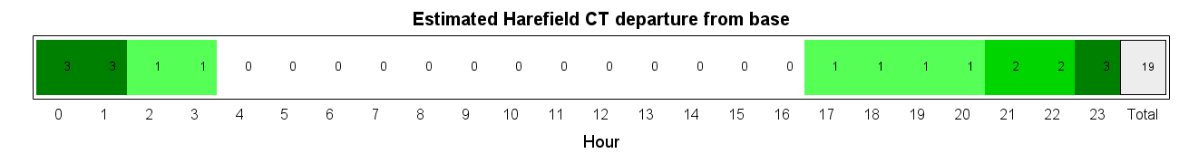
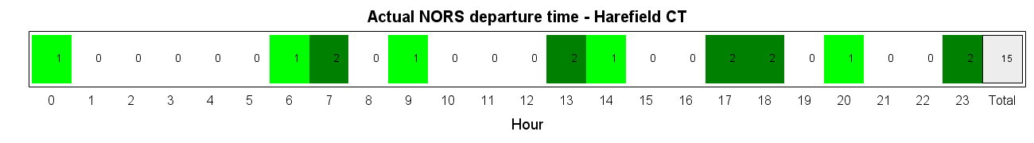
Phase 3 Modelling - NORS Heatmaps – Departure from base time
Harefield
Notes:
Actual number of attendances compared to simulated attendances may vary due to the differences in team allocation shown in slides 6 & 7

Slide 45
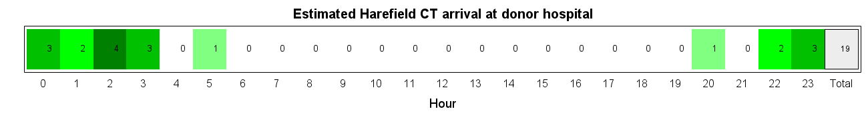

Phase 3 Modelling - NORS Heatmaps – Arrival at donor hospital time
Harefield
Notes:
Actual number of attendances compared to simulated attendances may vary due to the differences in team allocation shown in slides 6 & 7

Slide 46


Phase 3 Modelling - NORS Heatmaps – Arrival back at base time
Harefield
Notes:
Actual number of attendances compared to simulated attendances may vary due to the differences in team allocation shown in slides 6 & 7

Slide 47
Manchester CT NORS Heatmaps

Slide 48


Phase 3 Modelling - NORS Heatmaps – Departure from base time
Manchester
Notes:
Actual number of attendances compared to simulated attendances may vary due to the differences in team allocation shown in slides 6 & 7

Slide 49


Phase 3 Modelling - NORS Heatmaps – Arrival at donor hospital time
Manchester
Notes:
Actual number of attendances compared to simulated attendances may vary due to the differences in team allocation shown in slides 6 & 7

Slide 50


Phase 3 Modelling - NORS Heatmaps – Arrival back at base time
Manchester
Notes:
Actual number of attendances compared to simulated attendances may vary due to the differences in team allocation shown in slides 6 & 7

Slide 51
Newcastle CT NORS Heatmaps

Slide 52


Phase 3 Modelling - NORS Heatmaps – Departure from base time
Newcastle CT
Notes:
Actual number of attendances compared to simulated attendances may vary due to the differences in team allocation shown in slides 6 & 7

Slide 53


Phase 3 Modelling - NORS Heatmaps – Arrival at donor hospital time
Newcastle CT
Notes:
Actual number of attendances compared to simulated attendances may vary due to the differences in team allocation shown in slides 6 & 7

Slide 54


Phase 3 Modelling - NORS Heatmaps – Arrival back at base time
Newcastle CT
Notes:
Actual number of attendances compared to simulated attendances may vary due to the differences in team allocation shown in slides 6 & 7

Slide 55
Papworth CT NORS Heatmaps

Slide 56


Phase 3 Modelling - NORS Heatmaps – Departure from base time
Papworth
Notes:
Actual number of attendances compared to simulated attendances may vary due to the differences in team allocation shown in slides 6 & 7

Slide 57


Phase 3 Modelling - NORS Heatmaps – Arrival at donor hospital time
Papworth
Notes:
Actual number of attendances compared to simulated attendances may vary due to the differences in team allocation shown in slides 6 & 7

Slide 58


Phase 3 Modelling - NORS Heatmaps – Arrival back at base time
Papworth
Notes:
Actual number of attendances compared to simulated attendances may vary due to the differences in team allocation shown in slides 6 & 7

Slide 59
NORS Abdo Heatmaps A-Z

Slide 60
Birmingham Abdo NORS Heatmaps

Slide 61


Modelling - NORS Heatmaps – Departure from base time
Birmingham

Slide 62


Modelling - NORS Heatmaps – Arrival at donor hospital time
Birmingham
Notes:
Actual number of attendances compared to simulated attendances may vary due to the differences in team allocation shown in slides 6 & 7

Slide 63


Modelling - NORS Heatmaps – Arrival back at base time
Birmingham
Notes:
Actual number of attendances compared to simulated attendances may vary due to the differences in team allocation shown in slides 6 & 7

Slide 64
Cambridge Abdo NORS Heatmaps

Slide 65
Modelling - NORS Heatmaps – Departure from base time
Cambridge

Slide 66
Modelling - NORS Heatmaps – Arrival at donor hospital time
Cambridge
Notes:
Actual number of attendances compared to simulated attendances may vary due to the differences in team allocation shown in slides 6 & 7

Slide 67
Modelling - NORS Heatmaps – Arrival back at base time
Cambridge
Notes:
Actual number of attendances compared to simulated attendances may vary due to the differences in team allocation shown in slides 6 & 7

Slide 68
Cardiff Abdo NORS Heatmaps

Slide 69


Modelling - NORS Heatmaps – Departure from base time
Cardiff

Slide 70


Modelling - NORS Heatmaps – Arrival at donor hospital time
Cardiff
Notes:
Actual number of attendances compared to simulated attendances may vary due to the differences in team allocation shown in slides 6 & 7

Slide 71


Modelling - NORS Heatmaps – Arrival back at base time
Cardiff
Notes:
Actual number of attendances compared to simulated attendances may vary due to the differences in team allocation shown in slides 6 & 7

Slide 72
Edinburgh Abdo NORS Heatmaps

Slide 73


Modelling - NORS Heatmaps – Departure from base time
Edinburgh

Slide 74


Modelling - NORS Heatmaps – Arrival at donor hospital time
Edinburgh
Notes:
Actual number of attendances compared to simulated attendances may vary due to the differences in team allocation shown in slides 6 & 7

Slide 75


Modelling - NORS Heatmaps – Arrival back at base time
Edinburgh
Notes:
Actual number of attendances compared to simulated attendances may vary due to the differences in team allocation shown in slides 6 & 7

Slide 76
Kings College Abdo NORS Heatmaps

Slide 77


Modelling - NORS Heatmaps – Departure from base time
Kings College

Slide 78


Modelling - NORS Heatmaps – Arrival at donor hospital time
Kings College
Notes:
Actual number of attendances compared to simulated attendances may vary due to the differences in team allocation shown in slides 6 & 7

Slide 79


Modelling - NORS Heatmaps – Arrival back at base time
Kings College
Notes:
Actual number of attendances compared to simulated attendances may vary due to the differences in team allocation shown in slides 6 & 7

Slide 80
Leeds Abdo NORS Heatmaps

Slide 81


Modelling - NORS Heatmaps – Departure from base time
Leeds

Slide 82


Modelling - NORS Heatmaps – Arrival at donor hospital time
Leeds
Notes:
Actual number of attendances compared to simulated attendances may vary due to the differences in team allocation shown in slides 6 & 7

Slide 83


Modelling - NORS Heatmaps – Arrival back at base time
Leeds
Notes:
Actual number of attendances compared to simulated attendances may vary due to the differences in team allocation shown in slides 6 & 7

Slide 84
Manchester Abdo NORS Heatmaps

Slide 85


Modelling - NORS Heatmaps – Departure from base time
Manchester

Slide 86


Modelling - NORS Heatmaps – Arrival at donor hospital time
Manchester
Notes:
Actual number of attendances compared to simulated attendances may vary due to the differences in team allocation shown in slides 6 & 7

Slide 87


Modelling - NORS Heatmaps – Arrival back at base time
Manchester
Notes:
Actual number of attendances compared to simulated attendances may vary due to the differences in team allocation shown in slides 6 & 7

Slide 88
Newcastle Abdo NORS Heatmaps

Slide 89


Modelling - NORS Heatmaps – Departure from base time
Newcastle

Slide 90


Modelling - NORS Heatmaps – Arrival at donor hospital time
Newcastle
Notes:
Actual number of attendances compared to simulated attendances may vary due to the differences in team allocation shown in slides 6 & 7

Slide 91


Modelling - NORS Heatmaps – Arrival back at base time
Newcastle
Notes:
Actual number of attendances compared to simulated attendances may vary due to the differences in team allocation shown in slides 6 & 7

Slide 92
Oxford Abdo NORS Heatmaps

Slide 93


Modelling - NORS Heatmaps – Departure from base time
Oxford

Slide 94


Modelling - NORS Heatmaps – Arrival at donor hospital time
Oxford
Notes:
Actual number of attendances compared to simulated attendances may vary due to the differences in team allocation shown in slides 6 & 7

Slide 95


Modelling - NORS Heatmaps – Arrival back at base time
Oxford
Notes:
Actual number of attendances compared to simulated attendances may vary due to the differences in team allocation shown in slides 6 & 7

Slide 96
Royal Free Abdo NORS Heatmaps

Slide 97


Modelling - NORS Heatmaps – Departure from base time
Royal Free

Slide 98


Modelling - NORS Heatmaps – Arrival at donor hospital time
Royal Free
Notes:
Actual number of attendances compared to simulated attendances may vary due to the differences in team allocation shown in slides 6 & 7

Slide 99


Modelling - NORS Heatmaps – Arrival back at base time
Royal Free
Notes:
Actual number of attendances compared to simulated attendances may vary due to the differences in team allocation shown in slides 6 & 7

Slide 100
Transplant Centre Organ Arrival Time Heatmaps

Slide 101
Cardiothoracic Centres A-Z

Slide 102
Birmingham CT Heatmaps

Slide 103

Modelling - Organ Arrival Heatmaps - Birmingham
By Organ Group - Heart

Slide 104

Modelling - Organ Arrival Heatmaps - Birmingham
By Organ Group - Lung

Slide 105
Glasgow CT Heatmaps

Slide 106

Modelling - Organ Arrival Heatmaps - Glasgow
By Organ Group - Heart

Slide 107
Great Ormond Street CT Heatmaps

Slide 108
Modelling - Organ Arrival Heatmaps – Great Ormond St
By Organ Group - Heart
No organs accepted by this centre within this modelling period.

Slide 109
Modelling - Organ Arrival Heatmaps – Great Ormond St
By Organ Group - Lung
No organs accepted by this centre within this modelling period.

Slide 110
Harefield CT Heatmaps

Slide 111

Modelling - Organ Arrival Heatmaps - Harefield
By Organ Group - Heart

Slide 112

Modelling - Organ Arrival Heatmaps - Harefield
By Organ Group - Lung

Slide 113
Manchester CT Heatmaps

Slide 114
Modelling - Organ Arrival Heatmaps - Manchester
By Organ Group - Heart
No organs accepted by this centre within this modelling period.

Slide 115

Modelling - Organ Arrival Heatmaps - Manchester
By Organ Group - Lung

Slide 116
Newcastle CT Heatmaps

Slide 117

Modelling - Organ Arrival Heatmaps - Newcastle
By Organ Group - Heart

Slide 118

Modelling - Organ Arrival Heatmaps - Newcastle
By Organ Group - Lung

Slide 119
Papworth CT Heatmaps

Slide 120

Modelling - Organ Arrival Heatmaps - Papworth
By Organ Group - Heart

Slide 121

Modelling - Organ Arrival Heatmaps - Papworth
By Organ Group - Lung

Slide 122
Abdominal Centres A-Z

Slide 123
Belfast Heatmaps

Slide 124

Modelling - Organ Arrival Heatmaps - Belfast
By Organ Group - Kidney

Slide 125
Birmingham Abdo Heatmaps

Slide 126

Modelling - Organ Arrival Heatmaps - Birmingham
By Organ Group - Liver

Slide 127

Modelling - Organ Arrival Heatmaps - Birmingham
By Organ Group - Kidney

Slide 128


Modelling - Organ Arrival Heatmaps - Birmingham
By Organ Group - Multivisceral

Slide 129
Bristol Heatmaps

Slide 130

Modelling - Organ Arrival Heatmaps - Bristol
By Organ Group - Kidney

Slide 131
Cambridge Heatmaps

Slide 132

Modelling - Organ Arrival Heatmaps - Cambridge
By Organ Group - Liver

Slide 133


Modelling - Organ Arrival Heatmaps - Cambridge
By Organ Group - Pancreas

Slide 134

Modelling - Organ Arrival Heatmaps - Cambridge
By Organ Group - Multivisceral

Slide 135

Modelling - Organ Arrival Heatmaps - Cambridge
By Organ Group - Kidney

Slide 136
Cardiff Heatmaps

Slide 137

Modelling - Organ Arrival Heatmaps - Cardiff
By Organ Group - Pancreas

Slide 138

Modelling - Organ Arrival Heatmaps - Cardiff
By Organ Group - Kidney

Slide 139
Coventry Heatmaps

Slide 140

Modelling - Organ Arrival Heatmaps - Coventry
By Organ Group - Kidney

Slide 141
Edinburgh Heatmaps

Slide 142

Modelling - Organ Arrival Heatmaps - Edinburgh
By Organ Group - Liver

Slide 143

Modelling - Organ Arrival Heatmaps - Edinburgh
By Organ Group - Pancreas

Slide 144

Modelling - Organ Arrival Heatmaps - Edinburgh
By Organ Group - Kidney

Slide 145
Glasgow Heatmaps

Slide 146

Modelling - Organ Arrival Heatmaps - Glasgow
By Organ Group - Kidney

Slide 147
Guys Heatmaps

Slide 148

Modelling - Organ Arrival Heatmaps - Guys
By Organ Group - Pancreas

Slide 149

Modelling - Organ Arrival Heatmaps - Guys
By Organ Group - Kidney

Slide 150
Great Ormond Street Heatmaps

Slide 151

Modelling - Organ Arrival Heatmaps – Great Ormond Street
By Organ Group - Kidney

Slide 152
Hammersmith Heatmaps

Slide 153

Modelling - Organ Arrival Heatmaps - Hammersmith
By Organ Group - Kidney

Slide 154
King’s College Heatmaps

Slide 155

Modelling - Organ Arrival Heatmaps – King’s College
By Organ Group - Liver

Slide 156

Modelling - Organ Arrival Heatmaps – King’s College
By Organ Group - Kidney

Slide 157
Leeds Heatmaps

Slide 158

Modelling - Organ Arrival Heatmaps – Leeds
By Organ Group - Liver

Slide 159

Modelling - Organ Arrival Heatmaps – Leeds
By Organ Group - Kidney

Slide 160
Leicester Heatmaps

Slide 161

Modelling - Organ Arrival Heatmaps – Leicester
By Organ Group - Kidney

Slide 162
Liverpool Heatmaps

Slide 163

Modelling - Organ Arrival Heatmaps – Liverpool
By Organ Group - Kidney

Slide 164
Manchester Abdo Heatmaps

Slide 165

Modelling - Organ Arrival Heatmaps - Manchester
By Organ Group - Pancreas

Slide 166

Modelling - Organ Arrival Heatmaps - Manchester
By Organ Group - Kidney

Slide 167
Newcastle Abdo Heatmaps

Slide 168

Modelling - Organ Arrival Heatmaps - Newcastle
By Organ Group - Liver

Slide 169

Modelling - Organ Arrival Heatmaps - Newcastle
By Organ Group - Kidney

Slide 170
Nottingham Heatmaps

Slide 171

Modelling - Organ Arrival Heatmaps - Nottingham
By Organ Group - Kidney

Slide 172
Oxford Heatmaps

Slide 173

Modelling - Organ Arrival Heatmaps - Oxford
By Organ Group - Pancreas

Slide 174

Modelling - Organ Arrival Heatmaps - Oxford
By Organ Group - Multivisceral

Slide 175

Modelling - Organ Arrival Heatmaps - Oxford
By Organ Group - Kidney

Slide 176
Plymouth Heatmaps

Slide 177

Modelling - Organ Arrival Heatmaps - Plymouth
By Organ Group - Kidney

Slide 178
Portsmouth Heatmaps

Slide 179

Modelling - Organ Arrival Heatmaps - Portsmouth
By Organ Group - Kidney

Slide 180
Royal Free Heatmaps

Slide 181
Modelling - Organ Arrival Heatmaps – Royal Free
By Organ Group - Liver

Slide 182

Modelling - Organ Arrival Heatmaps – Royal Free
By Organ Group - Kidney

Slide 183
Royal London Heatmaps

Slide 184

Modelling - Organ Arrival Heatmaps – Royal London
By Organ Group - Kidney

Slide 185
Sheffield Heatmaps

Slide 186

Modelling - Organ Arrival Heatmaps – Sheffield
By Organ Group - Kidney

Slide 187
St George’s Heatmaps

Slide 188

Modelling - Organ Arrival Heatmaps – St George’s
By Organ Group - Kidney

