Slide 1
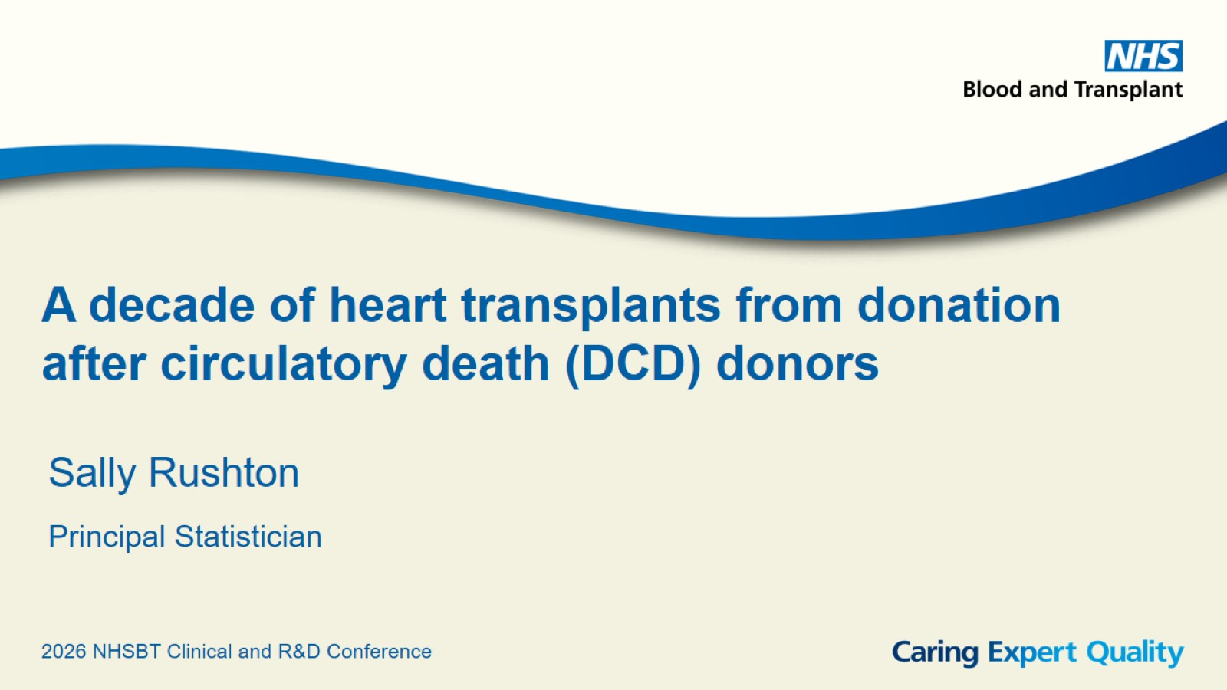
A decade of heart transplants from donation after circulatory death (DCD) donors

Slide 2
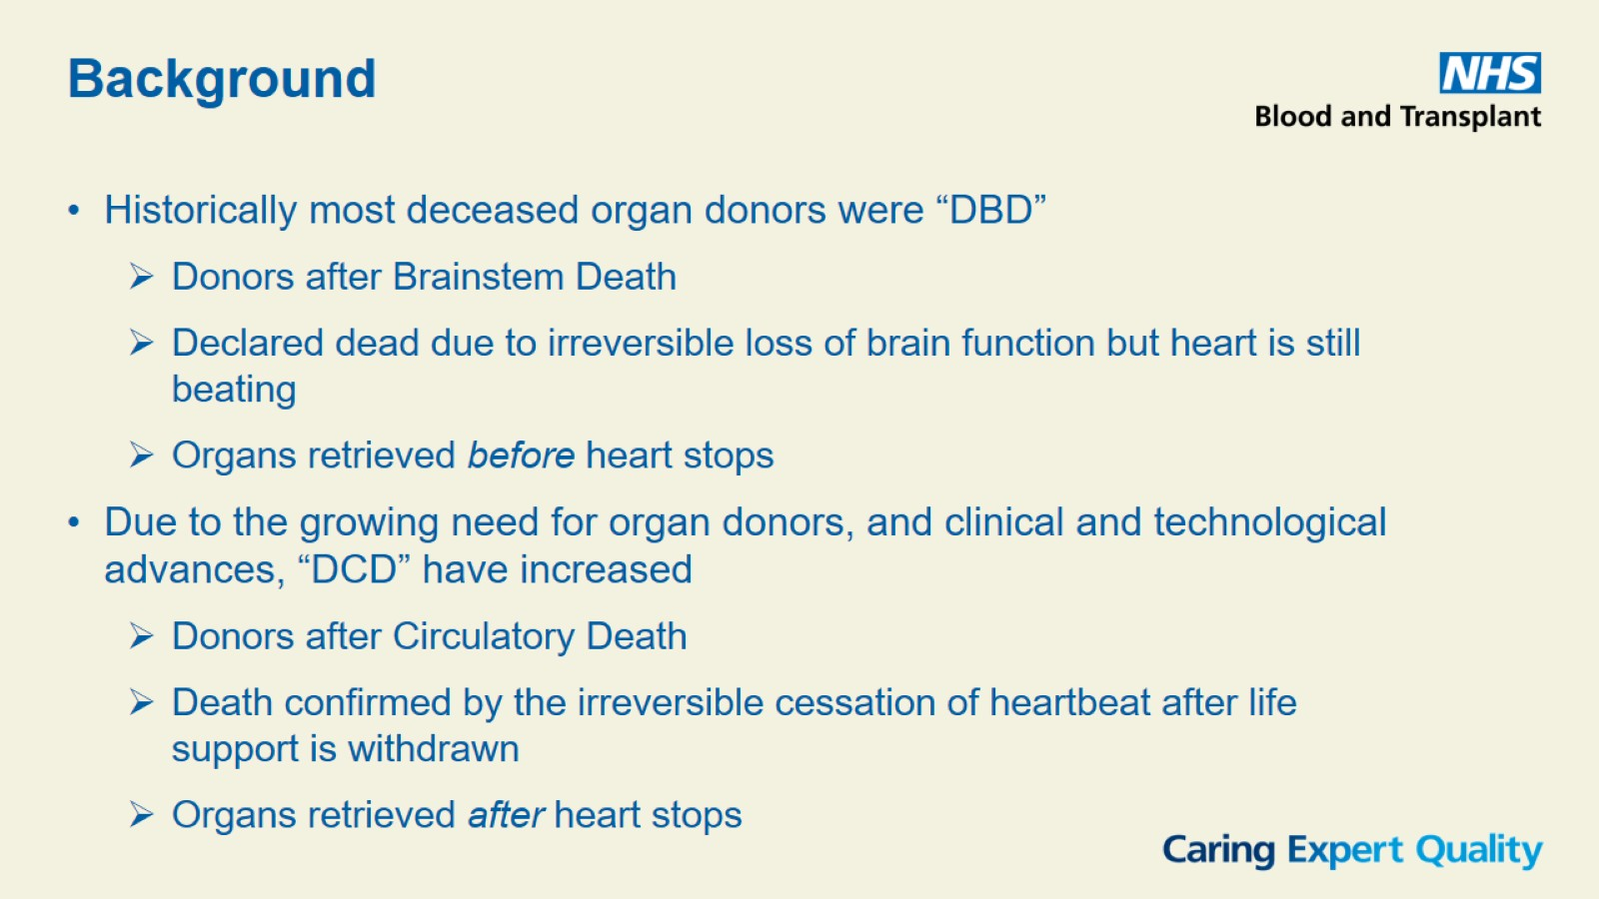

Slide 3
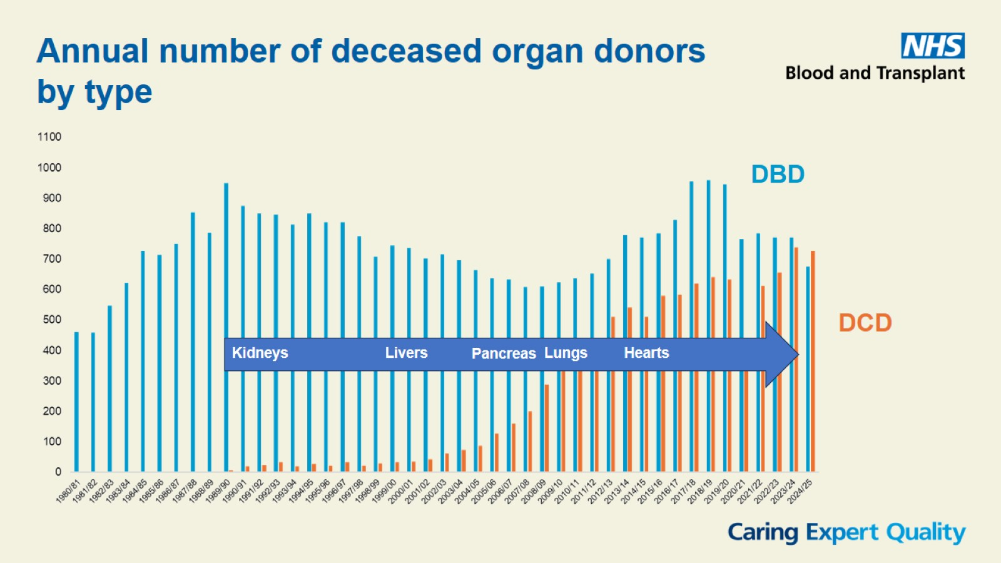

Slide 4
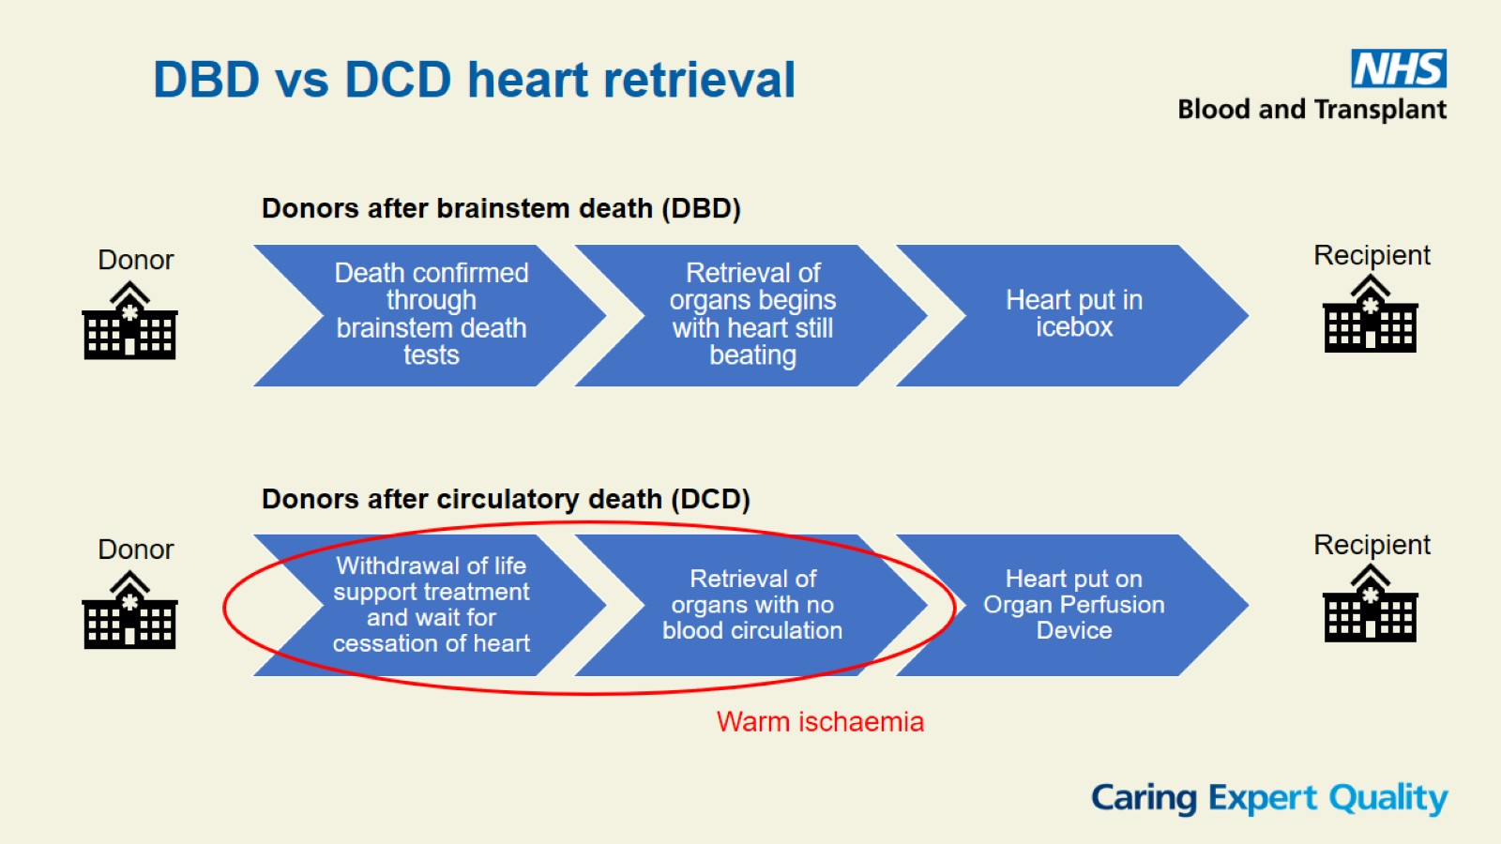

Slide 5
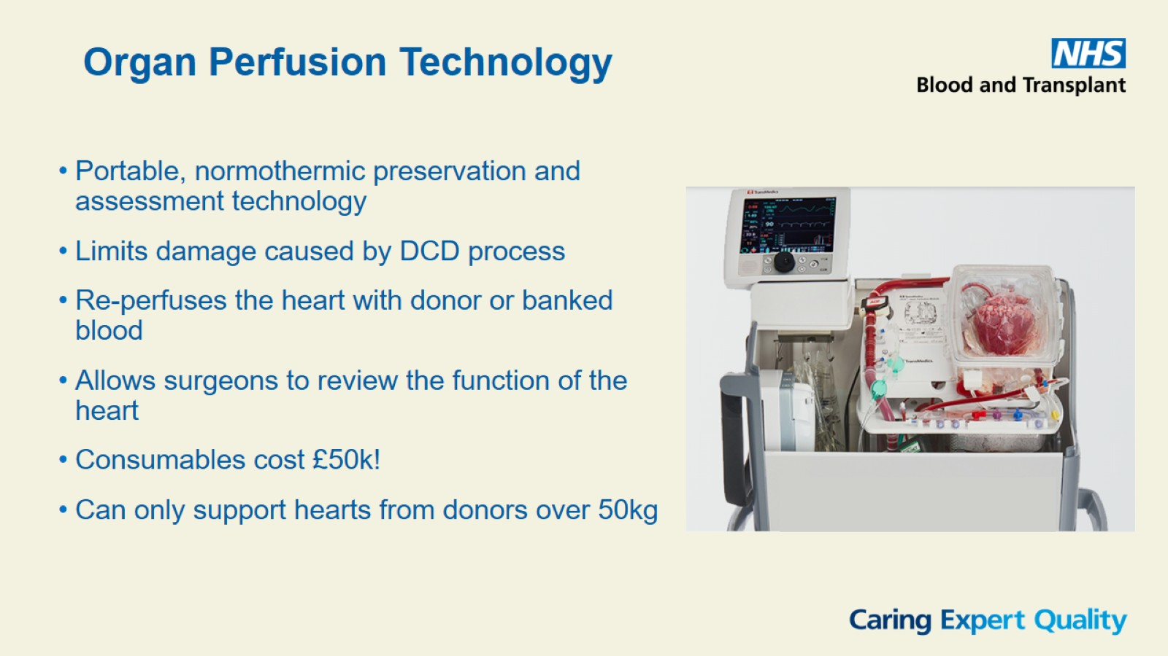

Slide 6
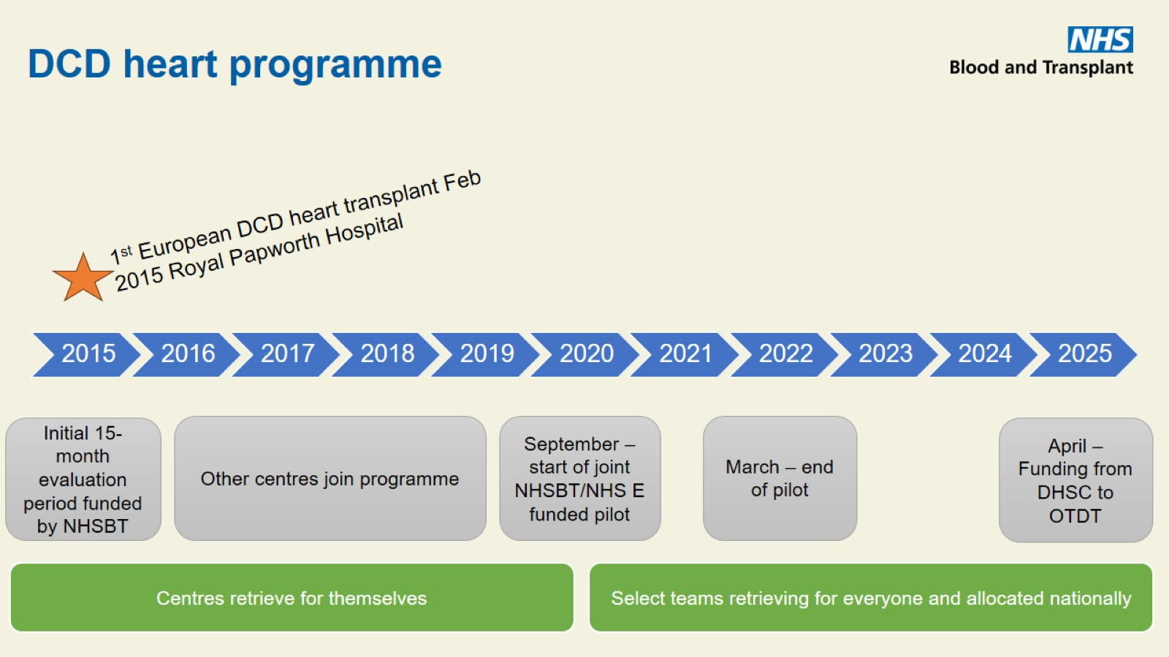
DCD heart programme

Slide 7
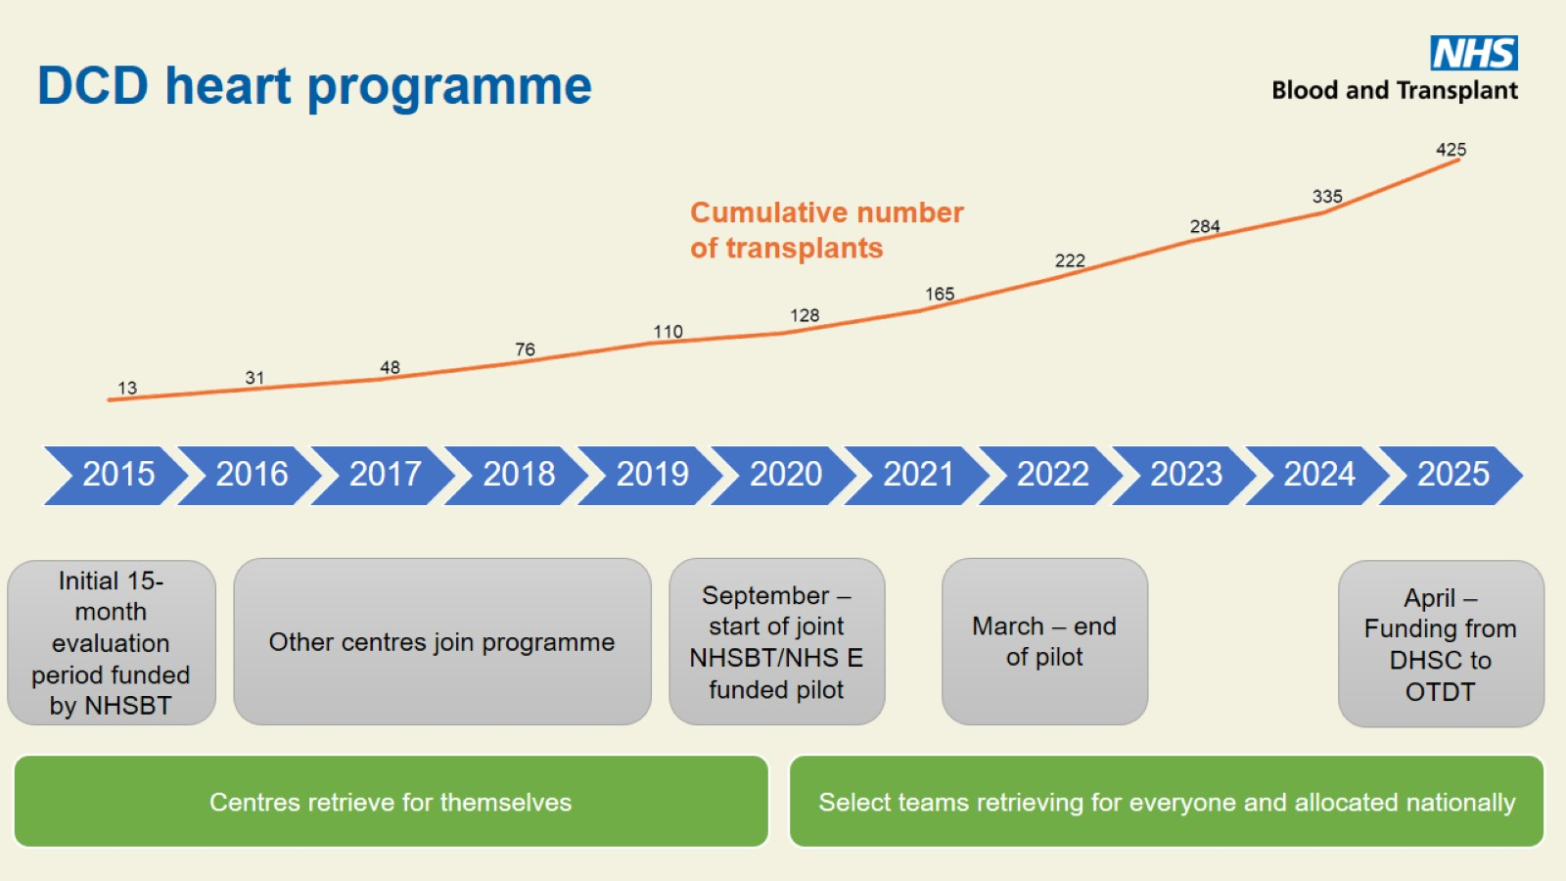
DCD heart programme

Slide 8
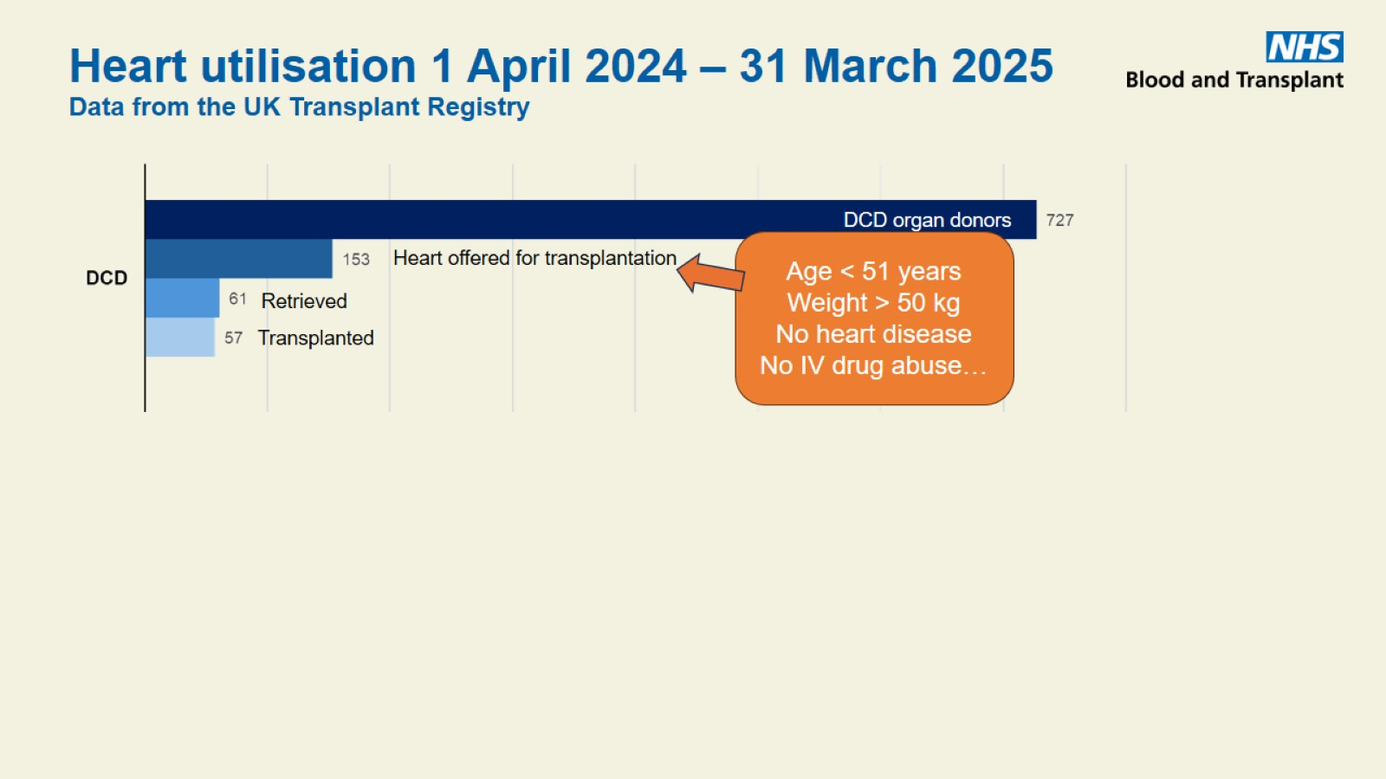
Heart utilisation 1 April 2024 – 31 March 2025
Data from the UK Transplant Registry

Slide 9
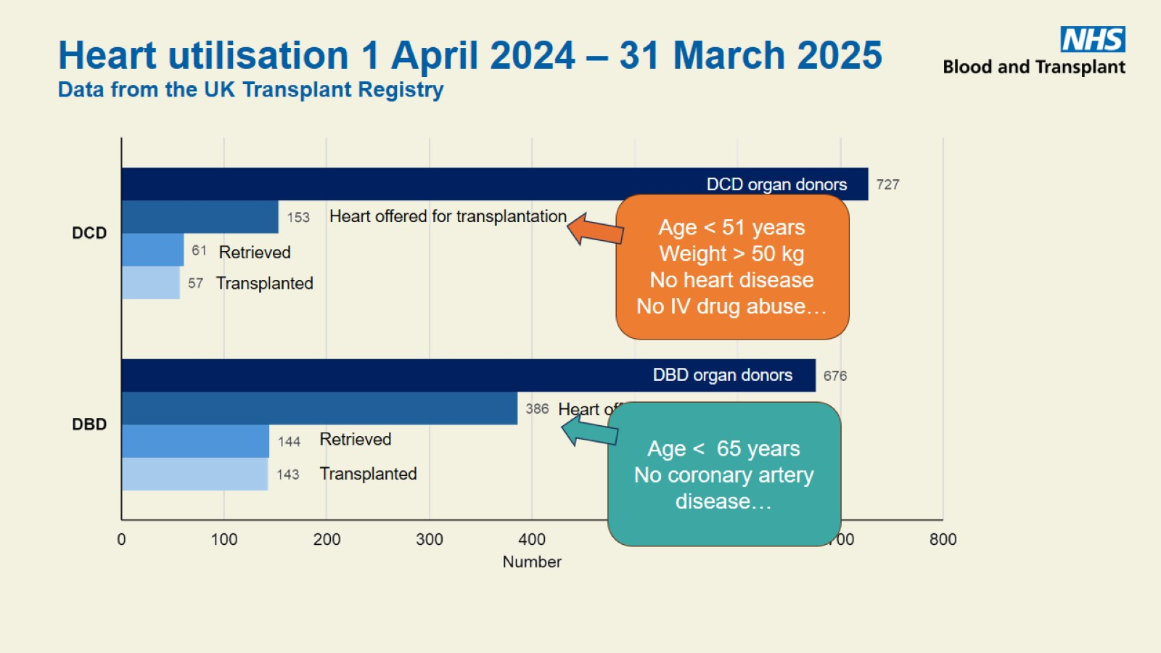
Heart utilisation 1 April 2024 – 31 March 2025
Data from the UK Transplant Registry

Slide 10
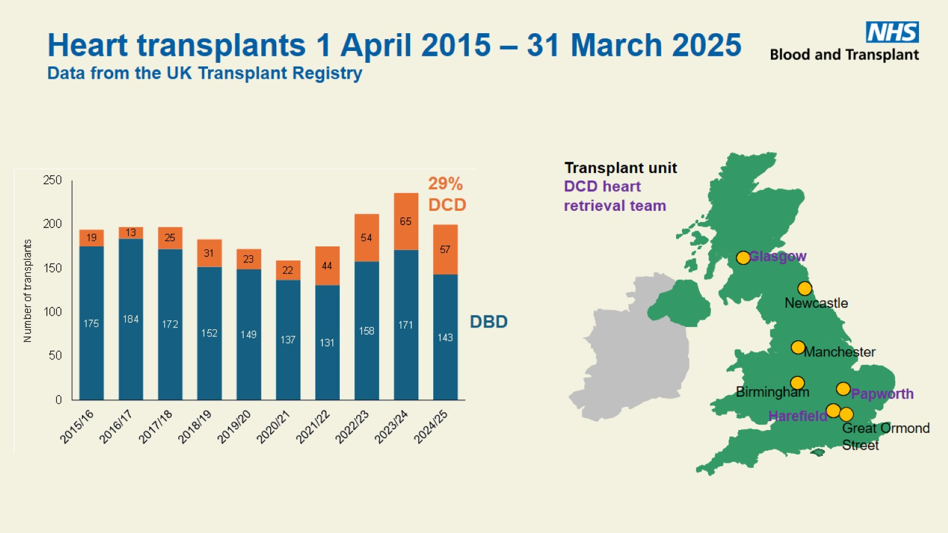
Heart transplants 1 April 2015 – 31 March 2025
Data from the UK Transplant Registry

Slide 11
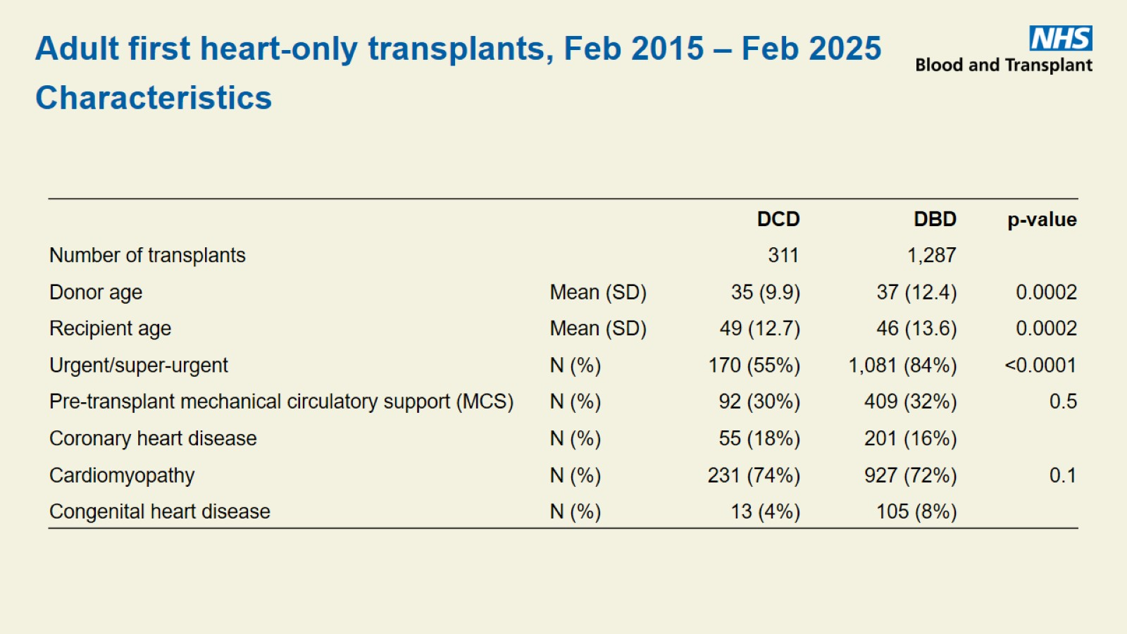

Slide 12
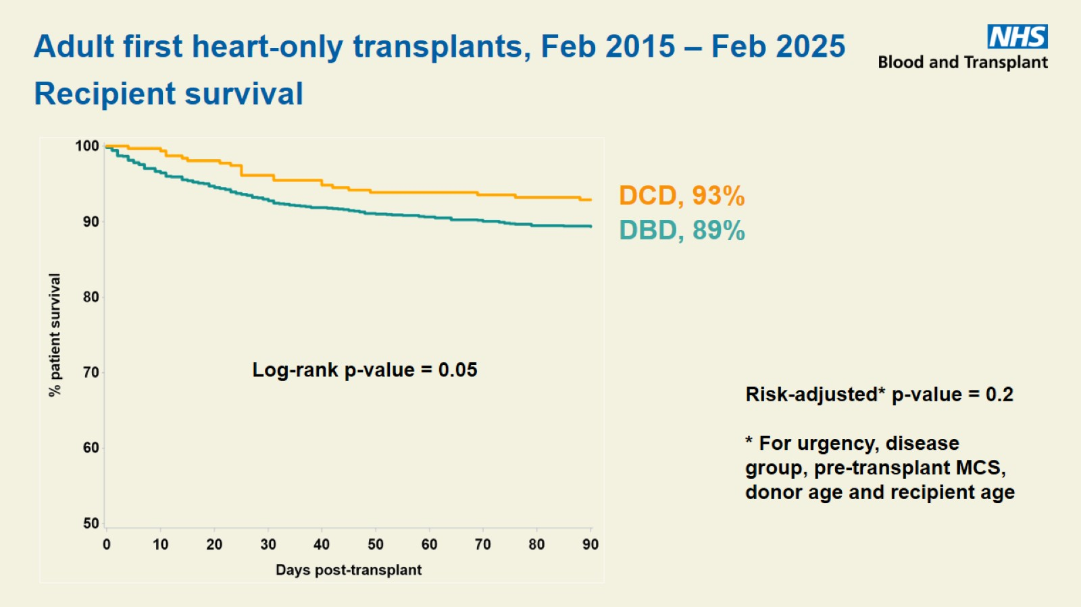

Slide 13
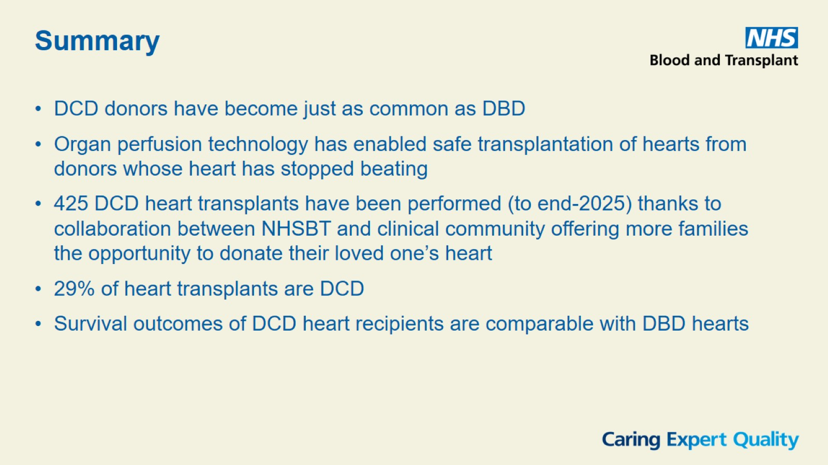

Slide 14
