Slide 1


Slide 2
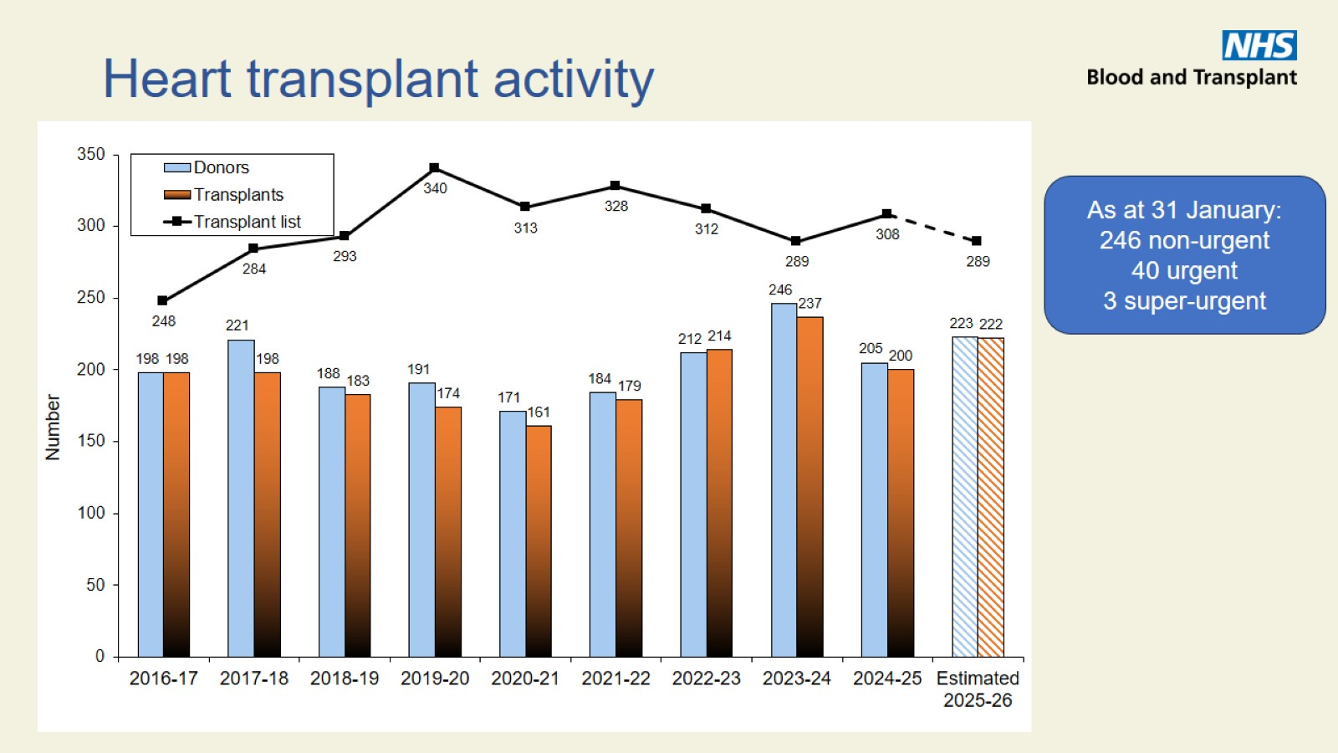
Heart transplant activity

Slide 3
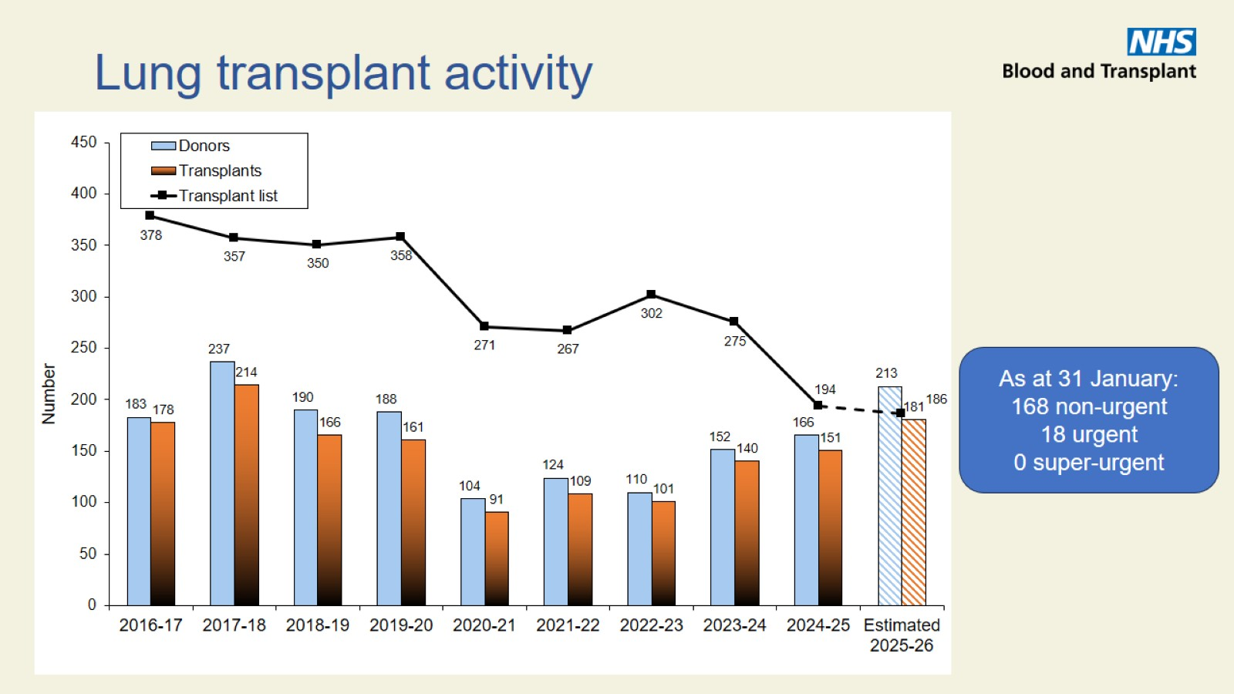
Lung transplant activity

Slide 4

Donation and transplant activity

Slide 5
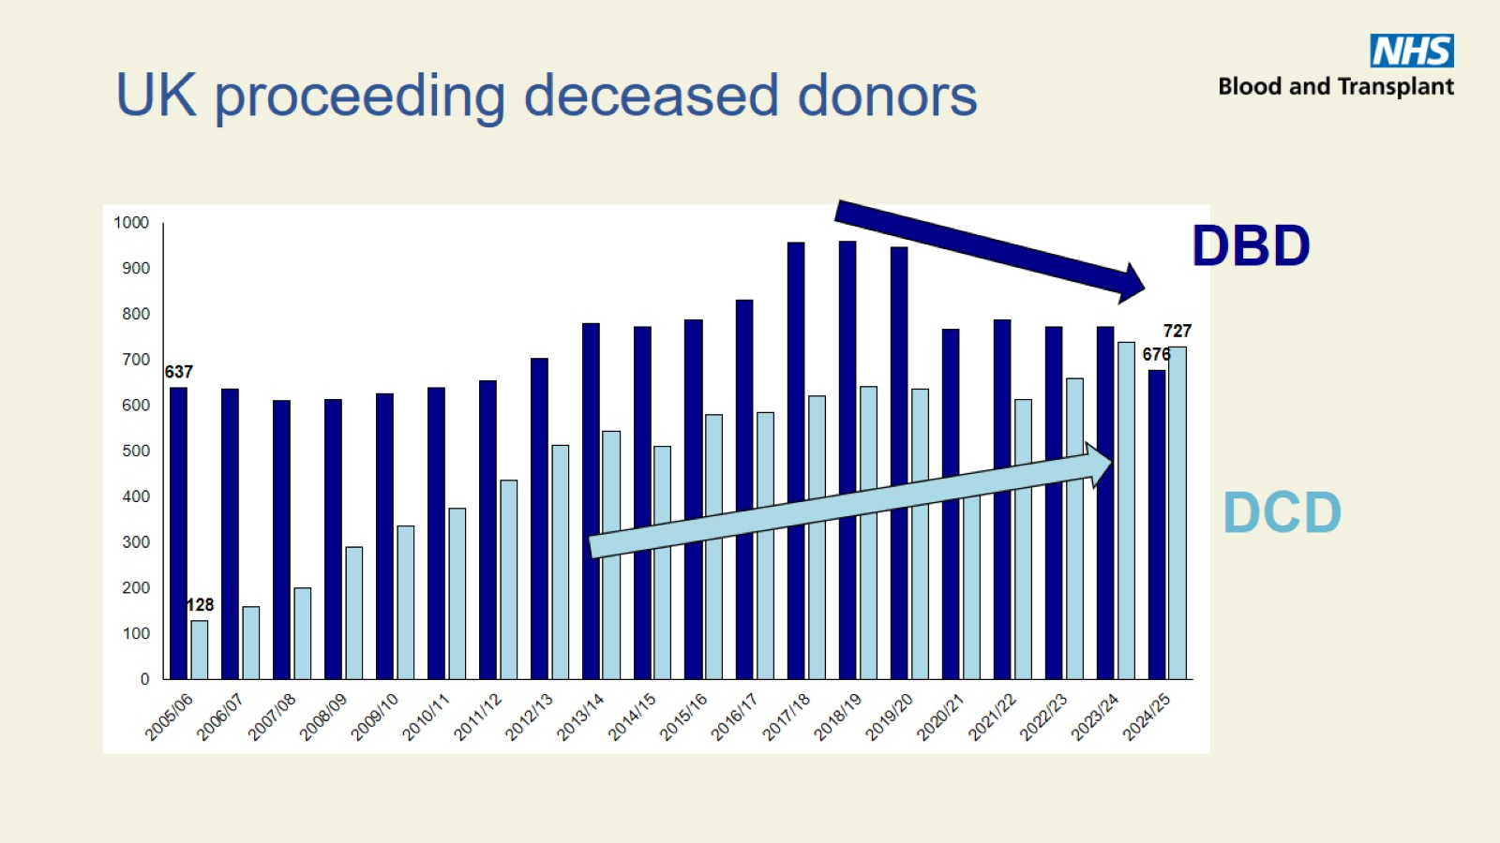
UK proceeding deceased donors

Slide 6
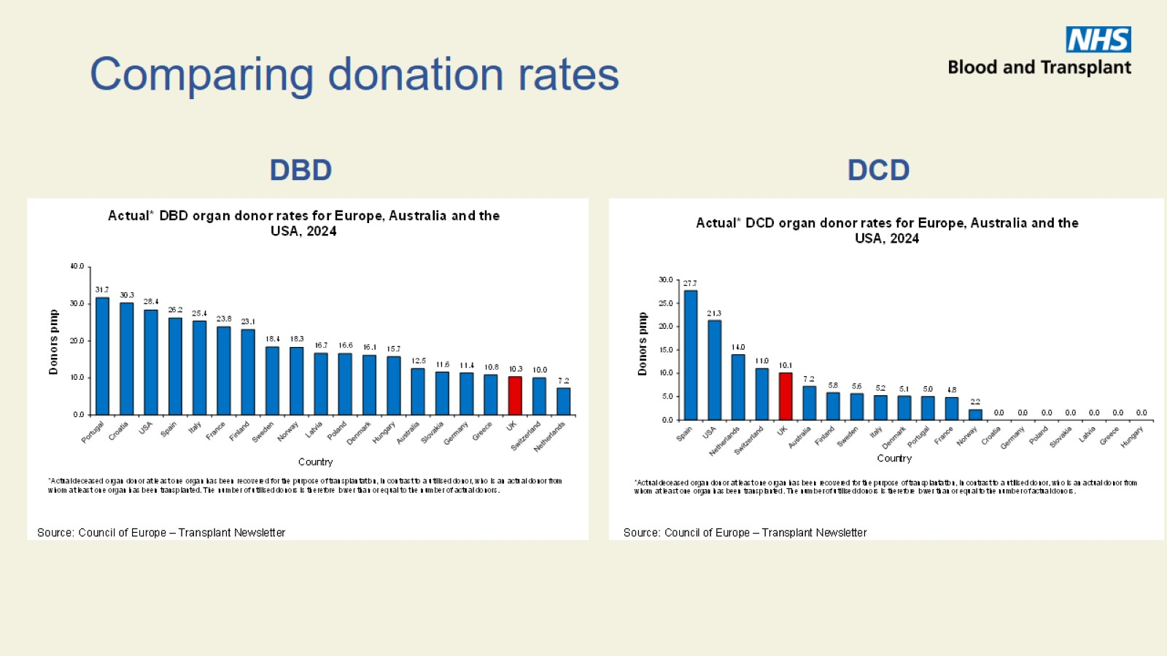
Comparing donation rates

Slide 7
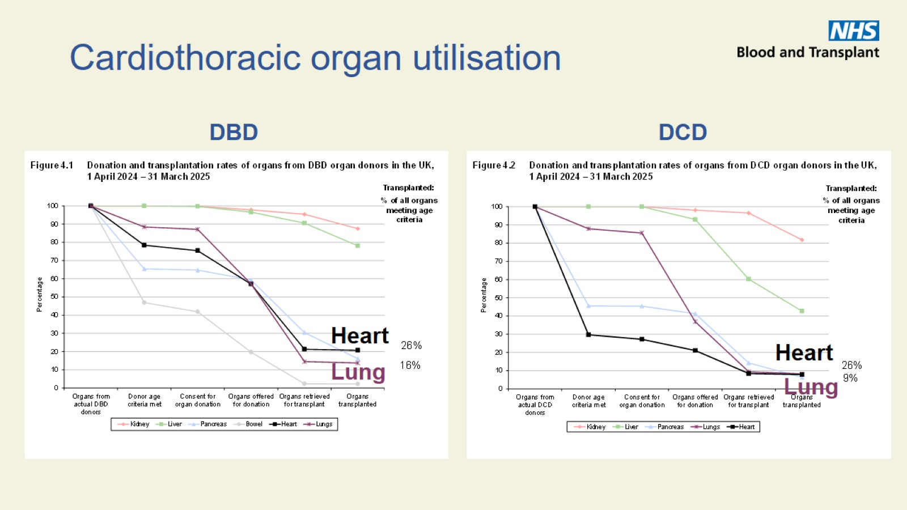
Cardiothoracic organ utilisation

Slide 8
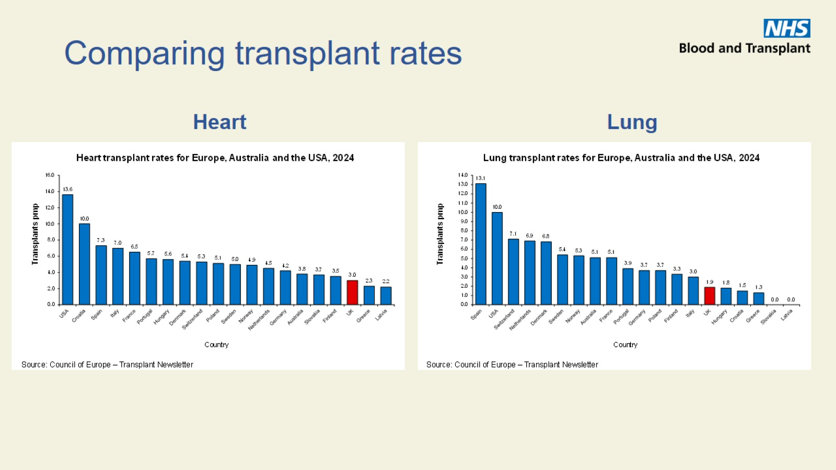
Comparing transplant rates

Slide 9
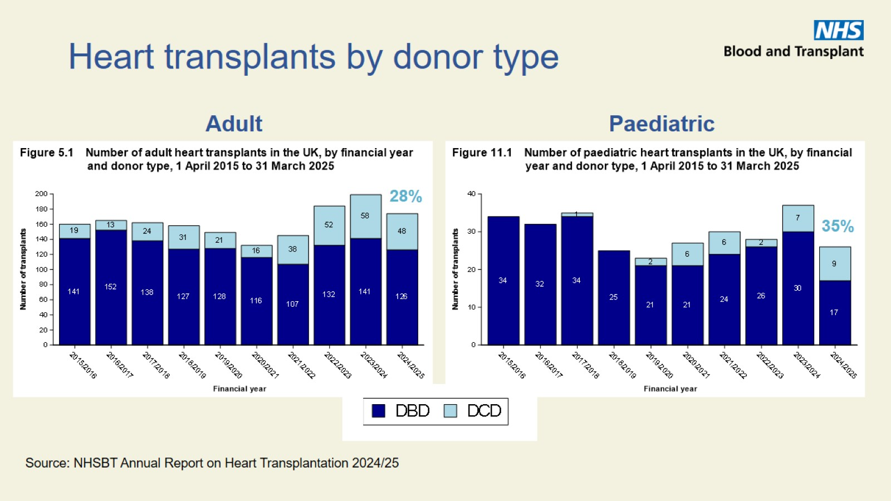
Heart transplants by donor type

Slide 10
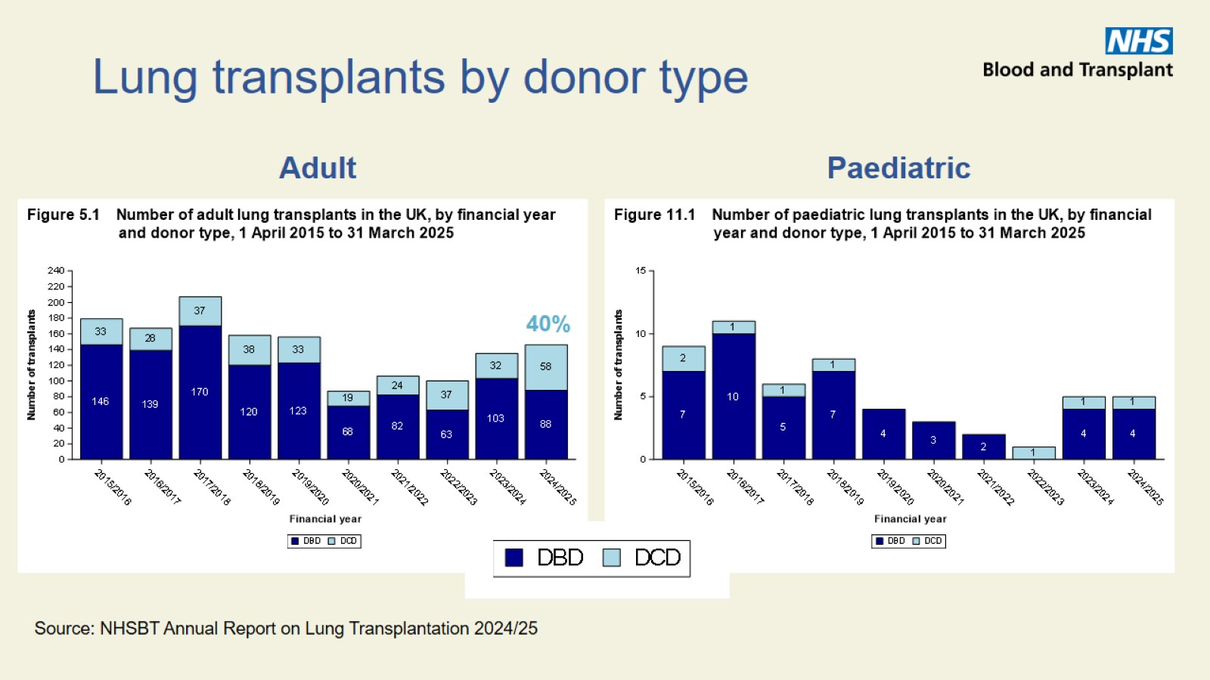
Lung transplants by donor type

Slide 11

Waiting times

Slide 12
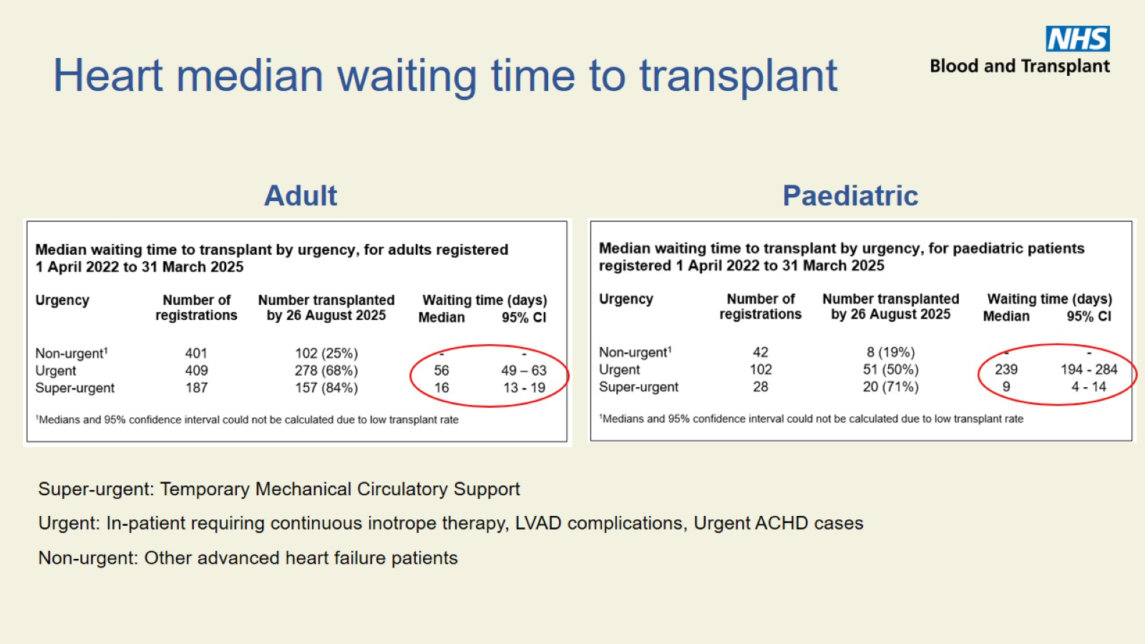

Slide 13
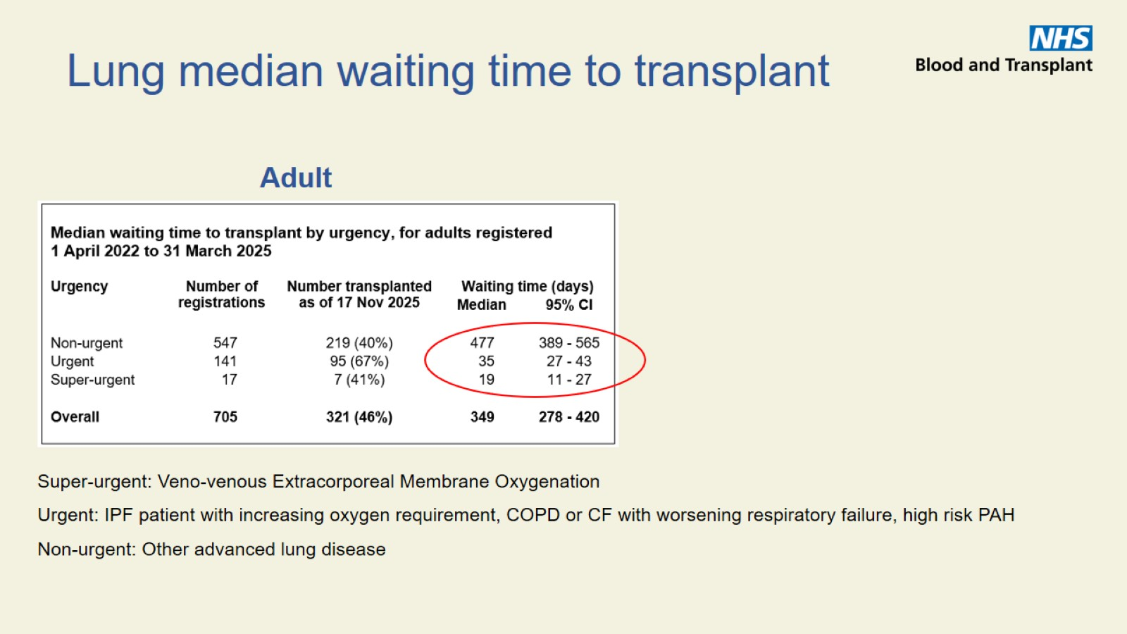

Slide 14

Transplant outcomes

Slide 15
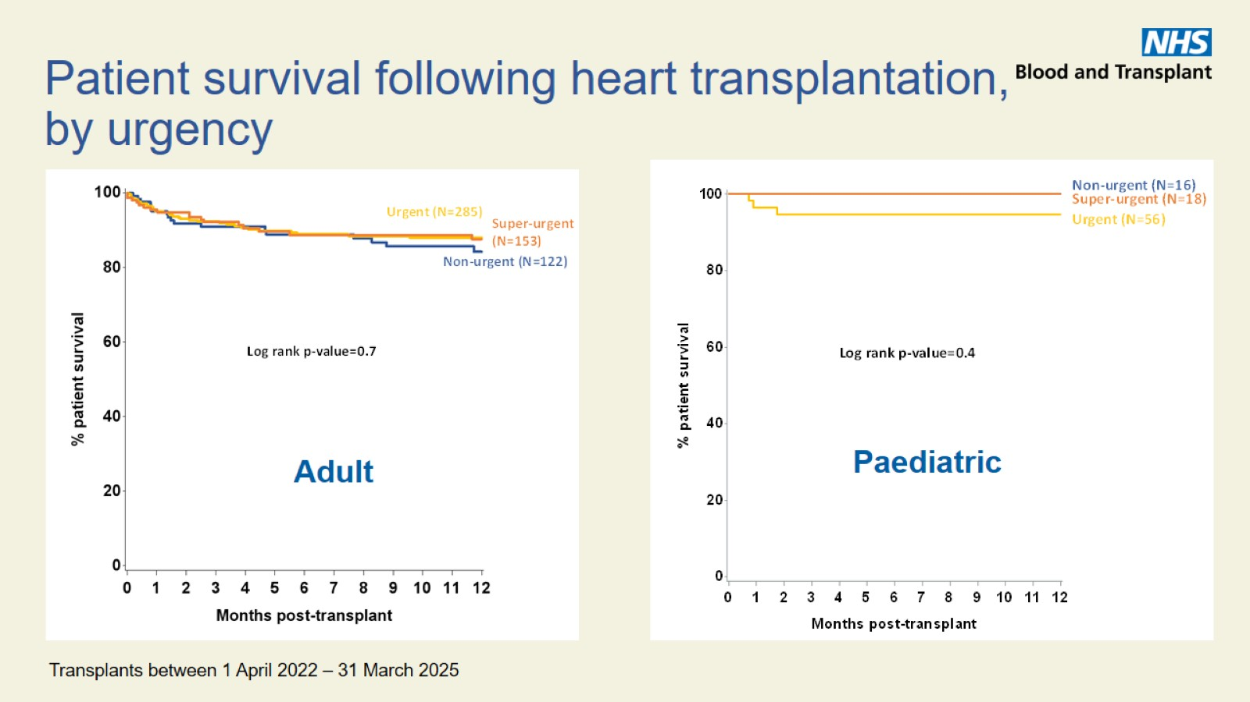

Slide 16
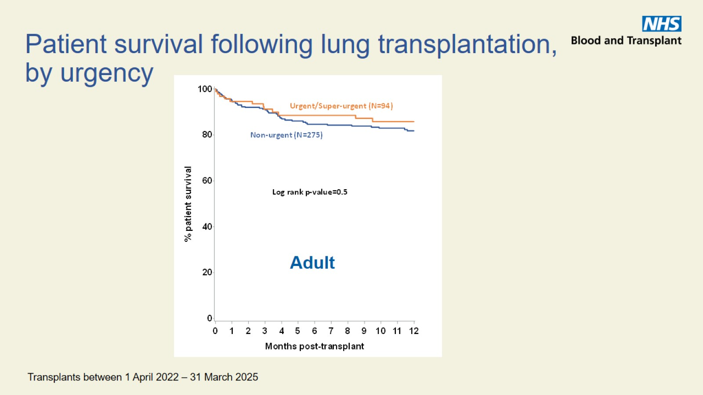

Slide 17

Key messages

Slide 18
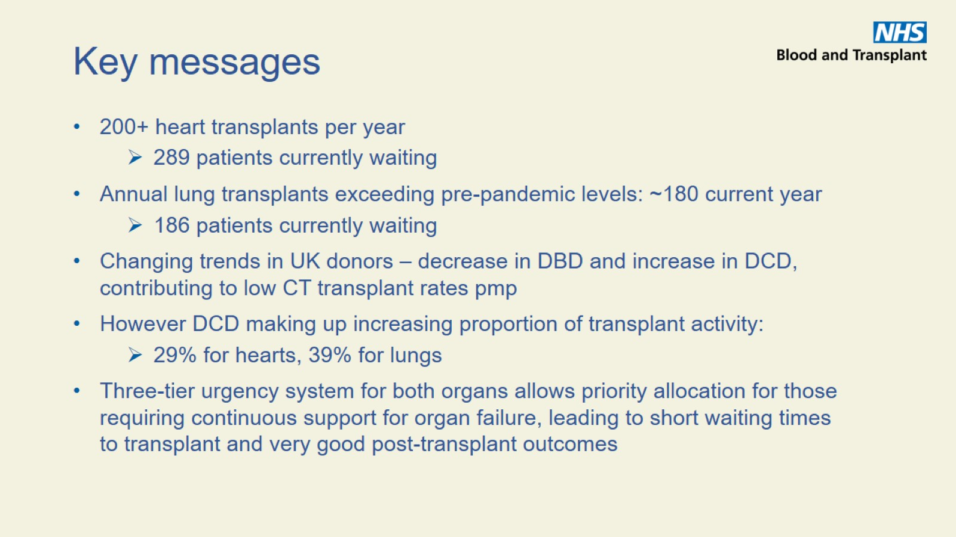
Key messages

Slide 19


