Slide 1


Slide 2

Disclosures

Slide 3
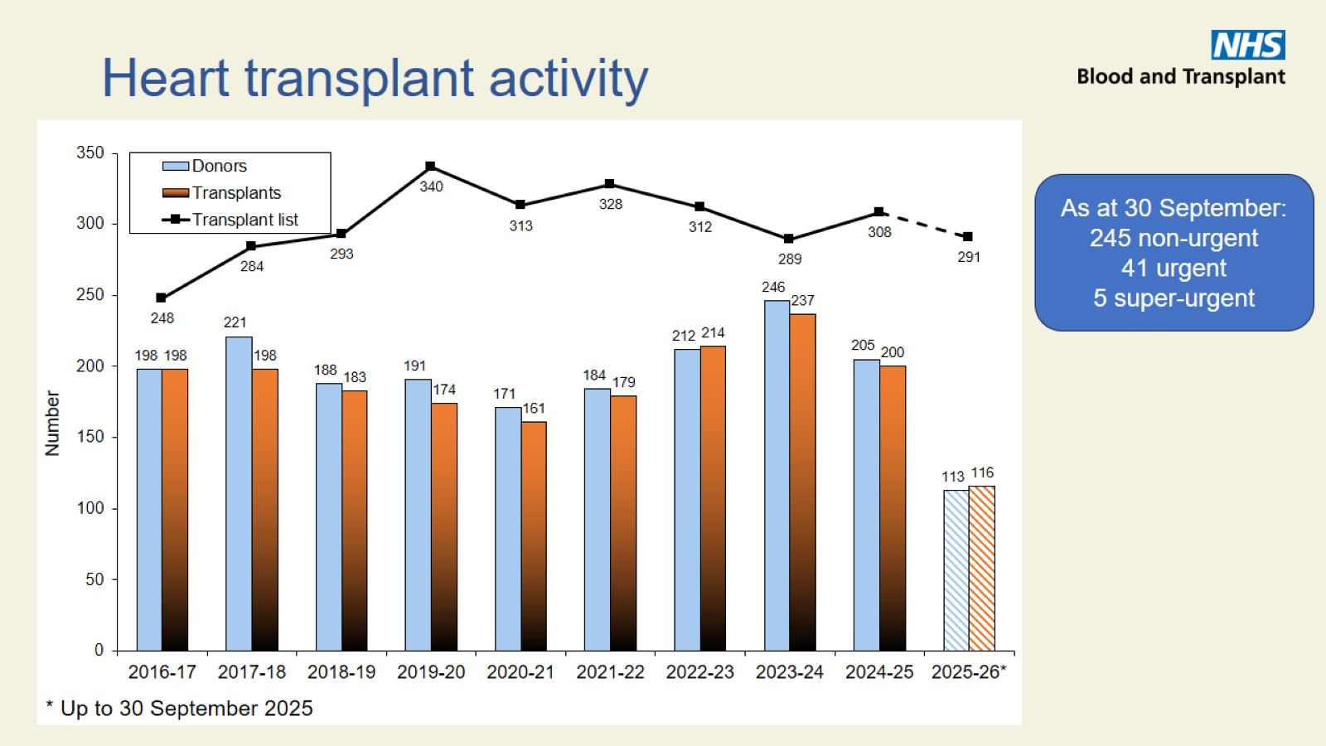
Heart transplant activity

Slide 4
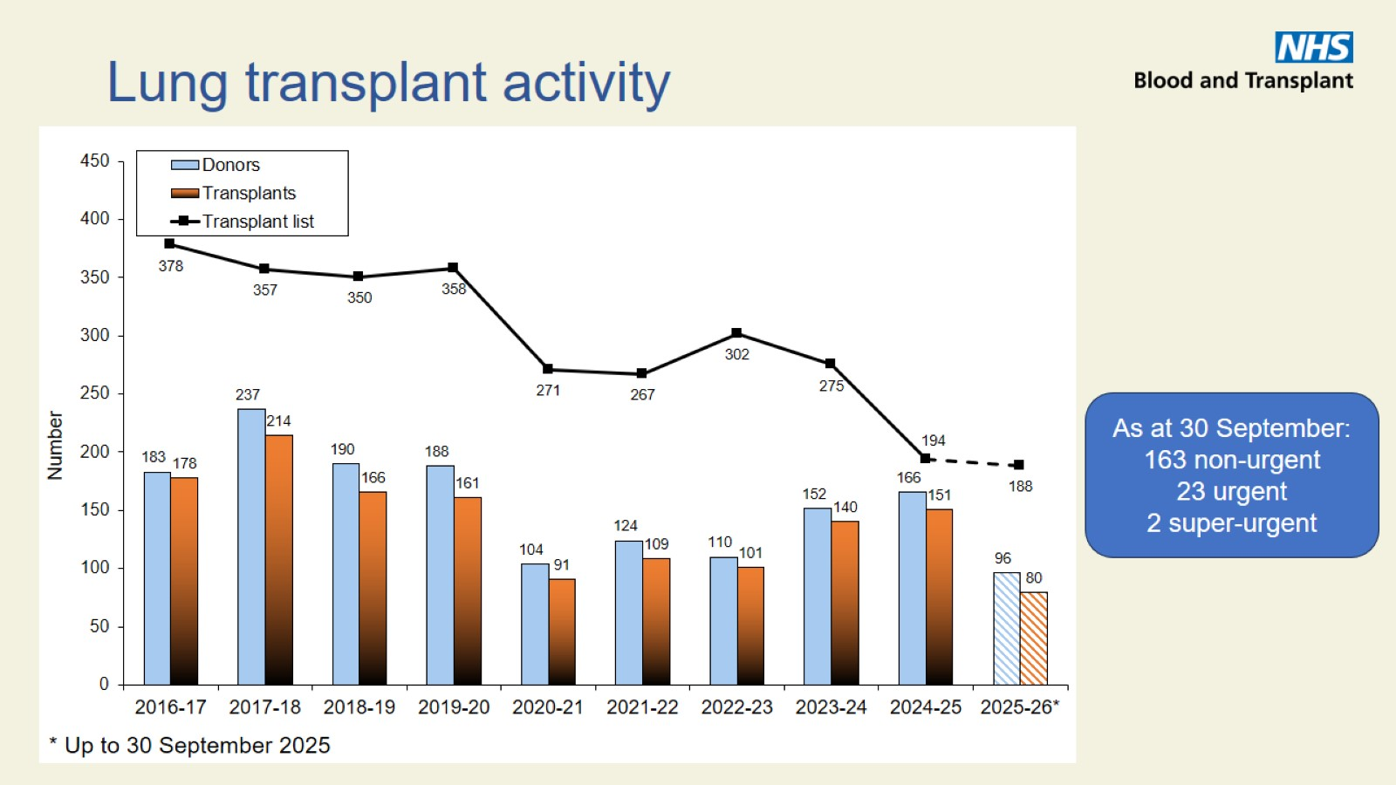
Lung transplant activity

Slide 5

Donation activity

Slide 6
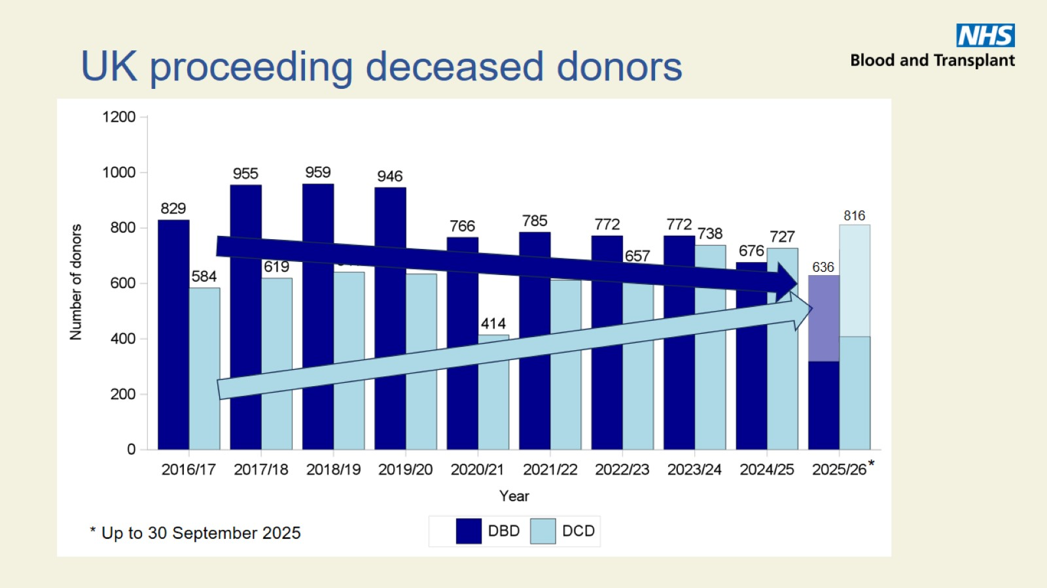
UK proceeding deceased donors

Slide 7
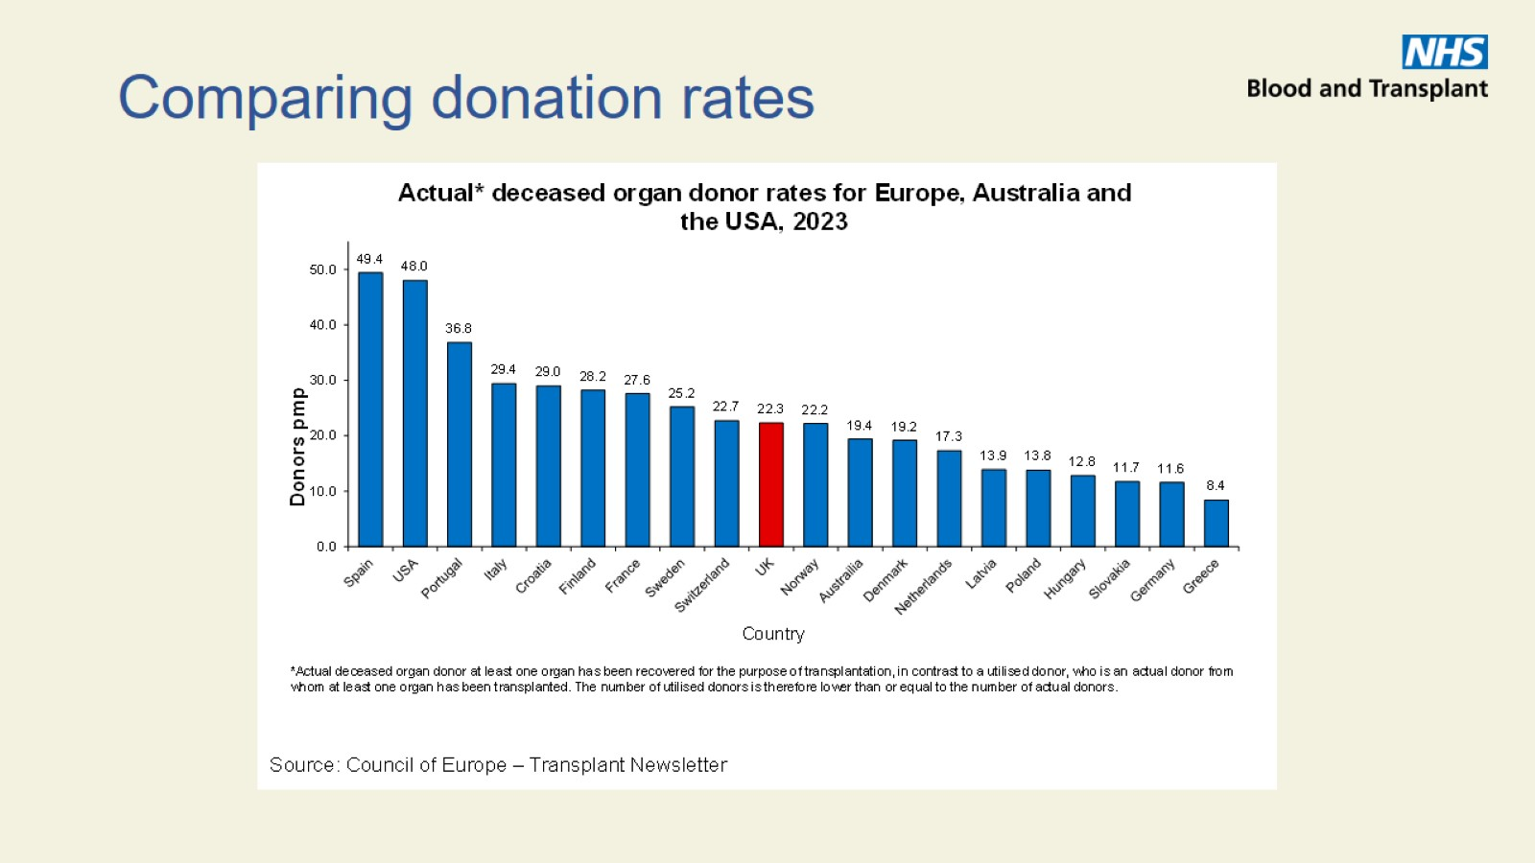
Comparing donation rates

Slide 8
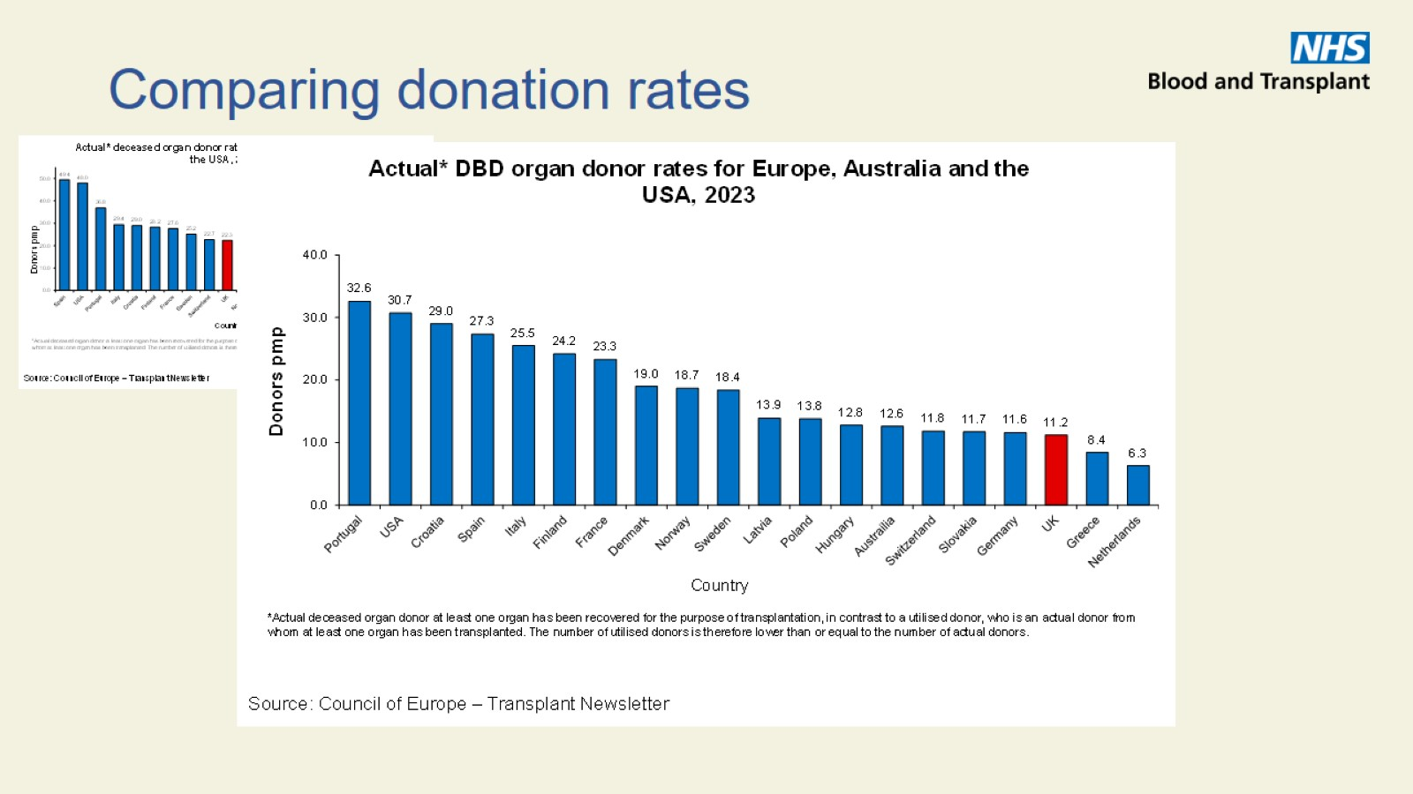
Comparing donation rates

Slide 9
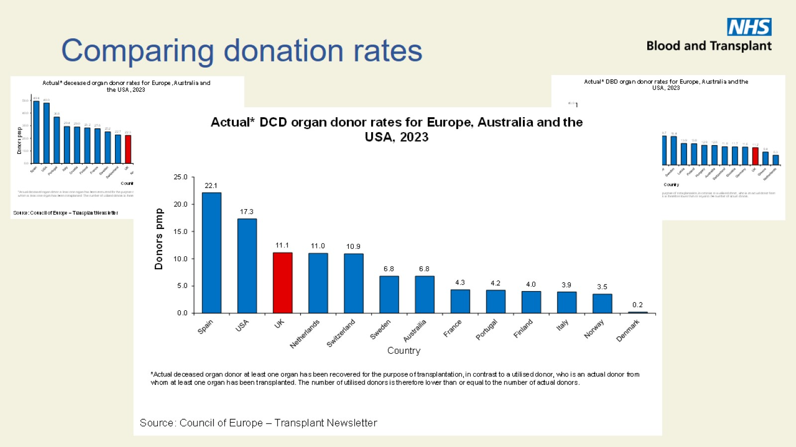
Comparing donation rates

Slide 10
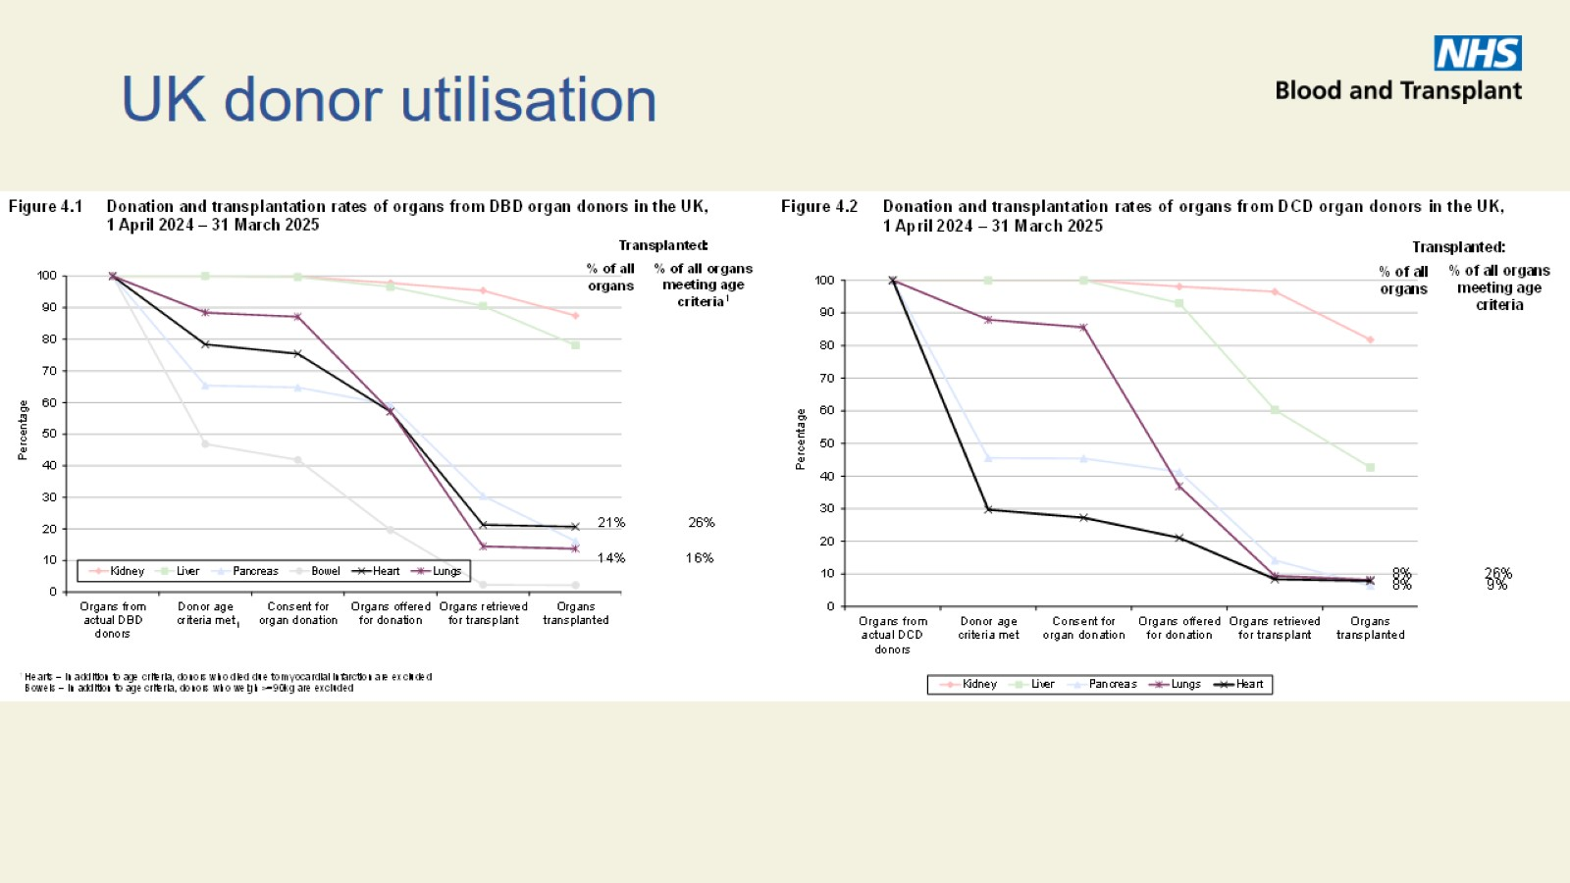
UK donor utilisation

Slide 11
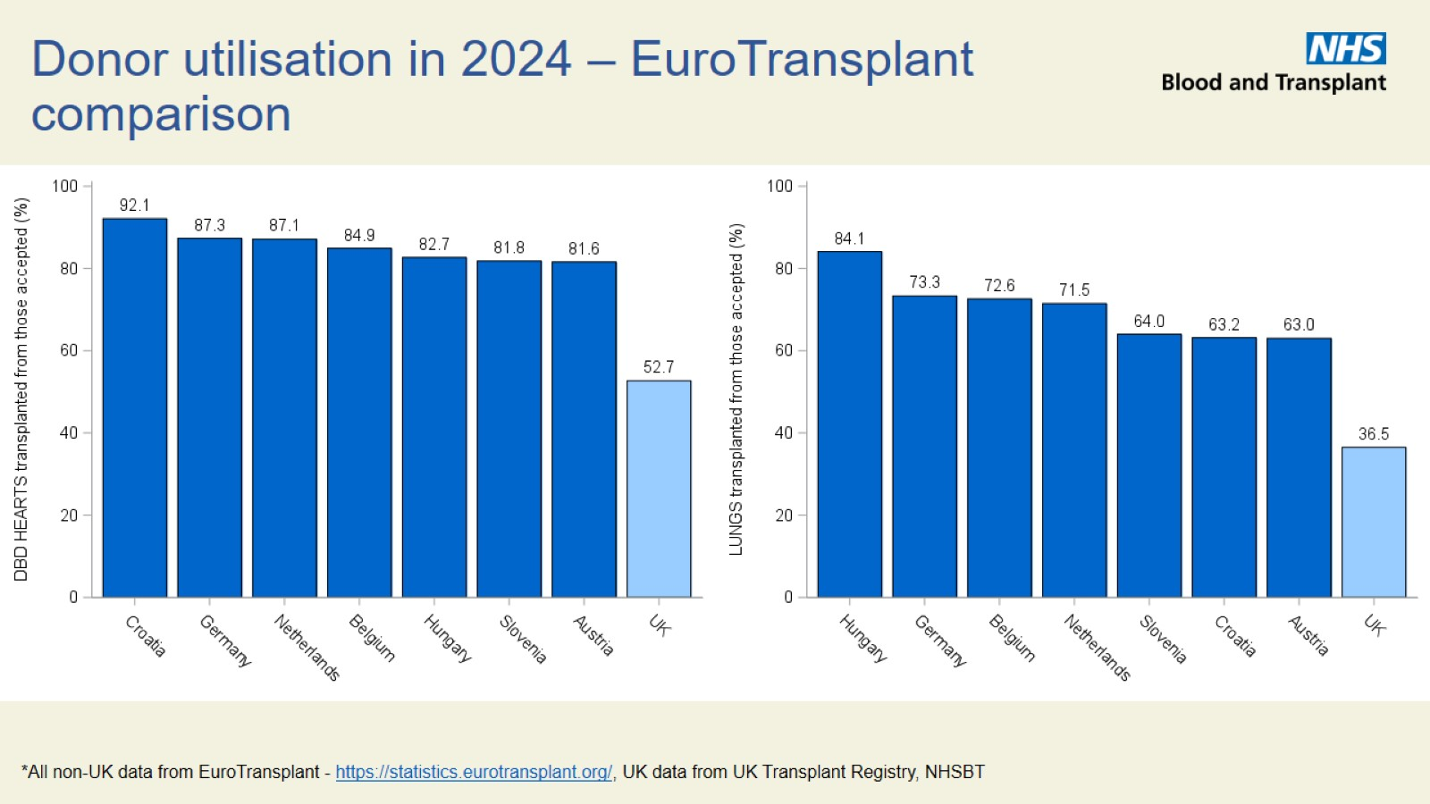
Donor utilisation in 2024 – EuroTransplant comparison

Slide 12

Waiting list outcomes

Slide 13
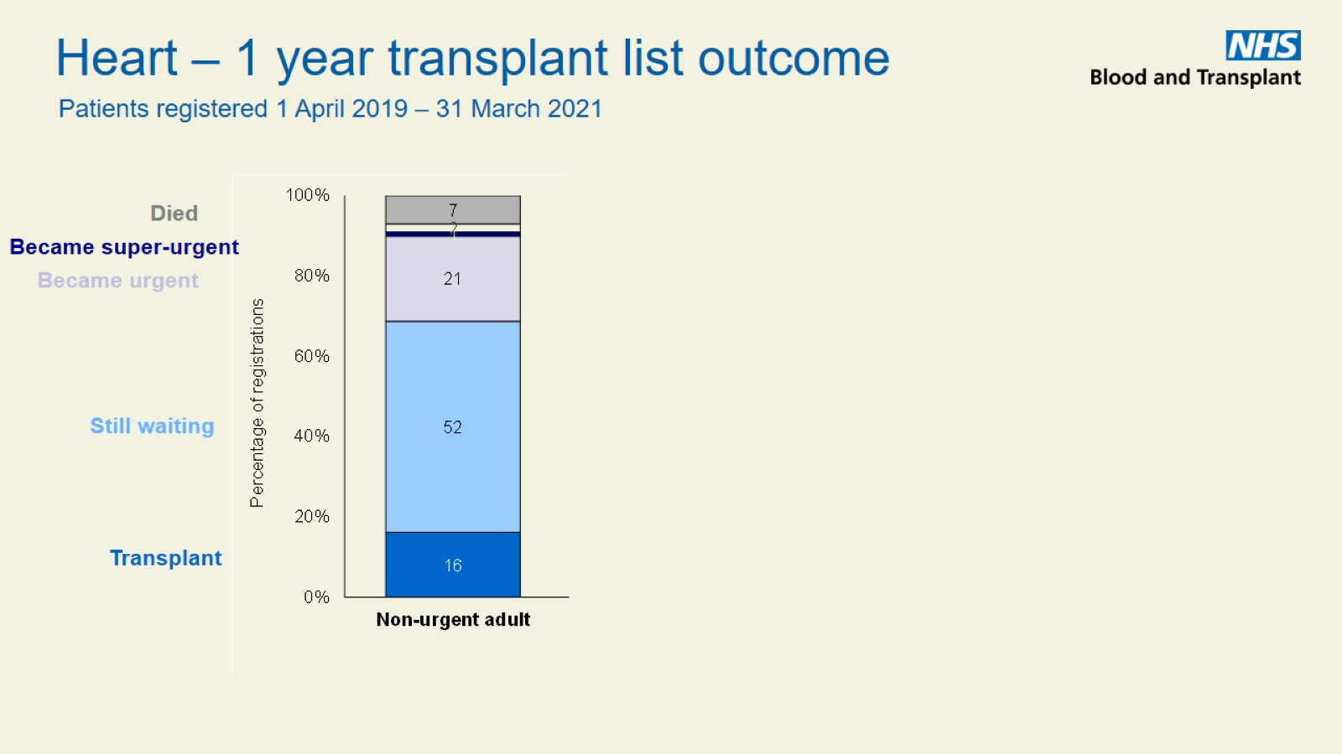

Slide 14
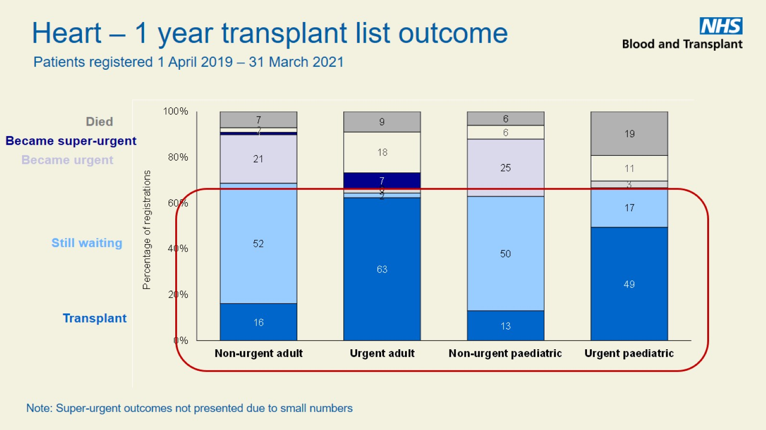

Slide 15
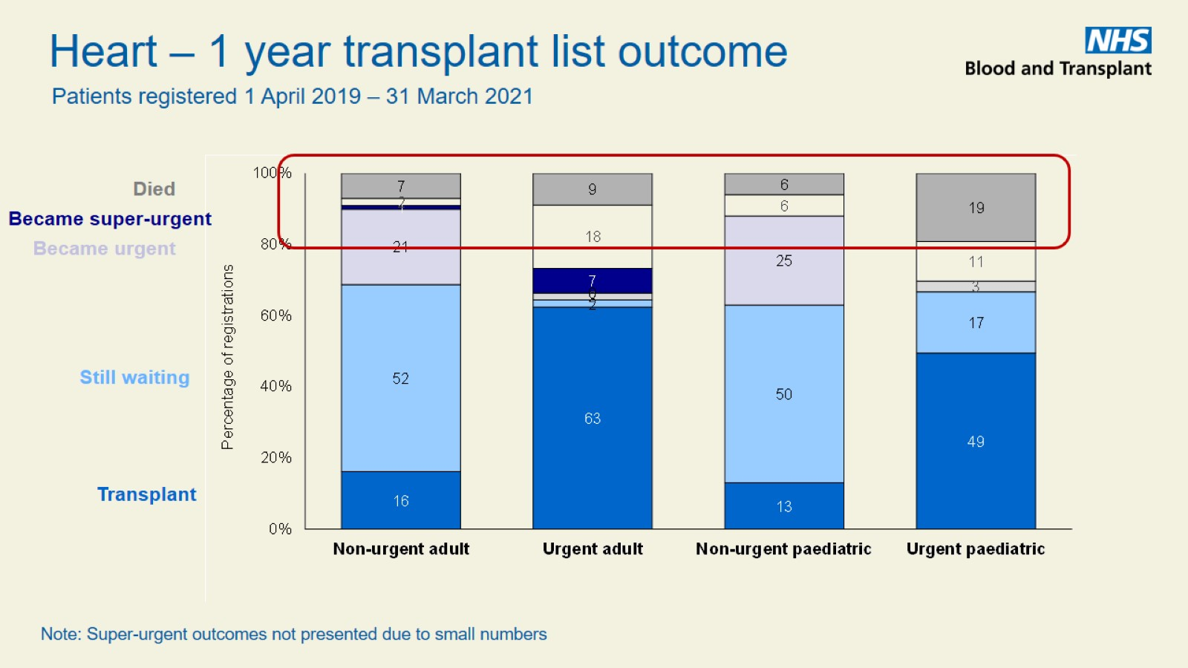

Slide 16
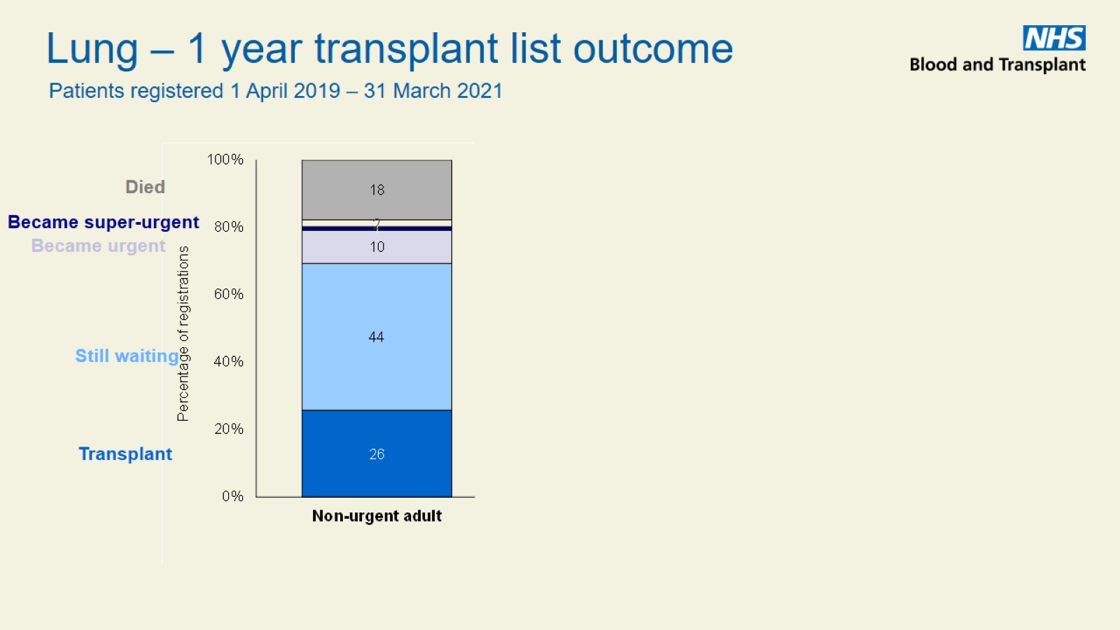

Slide 17
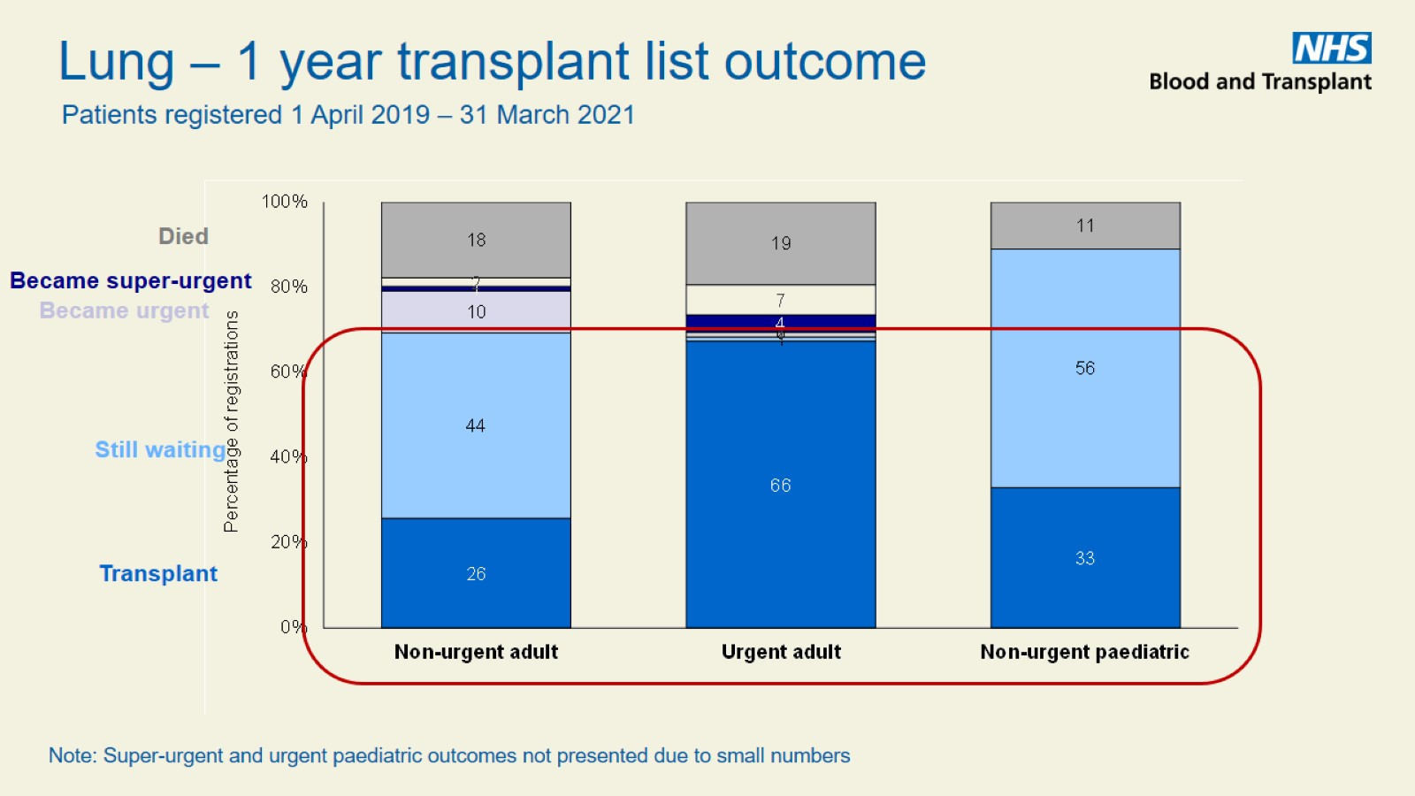

Slide 18


Slide 19

Transplants

Slide 20
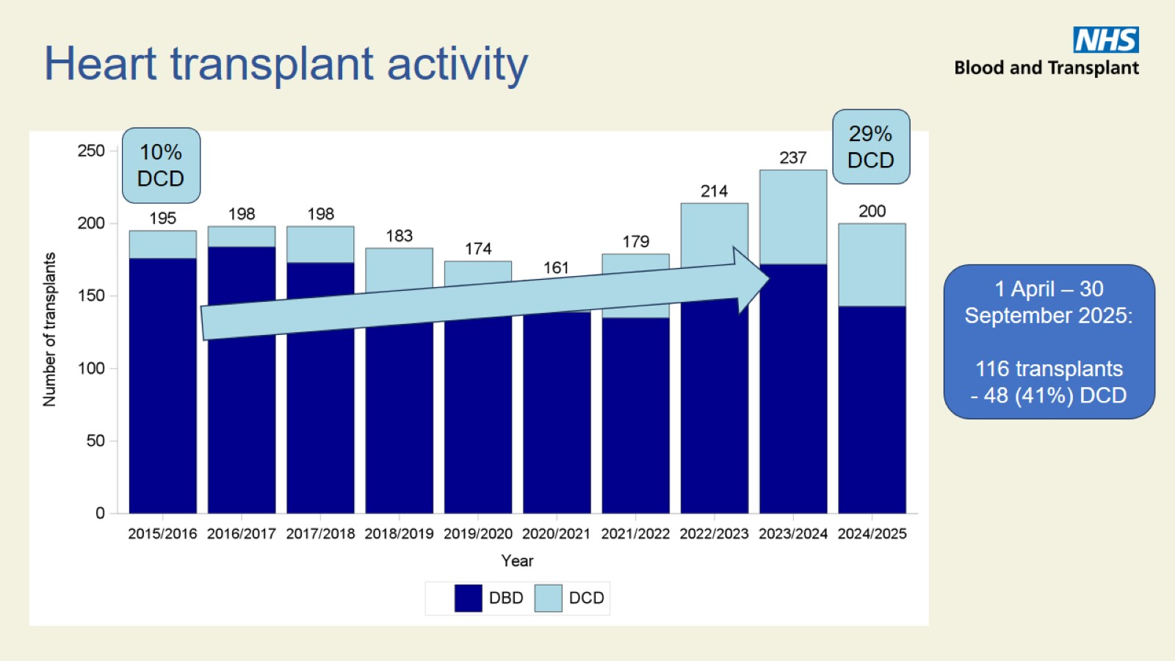
Heart transplant activity

Slide 21
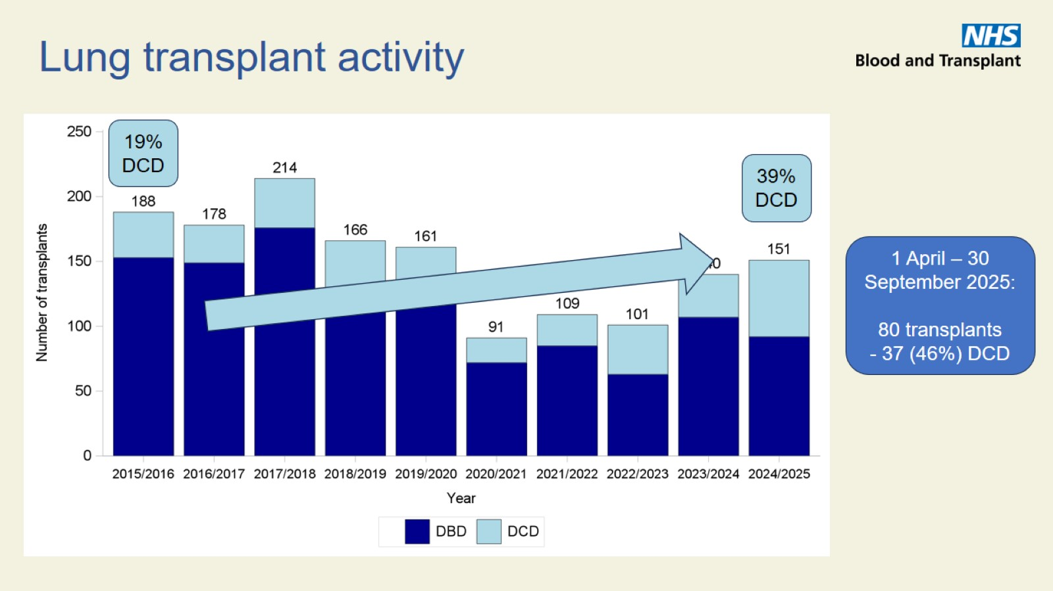
Lung transplant activity

Slide 22
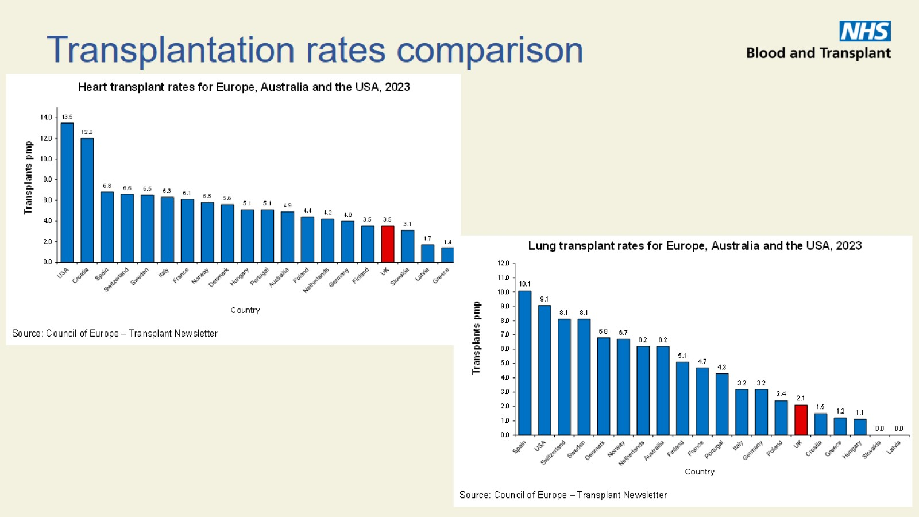
Transplantation rates comparison

Slide 23

Transplant outcomes

Slide 24
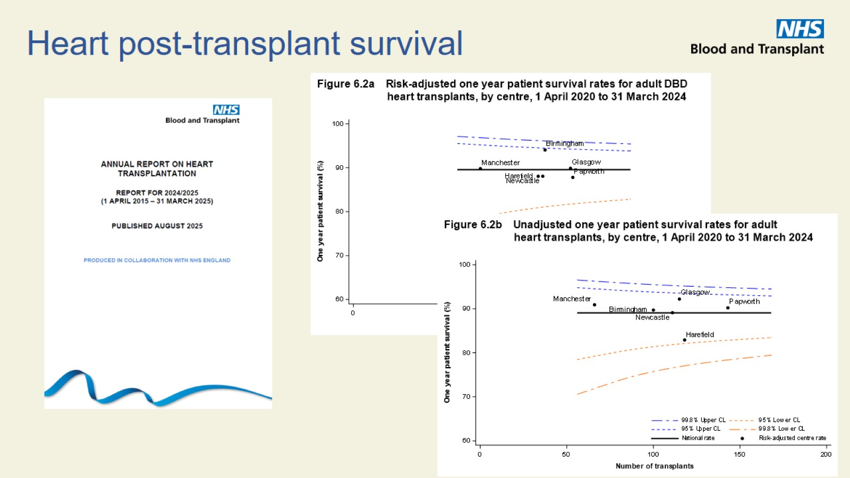
Heart post-transplant survival

Slide 25
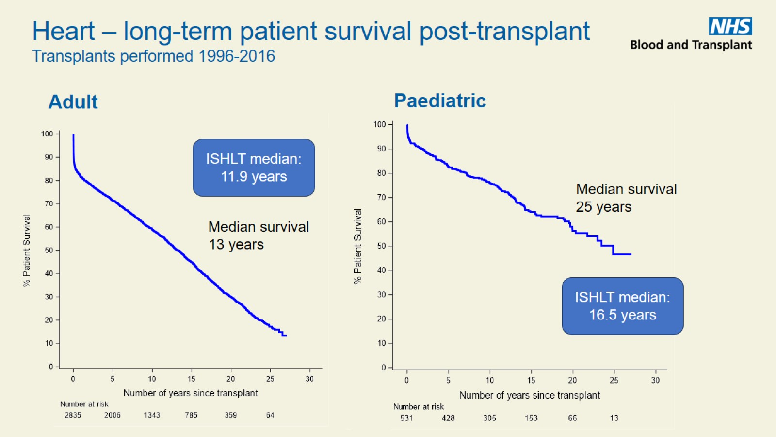

Slide 26
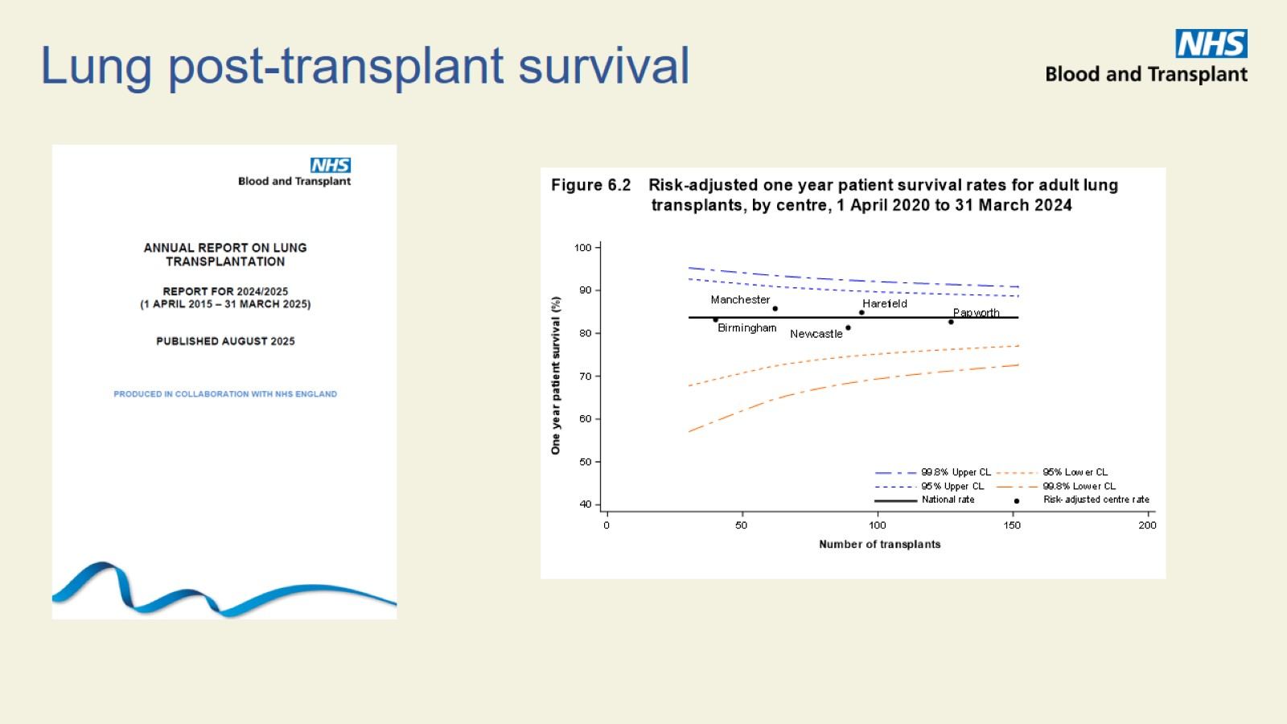
Lung post-transplant survival

Slide 27
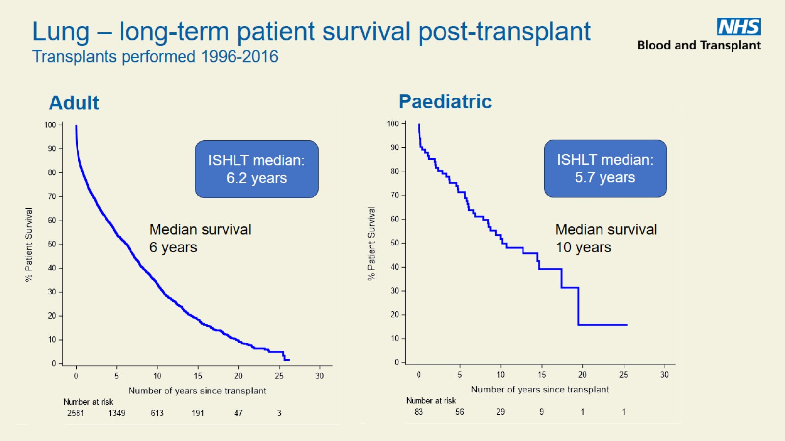

Slide 28

Key messages

Slide 29
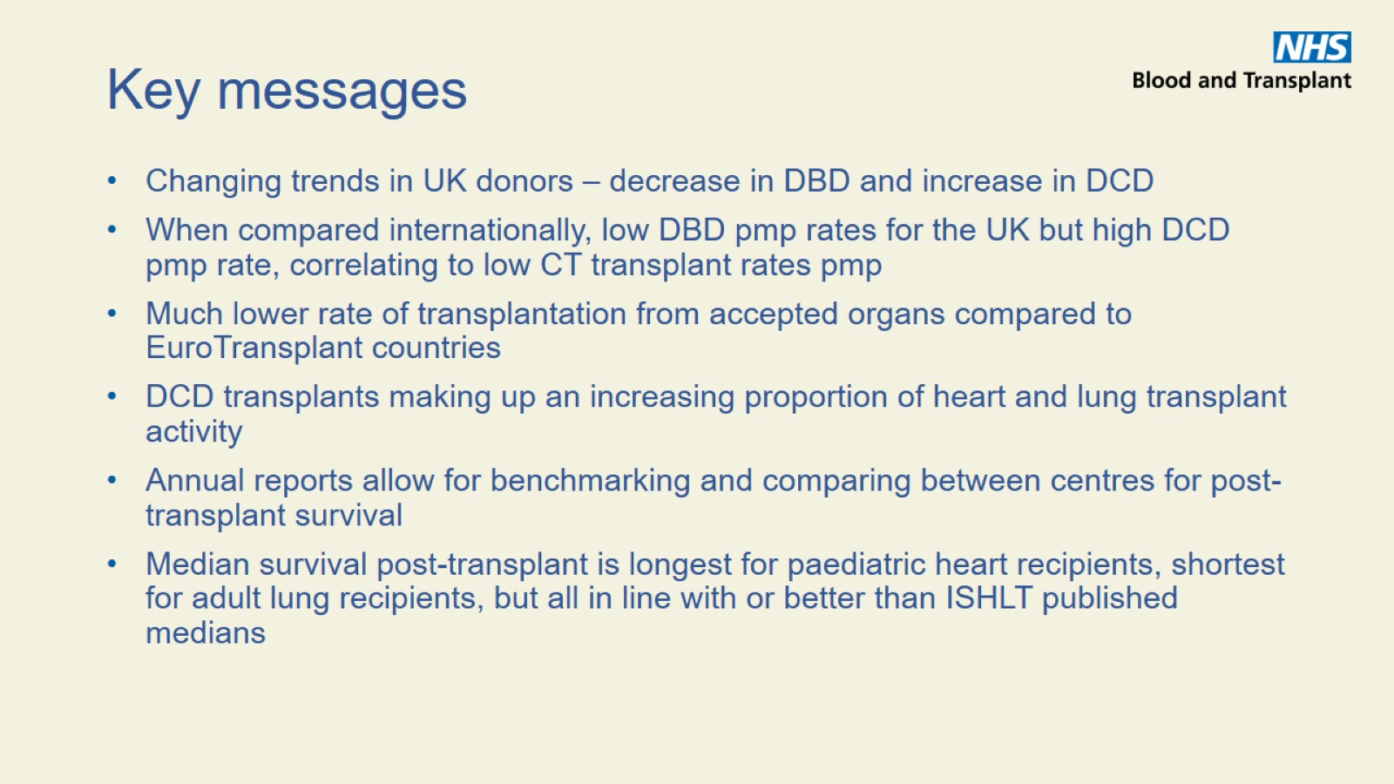
Key messages

Slide 30


