Slide 1


Presentation 2: What knowledge, skills and processes are needed to facilitate eye donation (ED) in your Hospice?
Notes:
This presentation talks you through the steps to identify potential donors, raise the option of eye donation in your conversation with patients and refer patients to the National Referral Centre.

Slide 2

Identifying potential donors
Contraindications to Eye Donation
Malignancies
Leukaemia
Lymphoma
Myeloma
Metastatic Malignant Myeloma
Brain Malignancy with ocular involvement
Malignant tumours of the anterior segment of the eye
Retinoblastoma
Neurodegenerative Disorders
vCJD or other prion disease
Diagnosed Parkinson's Disease
Diagnosed Alzheimer's Disease
Recent onset of memory loss that cannot be explained
Diagnosed Dementia
Diagnosed Motor Neurone Disease (MND)
Diagnosed Multiple Sclerosis (MS)
Infections
Current viral Hepatitis (B, C or E)
HIV Infection
Systemic Fungal Infection
Other
Corrective laser surgery (if aged under 55 years)
previous organ transplant (heart, liver, kidney, pancreas, lungs, bowel)
Any recorded non-prescriptive IV drug use (ie drugs of addiction) in the past 12 months
Best practice recommends that ALL patients are assessed for their potential to be an eye donor against the eye donation (ED) criteria BEFORE the option of ED is raised with them.
Discussing each patients’ eligibility at your MDT meetings is also good practice.
Use the ED Eligibility assessment checklist to undertake this assessment
Notes:
Eligibility for eye donation is assessed against criteria specified by NHS Blood and Transplant Organ & Tissue Donation & Transplantation (NHSBT-OTDT)
The criteria illustrated on this slide are some of the contraindications barring the use of eye tissue in transplant operations.
If your patient has any of the contraindications listed, then the patient is ineligible for referral for ED (Eye Donation).
Assessing a patient against the current criteria means that those patients who are not eligible for eye donation should not be approached and requested to consider it (therefore avoiding disappointment at being asked and then not be eligible).
Knowing these criteria also means that if the patient or family member raises the issue of eye donation with you, you can explain why they are not suitable.
Assessment outcomes can then be discussed in your regular MDT (multidisciplinary team) meetings so that any known views regarding donation that might have been shared with other team members (but are not recorded) can be established.
We have generated an easy-to-use eye donation eligibility assessment checklist, which asks you to determine whether any of the contraindications are present in the patient's medical history, followed by a submit request to decide if the patient can or cannot be referred for donation assessment.

Slide 3

Speaking to patients about eye donation: best practice.
Discussions about ED should take place as part of usual end-of-life care planning conversations.
Reassure the patient that they do not need to make a decision straight away.
Under the legislation your responsibility is solely to establish the decision of the patient regarding the option of ED (not to convince or persuade anyone) and to record that decision in their notes.
Please see the short film accessed via this link (https://youtu.be/tgUWnOxeyvI)
where a currently practicing clinician raises the topic of ED with a simulated patient.
Notes:
Conversations about the option of eye donation can be included in your usual planning conversations with patients. To give you some ideas of how this can be achieved we have generated a short video of Dr Sarah Mollart, Consultant in Palliative Medicine, talking you through her practice in raising the option of eye donation with patients under her care. A link to this video is available here.
A key point to make here is that it is not your responsibility to persuade, or convince patients to agree to eye donation, for those who are eligible following assessment, your responsibilities are to
Establish their decision regarding eye donation and
To record that decision in their notes.

Slide 4

What can help patients at this time?
Be aware of what is required of the patient and family in agreeing to ED.
Please encourage patients to share their decision with their family as their family will be requested to agree for eye donation to go ahead after their death
Offer to talk to the patient’s family members if they and the patient would like to have more information about eye donation.
  Providing leaflets about ED is also good practice as this can stimulate discussions and answer questions.
  The leaflets also include the contact details of NHSBT-OTDT
  Leaflets and other helpful guidance can be gained by following this link (https://www.nhsbt.nhs.uk/how-you-can-help/get-involved/order-printed-materials/)
Notes:
In agreeing to eye donation, the patient is agreeing for both their eyes (the whole eye) to be retrieved.
Encouraging the patient to share their decision if they have not already done so is helpful as the patient may not know that their next of kin/family will be asked questions about their health and asked to consent to the eye donation proceeding.
Providing information leaflets is evidenced in research as being helpful to both patients and family members, as they stimulate discussions, answer questions, and have the contact details for the NRC.
Leaflets can be ordered from NHSBT-OTDT via the link on this slide and from the Regional Tissue Donation Nurse Specialist Team.

Slide 5
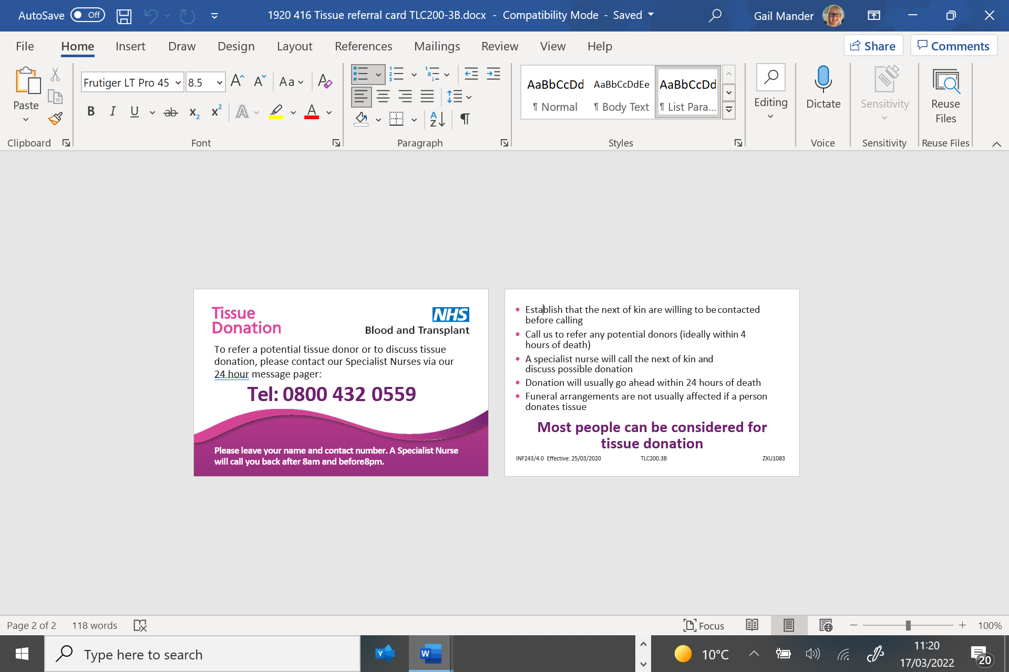
Next steps: Recording outcome of discussion
Please record the patient's decision about ED in their notes.
By recording the decision of the patient, you are complying with the Deemed Consent Legislation.
If the patient will be returning home please provide them with the contact details of the National Referral Centre and request that this is included with other documentation outlining the patient's wishes about their end-of-life care.
If the patient is expected to die in the hospice, please follow the process outlined over the next slides
Notes:
Please ensure that you have recorded the patient’s decision (shared with you), in the patients notes. By discussing eye donation and recording the patient’s decision you are complying with your responsibilities under the deemed consent legislation.
If the patient is not expected to die at your hospice, please provide them or their family with the NHS Blood and Transplant (NHSBT) contact card - illustrated on this slide, which gives them the contact details of the National Referral Centre. Encouraging the patient and family to keep this card with any other documents they have regarding the patients end of life wishes will mean that it is to hand when they need it.
If the patient is expected to die in your hospice, please follow the process outlined over the next slides.
5

Slide 6
Contacting NHSBT–OTDT and referring the patient.
  Please refer the patient as soon as possible after death
  To refer a potential eye donor, or to gain advice regarding whether a patient is a potential eye donor, call the National Referral Centre on 0800 4320559.
  You will get a voicemail.
  Leave your name, hospice name, and a telephone number on which someone is available who can answer questions about the deceased patient, and who has access to the patients notes.
If you refer a patient between the hours of 8am - 8pm a Specialist Nurse will call you back within 20 minutes.
If you refer a patient between 8pm - 8am details will be taken and a Specialist Nurse will call you back after 8 am.
Notes:
Please refer the patient as soon as possible after their death as the retrieval procedure must take place within 24 hours. The contact details are on this slide and can be added to your resources.

Slide 7
Referring a patient: What information you need to have ready.
All personal details (name, date of birth, NHS Number)
Details of admission, care, medical history and provisional cause of death, including any pre-emptive conversations held with the Medical Examiner
Actual time of death
Are family aware of death? Do they support referral?
Next of kin contact details
Funeral Directors contact details if patient is to be moved there and when they will be moved (if available).
Notes:
This slide outlines the information you need to have to hand when you receive a call to assess a patient for donation by the NRC.

Slide 8
Referring a patient: Judicial Process
  Every referral will be assessed against the need to obtain a lack of objection for donation from the Coroner’s Office. In most cases, this will mean a discussion with the local Medical Examiner to determine if the Coroner’s Office should be informed of the death.
  In cases where the Medical Examiner cannot be contacted, you may be asked, to the best of your knowledge and belief:
What is the proposed cause of death?
Is the responsible clinician (named doctor) aware of any reason for a referral to the Coroner Office?
Have any clinical concerns around care been raised?
Have any family concerns around care been raised?
Notes:
Since April 2025 it has been mandated that all deaths that do not require Coroner referral must be referred to a Medical Examiner for post-mortem scrutiny. As a standard part of the referral process, the National Referral Centre will seek to obtain lack of objection to donation from a Coroner or Procurator Fiscal in cases where these organisations will be involved in the care after death. In most cases, the NRC will liaise directly with the Medical Examiner to determine whether a person requires a referral to the Coroner and will speak directly with the Coroner when appropriate. There may be times that a referral is made where no discussion has been had with a Medical Examiner, and during the assessment the Medical Examiner will not be available to confirm that in this case the Coroner or Procurator Fiscal will not need to be notified of the death. In these cases, you may be asked the questions shown on the slide by the NRC. By answering these questions to the best of your knowledge and belief, you will support NHS Blood and Transplant as it makes the decision whether to further explore donation, to seek Coroner input, or to defer the case. In all instances, it is NHS Blood and Transplant that makes this decision; you and your organisation do not carry any accountability. Where possible, please inform the NRC as soon as possible in cases where no Medical Examiner will be available, as this will allow the NRC more time to follow their procedure to support this donation.

Slide 9
Eye Donation: Important information!
Each eye donated can potentially help up to 5 people
The whole eye is removed so that the cornea and sclera can be used in sight saving and sight restoring surgery and medical research.
Following the donation procedure, the appearance of the donor is restored by the retrieval team.
There are no restrictions to the family seeing their loved one following retrieval
The process of ED does not delay funeral arrangements
Unlike other types of tissue donation there is no strict time frame for patients to be transferred to colder care following death for eye donation
Notes:
Each eye donated can potentially help up to 5 people.
The key point to cover in any discussions is that the whole eye is removed so that the cornea and sclera can be used in sight saving and sight restoring surgery and medical research. Unlike other types of tissue donation there is no strict time frame for patients to be transferred to colder care following death for eye donation.
Following the donation procedure, the appearance of the donor is restored by the retrieval team and there are no restrictions to the family seeing their loved one following retrieval nor does eye donation (ED) delay funeral arrangements.

Slide 10
You have now completed - What knowledge, skills and processes are needed to facilitate Eye Donation (ED) in your Hospice?
Please complete the next training presentation –Who are NHSBT and what is their role in ED
A certificate of completion will be available when all slide sets and flash quiz 2 have been completed.

