Slide 1

Missed Opportunity Review Process at SASH
CLOD Induction October 2025
Dr Alice Myers – CLOD for Surrey and Sussex Healthcare NHS Trust

Slide 2
New CLOD challenges
Established practice
Identifying the barriers to donation
Knowledge?
Operational issues?
Capacity within the system?
Individual beliefs?
Do you need a culture change?
How do you tackle this?

Slide 3
Welcome to being CLOD…
Day 1 as CLOD (June 2023) – missed opportunity
  Fit and active 76 year old
  Catastrophic intracranial haemorrhage
  No neurosurgical intervention appropriate
  Intubated and stable in ED
  Patient had signed donor register several times
  Family keen on donation and aware of patient’s wishes
  Consultant spoke with family and extubated in ED resus to avoid prolonging further suffering

Slide 4
Tricky
Brand new to role!
How to challenge established practices
Avoid conflict AND PROMOTE LEARNING

Slide 5
Aims
Clear documentation
Prove I’m doing my job!
Keep good records
Transparent process
Fair
Useful
Avoid blame / victimisation
Whole team understand process and rationale
Identify learning points
Identify barriers to donation
Identify misunderstandings
Facts vs opinion vs personal beliefs vs guidelines
Generalizable learning points
Improve communication
Track progress
Structured

Slide 6
Process overview
Stage 1
SNOD alerts CLOD
CLOD gathers facts and contextual information
  Medical records, SNOD records, other colleagues, ICU bed status, skillmix / locums
CLOD contacts those significantly involved
  Collaborative completion of proforma during meeting
CLOD drafts document – share with SNOD
Confidential Report to MD, SNOD, OD Chairperson, RCLODs
[If no response to requests for meeting – Medical Director assists]
Stage 2
Separate Learning Points & Guidelines document circulated widely
Present Learning Points at Clinical Governance, teaching, etc

Slide 7
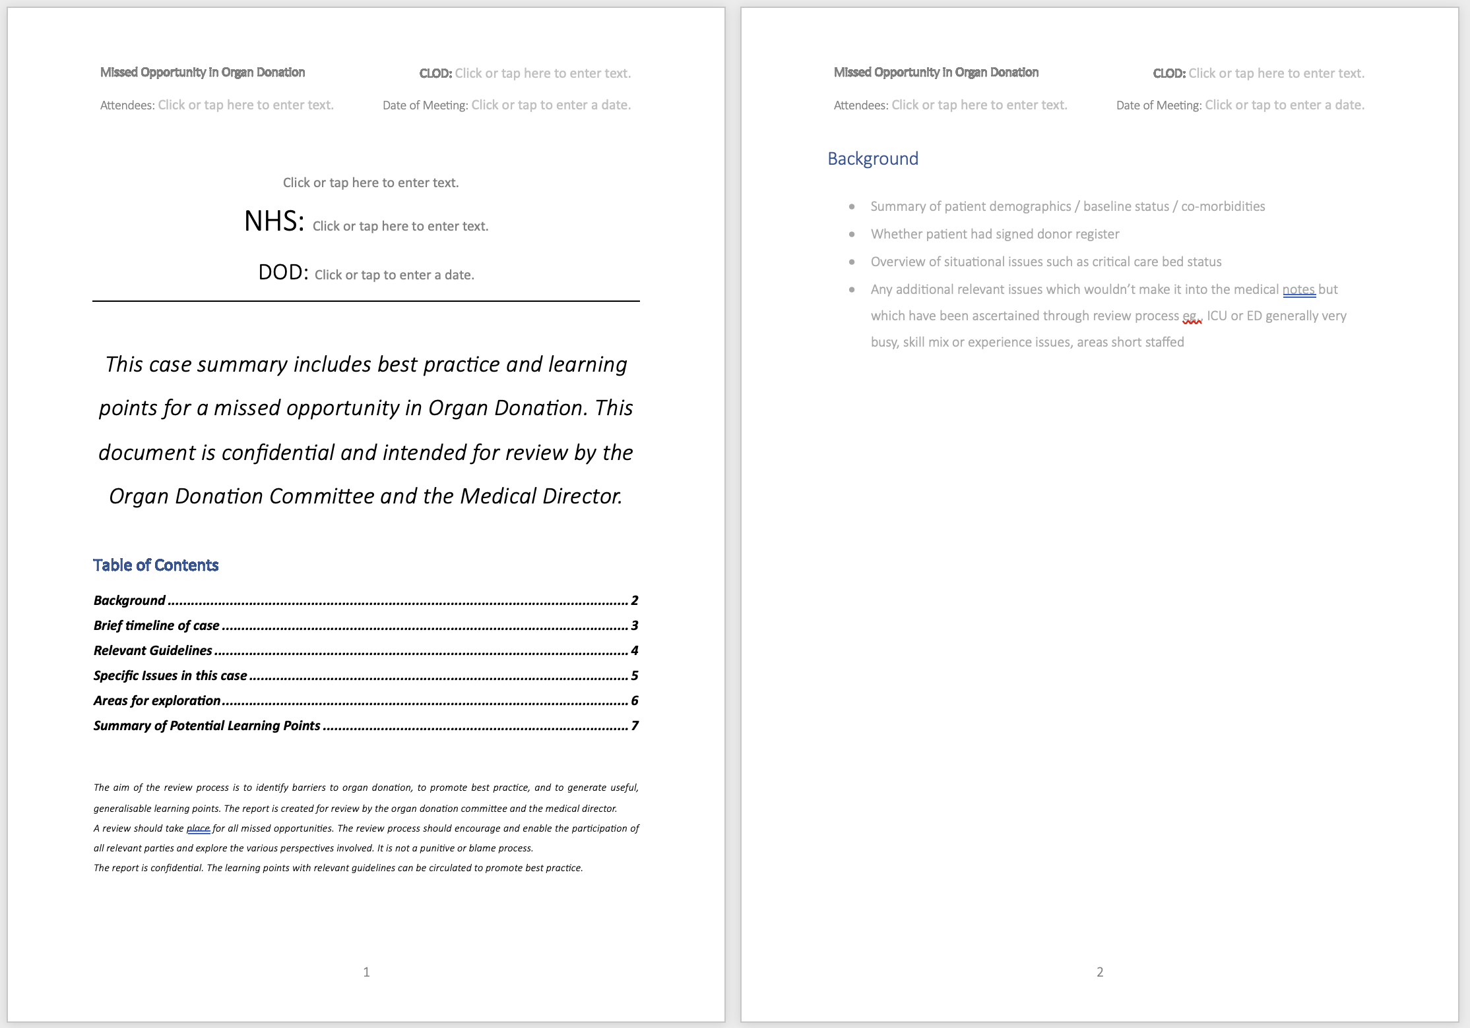

Slide 8
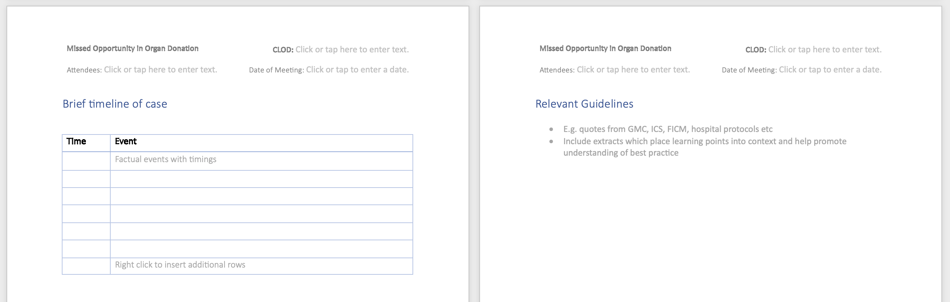

Slide 9
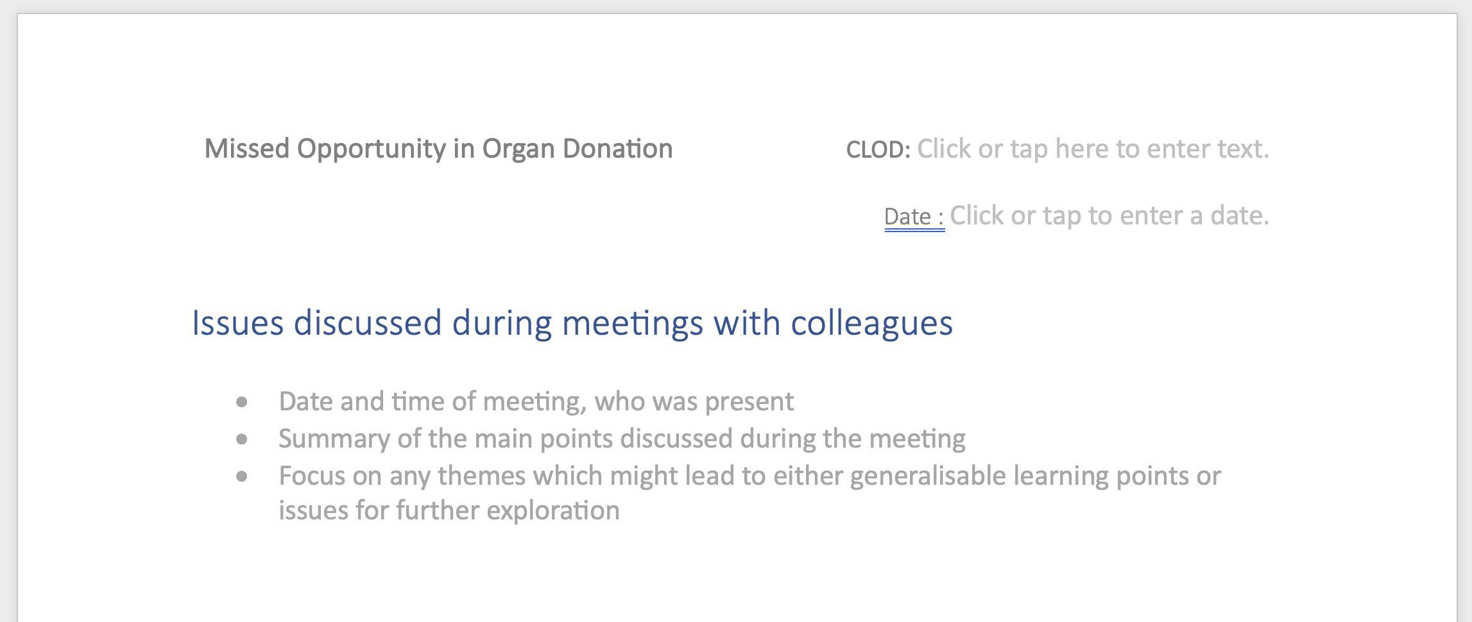
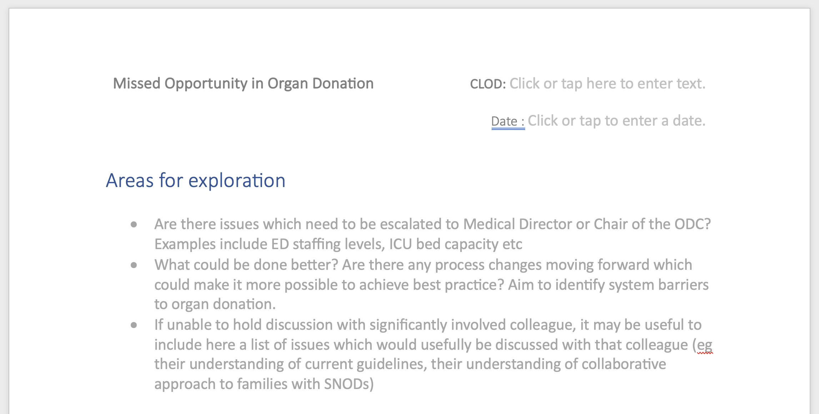

Slide 10
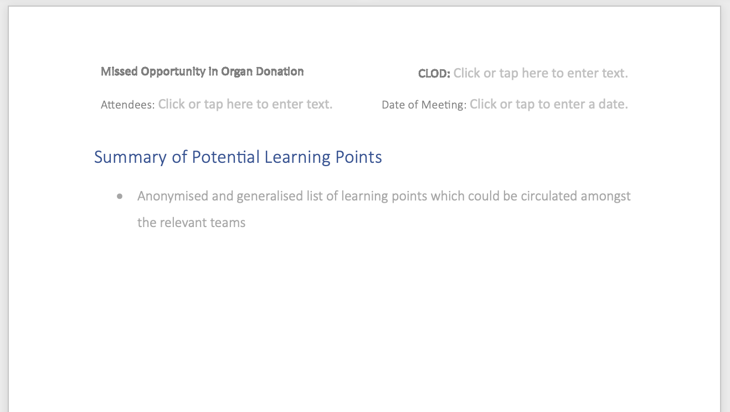

Slide 11
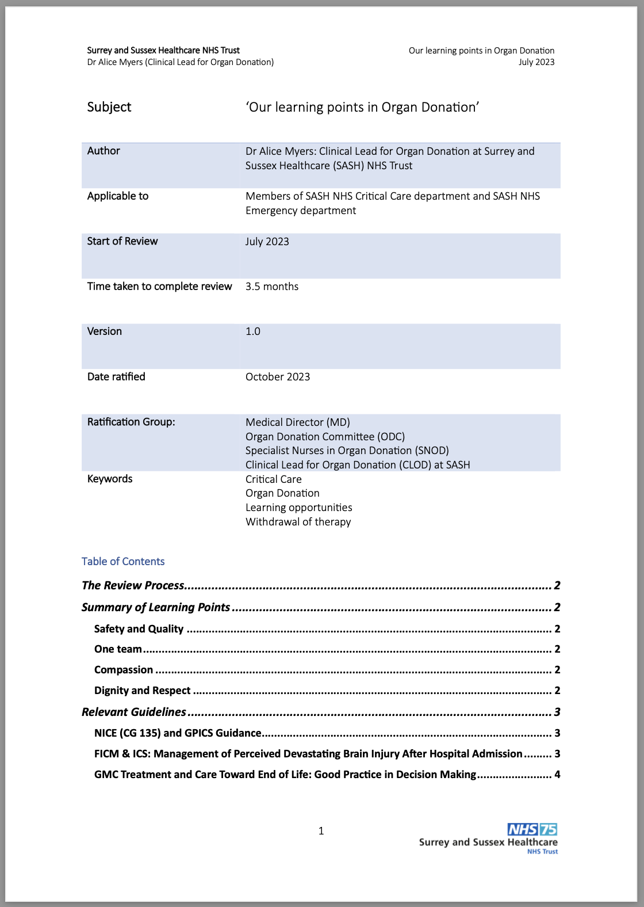
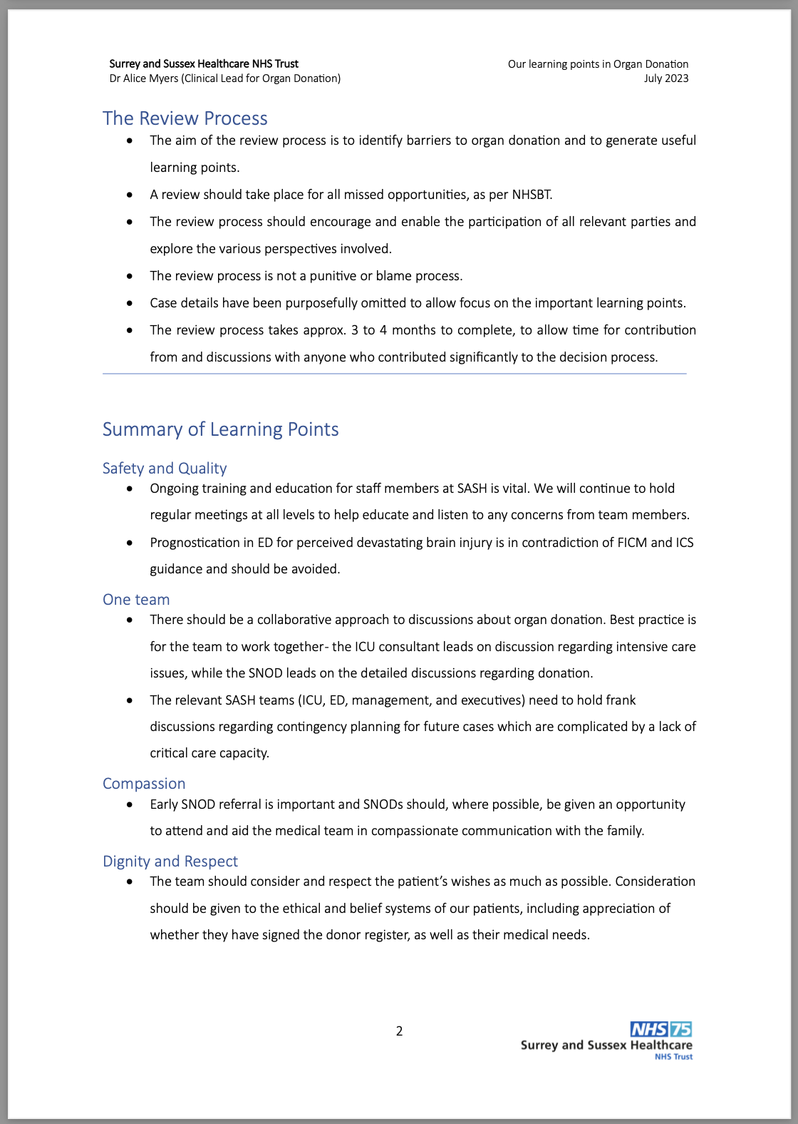
Learning Points document – for general circulation.
Section 1

Slide 12
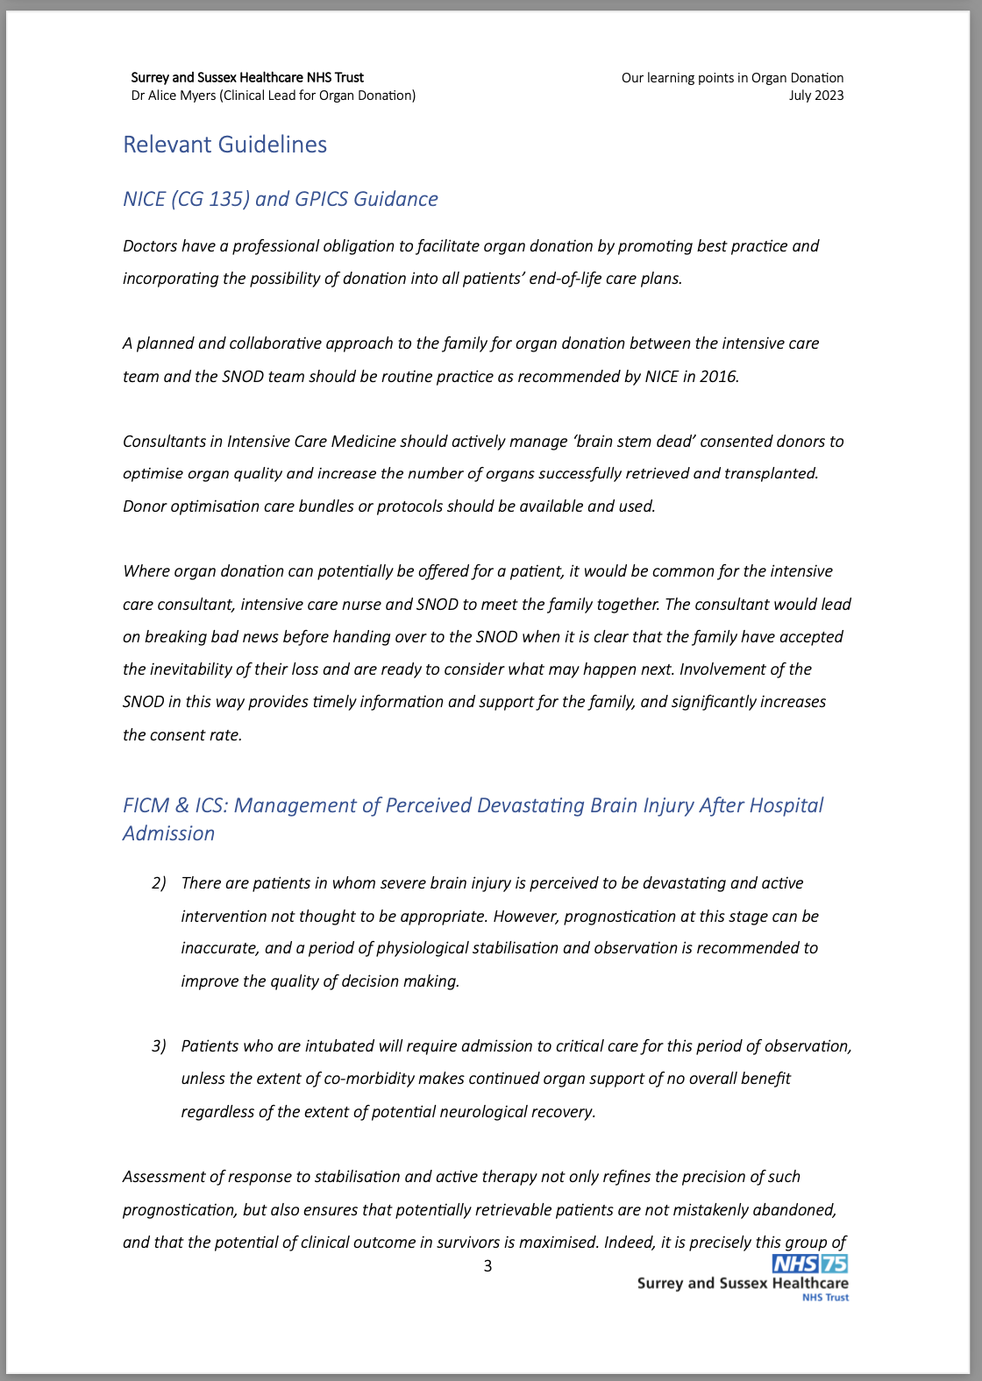
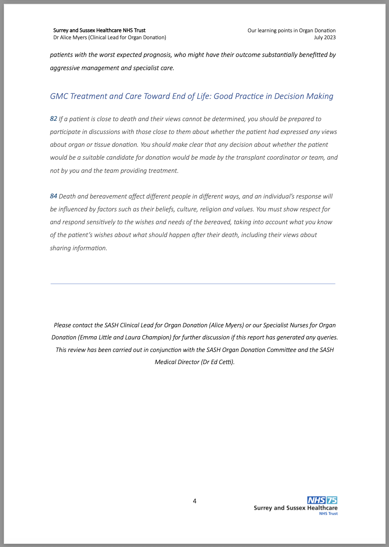
Section 2 - Guidelines

Slide 13
Reception
4 reviews so far
1 person fully engaged – found process very useful
3 reviews with 1 colleague, not engaged – handed to MD
SNOD team
Find it valuable
Consultant team
Mostly open and receptive
Wider team
Very receptive
Happy to hear learning points
MD
Pleased to see progress and evidence
Personally
Value structured process and record
Platform for challenging conversations

Slide 14
Outcomes – Positive culture change
Reduced number of missed opportunities
Improved communication
Identified areas requiring focus
Need for updates re guidance
ICU and ED
Personal views / ethical discussions
Improved education and support for the team and better engagement
Theatres
Open discussions
SNODs now welcomed as part of team
Earlier referrals
Organ and tissue donation integrated as good end of life care
Last financial year, one of only 3 Trusts in South East to have no missed opportunities (previously one of the worst!)
Individuals feel invested
Everyone more up to date
Organ and tissue donation at forefront
Positive reinforcement
Improved experience for SNODs

Slide 15
Sharing learning
Please share your learning
Please share your feedback on the process / proforma

Slide 16
Special thanks to….
Laura Champion
Emma Little
Jill Featherstone

Slide 17

Any questions?

