Slide 1


CLOD Induction
Dr Omer Aziz
National Paediatric Clinical Lead for Organ Donation

Slide 2
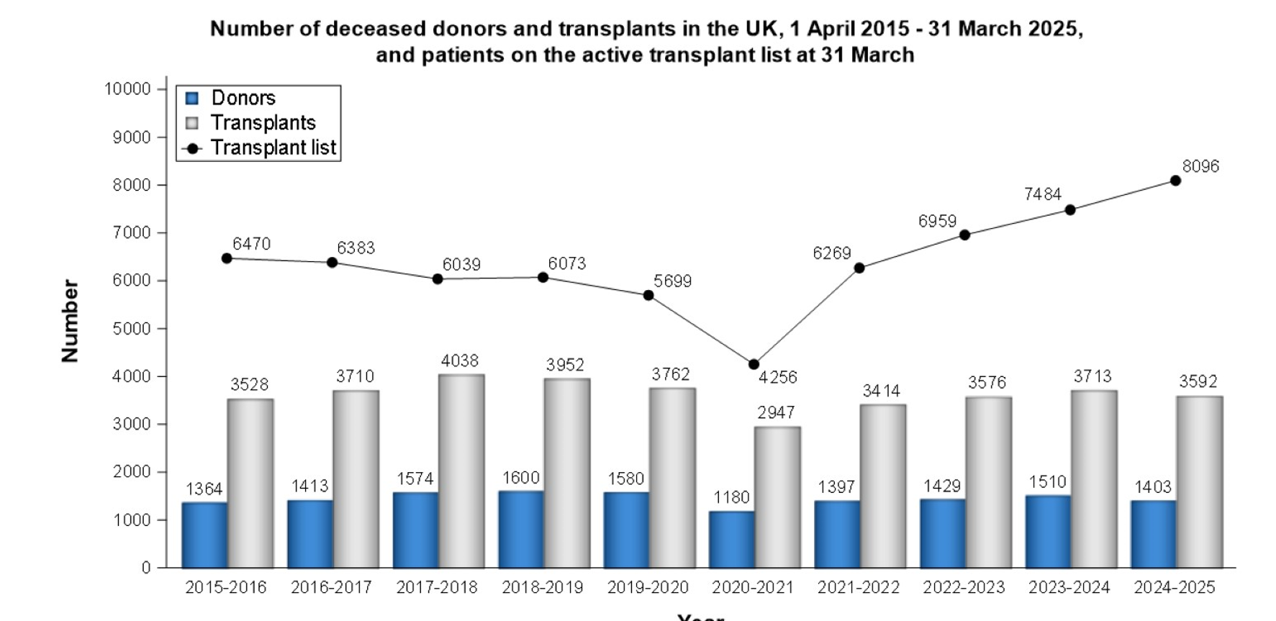

Slide 3
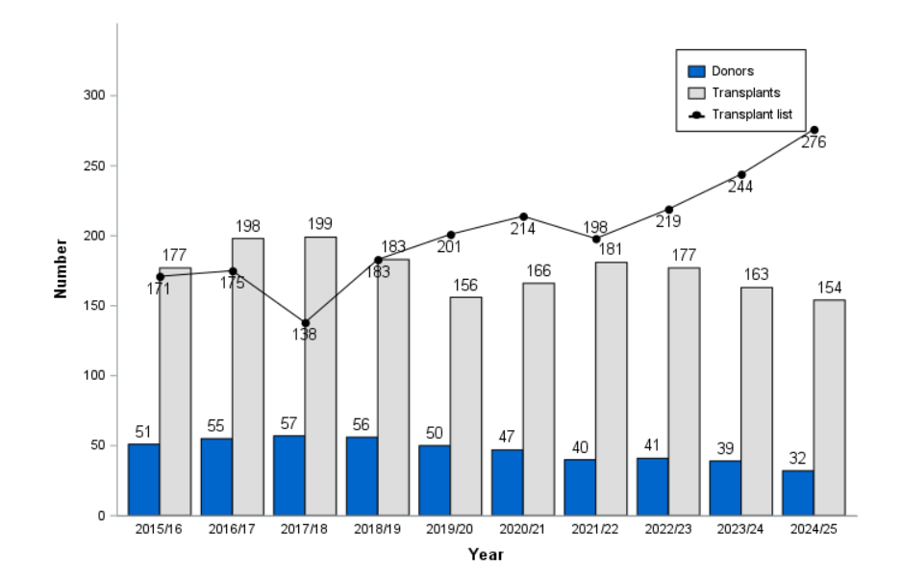

Slide 4

Paediatric DBD Consent / Authorisation
Paediatric DCD Consent / Authorisation

Slide 5
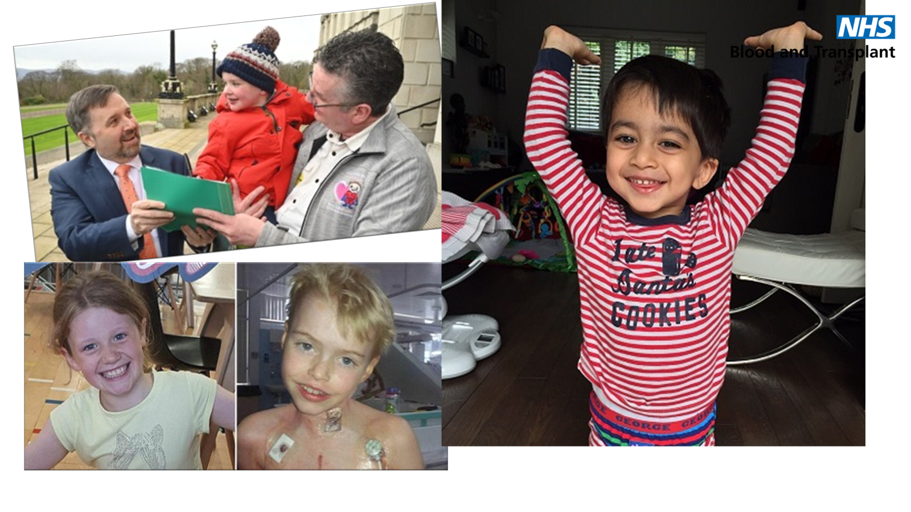

Slide 6


Slide 7
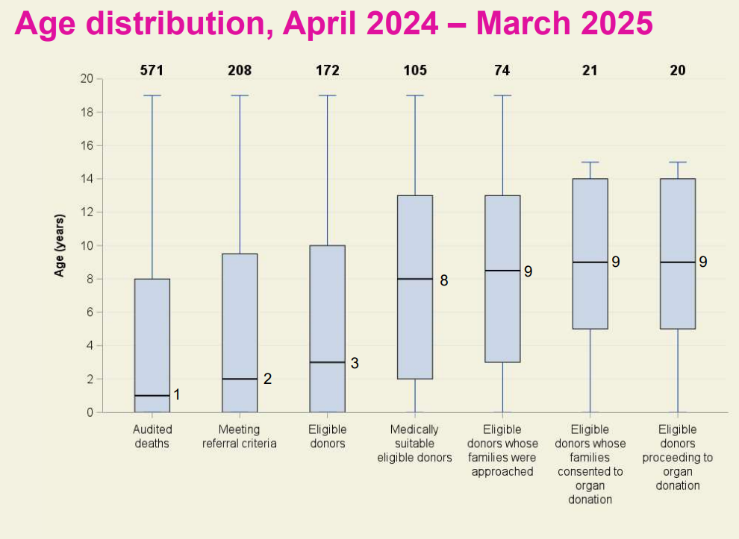

Slide 8
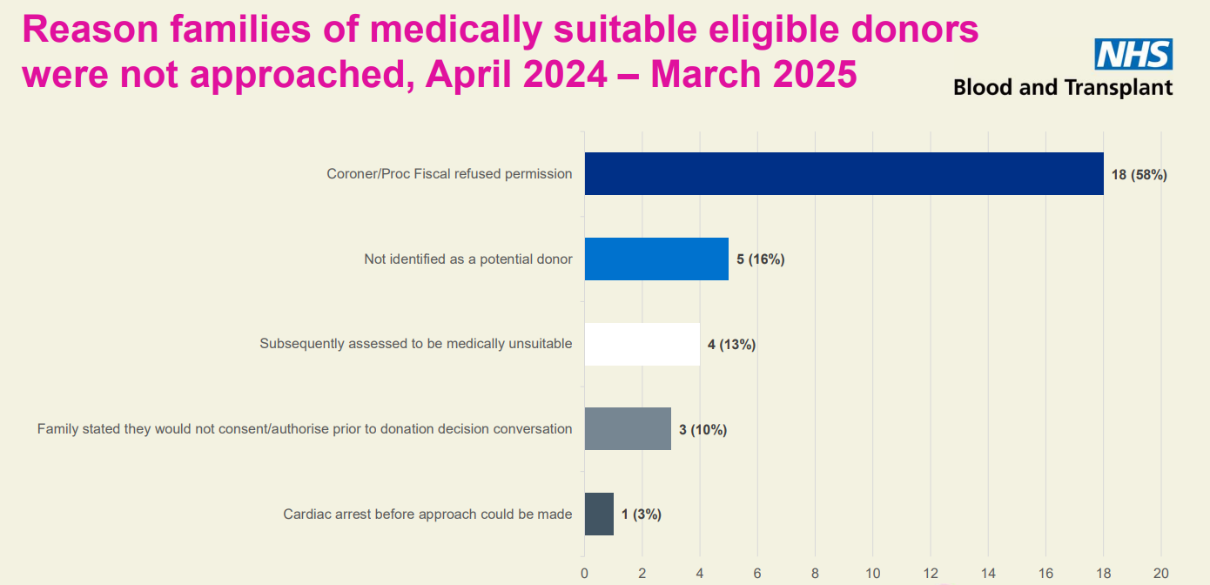

Slide 9
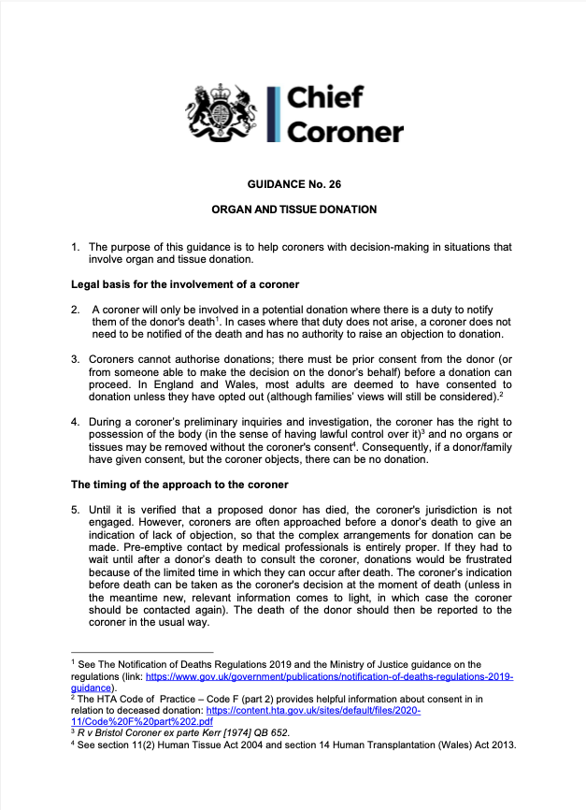
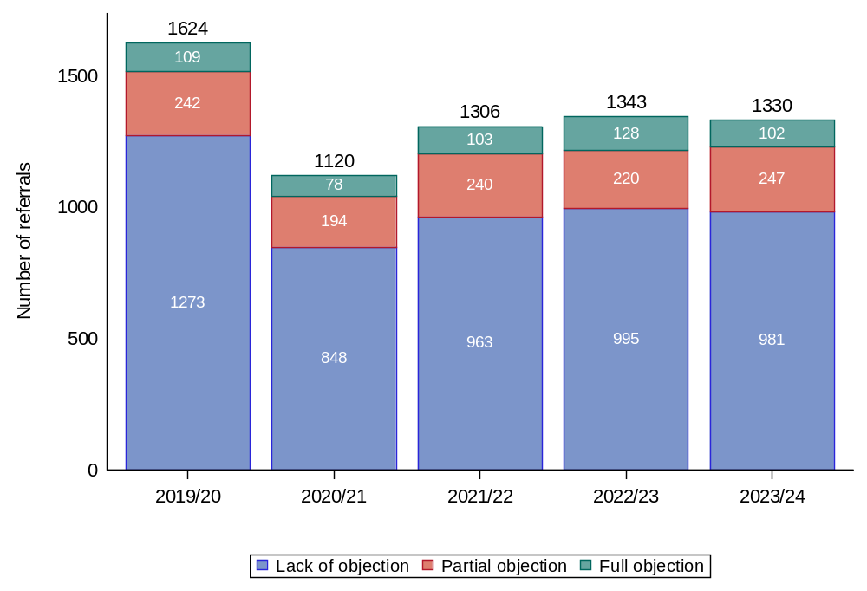
Number of referrals requiring Coroner/Fiscal permission and level of permission was granted, 1 April 2019 to 31 March 2024.
2023

Slide 10
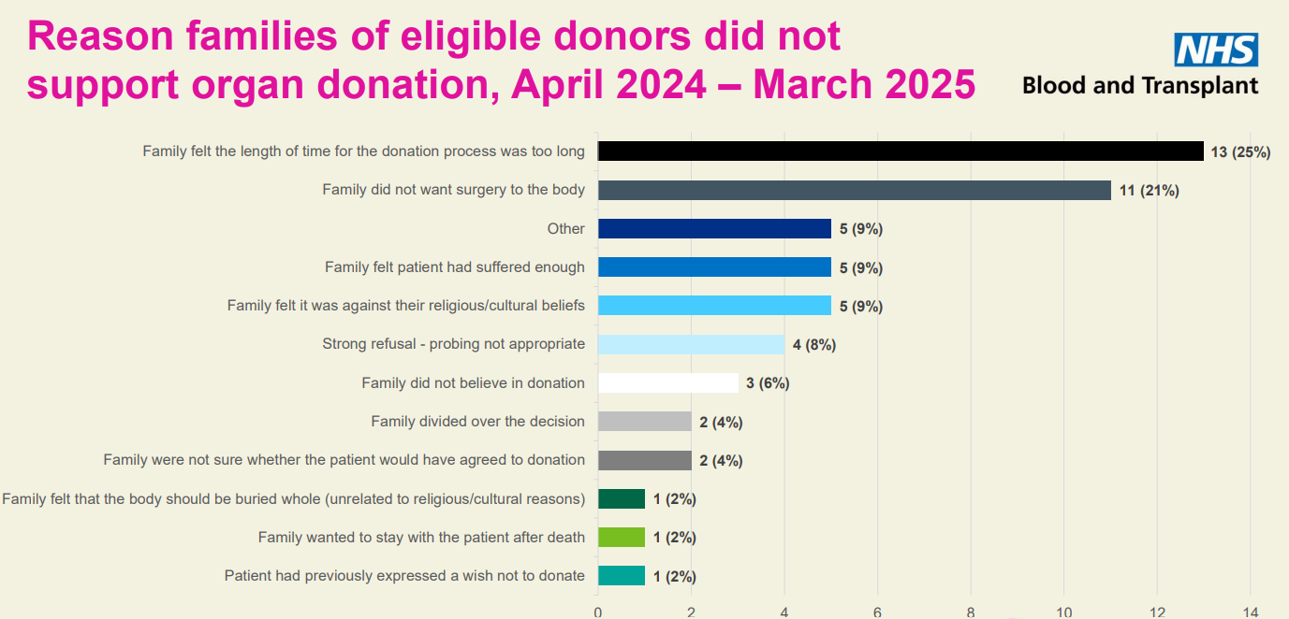

Slide 11
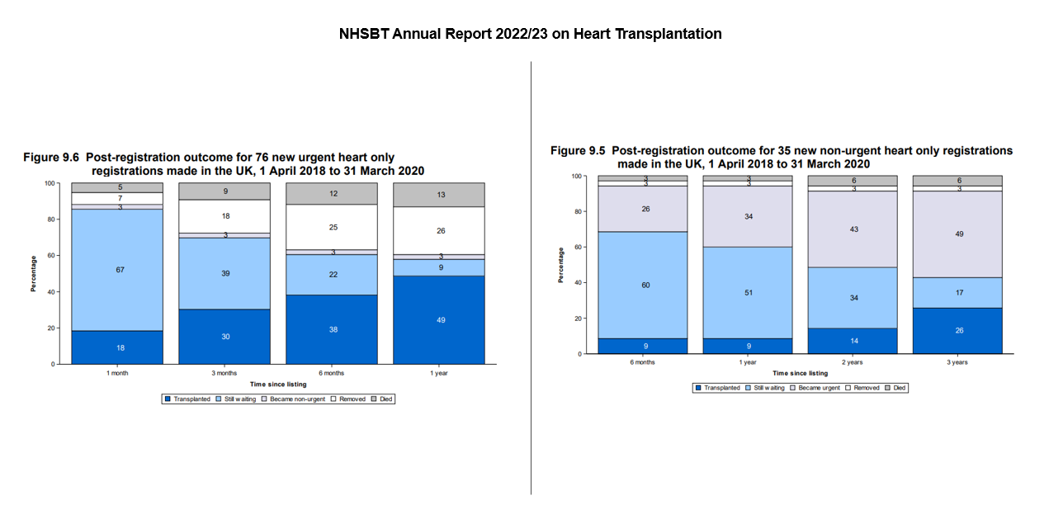
Notes:
We know that children waiting for a cardiothoracic organ wait at least 3 times the time as an adult who is waiting for a cardiothoracic organ.
For a child listed non-urgently in the UK, less than 10% are transplanted by one year. Six months after being listed urgently there is 33% chance of a child receiving a transplant. We all know the longer anyone is waiting for an organ, the more co-morbidities they are likely to acquire. We often hear about how the VAD program is at capacity. The reality is that there are many patients like Angus. The conference has heard the exceptional and much needed work that Louise Kenny and colleagues are doing in Newcastle to progress a DCD heart transplantation program. This needs support, funding and progression through the appropriate regulatory authorities. The reality is that there is a small pool of potential donors, so the demand for organs will always outweigh the need for organs, so it is incumbent on us as healthcare professionals to ensure that we offer organ donation as an option for end of life care. It is incumbent on the purse string holders to invest in children's transplant programs. There are many more patients and families that have been through similar journeys to Angus, affected by end organ failure and never end up receiving a transplant. Sadly, this effects patients waiting for every kind of transplant, not just cardiac. This is our collective challenge.

Slide 12
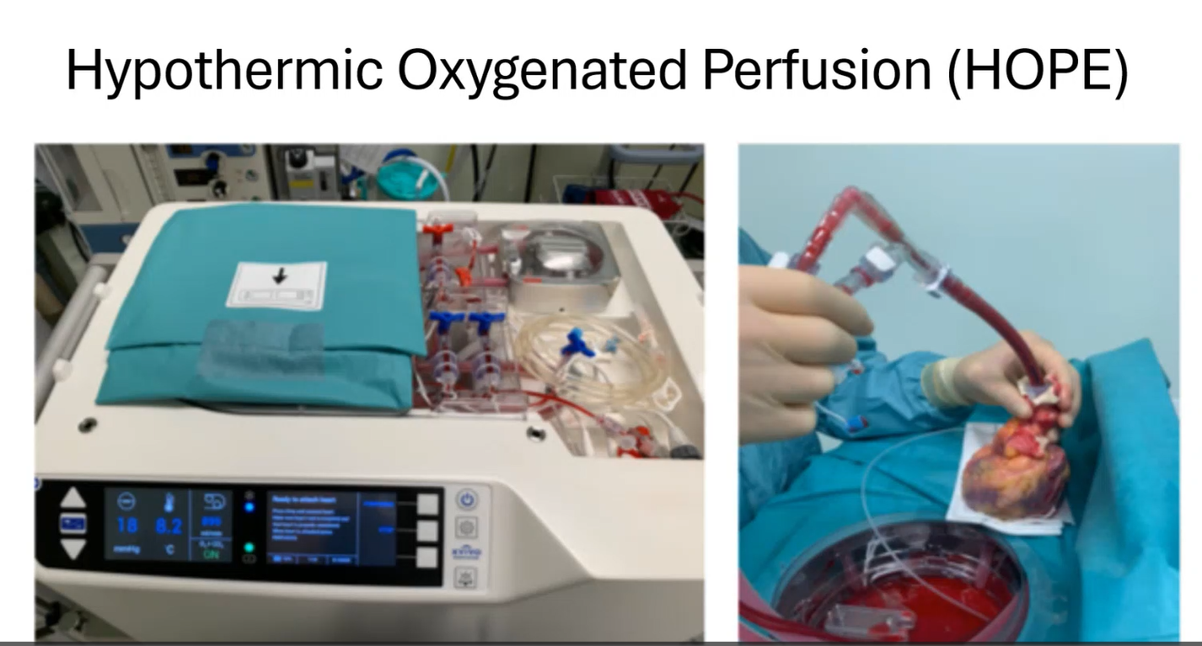
Louise.kenny4@nhs.net

Slide 13

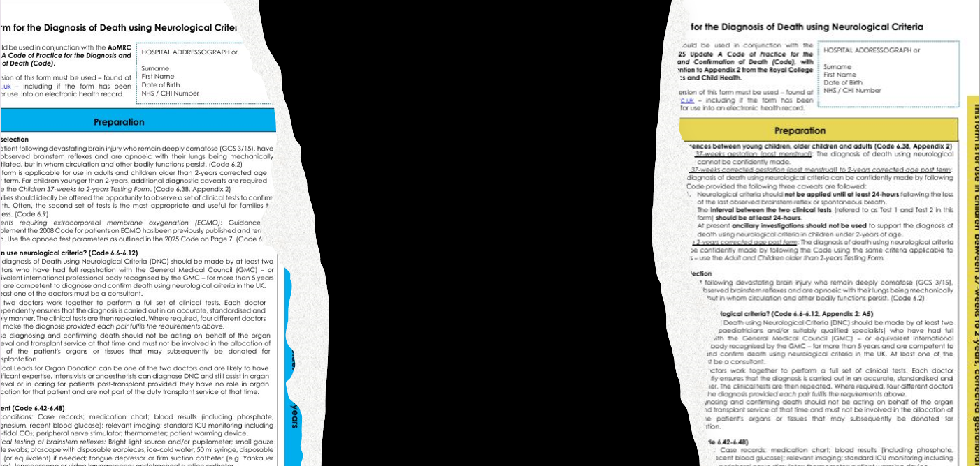

Slide 14
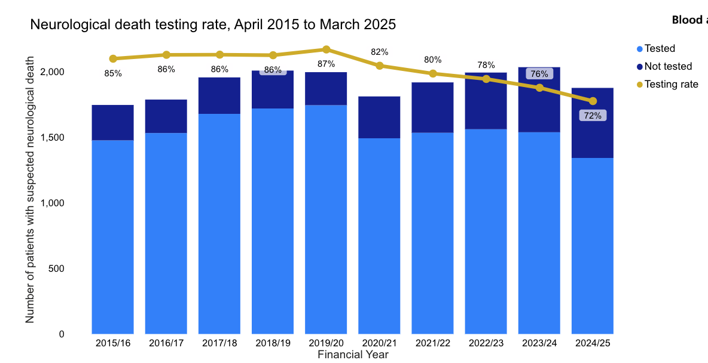
Estimating
impact on donation
‘all else equal’
2023/24 testing rate
75% = est. +25 donors
2019/20 testing rate
87% = +140 donors
87%
72%

Slide 15
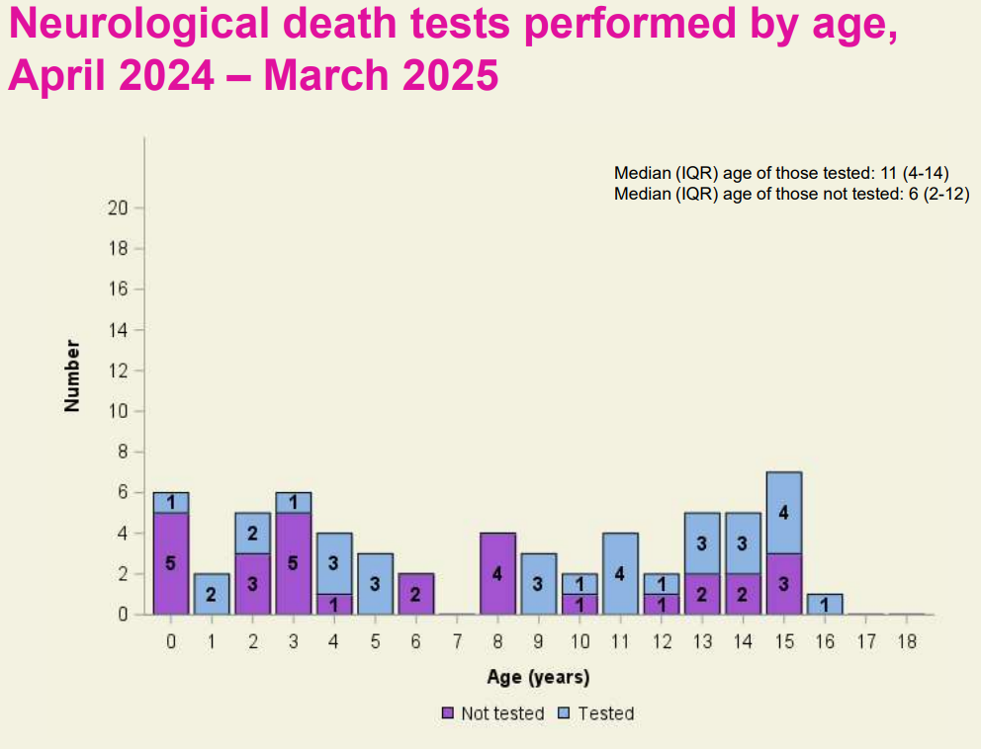

Slide 16
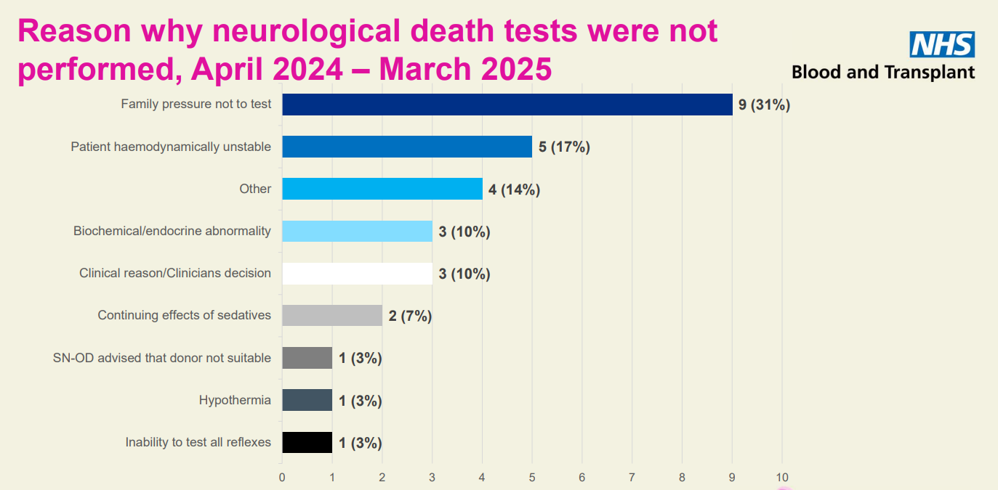

Slide 17
Testing rates since the introduction of new guidance: 1st January – 31st August
2024

Slide 18
Questions/Comments

