Slide 1

Sustainability and Certainty in Organ Retrieval (SCORE)
Shadow Modelling Summary Apr-Jul 2025

Slide 2
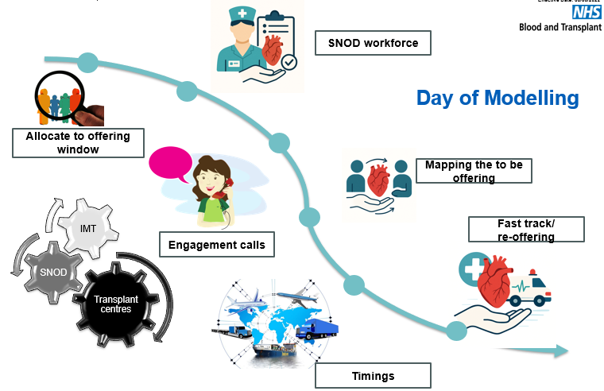
Planned Arrival Window (PAW)
Shadow modelling
Aims
Test viability of proposed PAW timings in real time
Understand the operational considerations across the pathway by involving operational colleagues
Identify barriers or issues which could impact implementation
Build confidence in the system’s readiness for change

Slide 3
PAW Shadow modelling – Headlines
8 April – 24 July 2025
33 days
145 Donors
145 Abdo attendances
54 CT attendances
500 organs accepted
433 abdominal
67 cardiothoracic
99% donors attended in the first PAW
No back-to-back retrievals
Of the 16 occasions (11%) donor registered 0800-1600 in PAW+
12 occasions (75%) facilitated that night
Of the 4/16 PAW+ not able to be facilitated that night
3 CT (2 DCD H)
1 Abdo
95% NORS teams arrivals between 2000-0300
8% (11 donors) priority pathway donors
9 with SU liver recipients
2 required daytime retrievals
69% all organs arrive 0600-1000
67% abdominal
85% cardiothoracic
Notes:
Deliberately targeted busy periods

Slide 4
Novel Technologies
DCD Heart teams attended 18 donors
(27% of all CT attendances)
1 DCD Heart family withdrew consent due to time frames
2 donors could not be considered in PAW+ due to multiple DCD H activity
NRP teams attended 27 donors
(19% of all Abdo attendances)
DCD Heart and NRP combined on 3 occasions

Slide 5
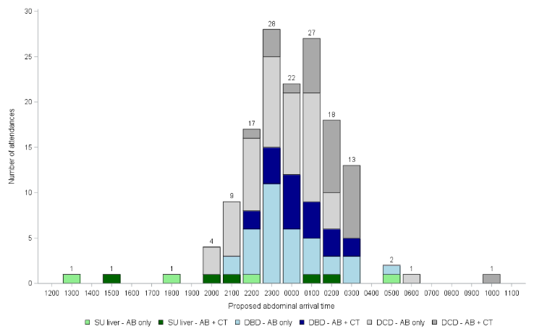
Simulated NORS team arrival time by donor and attendance type

Slide 6
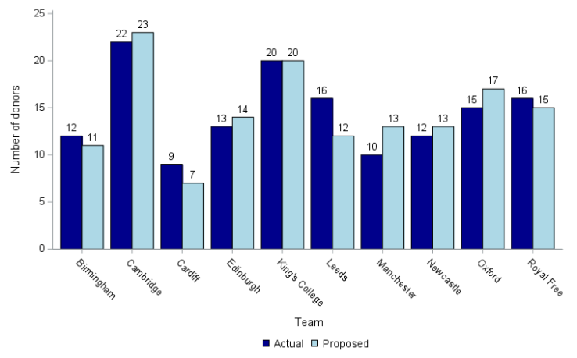
Actual and simulated abdominal NORS activity
Notes:
When comparing how the mobilisation of NORS teams differed under the proposed modelling, for the abdominal attendances the team would have been the same in 75 (52%) of cases

Slide 7
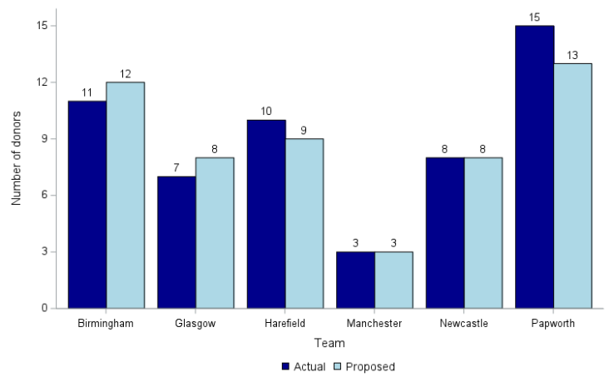
Actual and simulated cardiothoracic NORS activity
Notes:
When comparing how the mobilisation of NORS teams differed under the proposed modelling, for the cardiothoracic attendances the team would have been the same in 48 (89%) of cases

Slide 8


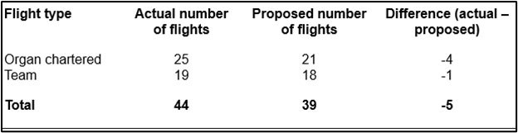




Example – NORS and organ travel requirements for 24hrs
Flight impact
LEGEND
ABDOMINAL TEAMS
CARDIOTHORACIC TEAMS
RENAL + PANCREATIC ORGANS
LIVER + BOWEL ORGANS
CARDIOTHORACIC ORGANS
NON-PROCEEDING DONORS
Aim - Better use of resources
Overall an 11% reduction in flights
ABERDEEN
GLASGOW
EDINBURGH
NEWCASTLE UPON TYNE
BELFAST
LEEDS
BOLTON
OLDHAM
MANCHESTER
BIRMINGHAM
LEICESTER
CAMBRIDGE
CAMBRIDGE
PONTYPRIDD
OXFORD
BRISTOL
LONDON
PORTSMOUTH

Slide 9
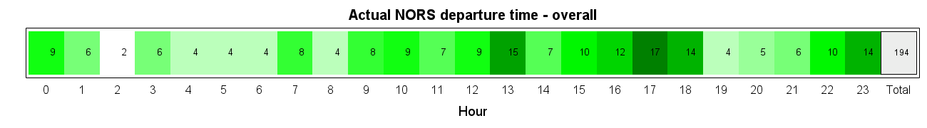
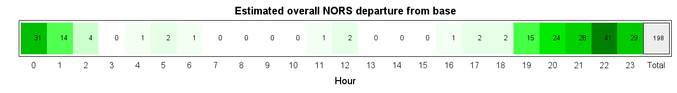
NORS departure time heatmaps
Actual v modelled
Notes:
Actual v modelled NORS departure from base times. – total is different due to not all RTI forms being returned at the point of running the report (4th Sept)

Slide 10
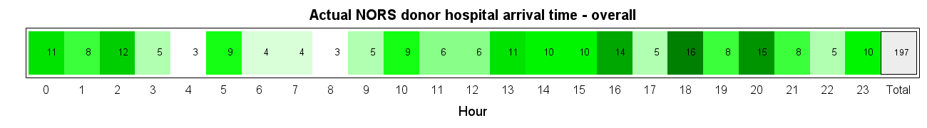
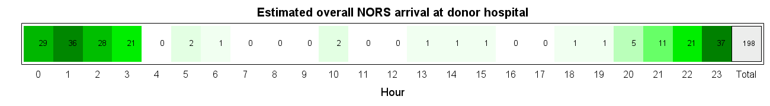
NORS arrival at donor hospital time heatmaps
Actual v modelled

Slide 11
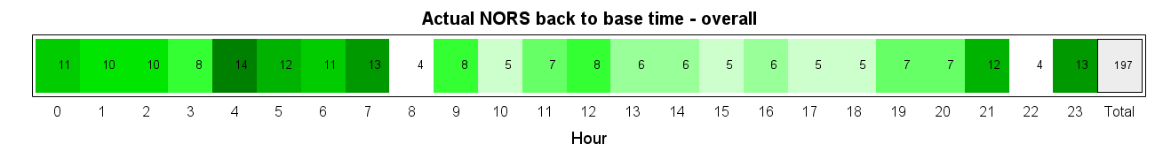
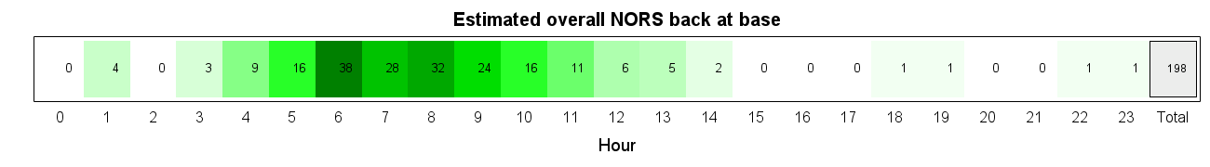
NORS arrival at donor hospital time heatmaps
Actual v modelled

Slide 12
Modelling – NORS Heatmaps – All Teams
Departure/Arrival/Return to Base

Slide 13
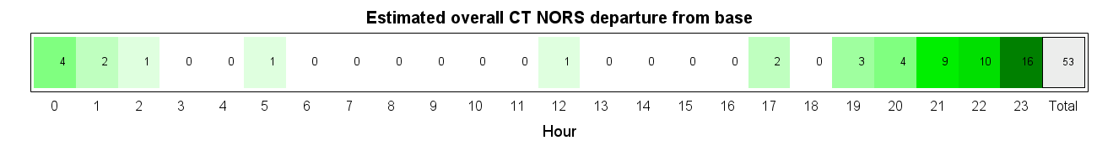
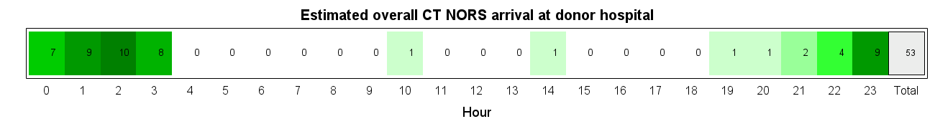
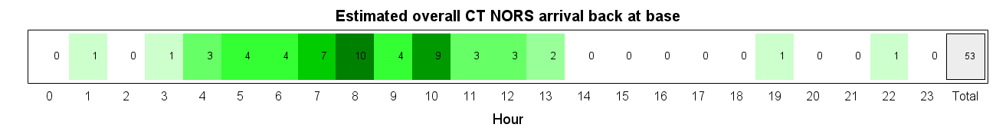
Modelling – NORS Heatmaps – Cardiothoracic Teams
Departure/Arrival/Return to Base

Slide 14
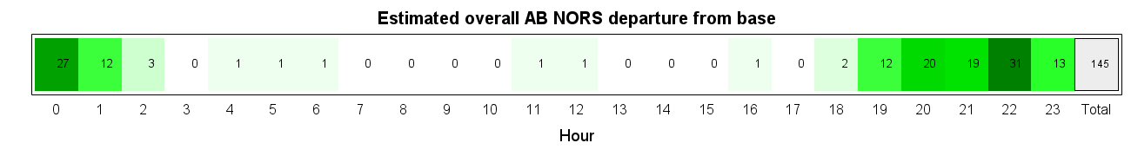
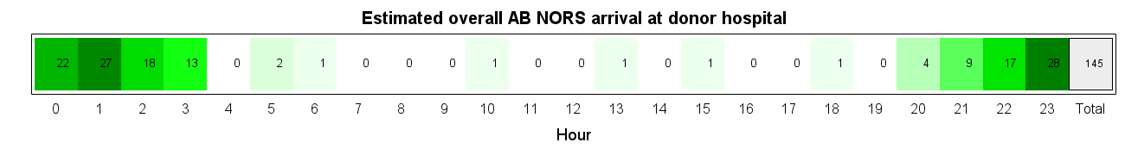

Modelling – NORS Heatmaps – Abdominal Teams
Departure/Arrival/Return to Base

Slide 15
Cambridge Abdo NORS Heatmaps

Slide 16
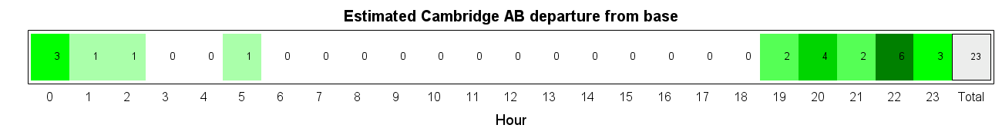
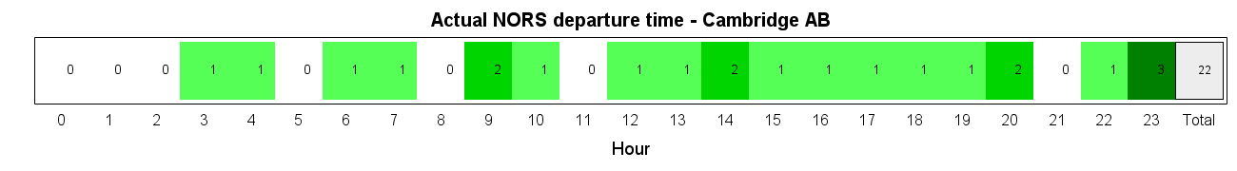
Modelling - NORS Heatmaps – Departure from base time
Cambridge
Notes:
Actual number of attendances compared to simulated attendances may vary due to the differences in team allocation shown in slides 6 & 7

Slide 17
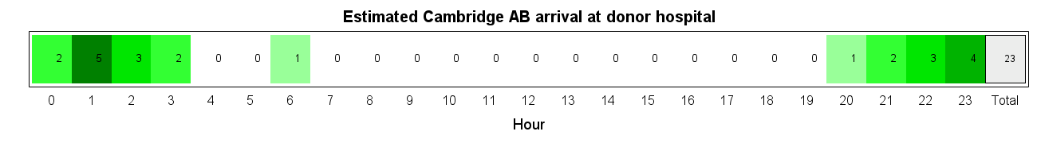
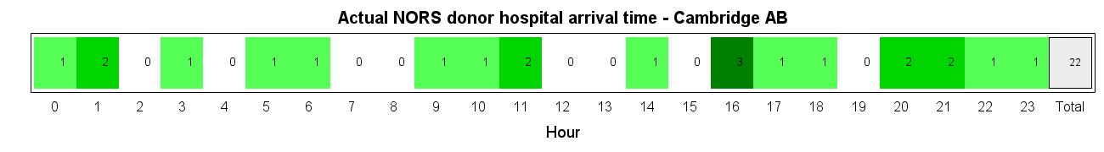
Modelling - NORS Heatmaps – Arrival at donor hospital time
Cambridge
Notes:
Actual number of attendances compared to simulated attendances may vary due to the differences in team allocation shown in slides 6 & 7

Slide 18
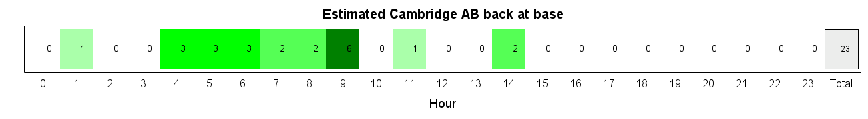
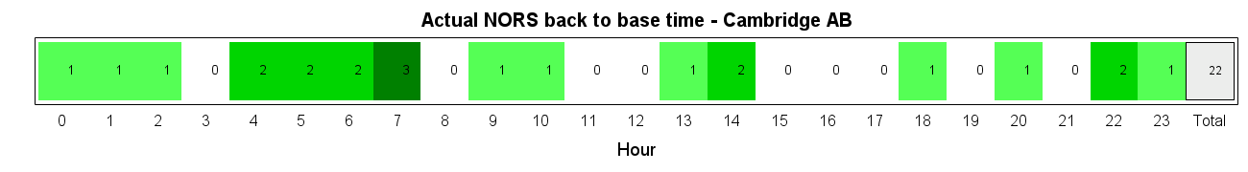
Modelling - NORS Heatmaps – Arrival back at base time
Cambridge
Notes:
Actual number of attendances compared to simulated attendances may vary due to the differences in team allocation shown in slides 6 & 7

Slide 19
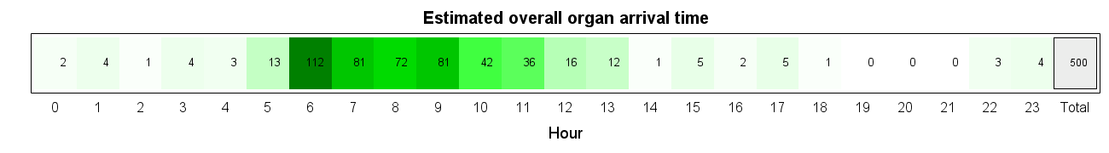
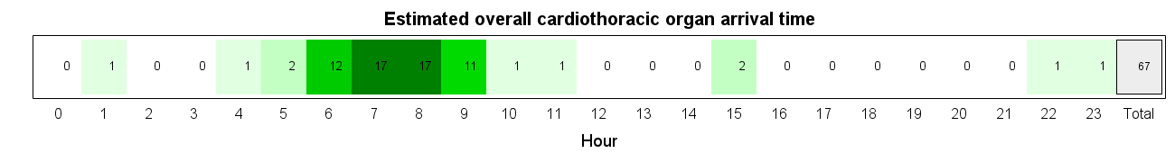

Modelling - Organ Arrival Heatmaps
All Organs/CT/Abdo

Slide 20

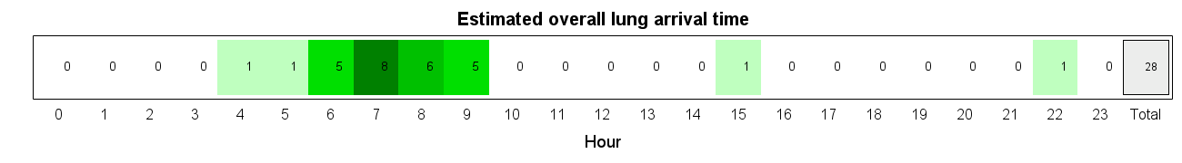
Modelling - Organ Arrival Heatmaps
By Organ Group - CT

Slide 21
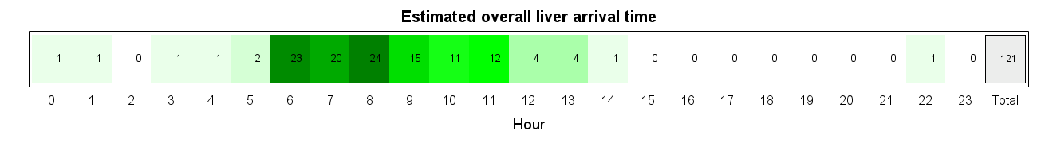
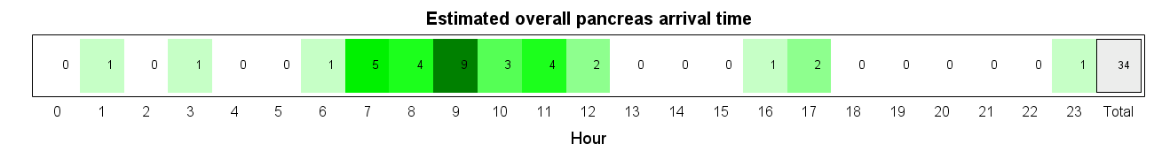
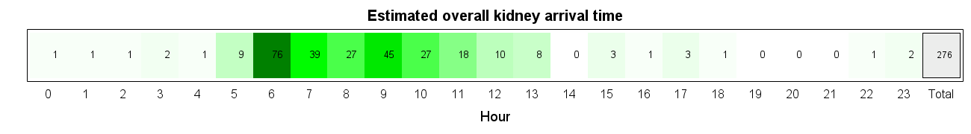
Modelling - Organ Arrival Heatmaps
By Organ Group - Abdo

Slide 22
Glasgow CT Heatmaps

Slide 23
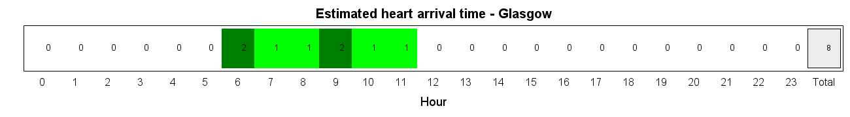
Modelling - Organ Arrival Heatmaps - Glasgow
By Organ Group - Heart

Slide 24
Learning
Fewer priority pathway donors as initial modelling predicted
Priority pathway abdominal teams are mobilised to fewer donors and mostly DBD’s.
DCD Heart teams always arrive latest in the PAW, so with 11hrs rest challenging if consecutive day DCD Heart retrievals
Consideration of capacity for islet isolation centres
European organ offers are accepted at all times in the 24hr clock.
Donors not fitting into the PAW+ windows most likely to be CT
Increase in NRP use for abdo only donors will add 3hrs to retrieval and bring more NORS arrival times 2000-2300
Potential DCD Heart donors lost if multiple DCD Heart activity
Consider how to measure success of transplant centre and SNOD input into PAW times

Slide 25
What next…
Centre specific reports
  NORS departure/arrival/return to base heatmaps by centre
  Organ arrival times by centre
More shadow modelling
  Sept – Dec to test autumn/winter logistics
  Include impact for labs
  Further test transport capability
  Widen SNOD demand and capacity modelling across all 12 Organ Donation teams

Slide 26


Sustainability and Certainty in Organ Retrieval (SCORE) - ODT Clinical - NHS Blood and Transplant
Thank you
FAQs

Slide 27
NORS CT Heatmaps A-Z

Slide 28
Birmingham CT NORS Heatmaps

Slide 29
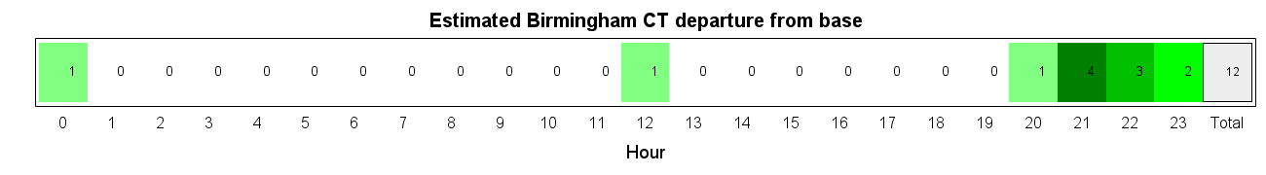
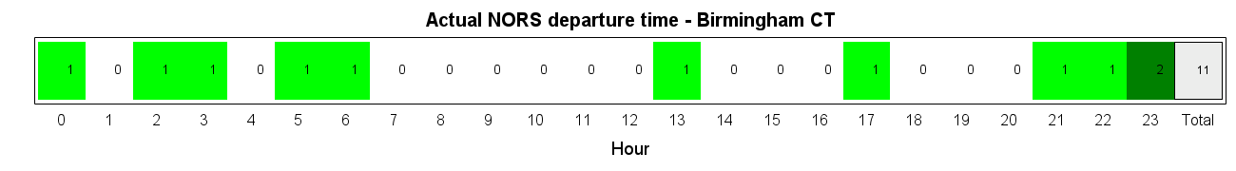
Modelling - NORS Heatmaps – Departure from base time
Birmingham
Notes:
Actual number of attendances compared to simulated attendances may vary due to the differences in team allocation shown in slides 6 & 7

Slide 30
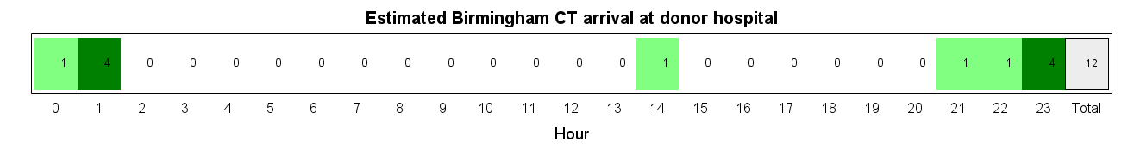
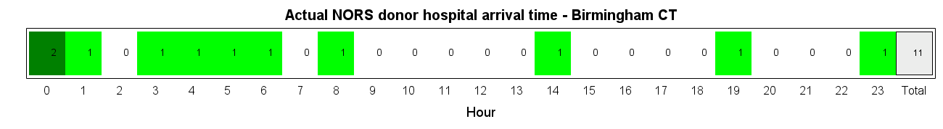
Modelling - NORS Heatmaps – Arrival at donor hospital time
Birmingham
Notes:
Actual number of attendances compared to simulated attendances may vary due to the differences in team allocation shown in slides 6 & 7

Slide 31

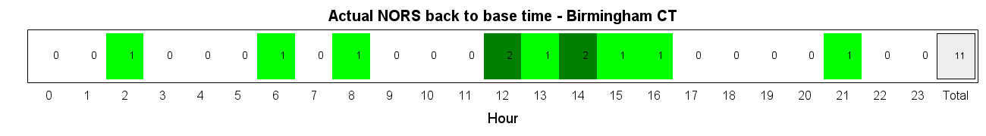
Modelling - NORS Heatmaps – Arrival back at base time
Birmingham
Notes:
Actual number of attendances compared to simulated attendances may vary due to the differences in team allocation shown in slides 6 & 7

Slide 32
Glasgow CT NORS Heatmaps

Slide 33
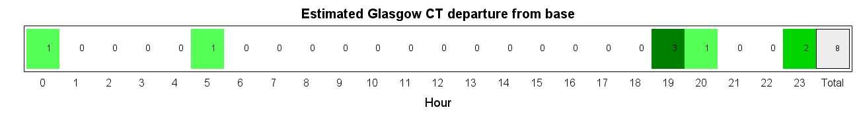
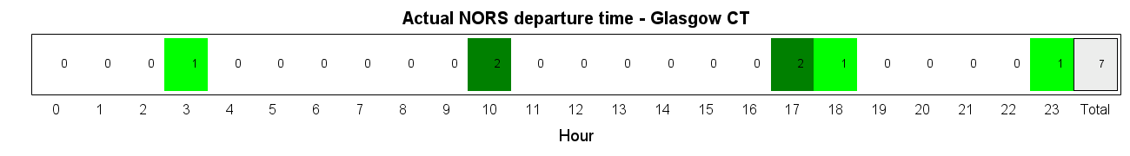
Modelling - NORS Heatmaps – Departure from base time
Glasgow
Notes:
Actual number of attendances compared to simulated attendances may vary due to the differences in team allocation shown in slides 6 & 7

Slide 34
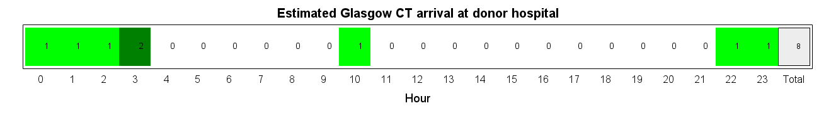
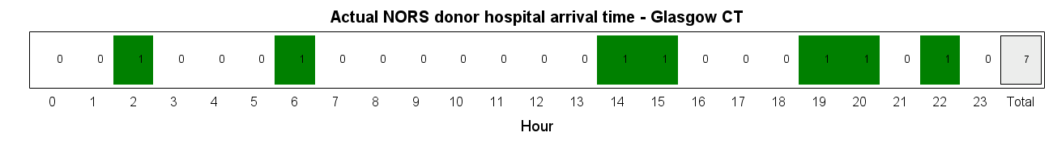
Modelling - NORS Heatmaps – Arrival at donor hospital time
Glasgow
Notes:
Actual number of attendances compared to simulated attendances may vary due to the differences in team allocation shown in slides 6 & 7

Slide 35
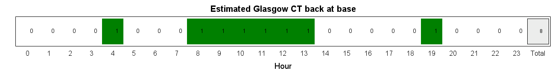
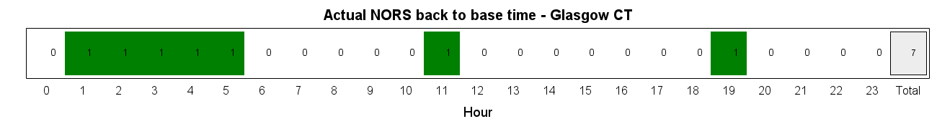
Modelling - NORS Heatmaps – Arrival back at base time
Glasgow
Notes:
Actual number of attendances compared to simulated attendances may vary due to the differences in team allocation shown in slides 6 & 7

Slide 36
Harefield CT NORS Heatmaps

Slide 37
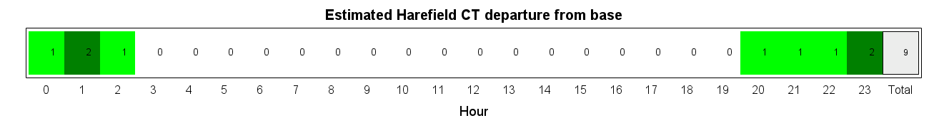
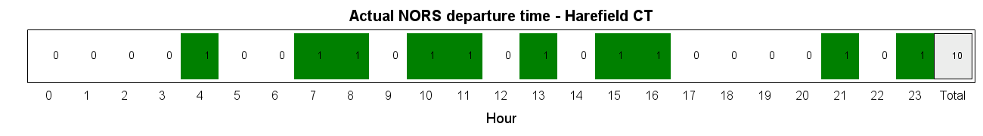
Modelling - NORS Heatmaps – Departure from base time
Harefield
Notes:
Actual number of attendances compared to simulated attendances may vary due to the differences in team allocation shown in slides 6 & 7

Slide 38
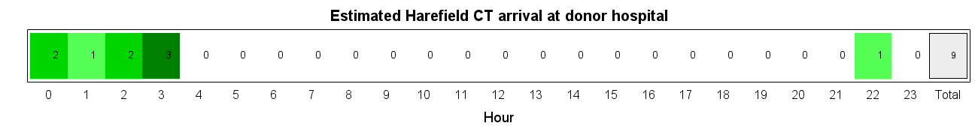
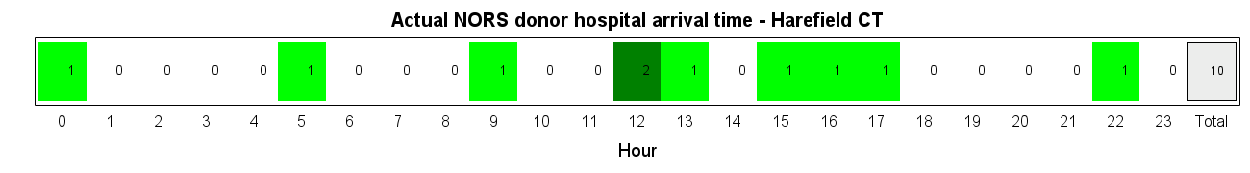
Modelling - NORS Heatmaps – Arrival at donor hospital time
Harefield
Notes:
Actual number of attendances compared to simulated attendances may vary due to the differences in team allocation shown in slides 6 & 7

Slide 39
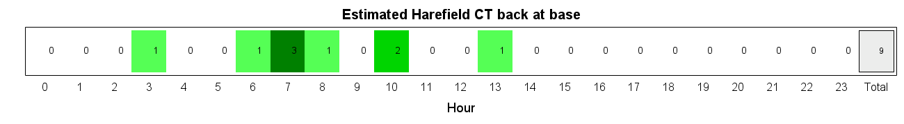
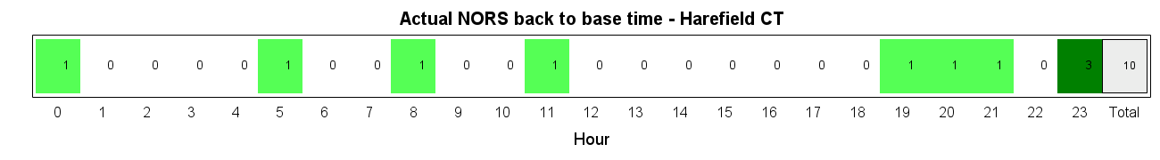
Modelling - NORS Heatmaps – Arrival back at base time
Harefield
Notes:
Actual number of attendances compared to simulated attendances may vary due to the differences in team allocation shown in slides 6 & 7

Slide 40
Manchester CT NORS Heatmaps

Slide 41
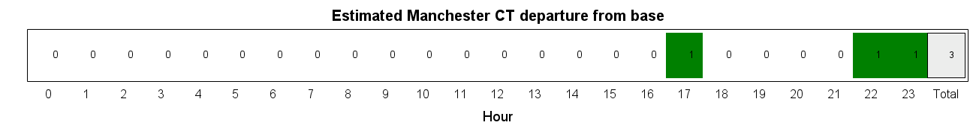
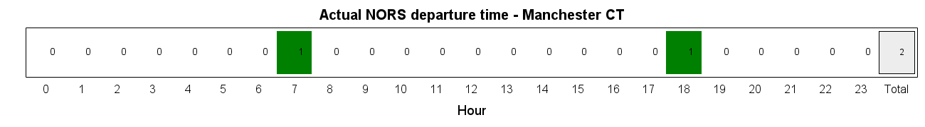
Modelling - NORS Heatmaps – Departure from base time
Manchester
Notes:
Actual number of attendances compared to simulated attendances may vary due to the differences in team allocation shown in slides 6 & 7

Slide 42
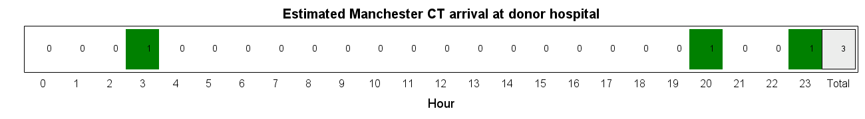
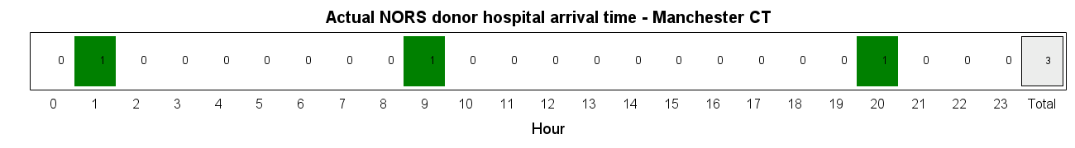
Modelling - NORS Heatmaps – Arrival at donor hospital time
Manchester
Notes:
Actual number of attendances compared to simulated attendances may vary due to the differences in team allocation shown in slides 6 & 7

Slide 43


Modelling - NORS Heatmaps – Arrival back at base time
Manchester
Notes:
Actual number of attendances compared to simulated attendances may vary due to the differences in team allocation shown in slides 6 & 7

Slide 44
Newcastle CT NORS Heatmaps

Slide 45


Modelling - NORS Heatmaps – Departure from base time
Newcastle
Notes:
Actual number of attendances compared to simulated attendances may vary due to the differences in team allocation shown in slides 6 & 7

Slide 46


Modelling - NORS Heatmaps – Arrival at donor hospital time
Newcastle
Notes:
Actual number of attendances compared to simulated attendances may vary due to the differences in team allocation shown in slides 6 & 7

Slide 47


Modelling - NORS Heatmaps – Arrival back at base time
Newcastle
Notes:
Actual number of attendances compared to simulated attendances may vary due to the differences in team allocation shown in slides 6 & 7

Slide 48
Papworth CT NORS Heatmaps

Slide 49


Modelling - NORS Heatmaps – Departure from base time
Papworth
Notes:
Actual number of attendances compared to simulated attendances may vary due to the differences in team allocation shown in slides 6 & 7

Slide 50


Modelling - NORS Heatmaps – Arrival at donor hospital time
Papworth
Notes:
Actual number of attendances compared to simulated attendances may vary due to the differences in team allocation shown in slides 6 & 7

Slide 51


Modelling - NORS Heatmaps – Arrival back at base time
Papworth
Notes:
Actual number of attendances compared to simulated attendances may vary due to the differences in team allocation shown in slides 6 & 7

Slide 52
NORS Abdo Heatmaps A-Z

Slide 53
Birmingham Abdo NORS Heatmaps

Slide 54


Modelling - NORS Heatmaps – Departure from base time
Birmingham

Slide 55


Modelling - NORS Heatmaps – Arrival at donor hospital time
Birmingham
Notes:
Actual number of attendances compared to simulated attendances may vary due to the differences in team allocation shown in slides 6 & 7

Slide 56


Modelling - NORS Heatmaps – Arrival back at base time
Birmingham
Notes:
Actual number of attendances compared to simulated attendances may vary due to the differences in team allocation shown in slides 6 & 7

Slide 57
Cambridge Abdo NORS Heatmaps

Slide 58
Modelling - NORS Heatmaps – Departure from base time
Cambridge
Notes:
Actual number of attendances compared to simulated attendances may vary due to the differences in team allocation shown in slides 6 & 7

Slide 59
Modelling - NORS Heatmaps – Arrival at donor hospital time
Cambridge
Notes:
Actual number of attendances compared to simulated attendances may vary due to the differences in team allocation shown in slides 6 & 7

Slide 60
Modelling - NORS Heatmaps – Arrival back at base time
Cambridge
Notes:
Actual number of attendances compared to simulated attendances may vary due to the differences in team allocation shown in slides 6 & 7

Slide 61
Cardiff Abdo NORS Heatmaps

Slide 62


Modelling - NORS Heatmaps – Departure from base time
Cardiff
Notes:
Actual number of attendances compared to simulated attendances may vary due to the differences in team allocation shown in slides 6 & 7

Slide 63


Modelling - NORS Heatmaps – Arrival at donor hospital time
Cardiff
Notes:
Actual number of attendances compared to simulated attendances may vary due to the differences in team allocation shown in slides 6 & 7

Slide 64


Modelling - NORS Heatmaps – Arrival back at base time
Cardiff
Notes:
Actual number of attendances compared to simulated attendances may vary due to the differences in team allocation shown in slides 6 & 7

Slide 65
Edinburgh Abdo NORS Heatmaps

Slide 66


Modelling - NORS Heatmaps – Departure from base time
Edinburgh
Notes:
Actual number of attendances compared to simulated attendances may vary due to the differences in team allocation shown in slides 6 & 7

Slide 67


Modelling - NORS Heatmaps – Arrival at donor hospital time
Edinburgh
Notes:
Actual number of attendances compared to simulated attendances may vary due to the differences in team allocation shown in slides 6 & 7

Slide 68


Modelling - NORS Heatmaps – Arrival back at base time
Edinburgh
Notes:
Actual number of attendances compared to simulated attendances may vary due to the differences in team allocation shown in slides 6 & 7

Slide 69
Kings College Abdo NORS Heatmaps

Slide 70


Modelling - NORS Heatmaps – Departure from base time
Kings College
Notes:
Actual number of attendances compared to simulated attendances may vary due to the differences in team allocation shown in slides 6 & 7

Slide 71


Modelling - NORS Heatmaps – Arrival at donor hospital time
Kings College
Notes:
Actual number of attendances compared to simulated attendances may vary due to the differences in team allocation shown in slides 6 & 7

Slide 72


Modelling - NORS Heatmaps – Arrival back at base time
Kings College
Notes:
Actual number of attendances compared to simulated attendances may vary due to the differences in team allocation shown in slides 6 & 7

Slide 73
Leeds Abdo NORS Heatmaps

Slide 74


Modelling - NORS Heatmaps – Departure from base time
Leeds
Notes:
Actual number of attendances compared to simulated attendances may vary due to the differences in team allocation shown in slides 6 & 7

Slide 75


Modelling - NORS Heatmaps – Arrival at donor hospital time
Leeds
Notes:
Actual number of attendances compared to simulated attendances may vary due to the differences in team allocation shown in slides 6 & 7

Slide 76


Modelling - NORS Heatmaps – Arrival back at base time
Leeds
Notes:
Actual number of attendances compared to simulated attendances may vary due to the differences in team allocation shown in slides 6 & 7

Slide 77
Manchester Abdo NORS Heatmaps

Slide 78


Modelling - NORS Heatmaps – Departure from base time
Manchester
Notes:
Actual number of attendances compared to simulated attendances may vary due to the differences in team allocation shown in slides 6 & 7

Slide 79


Modelling - NORS Heatmaps – Arrival at donor hospital time
Manchester
Notes:
Actual number of attendances compared to simulated attendances may vary due to the differences in team allocation shown in slides 6 & 7

Slide 80


Modelling - NORS Heatmaps – Arrival back at base time
Manchester
Notes:
Actual number of attendances compared to simulated attendances may vary due to the differences in team allocation shown in slides 6 & 7

Slide 81
Newcastle Abdo NORS Heatmaps

Slide 82


Modelling - NORS Heatmaps – Departure from base time
Newcastle
Notes:
Actual number of attendances compared to simulated attendances may vary due to the differences in team allocation shown in slides 6 & 7

Slide 83


Modelling - NORS Heatmaps – Arrival at donor hospital time
Newcastle
Notes:
Actual number of attendances compared to simulated attendances may vary due to the differences in team allocation shown in slides 6 & 7

Slide 84


Modelling - NORS Heatmaps – Arrival back at base time
Newcastle
Notes:
Actual number of attendances compared to simulated attendances may vary due to the differences in team allocation shown in slides 6 & 7

Slide 85
Oxford Abdo NORS Heatmaps

Slide 86


Modelling - NORS Heatmaps – Departure from base time
Oxford
Notes:
Actual number of attendances compared to simulated attendances may vary due to the differences in team allocation shown in slides 6 & 7

Slide 87


Modelling - NORS Heatmaps – Arrival at donor hospital time
Oxford
Notes:
Actual number of attendances compared to simulated attendances may vary due to the differences in team allocation shown in slides 6 & 7

Slide 88


Modelling - NORS Heatmaps – Arrival back at base time
Oxford
Notes:
Actual number of attendances compared to simulated attendances may vary due to the differences in team allocation shown in slides 6 & 7

Slide 89
Royal Free Abdo NORS Heatmaps

Slide 90


Modelling - NORS Heatmaps – Departure from base time
Royal Free
Notes:
Actual number of attendances compared to simulated attendances may vary due to the differences in team allocation shown in slides 6 & 7

Slide 91


Modelling - NORS Heatmaps – Arrival at donor hospital time
Royal Free
Notes:
Actual number of attendances compared to simulated attendances may vary due to the differences in team allocation shown in slides 6 & 7

Slide 92


Modelling - NORS Heatmaps – Arrival back at base time
Royal Free
Notes:
Actual number of attendances compared to simulated attendances may vary due to the differences in team allocation shown in slides 6 & 7

Slide 93
Transplant Centre Organ Arrival Time Heatmaps

Slide 94
Cardiothoracic Centres A-Z

Slide 95
Birmingham CT Heatmaps

Slide 96

Modelling - Organ Arrival Heatmaps - Birmingham
By Organ Group - Heart

Slide 97

Modelling - Organ Arrival Heatmaps - Birmingham
By Organ Group - Lung

Slide 98
Glasgow CT Heatmaps

Slide 99
Modelling - Organ Arrival Heatmaps - Glasgow
By Organ Group - Heart

Slide 100
Great Ormond Street CT Heatmaps

Slide 101

Modelling - Organ Arrival Heatmaps – Great Ormond Street
By Organ Group - Heart

Slide 102

Modelling - Organ Arrival Heatmaps – Great Ormond Street
By Organ Group - Lung

Slide 103
Harefield CT Heatmaps

Slide 104

Modelling - Organ Arrival Heatmaps - Harefield
By Organ Group - Heart

Slide 105

Modelling - Organ Arrival Heatmaps - Harefield
By Organ Group - Lung

Slide 106
Newcastle CT Heatmaps

Slide 107

Modelling - Organ Arrival Heatmaps - Newcastle
By Organ Group - Heart

Slide 108

Modelling - Organ Arrival Heatmaps - Newcastle
By Organ Group - Lung

Slide 109
Papworth CT Heatmaps

Slide 110

Modelling - Organ Arrival Heatmaps - Papworth
By Organ Group - Heart

Slide 111

Modelling - Organ Arrival Heatmaps - Papworth
By Organ Group - Lung

Slide 112
Wythenshawe CT Heatmaps

Slide 113

Modelling - Organ Arrival Heatmaps - Wythenshawe
By Organ Group - Heart

Slide 114

Modelling - Organ Arrival Heatmaps - Wythenshawe
By Organ Group - Lung

Slide 115
Abdominal Centres A-Z

Slide 116
Belfast Heatmaps

Slide 117

Modelling - Organ Arrival Heatmaps - Belfast
By Organ Group - Kidney

Slide 118
Birmingham Abdo Heatmaps

Slide 119

Modelling - Organ Arrival Heatmaps - Birmingham
By Organ Group - Liver

Slide 120

Modelling - Organ Arrival Heatmaps - Birmingham
By Organ Group - Kidney

Slide 121
Bristol Heatmaps

Slide 122

Modelling - Organ Arrival Heatmaps - Bristol
By Organ Group - Kidney

Slide 123
Cambridge Heatmaps

Slide 124

Modelling - Organ Arrival Heatmaps - Cambridge
By Organ Group - Liver

Slide 125

Modelling - Organ Arrival Heatmaps - Cambridge
By Organ Group - Pancreas

Slide 126


Modelling - Organ Arrival Heatmaps - Cambridge
By Organ Group - Multivisceral

Slide 127

Modelling - Organ Arrival Heatmaps - Cambridge
By Organ Group - Kidney

Slide 128
Cardiff Heatmaps

Slide 129

Modelling - Organ Arrival Heatmaps - Cardiff
By Organ Group - Pancreas

Slide 130

Modelling - Organ Arrival Heatmaps - Cardiff
By Organ Group - Kidney

Slide 131
Coventry Heatmaps

Slide 132

Modelling - Organ Arrival Heatmaps - Coventry
By Organ Group - Kidney

Slide 133
Edinburgh Heatmaps

Slide 134

Modelling - Organ Arrival Heatmaps - Edinburgh
By Organ Group - Liver

Slide 135

Modelling - Organ Arrival Heatmaps - Edinburgh
By Organ Group - Pancreas

Slide 136

Modelling - Organ Arrival Heatmaps - Edinburgh
By Organ Group - Kidney

Slide 137
Glasgow Heatmaps

Slide 138

Modelling - Organ Arrival Heatmaps - Glasgow
By Organ Group - Kidney

Slide 139
Guys Heatmaps

Slide 140

Modelling - Organ Arrival Heatmaps - Guys
By Organ Group - Pancreas

Slide 141

Modelling - Organ Arrival Heatmaps – Guy’s
By Organ Group - Kidney

Slide 142
Hammersmith Heatmaps

Slide 143

Modelling - Organ Arrival Heatmaps - Hammersmith
By Organ Group - Kidney

Slide 144
Kings College Heatmaps

Slide 145

Modelling - Organ Arrival Heatmaps – Kings College
By Organ Group - Liver

Slide 146
Leeds Heatmaps

Slide 147

Modelling - Organ Arrival Heatmaps - Leeds
By Organ Group - Liver

Slide 148

Modelling - Organ Arrival Heatmaps - Leeds
By Organ Group - Kidney

Slide 149
Leicester Heatmaps

Slide 150

Modelling - Organ Arrival Heatmaps - Leicester
By Organ Group - Kidney

Slide 151
Liverpool Heatmaps

Slide 152

Modelling - Organ Arrival Heatmaps - Liverpool
By Organ Group - Kidney

Slide 153
Manchester Abdo Heatmaps

Slide 154

Modelling - Organ Arrival Heatmaps - Manchester
By Organ Group - Pancreas

Slide 155

Modelling - Organ Arrival Heatmaps - Manchester
By Organ Group - Kidney

Slide 156
Newcastle Abdo Heatmaps

Slide 157

Modelling - Organ Arrival Heatmaps - Newcastle
By Organ Group - Liver

Slide 158

Modelling - Organ Arrival Heatmaps - Newcastle
By Organ Group - Pancreas

Slide 159

Modelling - Organ Arrival Heatmaps - Newcastle
By Organ Group - Kidney

Slide 160
Nottingham Heatmaps

Slide 161

Modelling - Organ Arrival Heatmaps - Nottingham
By Organ Group - Kidney

Slide 162
Oxford Heatmaps

Slide 163

Modelling - Organ Arrival Heatmaps - Oxford
By Organ Group - Pancreas

Slide 164

Modelling - Organ Arrival Heatmaps - Oxford
By Organ Group - Multivisceral

Slide 165

Modelling - Organ Arrival Heatmaps - Oxford
By Organ Group - Kidney

Slide 166
Royal Free Heatmaps

Slide 167

Modelling - Organ Arrival Heatmaps – Royal Free
By Organ Group - Liver

Slide 168

Modelling - Organ Arrival Heatmaps – Royal Free
By Organ Group - Kidney

Slide 169
Royal London Heatmaps

Slide 170

Modelling - Organ Arrival Heatmaps – Royal London
By Organ Group - Kidney

Slide 171
Portsmouth Heatmaps

Slide 172

Modelling - Organ Arrival Heatmaps - Portsmouth
By Organ Group - Kidney

Slide 173
Plymouth Heatmaps

Slide 174

Modelling - Organ Arrival Heatmaps - Plymouth
By Organ Group - Kidney

Slide 175
Sheffield Heatmaps

Slide 176

Modelling - Organ Arrival Heatmaps - Sheffield
By Organ Group - Kidney

Slide 177
St George’s Heatmaps

Slide 178

Modelling - Organ Arrival Heatmaps – St George’s
By Organ Group - Kidney

