Slide 1




Teachers’ notes
N.B. Teachers’ notes and background information can only be viewed
if this presentation is opened within the PowerPoint application,
not on interactive whiteboards.
The visuals on the PowerPoint slides display best in PowerPoint presentation mode.

Slide 2

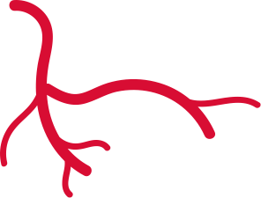
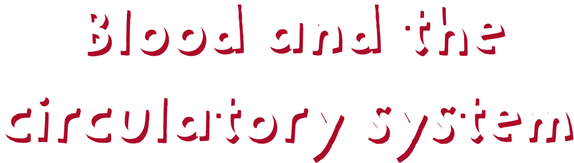




‘Giving to help others’

Slide 3


Activity summary
Pupils learn about the circulatory system and the composition of blood, before making ‘blood’ using ingredients to represent its different parts. Pupils discover how blood is used in blood transfusions to improve and save lives.
Key science vocab
Blood, circulatory system, heart, blood vessels, platelets, red blood cells, white blood cells, plasma, donation, transfusion, blood group, percentage (see glossary on slide 26).

Slide 4




Using these resources
How to use this presentation
Slides 3-7: Teachers’ notes (these slides will stay hidden in presentation mode.)
Slides 8–25: Use with pupils. Instructions and subject knowledge
included on the notes section of each slide.
Slides 18 and 19 contain differentiated versions of the clues pupils need to work out the blood recipe percentages.
What you’ll need
If making the blood with food items, you will need these minimum quantities per group of students:
7 white marshmallows (to represent white blood cells)
a handful of Cheerio cereal soaked in 2 drops of red food dye (to represent red blood cells)
a teaspoon of hundreds and thousands (to represent platelets)
100ml of yellow liquid, e.g. orange squash / lemonade (to represent plasma).
Alternative approach
If you do not wish to use food items, you will need these minimum quantities per group:
5 white maths cubes / place value counters (to represent white blood cells)
10 red maths cubes / place value counters (to represent red blood cells)
5 different coloured cubes / place value counters (to represent platelets)
100ml of water / orange squash (to represent plasma).
Extension activities
Comprehension homework task: Pupils answer SATs-style comprehension questions and learn more about blood donation. (See All about blood donation comprehension worksheet.)
Giving blood marketing campaign: Pupils run a campaign to raise awareness of the need for blood donors. (See Giving Blood Marketing Campaign PowerPoint.)
Alternative activities
To do this lesson without the practical element, use the All about blood activity to test pupils’ understanding of the lesson content.

Slide 5


Using these resources
Why use these resources?
Linked to the curriculum
The lesson supports the Year 6 Science topic of Animals, including humans, and the Key Stage 2 PSHE Association‘s Programme of Study, focusing on pupils’ role in their community and helping others.
Raise awareness of blood donation, and other forms of donation
Giving blood saves lives. The blood you give is a lifeline in an emergency and for people who need long-term treatments. Many people would not be alive today if donors had not generously given their blood.
This lesson aims to make pupils aware of blood donation, and other forms of donation, including stem cell donation. The aim is to encourage and empower them to tell their parents about what they have learnt and how their parents and other adults can help increase the number of donors now and in the future, particularly those from the Black, Asian other ethnic communities where the need
is greatest.
Who produced these resources?
These resources have been created for ‘Giving to Help Others’ by Team Margot Foundation, with the help of EdComs and NHS Blood and Transplant and practising teachers.
Are there sensitivities around this topic?
Discussing donation
The resources are age appropriate and designed to spark a positive discussion which empowers pupils. Guidance is offered on sensitive discussion of the topics in the slide notes, but you may wish to check
the slides before using them with your class.
Faith and donation
The major religions in the UK support the idea of blood donation.
NHS Blood and Transplant (NHSBT) is working with faith leaders to spread the message that donating blood can be an important part of caring for the lives of others. For more information on faith and donation, visit the NHSBT page on Faith and donation.

Slide 6
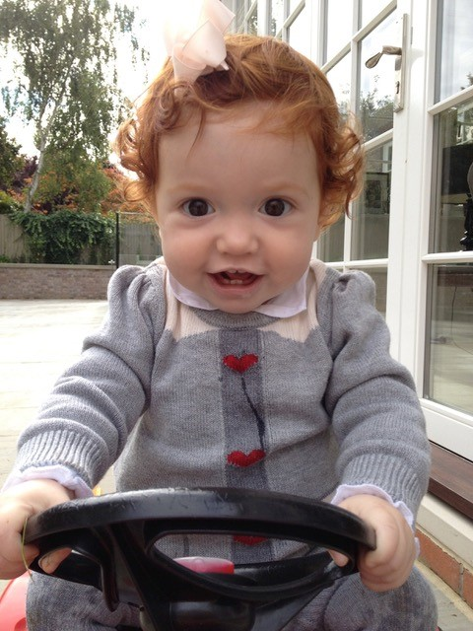

About Team Margot
Team Margot Foundation was formed because of a little girl called Margot who needed a bone marrow transplant. Margot’s family and friends came together as Team Margot to help find her a matching donor and ask people to do something amazing: register as potential stem cell and bone marrow donors.
Margot wasn’t able to find her perfect match, but did eventually find a suitable donor match and received her bone marrow transplant. Unfortunately, Margot’s leukemia was extremely aggressive and she passed away, aged 2 years and 2 months.
Team Margot continues to campaign for every individual that is eligible to register as a stem cell and bone marrow donor.
Through the ‘Giving to help others’ education programme, the charity also encourages organ donation, blood donation, stem cell donation and cord blood donation.

Slide 7


Curriculum links
England
PHSE Association Programme of Study, Key Stage 2 – Core Theme 3. Living in the wider world.
L7 – that they have different kinds of responsibilities, rights and duties at home, at school, in the community and towards the environment; to continue to develop the skills to exercise these responsibilities.
L9 – what being part of a community means, and about the varied institutions that support communities locally and nationally.
L10 – to recognise the role of voluntary, community and pressure groups, especially in relation to health and wellbeing.
Scotland
Mental, emotional, social and physical wellbeing;
Social wellbeing: Through contributing my views, time and talents, I play
a part in bringing about positive change in my school and wider community.
Physical wellbeing: I am developing my understanding of the human
body and can use this knowledge to maintain and improve my wellbeing and health.
Wales
Health and emotional well-being.
Learner should be given opportunities to:
Understand the features and physical and emotional benefits of
a healthy lifestyle, e.g. food and fitness.
Gather information in a variety of ways, including simple questionnaires or databases to support understanding of PSE-related issues.
Northern Ireland
Mutual understanding in the local and wider community.
Pupils should develop knowledge, understanding and skills in:
Human rights and social responsibility

Slide 8
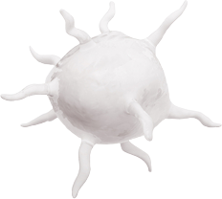




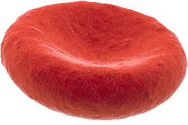
Myth busters!
Do you know which of these statements are true and which are false?
1. All blood is red
False
2. Blood contains metal
True
3. Blood is made in the heart
False
4. The average body contains roughly 9 pints (4.5 litres) of blood
True
5. A person’s blood vessels, arranged end-to-end, would stretch the length of the playground – and beyond!
True
Notes:
Explain to pupils that a fact is going to appear on each click. Their challenge is to decide whether the fact is true or false!
If they think the fact is true, they can put their thumbs up (or stand up) and if they think the fact is false, they can put their thumbs down (or stay sitting down).
All blood is red
False: Human blood is red, but some animals have different-coloured blood. For example, some types of worm and leeches have blue blood, grasshoppers have white blood, and spiders have transparent blood!
2. Blood contains metal
True: If you have ever been unlucky enough to taste blood (for example, from biting your lip) you will know blood tastes slightly metallic. This is because it contains tiny amounts of metal. In fact, human blood contains iron, copper, zinc and even, tiny traces of gold!
3. Blood is made in the heart
False: Blood stem cells are made by a soft, spongy tissue found in the middle of some bones called bone marrow. The heart’s job is to pump that blood around the body.
4. The average human body contains roughly 9 pints (or 4.5 litres) of blood.
True: The average adult has 9 pints of blood in their body – that’s the same as the amount of water used in a 30 second shower! But remember, it is just an average. The smaller you are, the less blood in your body. Your blood makes up about 7% of your total body weight.
5. A person’s blood vessels, arranged end-to-end, would stretch the length of the playground – and beyond!
True: Blood vessels (veins, arteries and capillaries) are the tubes that carry a person’s blood around the body. If you arranged the average person’s blood vessels end to end, they would be able to go around the world – 2 and a half times!

Slide 9

Learning aim
Can I describe the different components of blood and explain their impact on human health?
Success criteria:
Identify the main components of blood and their different functions
Describe the composition of blood using percentages
Explain how changes in a person’s blood can impact their health and wellbeing and how blood donation can help

Slide 10
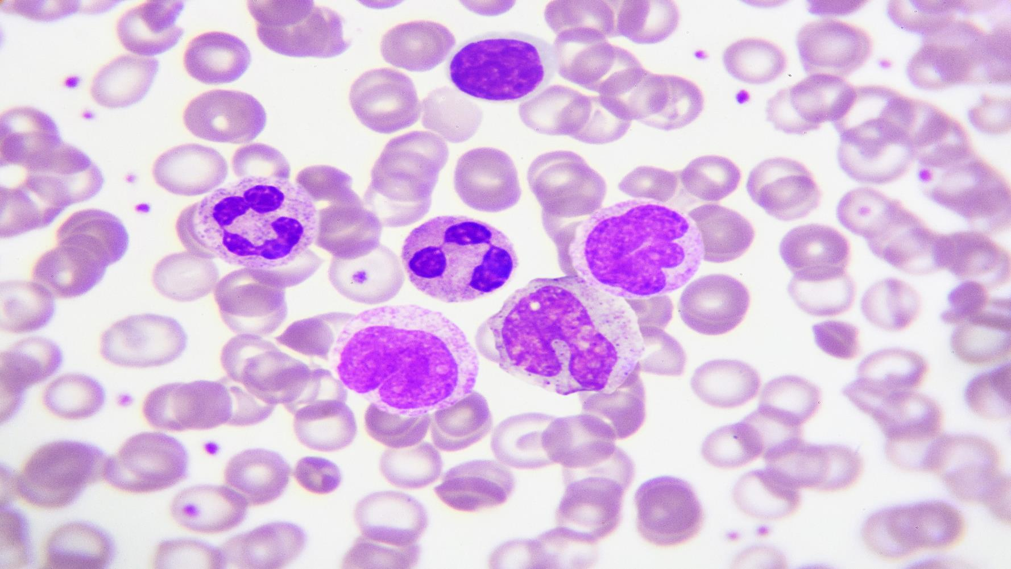
What can you see?
Notes:
Q. What can you see?
Once pupils have shared their ideas, explain the photograph shows blood under a microscope. The purple dots you can see are cells, or parts of cells which exist in our blood.
Q: Why can’t you see any cells in your blood when you get a cut or scrape?
These cells in the blood are so small, they cannot be seen with the naked eye. One drop of blood contains about 250 million cells.

Slide 11
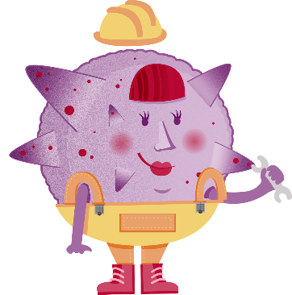
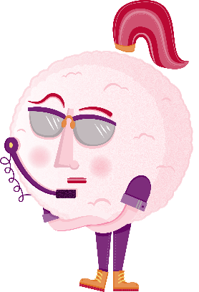
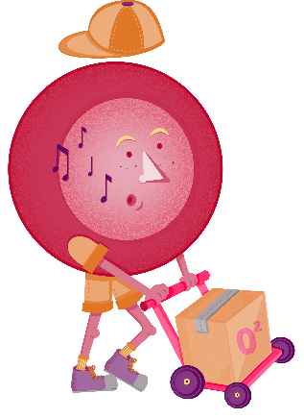
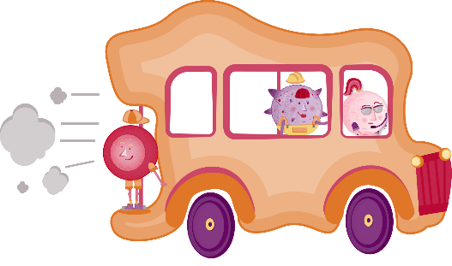
What’s blood made of?
Platelets
White blood cells
Red blood cells
Plasma
Notes:
The blood is made up of different parts and each part has a different, important job to do to keep the body healthy.
Click to reveal the different parts:
Red blood cells: Deliver oxygen (and remove waste). The second largest purple dots show red blood cells under the microscope.
White blood cells: Protect the body from bacteria, viruses and other ‘invaders’. The largest and brightest purple dots show white blood cells under the microscope.
Platelets: Help the blood to clot. The tiny, hardly visible purple dots show platelets under the microscope.
Plasma: Helps transport the red blood cells, white blood cells and platelets. The white liquid visible between the purple dots shows plasma under the microscope.
Our blood also contains stem cells - Stem cells are produced in bone marrow and are the 'building blocks' of the body as they can change into any of the other blood cells.
Note: Slides 12 to 15 explain the function of red blood cells, white blood cells, platelets and plasma in more detail.

Slide 12

Red blood cells
“I deliver oxygen around your body and take away waste”
Notes:
Q. Why is our blood red?
Our blood gets its red colour from red blood cells. Red blood cells contain a protein called haemoglobin (pronounced he-muh-glow-bin) and haemoglobin contains iron. When iron mixes with oxygen, it turns red – giving haemoglobin (and our blood) its red colour.
Explain:
Red blood cells are round with a slight dent in the centre – a bit like a donut…but without a hole!
They have the very important job of carrying oxygen around the body. Our muscles and organs need oxygen to work.
Red blood cells also remove waste, such as carbon dioxide, from your body and transport it to the lungs so you can exhale it.
Red blood cells are made in our bone marrow and have a lifespan of about 120 days.
Our bone marrows produces an amazing 2 million red blood cells every second! That’s 120 million red blood cells per minute.
When red blood cells die, they are broken up and returned to the bone marrow to be reused and made into new red blood cells.
Q. What would happen if a person didn’t have any red blood cells?
If a person had no red blood cells and their bone marrow wasn’t able to produce any more, they would die. Without oxygen, our body cannot perform all the functions it needs to in order to keep us alive.

Slide 13

White blood cells
“I hunt down germs and protect you from disease”
13￼
Notes:
Explain:
White blood cells are the largest cells in the blood and are very flexible – which means they can change their shape.
White blood cells have the important job of looking out for, and getting rid of, any intruders that might cause disease, such as harmful bacteria or viruses.
Once white blood cells identify intruders, they need to destroy them before they cause any harm to the body. White blood cells can destroy intruders in two ways:
1. Changing shape to engulf the intruder.
2. Producing special substances, called enzymes or antibodies, which destroy the intruders.
To reach the site of infection or injury, white blood cells move along like millipedes, creating tiny leg-like structures that attach and detach from the walls of the blood vessel within seconds. This allows them to swiftly crawl along the blood vessel and also keep a good grip on the vessels’ sides.
Q. What might happen if a person has no white blood cells?
A person with no white blood cells would get lots of illnesses or diseases, and would quickly die.

Slide 14


Platelets
“I carry out repairs by clotting your blood”
14￼
14￼
Notes:
Q. How does your body stop bleeding?
Explain:
Platelets’ main job is to stop bleeding – they do this by making scabs!
When you get a cut (or in other words, if one of your blood vessels gets damaged) your body sends a signal to the platelets.
On receiving this signal, platelets are ‘activated’ – they become sticky and rush to the site of the damage.
At the wound, platelets join together, like glue, to create a kind of plug or scab. If they need to, they can also signal more platelets to join them to help stop the bleeding.
Platelets are smaller than white and red blood cells. In fact, platelets are ‘fragments’ (little pieces) of bone marrow cells. (Note: platelets are not technically cells.)
Platelets are colourless and you will find between 1.5 and 4 million platelets in one drop of blood!
Q. What do scabs feel like?
e.g. hard and crusty!
Q. Why do you think they feel this way?
The scab’s hard surface has two purposes – it creates a strong barrier to stops germs and bacteria from being able to enter the body through the open wound and it protects the skin cells underneath the scab, giving them time to heal.
Q. What would happen if a person didn’t have any platelets?
If a person doesn’t have any platelets, or not enough platelets, their blood won’t be able to clot. This could cause uncontrollable bleeding, which can be really dangerous – if a person loses more than 30% of their blood, their life could be at risk.

Slide 15


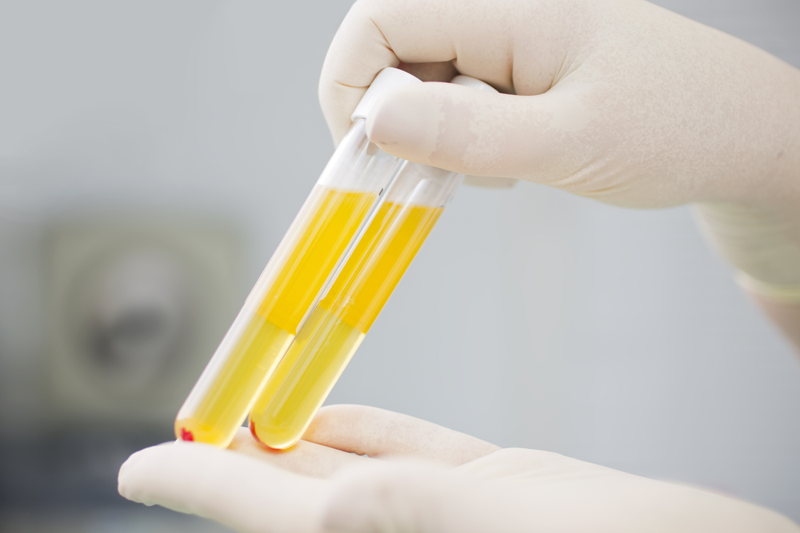

Plasma
“…and I provide the transport”
Notes:
Explain:
Blood’s job is to transport things around the body – to do this, it needs its liquid base, plasma!
Plasma carries the red blood cells, white blood cells, platelets and other substances, like nutrients and hormones, to wherever they are needed in the body.
Plasma is a light, yellow liquid similar to the colour of straw. The test tube photograph on screen shows plasma that has been separated from all the other components of blood.
Plasma is 90% water. It also contains important ingredients which help the blood cells to do their jobs, e.g. helping the white blood cells to defend our body and the platelets to form scabs.
Q. What might happen if a person didn’t have any plasma?
First of all, the red blood cells, white blood cells and platelets wouldn’t be able to get where they needed to go – think of it as a great big traffic jam in your blood vessels! Secondly, the important ingredients the plasma contains would be missing, which would mean the other cells couldn’t do their jobs properly.

Slide 16
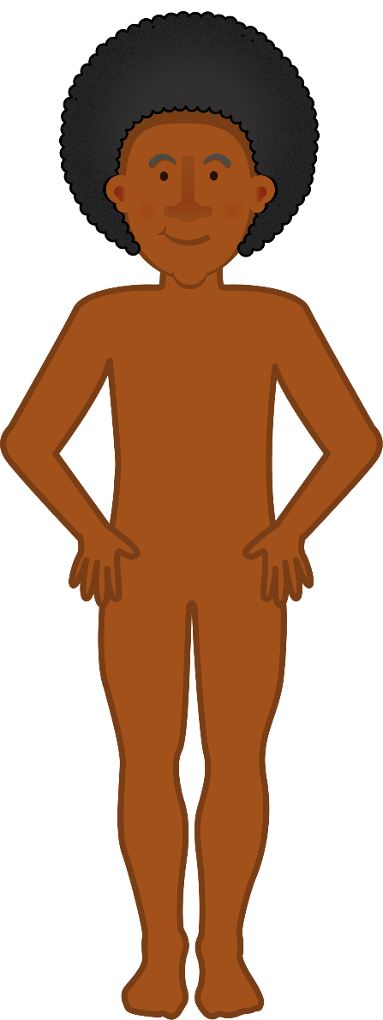
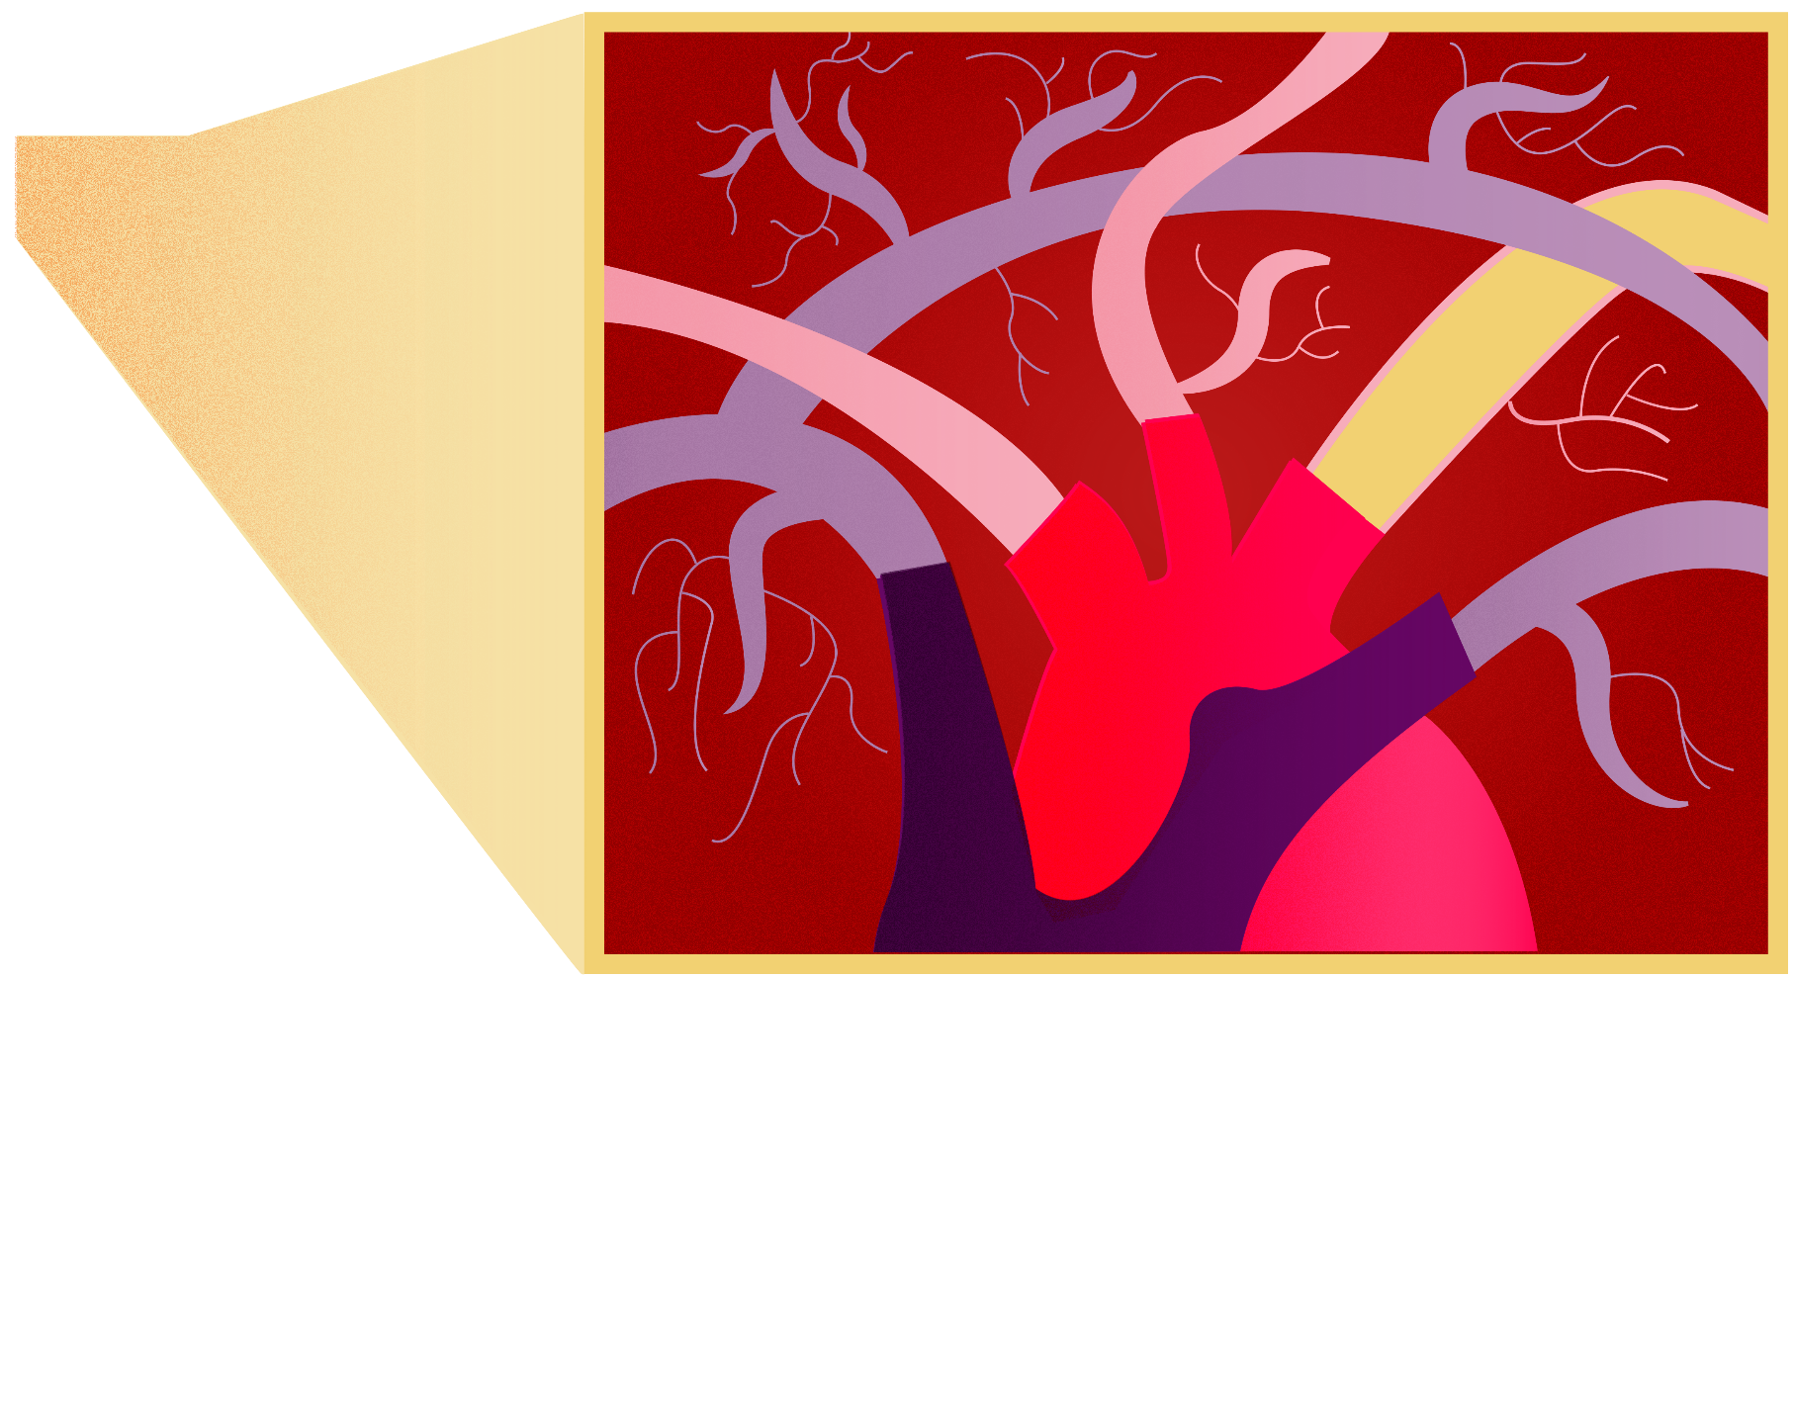
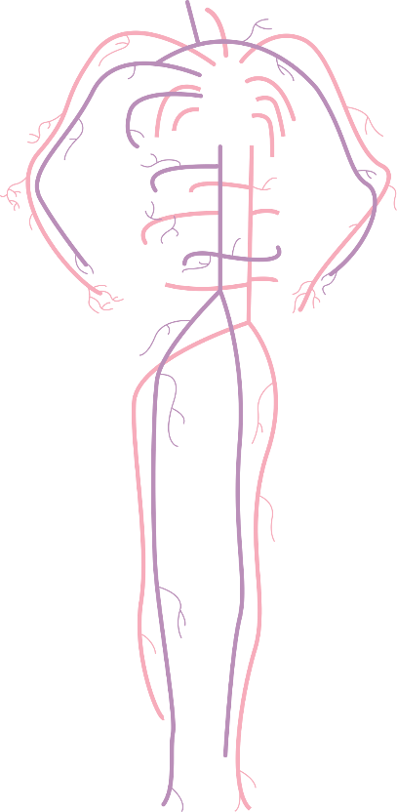


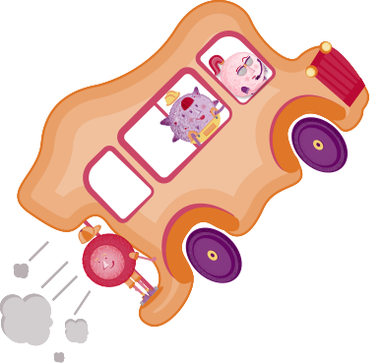

How does blood travel?
Notes:
Explain that it takes our blood roughly one minute to do a complete circuit of the body, and it moves at an even quicker speed if we are exercising.
Q. How does our blood move at such a fast speed?
The heart is a muscle which acts as a powerful pump, and keeps the blood moving around the body.
The heart takes in blood which is low in oxygen and pumps it through the right side of the heart towards the lungs, where the red blood cells can collect oxygen, ready to deliver to other parts of the body.
This blood then returns to the heart to receive another powerful pump, which carries it around the body.
All this time, the blood is travelling through circular tubes, called blood vessels (arteries, veins and capillaries).
The heart, blood vessels and blood make up the circulatory system – because together, they keep blood circulating.
You can think of the blood vessels as a big network of roads, which the plasma bus uses to carry its blood cells around. The heart is a bit like the engine, making sure the blood can get to where it needs to go.
Q. What can our pulse tell us about our heart?
If you want to get an idea of how hard your heart works, try measuring your pulse. For instructions on measuring your pulse, see the next slide.

Slide 17
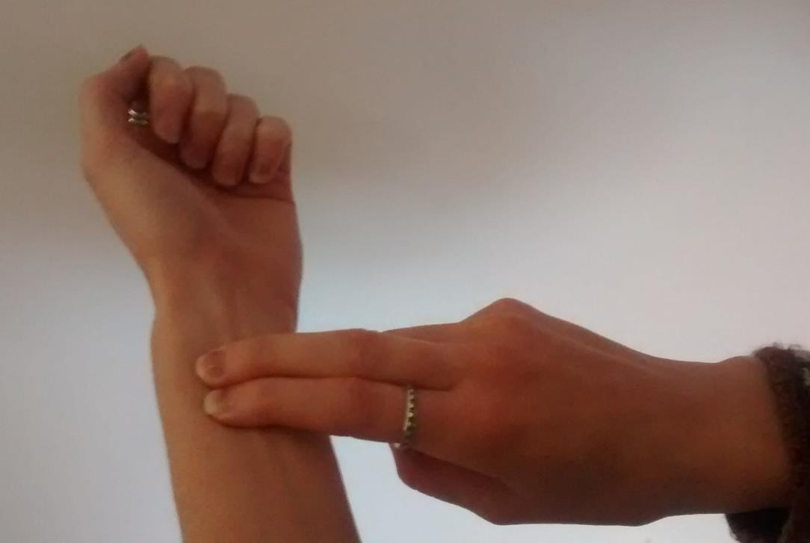
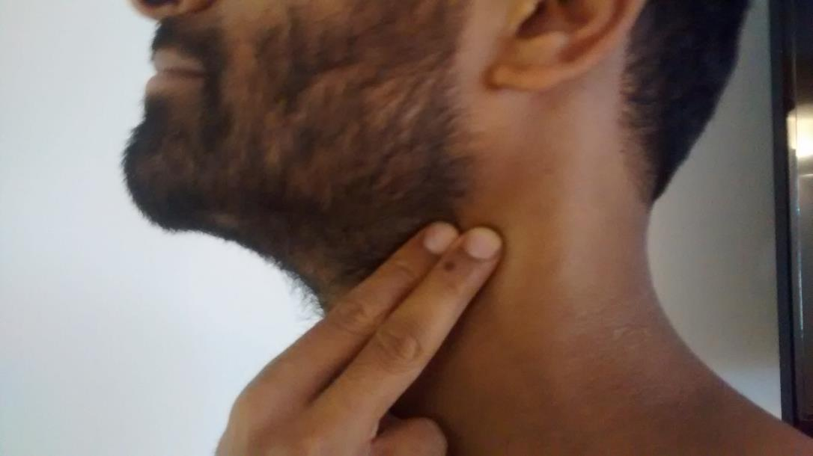
Finding your pulse
Notes:
Q: Has anyone found their pulse before? Can you instruct the rest of the class on where to find it?
The wrist and neck are the best places to find your pulse – use the instructions below if you don’t have a class expert handy.
To find your pulse on your wrist:
Take the first two fingers of one hand and place them on the inner forearm of the opposite arm, about two finger spaces away from your wrist.
Feel around until you find a tendon – this will feel like a long cord running along your wrist.
Move your fingers a little further up, towards the top of your inner forearm and you will feel a kind of throbbing under the skin. If you can’t feel it, try pressing down more firmly or moving your fingers around slightly.
You will know when you have found your pulse because you will feel a throbbing or beating.
To find your pulse on your neck:
Take the first two fingers of one hand and place them on the side of your neck, just under your jaw and next to your windpipe.
If you can’t feel it, try pressing down more firmly or moving your fingers around slightly.
You will know when you have found your pulse because you will feel a throbbing or beating.
When you have found a steady beat on your neck or wrist, count how many times your pulse beats in 30 seconds. If you multiply that number by 2, you will have you pulse rate per minute!
Q: What causes your pulse?
The throbbing feeling that we call a ‘pulse’ is caused by the blood pumping through an artery. This blood is under high pressure because it has received a big pump from the heart to get it around the rest of the body.
Although the pulse is most easily found by feeling your wrist or neck, blood is being pumped through blood vessels all of the time, all over your body.
It feels stronger in the wrist and neck because here, the artery is closer to the skin and it is just bene pumped by the heart so it is travelling under more pressure.

Slide 18





Can you calculate the quantities?
What you know:
White blood cells and platelets make up 2% of a person’s blood.
The ratio of white blood cells and platelets to red blood cells is 1:22.
1.5% of a person’s blood is made up of white blood cells.
Blood cells | Percentage of blood (%)
Plasma
54%
Red blood cells
44%
1.5%
White blood cells
Platelets
0.5%
Notes:
Challenge pairs/small groups to work out the correct percentage of each ingredient in the blood, using the clues provided.
Note: There is an alternative set of more difficult clues on the next slide.
The answers will come on at a click, in a logical order by which they can be calculated.
If you wish to skip this problem solving activity and go straight to making blood, they can just move onto slide 20 which shows pupils the correct percentages.

Slide 19
Can you calculate the quantities?
What you know:
A person’s blood contains three times more white blood cells than platelets.
The ratio of white blood cells and platelets to red blood cells is 1:22.
White blood cells and platelets make up 2% of a person’s blood.
Blood cells | Percentage of blood (%)
Plasma
54%
Red blood Cells
44%
1.5%
White blood cells
Platelets
0.5%
Notes:
Challenge pairs/small groups to work out the correct percentage of each ingredient in the blood, using the clues provided.
Note: There is an alternative set of easier clues on the previous slide.
The answers will come on at a click, in a logical order by which they can be calculated.
If you wish to skip this problem solving activity and go straight to making blood, they can just move onto slide 20 which shows pupils the correct percentages.

Slide 20

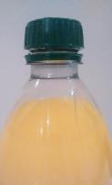
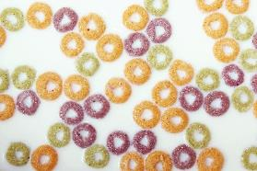
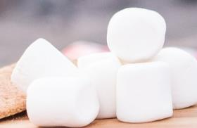
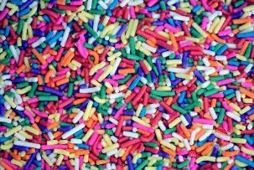
Your recipe
Use the recipe to make an accurate representation of blood.
Think carefully about how much of each ingredient you will need.
Blood cells | Ingredient | % of Blood
54%
Plasma
44%
Red blood cells
1.5%
White blood cells
Platelets
0.5%
Notes:
The pupils’ challenge is to make their own representation of blood using the items shown in this recipe! (Remind pupils that they must not eat the ingredients)
You will need these minimum quantities per group of students:
7 white marshmallows (to represent white blood cells)
a handful of loop / donut shaped cereal, preferably soaked in 2 drops of red food dye (to represent red blood cells)
a teaspoon of hundreds and thousands (to represent platelets)
100ml of yellow liquid, e.g. diluted orange squash / lemonade (to represent plasma). Note: A pale liquid works best, allowing pupils to see the other ingredients once mixed.
Alternative without using food items:
If you wish to use non-food alternatives, multi-link cubes or place value counters make a great alternative for this activity. Use different colours to represent the different components.
You will need these minimum quantities per group of students:
5 white maths cubes / place value counters (to represent white blood cells)
10 red maths cubes / place value counters (to represent red blood cells)
5 different coloured cubes / place value counters (to represent platelets)
100ml of water / diluted orange squash (to represent plasma).

Slide 21

What happens if your blood doesn’t have the right ingredients?
Notes:
A person’s health can be affected when their blood doesn’t have the right ingredients.
Examples include:
Changes in blood composition
Some diseases result in patients having the wrong amounts of these blood components we have been learning about.
For example:
in some blood cancers, like leukaemia, the bone marrow creates the wrong number of white blood cells
people with haemophilia don’t have some of the ingredients in their plasma which help platelets to do their job and stop bleeding.
Blood loss
Having enough blood is vital. The human body should be 7% blood.
If a person loses more than 30% of their blood over a short time period, the body cannot replace the blood quickly enough. This amount of blood loss can be life-threatening.
Patients who have been in an accident or undergone surgery might suffer from severe blood loss.
When the cells in a person’s blood start misbehaving
Explain that if a person’s blood cells don’t do the job they should, then they will become ill.
For example, if a person has sickle cell disease, their body produces red blood cells with a ‘sickle’ shape.
The shape of these cells means they can’t carry enough oxygen and they can get stuck in blood vessels, causing pain.

Slide 22
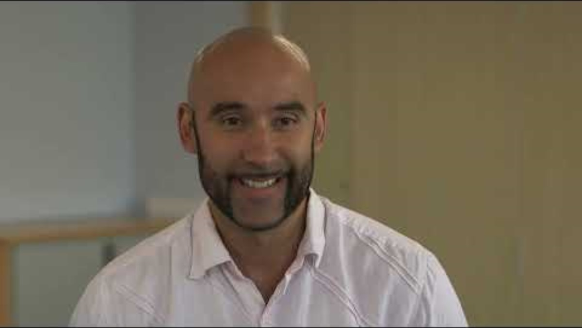
Why do people give blood?
Notes:
Luckily, there is a way to help all of these different patients.
Q: Can you think what that might be?
All of these patients can be helped through blood donation.
Play the film. Be aware there are images of blood and a small blood sample being taken from a donor’s finger.
Explain to pupils that we are going to be discussing what we have seen in the film and our thoughts and experiences around blood donation. It is important that we respect our rules for this kind of class discussion. (If you have your own class set of rules for group discussions, ask pupils to recap them.)
Emphasize that the pupils should listen to each other respectfully during the discussion.
Q: What reasons did people have for giving blood in the film?
Because they know it saves or improves the lives of others, because it is quick and easy (and you get tea and biscuits!), because it makes them feel good.
Q: What do you think about giving blood? Is this something you would like to do when you are old enough? Why?

Slide 23


Who could you help?
B+
AB+
O+
A+
A−
O−
B−
AB−
Notes:
Explain that people have different blood groups.
Your blood group can be any of the following: A+, A−, B+, B−, AB+, AB−, O+ or O− (NB: + = positive, − = negative)
A person’s blood group restricts who they can donate their blood to and who they can receive blood from.
For example, someone with A Positive (A+) blood can only give to AB+ and A+ blood groups, but they can only receive blood from A+, A-, O+ and O- blood groups.
To make things even more complicated, there are different blood ‘subtypes’ within these blood groups.
If a patient is given a blood group or subtype that isn’t compatible with their own, their body will reject it, which can be really dangerous.
O negative donors are often called ‘universal donors’ because anyone of any blood type can safely receive their donations.
One rare blood subtype is the ‘Ro’ subtype. All blood groups (A, B, AB and O) can be Ro. Lots of patients with the Ro subtype need to receive blood from a donor with the Ro subtype.
However the Ro subtype is rare – only 2% of NHSBT blood donors have it.
The Ro subtype is most common in Black African and African Caribbean people, which is why more of these donors are needed.
More information on blood types Blood types - NHS Blood Donation

Slide 24
Glossary
Blood donation: When an individual volunteers to give their blood to be used in a transfusion. It typically takes 5-10 minutes for 470ml (just under a pint) to be donated.
Blood transfusion: When a person is given someone else’s blood.
Donor: A term which refers to the individual who has donated blood (or organs / stem cells)
Recipient: A term which refers to the individual who receives a blood transfusion (or organ or stem cell donation).
Circulatory system: Made up of three parts; the heart, the blood vessels and the blood.
Heart: A very strong muscle which pumps blood around the body.
Blood Vessels: A network of tubes inside the body through which blood travels. The main blood vessels are the arteries, veins and capillaries.
Bone marrow: Soft, jelly-like tissue found in some bones which produces blood cells.
Blood group: Different people have different blood groups.
Your blood group decides who you can give blood to and who you can receive blood from.
Key words:
Blood donation, Blood transfusion,
Circulatory system, Heart, Blood vessels,
Bone marrow, Blood group

