Slide 1






Create a campaign
An English and PSHE education activity for pupils aged 7 to 11 exploring marketing. Pupils run their own campaign to raise awareness of the need for blood and/or stem cell donors.
N.B. Teachers’ notes and background information can only be viewed
if this presentation is opened within the PowerPoint application,
not on interactive whiteboards.
The visuals on the PowerPoint slides display best in PowerPoint presentation mode.

Slide 2

Using these resources
Activity summary
In this English and PSHE lesson, pupils aged 7 to 11 run their own campaign to raise awareness of the need for stem cell and/or blood donors. Pupils choose their audience, campaign materials and carry out research to find facts and figures to support their campaign.
When to use this activity
This activity can be used as a follow up to one or more of the following:
The ‘Giving to help others’ PSHE lesson (ages 7-11)
The Blood and circulatory system lesson (ages 10-11)
The ‘Giving to help others’ Assembly (ages 4-11).
You can find the resources at Educational resources - NHS Blood and Transplant
Your campaign focus
Depending on which lesson(s) pupils have completed, they may have learnt about stem cell donation or blood donation. Although these are two different ways of donating, both are ways of giving others the gift of healthy blood and both can result in life-saving outcomes.It is up to you whether you want pupils to create campaigns about blood donation, stem cell donation or both. The PowerPoint includes guidance for both, but all content is adaptable.
How to use this presentation
Slides 2-5: Teachers’ notes (these slides will stay hidden in presentation mode).
Slides 6-20: Use with pupils. Instructions and subject knowledge included on the notes section of each slide.
Slides 21-23: Additional teachers’ notes on documenting your campaign and running a donor registration event (these slides will stay hidden in presentation mode).
(Slide 17 is optional; contains links to online research.)
Timing
1 hour +
This activity is designed to be flexible. Pupils can spend as long or little as you want them to on the campaign.

Slide 3


Using these resources
Why use these resources?
Linked to the curriculum
The lesson supports the Key Stage 2 PSHE Association‘s Programme of Study, focusing on pupils’ role in their community and helping others. Pupils might be learning about helping others in a range of contexts, keeping healthy or about the work of voluntary organisations and campaign groups. It also links to the Year 6 Science topic of Animals, including humans.
Raise awareness of blood donation, and other forms of donation
Giving blood saves lives. The blood you give is a lifeline in an emergency and for people who need long-term treatments. Many people would not be alive today if donors had not generously given their blood.
This lesson aims to make pupils aware of blood donation, and other forms of donation, including stem cell donation. The aim is to encourage and empower them to tell their parents about what they have learnt and how their parents and other adults can help increase the number of donors now and in the future, particularly people who are of Black or Asian heritage and other ethnicities, where the need is greatest.
Who produced these resources?
These resources have been created for ‘Giving to Help Others’ by Team Margot Foundation, with the help of EdComs and NHS Blood and Transplant and practising teachers.
What preparation is required?
This lesson covers a sensitive topic. It is essential that you read the Creating a safe learning environment document before delivering this session.
Make sure you can play the video on slide 13.

Slide 4




Create a campaign
‘Giving to help others'
Notes:
Explain:
Team Margot was a charity, which campaigns to raise awareness of the need for bone marrow donors and stem cell donors, as well as blood donors.
The charity was set up to help a little girl called Margot, who had leukaemia. When a person has leukaemia, their bone marrow makes abnormal white blood cells. To help her get better, Margot needed a bone marrow transplant.
Margot’s family and friends came together to help find her a matching donor and ask people to do something amazing: register as potential bone marrow donors or blood donors and save lives!
Margot did eventually find a suitable donor match and received her bone marrow transplant. Unfortunately, Margot’s leukaemia was extremely aggressive and she passed away.
Team Margot continues to campaign for more people to register as donors and help save lives.
Now, you can join Team Margot and help to spread the word too!

Slide 5

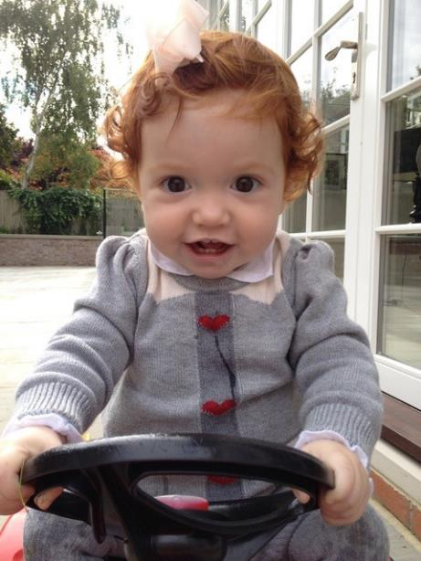

About Team Margot
Team Margot Foundation was formed because of a little girl called Margot who needed a bone marrow transplant. Margot’s family and friends came together as Team Margot to help find her a matching donor and ask people to do something amazing: register as potential stem cell and bone marrow donors.
Margot did eventually find a suitable donor match and received a bone marrow transplant. Unfortunately, Margot’s leukemia was extremely aggressive and she passed away, aged 2 years and 2 months.
Team Margot continued their campaign and education work for 10 years and closed in 2025.
Through the ‘Giving to help others’ education programme, the charity raised awareness of organ donation, blood donation, stem cell donation and cord blood donation.

Slide 6

Links to the PSHE Association Programme of Study
England
PSHE Association Programme of Study, Key Stage 2 – Core Theme 3. Living in the wider world.
L7 – that they have different kinds of responsibilities, rights and duties at home, at school, in the community and towards the environment; to continue to develop the skills to exercise these responsibilities.
L9 – what being part of a community means, and about the varied institutions that support communities locally and nationally.
L10 – to recognise the role of voluntary, community and pressure groups, especially in relation to health and wellbeing.
Scotland
Mental, emotional, social and physical wellbeing;
Social wellbeing: Through contributing my views, time and talents, I play
a part in bringing about positive change in my school and wider community.
Physical wellbeing: I am developing my understanding of the human
body and can use this knowledge to maintain and improve my wellbeing and health.
Wales
Health and emotional well-being.
Learner should be given opportunities to:
Understand the features and physical and emotional benefits of
a healthy lifestyle, e.g. food and fitness.
Gather information in a variety of ways, including simple questionnaires or databases to support understanding of PSE-related issues.
Northern Ireland
Mutual understanding in the local and wider community.
Pupils should develop knowledge, understanding and skills in:
Human rights and social responsibility

Slide 7
Create a campaign

Slide 8




Learning aim
Can I design a campaign to raise awareness of blood donation?
Success criteria:
Use facts and figures to support my campaign
Have a clear message
Create a positive campaign message that inspires others to get involved
Use creativity to grab my audience’s attention

Slide 9
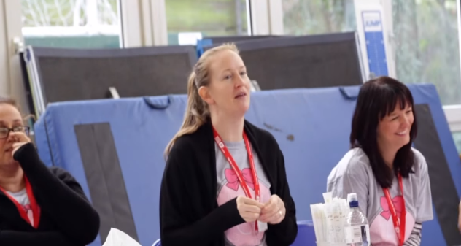
What do you want to know about campaigning?
What do you know about campaigning?
Notes:
Use this slide to assess pupils understanding of campaigning.
Place two large pieces of paper on the wall, one titled ‘What I know about campaigning’ and the other titled ‘What I want to know about campaigning’.
Pupils should write their responses on sticky notes and place their sticky notes on the appropriate sheet.
Support: Where needed an adult may scribe their answers/responses for them.

Slide 10


Your challenge…
Join 'Giving to help others' and help save lives!
Create your own campaign to inform your school community about the power of donation – and inspire adults to sign up.
You can campaign to raise awareness of the need for:
blood donors
stem cell donors
Notes:
Q: What is a campaign?
Encourage pupils to share their ideas and any past experience of ‘campaigning’. Explain that a campaign is all about change – usually, run by a group of people with a shared goal or vision. They plan activities to get others involved and make that vision a reality.
Explain that the pupils’ challenge is to create and run their very own campaign to spread the word about the need for blood donors and potential bone marrow or stem cell donors.
Their mission is to raise awareness of the need for donations and encourage others in their community to register as donors.
Note: If your class completed the PSHE lesson, you may wish to adapt the lesson and have pupils focus their campaign on potential stem cell donors. If your class completed the Blood and circulatory lesson, you may wish to adapt the lesson and have pupils focus on campaigning for blood donors.

Slide 11
What will you need to do?
1. Understand your audience
2. Find fascinating facts and figures
3. Choose a format (e.g. poster, TV / online advert, blog, news story)
Notes:
Explain:
To run a successful campaign, there are several things pupils will need to think about…
Run through the three bullet points on the board, explaining their importance. For example, your chosen audience might affect the words you use or the format you choose, facts and figures will help your audience to understand the problem and what they can do to help, and an effective format will get your audience engaged and make sure they remember your message!

Slide 12

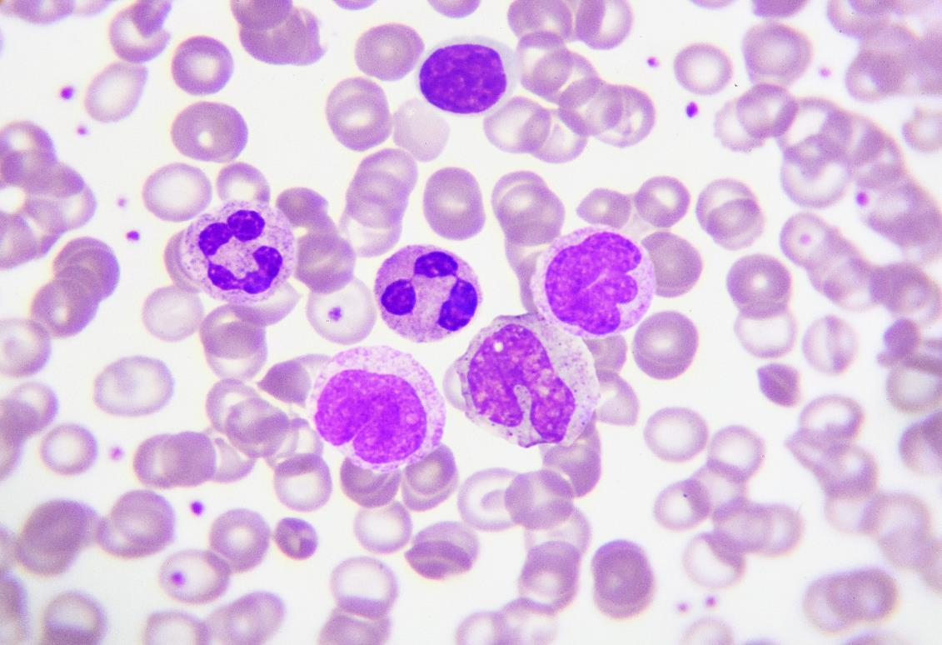

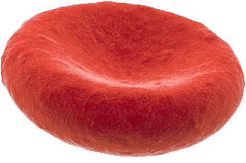
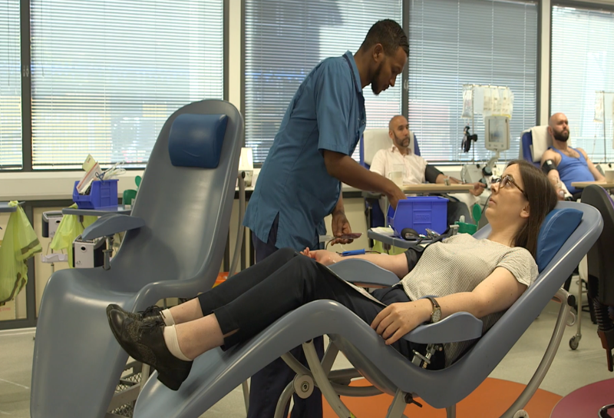
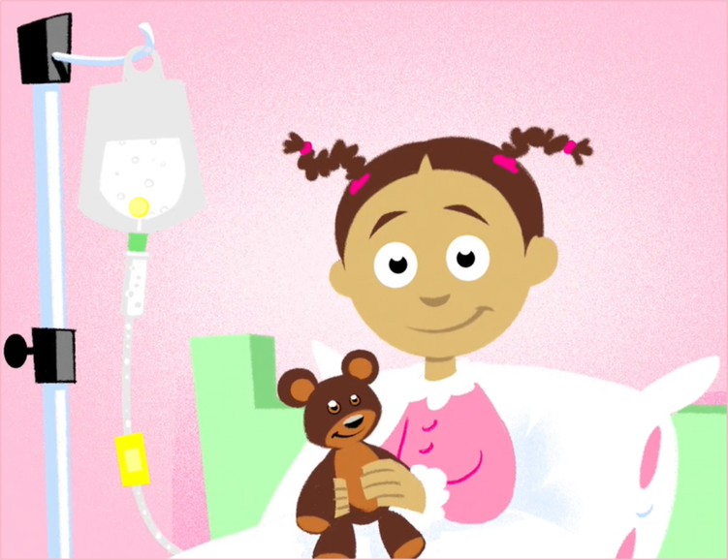
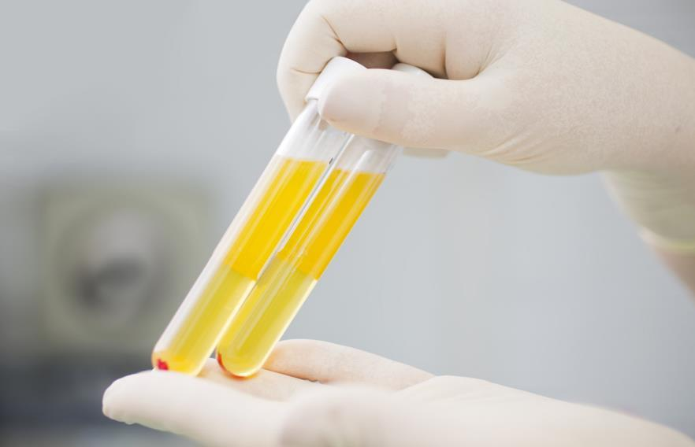

What do we know already?
Notes:
Use this slide to assess what pupils already know.
For example, pupils may recall the following points from the Blood and circulatory lesson:
Blood, the blood vessels and the heart all make up the human circulatory system. Amongst other things, the circulatory system helps to fight disease and to carry oxygen around the body – both of which are vital for keeping us alive and healthy.
Blood is made up of four main components: plasma, red blood cells, white blood cells and platelets.
When blood is donated, it is separated into these different components, using filtering and a centrifuge. This means that the different parts can be used to help different patients. For example, red blood cells help those who have experienced heavy blood loss, white blood cells can help treat those suffering life threatening infections, platelets can help those with bone marrow failure and plasma can help patients with liver disease.
Pupils may recall the following points from the PSHE lesson:
There are lots of different ways in which individuals can help different groups and communities.
The groups and communities we can help can include our family and friends (for example, by tidying our room), our school community (for example, by handing our exercise books in class), our local community (for example, by holding the door open) and the wider world.
Helping the ‘wider world’ means helping people we might not know. We could do this by giving clothes or toys to a charity shop or by telling our adult at home about how they could help others like Leila helped Asha in the Giving to help others video.
There are lots of different reasons why we might choose to help others. Perhaps, because it makes use feel good to help or because we have empathy for them and can put ourselves in their shoes.

Slide 13
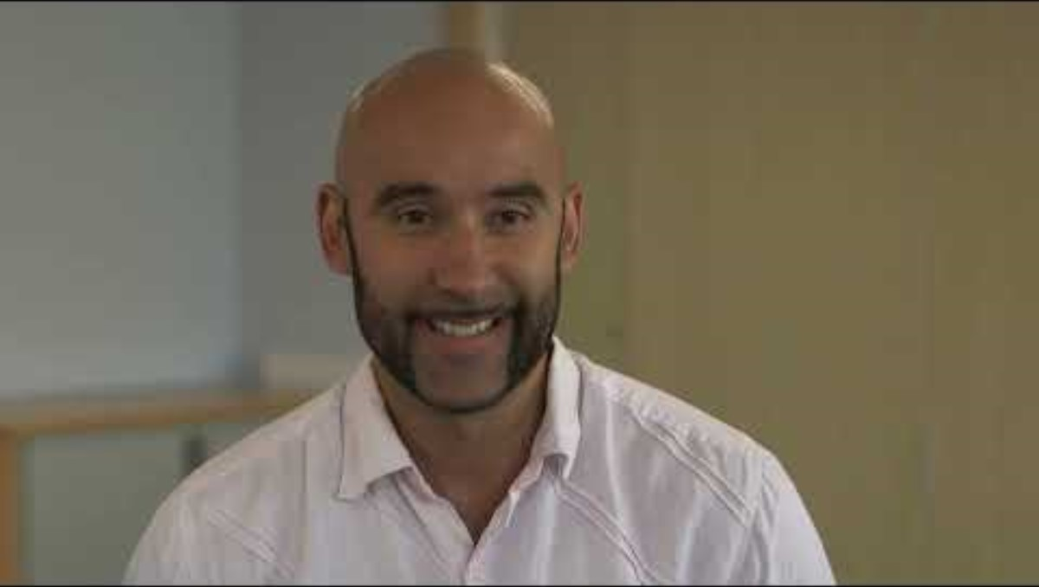
Why do people give blood?
Notes:
If needed, play the film to remind pupils why people want to give blood and why patients need to receive it.
Q: Why do people give blood? It’s easy, they see it as their responsibility to society, it makes them feel good to know they are saving up to three lives, they themselves might need a blood transfusion in the future…and they get tea and biscuits from the friendly nurses!
Q: Why do people need blood transfusions? There are many different reasons – it is thought that at least 1 in 4 of us will need a blood transfusion at some point in our lives. This may be because of an accident, because of an operation, because of blood cancers or because of diseases which affect the blood like sickle cell or liver disease.

Slide 14



Who is your target audience?
Parents and families
Other pupils
in school
Teachers
Wider community
Notes:
Q: Why might you need to think about your audience?
Different audiences will be interested in different things, and might use different language or perhaps spend more time in certain places. By being clear on who you want to spread the word to, you can make sure you tailor it to them.
Ask pupils to discuss who they want to target from the options on the board (or their own ideas) and decide how this could change their message.
Examples:
Other pupils in school: Younger pupils might need simpler language and a smaller amount of information. They will need to be kept engaged so you will need to think carefully about the format you use – make sure it is attention grabbing! They can’t give blood, so messages aimed at them would be about telling adults in their lives about blood donation, and signing up when they are older.
Parents: Formal language might be more appropriate. Using facts and statistics can be a good way to help parents understand the issue.
Teachers and staff: Teachers and staff don’t have much time! Think about how you can deliver the key message to them in a way they will understand quickly and remember.
Wider community: If you are targeting the wider community, you will need to think about the best format to use. For example, a presentation would only work if you could get lots of members of the local community in one place. If this is not possible, creating posters or information leaflets may be a better option.

Slide 15


What might you need to be conscious of with target audience?
Parents and families
Other pupils
in school
Teachers
Wider community
Notes:
Ask pupils to consider the question on the board. They should reflect back on the differences discussed in the PSHE lesson.
Explain that it is great to donate, or tell other people about donating stem cells, bone marrow or blood. However some people may have personal reasons why they can’t donate, which you should always respect, and not press them to explain. They may have health issues themselves, and some people do not support donations on religious grounds. It is important pupils remember this when talking to their target audience about donation.

Slide 16
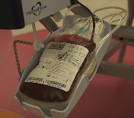
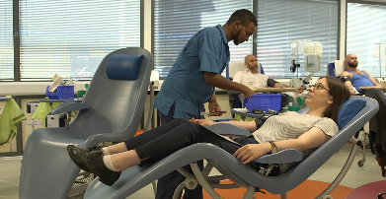
How can you use facts and figures?
A single blood donation can save up to 3 lives!
In England, 5,000 blood donations are needed every day to treat patients in need.
Notes:
Q: Why are facts and figures going to be important for a successful campaign?
Statistics and facts can be really powerful because they are hard to argue with. People can disagree with opinions, but that becomes more difficult when facts and figures are involved. Remind pupils that they should only ever use facts and figures they know to be true. If they find a fact online, they should double check it with another source to make sure it is correct.
Pupils can use the All about blood comprehension sheet to identify useful facts and figures for their campaign. This sheet can be downloaded from Educational resources - NHS Blood and Transplant

Slide 17



How can you use online research?
What is in your blood?
Recaps on the different components of your blood and their different functions…
What does my blood do for me?
Find out just how amazing your blood really is…
Blood and the heart
Read about the heart, blood and blood types…
Online quiz
Test yourself and see what else you can find out for your campaign!…
News and campaigns - NHS Blood Donation
Then latest blood donation news and campaigns
Blood donation key messages and information - NHS Blood and Transplant
Key messages and facts about blood donation
Stem Cell Donor Registry - NHS Blood Donation
All about stem cell donation
Notes:
If pupils are conducting research online for their campaign, provide them with the links on the slide as a starting point.
Challenge pupils to identify a public figure who has given blood or maybe even made another donation – organs, bone marrow or stem cells - and find out why they donated.
The hyperlinks on the slide are as follows:
What’s in your blood? https://www.bbc.com/bitesize/articles/zqv4cwx
What does my blood do for me? http://www.bbc.co.uk/guides/zw6nyrd
Blood and the heart: https://www.ducksters.com/science/blood_and_the_heart.php
Online quiz: https://www.ducksters.com/science/quiz/blood_and_the_heart_questions.php
Blood donation text service is a hit: https://www.blood.co.uk/news-and-campaigns/the-donor-magazine-winter-2016/new-text-service-is-a-hit/
News and campaigns - NHS Blood Donation
Blood donation key messages and information - NHS Blood and Transplant
Stem Cell Donor Registry - NHS Blood Donation

Slide 18

What campaign materials will you use?
News story
Film
Song
Poster
Art
Performance
Blog
Poetry
Presentation
Advert
Video
Leaflet
Notes:
Remind pupils to think about their audience when choosing their campaign materials. They should consider what would be most appealing to their audience and remember that they can use more than one campaign material.
Depending on the amount of time you would like to spend on creating the campaign, you may wish to set a limit, e.g. of 3 different campaign materials per group.
Tips:
If pupils choose written campaign materials, use this as an opportunity to reinforce the use of appropriate grammar and vocabulary choices.
If pupils are using a song, drama, social media video etc, you may want to have them practice their piece, self evaluating and improving each time. Pupils can write scripts or lyrics that include key campaign messages. If possible, pupils can film their finished piece on a school tablet.
Blogs can be drafted on paper before being published, for example on Word Press (https://wordpress.org/)

Slide 19

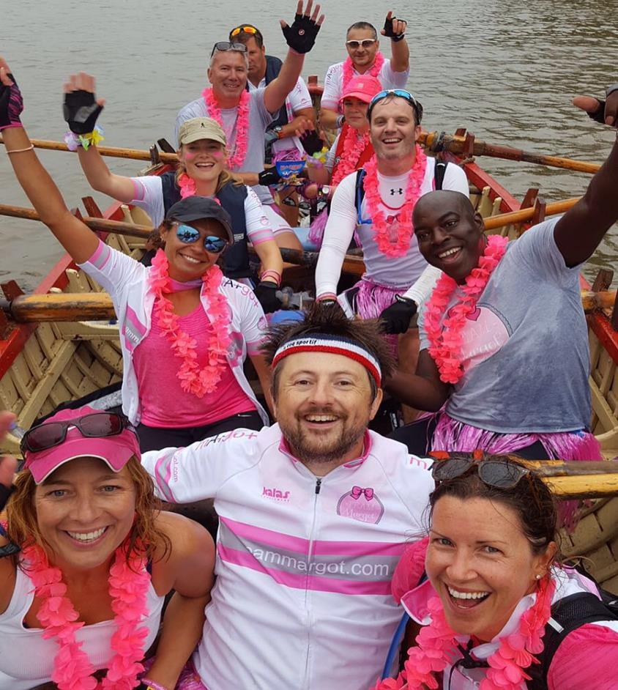
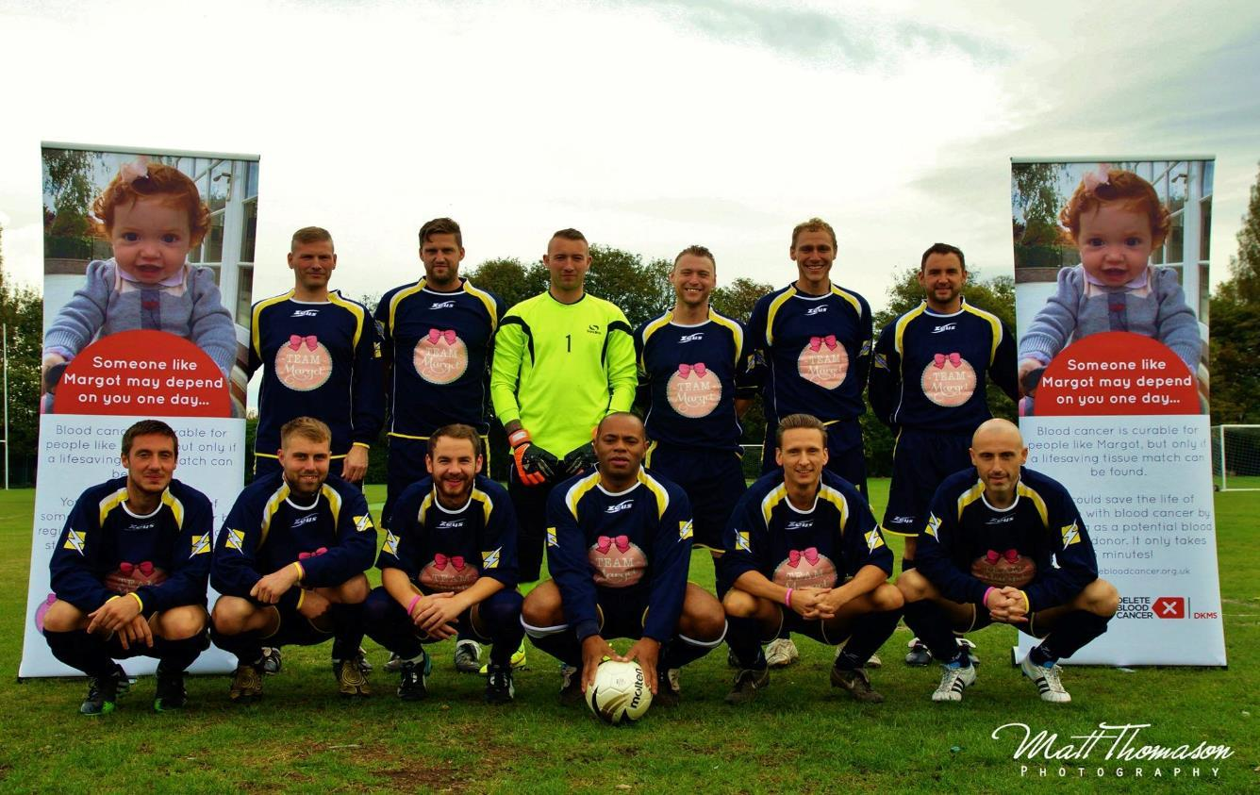



How will you get your message out?
Notes:
Pupils could do any of the following to spread the word:
• Hold an assembly to teach the school about blood donation – they could create a presentation, play their videos or perform their songs.
• Create displays and hold an exhibition of their work.
• Put posters around school where other pupils and parents can see them.
• Send leaflets home to parents, put articles into school newsletters or on the school website. Pupils could even send an article to the local paper.
• Invite parents or members of the local community to visit the school to view their work or assembly.

Slide 20
What do you want to know about campaigning?
What do you know about campaigning?
Notes:
Use this slide to assess what pupils have learnt and what they think about campaigning now.
Display two more large pieces of paper on the wall, one titled ‘What I now know about campaigning’ and the other titled ‘What I still want to know about campaigning’.
Once more, pupils should write their responses on sticky notes and place their sticky notes on the appropriate sheet.
Support: Where needed an adult may scribe their answers/responses for them.
Pupils can add their new ideas to the same post-it note and take time to reflect on what they have learnt.

