Slide 1






PSHE lesson
A PSHE education lesson for pupils aged 7 to 11 exploring the concept of helping others, and how adults can help others through bone marrow, stem cell and blood donation.
N.B. Teachers’ notes slides can only be viewed
if this presentation is opened within the PowerPoint application,
not on interactive whiteboards.
The visuals on the PowerPoint slides display best in PowerPoint presentation mode.

Slide 2

Using these resources
Activity summary
In this PSHE lesson, pupils aged 7 to 11 explore the concept of helping others, including family and friends, as well as people they may not know in the local and global community.
Pupils learn about donation as one way adults can help others and how they, as children, can help by promoting an awareness of donation.
The lesson includes a video to stimulate discussion and a group card sorting activity.
When to use this lesson
This lesson can:
stand alone
be used before the ‘Giving to help others’ Create a campaign activity (ages 7-11)
be used before the Blood and the circulatory system lesson (ages 10-11)
be used to explore in more detail the themes of the ‘Giving to help others’ Assembly (ages 4-11).
You can find the resources at Educational resources - NHS Blood and Transplant
How to use this presentation
Slides 2-5: Teachers’ notes (slides hidden in presentation mode).
Slides 6-20: Use with pupils. Slide notes include guidance for teachers.
Slides 21-25: FAQs, background information
Note: Please read ‘Creating a safe learning environment’ before delivering this lesson.
Timing
45 minutes to 1 hour

Slide 3
Using these resources
Why use these resources?
Linked to the curriculum
The lesson supports the Key Stage 2 PSHE Association‘s Programme of Study, focusing on pupils’ role in their community and helping others. Pupils might be learning about helping others in a range of contexts, keeping healthy or about the work of voluntary organisations and campaign groups. It also links to the Year 6 Science topic of Animals, including humans.
Raise awareness of blood and stem cell donation, and other forms of donation
This lesson aims to make pupils aware of various forms of donation, in particular blood and stem cell donation, and, importantly, to encourage and empower them to tell their parents about what they have learnt and how their parents and other adults can help increase the number of donors now and in the future.
Who produced these resources?
These resources have been created for by the Team Margot Foundation, with the help of EdComs and NHS Blood and Transplant and practising teachers.
What preparation is required?
This lesson covers a sensitive topic. It is essential that you read the Creating a safe learning environment document before delivering this session.
Find a suitable container to be your Ask It Basket (see slide TBC).
Make sure you can play the video on slide 11.
Print and cut the Help discussion cards (one set per group).
Print one copy of slide 7 to display during the lesson.
Hand out at least 12 post its to each pupil (half of one colour, and half another).

Slide 4
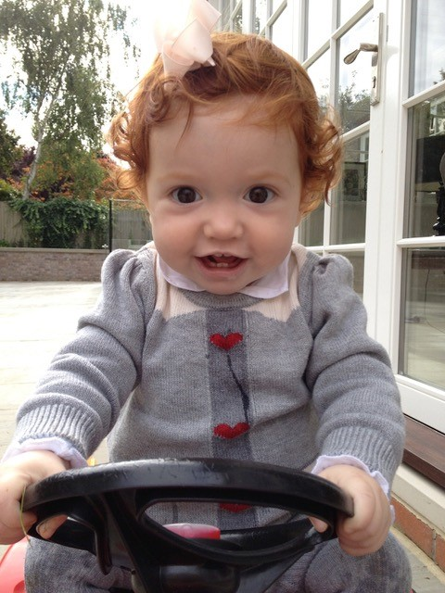
About Team Margot
Team Margot Foundation was formed because of a little girl called Margot who needed a bone marrow transplant. Margot’s family and friends came together as Team Margot to help find her a matching donor and ask people to do something amazing: register as potential stem cell and bone marrow donors.
Margot did eventually find a suitable donor match and received a bone marrow transplant. Unfortunately, Margot’s leukemia was extremely aggressive and she passed away, aged 2 years and 2 months.
Team Margot continued their campaign and education work for 10 years and closed in 2025.
Through the ‘Giving to help others’ education programme, the charity raised awareness of organ donation, blood donation, stem cell donation and cord blood donation.

Slide 5
Links to the PSHE Association Programme of Study
England
PSHE Association Programme of Study, Key Stage 2
Core Theme 1. Health and wellbeing.
H2 – how to make informed choices
Core Theme 2. Relationships.
R13 – that differences and similarities between people arise from a number of factors, including family, cultural, ethnic, racial and religious diversity (see protected characteristics in the Equality Act 2010)
R10 – to listen and respond respectfully to a wide range of people…to try to see, respect and if necessary constructively challenge others’ points of view
R7 – that their actions affect themselves and others
Core Theme 3. Living in the Wider World.
L7 – that they have different kinds of responsibilities, rights and duties at home, at school, in the community and towards the environment; to continue to develop the skills to exercise these responsibilities
L9 – what being part of a community means, and about the varied institutions that support communities locally and nationally
L10 – to recognise the role of voluntary, community and pressure groups, especially in relation to health and wellbeing
Scotland
Mental, emotional, social and physical wellbeing;
Social wellbeing: Through contributing my views, time and talents, I play
a part in bringing about positive change in my school and wider community.
Physical wellbeing: I am developing my understanding of the human
body and can use this knowledge to maintain and improve my wellbeing and health.
Wales
Health and emotional well-being.
Learner should be given opportunities to:
Understand the features and physical and emotional benefits of
a healthy lifestyle, e.g. food and fitness.
Northern Ireland
Mutual understanding in the local and wider community.
Pupils should develop knowledge, understanding and skills in:
Human rights and social responsibility

Slide 6
PSHE lesson

Slide 7
Ground rules
1.
2.
3.
4.
5.
Talk about
‘someone I know’
Ask questions…
…but not
personal ones
Comment on what is said,
not who has said it
Let people speak
for themselves
6.
7.
8.
9.
10.
Keep the conversation
in the room
Respect others
It’s ok to pass
Listen
Ask for help
Notes:
Explain that:
today we are going to be thinking about giving to help others
a good discussion needs ground rules so that everyone feels able to share their ideas
everyone in the class needs to follow these ground rules throughout the lesson:
Talk about ‘someone I know’– We will be open and honest, but won’t discuss our own or others’ personal / private lives. We should say ‘someone I know’ instead of giving names, and not say anything that could help others to work out who we are talking about.
Ask questions… – There are no stupid questions. If you don’t want to ask a question in class, you can write down anonymous questions and put them in the Ask It Basket at any time during the lesson. At the end, everyone will get a chance to write a question.
…but not personal ones – Don’t ask questions about others’ personal / private lives that might upset them, embarrass them, or put them ‘on the spot’.
Comment on what is said, not who has said it
Let people speak for themselves – Don’t assume you know what other people or groups might think, feel or do on a particular subject, based on what else you know about them.
Keep the conversation in the room – We will not repeat what other people have said outside this the room. This goes for the teacher too, unless s/he feels worried about a child, in which case s/he will follow the schools rules about what to do, which might involve talking to another teacher, or to the pupil’s parent or carer.
Respect others – It’s ok to disagree with another person’s point of view, but respect others, and don’t make fun of them or what they say, or put them down.
It’s ok to pass – Taking part is important, but it is ok to pass on a question or activity if it makes you feel upset or uncomfortable.
Listen – It is important to value and listen to everyone’s contributions.
Ask for help – Review where pupils might go for help and advice if they need it (teachers, parents, other family members or trusted adults, friends). If they would rather speak to someone they don’t know, they could contact ChildLine (www.childline.org.uk).
Note: Ground rules work best when they are developed by the teacher and the class in their own words. You may wish to ask pupils to play back the meaning of each rule in their own words to ensure that they have fully understood. It is a good idea to print this slide in A3 to display for pupils to refer to throughout the session, particularly in their paired discussions and group work.

Slide 8
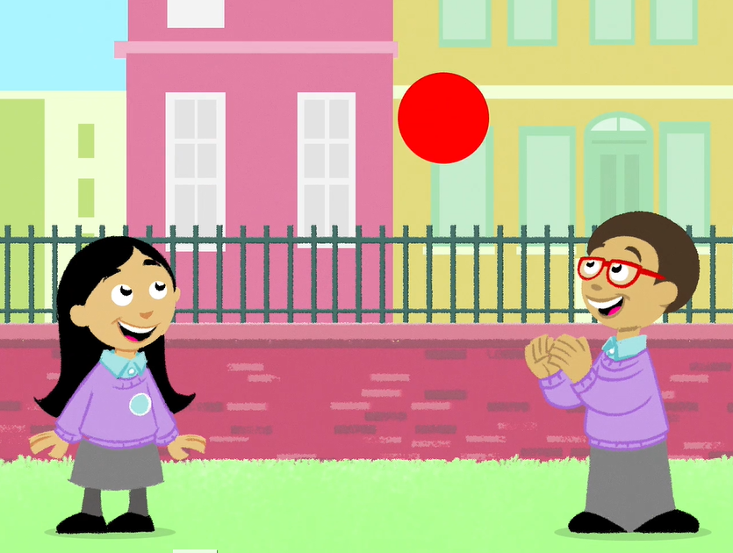
When did you last help someone?
Notes:
Ask pupils to think quietly for a minute about the last time they helped someone. Who did they help, and what did they do? How did it make them feel? What difference did it make to the other person? Explain that they don’t need to share this example.

Slide 9
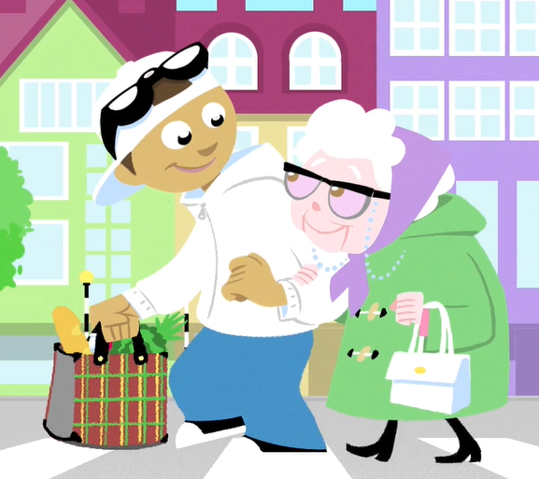
How can we help others?
Why might we
help others?
Notes:
Explain to pupils that they are going to begin by thinking about two questions:
How can children like us help others?
Why might children like us help others?
Ask pupils to write their answers on up to three post it notes per question, and put them on the wall or board. Tell them which colour post it to use. They will need the other colour later.
Support: Pupils who need support can use their example from the last slide to help their thinking. Where needed an adult may scribe their answers/responses for them.
Note: These questions will serve as an initial assessment to find out the starting point of pupils. The activity will be repeated at the end of the session, in order to show evidence of progress made. For that reason, avoid supplying pupils with possible answers at this stage, encouraging them to offer their own ideas. Think about how you will tailor the session to the class depending on your pupils’ responses.

Slide 10
Learning aim: I can explain some of the ways people can help each other
Success criteria:
List different ways people can help each other
Identify ways in which individuals can help different groups and communities
Explain that one way adults can help others is by giving blood or stem cells to help someone else to feel better or to save their life
Explain reasons why people might help each other
Notes:
Share the learning aim with pupils so they know what the lesson will be about.
Click to reveal each of the success criteria and explain that by the end of today’s lesson, pupils should be able to do a number of these things. Note that the success criteria are differentiated to allow for different outcomes among pupils.

Slide 11
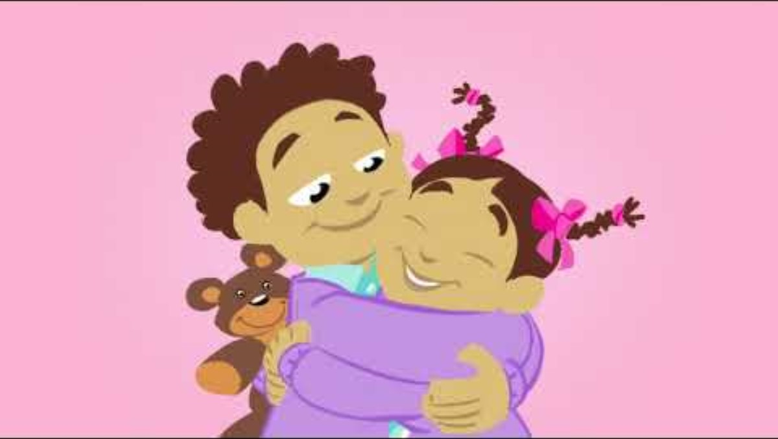
Watch the video and try to identify different ways people can help each other
Notes:
Explain that we are going to watch a video to explore the idea of giving to help others.
Instruct pupils to look out for any examples of individuals helping each other.
When the video is finished, ask pupils to list the examples they noticed.

Slide 12
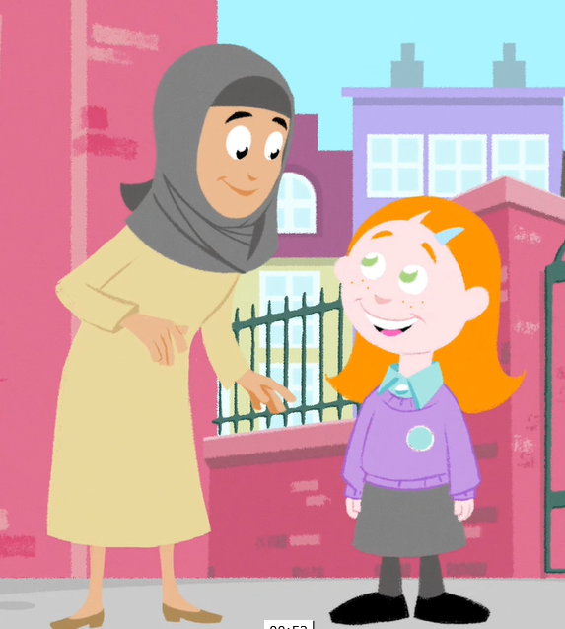
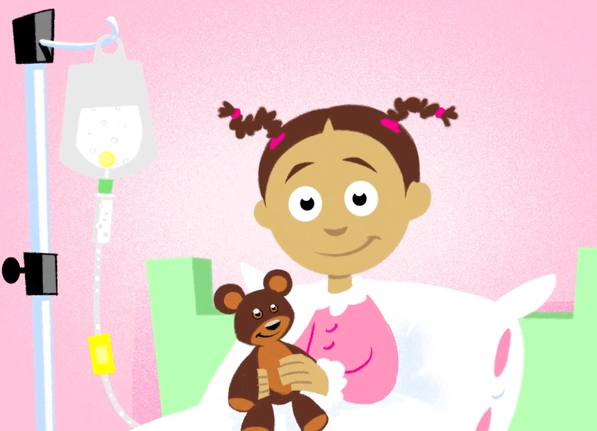
What different kinds of help did you see?
Notes:
Ask pupils to look at the picture and consider this question: How could you group the types of help that you saw in the video? Think about the type of person doing the helping, and the type of help they are giving.
Emphasize that there is no right answer. For example, pupils could mention that:
different types of people help each other in each example – children help adults, adults help children or children help children
some help is physical/practical (for example, Mrs Kahn helping Olivia or Leila helping Asha), some is emotional (like when Amira decides to play with Noah)
different groups and communities can help each other; whether it be helping others in the school community, the local community or the global community – helping people they haven’t even met (just like Leila helped Asha!).
Support: The teacher could describe the different types of help listed above, and ask pupils to identify the correct pictures for each.
Challenge: Extend the activity by asking pupils to predict what effects the help given would have on those receiving the help.

Slide 13
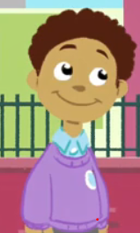
my family and friends
my school community
my local community
the wider world
This has got me thinking. I want to
help others too!
I wonder how I could help…
Notes:
Hand out a set of sorting cards to each table.
Explain that these cards list some of the different ideas Kofi has had for helping others. In pairs or groups of three, pupils need to help Kofi to work out which group or community each of his ideas would help. They need to sort the cards under the four bold headings.
Once they have finished sorting the cards, they should think of at least one further idea on how Kofi could help each different group or community. Pupils should write these ideas onto the blank sorting cards.
Support: Use the picture version of the cards, and ask pupils to draw their ideas.
Challenge: Extend the activity by asking pupils to predict what effects the help given would have on those receiving the help.
Note: Slide 17 displays some answers – you may not wish to move onto this until pupils have finished their group discussions.

Slide 14

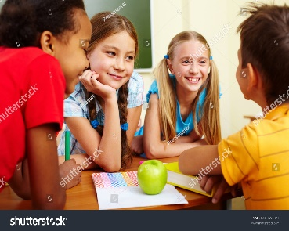
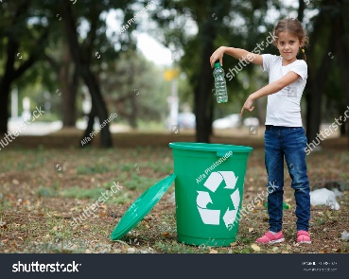
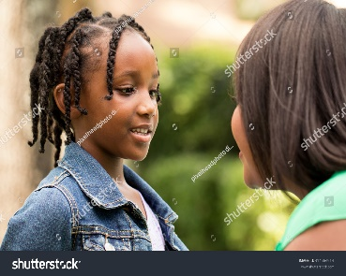
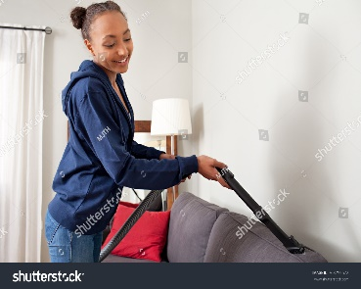


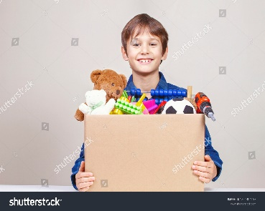
my family and friends
my school community
my local community
the wider world
Helping my sister with her homework.
Talking to a new pupil and showing them around school.
Looking after the park and clearing up my litter.
Telling adults about how they could help others like Leila helped Asha.
Helping to tidy my room.
Handing out the maths books for the teacher.
Holding the door open for others.
Giving clothes and toys to the charity shop.
Notes:
Once pupils have sorted their cards, show them how the cards might have been sorted.
For some of the cards you might want to ask:
Could this card go under more than one heading?
What other ways did you think of for Kofi to help e.g. his family and friends?
Ask pupils to share the other examples they thought of for how Kofi could help each different group or community.
Challenge: Extend the activity by asking pupils to predict what effects the help given would have on those receiving the help.

Slide 15
Why might some people want to help the wider world, including others they have never even met?
Notes:
Explain that there are lots of ways people can help those they have never met. They can give to charity (money, things or time!) or they can look after the environment by recycling.
Ask pupils to consider why people might help those they have never met before.
They can use the examples they have sorted to help them think about this.
For instance, why might people give clothes and toys to a charity shop? (Because they want others to benefit from the clothes and toys they have enjoyed but no longer need.)
Challenge: Ask pupils what qualities and attributes people show when they help others? (Answers might include kindness or thoughtfulness. Ask if anyone knows the meaning of compassion and empathy, which are two attributes that people who help others often have.)

Slide 16
Asha needed help because her blood cells weren’t healthy
Notes:
Remind pupils that Asha is Kofi’s sister. She needed help because at the start of the film, some of her blood cells weren’t healthy.
Explain to pupils:
Each of our blood cells has a special job – whether that is to give us energy, help us fight disease or to form scabs (!). If a person’s blood cells are not doing their jobs properly, they can become ill.
Bone marrow is a soft, spongy tissue in the middle of some bones. It makes special cells, called stem cells.
Stem cells are special because they become blood cells.
If our bone marrow isn’t working properly, it can start to make unhealthy blood cells which means our blood can’t do its job.
When this happens, a person needs to get new bone marrow or stem cells that are working properly. This is called a bone marrow transplant or a stem cell transplant.
Doctors will see if their family has the right type of stem cells to donate.
If their family doesn’t have ‘a match’, doctors will search a global stem cell donor registry to see if anyone on the list matches.
Note: You might want to remind pupils about the ground rules, especially the Ask It Basket, and asking for help from trusted adults if they need it.
Additional information for teachers:
Bone marrow produces blood stem cells, which are the building blocks of our blood.
Stem cells can turn into:
white blood cells – which fight infection
red blood cells – which carry oxygen around the body
platelets – which stop bleeding.

Slide 17
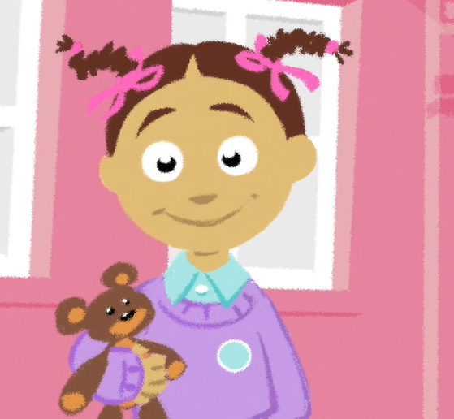
Who helped Asha?
How did Leila help Asha?
Notes:
Ask pupils:
Who helped Asha? (Someone called Leila – we never see Leila. She does not know Asha or her family, or live in the local area.)
How did Leila help Asha? (She gave her some of her stem cells, or ‘donated’ it. She did this by signing up to a special register to be a potential stem cell donor. The NHS Stem Cell Donor Register is what doctors around the world will look at when someone urgently needs a stem cell transplant.
Explain that thanks to Leila, Asha is better and back at school by the end of the film.
Ask pupils:
Why do you think Leila helped Asha? (She felt empathy with people who are ill, put herself in their position, it made her feel good. We never get to see Leila in the film.)
What kind of qualities do you think Leila showed when she donated? (Kindness, being caring, bravery.)
Explain to pupils that lots of other people helped Asha too by donating blood. While she was waiting for her transplant, the doctors and nurses will have given Asha something called a blood transfusion. This is when a person is given new, healthy blood cells to make them feel better.
Explain that becoming a potential bone marrow, stem cell donor or a blood donor are important ways that adults can help other people.
Ask pupils why might someone not be able to help by donating? (Explain that it is great to donate, or tell other people about donating stem cells, bone marrow or blood. However some people may have personal reasons why they can’t donate, which you should always respect, and not press them to explain. They may have health issues themselves, and some people do not support donations on religious grounds. If you’re talking to people about donation, it’s good to use the same ground rules we’re using today.)
Support: Explain that there are some people who may not believe in donation, or who cannot donate because of health reasons. Ask pupils how we should treat people who hold different beliefs or opinions to our own? (Explain that these different reasons why people can’t donate should be respected and we should not press them to explain.)
Additional information for teachers:
Some people do not support donations on religious grounds, but the major religions in the UK support the idea of blood and stem cell donation. NHS Blood and Transplant (NHSBT) is working with churches and faith leaders to spread the message that donation can be an important part of caring for the lives of others. For more information on faith and donation, visit the NHSBT page on Faith and donation.

Slide 18
There are lots of people like Asha
How can we help?
Notes:
Explain to pupils that they are not old enough to sign up to be stem cell or blood donors, you have to be aged 17, so how can children like them help?
Encourage pupils to share their own ideas on what they could do to help. Pupils may suggest telling their adults at home or doing something at school to raise awareness of donation and the need for donors.

Slide 19
How can we help others?
Why might we
help others?
Notes:
Ask pupils to think back to the questions we explored at the beginning of the lesson:
Q: How can we help others?
Q: Why might we help others?
Ask pupils to write their answers on a different coloured post it note and stick it next to the post it note they posted at the start of the lesson.
Where needed an adult may scribe their answers/responses for them
Q: What new ways of helping others have you learnt about?
Q: Have you learnt about any groups or individuals you can help, that you hadn’t thought of before?
Q: Have you learnt any new reasons why people help each other that you didn’t know about before?

Slide 20

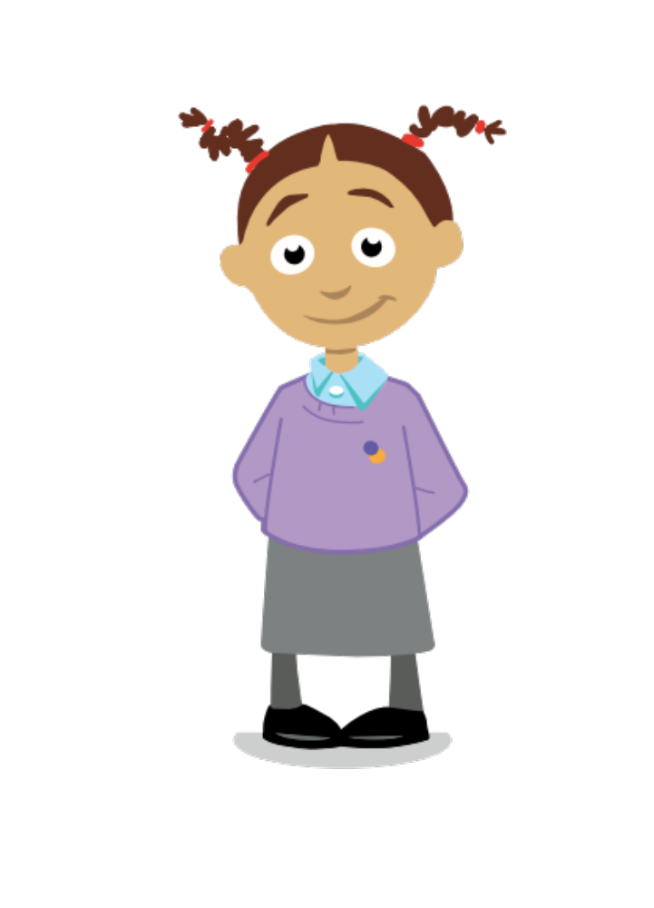
Questions?
Notes:
An Ask-It-Basket/Question Box (or similar) will provide the pupils with an opportunity to disclose in a safe, appropriate way, and further, is an anonymous way for pupil to ask questions. It is important therefore, to set aside some time at the end of each session to allow for pupils to write/ask a question if they wish. To avoid any pupils feeling self-conscious about writing a question, teachers could give all pupils a piece of paper and ask them to write their question, then put it in the box. If they don’t have a question to ask, pupils can write down what they had for breakfast, and put that in the box. After the session, teachers should read the pupils questions/comments and take appropriate action if any concerns are raised. For children who may not be able to write a question, voice recorders or similar could be made available.

Slide 21
Giving to help others
Links to the PSHE Association Programme of Study
Key Stage 1
Pupils should be taught:
1b. to share their opinions on things that matter to them and explain their views;
2c. to recognise choices they can make, and recognise the difference between right and wrong;
2e. to realise that people and other living things have needs, and that they have responsibilities to meet them;
2f. that they belong to various groups and communities, such as family and school;
4d. that family and friends should care for each other;

Slide 22
Giving to help others
Links to the PSHE Association Programme of Study
Key Stage 2
Pupils should be taught:
2a. to research, discuss and debate topical issues, problems and events;
2d. that there are different kinds of responsibilities, rights and duties at home, at school and in the community, and that these can sometimes conflict with each other;
2e. to reflect on spiritual, moral, social, and cultural issues, using imagination to understand other people's experiences;

Slide 23
Giving to help others
Frequently asked questions
What is blood donation?
Only adults aged between 17 and 65 can give blood.
Blood donation saves lives. Each donation is a precious and generous gift which can save or improve the lives of up to three seriously ill adults or six children.
A blood donation appointment takes place at a donor centre or in a community venue, with specially trained staff.
The blood donation experience takes about an hour in total. Giving blood itself takes around 5 to 10 minutes.
After a grown up has given blood they are given a drink and a snack and can relax for a short time.
What happens to the blood that has been donated?
During a blood donation we take 470ml of blood, which is just under a pint. The blood is then transported to a blood centre where it is tested and processed before being sent to hospitals where it will be given to a patient. After donation, the body will quickly replace the blood that has been donated by making more.

Slide 24
Giving to help others
Frequently asked questions
What is bone marrow?
Bone marrow is a sort of thick, spongey tissue found inside some of your bones – like your hip and thigh bones. It is important because it makes stem cells.
What are stem cells?
Stem cells can be viewed as the 'building blocks' of the body. They can grow into any of the other blood cellsor immune system cells that we need so they are vital for keeping our blood healthy and our bodies working properly.
Who needs a stem cell transplant?
Anyone whose bone marrow or blood cells aren’t working properly. Leukaemia is one example of a disease that stops people’s bone marrow working.
What does my religion say about donation?
Lots of major religions in the UK support the idea of donation and transplantation – and this makes sense when you think that an important part of all religions is caring for and helping others. (Teachers can get more information on different religious views on donation here).

Slide 25
Giving to help others
Background information for teachers
Who can donate bone marrow or stem cells?
In some cases, a matched donor can be found from within the patient's family; for example from a brother or sister, but more often a patient must rely on a matched unrelated volunteer donor, identified through the NHS Stem Cell Donor Registry or other global stem cell registers.
What is involved in donating?
Nearly 90% of people donate their stem cells quickly and easily in a process similar to giving blood, called peripheral blood stem cell collection. The other 10% donate through bone marrow, where they give cells from the bone marrow in their pelvis.
How can you register as a stem cell donor?
You can join the NHS Stem Cell Donor Registry when you give blood at a blood donation session. An extra sample of blood is taken and this is then sent off to be genetically typed. Find out more about stem cell donation at www.blood.co.uk/stemcells

