Slide 1
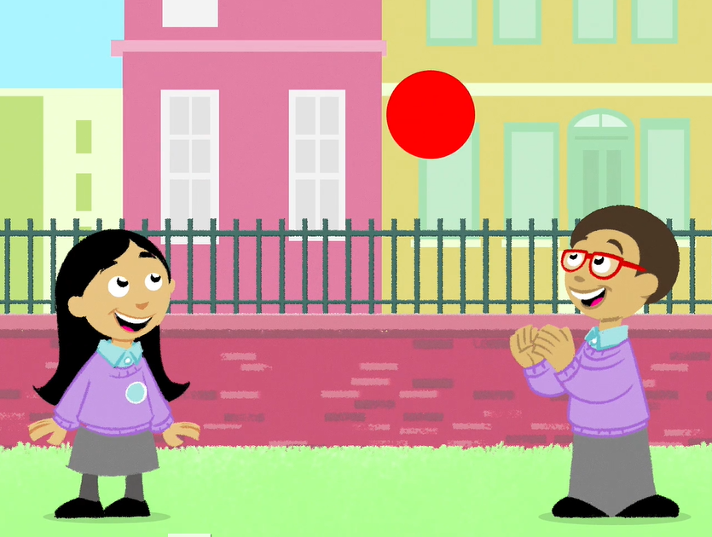
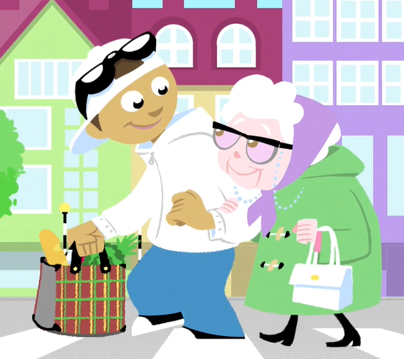
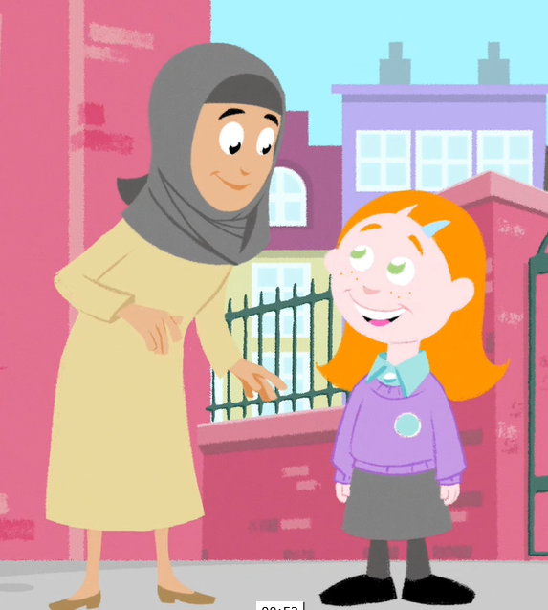
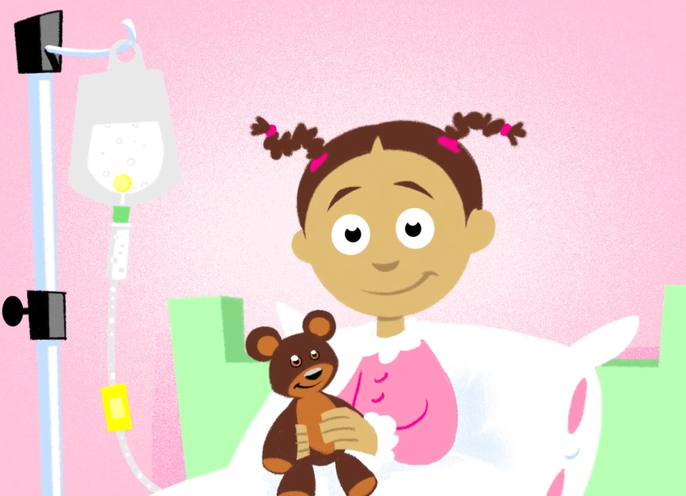
Giving to help others
Teacher notes
N.B. Teacher notes & background information can only be viewed if this presentation is opened within the PowerPoint application

Slide 2
Giving to help others
Teachers’ notes
Why use these resources?
Every 20 minutes in Britain someone is taken ill with blood cancer. For many blood cancer patients their only chance of survival is through a stem cell donation.
This lesson aims to make pupils aware of various forms of donation, in particular blood and stem cell donation, and, importantly, to encourage and empower them to tell their parents about what they have learnt and how their parents and other adults can help increase the number of donors now and in the future.
The lesson supports the PSHE Association programme of study, focusing on pupils’ role in their community and helping others.
Development
This lesson has been developed in partnership with:
  Team Margot Foundation, a charity which was set up to campaign for more people to register as potential stem cell / bone marrow donors.
  NHS Blood and Transplant
  Pupils and practicing teachers

Slide 3
Resource summary
This presentation and animation can be used in an assembly or in class with pupils aged 5 to 11.
  Learning objectives
Pupils should understand that:
  their choices can help other people, including people that they know, and people that they don’t know
  adults donating blood and bone marrow can help make other people better and save lives
  when they are old enough, they can help others via donation
  until then, they have a really important role in that they can explain to adults how they can help and encourage them to become potential donors.
  Key words
  Help, healthy, responsibility, community, blood, bone marrow, giving, donate
Approx. time required
15-25 minutes

Slide 4
Using this presentation
Slides 2 to 4 (teacher notes): Overview of the presentation for teachers
Slides 5 to 14: For use with pupils – see the slide notes for further information for teachers.
Slides 17 to 21 (teacher notes): Curriculum links, FAQs and useful background information for teachers
Slide 22: Adaptable text for your newsletter or school website to inform parents and carers
Note: These teacher note slides are hidden, so they will not display when you are in presentation mode.
  Preparation and follow up
  Make sure you can play the video on slide 8 before delivering the presentation.

Slide 5
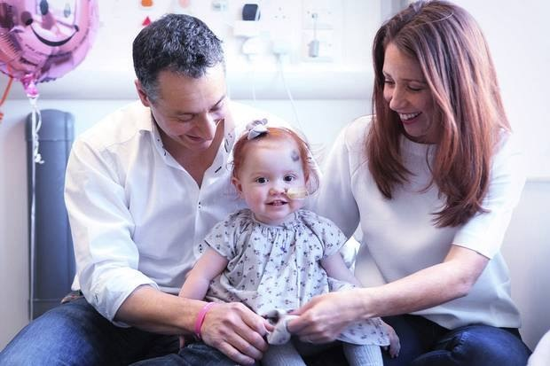
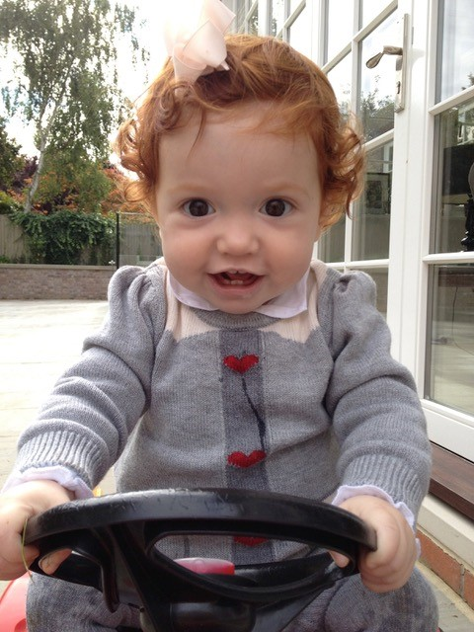
Introducing ‘Giving to help others’
Team Margot Foundation in partnership with NHS Blood and Transplant
Notes:
Note:
You can choose whether or not you wish to share this slide with pupils. The PowerPoint can also be started from slide 6.
About Team Margot:
When a little girl called Margot needed a bone marrow transplant, her family and friends came together as Team Margotto help find her a matching donor and ask people to do something amazing: register as potential stem cell and bone marrow donors.
Margot wasn’t able to find her perfect match, but did eventually find a suitable donor match and received her bone marrow transplant.
Unfortunately, Margot’s leukaemia was extremely aggressive and she passed away, aged 2 years and 2 months. Team Margot continues to campaign for more people to sign up and register as potential bone marrow / stem cell donors.
They also want people to spread the word and encourage others to sign up to be donors.
Team Margot closed as a charity in 2025 after 10 years of campaigning to save and improve lives in Margot’s name.

Slide 6
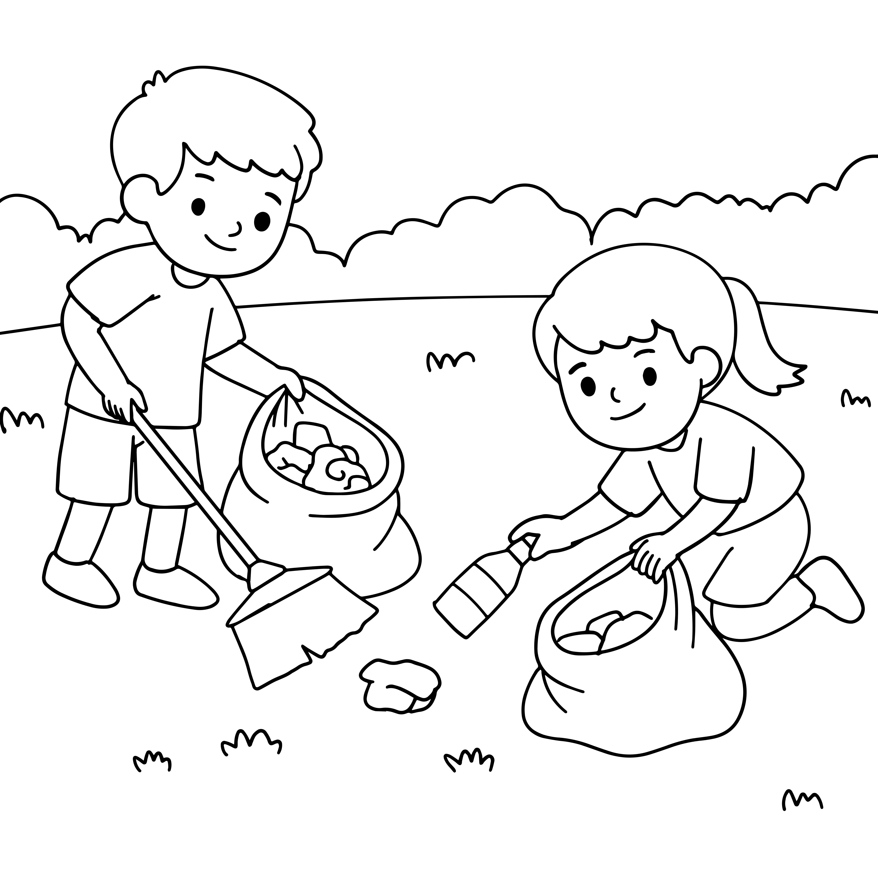
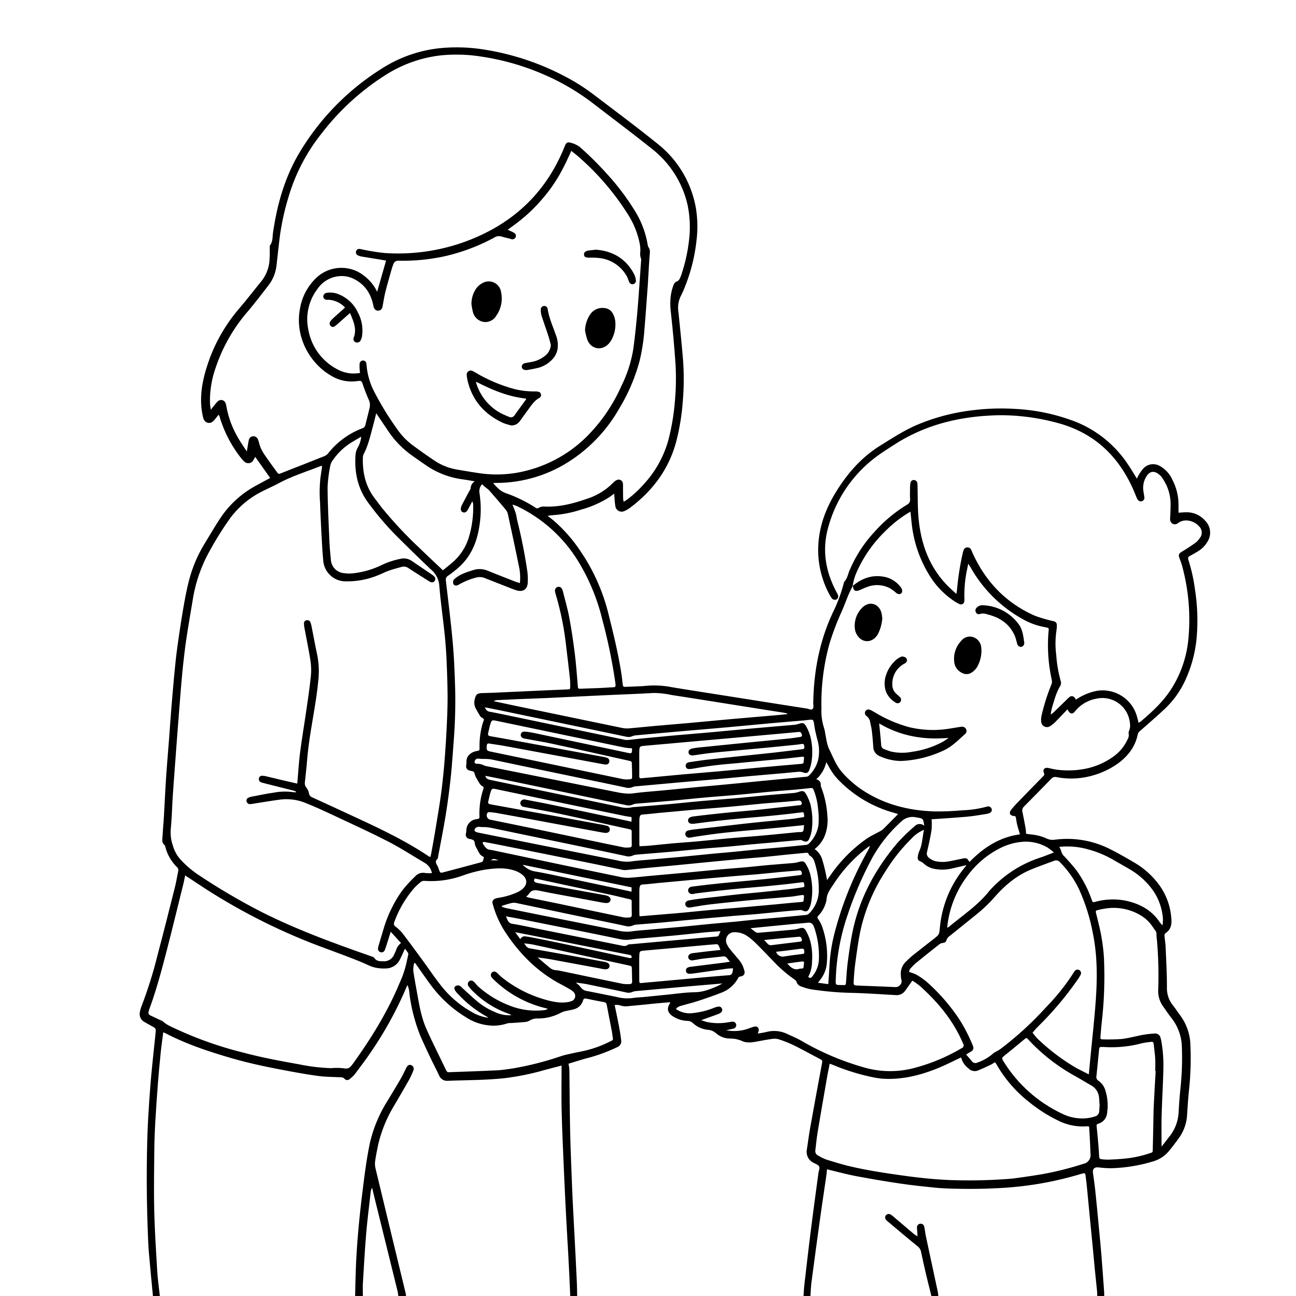
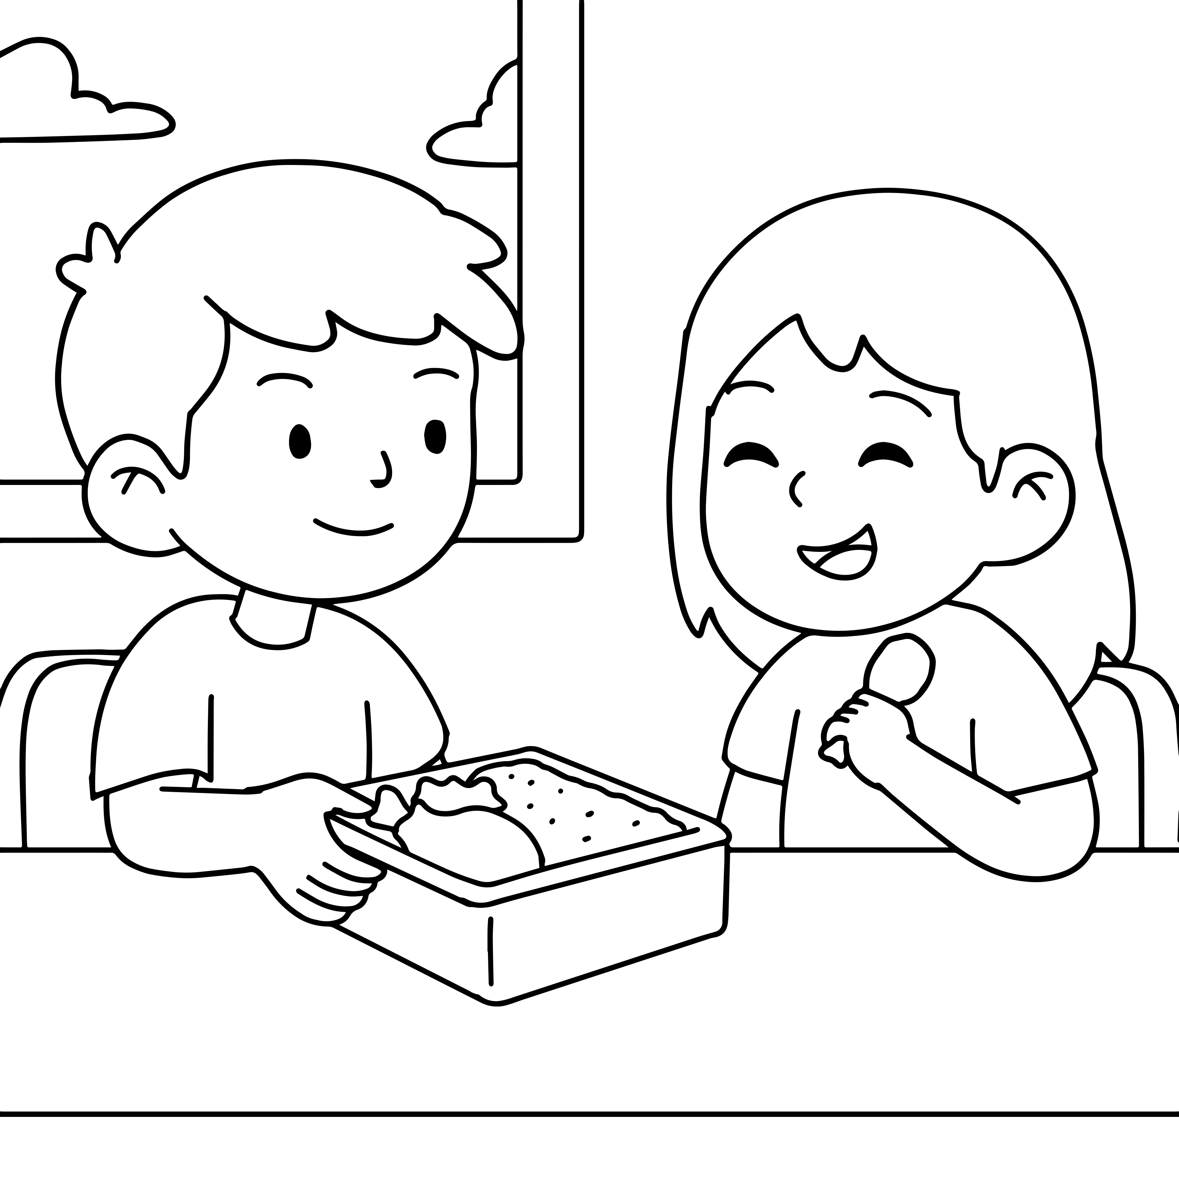
Giving to help others
Assembly presentation

Slide 7
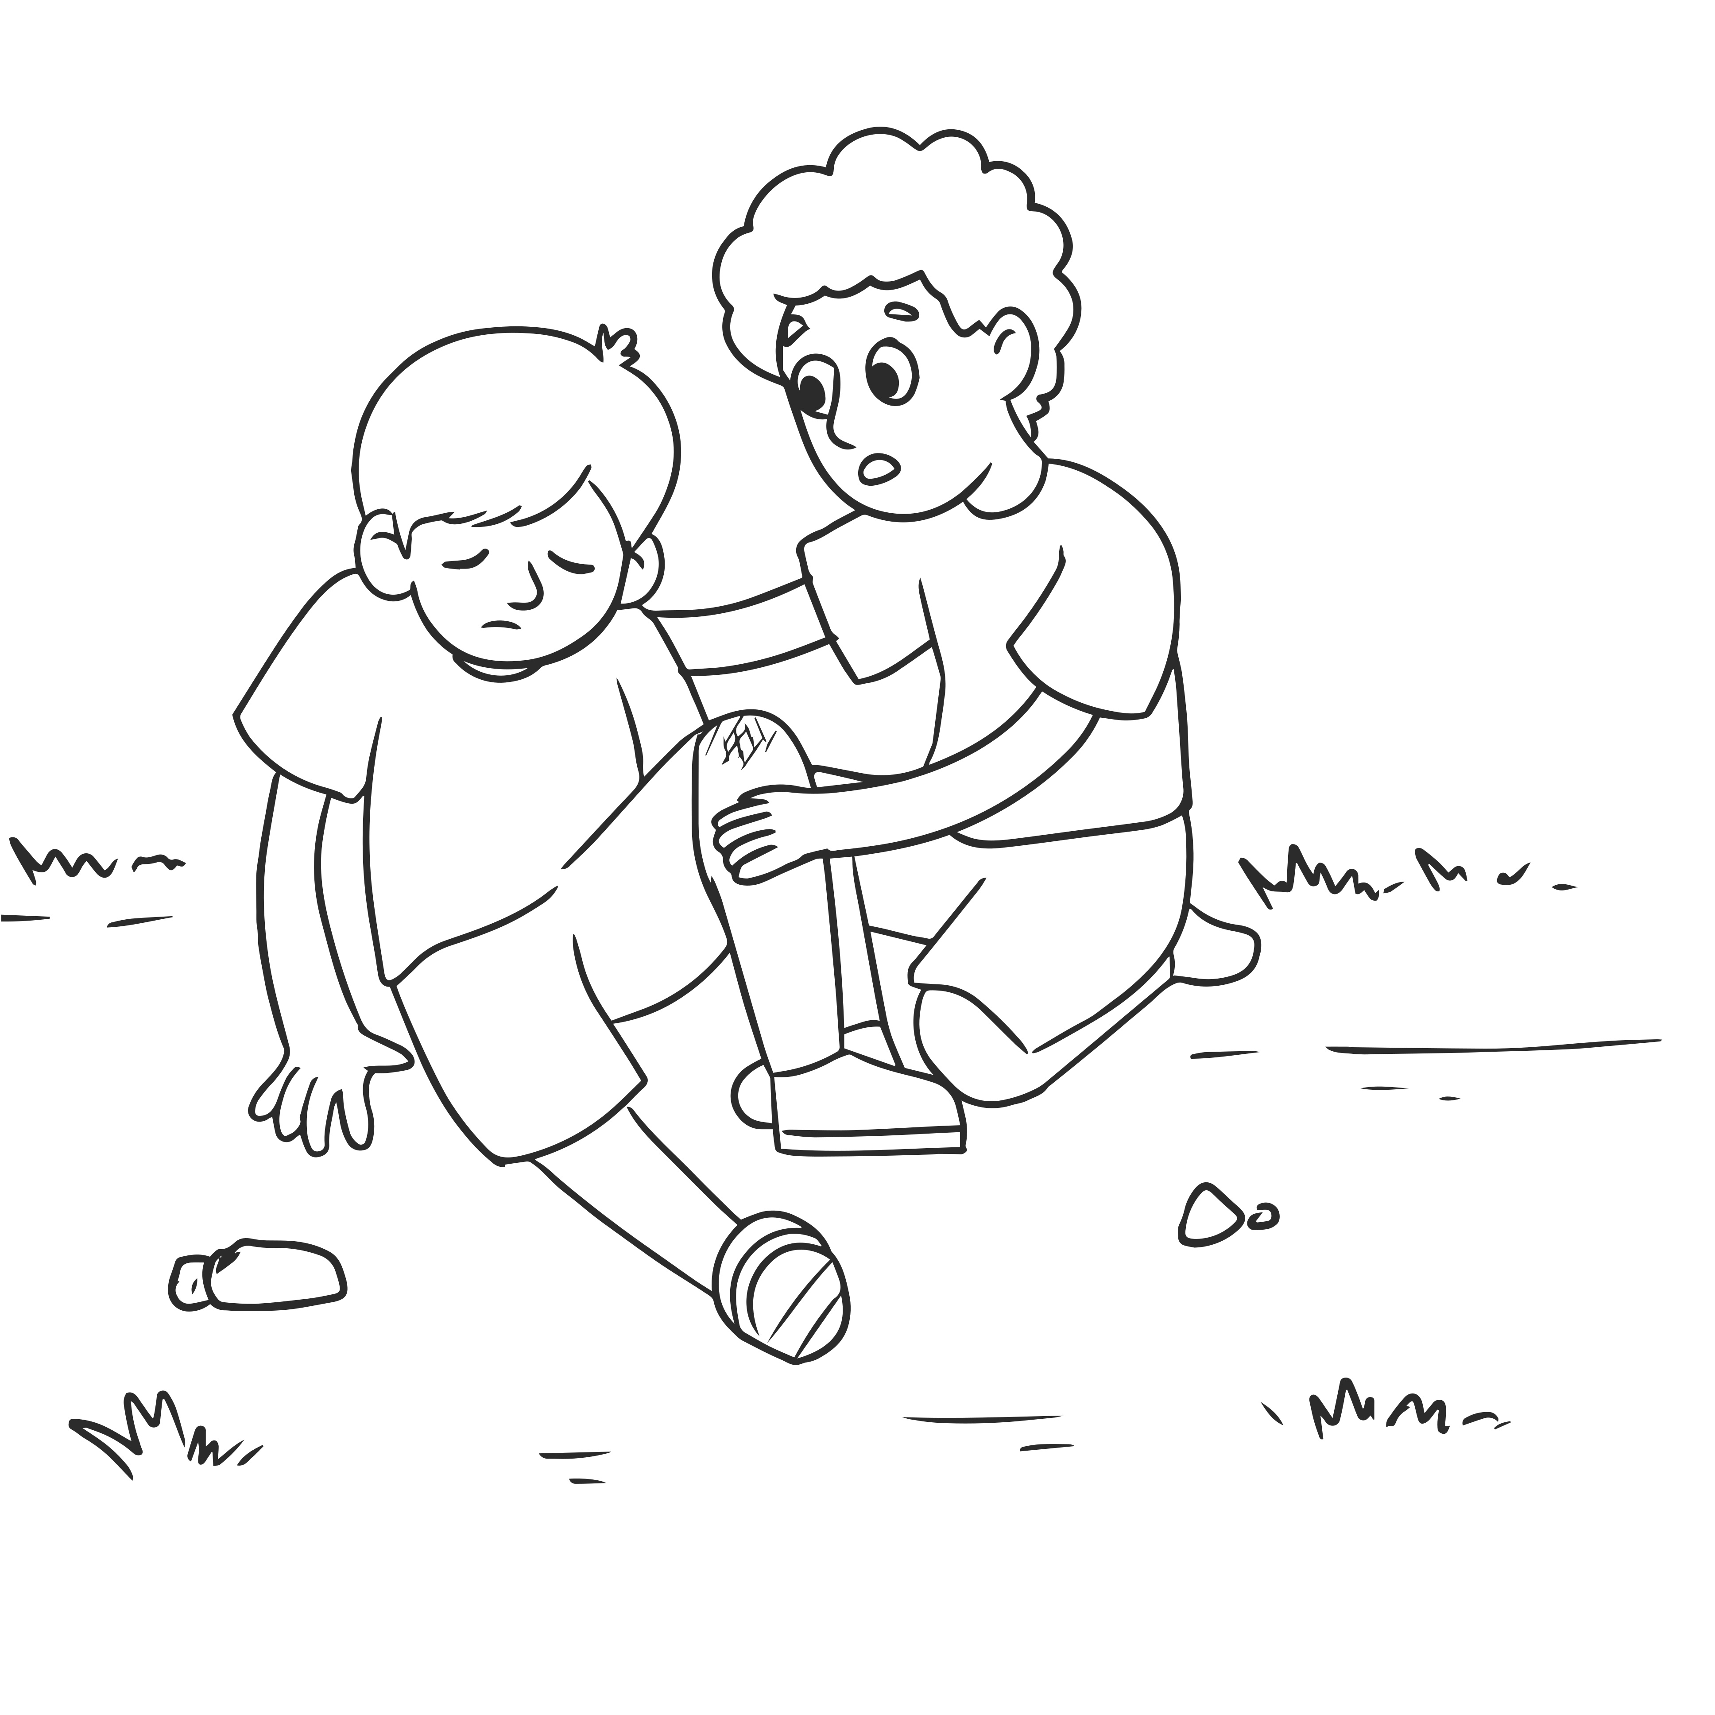

When did you last help someone?
Notes:
Ask pupils:
When did they last help someone?
What did they do?
How did it make them feel?
Ask pupils:
When did someone last help them?
What did they do?
How did it make them feel?

Slide 8
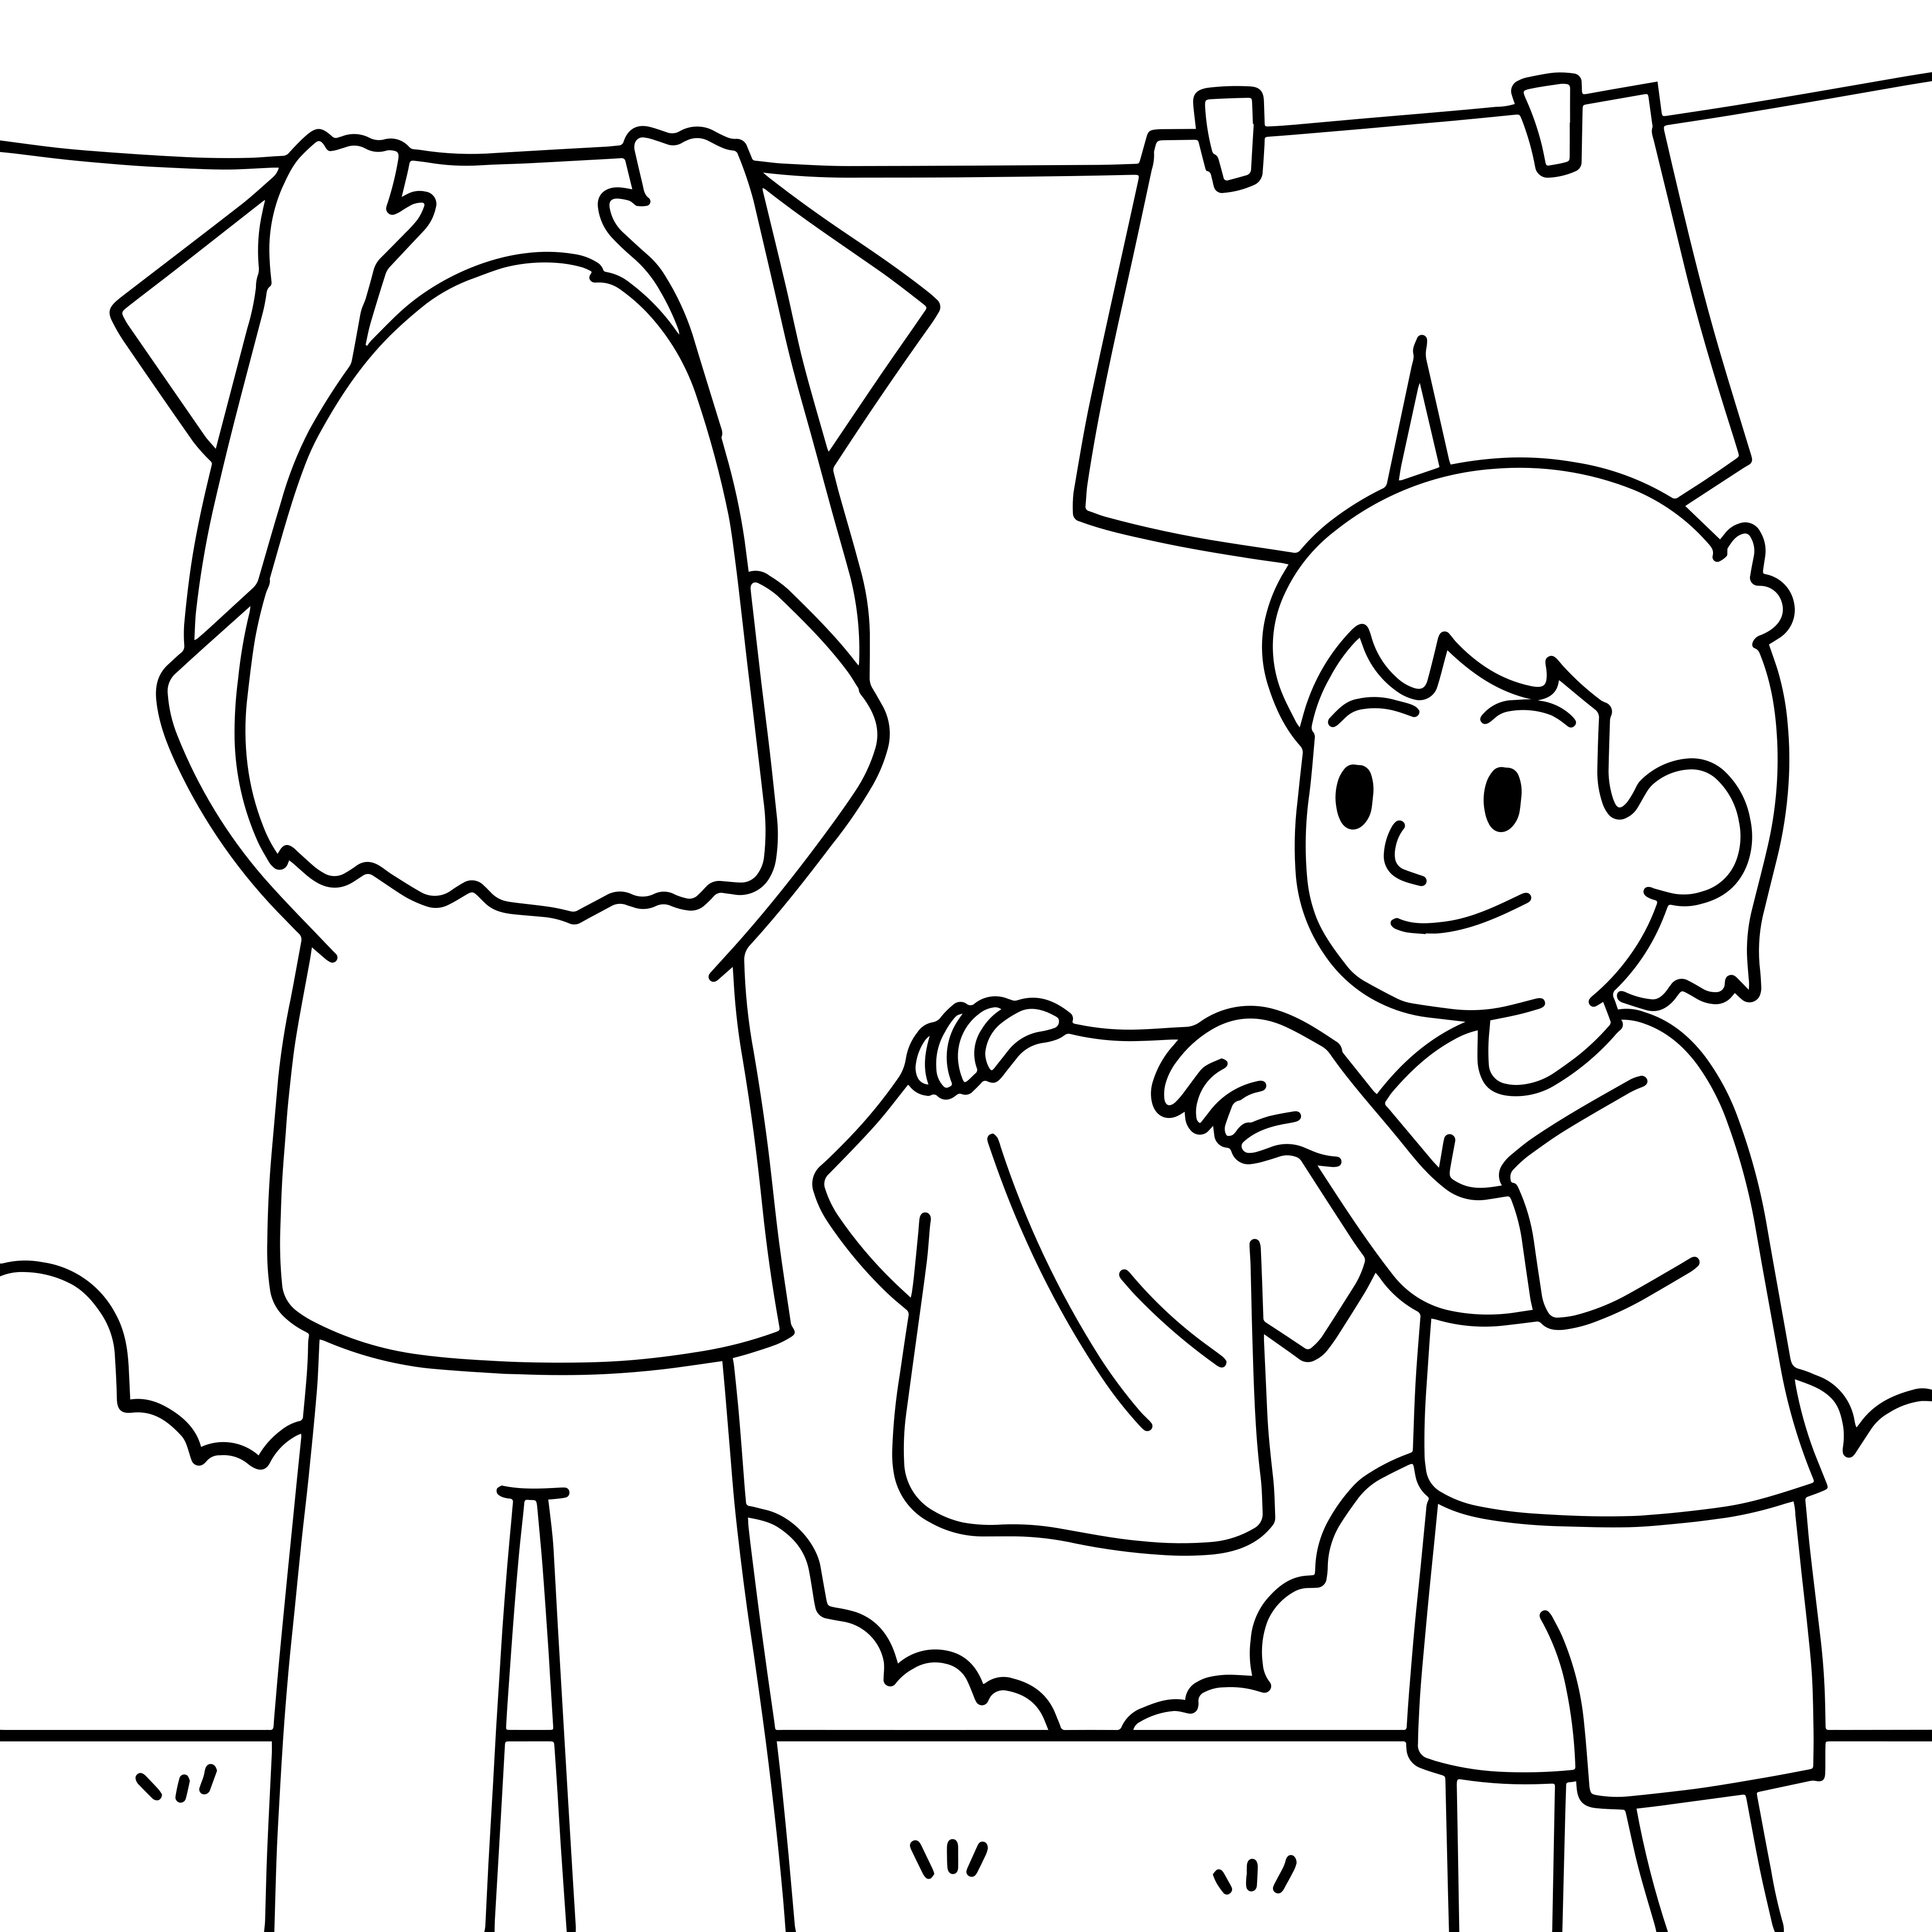
Why do we help?
Notes:
Ask pupils:
Why do we help others? (It makes us feel good / happy, it’s the right thing to do, it’s part of being a responsible citizen of the world)

Slide 9
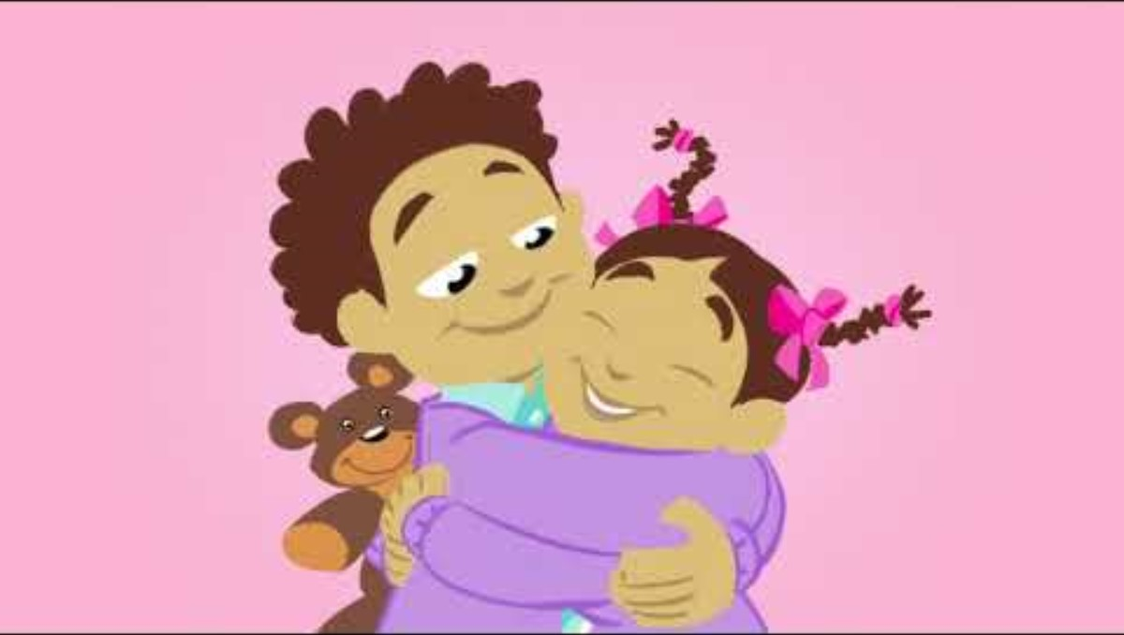
Notes:
Ask pupils:
How did the video make you feel?

Slide 10
How did Amira help Noah?
Notes:
Explain to pupils that children and adults can all help each other.
Ask pupils:
In this situation, who is helping whom? (A child is helping another child)
Ask pupils:
How was Noah feeling? (Sad, lonely)
Why did Amira help (She felt empathy, put herself in his position, cares about him, it made her feel good)
Explain that Amira gave Noah emotional help

Slide 11
How did Miss Khan help Olivia?
Notes:
Explain to pupils that children and adults can all help each other.
Ask pupils:
In this situation, who is helping whom? (An adult is helping a child)
Ask pupils:
What was wrong with Olivia? (Hurt her knee, in pain)
Why did Mrs Khan help (She felt empathy, put herself in her position, cares about her, it’s her job, she has plasters, she knows what to do, it made her feel good)
Explain that Mrs Khan gave Olivia physical help

Slide 12
How did Rudy help Mrs Williams?
Notes:
Ask pupils:
In this situation, who is helping whom? (A child, young person is helping an adult)
Ask pupils:
Does Rudy know Mrs Williams? (Not very well, but they live in the same area)
Why did Rudy help (He felt empathy, put himself in her position, noticed that she looked worried, thought it was the right thing to do, it made him feel good)
Explain that Rudy gave Mrs Williams community help

Slide 13
What was wrong with Asha?
Notes:
Ask pupils:
Who is Asha? (Kofi’s sister)
What was wrong with her at the start of the film? (Some of her blood cells aren’t healthy)
Explain to pupils:
Bone marrow is a soft, spongy tissue in the middle of some bones. It makes blood stem cells, which are really important for your body to work properly.
If a person needs new bone marrow or stem cells, doctors will see if their family has the right type of bone marrow or blood stem cells to donate.
If they don’t, they look at the global register of stem cell donors around the world to see if anyone on the list is a match for the person who is poorly.
A stem cell donor is someone who donates stem cells from their blood to help someone else to get better.

Slide 14
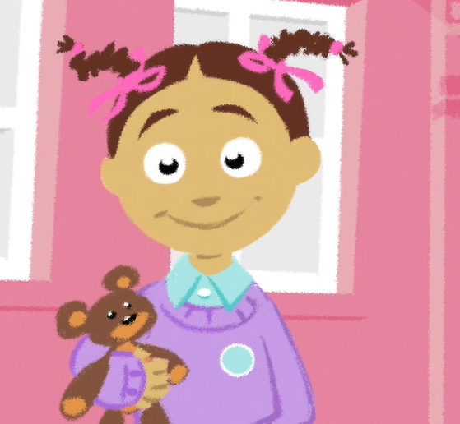
How did Leila help Asha?
Notes:
Ask pupils:
How was Asha at the end of the film? (Better, back at school)
Why did she get better? (A woman called Leila gave her some of her stem cells – she donated them)
Explain that Leila didn’t know Asha or her family, and doesn’t live in the same area as them.
But Leila had joined the NHS Stem Cell Donor Registry in case one day she was a match for someone that she could help by giving them some of her stem cells.
Ask pupils:
Why did Leila help? (She felt empathy with people who are ill, put herself in their position, it made her feel good)
Explain that blood donation is a very important way that adults can help other people
Emphasise that people can help each other, even if they don’t know each other, or they live far away

Slide 15
How can you help?
People you know
Family
Friends
Teachers
Neighbours
People you don’t know
In your local community
Around the world
Notes:
Ask pupils:
How can they help people they know now? (Get ready for school on time, tidy up, do chores, play with younger brothers and sisters or friends, teach younger brothers and sisters or friends how to do things, help older relatives or neighbours with technology, listening to people if they feel sad, bringing them things they need, especially if they’re feeling ill, turning off lights, the TV etc. if they aren’t using them)
How can they help people they know in the future? (Help their own children to learn about the world, earn money to buy the things that their family needs)
How can they help people they don’t know now? (Using a bin for their rubbish to keep the local environment clean and safe, tidying up after themselves in public places, e.g. the library or cafes, donate or raise money for charity)
How can they help people they don’t know in the future? (When they are older they can help by registering to donate blood or stem cells like Asha needed)

Slide 16
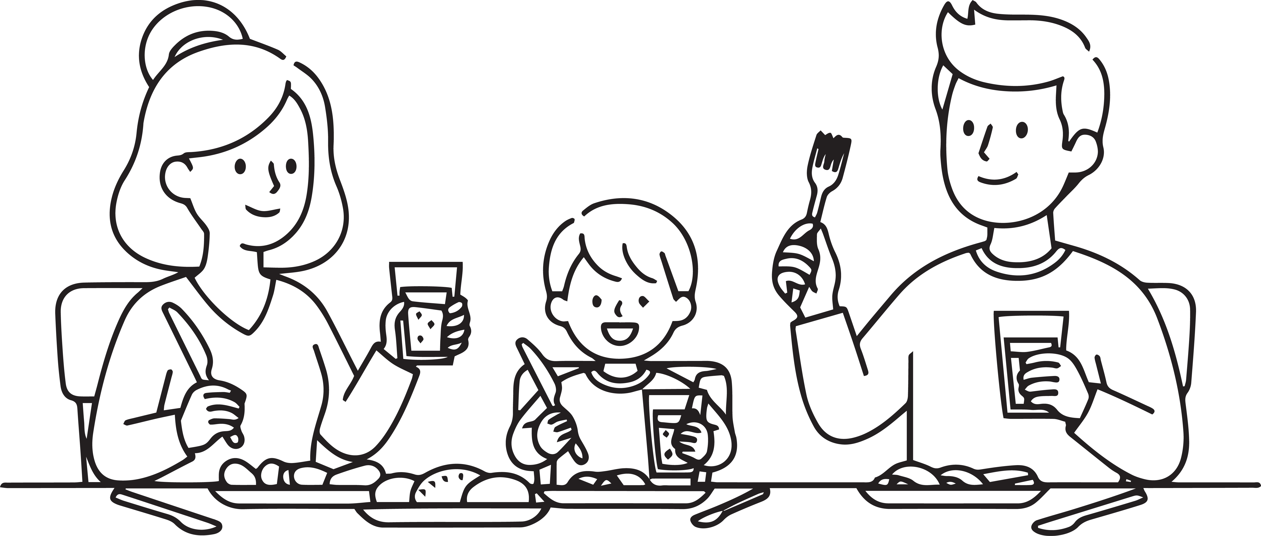
How could you encourage others to help too?
Notes:
Explain to pupils:
They could help by sharing what they have learnt today with their adults at home. Challenge them to explain all about Asha and how being a donor can save lives – maybe some of their adults will sign up to be a donor!
Adults can register to give blood online and join the NHS Stem Cell Donor Registry
Giving blood takes one hour and can save up to 3 adult lives and 6 children’s lives

Slide 17
Giving to help others
Links to the PSHE Association Programme of Study
Key Stage 1
Pupils should be taught:
1b. to share their opinions on things that matter to them and explain their views;
2c. to recognise choices they can make, and recognise the difference between right and wrong;
2e. to realise that people and other living things have needs, and that they have responsibilities to meet them;
2f. that they belong to various groups and communities, such as family and school;
4d. that family and friends should care for each other;

Slide 18
Giving to help others
Links to the PSHE Association Programme of Study
Key Stage 2
Pupils should be taught:
2a. to research, discuss and debate topical issues, problems and events;
2d. that there are different kinds of responsibilities, rights and duties at home, at school and in the community, and that these can sometimes conflict with each other;
2e. to reflect on spiritual, moral, social, and cultural issues, using imagination to understand other people's experiences;

Slide 19
Giving to help others
Frequently asked questions
What is blood donation?
Only adults aged between 17 and 65 can give blood.
Blood donation saves lives. Each donation is a precious and generous gift which can save or improve the lives of up to three seriously ill adults or six children.
A blood donation appointment takes place at a donor centre or in a community venue, with specially trained staff.
The blood donation experience takes about an hour in total. Giving blood itself takes around 5 to 10 minutes.
After a grown up has given blood they are given a drink and a snack and can relax for a short time.
What happens to the blood that has been donated?
During a blood donation we take 470ml of blood, which is just under a pint. The blood is then transported to a blood centre where it is tested and processed before being sent to hospitals where it will be given to a patient. After donation, the body will quickly replace the blood that has been donated by making more.

Slide 20
Giving to help others
Frequently asked questions
What is bone marrow?
Bone marrow is a sort of thick, spongey tissue found inside some of your bones – like your hip and thigh bones. It is important because it makes stem cells.
What are stem cells?
Stem cells can be viewed as the 'building blocks' of the body. They can grow into any of the other blood cellsor immune system cells that we need so they are vital for keeping our blood healthy and our bodies working properly.
Who needs a stem cell transplant?
Anyone whose bone marrow or blood cells aren’t working properly. Leukaemia is one example of a disease that stops people’s bone marrow working.
What does my religion say about donation?
Lots of major religions in the UK support the idea of donation and transplantation – and this makes sense when you think that an important part of all religions is caring for and helping others. (Teachers can get more information on different religious views on donation here).

Slide 21
Giving to help others
Background information for teachers
Who can donate bone marrow or stem cells?
In some cases, a matched donor can be found from within the patient's family; for example from a brother or sister, but more often a patient must rely on a matched unrelated volunteer donor, identified through the NHS Stem Cell Donor Registry or other global stem cell registers.
What is involved in donating?
Nearly 90% of people donate their stem cells quickly and easily in a process similar to giving blood, called peripheral blood stem cell collection. The other 10% donate through bone marrow, where they give cells from the bone marrow in their pelvis.
How can you register as a stem cell donor?
You can join the NHS Stem Cell Donor Registry when you give blood at a blood donation session. An extra sample of blood is taken and this is then sent off to be genetically typed. Find out more about stem cell donation at www.blood.co.uk/stemcells

