Slide 1
Clinical Leads for Organ Utilisation Handbook for CLUs
Updated April 2025

Slide 2
Contents
Title
Introduction to the CLU Scheme
CLU Core Role overview
Education Opportunities
Key contacts
Appendix 1: CLU Project Registration Process & Template
Appendix 2: OU Stats Team
Appendix 3: CLU Onboarding & Reimbursement Process
Slide:
3
7
14
15
19
21
23

Slide 3
Introduction to the CLU Scheme
Welcome to your role as a CLU
The Clinical Leads for Utilisation (CLU) scheme comprises a network of senior transplant clinicians across the UK, empowered to report and address barriers to organ utilisation
Recommendation 3 of the February 2023 Organ Utilisation Group (OUG) report 'honouring the gift of donation’ specifically sought the establishment of organ-specific Clinical Leads for Utilisation at every transplant centre, to:
Improve organ utilisation, across solid organs, implementing new interventions to deliver improvements at both a local and national level.
Disseminate best practice in organ utilisation and improve equity of access across all centres.
To ensure additional activity can be sustained within local transplant centres, as visions of increasing donation rates and organ utilisations are realised.
Drive improved organ utilisation through organ utilisation research.
Following this the CLU scheme began in November 2020 and has gone from strength to strength since this time. Further information and background can be found on the OUDT website.
Local CLU Posts
53
Local CLUs
5
Organ Lead CLUs
5
Organ communities
*Some posts may be shared between two individuals / some individuals cover two organ types

Slide 4
Introduction to the CLU Scheme
The Organ Utilisation Development Team
Our Vision
Supporting colleagues to make the best use of every precious organ offered, to achieve maximum positive impact on patients.
Welcome - from the Organ Utilisation Development Team (OUDT)
OUDT lead the national CLU scheme, from NHSBT. Our details are on slide 15. We help to keep you connected with the CLU community, keep you up to date with what is happening within organ utilisation, and provide structure and guidance for you in your CLU role. In your new role, there is a specific process to help bring you onboard, outlined in slide 22
Optimising organ donation processes and organ utilisation decision-making pathways are essential to improving transplant outcomes; both require dedicated focus. The deceased donor pool is smaller since 2020 and donor demographics are changing, with more older donors, donors with co-morbidities, and DCD donors. In general, deceased donor transplant activity is steady or rising after the pandemic, driven by greater utilisation of offered organs. Increasing organ utilisation contributes toward the OUG vision of fully honouring the gift of donation and supporting transplant teams. This is needed to ensure that as many organs as possible that are offered for transplantation can be safely used to improve the life-span or quality of life of those on the waiting list.
As a team, we aspire to support the delivery of much-needed improvements within the field of organ utilisation, for the benefit of all. We aspire to foster a culture of shared learning and collaboration and are excited by our role in shaping the future of organ utilisation in the UK and internationally.
What you can expect from us:
We look forward to working with you.
The Organ Utilisation Development Team
Our Mission
We work together to increase the number of people positively impacted by increased organ utilisation, through the dissemination of data and information, and the sharing of knowledge and expertise across our clinical community.
Admin support
Our admin team will invite you to CLU Community Calls and provide support during these meetings.
Our admin team are on hand for any queries that you might have – email us at organutilisationdevelopmentteam@nhsbt.nhs.uk.
Leadership & development:
Online induction (held every few months) for OUDT and new CLUs to meet – keep an eye out for your invitation.
Subscription to the CLU six-monthly newsletter, plus ad hoc updates from the OUDT mailbox.
Invitations to partake in surveys and discussion groups,
Annual 121s to support you in meeting your CLU core operational role requirements.
Oversight of CLU projects, and provision of national direction (and standardised approaches, where appropriate) for the overall CLU scheme.

Slide 5
How will we know the CLU scheme is successful?
Our vision is for the CLU scheme to support colleagues to make the best use of every precious organ offered, to achieve maximum positive impact on patients. We will employ the following metrics to monitor our impact and success:
The direct impact we will have on organ utilisation will often be hard to quantify. As a result, we focus on:
Improving understanding of OU and increased engagement with organ utilisation issues, at all levels
Sharing learnings and best practice and promoting collaboration, to reduce unwarranted variation in offer declines
Improved understanding of OU local barriers, for collaborative mitigating action
Overcoming barriers within transplant centres to increasing OU
Attracting and retaining talent in transplantation (including physicians, surgeons, and nurses) through the creation of a supportive community and through promoting adoption of latest technologies at a local level
Developing and sharing standard OU-related protocols and processes to increase productivity across all transplant centres
Adopting best practice and emerging innovations at the earliest opportunity, to drive OU-related improvements.
Lead and Local CLU feedback, via a bi-annual survey
A reduction in the number of non-clinical organ offer declines
Education events and feedback
An increase in overall organ utilisation rates (we are one of many contributing schemes)
The number of Local CLU projects in progress and implemented, positively impacting OU at a local or regional level
Attendance at (Lead and Local) CLU Community meetings
Number of ‘missed opportunities’ recognised within the Offer Review Scheme, and emerging themes

Slide 6
Introduction to the CLU Scheme
PA Allocations & Remuneration
PA Allocations for CLU Roles
NHSBT transfer funding to your employing organisation in relation to the CLU scheme.
Local CLUs
Each transplant centre will be reimbursed 0.5PA for each CLU role. Where a CLU represents more than one specialty (such as kidney and pancreas transplant), trusts will be reimbursed 0.5PA for each specialty respectively (up to a maximum of 1 PA). Some CLUs may choose to share the role with a colleague, on which basis NHSBT support an even split of 0.25 PAs each.
Payments are made quarterly from NHSBT to the relevant Trusts/Boards (via BACS payment), and not to CLUs directly. You should work with your Hospital / Trust team to ensure your CLU role is incorporated into your job plan, and to ensure that you are appropriately renumerated for the work you undertake as CLU.
We will periodically check in with you to ensure that your role has been incorporated into your job plan and can support you in escalating this internally within your organisation if it becomes an issue for you.
Organ Lead CLUs
1 PA is allocated to each Organ Lead CLU role, and this should be reflected within their job plan.
Slide 23 provides further information regarding the organisational reimbursement process.
If you are experiencing issues in relation to remuneration and job planning, please liaise with your Organ Lead CLU and/or email organutilisationdevelopmentteam@nhsbt.nhs.uk for further support.

Slide 7
CLU Core Role
Role Overview
What we expect from you (role summary from CLU Job Description)
Provide clinical leadership to champion and promote the values of organ utilisation, through shared learning, promoting culture change, and promulgation of best practice.
Establish effective working relationships with key stakeholders throughout the hospital(s).
Optimise organ utilisation potential, by minimising missed transplant opportunities and by implementing the recommendations of national guidelines, focusing on those areas with greatest potential positive impact.
Establish and maintain regular centre-level organ utilisation meetings, to support shared learning and peer discussion regarding local organ acceptance activity.
Maintain oversight of local organ utilisation data and trends and work alongside clinical and management colleagues to deliver improvements – which may include adoption of latest technologies and implementing digital change.
Evaluate the barriers to increased organ utilisation (within and beyond your unit) to inform an organ utilisation improvement action plan. This action plan should be aligned to the overall Trust/Board Utilisation Strategy. CLUs are encouraged to pro-actively engage with Executive sponsors to develop, maintain, and refresh these strategies.
Encourage trainees and allied members of the MDT to become involved in organ utilisation projects.
Build an understanding of the relationships between organ donation and organ acceptance, through working with Clinical Leads for Organ Donation, and local Trust/Board Organ Donation & Transplant Committees.
Support and educate colleagues regarding the appropriate action to be taken in relation to non-clinical reasons for organ decline, including incident reporting and facilitation of discussion at Safety & Quality meetings. Use data to improve awareness of non-clinical barriers to organ utilisation at Trust/Board level, and work with senior colleagues to support mitigating action and reduce these turndowns.
Have input into actions arising from NHSBT Offer Review Scheme letters.
Partake in and input into national surveys run by NHSBT, to support improvements in organ utilisation.
In collaboration with CLUs across the country, to contribute towards:
Development of national organ-specific forums for discussion of organ utilisation issues and dissemination of learning points.
Development of national guidance on organ acceptance criteria.
Development of an organ-specific strategy for optimising organ utilisation.
Identification of priorities for coordinated research into optimising organ utilisation.
Design of current and future local and national audits to capture key metrics in organ utilisation

Slide 8
CLU Core Role
CLU Core Operational Requirements
Core Operational Requirements | Attendance at organ community calls with Lead and Local CLUs (>90%, including a deputy attending in your place).
 | Attendance at Trust Organ Donation and Transplantation Committees (>90%, including a deputy attending in your place).
 | Attendance at the annual NHSBT National Organ Utilisation Conference
 | Involvement in development of your Trust OU Strategy and Annual Reports and progressing the supporting action plan
 | Every CLU will have an annual 1:1 with their respective Lead CLU (or their nominated deputy), which will include a review of organ utilisation metrics and other outcomes that may determine if extra support is needed for the Local CLU.
Activity | Expected frequency
Areas of responsibility Undertake correspondence in respect of role and utilisation issues as required. Ensure all areas have appropriate local policies in place, developed in line with national policy and guidelines. Report local utilisation performance information to a designated hospital governance structure. | Weekly Monthly Annually
Clinical Expertise / Advice Act as a source of knowledge regarding organ utilisation and provide advice as required. Escalate both locally and via NHSBT Clinical Governance structures any critical incident or ‘near-miss’ relating to organ utilisation practice. | Ad hoc Ad hoc
Consider any Missed Utilisation Opportunities With Recipient Coordinators, including analysis of data and case investigations, and progress actions as required. Challenge colleagues and local barriers as required to eliminate missed opportunities. In conjunction with colleagues including Recipient Coordinators assist in production of local reports, as required, which will include outlining local barriers to utilisation and where missed opportunities can be best addressed. Actively contribute to the offer review scheme | Monthly Ad hoc Annually As required
Promotion - e.g. local, regional and national promotion activities Act as a spokesperson/ advocate for utilisation locally as required. | Ad hoc and as per personal interest
Academic - e.g. research / publications, presentations at regional / national / international meetings | Ad hoc and as per personal interest

Slide 9
CLU Core Role
Key Relationships
Internal
Transplantation-focused professionals, including clinicians, nursing and AHPs
Medical trainees and students
Anaesthetic, ITU, theatre and perioperative teams.
Clinical Lead for Transplantation / Centre Director, plus Operational management and Exec Teams (as appropriate)
ODTC Chair, Clinical Lead for Organ Donation, Local Specialist Nurse(s) for Organ Donation, and Organ Donation and Transplantation Committee (ODTC)
The designated hospital governance structure to report transplant activity (e.g. departmental/directorate clinical governance meeting)
External
NHS Blood and Transplant, particularly Organ Utilisation Development Team and (including Lead Organ CLU and National Clinical Lead for Organ Utilisation)
NHSBT Organ Utilisation Statistics team
NHSBT Lead Recipient Transplant Coordinator
Referring centres
Patient / community groups

Slide 10
CLU Core Role
CLU Community Calls
Attendance at organ community calls is one of the Core Operational Requirements for Local CLUs (>90%, including a deputy attending in your place). If you are unable to attend a CLU community call, we ask for a medical deputy to be nominated.
We also strongly encourage nursing and AHP colleagues (involved in organ utilisation) to be invited to CLU community calls and input into discussions and workstreams.
Aim
To meet as a CLU organ Committee to discuss barriers and potential solutions to Organ Utilisation. To share updates on local projects and ideas for local or national organ utilisation projects. To create a supportive and collaborative environment for members of each of the five organ communities.
Suggested Membership
Chair: Organ Lead CLU
Local CLUs
In some instances, the Advisory Group Chair(s)
NHSBT Transplant Development Nurse
NHSBT Stats team
Member of the Medical Director and Group Support Team, for admin support
Meeting administration
Quarterly meetings, at minimum, with meetings set 6 weeks in advance, with guidance from Organ Lead CLU
Invites to be sent by the Medical Director and Group Support Secretaries
Actions to be captured by a member of the Medical Director and Group Support Team and circulated after the meeting
Topics covered during CLU community calls
Offer review scheme
Emerging trends and opportunities, and sharing of best practice within organ utilisation
New barriers or emerging issues, including mitigating actions
Local CLU project updates, and Trust Organ Utilisation strategy updates
Cascading national news and latest OUDT updates.

Slide 11
CLU Core Role
Offer Review Scheme
One of the key areas of the CLU role is supporting the NHSBT Offer Review Scheme.
What is it?
The offer review schemes provide a weekly report of any High-Quality Donor (HQD) offers that are declined by transplanting centres. These include heart, lung, kidney, liver and pancreas transplant offers.
Organ Lead CLUs review the decline data and liaise with the transplanting centre to understand the circumstances and reasons leading to the decline.
Offer decline reports are shared with centres to encourage learning, help identify missed opportunities, and reduce barriers to transplantation.
The process
Where there is a suspected missed opportunity and the need to explore the reasons for decline in more detail, the lead CLU will formally write to the local CLU and Transplant Unit Clinical Lead, requesting the particular circumstances and outcomes of discussions at the local OU meeting. Once the lead CLU has all required information, they will confirm any missed opportunities. Outcomes and themes are then shared with the NHSBT OTDT Senior Management Team. At the time of writing (April 2025) this data is also being rolled out for review as part of CLU Community Calls.
What can I do?
Respond to requests for information in a timely way
Ensure that all appropriate cases are discussed at local organ utilisation meetings
Provide education to colleagues to ensure data is captured as accurately as possible in relation to organ allocation decision making
Identify themes and trends within local organ decline data, and take action within your local centres to reduce the incidence of missed opportunities
Discuss the outcomes of the offer review scheme within your local centre and organ utilisation meetings

Slide 12
CLU Core Role
Organ Utilisation & Decline Meetings
One of the Organ Utilisation Group report’s key recommendations is:
Recommendation 3: Decline meetings in transplant units must be established as a mandatory requirement along with a nationally agreed profile and template
All CLUs are expected to ensure that regular organ decline meetings take place within their local centres. The national standardised framework for these meetings can be found on the OUDT webpage here [direct link to be added once uploaded]. The framework covers all CLU organ groups (heart, lung, liver, kidney and pancreas) and was developed by the CLU community, through a robust consultation process.
The standardised framework provides recommendations along the following themes:
Frequency of meetings
Attendees
The criteria for case review
Outcome data review
Minimum recommended dataset
Processes related to learnings and action points

Slide 13
CLU Core Role
Organ Utilisation Strategies and Local Improvement Projects
All CLUs are expected to lead, and contribute to, improvements in organ utilisation within their local unit, engaging the wider MDT to help realise sustained change.
Organ Utilisation Strategies
CLUs should expect to be involved in the development of a local Trust-wide Organ Utilisation strategy (key Trust Engagement OUG recommendation). This should comprise working with an Executive Sponsor and should seek to address local barriers and improvement opportunities.
Local Improvement Projects
CLUs are encouraged to pursue OU improvement opportunities, and/or initiate projects to support delivery of OU strategy.
These individual projects should be registered with OUDT, and updates should be provided by Local CLUs during CLU Community Calls.
An example of the project registration form is in Appendix 1, slide 19.

Slide 14
Education Opportunities
We strive to provide education to CLUs and other transplant-focused healthcare professionals, to support improvements in organ utilisation. This is an evolving area of work for OUDT, but current examples include:
National Organ Utilisation Conference (NOUC): An annual one-day event bringing together the transplantation community, as well as organ donation and retrieval colleagues. This event is an opportunity for CLUs to showcase their work towards improving Organ Utilisation, as well as engage the wider transplant community, hear updates from others, and contribute to discussions regarding future opportunities.
Webinars: Throughout the year various one-hour online sessions will be held, all of which will cover different topics, and seek to provide education on organ utilisaton to a number of different audiences. For example, topics could include:
  What is organ utilisation? (for wider community and management colleagues)
  How do you involve patients in your CLU work? (for CLUs)
  Complex-case scenarios and decision-making around organ allocation (for all transplant-focused colleagues)
  If you have any ideas how to support OU education, please get in touch (organutilisationdevelopmentteam@nhsbt.nhs.uk).

Slide 15
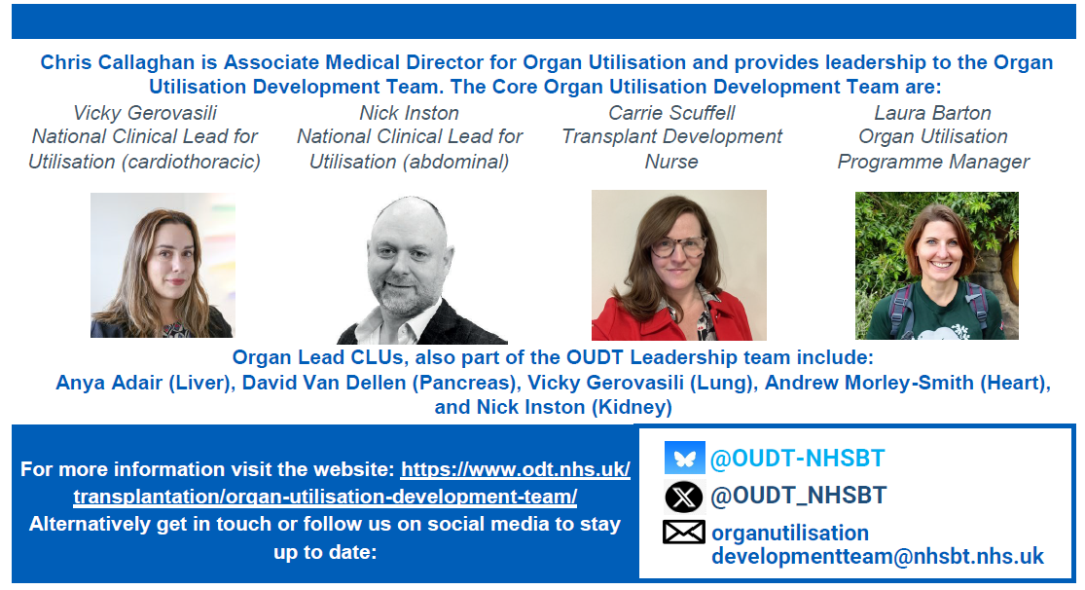
Key Contacts for CLUs

Slide 16
Key Contacts for CLUs
Name | Role
Organ Utilisation Leadership Team & Admin Support | CLUs are asked to direct all queries, except those to their Organ Lead CLUs to organutilisationdevelopmentteam@nhsbt.nhs.uk.
Carrie Scuffell | Transplant Development Nurse, Organ Utilisation Development Team Leadership – carrie.Scuffell@nhsbt.nhs.uk
Laura Barton | Programme Manager, Organ Utilisation Development Team Leadership – laura.barton@nhsbt.nhs.uk
Vicky Gerovasili | Cardiothoracic National Lead CLU, and Organ Lead CLU – Lung v.gerovasili@rbht.nhs.uk
Nick Inston | Abdominal National Lead CLU, and Organ Lead CLU – Kidney nicholas.inston2@uhb.nhs.uk
David Van Dellen | Organ Lead CLU – Pancreas david.vandellen@mft.nhs.uk
Andrew Morley-Smith | Organ Lead CLU – Heart a.morley-smith@rbht.nhs.uk
Anya Adair | Organ Lead CLU – Liver anya.adair@nhslothian.scot.nhs.uk

Slide 17
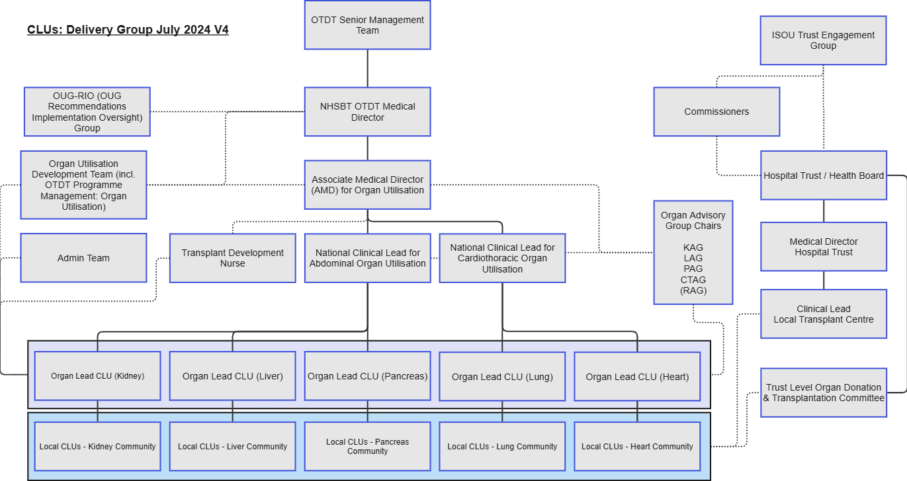
CLU Scheme Governance Overview

Slide 18
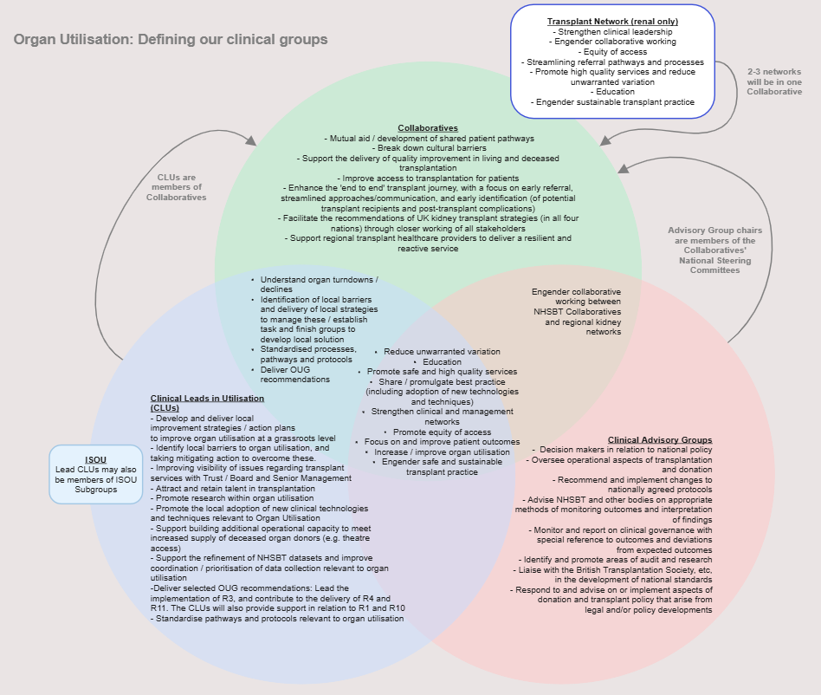
Working with Stakeholders
Collaboratives & Networks Venn
This is a very busy venn diagram – but it provides an overview of the different roles of CLUs, Transplant Collaboratives and the Clinical Advisory Groups – how they overlap, and where their roles are distinct.

Slide 19
Appendix 1: CLU Project Registration Process
Local CLUs decide on which project to pursue
Project discussed at CLU Community call or with OL CLU
Local CLU project registered via CLU project form (next slide)
OUDT keep a record of CLU projects in flight
Process of CLU project registration:
The central CLU project repository will ensure we can demonstrate CLU output and the scheme efficacy on an ongoing basis.
It will also enable us to identify opportunities for sharing best practice and connecting CLUs together where there is synergy.

Slide 20
Appendix 1: CLU Project Registration Template
CLU Name
Centre
Organ Type
Adult / Paeds
6. Who is involved? Please provide job titles of MDT colleagues involved. Please also detail which senior managerial and clinical colleagues have you discussed this with? (please select all that apply)
MDT colleagues:
Examples of wider team engagement (please add/delete where appropriate) | Trust Medical Director Transplant centre managers RTCs OL CLU Patients (and patient) groups Trust Executive or SRO
1. Title of project
2. Which barriers to organ utilisation are you looking to address through this project?
3. Please provide a brief outline of the project, including aims and objectives.
7. Project checklist - Do you have the following in place?
Baseline data | Y/N
Expected benefits and measures of success [including expected impact on OU] | Y/N
Project timescale (please confirm expected end date MMYY)
A Trust / Board Executive Sponsor | Y/N
4. Have you identified any risks or issues that might affect the project? If yes, please provide detail below.
5. Do you need any additional support to deliver this project? If yes, please provide detail below.

Slide 21
Appendix 2: OU Stats Team
Process for CLU Stats requests
Local CLUs have an initial discussion with Organ Lead CLU
If agreed, further detail will be requested and a Local CLU Project Checklist should be completed and returned to organutilisationdevelopmentteam@nhsbt.nhs.uk
The completed checklist will be reviewed by OUDT, to register the project, and will then share with OU Stats who can advise on next seps, e.g. the level of available support and the quality of data available
**Responsibilities of lead statisticians
Scope of requests to Stats Team
The OU Stats team are highly skilled colleagues who provide expertise and insight into organ utilisation statistic. The team provide capacity to support projects, depending on the complexity and priority of requests (e.g. descriptive statistics)
Organ specific Stats Leads:
  Organ specific utilisation projects
  Organ specific annual reports
  Allocation schemes
  DCD hearts monitoring
  Organ specific data applications
Organ Utilisation Stats Lead:
  Key performance metrics
  Offer decline reports
  Offer review schemes
  OU data applications spanning all organs
  Machine perfusion data specification and reporting

Slide 22
Appendix 3: CLU Onboarding Process
The process for nominating and appointing a CLU is as follows:
Transplant Unit Clinical Lead recommends a senior transplant clinician for the CLU role.
Recommendation reviewed by Organ Lead CLU and OUDT
Once agreed, an induction meeting will be arranged between the new CLU and Organ Lead CLU.
The new CLU will be given access to relevant meetings and resources, and central NHSBT databases will be updated.
An induction is held every few months, and new CLUs are invited to attend and meet OUDT.

Slide 23
Appendix 3: Reimbursement Process
Trusts receive funding from NHSBT, quarterly in arrears, in relation to the CLU scheme. The level of funding is based on the number of CLU roles within the local unit and agreed PAs.
Payments are sent directly to the Trust, by BACs transfer, quarterly in arrears.
CLU to liaise with Trust Finance Department to complete Annex A form.
Completed Annex A form should be returned to OUDT mailbox.
OUDT review and retain completed form, and payment information is added to finance systems.
NHSBT Finance Team make quarterly payment by BACS to Hospitals / Trusts
Additional Notes
CLUs should ensure their CLU role is incorporated into their job plan, and should liaise with their management and finance colleagues, within their employing organisation, for remuneration purposes.
Payments from NHSBT are issued to Hospitals / Trusts and not directly to clinicians.
Clinical Excellence awards / consultant award schemes are not included in the rate to be reimbursed.
The Transplant Development Nurse within OUDT is the main contact for payment-related queries and can be contacted at organutilisationdevelopmentteam@nhsbt.nhs.uk.

