Slide 1
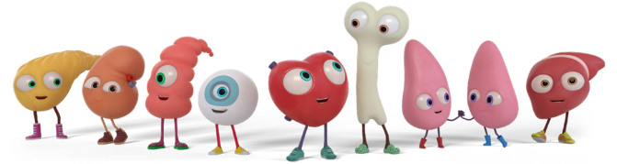

An Introduction to Organ and Tissue Donation
Judicial Multi-Disciplinary Team Presentation
Notes:
Hello and welcome to our presentation on Organ and Tissue Donation. We have developed this presentation for members of the Judicial MDT. We are specialist nurses that are part of NHS Blood and Transplant, and we facilitate organ and tissue donation. I am a specialist nurse in organ donation but if we are involved then I would also take consent for tissue donation and Lizzie is a specialist nurse who focuses primarily on tissue donation.

Slide 2

Aims
​
Gain an awareness of organ and tissue donation and the key differences between them​
Develop an understanding of how you can have an impact on donation​ and why a timely decision is so important
Ensure loved ones are spoken to about donation at the right time, by the right person and in the right place
Gain an appreciation of the impact of tissue and organ donation on donor families and recipients​
Notes:
The aim of this presentation is to give you an awareness of organ and tissue donation and discuss the key differences between them. We hope that you develop more of an understanding of how YOUR role can have an impact on donation and the importance of ensuring that families are spoken to at the right time, by the right person and in the right place. We also want to dispel some of the myths around donation and for you to gain an appreciation of the impact organ and tissue donation has on our donor families, the recipients and the ripple effect that it has on a recipients family and others surrounding them. Just to clarify when we refer to family it may not always be a family member that acts as a persons next of kin, it could be a friend for example.

Slide 3

Deemed consent/deemed authorisation
What is meant by these terms?
In an opt-out system, you still have a choice if you want to be an organ and/or tissue donor when you die. You can record this decision on the NHS Organ Donor Register
This applies to all the UK Nations
https://www.organdonation.nhs.uk/register-your-decision/
Notes:
You may be aware that the legislation regarding Organ and Tissue Donation has changed.
Specialist nurses will work with families to help them support decisions that are right for the patient and the family as a whole but the decision about donation rests with individual patients.
Deemed consent means that
if the patient has not ‘opted out’ by logging this decision on the Organ Donor Register or making their decision know to those close to them and are NOT in the excluded groups which the specialist nurses will assess they will be considered to be willing to save and improve the lives of others through donation.
Adults can still opt in or out of the organ donor register and we actively encourage people to do this and talk to their loved ones about their decision.

Slide 4
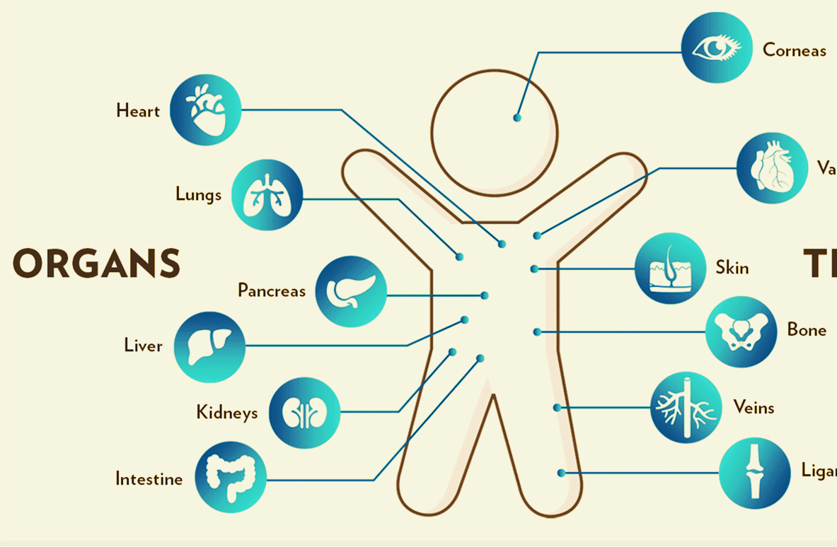
What can be donated?
Corneas
Heart
Heart valves
Lungs
Tissues
Pancreas
Skin
Liver
Bone
Kidneys
Veins
Ligaments
Bowel
Notes:
Organ and tissue donation follow two completely different pathways. Only patients on the intensive care unit at the end of life can be considered for organ donation whereas almost everybody could be considered for tissue donation.
So what can be donated …..These are the organs that can be donated on the left-hand side that you can see on this slide. Organs are donated very quickly after death, and they are transplanted as soon as possible into a recipient. On the right hand-side you can see the tissues that can be donated. Tissues are retrieved up to 48 hours after death and some are transplanted within 28 days, or others can be stored for up to 10 years before being allocated to a recipient. For example, corneas are allocated for up to 28 days after donation and heart valves stored for up to 10 years.

Slide 5
What happens if loved ones raise organ donation?
'Thank you for asking and considering others but if and when it is appropriate the medical team in the hospital will give you more information about this'
STOP
What happens if a loved one raises tissue donation?
‘Tissue donation be a possibility, if you would like more information please contact the National Referral Centre on 0800 432 0559'
Notes:
We know that on occasions a family member may mention donation to yourselves. We want to reassure you that it is not expected within your role to have any discussions around donation with a family. Each person is assessed thoroughly to see if organ and/or tissue donation is a possibility before a specialist nurse would speak to a family about donation. We would not want to raise someone's hopes that their loved one could become a donor if they are unsuitable and therefore, we ask that it is not discussed with family.
In terms of organ donation if a loved one does raise the subject, then please thank them for asking and considering others and advise them that the medical team in the hospital will give them more information if, and when, it is the appropriate time. Tissue donation may not always be possible, if a family member raises tissue donation with you, please ask them to contact the specialist nurses at the National Referral Centre on 0800 4320559, they will be able to provide further support and guidance.

Slide 6
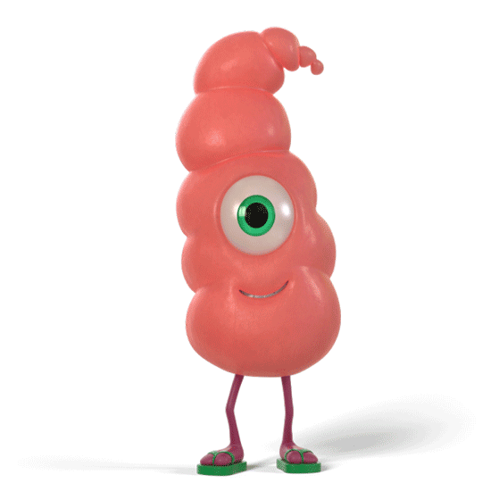
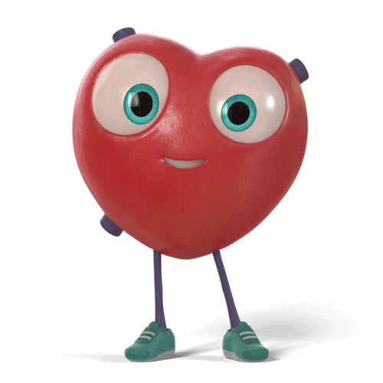
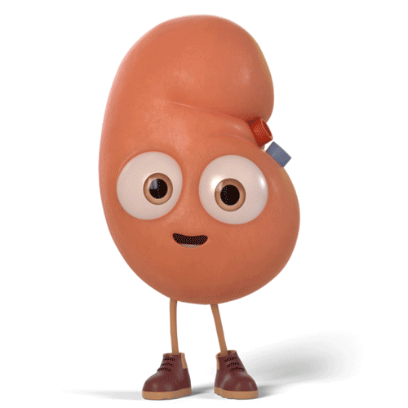
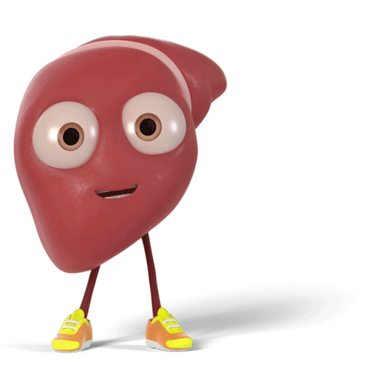
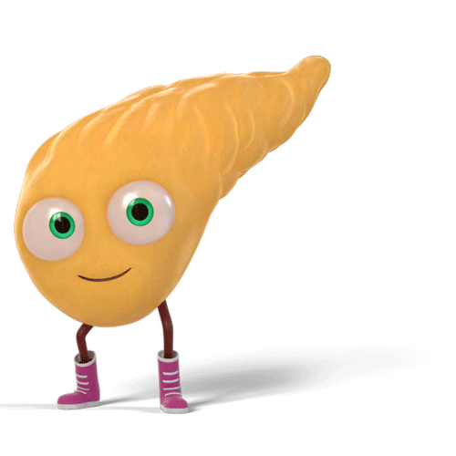
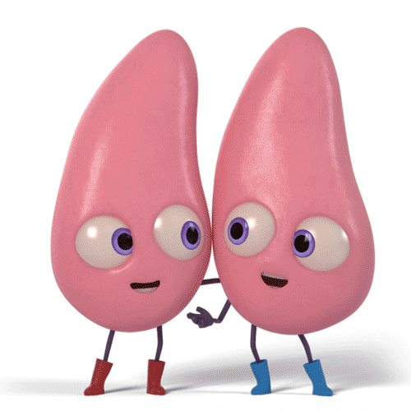
Organ Donation
Notes:
I am now going to talk to you in a bit more detail about organ donation and then Lizzie will go on to talk about tissue donation shortly.

Slide 7
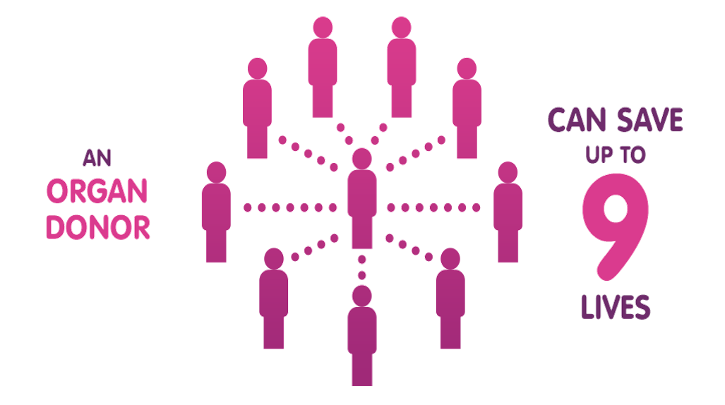
Why become an organ donor?
Notes:
As I am sure that you are all aware organ donation is a precious gift that saves lives but I do not think most people are aware that one donor can donate lifesaving organs for up to 9 people.

Slide 8
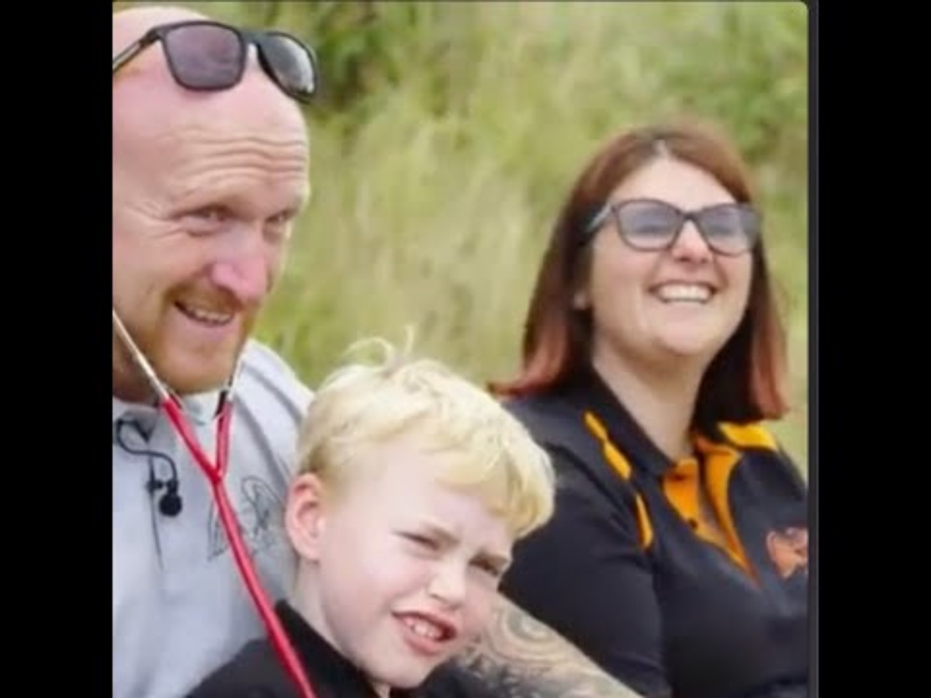
Recipient
Story
Notes:
I am now going to share with you a video that shows the experience of a recipient and illustrates the impact donation has had on them. This is Max and Kiera’s story. Keira was a young girl that died suddenly after a road traffic collision and her parents made the decision to donate her organs. Max was in need of a heart transplant and received Kiera’s heart. You may have heard about their story in the media as the deemed legislation in England was inspired by them and is called Max and Kiera’s law. This video shows Kiera’s parents meeting Max.

Slide 9
Organ Donation
Admission to intensive care
Sad conclusion that death has occurred or is inevitable
Organ Donation will only be discussed by the Specialist nurses
Sudden and unexpected medical emergency requiring mechanical ventilation
Notes:
How does organ donation happen??
I will give you a brief overview of the circumstances that would lead to organ donation.
In the event of a sudden medical emergency that requires mechanical ventilation, a patient will be admitted to an Intensive Care unit. If, despite best efforts, the sad conclusion is that death has occurred or is inevitable, organ and tissue donation will be considered as part of end-of-life care discussions with the patient’s loved ones. It has become in most areas of the country a normal part of end of life care planning when a patient is on the intensive care unit and occasionally accident and emergency. Organ Donation will only be discussed with a family following assessment by a specialist nurse.

Slide 10
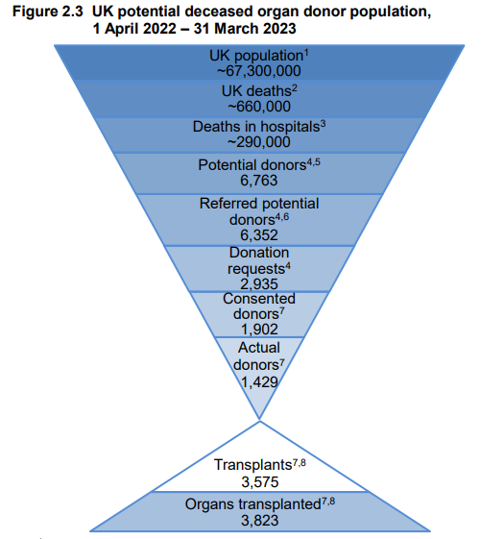
A Small Pool
A person has to die in hospital in a critical care environment where continuing their treatment is futile or they have died a neurological death
Patients who were identified as potential donors by the critical care teams.
Families who are approached for donation
Out of 660,000 deaths, only 1,429 became donors
This is why it is so important to offer donation to all appropriate families
Notes:
Organ donation is one of the greatest gifts one person can give to another but is also one of the most complex processes the NHS carries out. As you can see from this diagram, not many people die in circumstances that make it possible for them to donate their organs and because it is so rare, every opportunity should be optimised. Only 1% of the population die under these circumstances and that is why it is so important to offer donation to the loved ones of ALL potential donors. As I mentioned before these are only patients that are ventilated on the intensive care unit and stable enough for the donation process to be set up which can take up to 24-48 hours. Coronial/ procurator fiscal support is essential to this process and your help and support is vital. In circumstances where there is an ongoing police investigation it is vital that any decisions are made as soon as possible to ensure that any delay will not impact or prevent donation.

Slide 11
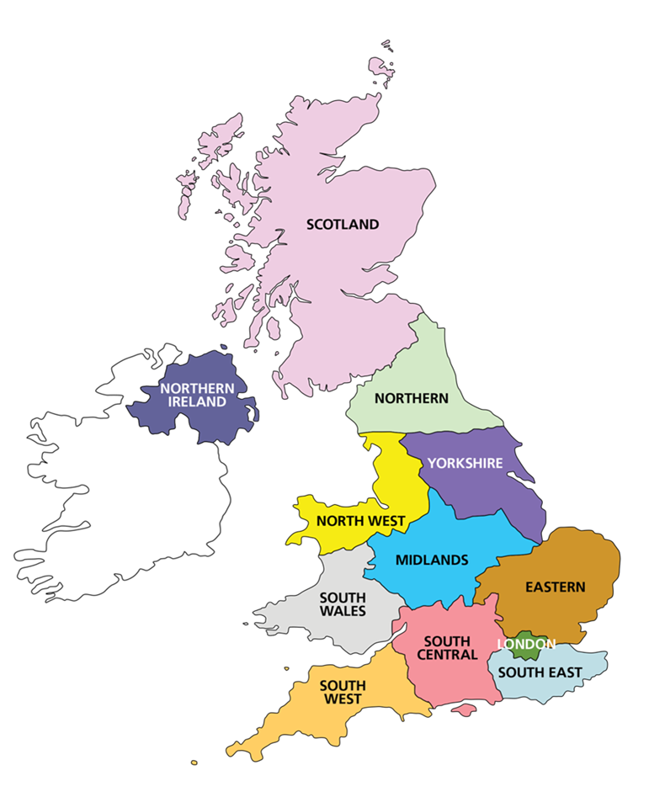
Specialist Nurse Organ Donation (SNOD) Role
UK is split into 12 regions
Work within hospital trusts/health boards to facilitate & educate teams about Organ Donation
Work as part of a team to provide a 24/7 service
Facilitate the whole donation process from the referral of a patient through to caring for the deceased patient after the organ retrieval
Notes:
Our teams of Specialist Nurses Organ Donation (SNODs) are split into 12 regions across the UK. We work within hospital trusts to help facilitate and educate teams about organ donation. As a team we provide a 24 hour service 365 days of the year facilitating the whole donation process from the referral of a patient through to caring for the deceased patient after the organ retrieval surgery.

Slide 12

Family conversations
It is best practice to gain a lack of objection from the coroner/procurator fiscal prior to speaking to the patient’s loved ones
The specialist nurse will assess if they are understanding and accepting of the situation
A collaborative plan is made between the medical staff and the specialist nurse before speaking to the patient’s loved ones
Notes:
Collaborative discussions amongst teams are encouraged throughout the donation process. It is best practice to gain a lack of objection from the coroner/procurator fiscal prior to speaking to the patient’s loved ones so that we are not offering something that is not a possibility. We only have 1 chance at this conversation and we do not want to offer something that we will later have to take away. These conversations should include the specialist nurses and the medical team speaking to the coronial service or the medical examiners at the earliest opportunity if a referral is required.

Slide 13
Referral of patient
Discussions with the patient’s loved ones
Lack of objection from coroner/PF
Clinical assessment
Additional information sought
Family care and follow up
Matching recipients
Organ retrieval
Notes:
Organ donation is a complex process involving many elements that all need to fit into place at just the right time a bit like a jigsaw. Following referral of a patient, a thorough assessment is carried out to ensure there are no potential risks to the recipients. Clear communication with multi disciplinary and multi agency teams is required throughout and is essential to maintain the safety of the process. As I have already mentioned a lack of objection from the coroner/procurator fiscal is essential and it is best practice to establish this prior to speaking to a family. We would seek to gain additional information from various sources including the patients GP and through completing a questionnaire with the family to ascertain the patients medical and social history. If you have donated blood this questionnaire is similar to the questions that you will have been asked, this is part of the information gathered to help make a match to a suitable recipient. Once recipients are matched we can ask a specialist surgical team to attend the hospital to carry out the operation. Supporting our donors and their loved ones through this extraordinary process is our utmost priority and carried out with dignity and respect. The process is paused to provide a moment of honor for the patient in recognition of the person and their extraordinary gift. Once the organs are removed from the donor they need to be transplanted as soon as possible- the heart for example must be transplanted within 4-6 hours where as the kidneys are more robust and are transplanted up to 24 hours after. We would update any of the staff involved with the outcome after the retrieval. If the police and coroner are involved we would also include updating them.

Slide 14
DBD – Donation following brain death
After a period of assessment on the intensive care unit it is apparent that an irreversible brain injury has occurred
Tests can be performed to confirm the time of death
The organ donation process is set up if consent is gained from the patient’s loved one
Transferred to theatre
Organ retrieval takes place
Notes:
Donation after Brain Death (DBD) is possible from patients whose death has been confirmed using neurological criteria, also known as brain-stem death. Following an irreversible brain injury and a period of assessment on the intensive care unit a set of tests will be performed to confirm death. These tests are performed twice by 2 senior clinicians working together. This will be the date and time of death transcribed onto the death certificate. Only when consent is gained can the organ donation process proceed. Family will say their goodbyes and then the patient will be transferred to theatre and organ retrieval surgery will start.

Slide 15
DCD – Donation following circulatory death
Death is inevitable after a period of observation on the intensive care unit
The patient’s loved ones are fully informed of the transition to end-of-life care in the best interests of the patient
Full withdrawal of supportive treatment occurs in a controlled environment
Death is verified when the heart stops
Death needs to happen within 3 hours of withdrawal of supportive treatment for organ donation to proceed
Notes:
Donation after Circulatory Death (DCD) refers to the retrieval of organs from patients whose death is diagnosed and confirmed after the heart stops and the patient has been confirmed dead. Following a period of observation on the intensive care unit a decision is made by the medical team that death is inevitable and that life sustaining treatments that have been considered to be of no overall benefit to the patient should be withdrawn. The family are informed of the transition to end-of-life care in the best interests of the patient. Although withdrawal of treatment is planned this does not mean that care will be withdrawn for that patient. Full withdrawal of supportive treatment occurs in a controlled environment and death is verified when the heart stops. Death needs to happen within 3 hours of withdrawal of supportive treatment for organ donation to proceed.

Slide 16
Donation the Role you play …..
A timely decision is needed…..
In complex scenarios the specialist nurse may set up a virtual call with other multi agencies involved
Think outside the box.....
Specialist nurses are unable to mobilise the surgical teams until they have coronial/procurator fiscal consent
Notes:
Your role in the organ donation process is sometimes vital to help save and improve lives.
If there is a police investigation in order to make a decision the coroner/procurator fiscal will require timely information. Effective communication between the multi agencies is essential and this may occasionally involve a virtual call being facilitated by the specialist nurse.
Thinking outside the box- so as we alluded to earlier this is one of the most complex processes within the NHS and there can be many curve balls and complexities involved. We recognise the dedication of the teams who often go above and beyond to ensure that something positive can come out of these awful situations and the donor families see the legacy that their loved ones leave behind. The pathologist and the police may need to be involved however we can only go so far into the process until a final decision has been ascertained by the coroner/ procurator fiscal.

Slide 17
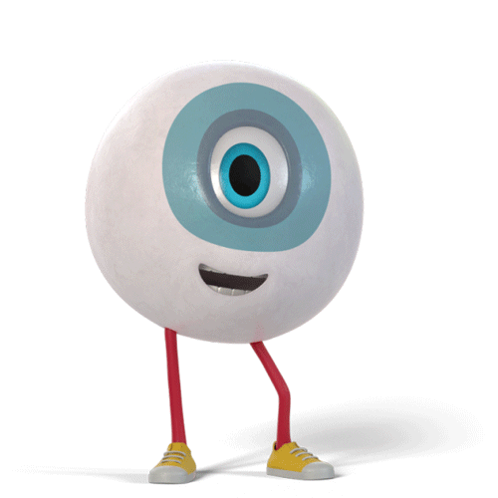
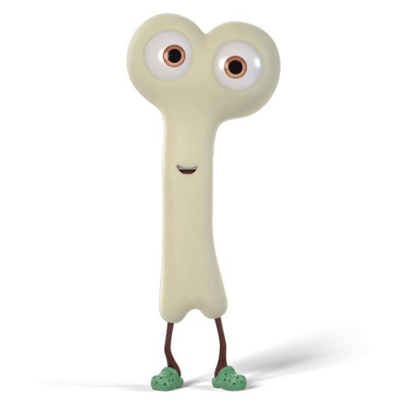
Tissue Donation
Notes:
Hello we are now going to discuss tissue donation in more detail.

Slide 18



As many as 50 people can be helped by one tissue donor
Notes:
You may not be aware that up to 50 people can be helped by one tissue donor.

Slide 19
Tissues that can be donated
Heart valves can be transplanted to save the lives of children born with heart defects and adults with damaged heart valves.
Corneas help restore sight. Most people are able to donate their corneas after death.
Skin can be used as a natural dressing to help treat people with serious burns.
Tendons & Meniscus can rebuild damaged joints, helping people to move more easily.
Bone can be used in bone grafts, restoring health and mobility to many patients.
Femoral arteries replace damaged or infected arteries to improve quality of life.
Notes:
This is an overview of the different tissues that can be donated and their use.
Corneas protects the eye and filters and screens out some of the sun’s damaging UV waves. Donated corneas help restore sight, and most people can potentially donate their corneas after their death, even if they have had certain cancers or poor eyesight.
Heart valves can be transplanted to save the lives of children born with congenital heart defects and adults with damaged valves. There is little evidence of rejection.
Meniscus is a piece of cartilage that provides a cushion between your femur (thighbone) and tibia (shinbone). They can be damaged or torn during activities that put pressure on or rotate the knee joint.
A tendon connects muscle to bone. The recipients of tendons and meniscus are often younger people who may have damaged their joints playing sports.
Skin can be used as a natural dressing to help treat people with serious burns and helps reduce pain, infection and scarring, it can prepare the underlying skin for later cosmetic grafting.
Donated femoral arteries can improve quality of life by replacing damaged or infected arteries. Donated bone is used where bone needs to be replaced due to trauma or disease and can be used as packing to replace worn bone restoring health and mobility to many patients.

Slide 20
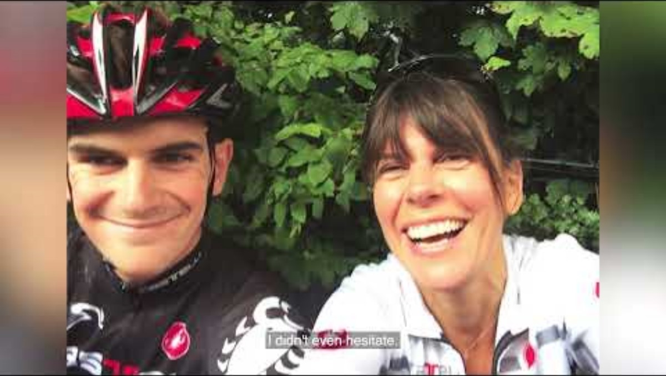
Donor Family Story
Notes:
I would like to share Wills story told by his mother Liz. Will was a cyclist that had always carried an organ donor card. His mother was initially uncertain about him donating his eyes but recognised that this was something that he would have wanted.

Slide 21
Patient dies
Patient's wishes established or family wish to discuss tissue donation further
Call to the National Referral Centre on 0800 432 0559
Family contacted to answer questions and discuss donation decision and consent
Patient becomes a tissue donor
Retrieval
Notes:
The tissue donation process starts after a person dies and the person and/ or their family have expressed a wish to donate or would like to discuss the possibility of donation further. This is followed by a call to the National Referral Centre (NRC) by the family or a Health Care Professional (HCP) where a team of specialist nurses can guide them through the process and answer any questions they may have. If the family wish to proceed they are asked a series of questions on their loved ones medical and social history and their consent is sought for donation to go ahead. The NRC will organise the retrieval of the tissues by a team of specially trained staff, maintaining the dignity of the person and restoring their appearance. If the family would like to see their loved one after donation has taken place, this is possible.
Although every effort is made to support a person's donation decision it is not always possible to become a tissue donor; there are several factors to consider including eligibility, patient and family wishes and the person’s location. It may not always be possible for a retrieval team to reach every potential donor. This will be assessed by the specialist team at the National Referral Centre on the initial call.

Slide 22
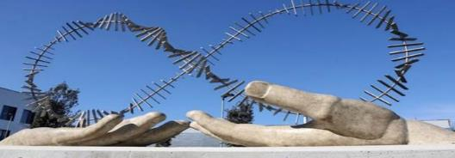
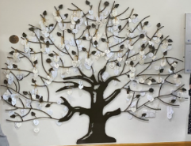
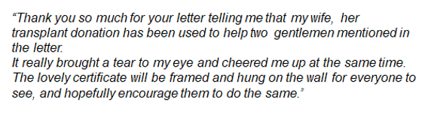
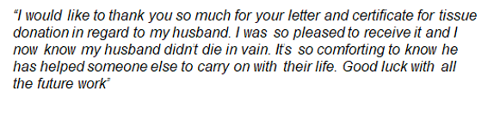
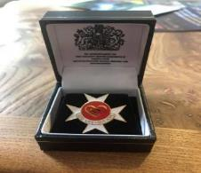

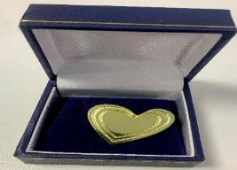
Family Aftercare
Donation Memorials
Notes:
Support is provided to the loved ones of organ and tissue donors by the Donor Family Care Team at NHS Blood and Transplant. All organ donor families are invited to an awards ceremony to receive an award presented to them on behalf of their loved one. The ceremony also gives them the opportunity to meet other donor families.
Families of tissue donors are asked if they would like to receive the order of St Johns certificate and pin badge illustrated in the bottom right-hand corner of the slide. They are also asked if they would like their loved one's name added to the Tree of Thanks, which is a permanent memorial in the reception area of NHS Blood and Transplant’s Liverpool Centre where the National Referral Centre are based. They are also sent a letter of thanks and recognition of the incredible gift and provided with guidance on how to seek further information if they should wish.

Slide 23

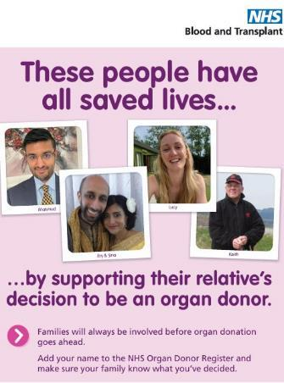

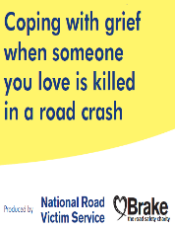
Resources and Information for General Public and Healthcare Professionals
www.organdonation.nhs.uk
Tissue Donation - National Referral Centre – 0800 432 0559
https://library.college.police.uk/docs/NPCC/Major-Crime-Investigation-Manual-Nov-2021.pdf
NPCC National Police Council Practice Advice FLO Deployments - Identification, Visiting, Inquests, Organ and Tissue Donation
BRAKE Charity Booklet – www.brake.org.uk
Notes:
These are some resources that have organ and tissue donation guidance within them that you may find useful.

Slide 24
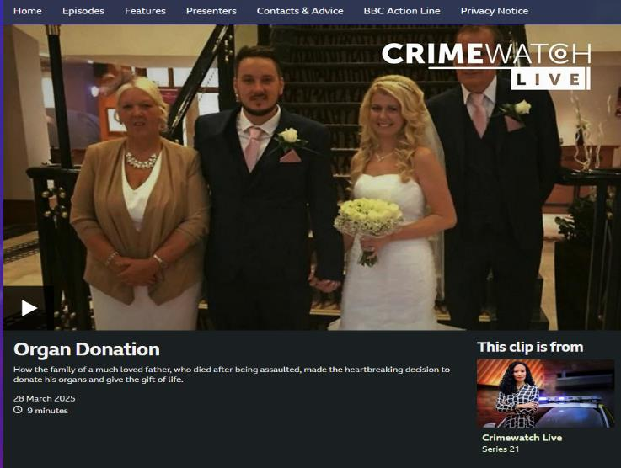
BBC One - Crimewatch Live, Series 21, Organ Donation
Notes:
This is a case that you may have heard about-it was on crimewatch recently and a family share their experience of organ donation. It highlights the complexities involved in some cases involving the coroner and how multiagency collaboration is vital in supporting donation.

Slide 25
To conclude …....
We all have a part to play
Ensure families are spoken to about donation at the right time, by the right person and in the right place​
Communication is key
Collaborating and working together can save and improve many lives
Notes:
It is everyone's responsibility to follow best practice and make every effort to help save and improve lives through organ and tissue donation. Learning and understanding each other’s roles and sharing practice can only be a positive. The key messages we hope to have shared is that we all have a part to play, and we want to ensure families are spoken to at the right time, by the right people and in the right place.
We cannot underestimate the impact of donation on a person’s loved ones and how this is often seen as a positive outcome out of unbelievable sadness.
Thank you for your role in helping to save and improve more lives.

