Slide 1

Simulation studies for the UKLKSS
Lisa Burnapp, Rachael Colley, David Manlove, William Pettersson, Matthew Robb
Supported by EPSRC Grant EP/X013618/1 KidneyAlgo

Slide 2



University of Glasgow Team
Prof David Manlove
Professor of Algorithms and Complexity
Dr Rachael Colley
Postdoctoral Research Associate
Dr William Pettersson
Research Software Engineer
2

Slide 3




Projects and spin-out company
www.kepsoft.org
3

Slide 4


Currently allowed cycles and chains in the UKLKSS
Cyclic exchanges
d₁
d₂
d₁
d₂
r₁
r₂
r₁
r₂
3-cycle
2-cycle
d₃
r₃
      Non-directed donor chains
N₁
N₁
r₂
d₂
r₂
d₂
r₃
d₃
DDWL
3-chain
DDWL
2-chain
4

Slide 5
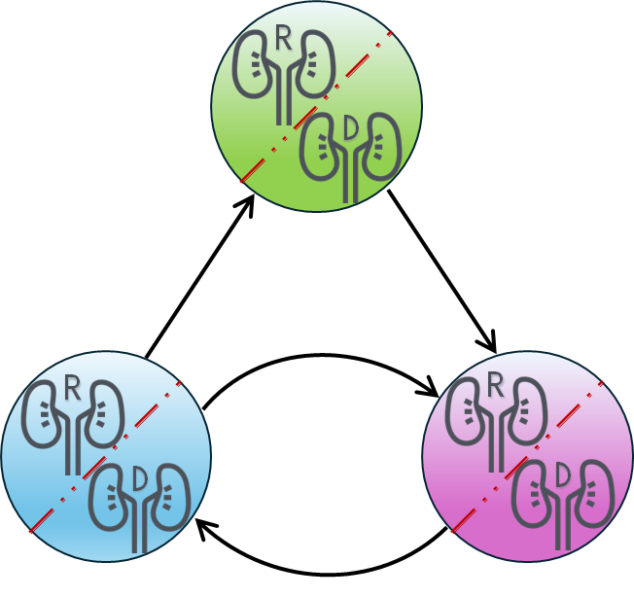
Optimisation policy and goal of the simulations
Current UKLKSS Optimisation Policy:
Maximise the number of effective pairwise exchanges
Maximise the number of transplants selected
Minimise the number of 3-cycles and 3-chains selected
Maximise the number of back-arcs selected
Maximise the sum of the scores of the selected transplants
Goal: investigate the effects of different policy changes that NHSBT may enact for the UKLKSS
5

Slide 6
Simulations - Static vs Dynamic
Static simulations only look at single match runs based on historical data from UKLKSS, including the make-up of the pool of recipients
If a different set of transplants is identified, this will affect the next match run, and thus the make-up of the pool differs, but static simulations cannot take this into account
Therefore, static simulations won't accurately reflect the make-up of the pool of recipients
Dynamic simulations simulate the process of recipients and donors arriving, match runs being performed, transplants being identified, laboratory crossmatching, transplants being performed, and also transplants being missed due to e.g. illness or other factors and subsequently rejoining the pool
Dynamic simulations can more accurately reflect changes to make-up of the pool
To do this, we need to make assumptions about these processes
6

Slide 7
Dynamic simulations
It is important to simulate changes over a long enough time-period to mimic the accrual of hard-to-match recipients
We simulate over 14 years – the first 7 years builds up the pool (to accurately reflect Tier A recipients) and the second 7 years gives us the statistics shown in this presentation
We generate recipients and their donors randomly, including when they arrive, when they leave, when they miss match runs, and which donors are compatible with which recipients
Data is generated based on statistics supplied by NHSBT
Each policy change is tested over 30 sets of randomly generated 14-year data sets
Caveat: We are not taking practicalities into account (such as more transplants meaning greater logistical challenges)
7

Slide 8
Dynamic simulations – data used
Number of recipients arriving, and number of paired donors per recipient [2]
Number of NDADs arriving [2]
Distribution of blood groups of recipients and donors [1]
Distribution of cRF values of recipients [1]
Probability of donor being compatible with a given recipient [1]
Probability of a positive laboratory crossmatch after a negative virtual crossmatch [2]
Chance of a recipient missing a match run [2]
Duration a recipient stays in the UKLKSS without receiving a transplant [2]
Time taken to arrange, schedule, and perform transplants associated with an exchange [2]
[1] M. Delorme, S. García, J. Gondzio, J. Kalcsics, D. Manlove, W. Pettersson, J. Trimble; Improved instance generation for kidney exchange programmes; Computers & Operations Research 2022; doi: 10.1016/j.cor.2022.105707
[2] Based on summary statistics shared by NHSBT
8

Slide 9
Current UKLKSS Optimisation Policy
Maximise the number of effective pairwise exchanges
Maximise the number of transplants selected
Minimise the number of 3-cycles and 3-chains selected
Maximise the number of back-arcs selected
Maximise the sum of the scores of the selected transplants
 | Recipients in pool | Transplants identified | Transplants performed | Conversion rate | Time to transplant
NHS Statistics | 241.52 | 69.82 | 47.33 | 67.79% | 5.85 months
Baseline | 241.45 | 62.22 | 45.82 | 70.33% | 6.96
Increased conversion rate | 243.07 | 58.67 | 45.75 | 77.26% | 6.69
9

Slide 10
Dropping the first objective maximise the number of effective pairwise exchanges
The objective to maximise the number of effective pairwise exchanges was originally included to minimise risk when 3-cycles were introduced
This is now less important due to the increased experience with 3-cycles
 | Recipients in pool | Transplants identified | Transplants performed | Conversion rate | Time to transplant | No. of 3-cycles & 3-chains
Baseline with effective pairwise | 241.45 | 62.22 | 45.82 | 70.33% | 6.96 | 19.04
Baseline without effective pairwise | 235.34 | 64.59 | 46.36 | 69.00% | 6.66 | 19.85
Inc. conversion with effective pairwise | 243.07 | 58.67 | 45.75 | 77.26% | 6.69 | 18.07
Inc. conversion without effective pairwise | 236.03 | 60.53 | 46.06 | 76.24% | 6.39 | 18.79
10

Slide 11
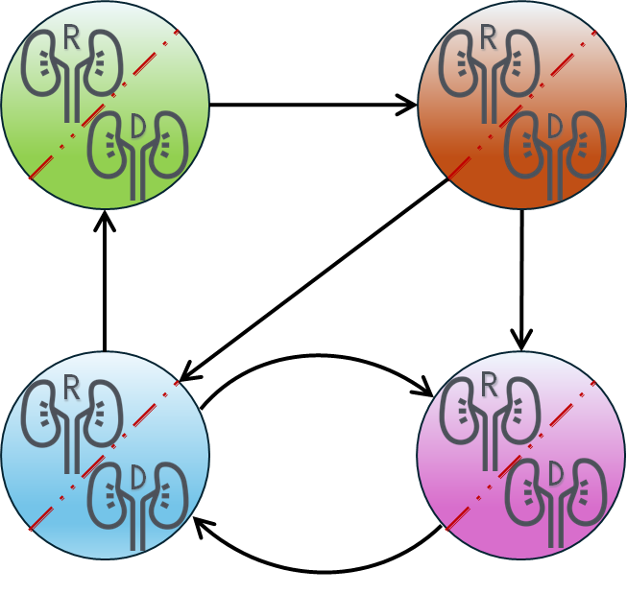
New UKLKSS Optimisation Policy
What if longer cycles and chains were allowed?
Maximise the number of transplants selected
Minimise the number of exchanges of a given length
  Minimise the number of 6-chains selected
  Minimise the number of 5-chains selected
  Minimise the number of 4-cycles and 4-chains selected
  Minimise the number of 3-cycles and 3-chains selected
Maximise the number of cross-arcs + back-arcs selected
Maximise the sum of the scores of the selected transplants
11

Slide 12
Allowing longer cycles and chains
Allowing longer cycles and chains can mean more transplants identified
Although this will introduce logistical challenges, our simulations assume that these logistical challenges can be met
Recipient arrivals | Cycle limit | Chain limit | Recipients in pool | Transplants identified | Transplants performed | Conversion rate | Time to transplant
71 | 3 | 3 | 235.34 | 64.59 | 46.36 | 69.00% | 6.66
71 | 3 | 4 | 228.16 | 66.15 | 46.93 | 68.55% | 6.18
76 | 3 | 5 | 235.11 | 71.01 | 49.50 | 68.49% | 5.94
76 | 3 | 6 | 232.85 | 73.02 | 49.28 | 66.44% | 6.00
81 | 4 | 4 | 247.51 | 79.29 | 53.38 | 65.83% | 5.88
81 | 4 | 5 | 245.94 | 79.83 | 53.45 | 64.61% | 5.85
81 | 4 | 6 | 245.23 | 79.92 | 53.17 | 65.23% | 5.79
12

Slide 13
Allowing longer cycles and chains with increased conversion rate
We now consider a scenario in which NHSBT achieves a higher conversion rate
Recipient arrivals | Cycle limit | Chain limit | Recipients in pool | Transplants identified | Transplants performed | Conversion rate | Time to transplant
71 | 3 | 3 | 236.03 | 60.53 | 46.06 | 76.24% | 6.39
71 | 3 | 4 | 227.78 | 61.68 | 46.88 | 76.04% | 5.91
76 | 3 | 5 | 239.76 | 68.67 | 50.87 | 73.31% | 5.94
76 | 3 | 6 | 236.86 | 70.10 | 51.13 | 71.54% | 5.67
81 | 4 | 4 | 250.59 | 74.04 | 53.94 | 72.54% | 5.52
81 | 4 | 5 | 249.19 | 74.13 | 54.02 | 72.38% | 5.46
81 | 4 | 6 | 248.69 | 74.50 | 54.17 | 71.75% | 5.52
13

Slide 14
Allowing longer cycles and chains with increased conversion rate
Effect on highly sensitised and Tier A recipients:
 |  |  | Highly sensitised recipients |  | Tier A recipients
Recipient arrivals | Cycle limit | Chain limit | Transplants performed | Time to transplant | Transplants performed | Time to transplant
71 | 3 | 3 | 17.23 | 8.58 | 3.97 | 11.43
71 | 3 | 4 | 17.46 | 7.65 | 4.14 | 10.26
76 | 3 | 5 | 18.76 | 7.47 | 4.59 | 9.15
76 | 3 | 6 | 18.94 | 7.32 | 4.7 | 8.55
81 | 4 | 4 | 20.72 | 6.51 | 5.04 | 8.28
81 | 4 | 5 | 20.82 | 6.36 | 5.06 | 8.1
81 | 4 | 6 | 20.99 | 6.42 | 5.11 | 8.1
14

Slide 15
Allowing longer cycles and chains with increased conversion rate
Numbers of cycles and chains of different lengths:
Recipient arrivals | Cycle limit | Chain limit | 2-cycles | 3-cycles | 4-cycles | 2-chains | 3-chains | 4-chains | 5-chains | 6-chains
71 | 3 | 3 | 3.97 | 13.38 | 0 | 1.63 | 5.41 | 0 | 0 | 0
71 | 3 | 4 | 3.84 | 12.31 | 0 | 1.4 | 1.52 | 4.21 | 0 | 0
76 | 3 | 5 | 3.9 | 12.04 | 0 | 0.6 | 0.93 | 1.76 | 4.25 | 0
76 | 3 | 6 | 3.81 | 10.66 | 0 | 0.42 | 0.59 | 0.99 | 2.11 | 3.5
81 | 4 | 4 | 3.9 | 7.45 | 7.24 | 1.55 | 2.97 | 2.48 | 0 | 0
81 | 4 | 5 | 3.54 | 6.98 | 7.19 | 1.42 | 2.4 | 1.94 | 1.32 | 0
81 | 4 | 6 | 3.48 | 6.49 | 6.86 | 1.18 | 2.02 | 1.62 | 1.26 | 1.1
15

Slide 16
Prioritising Tier A recipients
We now consider how to prioritise Tier A recipients directly in the objectives
Option 1: TA-1st
Option 2: TA-2nd
Maximise number of transplants to Tier A recipients
Maximise number of transplants
Minimise use of longer cycles and chains
Maximise recourse options
Maximise score
Maximise number of transplants
Maximise number of transplants to Tier A recipients
Minimise use of longer cycles and chains
Maximise recourse options
Maximise score
16

Slide 17
Prioritising Tier A recipients
Scenario | Recipients in pool | Transplants identified | Transplants identified (TA) | Transplants performed | Transplants performed (TA) | Time to transplant | Time to transplant (TA)
Baseline | 235.34 | 64.59 | 5.65 | 46.36 | 3.97 | 6.66 | 13.08
Baseline with TA-1st | 238.18 | 64.01 | 6.17 | 46.15 | 4.37 | 6.63 | 11.01
Baseline with TA-2nd | 236.29 | 64.62 | 5.93 | 46.28 | 4.28 | 6.57 | 10.92
Inc. conversion | 236.03 | 60.53 | 5.28 | 46.06 | 3.97 | 6.39 | 11.43
Inc. conversion with TA-1st | 237.88 | 60.04 | 5.76 | 45.87 | 4.32 | 6.39 | 10.44
Inc. conversion with TA-2nd | 236.56 | 60.20 | 5.61 | 46.09 | 4.20 | 6.30 | 10.95
17

Slide 18
Non-simultaneous Extended Altruistic Donor Chains
N₁
d₃
d₅
r₂
d₂
r₄
d₄
r₆
d₆
“3-chain”
r₃
“3-chain”
r₅
r₇
“3-chain”
Matching run r
Matching run r+2
Matching run r+4
…
We considered different probabilities that the final donor in a chain segment would be willing to be a “bridge donor” in a subsequent matching run
18

Slide 19
Non-simultaneous Extended Altruistic Donor Chains
Bridge donor willingness | Recipients in pool | Transplants identified | Transplants performed | Conversion rate | Time to transplant
0% | 235.34 | 64.59 | 46.36 | 69.00% | 6.66
25% | 232.27 | 64.89 | 46.76 | 69.13% | 6.48
50% | 228.15 | 64.83 | 47.17 | 70.02% | 6.24
75% | 224.33 | 65.26 | 47.62 | 69.70% | 6.18
100% | 221.22 | 65.05 | 48.12 | 70.59% | 6.06
19

Slide 20
Key messages / concluding remarks (1)
Could consider removing “effective pairwise” objective
Increasing the exchange length limits can be beneficial
  Allowing 4-cycles and 4-chains can be beneficial
Prioritising Tier A recipients can decrease their time to transplant with minimal side effects to the rest of the pool
NEAD chains can lead to a modest increase in transplants and a modest decrease in waiting time
20

Slide 21
Key messages / concluding remarks (2)
Many more results available at https://optimalmatching.com/kep-results
We can perform more simulations on request
21

Slide 22




Thank you for listening
Any questions?
#UofGWorldChangers
@UofGlasgow

