Slide 1
Enhanced Recovery After Surgery (ERAS) in transplantation
Carrie Scuffell
SME for ERAS in Transplantation,
NHS Blood and Transplant
Notes:
NHSBT strategy
Falls under Recipient and transplant outcomes

Slide 2


What is ERAS?
Multimodal, pathway to help improve recovery
  Reduce surgical stress
  Patent centred - encourages patient engagement and autonomy
  Reduces the risk of complications
  Better use of resources
  Reduced Length of Stay (LOS)
‘Business as usual’ in other realms of surgery

Slide 3
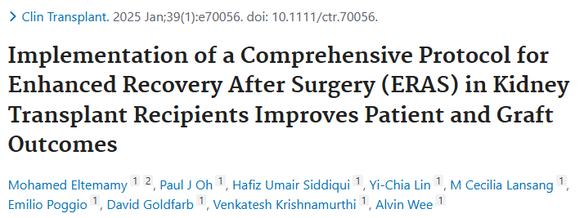
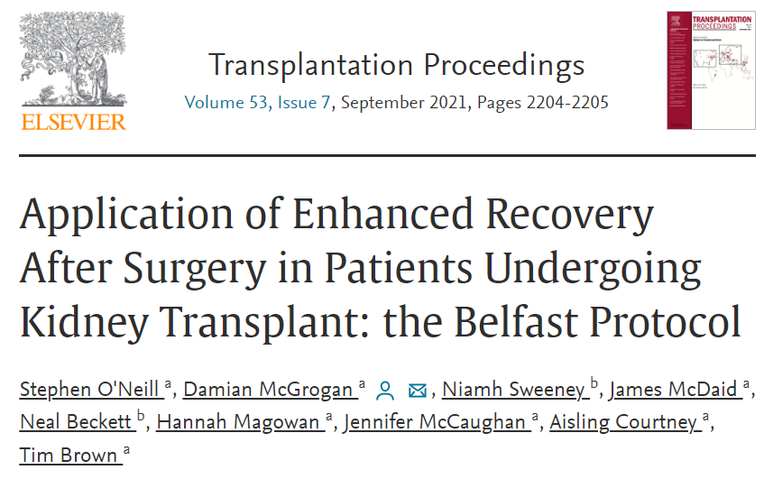
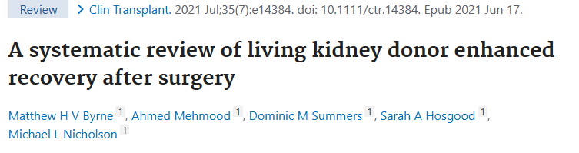
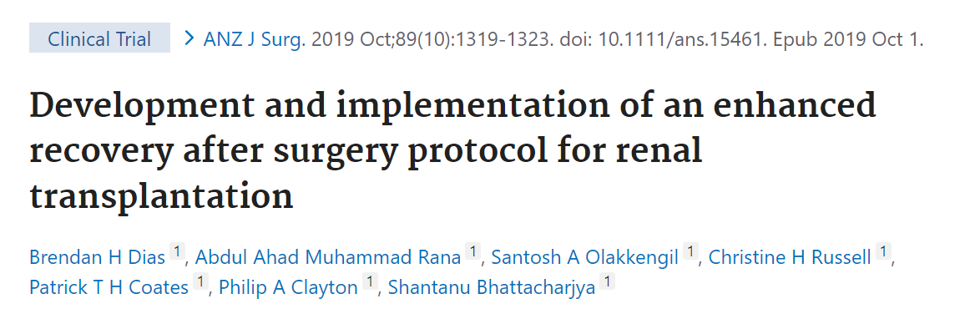
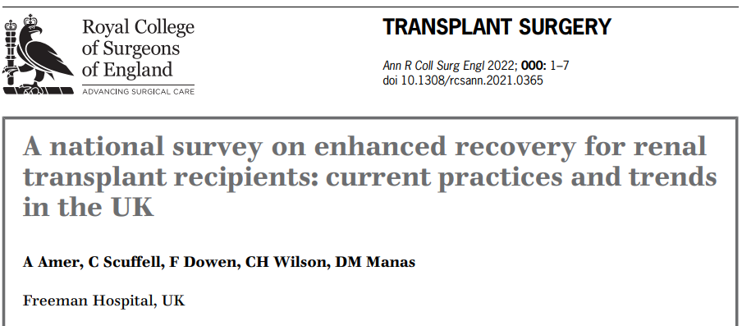
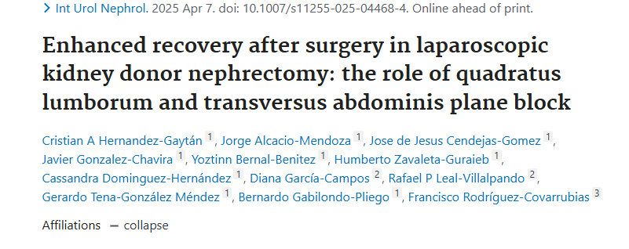
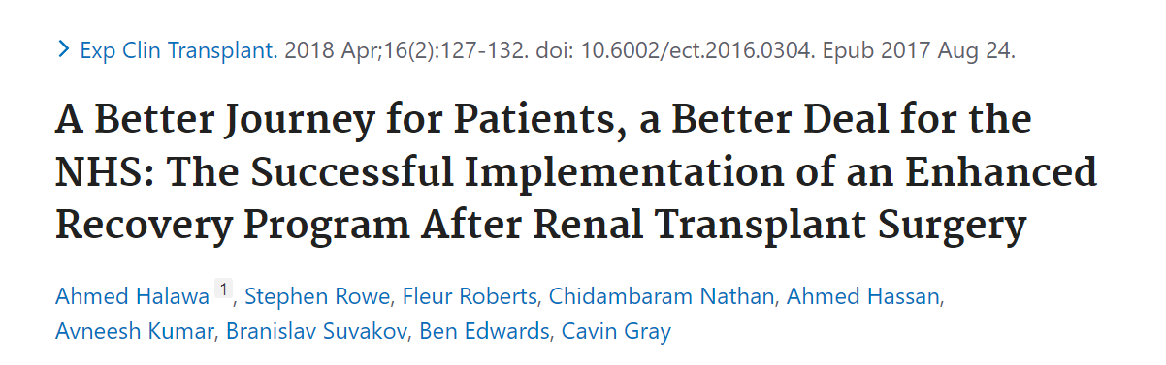
ERAS in transplantation

Slide 4

NHSBT ERAS project aims
To facilitate a UK-wide roll out of ERAS in Transplantation by*
Adult Liver
Paediatric
kidney
Drawing from existing best practice
Providing a repository of evidence-based resources to support adoption of ERAS in centres
Started with adult kidney transplant recipients
Scope to include other organs and living donors
Adult lung
Pancreas
Living kidney
donor
Adult Kidney
Key deliverable for the Implementation and Steering Organ Utilisation (ISOU) Group¹
Workstreams
¹https://www.gov.uk/government/publications/honouring-the-gift-of-donation-utilising-organs-for-transplant/honouring-the-gift-of-donation-utilising-organs-for-transplant-summary-report-of-the-organ-utilisation-group
*ERAS Steering Group ToR, May 2023
Steering group

Slide 5


NHSBT ERAS project structure
NHSBT
Derek Manas, Medical Director
Lisa Burnapp, ERAS Programme lead
Carrie Scuffell, ERAS Subject Matter Expert
Interested and participated centres
Geographically diverse
Variety of disciplines
Lay and recipient/donor representation
Multidisciplinary Steering group
Living donors and transplant recipients
Expert by experience panels
  Stage 1
    core and desirable ERAS components with supporting evidence
Stage 2
  Downloadable resources for centres
  Evaluation and measurement criteria
Stage 3
  Circulation and communication
  Patient facing content
Adult kidney transplant
Adult liver transplant
Living kidney donor
Pancreas transplant
Lung
transplant
Paediatric kidney
transplant
Evaluation and measurements

Slide 6
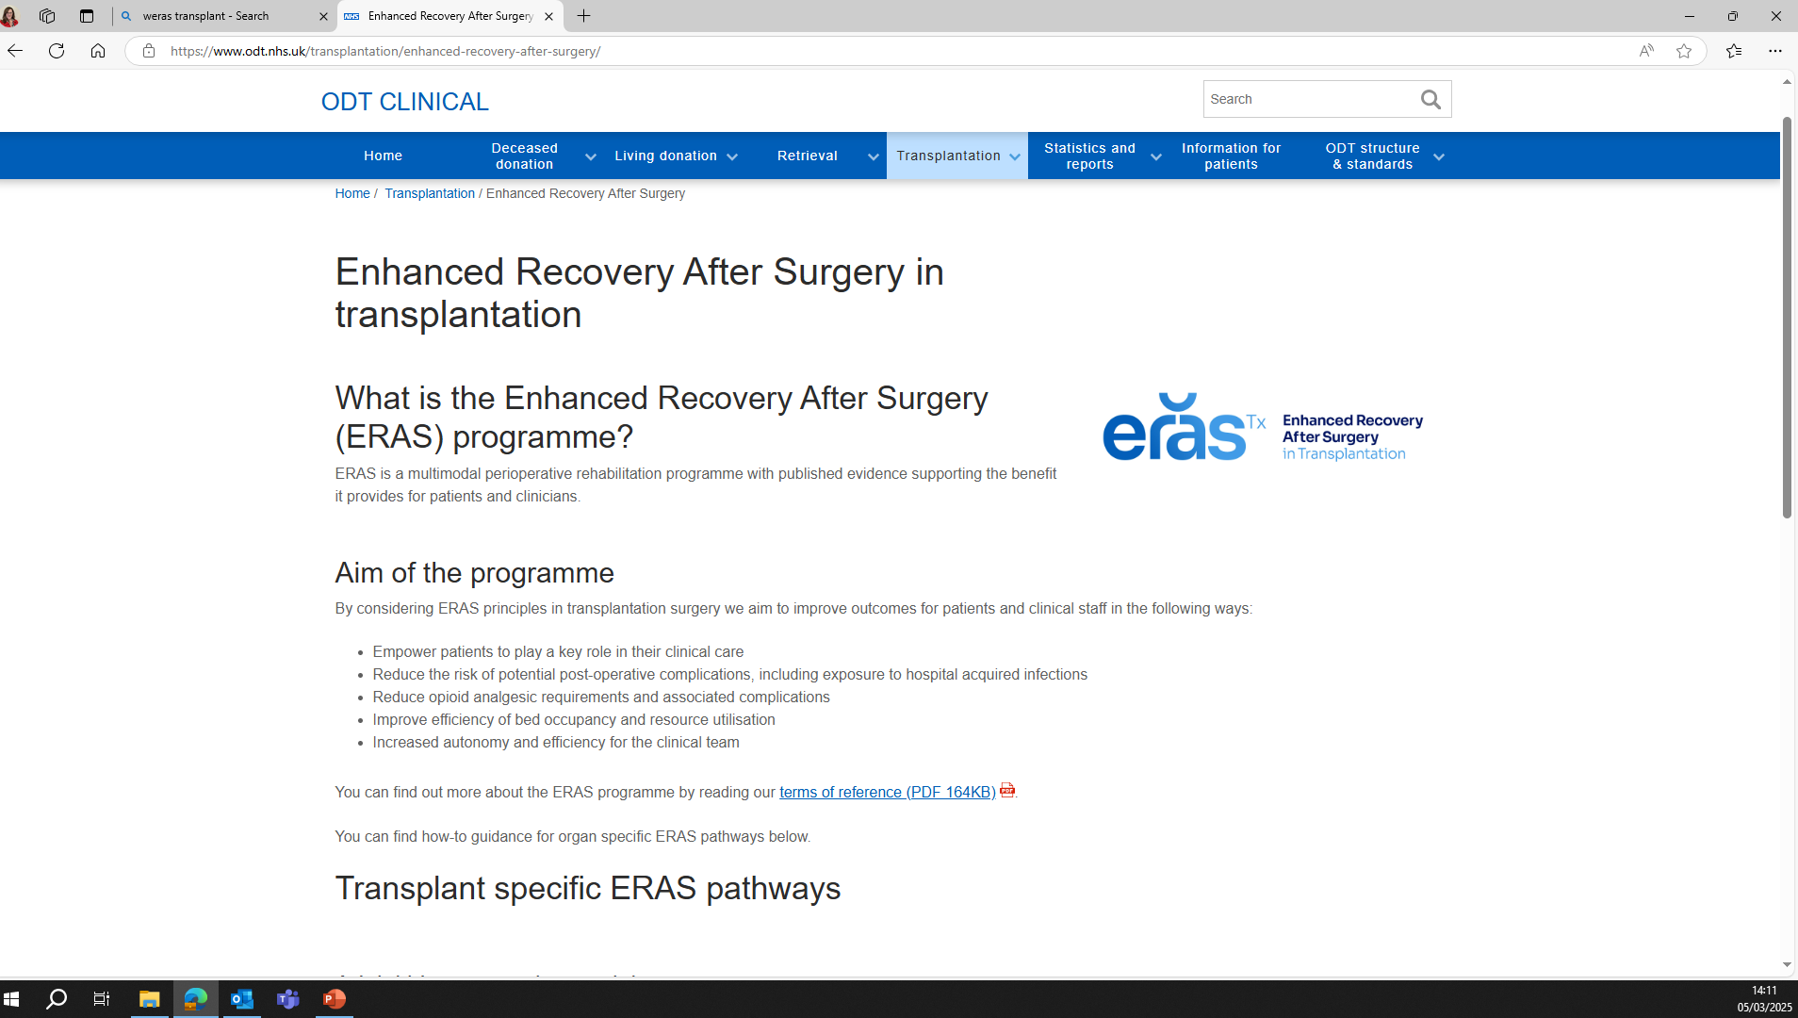

www.odt.nhs.uk

Slide 7
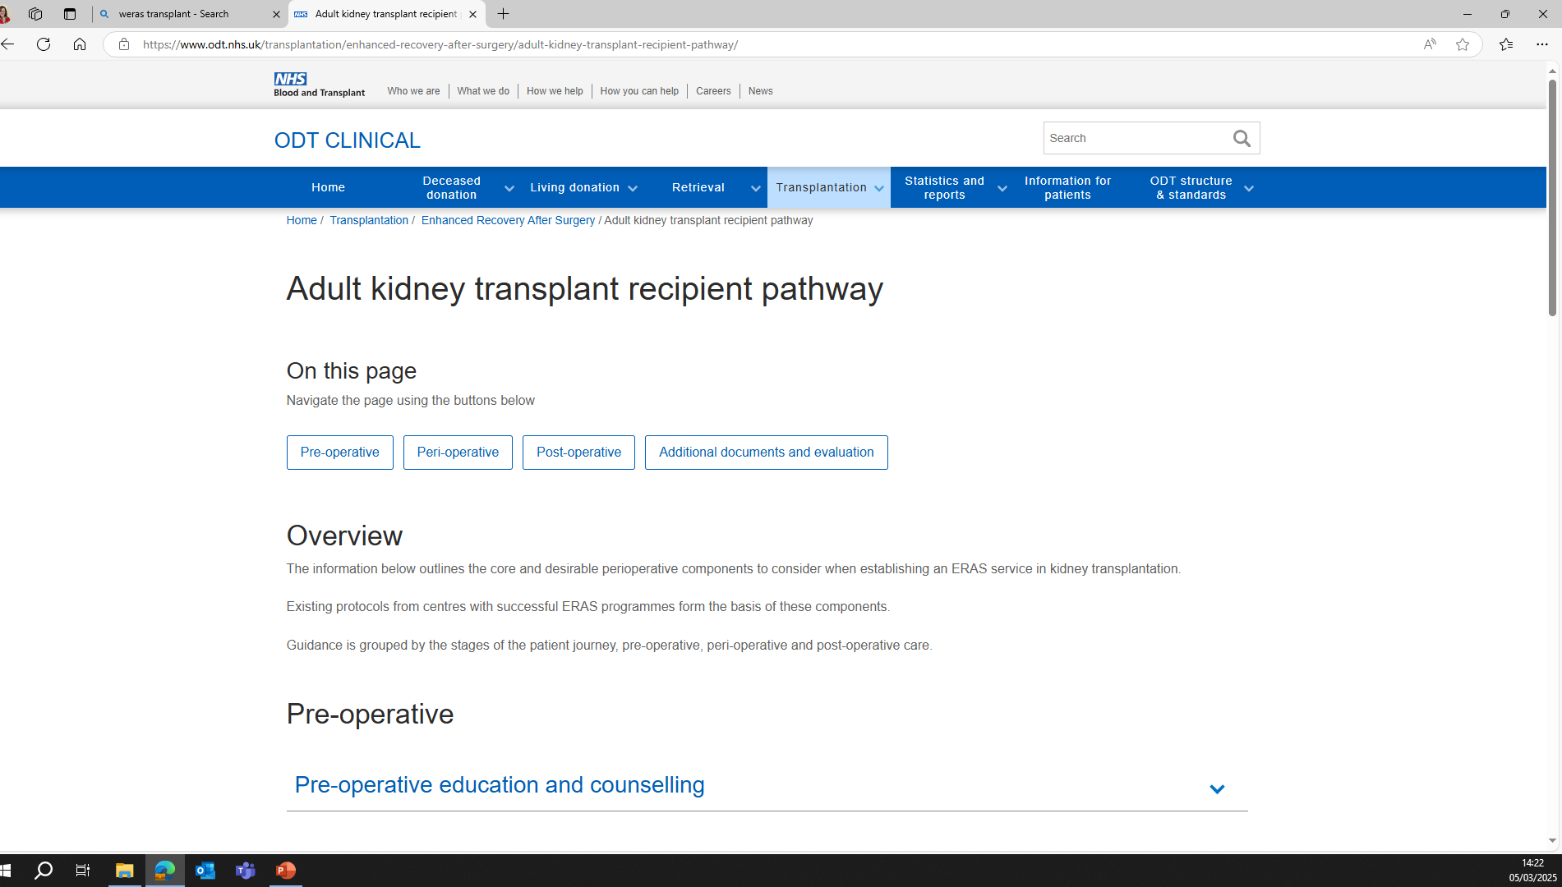
www.odt.nhs.uk

Slide 8
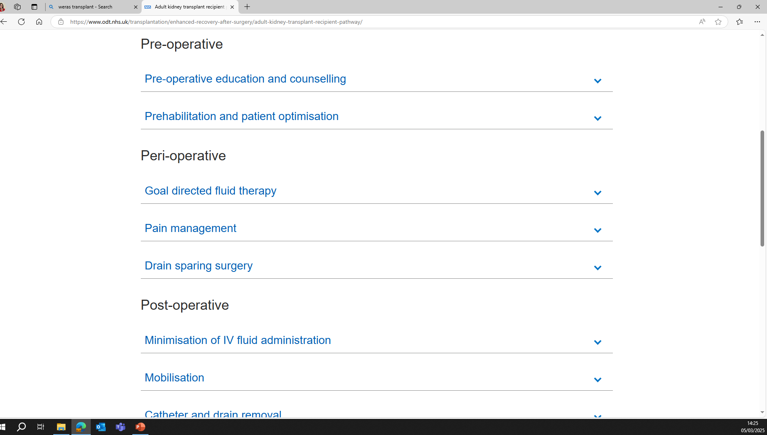
www.odt.nhs.uk

Slide 9
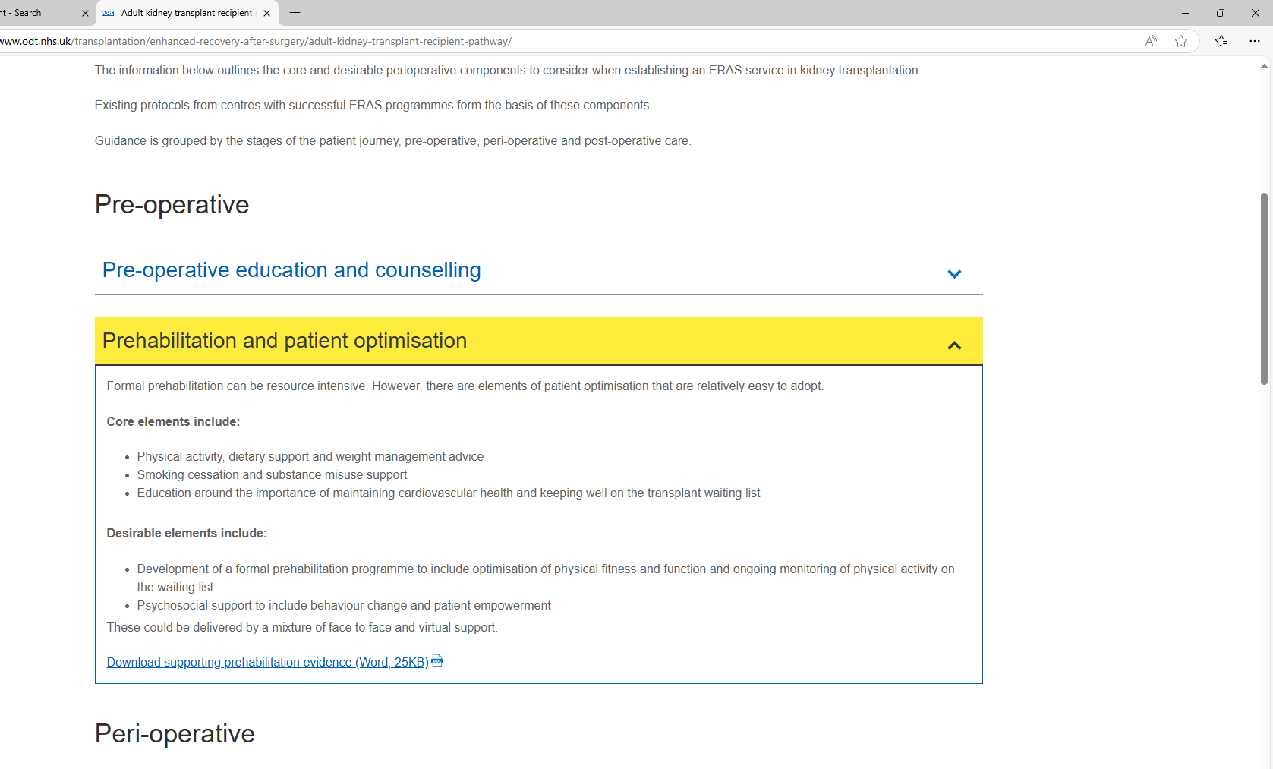
www.odt.nhs.uk

Slide 10
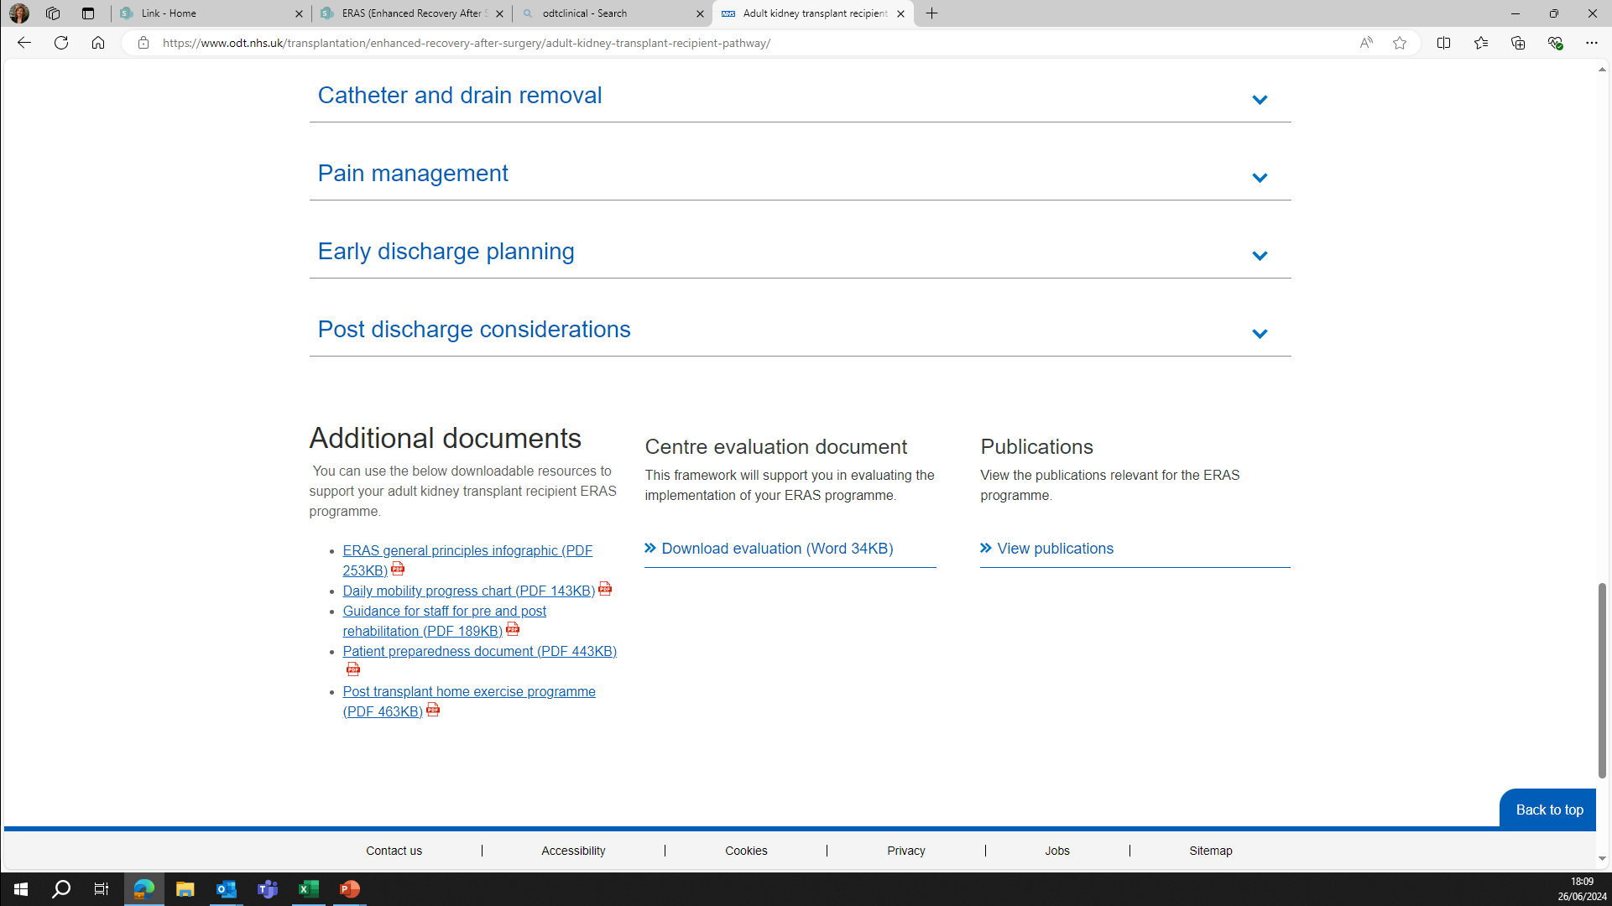
www.odt.nhs.uk

Slide 11
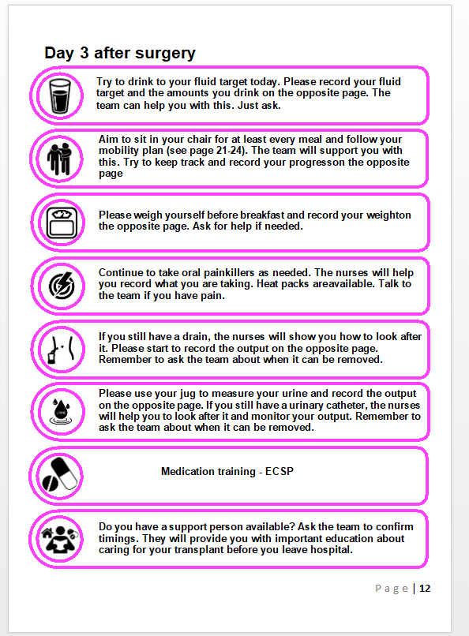
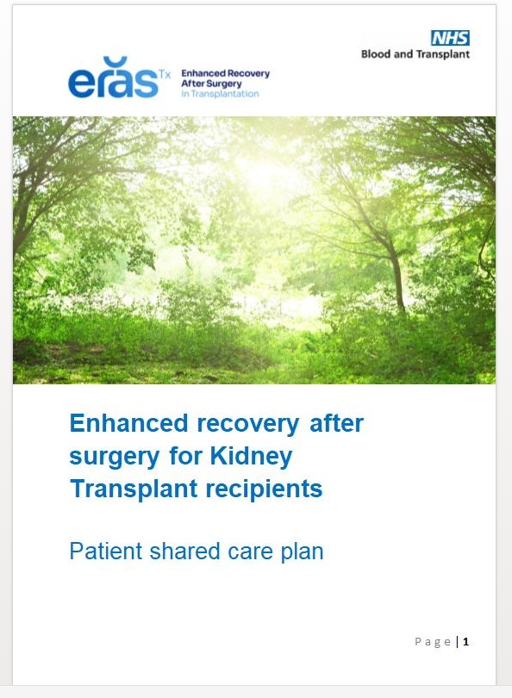
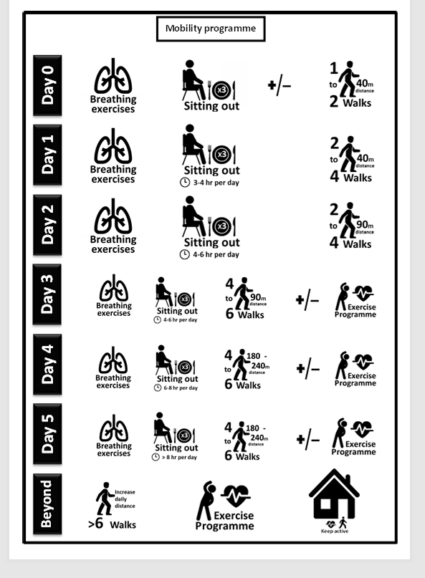
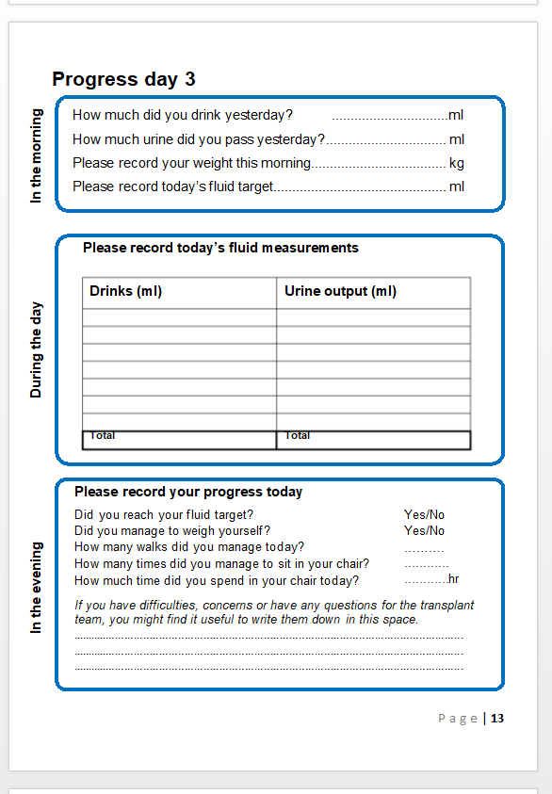
www.odt.nhs.uk
Shared care plan

Slide 12
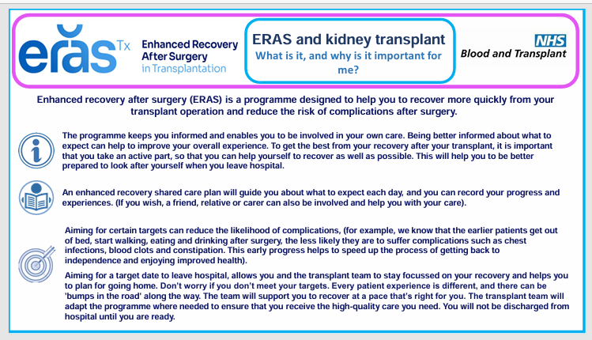
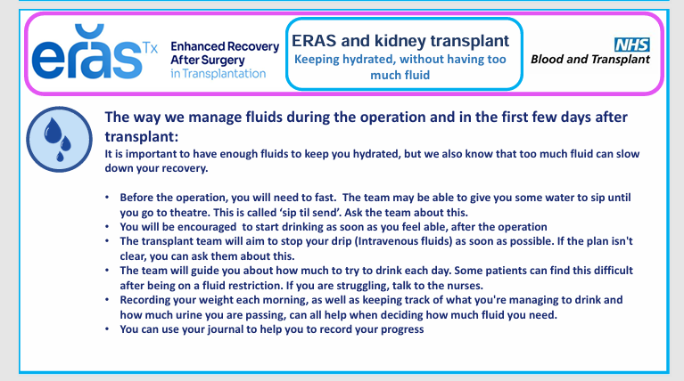
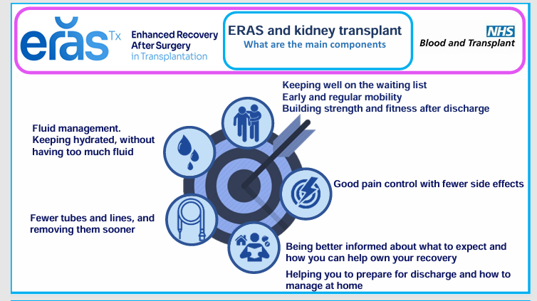
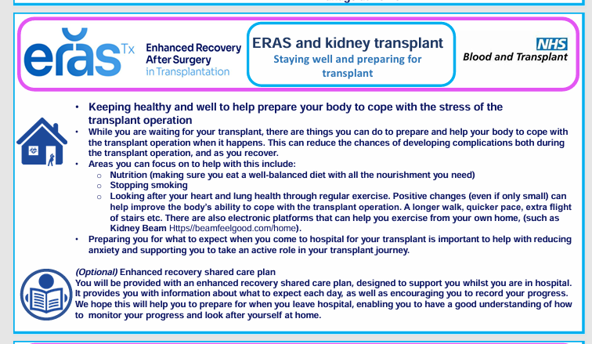
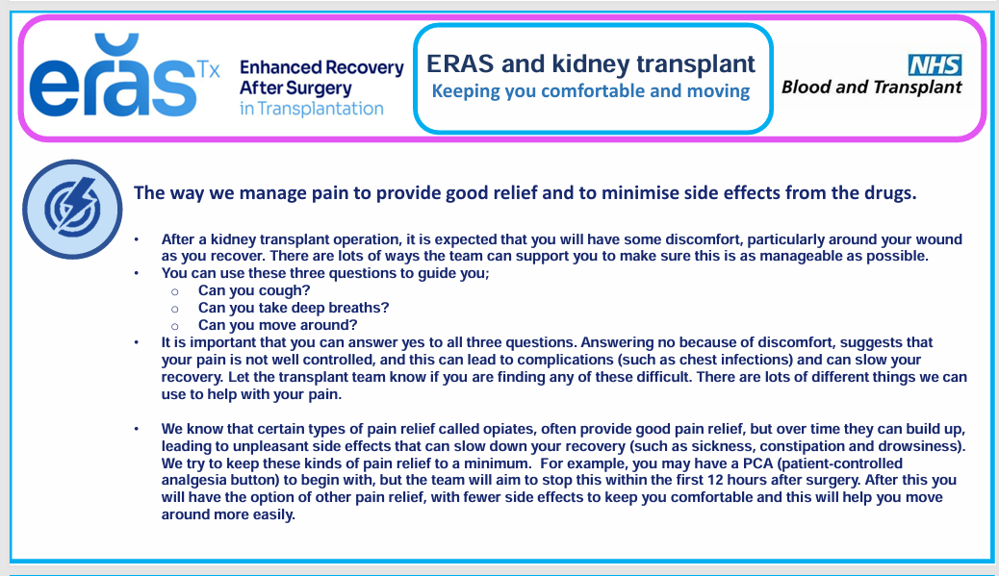
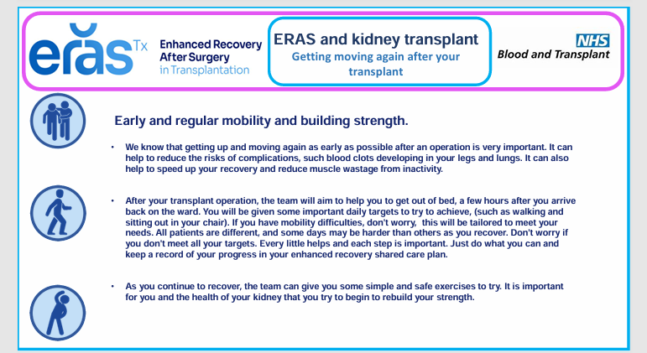
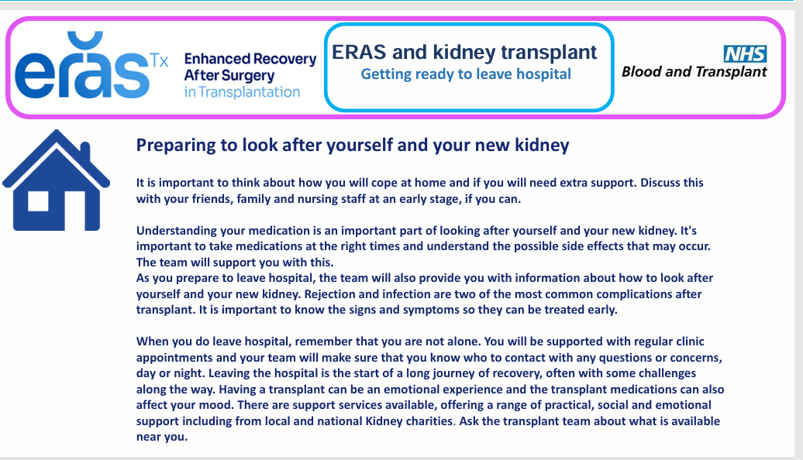
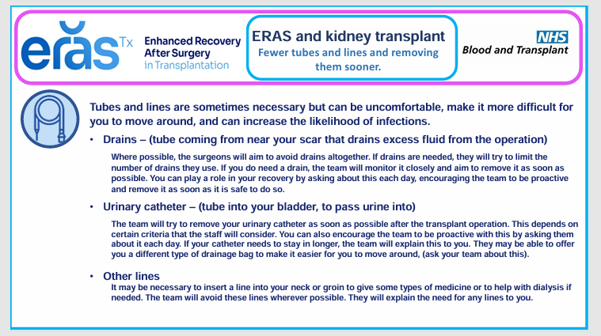
www.odt.nhs.uk
Patient preparedness

Slide 13
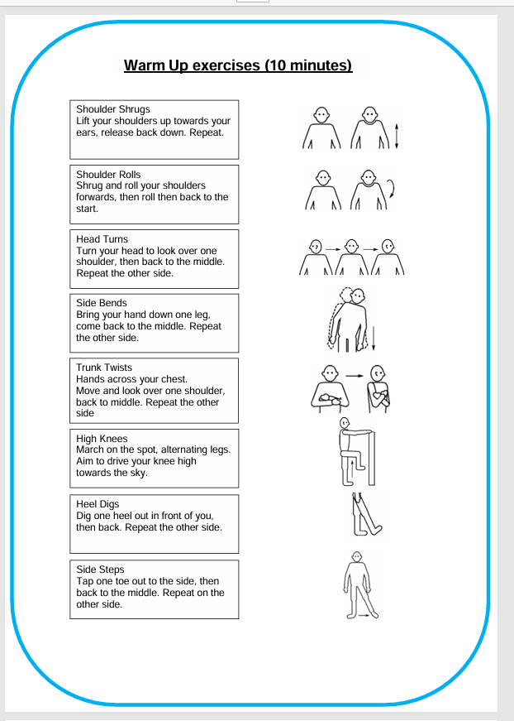
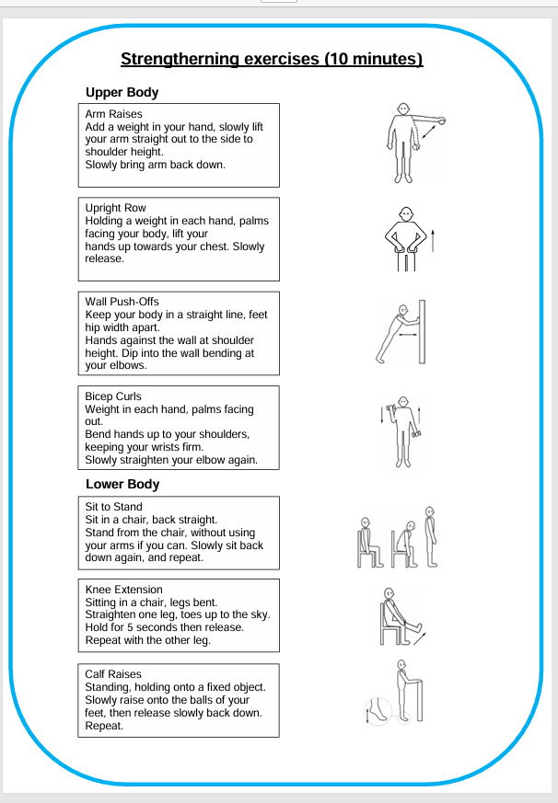
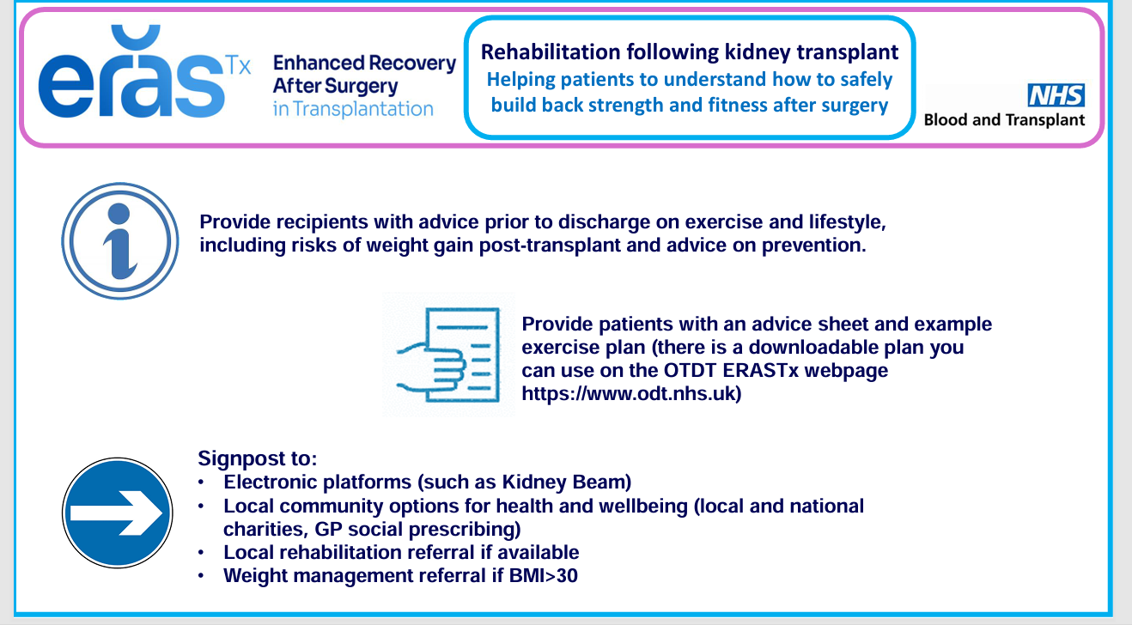
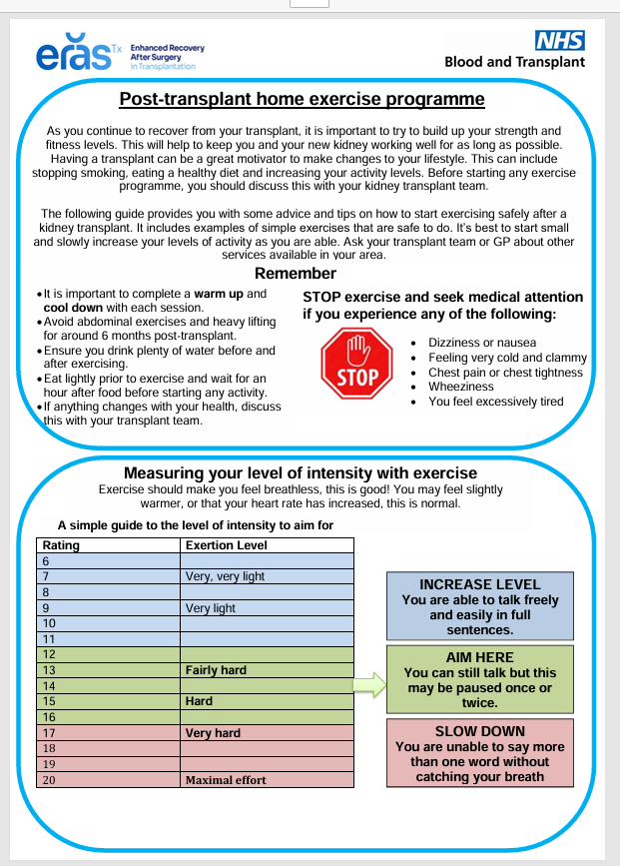
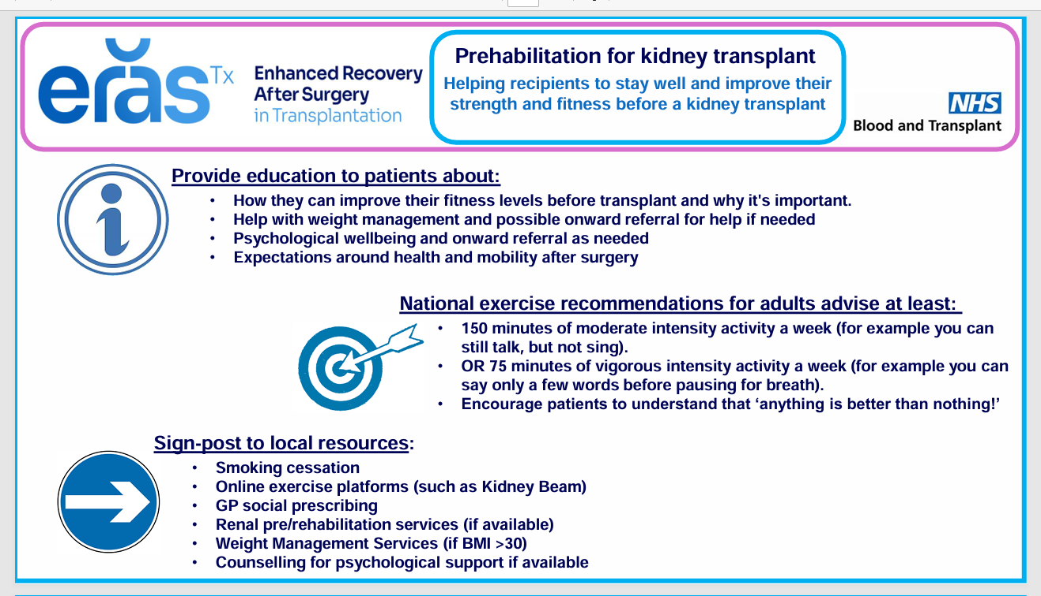
www.odt.nhs.uk
Prehab and Rehab documents

Slide 14
NHSBT ERAS project next steps
NHSBT
Derek Manas, Medical Director
Lisa Burnapp, ERAS Programme lead
Carrie Scuffell, ERAS Subject Matter Expert
  Stage 1
    core and desirable ERAS components with supporting evidence
Stage 2
  Downloadable resources for centres
  Evaluation and measurement criteria
Stage 3
  Circulation and communication
  Patient facing content
  Additional resources
Multidisciplinary Steering group
Expert by experience panels
Stage 3
Stage 2
Adult kidney transplant
Living kidney donor
Pancreas transplant
Adult liver transplant
Lung
transplant
Paediatric kidney
transplant
? Heart
transplant
? Living donor liver
Evaluation and measurements

Slide 15




Rachel Thomas, Ben Stutchfield
Royal Infirmary of Edinburgh
Emily Bonner, Aimen Amer, Frankie Dowen
Freeman Hospital Newcastle
Alice Greenwood,
SJUH Leeds
Patients
Ciaran Campbell
Nick Palmer KCUK
Mae Law (KRUK)
Stephen Emmerson
Alan Hancock
Ben Stokes
Fez Awan
Mark Smith
Sue Lyon
Keith Pennington
Pam Nye
Pete Revell (NKF)
Patricia Gooden
Paula Appleton, Stephen Bond
Addenbrooke’s Hospital, Cambridge
Jeremy Fabes,
Plymouth
Lisa Donohoe,
Glasgow
Frank Dor,
London WLRTC
ERASforTransplant@nhsbt.nhs.uk
Sharlene Greenwood, Juliet Briggs,
Kings College Hospital, London
Kiran Sran
Guy’s and St Thomas’, London
@ERAS4txnhsbt.bsky.social
Michael Spiro,
The Royal Free, London
Suzan Yannis,
Kidney care UK
Aisling Courtney, Carla Erskine
Belfast Health and Social Care Trust
Derek Manas, Lisa Burnapp, Carrie Scuffell, Liz Armstrong, Jen Hobbs, Sapna Marwaha, Trudy Monday, Conner Sweet
NHSBT

