Slide 1
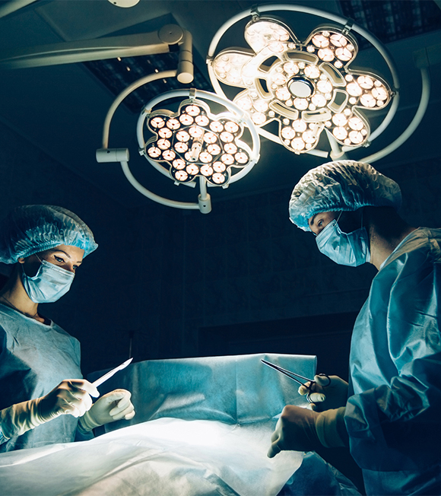
Sustainability and Certainty in Organ Retrieval (SCORE)
Organ Donation Update, Autumn / Winter 2024/25

Slide 2
This Session
Why we need change
What is the Planned Arrival Window (PAW)
What are the impacts across the pathway?
How you can support the change
Q&A

Slide 3






Journey so far
NORS Workforce
Jan 2023 Extraordinary NORS summit – serious concerns about the sustainability of the NORS service.
NHSBT agreed to set up a programme to address issues, make changes and secure future sustainability.
4 operational workstreams established (7 workstreams in total)
NORS
Model
SCORE
Donation /
Offering
Support
Services

Slide 4
Key Issues
Fast as possible model removes all planning across the system (no improvement on LOP despite efforts)
No oversight of activity = reactive deployment of resources
Frequent delays , most notable at retrieval and has a resultant negative impact across the system
LOP now means that complex implant surgery is performed out of hours
Fragility of NORS teams resulting in teams standing down from retrieval commitments
NORS teams asked to attend more than 1 donor in 24 hours
Increase in NORS travel time over 3 hours
NORS
Model
After identification of the key issues relating to the fragility of the NORS service, SCORE set about designing a solution.

Slide 5


https://forms.office.com/e/t4Ub9rZebD
Donation, retrieval and transplantation needs a reset.
It will require many changes across the pathway
Redesign a service that’s robust, sustainable, more predictable and able to cope with future demands
A service designed to maximise our ability to save lives.
Notes:
Redesign a service as a whole that’s robust, sustainable, more predictable and able to cope with future demands
A service designed to maximise our ability to save lives.

Slide 6


Slide 7



Slide 8
Need for Change

Slide 9
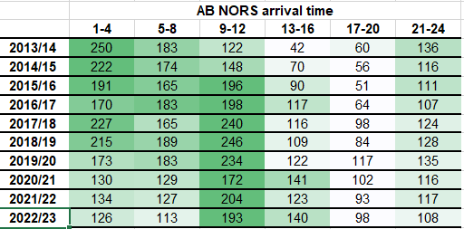
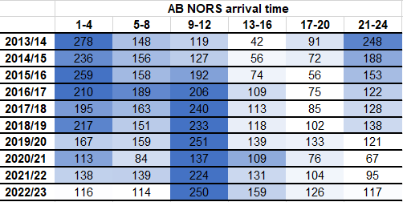
NORS Arrival Time
DBD
DCD
Donor hospital elective lists (+/- fines for cancelled surgery)
Delays and challenges accessing daytime theatres
Implanting surgery (now nighttime activity)

Slide 10
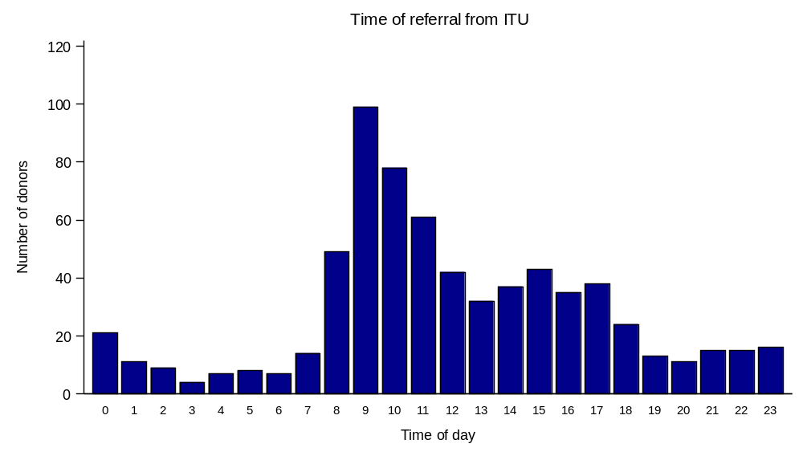
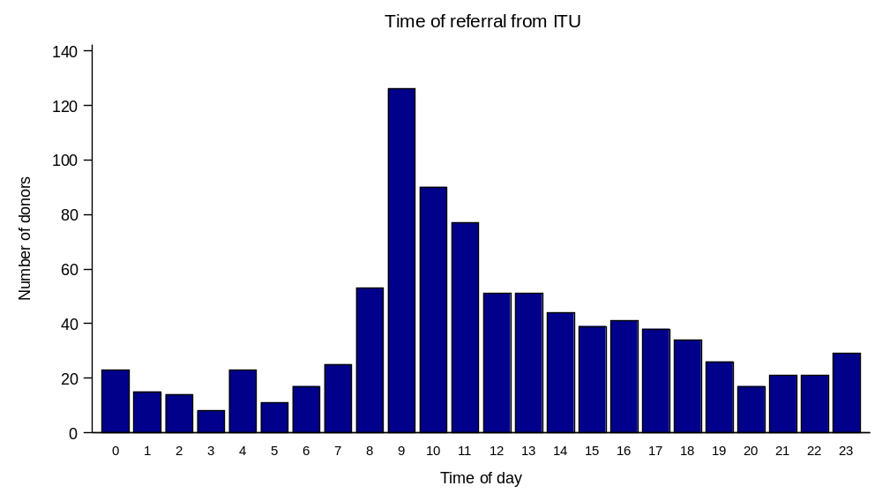
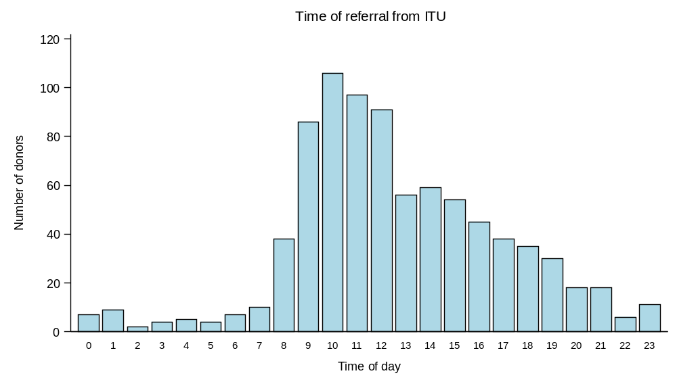
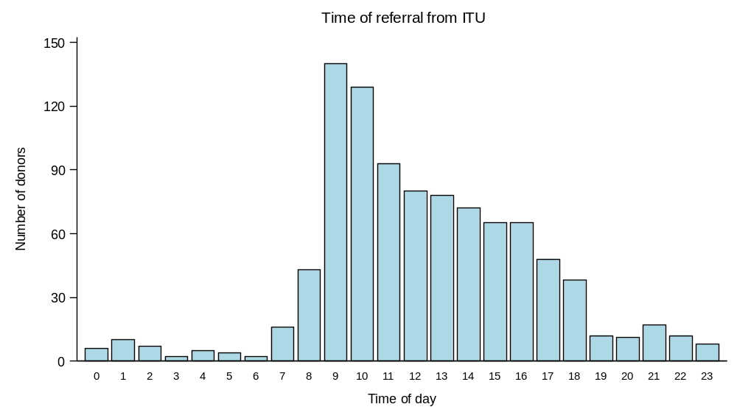
Time of Referral from ICU
2011
DBD
2021
DCD
Notes:
Pathway Intelligence Group (PIG) data

Slide 11
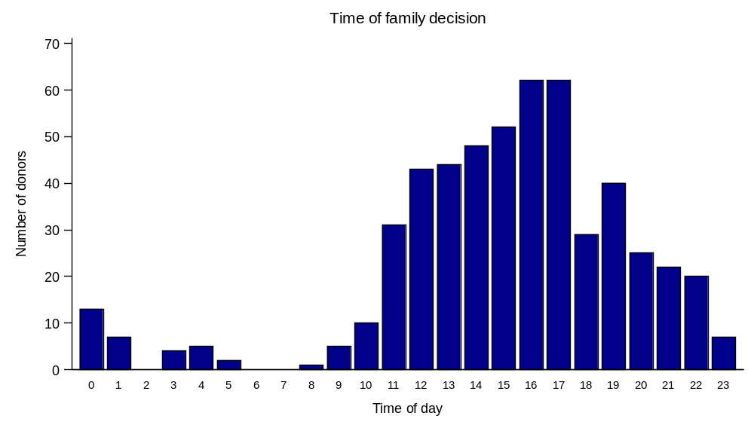
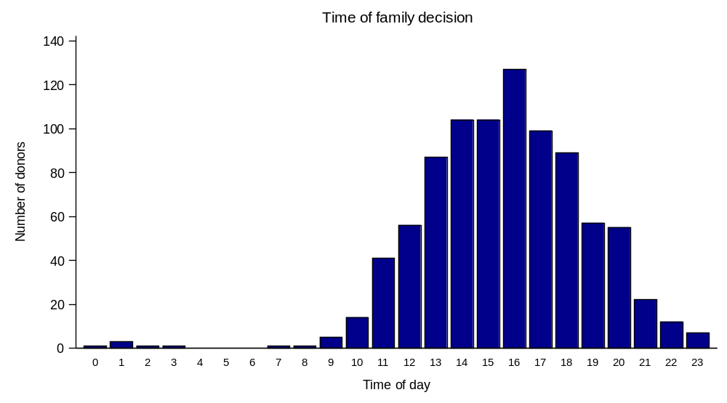
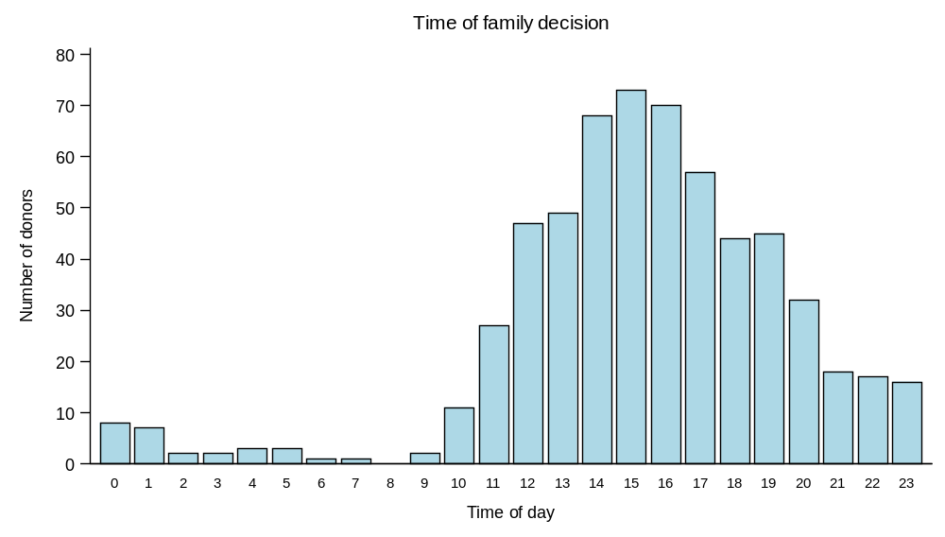
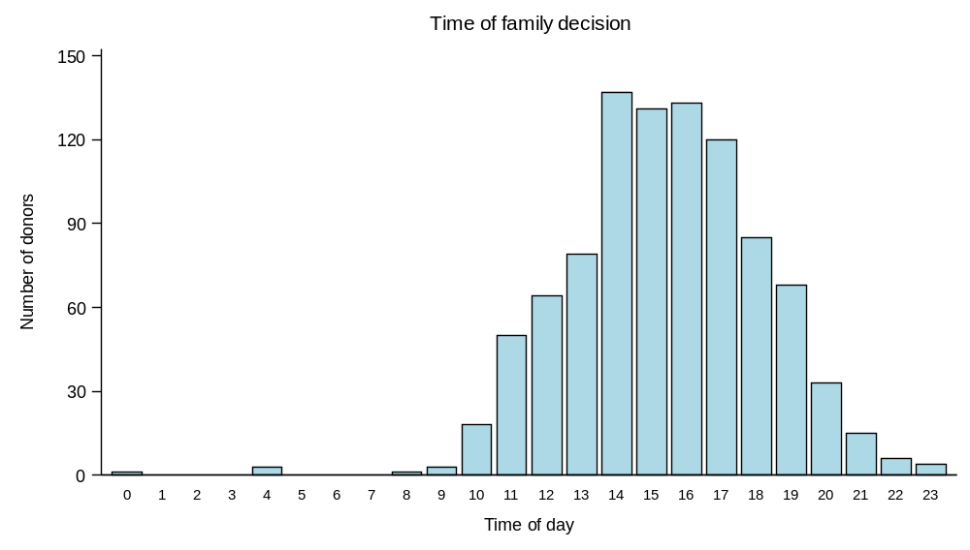
Time of Family Decision
2011
DBD
2021
DCD

Slide 12
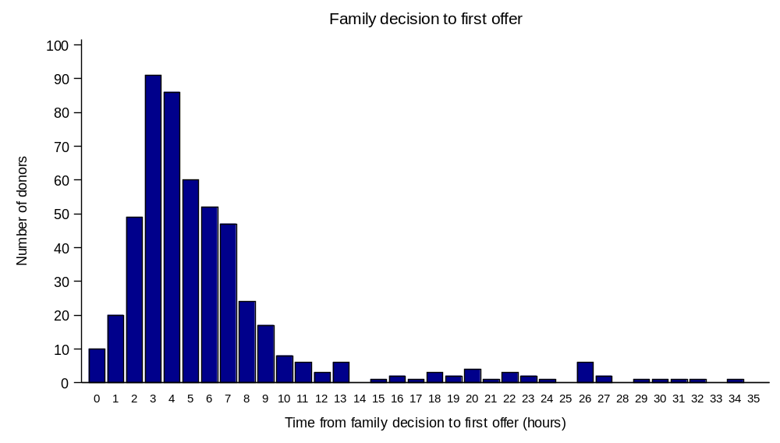
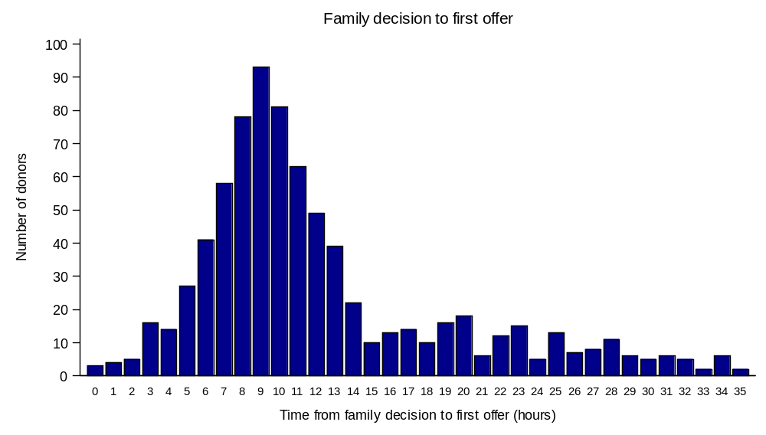
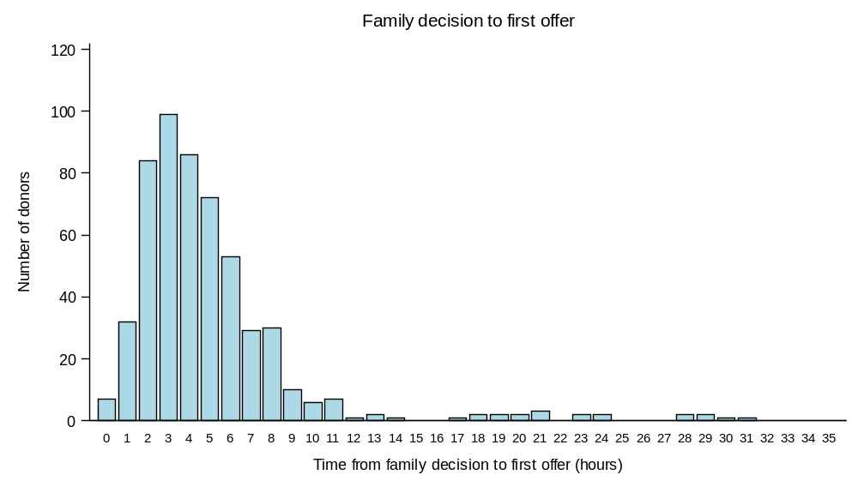
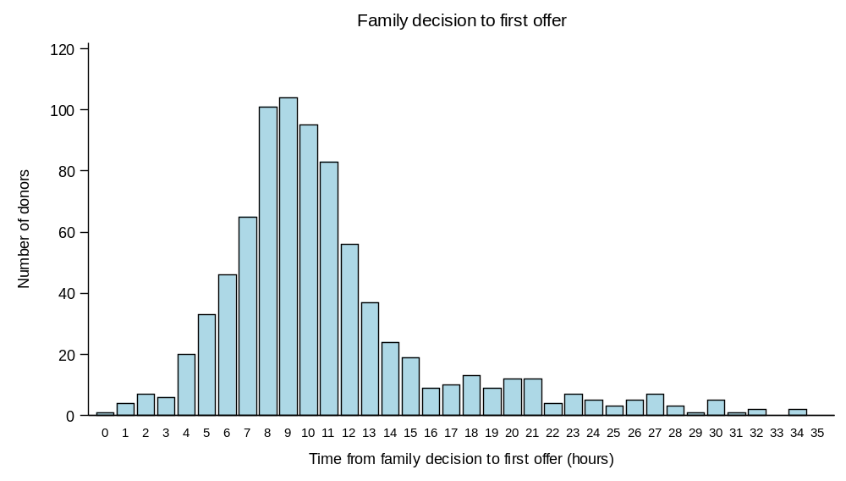
Retrieval timings – Family decision to Offering
DBD
2021
2011
3 hours
9 hours
6 hours longer
DCD
3 hours
9 hours
Notes:
Time taken to move from family decision to offering

Slide 13
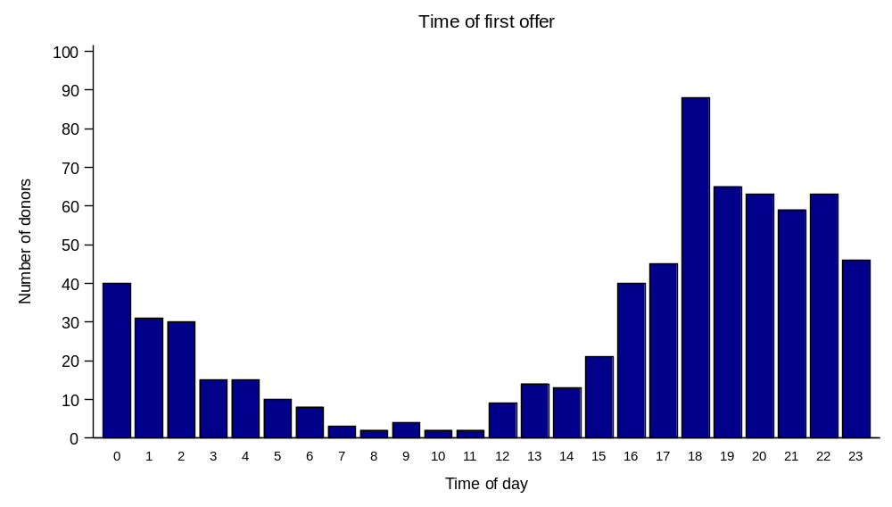
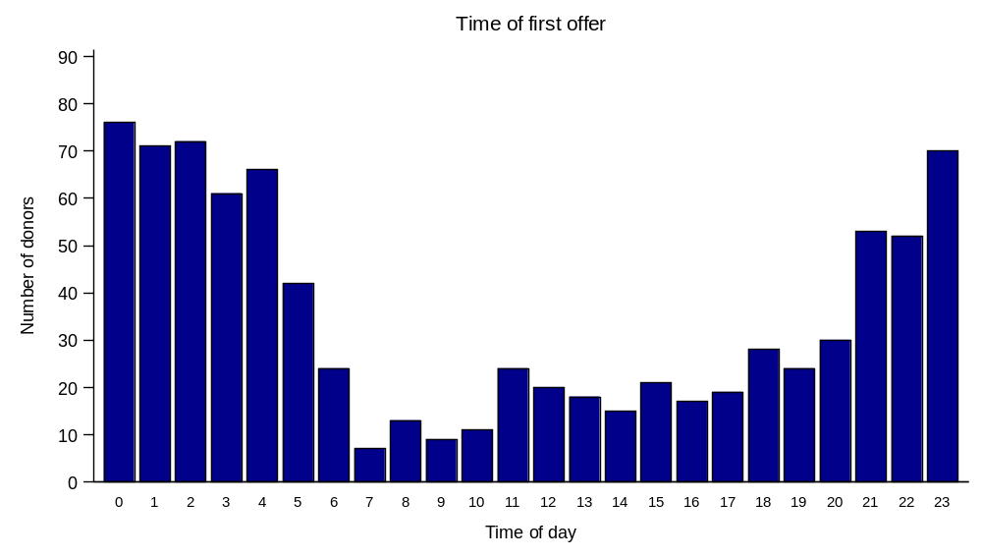
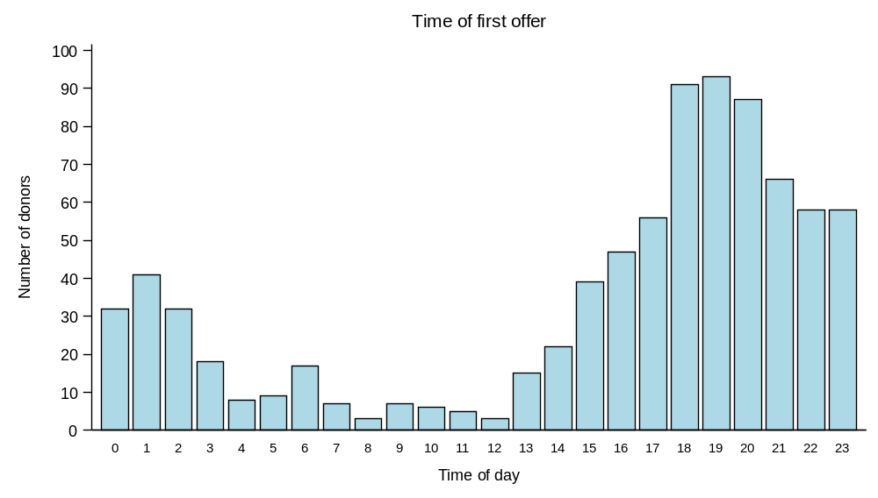
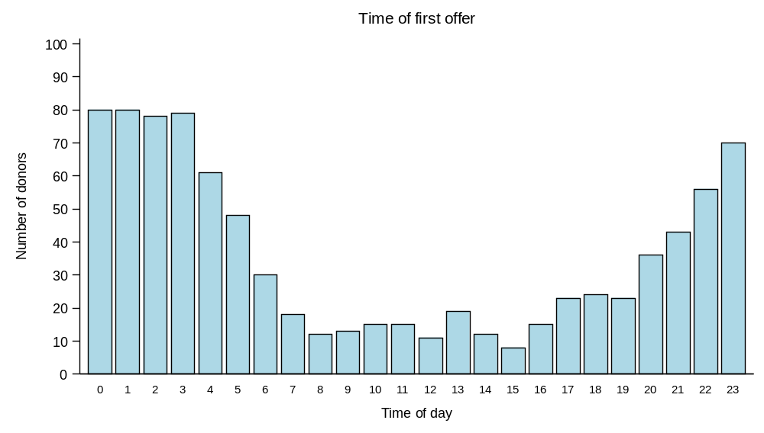
Retrieval timings – Time of Offering
2011
DBD
2021
6 hours later
DCD
Notes:
Offering was an evening activity, the majority is now in the early hours of the morning.

Slide 14
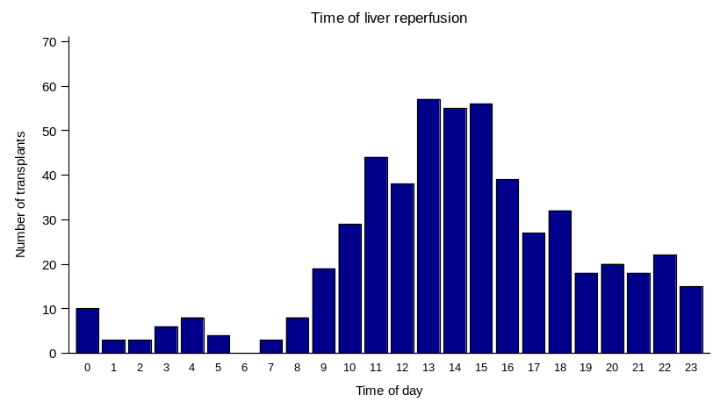
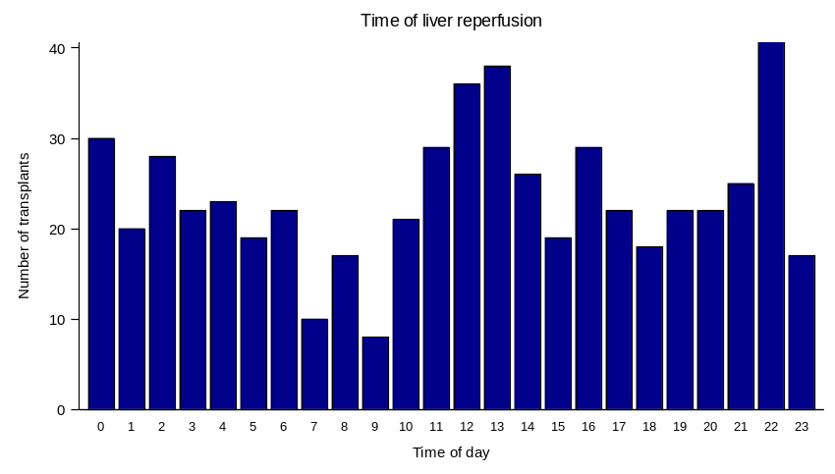
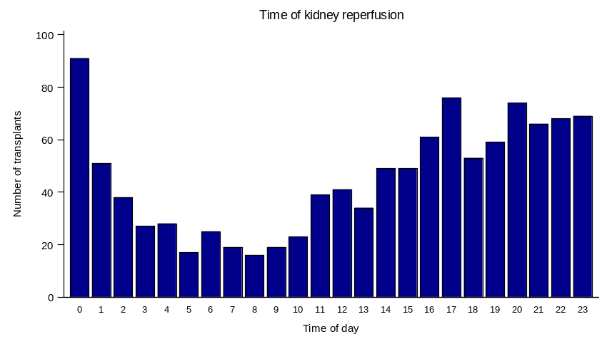
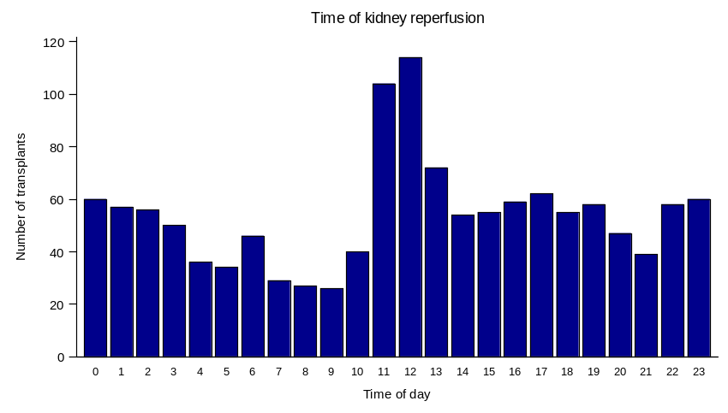
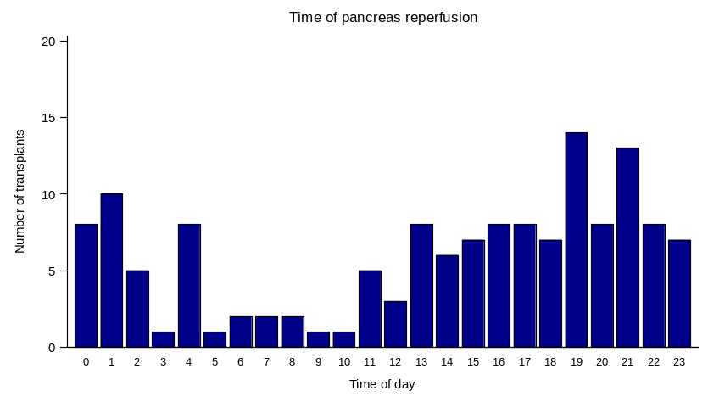
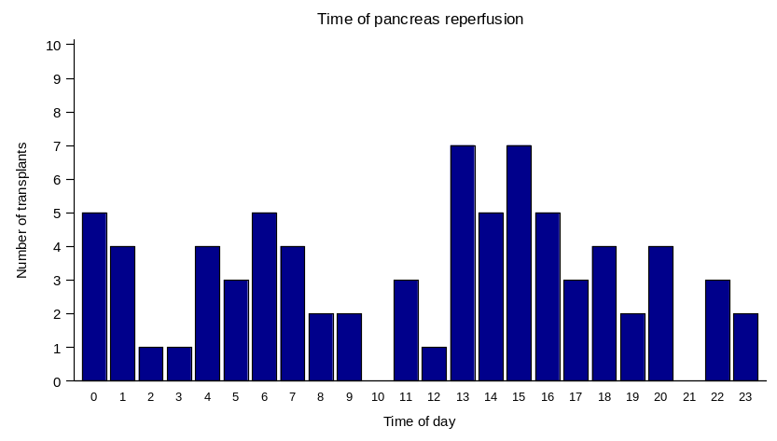
Time of Reperfusion – DBD Abdominal Organs
2011
2021
Liver
Kidney
Pancreas
Notes:
Offering was an evening activity, the majority is now in the early hours of the morning.

Slide 15
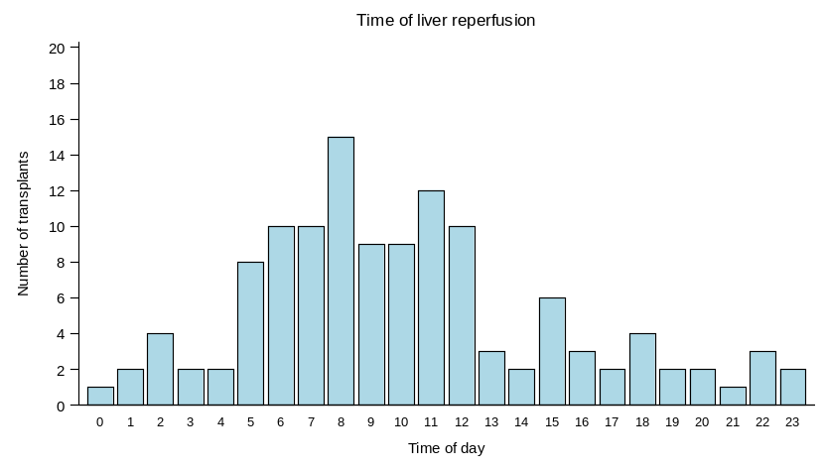
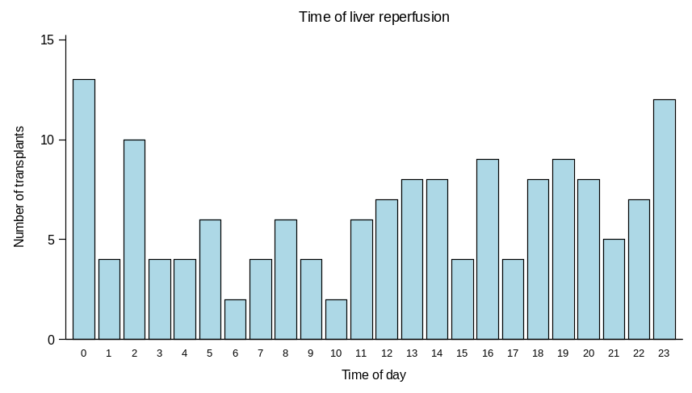
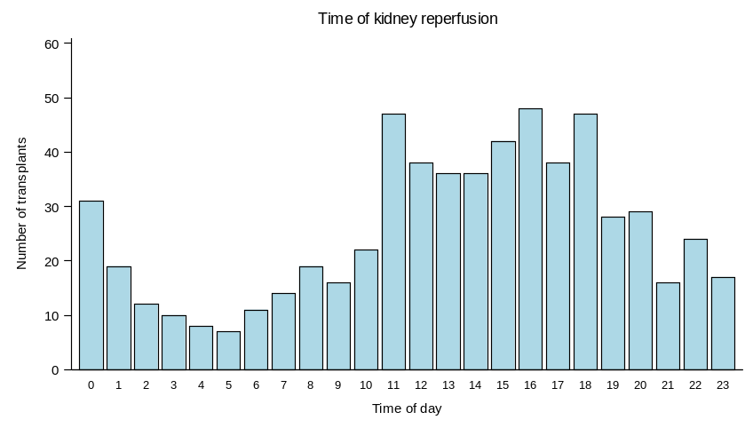
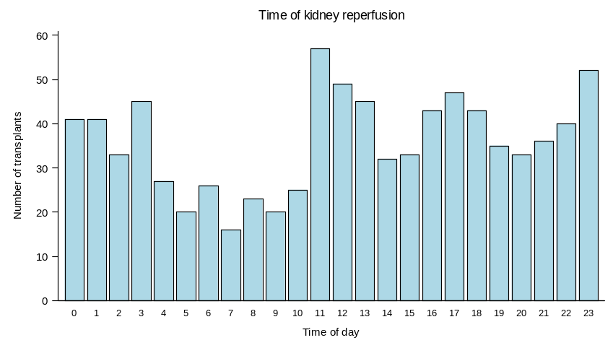
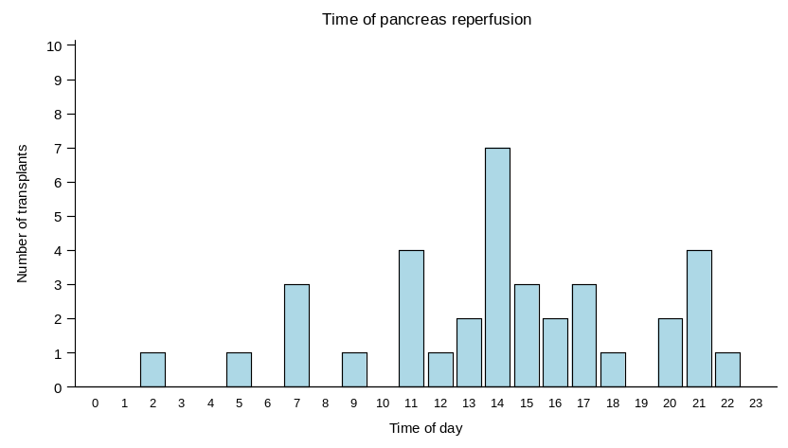
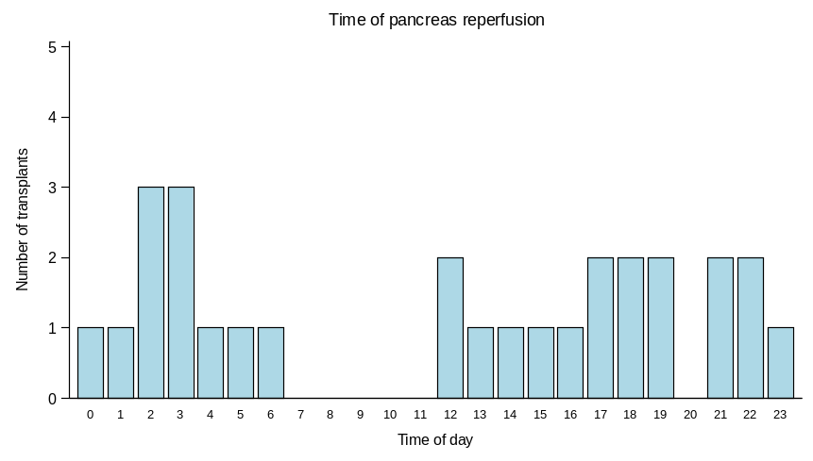
Time of Reperfusion – DCD Abdominal Organs
2011
Liver
Kidney
Pancreas
Notes:
Offering was an evening activity, the majority is now in the early hours of the morning.

Slide 16
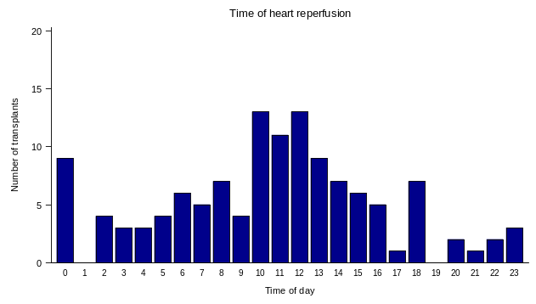
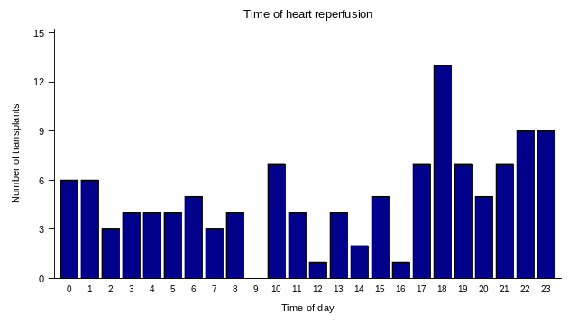
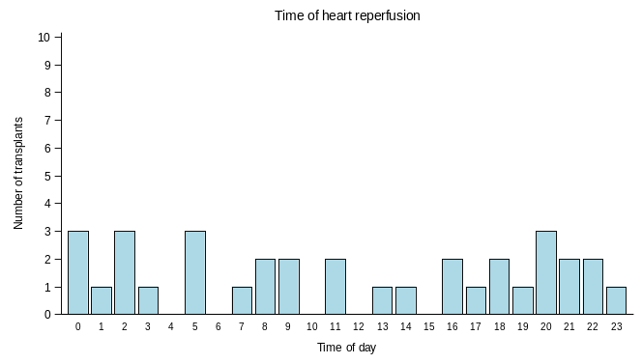
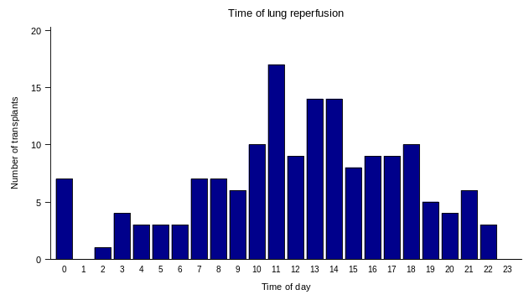
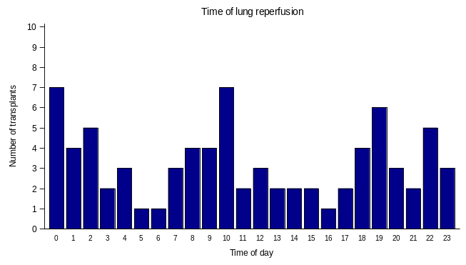
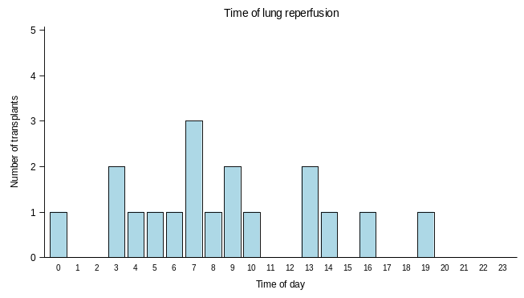
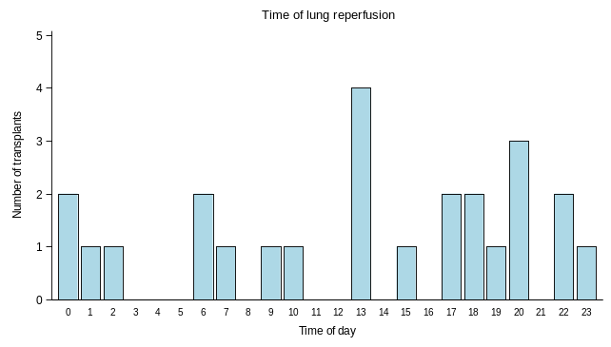
Time of Reperfusion – Cardiothoracic Organs
2011
DBD
2021
2011
DCD
2021
Heart
Heart
Lung
Lung

Slide 17
Theatre access delays reasons
Reason | Out of hours arrival (1800-0800) | In hours arrival (0800-1800) | Total
Waiting for theatre availability | 24 (32%) | 59 (45%) | 83
Waiting for donor staff availability | 27 (36%) | 27 (21%) | 54
Waiting for another retrieval team to arrive | 11 (15%) | 16 (12%) | 27
Donor family requested delay | 3 (4%) | 7 (5%) | 10
Back-to-back retrieval at same hospital | 2 (3%) | 4 (3%) | 6
Other | 7 (9%) | 18 (14%) | 25
Total | 74 (100%) | 131 (100%) | 205

Slide 18










Planned Arrival Window
Planned Arrival Window (PAW) between 20:00 and 03:00 for NORS teams to undertake organ retrieval.
There will be provision in this model for exempted cases where accelerated retrieval can take place, e.g. SU liver, paediatrics and uterine or limb retrieval.
Benefits of PAW
Certainty around timings
Better utilisation of NORS teams
Planned and efficient use of transport
Efficient organ offering systems
Daytime transplantation
Predictability and certainty for donor families

Slide 19
Registration of donors with hub 2022/23
64%

Slide 20
Planned Arrival Window PLUS
For registrations after 8 am
If organs are accepted
NORS teams are available
Donors will be registered in the same day’s PAW
Modelling the 2023 data, 203 of 267 would be accommodated in the same PAW window.

Slide 21
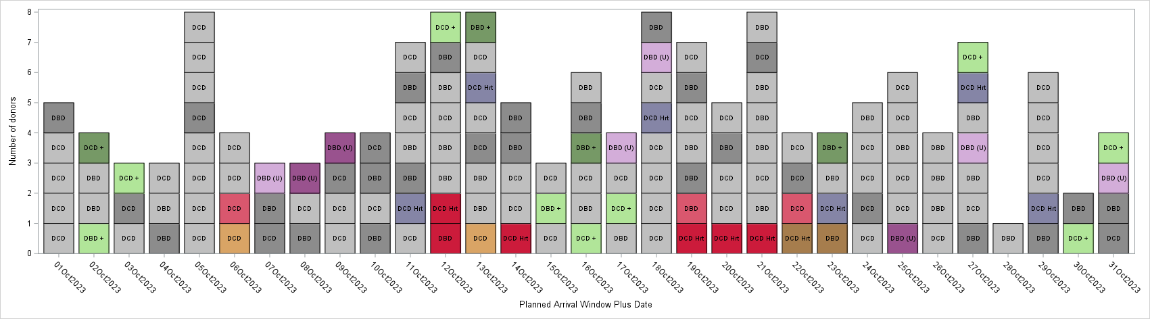
PAW Plus – 1 – 31 Oct 2023
Abdominal only donor
Abdominal only donor moved to next PAW
Abdominal and Cardiothoracic donor
Abdominal and Cardiothoracic donor moved to next PAW
SU liver Abdominal only donor
Abdominal only donor registered 8am-4pm
SU liver Abdominal and Cardiothoracic donor
Abdominal and Cardiothoracic donor registered 8am-4pm
DCD heart attendance
Abdominal only donor registered 8am-4pm facilitated
Abdo and Cardio donor registered 8am-4pm facilitated

Slide 22
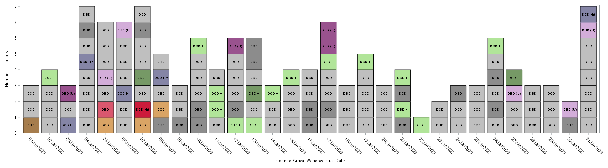
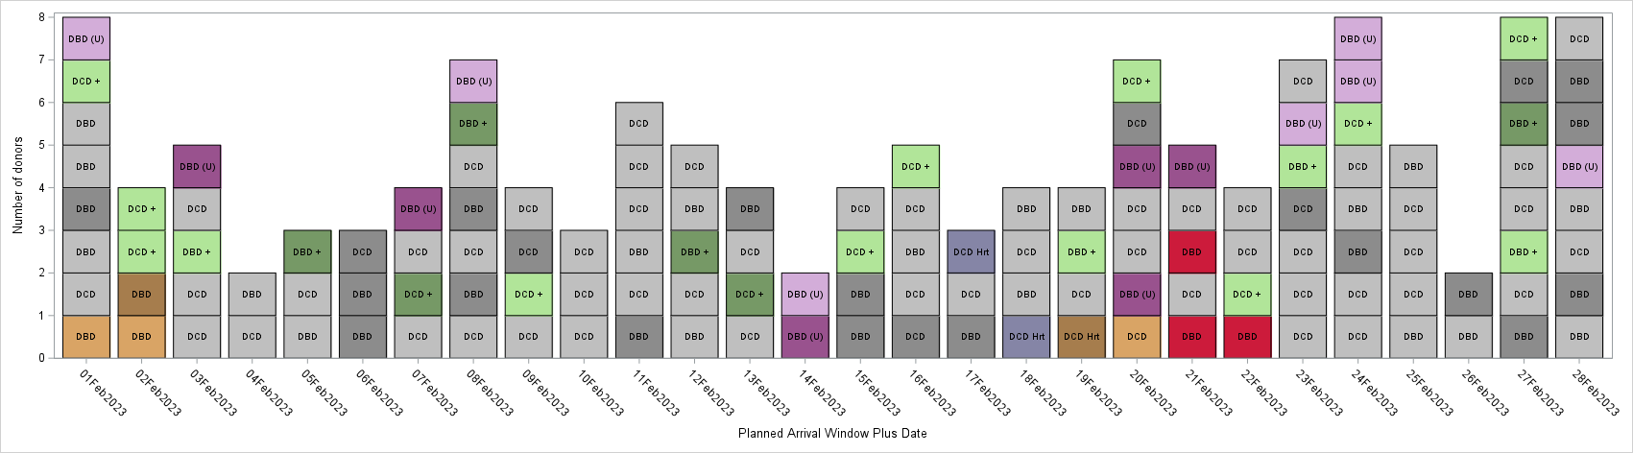
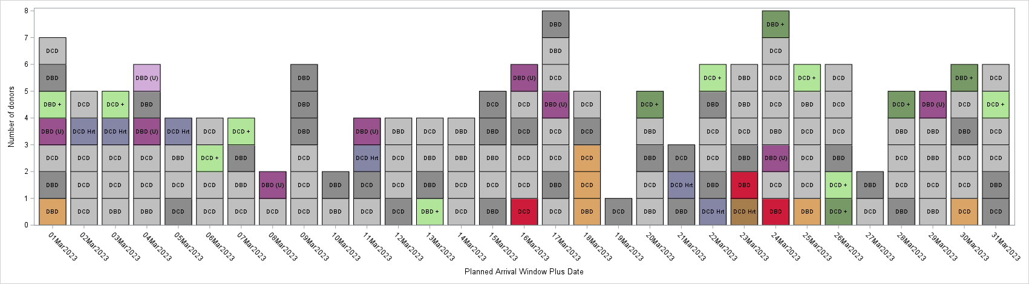
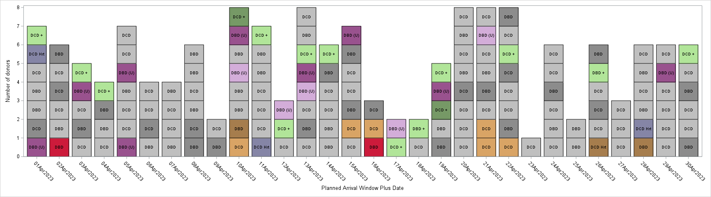
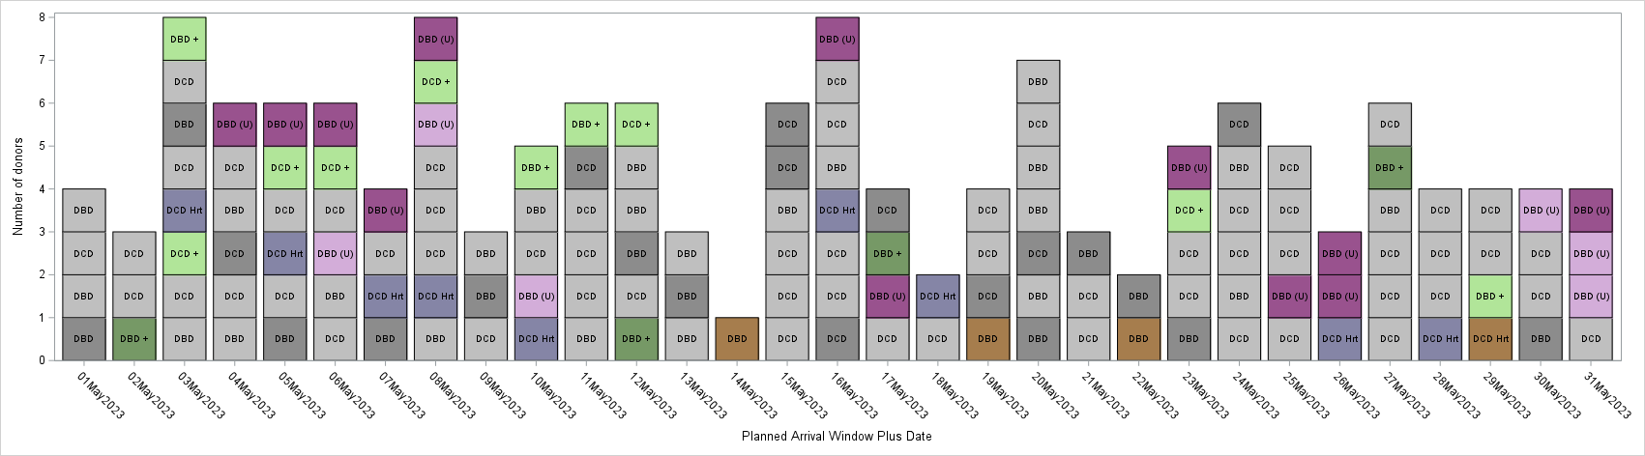
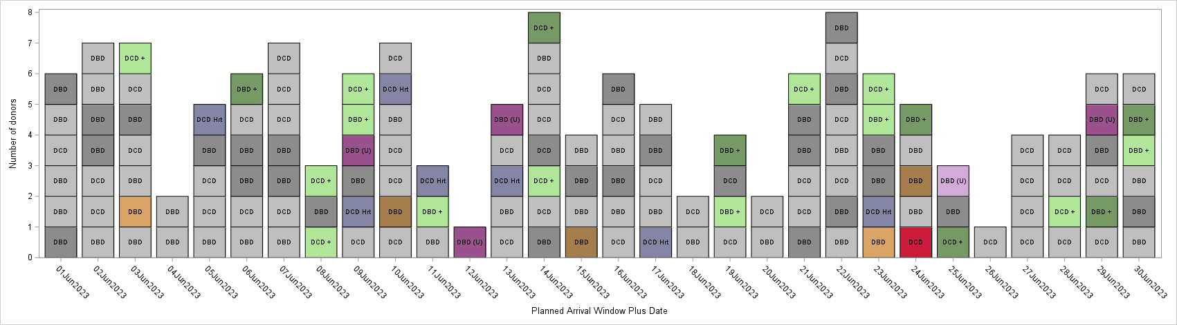
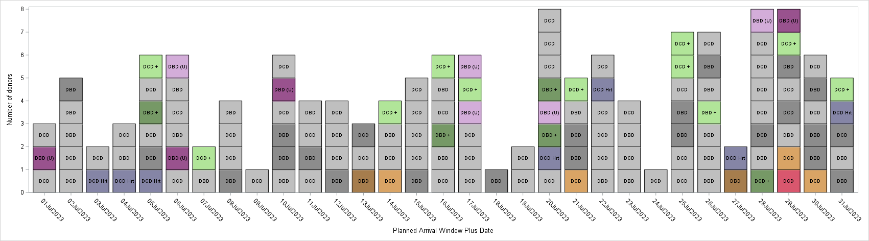
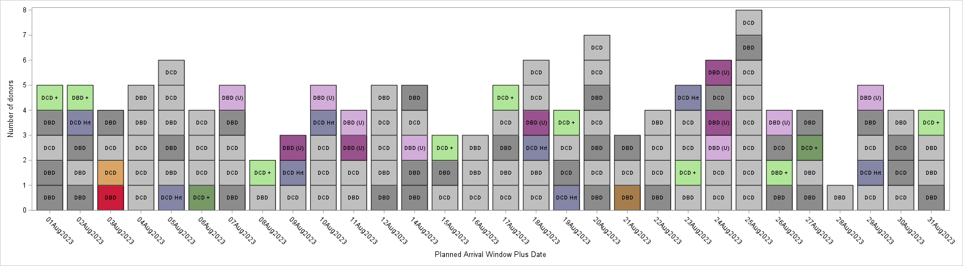
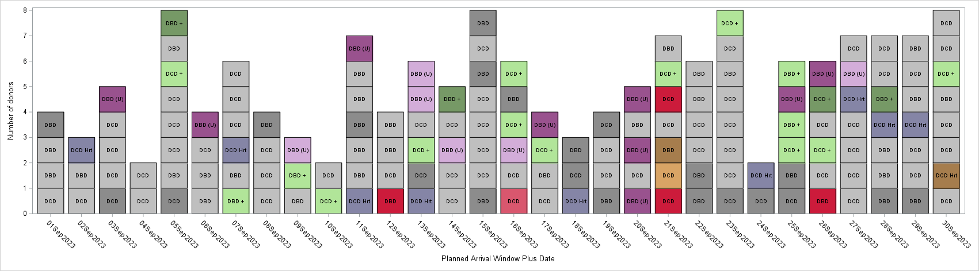
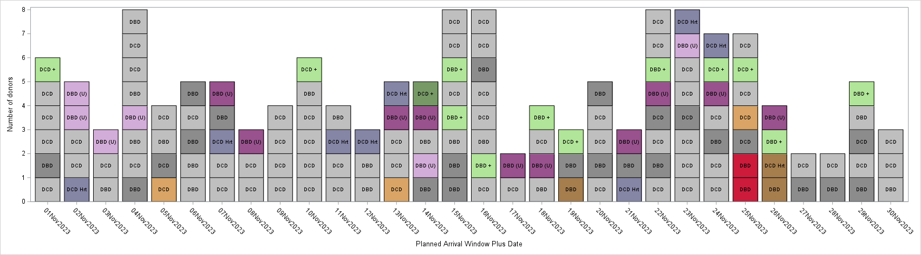
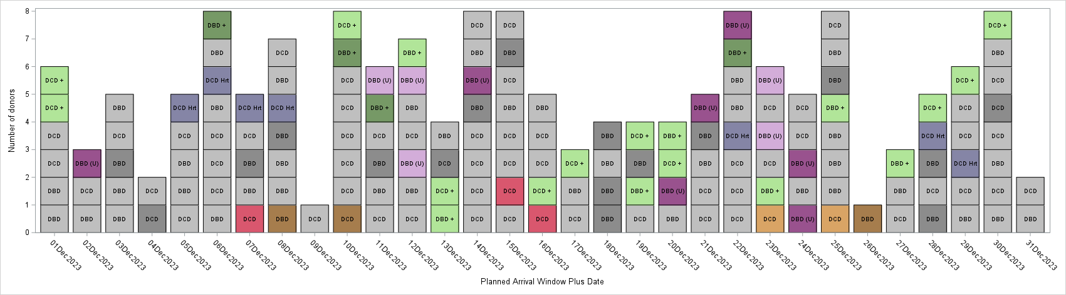
PAW Plus: 2023 – current set-up (8 AB, 3 CT – 1 DCD heart)
Between 1 Jan – 31 Dec 23:
1758 donors attended
Of these, 267 donors registered between 8am and 4pm - eligible for window starting next evening
However, 203/267 able to be facilitated that evening
1726/1758 (98%) accommodated in planned window or earlier window
Only 32 (2%) moved to following planned arrival window
Notes:
Without PAW Plus, strict PAW with 8 / 3 / 1, 60 (3%) of donors would have to be moved to next PAW so PAW plus reduces this by 28

Slide 23
Factors affecting what time NORS will arrive within PAW
CT Organs
CT organs have a shorter CIT so teams would need to arrive later in the PAW to ensure daytime implant.
Time of organ acceptance
Current principles apply (1 Abdo/1CT to be accepted before mobilising)
Kidney only donors – renal offering is complicated
Flights
Airports around the country have different opening and closing times – this will impact arrival / departure
The introduction of a clinical decision maker in the hub to oversee NORS allocation and mobilisation will enable good decisions being made regarding arrival times.

Slide 24
Clinical decisions in pathway
Clinical role
Which donors?
Where in PAW?
PAW +?
Fast Track?
Adherence to offering windows?
Logistics
Flights vs road?
Allocation of flights?
Allocation of teams
Clinical elements
Use of limited resources and allocation to donors
Priority pathway donors – is there capacity

Slide 25
Offering

Slide 26
Offering proposals – Options considered
Option 1: Sequential Offering
Pros: Maintains individual focus on each recipient centre, minimising overlap.
Cons: Lengthy process often leading to delays in organ acceptance, impacting retrieval timelines.
Option 2: Simultaneous Offering of all organs (considered and discounted)
Pros: Reduces offering times, enabling quicker decision-making and supporting timely retrieval.
Cons: unmanageable levels of hub support required if all organ types are offered simultaneously; needs immediate IT support to implement.
Option 3: Simultaneous Offering by organ type with capability for accelerated pathway. (Selected Option)
Pros: Reduces offering times compared to sequential offering, enabling quicker decision-making and supporting timely retrieval.
Enables accelerated pathway
Cons: Potential increased administrative workload for the Hub, but less so than option 2

Slide 27
Proposed Offering System
08:00 – 13:00
Sequential offering TIER A recips
08:00 – 10:00
13:00 – 15:00
CT offers
Renal & Pancreas simultaneous offers
10:30-12:30
Offering and allocation must end by 16:00 to enabled NORS mobilisation and transplant logistics
Liver & Bowel offers
08:00
09:00
10:00
11:00
12:00
13:00
14:00
15:00
16:00
Notes:
SU/U hearts and lungs can be allocated after CT offering
Routine heart and lungs can be allocated after CT offering, unless there is a CT/liver recipient then they can be allocated after liver offering
Tier A KMR kidney only can be allocated on offer
Tier A KMR SPK/SIK can be allocated on offer, unless bowel is on offer and recipient requires pancreas then it will be allocated after bowel offering
Liver and bowel can be allocated after liver/bowel offering
Non-Tier A kidney and pancreases can be allocated after renal/pancreas offering

Slide 28
Impact across the pathway

Slide 29
Impact
Transplant Centres
SNODs
NORS
Each area will need to make changes to accommodate the PAW

Slide 30
Impact to SNODs
SNOD
Consent / Authorisation
Family care
Local hospital

Slide 31

Consent / Authorisation

Slide 32


Learning from practice at
St George's
Notes:
St George's in SE region had a cultural shift to retrieval overnight many years ago – there is a cut off for K2S by 03:00 or the retrieval will roll over to the end of the next day. This practice has been embraced and embedded by SN and Trust staff and there are many useful learnings we can benefit from as we move to a similar model of predictability for time-frames in SEED.
When it comes to consenting families, they are transparent with factors affecting theatre slots (like emergencies) and time frames. They avoid being apologetic and find families accept a lengthy process time when it is explained that this is normal practice. This practice is engrained in the culture at St George’s. All of the staff across critical care know that donors are taken to theatre overnight. Therefore there are no misconceptions, no queries, no lack of clarity and they all echo the same explanation of length of process.
The results speak for themselves - this year to date they have approached 41 families for donation, and had 13 declines. Only 1 of these 13 gave Length Of Process as rationale for declining, and none of the consenting donor families withdrew consent when met with significant delays due to theatre timings.
We hope this evidence gives confidence that tweaking the conversation with families in this way should not result in declines on LOP.

Slide 33
"The most likely scenario is that the operation will take place tomorrow night. By tomorrow afternoon, I should have a better idea of the exact time. However, there are some recipients who are very sick and will need a transplant sooner. In such cases, the operation would be earlier. I will know overnight tonight if 'X' has matched with a patient in this situation and will keep you updated."
Notes:
This slide shows what could the family conversation could sound like...

Slide 34

Family care
Feedback from donor families was to ensure that they are well supported at the bedside including suggestions about how to fill the time (what they’re allowed to do)
SNs fed back about ensuring there are mechanisms in place to support the families back to their transport when the hospital has limited entry and exit points

Slide 35




Care for self and family
Prepare for tomorrow
  Go home/rest/eat​
  Spend time together with your family​
  Have a cuddle in the bed and/or some protected time together
  Time to think about who wants to be there​
  You don't have to be there​
Prepare for loved one
Support at the hospital
  Gather items from home that are important to 'X' (e.g. their favourite photos/things you could use to help care for 'X' like nail polish/favourite aftershave/moisturiser/important books or poems)​
  Gather keepsakes​
  Consider if there is something important to the donor that needs to happen (pets/favourite music etc.)
  Signpost to bereavement resources​
  Consider if there may be funds available for parking/transport/accommodation and any bespoke services the hospital has​
Notes:
This slide is for helping to support families to spend this time meaningfully
Here are some ideas that SNs could gently offer as suggestions to family to spend the time between consent and the retrieval operation. What feels right will differ depending on the family but emphasizing 'preparation for tomorrow' can be a really supportive and universal suggestion. Using open questions can help them to think about what preparation could look like for them and what is most important now.
Please feel free to take a photo of this slide for reference.
If there are suggestions to extend this list, please let us know so we can include them.

Slide 36




Local hospital
NORS arrival time by hospital level – South West
Level 1
Level 2

Slide 37




Local hospital
NORS arrival time by hospital level – South West
Level 3
Level 4

Slide 38




Local hospital
NORS arrival time by hospital level – Northern team
Level 1
Level 2

Slide 39


Local hospital
NORS arrival time by hospital level – Northern team
Level 3
Level 4

Slide 40




Local hospital
NORS arrival time by hospital level – Eastern
Level 1
Level 2

Slide 41




Local hospital
NORS arrival time by hospital level – Eastern
Level 3
Level 4

Slide 42




Local hospital
NORS arrival time by hospital level – London
Level 1
Level 2

Slide 43


Local hospital
NORS arrival time by hospital level – London
Level 3
Level 4

Slide 44




Local hospital
NORS arrival time by hospital level – Midlands
Level 1
Level 2

Slide 45




Local hospital
NORS arrival time by hospital level – Midlands
Level 3
Level 4

Slide 46




Local hospital
NORS arrival time by hospital level – North West
Level 1
Level 2

Slide 47




Local hospital
NORS arrival time by hospital level – North West
Level 3
Level 4

Slide 48




Local hospital
NORS arrival time by hospital level – Northern Ireland
Level 1
Level 2

Slide 49


Local hospital
NORS arrival time by hospital level – Northern Ireland
Level 3
Level 4

Slide 50




Local hospital
NORS arrival time by hospital level – Scotland
Level 1
Level 2

Slide 51




Local hospital
NORS arrival time by hospital level – Scotland
Level 3
Level 4

Slide 52




Local hospital
NORS arrival time by hospital level – South Central
Level 1
Level 2

Slide 53




Local hospital
NORS arrival time by hospital level – South Central
Level 3
Level 4

Slide 54




Local hospital
NORS arrival time by hospital level – South East
Level 1
Level 2

Slide 55




Local hospital
NORS arrival time by hospital level – South East
Level 3
Level 4

Slide 56




Local hospital
NORS arrival time by hospital level – South Wales
Level 1
Level 2

Slide 57




Local hospital
NORS arrival time by hospital level – South Wales
Level 3
Level 4

Slide 58




Local hospital
NORS arrival time by hospital level – Yorkshire
Level 1
Level 2

Slide 59




Local hospital
NORS arrival time by hospital level – Yorkshire
Level 3
Level 4

Slide 60







Impact to NORS Teams
8
8 abdominal teams
2 available 24/7
Notification at 1600
if they need to mobilise and for what time
Increase to overnight retrievals
(currently 25% attendance between 2000-0300)
3
3 cardiothoracic teams
Improved allocation to reduce travel times
No back-to-back retrievals

Slide 61


NORS allocation modelling
– actual travel times
Notes:
Actual travel time
Abdo teams – 167hrs CT teams – 80hrs
Total travel time for all teams - 247hrs
Potential improvements
Abdo teams – 137hrs – saving of 30hours
CT teams – 70hrs – saving of 10 hours

Slide 62




Impact to Transplant Centres
Time of organ arrival for daytime implant
Multiple organs arriving at similar times
Challenge of accessing daytime theatre space
Challenge of new offering windows taking place at the same time organs are arriving
Screening calls
Notes:
Use a list or timetable instead of hospital
Screening call – call to transplant centre

Slide 63


Manchester - CT transplants

Slide 64


Newcastle - Abdominal transplants
Notes:
Example of actual number of organs arriving at Newcastle v simulated number of organs arriving per day at Newcastle using the planned arrival window plus modelling.
If multiple organs arriving, the difference would be the time of organ arrival is more likely to be similar under the modelling

Slide 65





















DAY 1
0800 | 0900 | 1000 | 1100 | 1200 | 1300 | 1400 | 1500 | 1600 | 1700 | 1800 | 1900 | 2000 | 2100 | 2200 | 2300 | 2400 | 0100 | 0200 | 0300 | 0400 | 0500 | 0600 | 0700
hour commencing
Referral
Consent / authorisation
Donor characterisation
Registration
Registration cut-off
DAY 2
0800 | 0900 | 1000 | 1100 | 1200 | 1300 | 1400 | 1500 | 1600 | 1700 | 1800 | 1900 | 2000 | 2100 | 2200 | 2300 | 2400 | 0100 | 0200 | 0300 | 0400 | 0500 | 0600 | 0700
hour commencing
Donor / Family / ICU support
CT Offering
Liver & Bowel Offering
Organ allocation
x 3
TIER A, D1 offering
Renal & Pancreas Group Offering
Recipient considerations
Cross matching
NORS allocation
NORS travel
Overnight Retrieval (PAW)
Organ transportation
Organ arrival
DAY 3
0800 | 0900 | 1000 | 1100 | 1200 | 1300 | 1400 | 1500 | 1600 | 1700 | 1800 | 1900 | 2000 | 2100 | 2200 | 2300 | 2400 | 0100 | 0200 | 0300 | 0400 | 0500 | 0600 | 0700
hour commencing
Organ arrival
Cross matching
Implant surgery
Post-op recovery
Notes:
Show which is which stakeholder’s activity to highlight simultaneous effort?
Use only one

Slide 66


Slide 67
Asks of you
NHSBT
Local hospital
Share experience/ideas of the consent/authorisation conversation with PDS team. New approach/potential phrasing
Decide what/if any engagement is needed in each of your hospitals
1
1
What support might you need to make a decision to leave donors once registered?
Mechanism to support donor family out of the hospital
2
2
Covering donor activity
Access to Echos
3
3
What else?
4

Slide 68



FAQs
Thank you.
Score Information
Recording of this presentation
SCORE@nhsbt.nhs.uk

