Slide 1
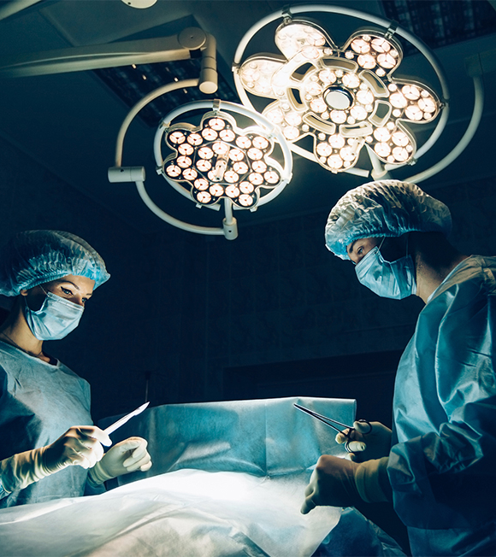
Sustainability and Certainty in Organ Retrieval (SCORE)
Transplant Centre Updates, Autumn / Winter 2024/25

Slide 2
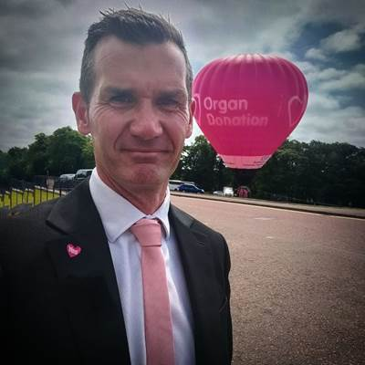
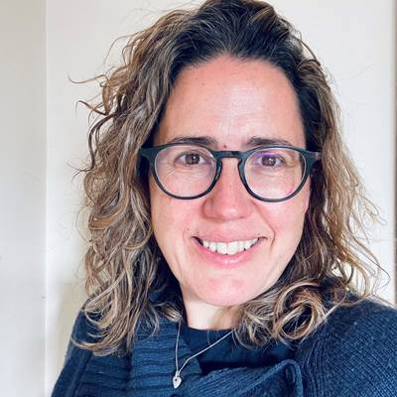
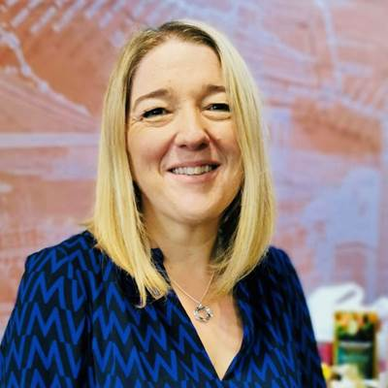
Presenters
Phil Walton
Communication and Engagement Lead: SCORE Programme
Sarah Beale
Service Development Manager:
Retrieval Technologies
Julie Whitney
Head of Service Delivery:
ODT Hub

Slide 3
This Session
Why we need change
What is the Planned Arrival Window (PAW)
What are the impacts across the pathway?
How you can support the change

Slide 4






Journey so far
NORS Workforce
Jan 2023 Extraordinary NORS summit – serious concerns about the sustainability of the NORS service.
NHSBT agreed to set up a programme to address issues, make changes and secure future sustainability.
4 operational workstreams established (7 workstreams in total)
NORS
Model
SCORE
Donation /
Offering
Support
Services

Slide 5
Key Issues
Fast as possible model removes all planning across the system (no improvement on LOP despite efforts)
No oversight of activity = reactive deployment of resources
Frequent delays , most notable at retrieval and has a resultant negative impact across the system
LOP now means that complex implant surgery is performed out of hours
Fragility of NORS teams resulting in teams standing down from retrieval commitments
NORS teams asked to attend more than 1 donor in 24 hours
Increase in NORS travel time over 3 hours
NORS
Model
After identification of the key issues relating to the fragility of the NORS service, SCORE set about designing a solution.

Slide 6


Donation, retrieval and transplantation needs a reset.
It will require many changes across the pathway
Redesign a service that’s robust, sustainable, more predictable and able to cope with future demands
A service designed to maximise our ability to save lives.
Notes:
Redesign a service as a whole that’s robust, sustainable, more predictable and able to cope with future demands
A service designed to maximise our ability to save lives.

Slide 7


Slide 8



Slide 9
Need for Change

Slide 10
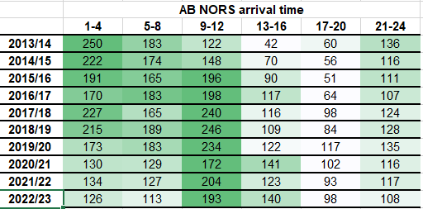
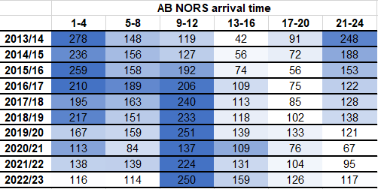
NORS Arrival Time
DBD
DCD
Donor hospital elective lists (+/- fines for cancelled surgery)
Delays and challenges accessing daytime theatres
Implanting surgery (now nighttime activity)

Slide 11
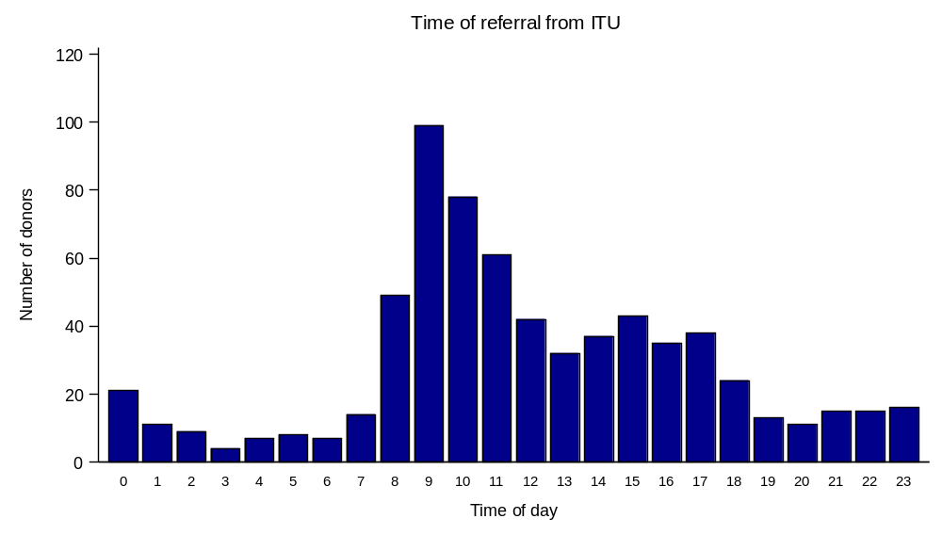
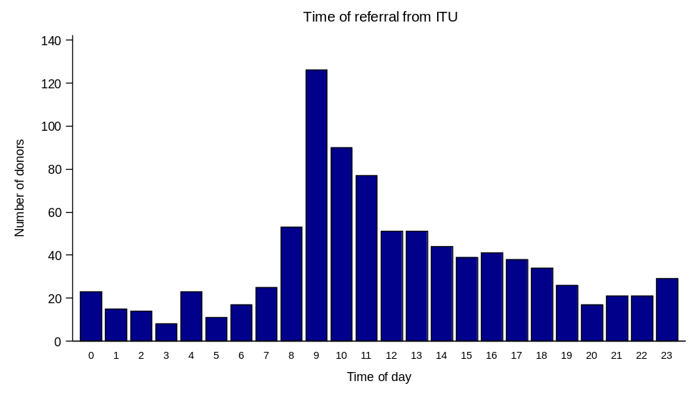
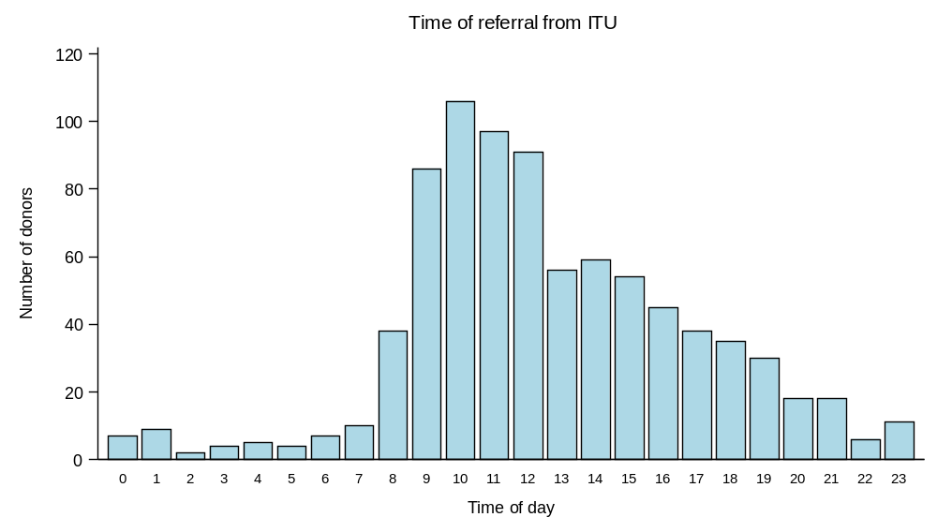
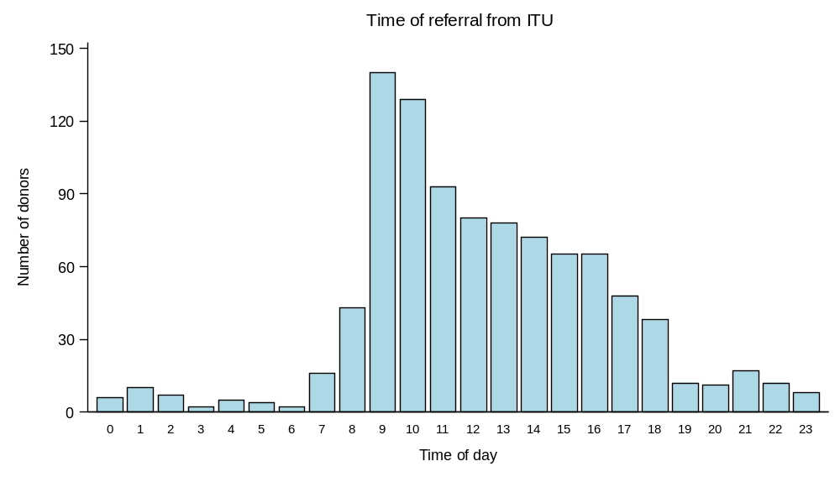
Time of Referral from ICU
2011
DBD
2021
DCD
Notes:
Pathway Intelligence Group (PIG) data

Slide 12
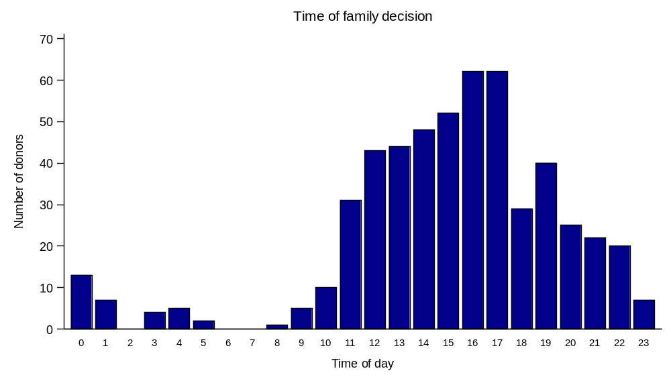
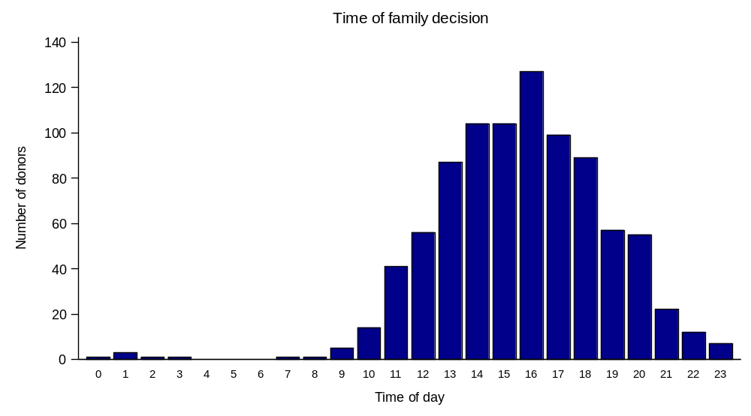
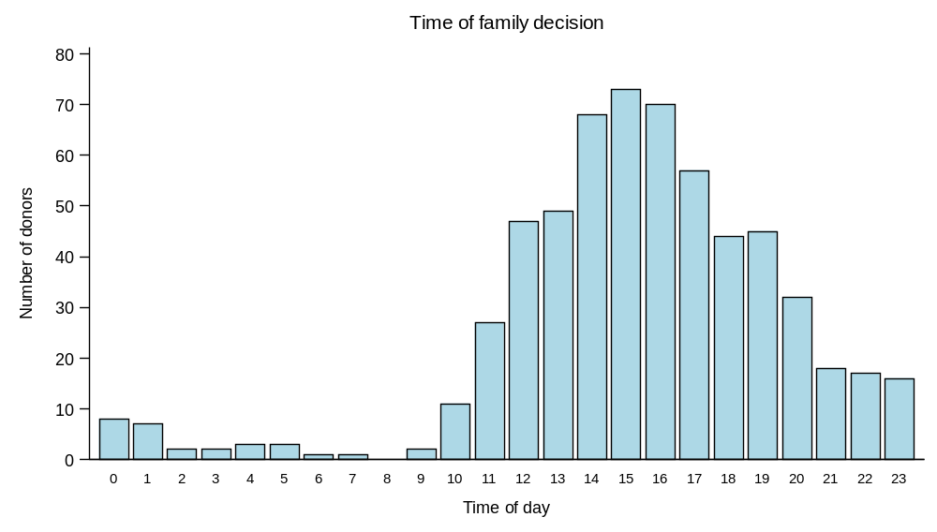
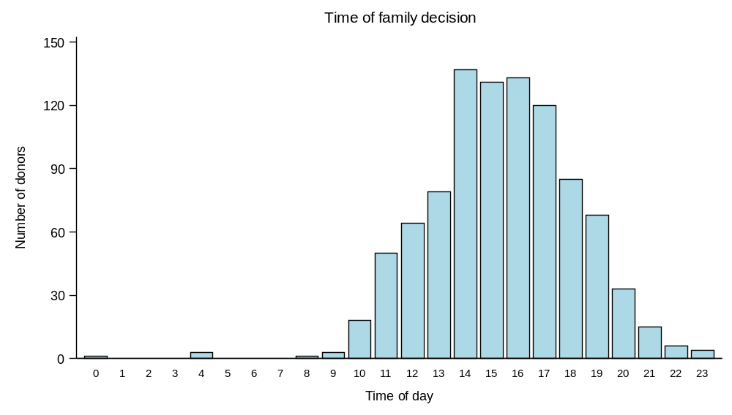
Time of Family Decision
2011
DBD
2021
DCD

Slide 13
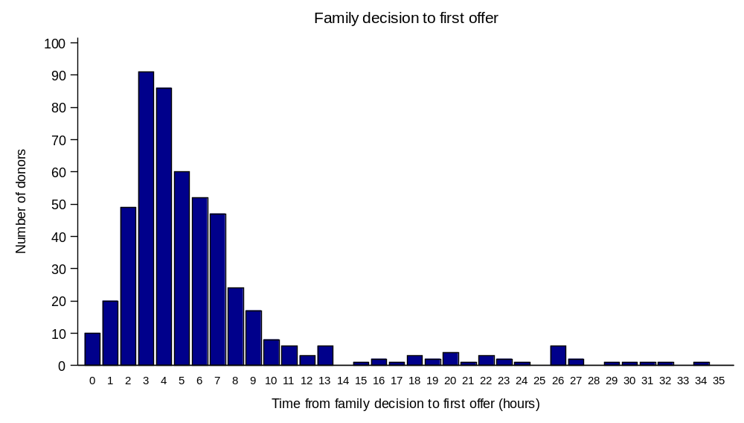
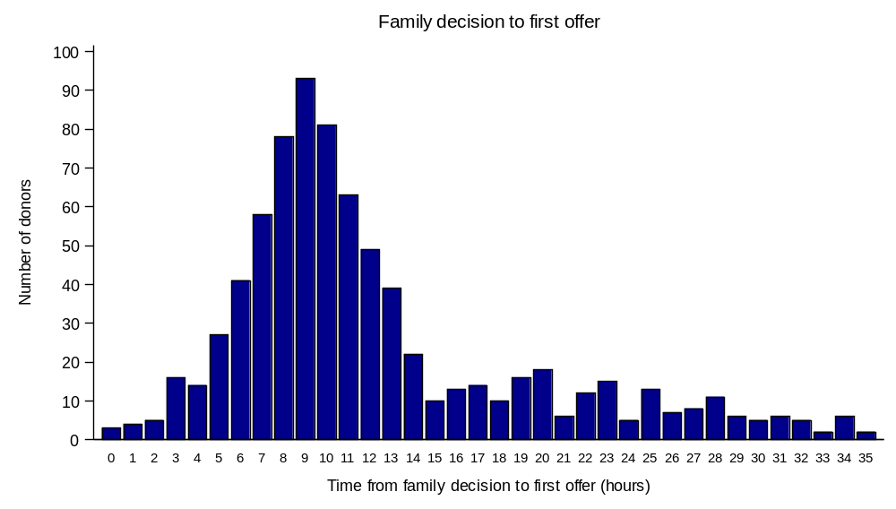
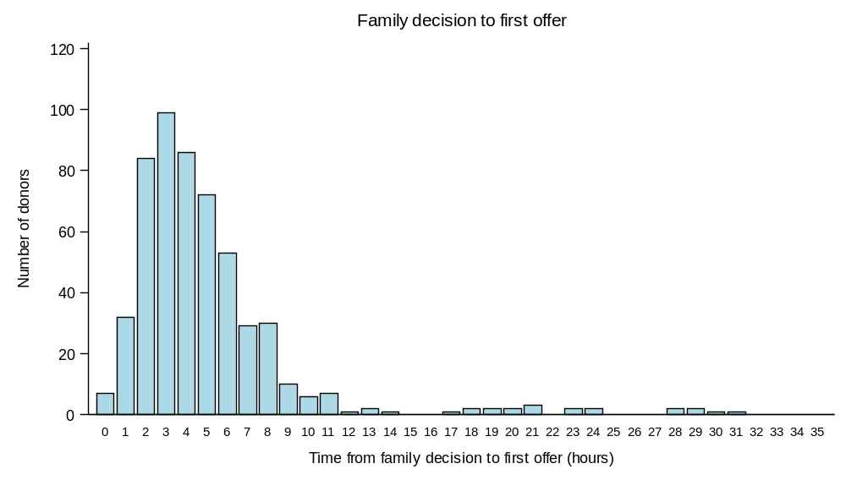
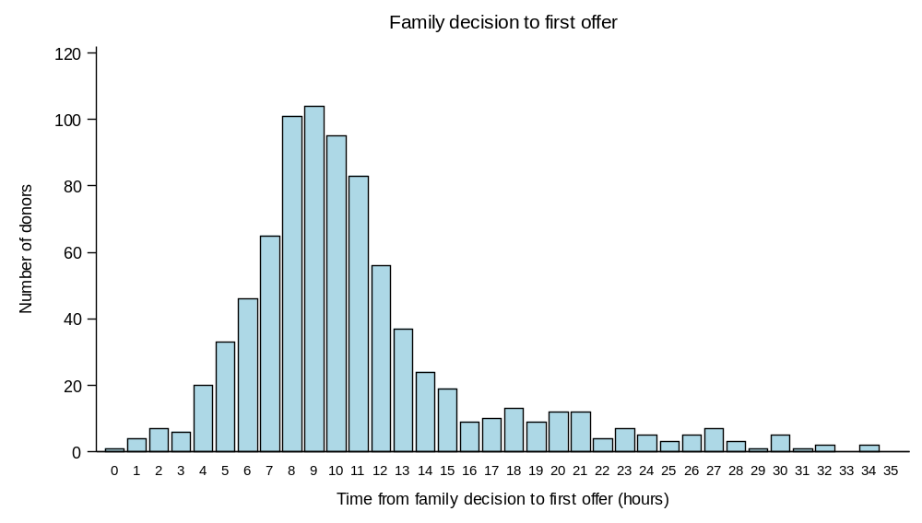
Retrieval timings – Family decision to Offering
DBD
2021
2011
3 hours
9 hours
6 hours longer
DCD
3 hours
9 hours
Notes:
Time taken to move from family decision to offering

Slide 14
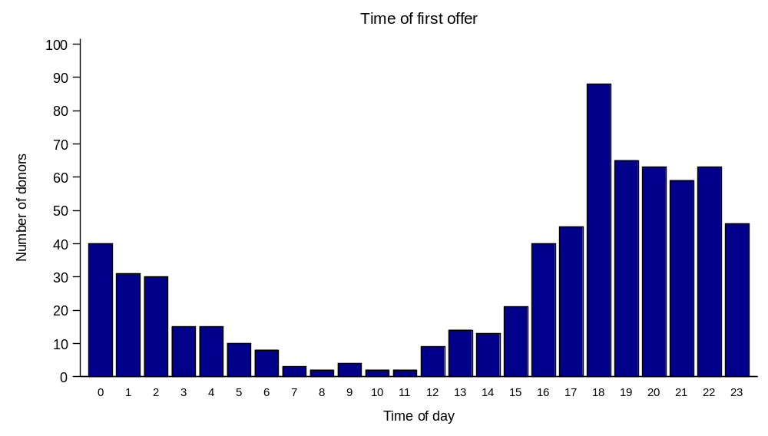
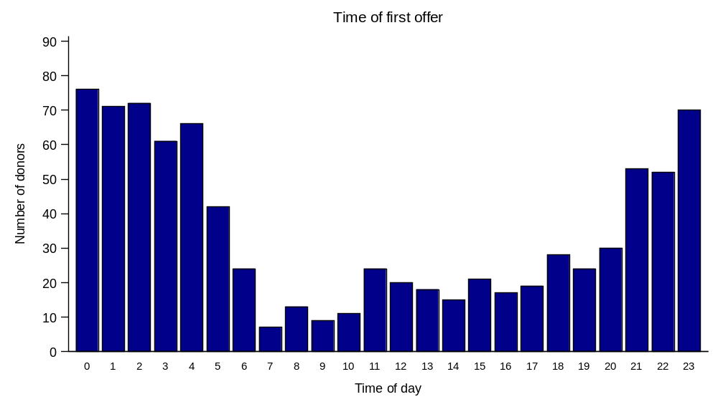
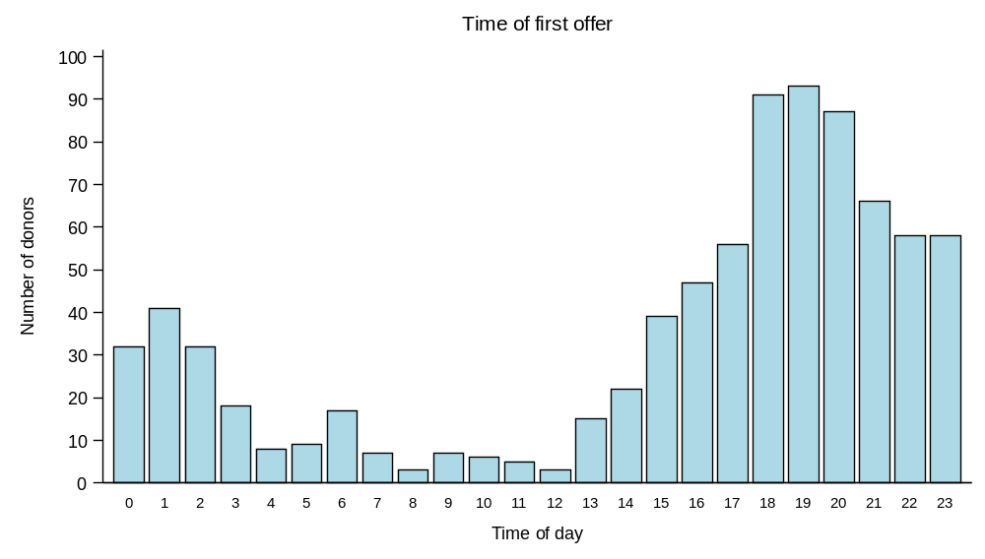
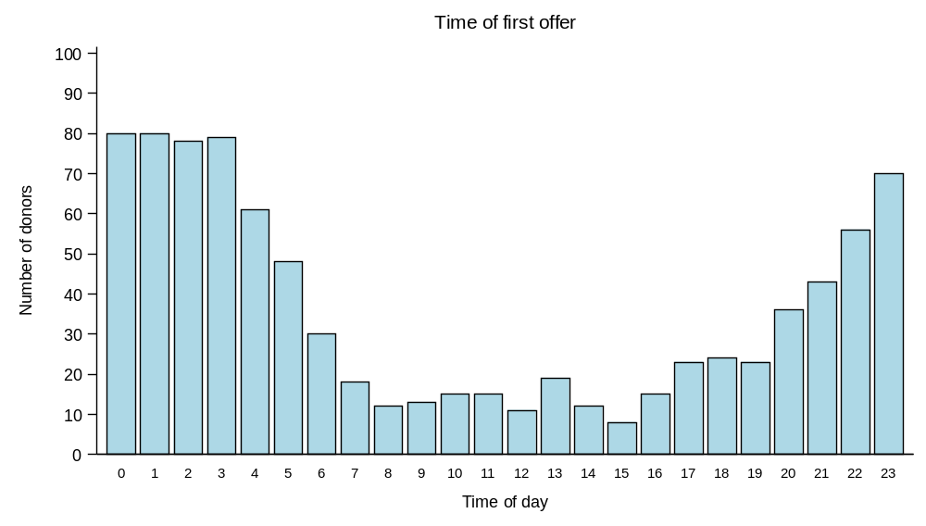
Retrieval timings – Time of Offering
2011
DBD
2021
6 hours later
DCD
Notes:
Offering was an evening activity, the majority is now in the early hours of the morning.

Slide 15
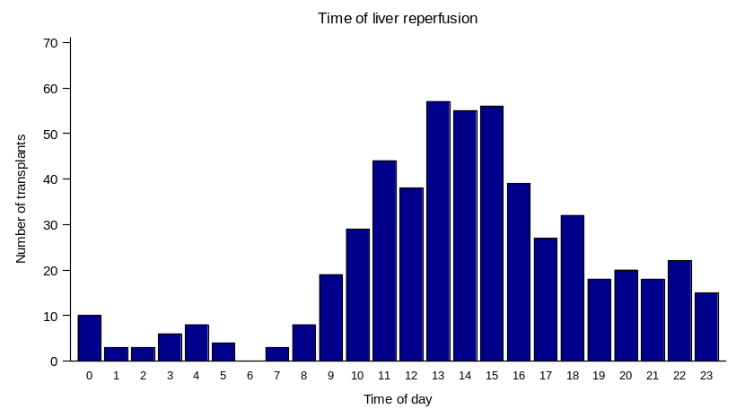
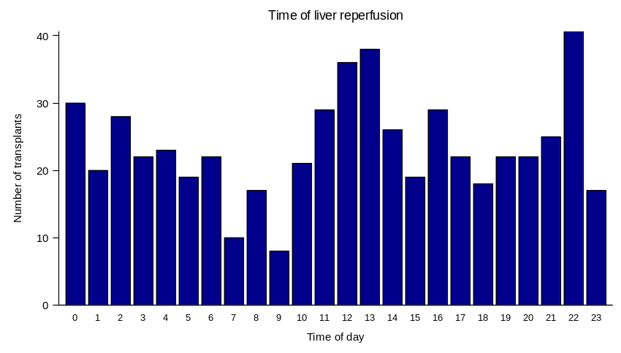
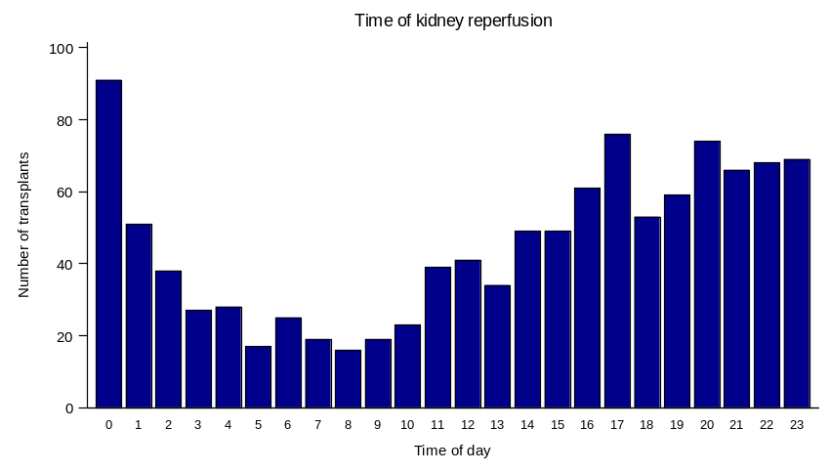
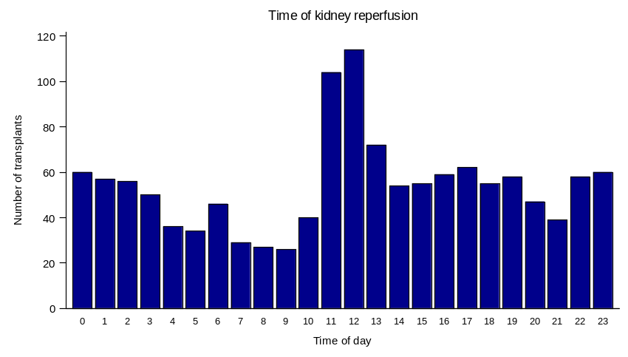
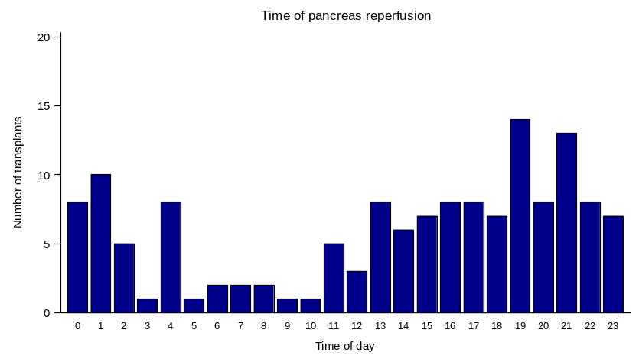
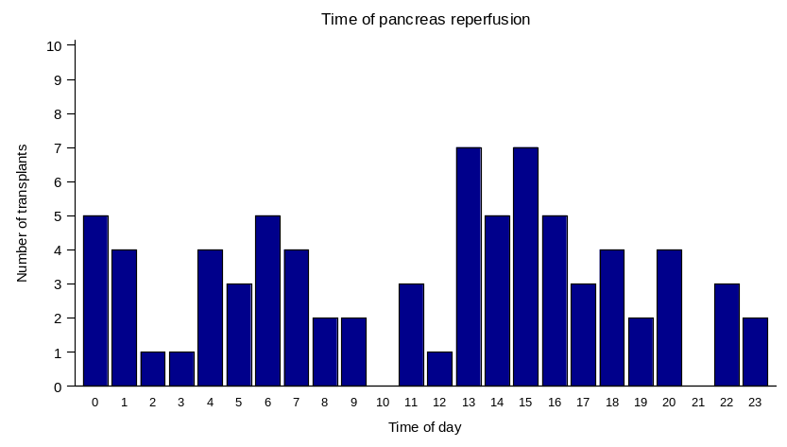
Time of Reperfusion – DBD Abdominal Organs
2011
2021
Liver
Kidney
Pancreas
Notes:
Offering was an evening activity, the majority is now in the early hours of the morning.

Slide 16
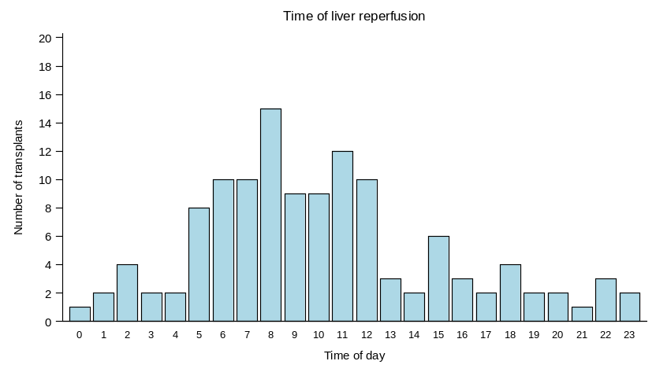
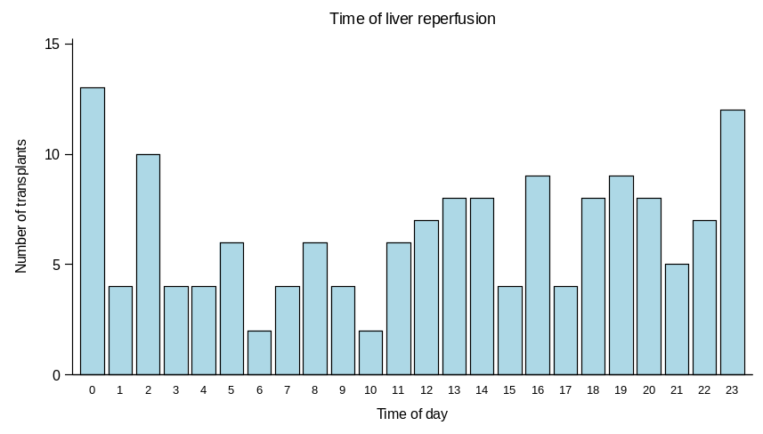
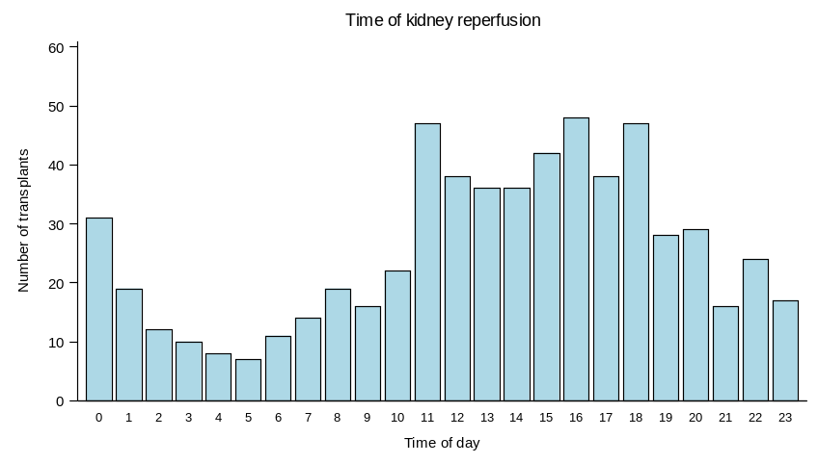
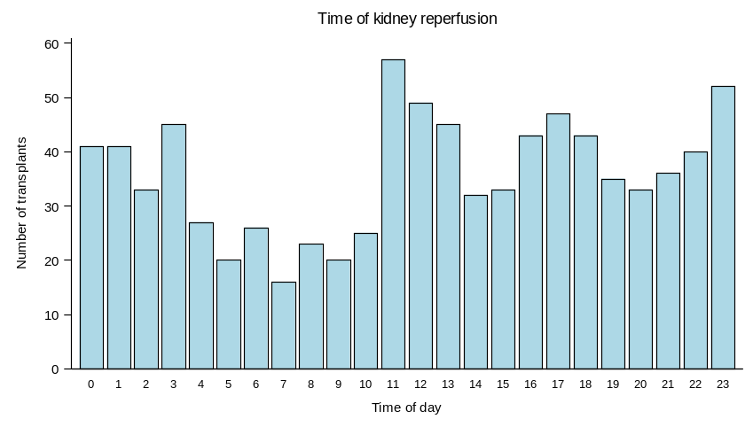
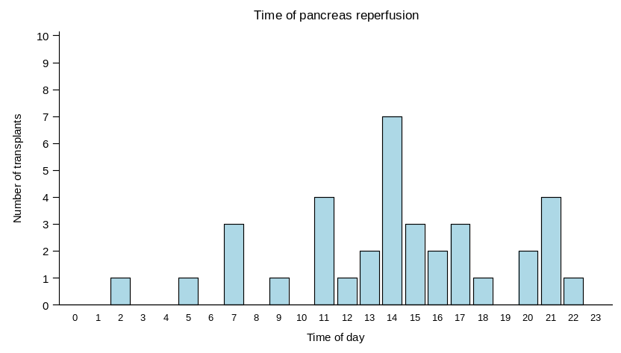
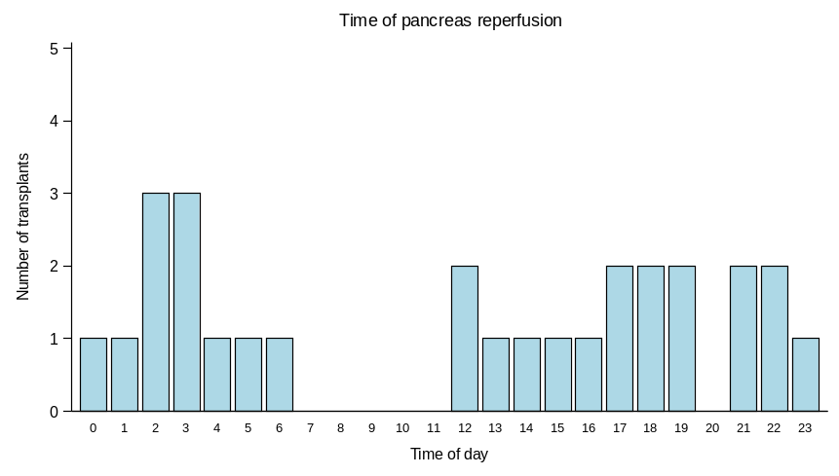
Time of Reperfusion – DCD Abdominal Organs
2011
Liver
Kidney
Pancreas
Notes:
Offering was an evening activity, the majority is now in the early hours of the morning.

Slide 17
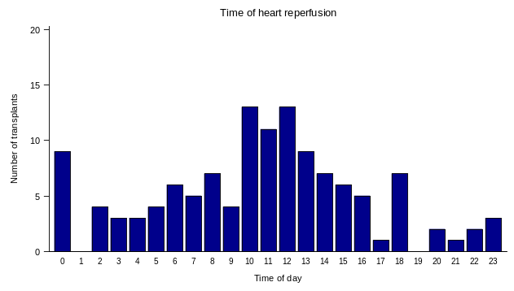
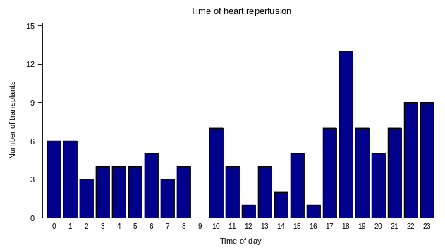
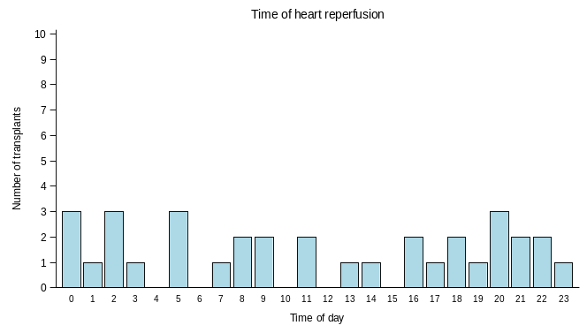
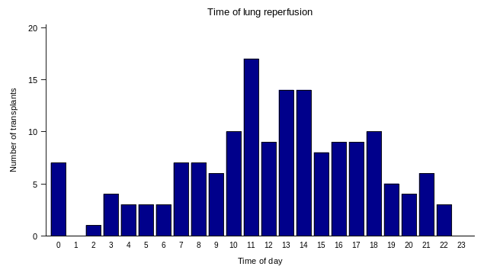
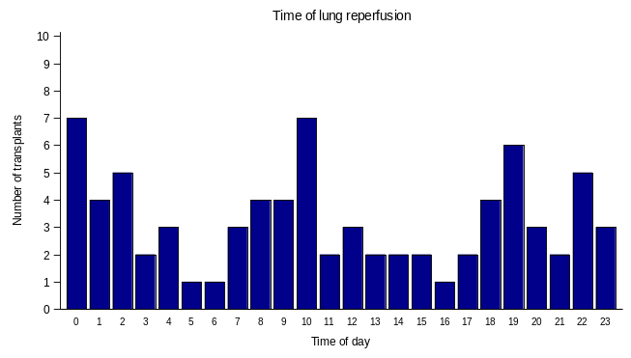
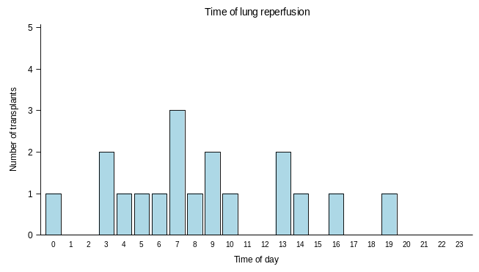
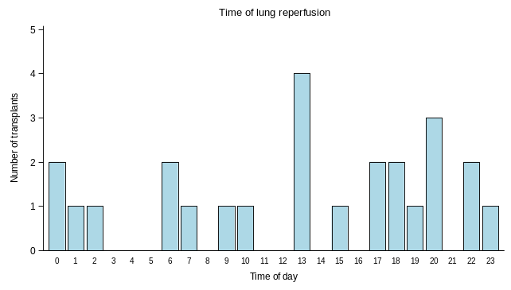
Time of Reperfusion – Cardiothoracic Organs
2011
DBD
2021
2011
DCD
2021
Heart
Heart
Lung
Lung

Slide 18
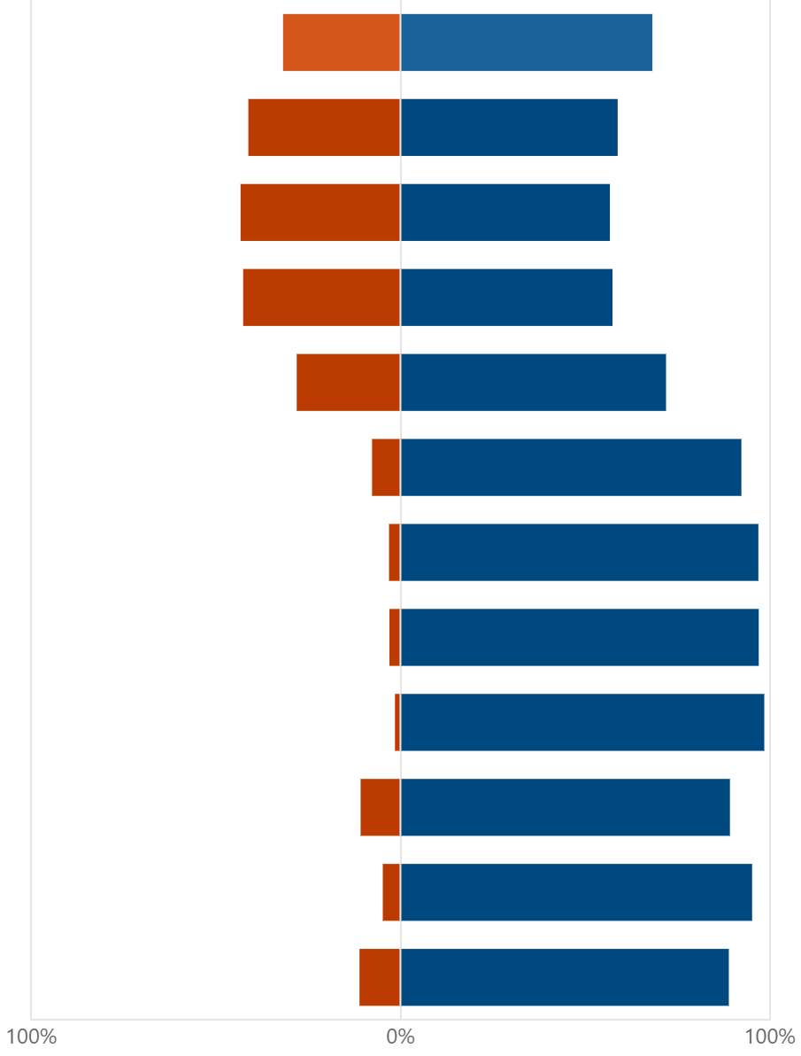
NHSBT: Survey for Specialist Nurses in OTDT (n=74)
Considering Organ Donation following Death by Neurological Criteria.
Considering the needs of the family, what time(s) should we very much avoid or generally accept transferring the patient from ICU to the operating theatre?
0000-0200
0200-0400
0400-0600
0600-0800
0800-1000
1000-1200
1200-1400
1400-1600
1600-1800
1800-2000
2000-2200
2200-2400
Notes:
We asked the donation pathway which times they would consider avoiding or accepting for their individual parts of the pathway.
SNODs were asked considering the families needs which times of day to very much avoid or generally accept transferring the pt from ICU to theatres for DBD donors…

Slide 19
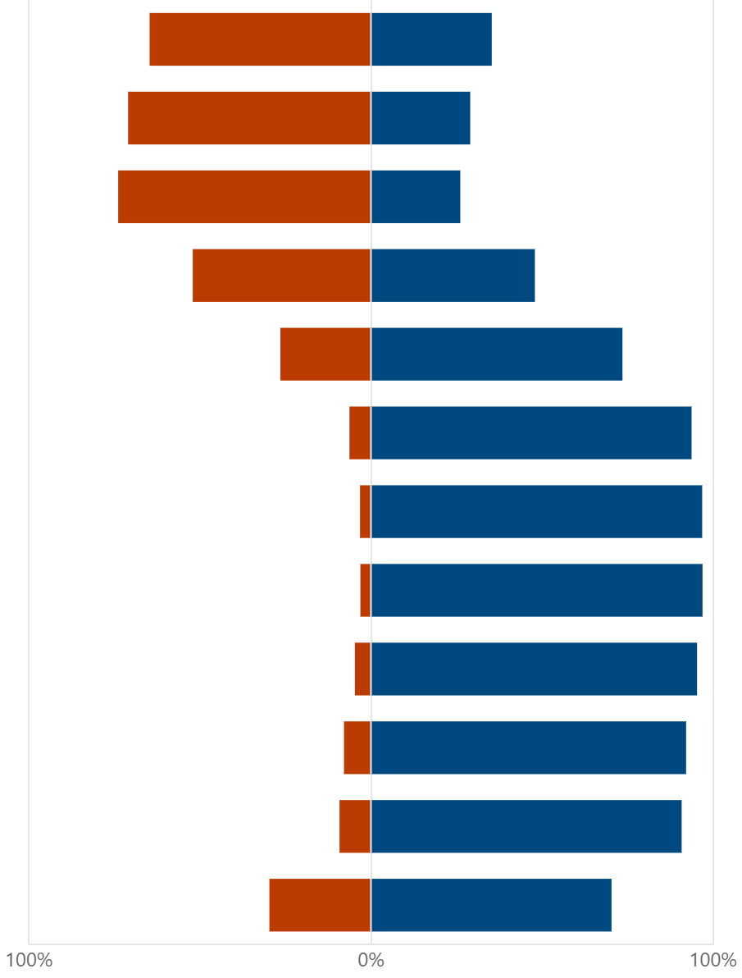
NHSBT: Survey for Specialist Nurses in OTDT (n=74)
Considering Organ Donation following Death by Circulatory Criteria.
Considering the needs of the family, what time(s) should we very much avoid or generally accept transferring the patient from ICU to the operating theatre?
0000-0200
0200-0400
0400-0600
0600-0800
0800-1000
1000-1200
1200-1400
1400-1600
1600-1800
1800-2000
2000-2200
2200-2400
Notes:
And for DCD donors

Slide 20
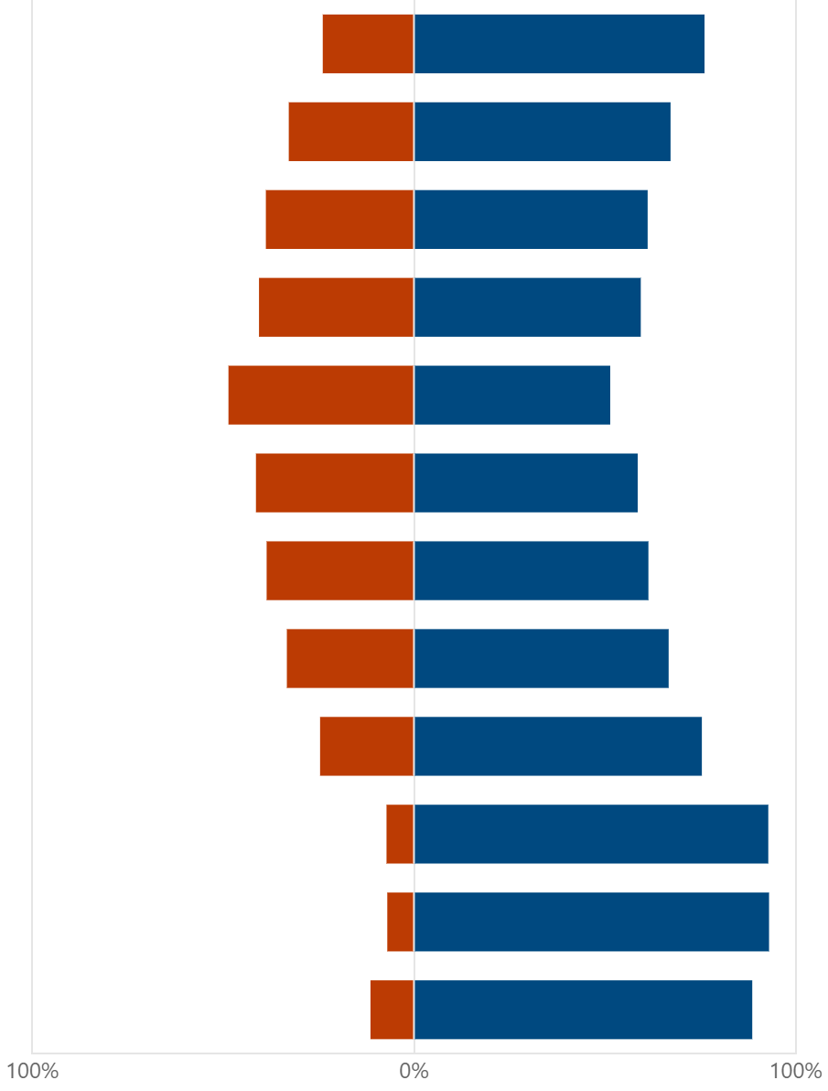
NHSBT: Survey for Clinical Leads for Organ Donation (n=76)
Considering Organ Donation following Death by Neurological Criteria (DNC; formerly known as DBD).
Considering the needs of the family, those caring for the patient and the wider hospital perspective, what time(s) should we very much avoid or generally accept transferring the patient from ICU to the operating theatre?
0000-0200
0200-0400
0400-0600
0600-0800
0800-1000
1000-1200
1200-1400
1400-1600
1600-1800
1800-2000
2000-2200
2200-2400
Notes:
CLODs were asked considering the needs of the family, the ICU, theatres and wider hospital perspective what time should we very much avoid or generally accept transferring a pt to theatres for a DBD

Slide 21
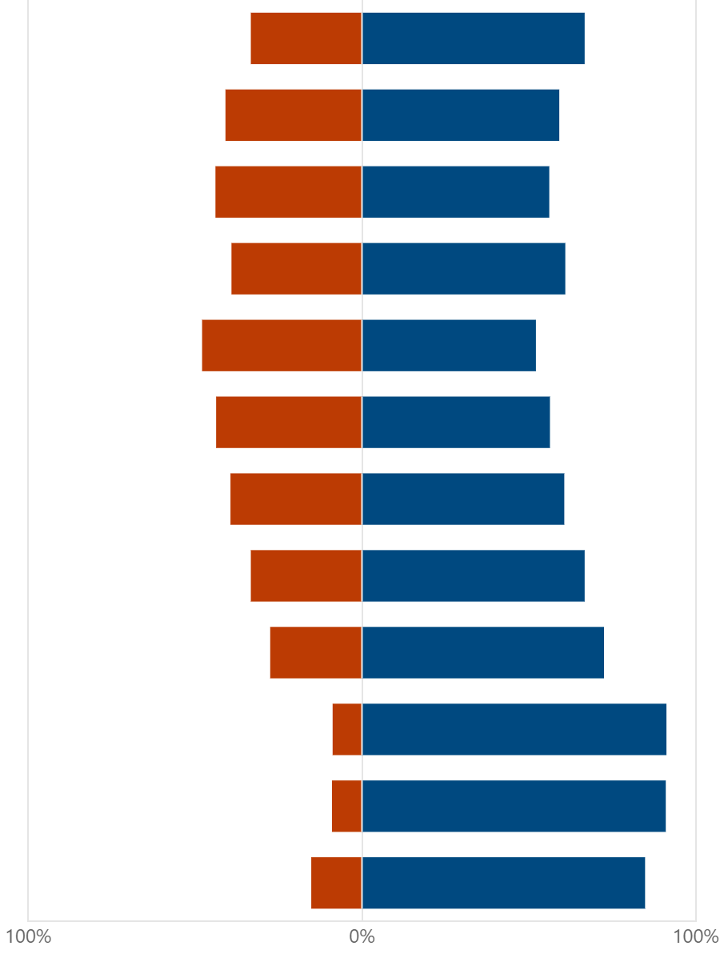
NHSBT: Survey for Clinical Leads for Organ Donation (n=76)
Considering Organ Donation following Death by Circulatory Criteria (DCD).
Considering the needs of the family, those caring for the patient and the wider hospital perspective, what time(s) should we very much avoid or generally accept the withdrawal of life sustaining treatment?
0000-0200
0200-0400
0400-0600
0600-0800
0800-1000
1000-1200
1200-1400
1400-1600
1600-1800
1800-2000
2000-2200
2200-2400
Notes:
And a DCD

Slide 22
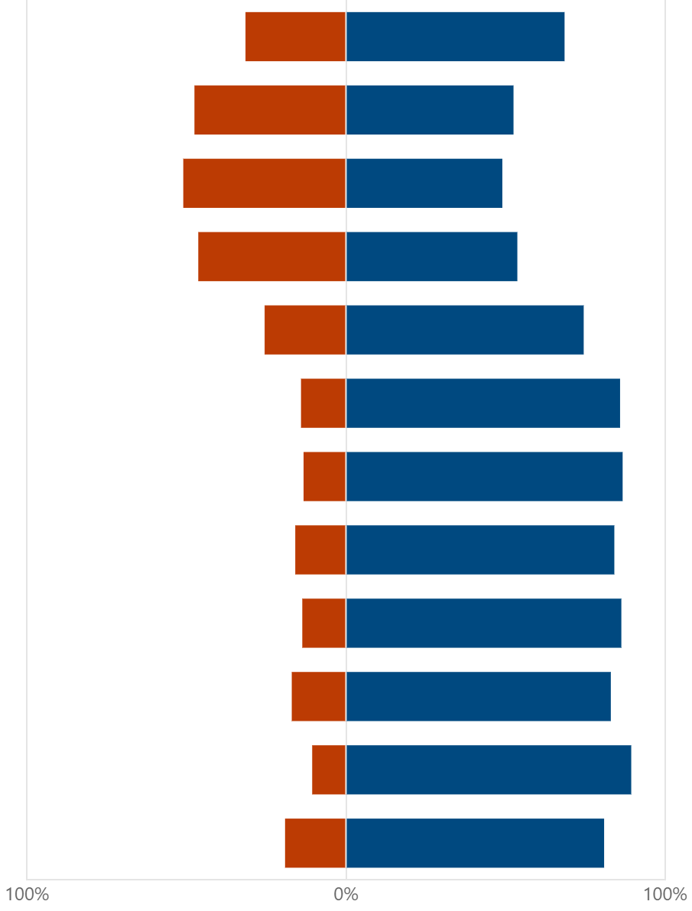
NHSBT: NORS Timings (n=157)
For Joint Cardiothoracic and Abdominal Retrievals - DBD only
What times in the 24-hour day should we very much avoid or generally accept starting joint CT/AB DBD retrievals (knife to skin time), as below.
0000-0200
0200-0400
0400-0600
0600-0800
0800-1000
1000-1200
1200-1400
1400-1600
1600-1800
1800-2000
2000-2200
2200-2400
Notes:
NORS surgeons, and senior periop staff were asked what times of day should we very much avoid or generally accept starting a CT/SB retreival for DBD

Slide 23
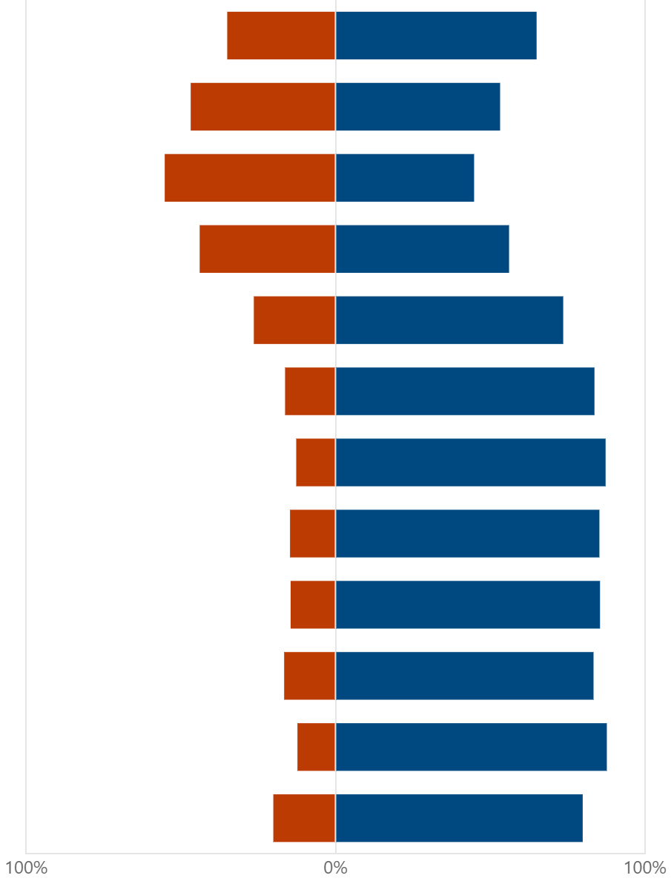
NHSBT: NORS Timings (n=157)
For Joint Cardiothoracic and Abdominal Retrievals - DCD only
What times in the 24-hour day should we very much avoid or generally accept starting joint CT/AB DCD retrievals (knife to skin time), as below.
0000-0200
0200-0400
0400-0600
0600-0800
0800-1000
1000-1200
1200-1400
1400-1600
1600-1800
1800-2000
2000-2200
2200-2400
Notes:
And DCD

Slide 24
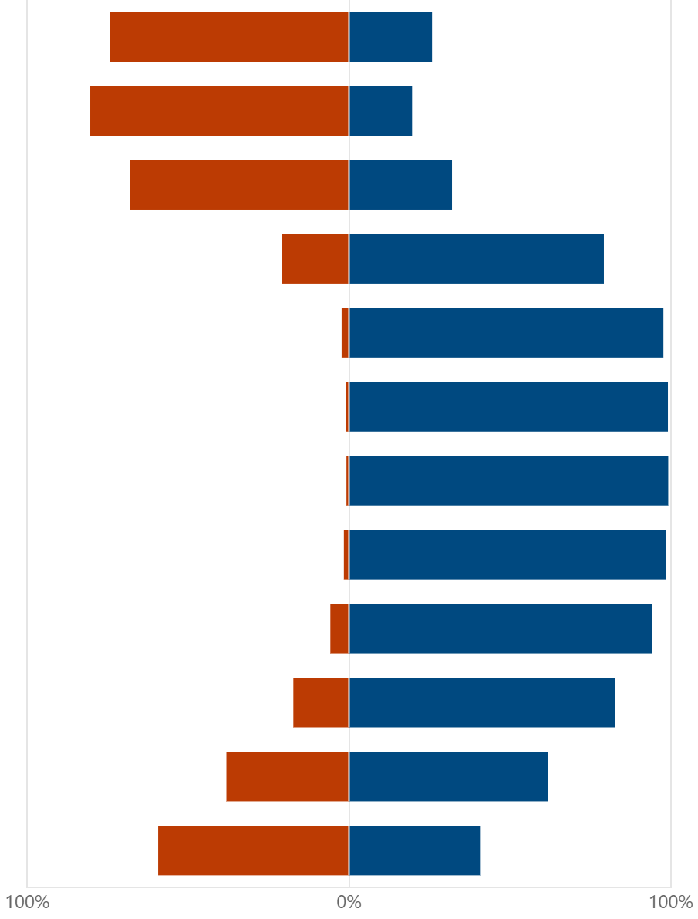
NHSBT: Timing of Deceased Donor Transplantation (n=683)
Some operation start times could disadvantage organ transplantation because of demands made on the wider transplant team, as well as supporting services, across the 24-hour day.
What times in the 24-hour day should we very much avoid or generally accept starting a transplant (knife to skin time), as below.
0000-0200
0200-0400
0400-0600
0600-0800
0800-1000
1000-1200
1200-1400
1400-1600
1600-1800
1800-2000
2000-2200
2200-2400
Notes:
Transplant consultants, transplant anaesthetic consultants and senior transplant perioperative staff were asked what time should we very much avoid or generally accept starting a transplant (KTS) time for a routine recipient

Slide 25
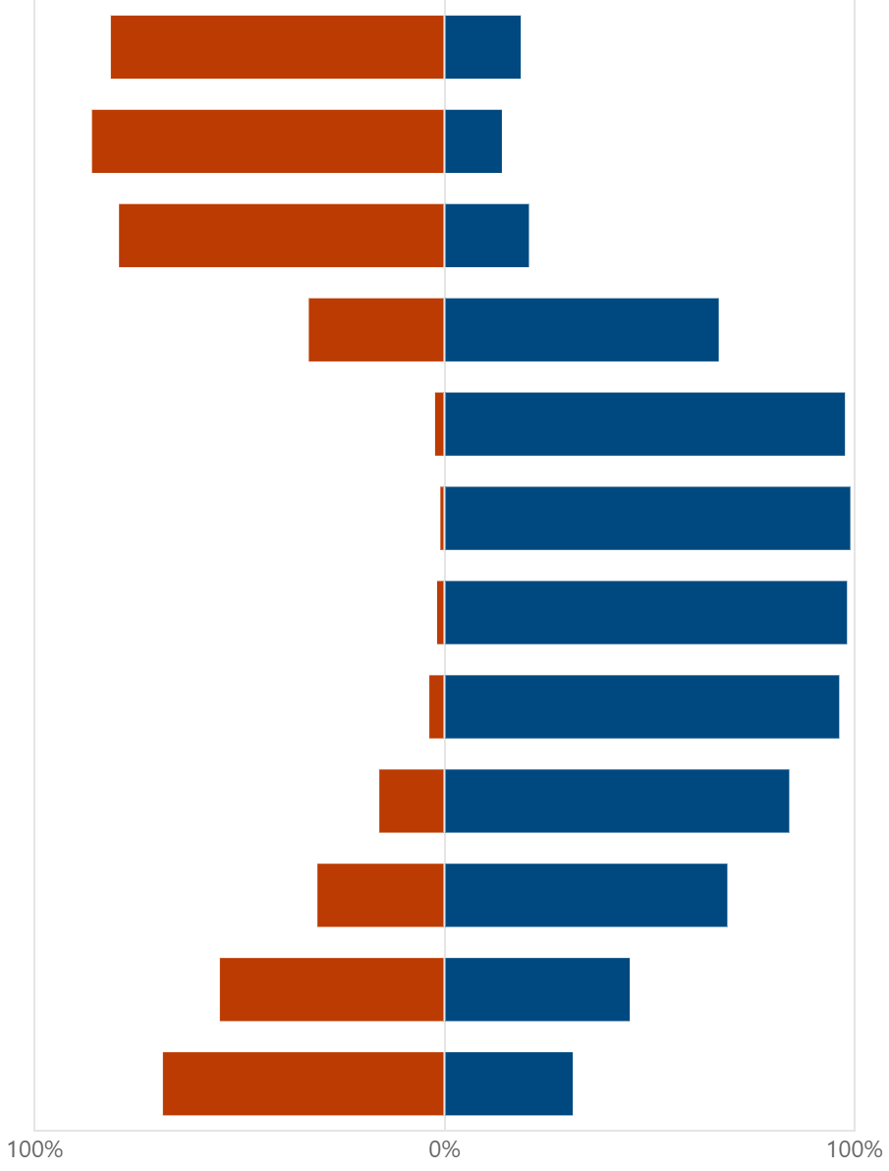
NHSBT: Timing of Deceased Donor Transplantation (n=683)
Some recipients have increased intra-operative needs, requiring additional consultant support.
What times in the 24-hour day should we very much avoid or generally accept starting this more complex transplant (knife to skin time), as below.
0000-0200
0200-0400
0400-0600
0600-0800
0800-1000
1000-1200
1200-1400
1400-1600
1600-1800
1800-2000
2000-2200
2200-2400
Notes:
And for a more complex recipient requiring additional consultant support

Slide 26
Planned Arrival Window

Slide 27










Planned Arrival Window
NORS team to arrive between 20:00 and 03:00.
3 assumptions for PAW
1 retrieval per team per window
Donors registered by 8 am
Provision for accelerated pathway, e.g. SU liver and paediatrics
Benefits of PAW
Certainty around timings
Better utilisation of NORS teams
Planned and efficient use of transport
Efficient organ offering systems
Daytime transplantation
Predictability and certainty for donor families

Slide 28
Registration of donors with hub 2022/23*
* Also represents the start of offering
64%

Slide 29
Planned Arrival Window PLUS
For registrations after 8 am
If organs are accepted
NORS teams are available
Donors will be registered in the same day’s PAW
Modelling the 2023 data, 203 of 267 would be accommodated in the same PAW window.

Slide 30
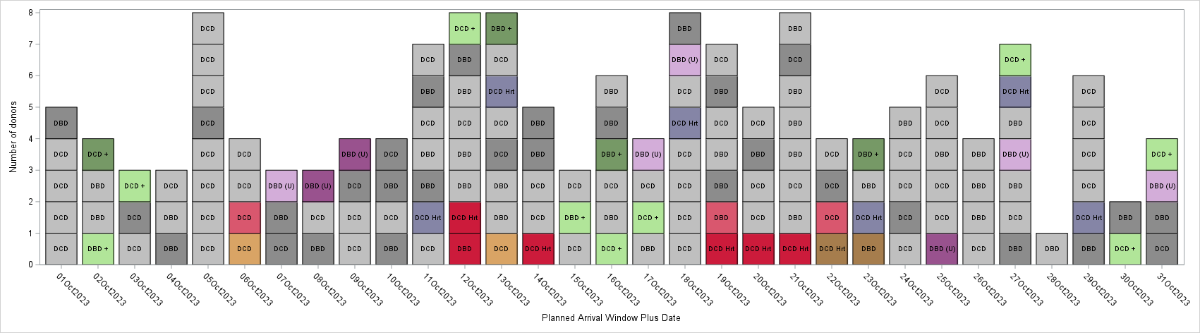
PAW Plus – 1 – 31 Oct 2023
Abdominal only donor
Abdominal only donor moved to next PAW
Abdominal and Cardiothoracic donor
Abdominal and Cardiothoracic donor moved to next PAW
SU liver Abdominal only donor
Abdominal only donor registered 8am-4pm
SU liver Abdominal and Cardiothoracic donor
Abdominal and Cardiothoracic donor registered 8am-4pm
DCD heart attendance
Abdominal only donor registered 8am-4pm facilitated
Abdo and Cardio donor registered 8am-4pm facilitated

Slide 31











PAW Plus: 2023 – current set-up (8 AB, 3 CT – 1 DCD heart)
Between 1 Jan – 31 Dec 23:
1758 donors attended
Of these, 267 donors registered between 8am and 4pm - eligible for window starting next evening
However, 203/267 able to be facilitated that evening
1726/1758 (98%) accommodated in planned window or earlier window
Only 32 (2%) moved to following planned arrival window
Notes:
Without PAW Plus, strict PAW with 8 / 3 / 1, 60 (3%) of donors would have to be moved to next PAW so PAW plus reduces this by 28

Slide 32
Factors affecting what time NORS will arrive within PAW
CT Organs
CT organs have a shorter CIT so teams would need to arrive later in the PAW to ensure daytime implant.
Time of organ acceptance
Current principles apply (1 Abdo/1CT to be accepted before mobilising)
Kidney only donors – complexities of renal offering.
Flights
Airports around the country have different opening and closing times – this will impact arrival / departure
The introduction of a clinical decision maker in the hub to oversee NORS allocation and mobilisation will enable the best decisions regarding arrival times based on clinical need.

Slide 33
Clinical decisions in pathway
Clinical Decision Maker
Which donors?
Where in PAW?
PAW +?
Fast Track?
Adherence to offering windows?
Logistics
Flights vs road?
Allocation of flights?
Allocation of teams
Clinical elements
Use of limited resources and allocation to donors
Accelerated pathway donors – is there capacity
What other benefits do you see to the clinical decision maker?

Slide 34
Offering

Slide 35
Offering proposals – Options considered
Option 1: Sequential Offering
Pros: Maintains individual focus on each recipient centre, minimising overlap.
Cons: Lengthy process often leading to delays in organ acceptance, impacting retrieval timelines.
Option 2: Simultaneous Offering of all organs (considered and discounted)
Pros: Reduces offering times, enabling quicker decision-making and supporting timely retrieval.
Cons: unmanageable levels of hub support required if all organ types are offered simultaneously; needs immediate IT support to implement.
Option 3: Simultaneous Offering by organ type with capability for accelerated pathway. (Selected Option)
Pros: Reduces offering times compared to sequential offering, enabling quicker decision-making and supporting timely retrieval.
Enables accelerated pathway
Cons: Potential increased administrative workload for the Hub, but less so than option 2

Slide 36


As is activity
The image below gives the view of the offering and retrieval activity for a 48hr period from 15:00 on 28th July 2023.
Notes:
Key – the dotted line after 2300 notes the end of the day. The dotted window around 7am notes the Hub Operations shift handover
Where it states ‘NORS arrival’ data is missing to mark the end of the retrieval.
Where known we have stated any onward offering and histopathology – but this data is not complete.
Colour on donor numbers aligns with Sarah’s key
Colour on activity in heat map is to provide differentiation between donors and has no meaning
AB = abdominal only retrieval
AB+CT = abdominal and CT retrieval
K or K’s offered on = kidney or kidneys were offered on
L offered on = liver was offered on
Histo – Histopathology was requested

Slide 37

Impact of PAW on the Hub and Recipient Centres
Below is the same 48hr period with the PAW and no changes to the offering progress.
This shift shows an unsustainable peak of activity for Hub Operations overnight and in the morning, with a less busy period during the afternoon.
Notes:
As registrations most occurs overnight, no change in offering would see instances of offering period coinciding with the PAW of that day. This would lead to a peak of activity for Hub Operations where organs may require offering on (and therefore potential change in transport etc) from the day's retrievals while the organs for the next PAW are offered.
As we do not know when in the PAW the retrieval will start, the thick dotted box represents the potential time the retrieval could last depending on the PAW of the team.

Slide 38



Let’s work through an example – 30th July PAW
CT + AB organs offered
AB organs offered
8.DCD
Bristol
7.DBD
Glasgow
6.DCD
5.DBD
Aberdeen
Birmingham
4.DBD
Chelmsford
3.DCD
2x SU liver offers made – offers declined
Liverpool
2x SU liver offers made – offers declined
2.DBD
Exeter
SU liver offer accepted
1.DCD
Cambridge
SU liver pathway
11:00
13:00
15:00
17:00
19:00
21:00
23:00
01:00
03:00
05:00
07:00
29th July
30th July

Slide 39


Cardiothoracic offering
3.DCD
8.DCD
Liverpool
Bristol
CT + AB organs offered
AB organs offered
7.DBD
Hub offering admin
Donor 7
- Heart accepted for R Adult
- Lungs declined by all centres
Glasgow
6.DCD
Donor 6
- Lungs declined by all centres
More CT organs have been accepted than available NORS teams
Aberdeen
5.DBD
Donor 5
- Heart accepted for U Adult
- Lungs accepted for R Adult
Birmingham
4 Hearts offered
5 Pairs of lungs offered
Clinical decision point
4.DBD
Donor 4
- Heart accepted for U Adult
- Lungs accepted for R Adult
Chelmsford
1.DCD
Donor 1
- Heart accepted for SU Adult
- Lungs accepted for R Adult
Cambridge
08:00
09:00
10:00
11:00
12:00
13:00
14:00
15:00
16:00
30th July
Notes:
Note that we have more CT organs accepted than teams available (also a team out for the SU donor).
Trigger clinical decision making on what to do here – we’re not going to talk through that now as we want to focus on the offering model
(Further explored in NORS Service Model) – capacity and alignments – nothing decided.

Slide 40
Liver & Bowel offering
8.DCD
Donor 8
- Liver accepted
Bristol
CT + AB organs offered
7.DBD
AB organs offered
7.DBD
Hub offering admin
Glasgow
Hub offering admin
Donor 7
- Left & right lobes accepted
Glasgow
Bowel offered
6.DCD
6.DCD
Aberdeen
Donor 6
- Liver accepted
Aberdeen
5.DBD
Donor 5
- Liver accepted
- Bowel & Pancreas accepted
5.DBD
Birmingham
Birmingham
4 Hearts offered
5 Pairs of lungs offered
4.DBD
Chelmsford
2 Bowels offered
7 Livers offered
Donor 4
- Left lobe accepted
- Bowel & Pancreas accepted
4.DBD
Chelmsford
3.DCD
Liverpool
Donor 3
- Liver declined by all centres
1.DCD
Cambridge
1.DCD
Cambridge
Donor 1
- Liver accepted
08:00
09:00
10:00
11:00
12:00
13:00
14:00
15:00
16:00
30th July

Slide 41
Renal/Pancreas ‘spotlight’ Offering
Renal & Pancreas simultaneous offers
3 centres at a time
Sequential offering TIER A recipients , D1 donors and Pancreas where possible
08:00
09:00
10:00
11:00
12:00
13:00
14:00
15:00
16:00
Round 1 offering
Allocation & Admin
Round 2 offering
Allocation & Admin
Round 3 offering
Allocation & Admin
13:00
14:00
15:00
16:00
17:00
Notes:
Renal offering will be different in that we will still do some sequential offering in the morning with simultaneous offering in the afternoon on rounds of 3 centres per round

Slide 42
Proposed Offering System
08:00 – 13:00
Sequential offering TIER A recips
08:00 – 10:00
13:00 – 15:00
CT offers
Renal & Pancreas simultaneous offers
10:30-12:30
Offering and allocation must end by 16:00 to enabled NORS mobilisation and transplant logistics
Liver & Bowel offers
08:00
09:00
10:00
11:00
12:00
13:00
14:00
15:00
16:00
Notes:
SU/U hearts and lungs can be allocated after CT offering
Routine heart and lungs can be allocated after CT offering, unless there is a CT/liver recipient then they can be allocated after liver offering
Tier A KMR kidney only can be allocated on offer
Tier A KMR SPK/SIK can be allocated on offer, unless bowel is on offer and recipient requires pancreas then it will be allocated after bowel offering
Liver and bowel can be allocated after liver/bowel offering
Non-Tier A kidney and pancreases can be allocated after renal/pancreas offering

Slide 43
Modelling data

Slide 44



Number of offers/PAW
Kidney
Heart
Liver
Lung
Pancreas
Notes:
Mean number of offers per PAW based on current offering (sequentially)
Newcastle – 2.8
Leeds - 3.5
Cambridge – 2.8
RFH – 2.7
KCH - 5.2
Bham - 3.9
Edinburgh - 2.7

Slide 45







Notes:
Blue boxes are busy offering days/donor activity days – on most days you will get 3 offers/centre

Slide 46



Offers /PAW frequency liver, Pancreas and Kidney
4.4 Liver offers/day average
9 kidney offers/day average
2.13 Pancreas offers/day average

Slide 47


Offers /PAW frequency
1.6 Heart offers/day average
2.2 Lungs offers/day average

Slide 48
Impact across the pathway

Slide 49
Impact
NORS
Transplant Centres
SNODs
Hub Ops
Each area will need to make changes to accommodate the PAW

Slide 50



Impact to SNODs
SNOD
Consent / Authorisation
Family care
Local hospital

Slide 51








Impact to ODT Hub Operations
Registration as usual Holding area until
08:00
Time of organ offering Windows
CT/Liver
8:00-10:00 & 10:30-12:30
Renal Offering
Sequential am/Group offering pm
Digital accept & Decline
Anatomy confirmation
Overnight/Morning time
Expedited pathway
SU liver recipients
Clinical Support for Hub
Dedicated support in Hub
Coordination of retrieval pathway
Notes:
NORs dispatch
Flight allocation

Slide 52







Impact to NORS Teams
8
8 abdominal teams
2 available 24/7
Notification at 1600
if they need to mobilise and for what time
Increase to overnight retrievals
(currently 25% attendance between 2000-0300)
3
3 cardiothoracic teams
Improved allocation to reduce travel times
No back-to-back retrievals

Slide 53


NORS allocation
– actual travel
ABERDEEN
GLASGOW
EDINBURGH
NEWCASTLE UPON TYNE
BELFAST
LEEDS
LEGEND
BOLTON
OLDHAM
MANCHESTER
ABDOMINAL TEAMS
BIRMINGHAM
CAMBRIDGE
PONTYPRIDD
LONDON

Slide 54



Impact to Transplant Centres
Time of organ arrival for daytime implant
Organ(s) arriving at similar times
Challenge of accessing daytime theatre space
Challenge of new offering windows taking place at the same time organs are arriving
Screening calls
Notes:
Use a list or timetable instead of hospital
Screening call – call to transplant centre

Slide 55
Individual centre data
Notes:
We need to add in all relevant and up to date data per team and per organ.
On this slide, please say the following:
“I’m now going to show some centre specific data from XXXXX <insert name of centre> - this will be used as an example for you to understand the impact of changes resultant from the planned arrival window in regard to the frequency of organs arriving at your centre, and the number of occasions this may happen in multiples.
To access your own data, please use the QR code presented on the screen, or use the link in the that’s been posted in the video description. This will take you to the powerpoint slides we’ve used in this presentation where you’ll find the data relating to your centre, starting from slide XXX <confirm slide – currently its slide 56>”
** I will create a QR code later and see if I can edit the audio / new place holder so it doesn’t need to be re-recorded**

Slide 56
Abdominal Transplant Centres A-Z

Slide 57
SCORE modelling – Transplants arriving per day
Belfast 2024 data

Slide 58


Belfast - transplants (per centre)

Slide 59
SCORE modelling – Transplants arriving per day
Birmingham 2024 data

Slide 60


Birmingham - transplants (per centre)

Slide 61


Birmingham - transplants (per organ – kidney only)

Slide 62


Birmingham - transplants (per organ – liver only)

Slide 63


Birmingham - transplants (per organ – small bowel)

Slide 64


Birmingham - transplants (per organ – other AB only multi-organ)

Slide 65
SCORE modelling – Transplants arriving per day
Bristol 2024 data

Slide 66


Bristol - transplants (per centre)

Slide 67
SCORE modelling – Transplants arriving per day
Cambridge 2024 data

Slide 68


Cambridge - transplants (per centre)

Slide 69


Cambridge - transplants (per organ – kidney only)

Slide 70


Cambridge - transplants (per organ – liver only)

Slide 71


Cambridge - transplants (per organ – pancreas or islets only)

Slide 72


Cambridge - transplants (per organ – SPK or SIK only)

Slide 73


Cambridge - transplants (per organ – small bowel)

Slide 74


Cambridge - transplants (per organ – other AB only multi-organ)

Slide 75
SCORE modelling – Transplants arriving per day
Cardiff 2024 data

Slide 76


Cardiff - transplants (per centre)

Slide 77


Cardiff - transplants (per organ – kidney only)

Slide 78


Cardiff - transplants (per organ – SPK or SIK only)

Slide 79
SCORE modelling – Transplants arriving per day
Coventry 2024 data

Slide 80


Coventry - transplants (per centre)

Slide 81
SCORE modelling – Transplants arriving per day
Edinburgh 2024 data

Slide 82


Edinburgh - transplants (per centre)

Slide 83


Edinburgh - transplants (per organ – kidney only)

Slide 84


Edinburgh - transplants (per organ – liver only)

Slide 85


Edinburgh - transplants (per organ – pancreas or islets only)

Slide 86


Edinburgh - transplants (per organ – SPK or SIK only)

Slide 87
SCORE modelling – Transplants arriving per day
Glasgow 2024 data

Slide 88


Glasgow - transplants (per centre)

Slide 89
SCORE modelling – Transplants arriving per day
GOSH 2024 data

Slide 90


GOSH - transplants (per centre)

Slide 91
SCORE modelling – Transplants arriving per day
Guys 2024 data

Slide 92


Guys - transplants (per centre)

Slide 93


Guy’s - kidney only transplants

Slide 94


Guy’s - SPK or SIK transplants

Slide 95
SCORE modelling – Transplants arriving per day
Hammersmith 2024 data

Slide 96


Hammersmith - transplants (per centre)

Slide 97


Hammersmith - transplants (per organ – kidney only)

Slide 98


Hammersmith - transplants (per organ – pancreas or islets only)

Slide 99


Hammersmith - transplants (per organ – SPK or SIK only)

Slide 100
SCORE modelling – Transplants arriving per day
Kings College 2024 data

Slide 101


Kings College - transplants (per centre)

Slide 102


Kings College - transplants (per organ – liver only)

Slide 103


Kings College - transplants (per organ – small bowel)

Slide 104


Kings College - transplants (per organ – other AB only multi-organ)

Slide 105
SCORE modelling – Transplants arriving per day
Leeds 2024 data

Slide 106


Leeds - transplants (per centre)

Slide 107


Leeds - transplants (per organ – Liver only)

Slide 108


Leeds - transplants (per organ - kidney)

Slide 109
SCORE modelling – Transplants arriving per day
Leicester 2024 data

Slide 110


Leicester - transplants (per centre)

Slide 111
SCORE modelling – Transplants arriving per day
Liverpool 2024 data

Slide 112


Liverpool - transplants (per centre)

Slide 113
SCORE modelling – Transplants arriving per day
Manchester 2024 data

Slide 114


Manchester - transplants (per centre)

Slide 115


Manchester - transplants (per organ – kidney only)

Slide 116


Manchester - transplants (per organ – pancreas or islets only)

Slide 117


Manchester - transplants (per organ – SPK or SIK)

Slide 118
SCORE modelling – Transplants arriving per day
Newcastle 2024 data

Slide 119


Newcastle - transplants (per centre)

Slide 120


Newcastle - transplants (per organ – kidney only)

Slide 121


Newcastle - transplants (per organ – liver only)

Slide 122


Newcastle - transplants (per organ – pancreas or islets only)

Slide 123


Newcastle - transplants (per organ – SPK or SIK only)

Slide 124


Newcastle - transplants (per organ – other AB multi-organ only)

Slide 125
SCORE modelling – Transplants arriving per day
Nottingham 2024 data

Slide 126


Nottingham - transplants (per centre)

Slide 127
SCORE modelling – Transplants arriving per day
Oxford 2024 data

Slide 128


Oxford - transplants (per centre)

Slide 129


Oxford - transplants (per organ - kidney)

Slide 130


Oxford - transplants (per organ – pancreas or islets only)

Slide 131


Oxford - transplants (per organ – SPK or SIK)

Slide 132


Oxford - transplants (per organ – small bowel)

Slide 133
SCORE modelling – Transplants arriving per day
Plymouth 2024 data

Slide 134


Plymouth - transplants (per centre)

Slide 135
SCORE modelling – Transplants arriving per day
Portsmouth 2024 data

Slide 136


Portsmouth - transplants (per centre)

Slide 137
SCORE modelling – Transplants arriving per day
Royal Free 2024 data

Slide 138


Royal Free - transplants (per centre)

Slide 139


Royal Free - transplants (per organ – kidney only)

Slide 140


Royal Free - transplants (per organ – liver only)

Slide 141


Royal Free - transplants (per organ – other AB multi-organ only)

Slide 142
SCORE modelling – Transplants arriving per day
Royal London 2024 data

Slide 143


Royal London - transplants (per centre)

Slide 144
SCORE modelling – Transplants arriving per day
Sheffield 2024 data

Slide 145


Sheffield - transplants (per centre)

Slide 146
SCORE modelling – Transplants arriving per day
St George’s 2024 data

Slide 147


St George’s - transplants (per centre)

Slide 148
Cardiothoracic Transplant Centres A-Z

Slide 149
SCORE modelling – Transplants arriving per day
Birmingham 2024 data

Slide 150


Birmingham - transplants (per centre)

Slide 151


Birmingham - transplants (per organ – heart only)

Slide 152


Birmingham - transplants (per organ – lung only)

Slide 153


Birmingham - transplants (per organ – heart/lung only)

Slide 154
SCORE modelling – Transplants arriving per day
Glasgow 2024 data

Slide 155


Glasgow - transplants (per centre)

Slide 156
SCORE modelling – Transplants arriving per day
Great Ormond Street 2024 data

Slide 157


GOSH - transplants (per centre)

Slide 158


GOSH - transplants (per organ – heart only)

Slide 159


GOSH - transplants (per organ – lung only)

Slide 160
SCORE modelling – Transplants arriving per day
Harefield 2024 data

Slide 161


Harfield - transplants (per centre)

Slide 162


Harefield - transplants (per organ – heart only)

Slide 163


Harefield - transplants (per organ – lung only)

Slide 164


Harefield - transplants (per organ – heart/lung only)

Slide 165
SCORE modelling – Transplants arriving per day
Manchester 2024 data

Slide 166


Manchester - transplants (per centre)

Slide 167


Manchester - transplants (per organ – heart only)

Slide 168


Manchester - transplants (per organ – lung only)

Slide 169
SCORE modelling – Transplants arriving per day
Newcastle 2024 data

Slide 170


Newcastle - transplants (per centre)

Slide 171


Newcastle - transplants (per organ – heart only)

Slide 172


Newcastle - transplants (per organ – lung only)

Slide 173


Newcastle - transplants (per organ – heart/lung only)

Slide 174
SCORE modelling – Transplants arriving per day
Papworth 2024 data

Slide 175


Papworth - transplants (per centre)

Slide 176


Papworth - transplants (per organ – heart only)

Slide 177


Papworth - transplants (per organ – lung only)

Slide 178
Heat maps to show organ arrival time at transplant centres by organ group and centre (A-Z) for round 1 of shadow modelling

Slide 179

Modelling - Organ Arrival Heatmaps
By organ group

Slide 180

Modelling - Organ Arrival Heatmaps
CT – centres

Slide 181

Modelling - Organ Arrival Heatmaps
Abdominal Centres

Slide 182

Modelling - Organ Arrival Heatmaps
Abdominal Centres

Slide 183

Modelling - Organ Arrival Heatmaps
Abdominal Centres

Slide 184

Modelling - Organ Arrival Heatmaps
Abdominal Centres

Slide 185

Modelling - Organ Arrival Heatmaps
Abdominal Centres

Slide 186





















DAY 1
0800 | 0900 | 1000 | 1100 | 1200 | 1300 | 1400 | 1500 | 1600 | 1700 | 1800 | 1900 | 2000 | 2100 | 2200 | 2300 | 2400 | 0100 | 0200 | 0300 | 0400 | 0500 | 0600 | 0700
hour commencing
Referral
Consent / authorisation
Donor characterisation
Registration
Registration cut-off
DAY 2
0800 | 0900 | 1000 | 1100 | 1200 | 1300 | 1400 | 1500 | 1600 | 1700 | 1800 | 1900 | 2000 | 2100 | 2200 | 2300 | 2400 | 0100 | 0200 | 0300 | 0400 | 0500 | 0600 | 0700
hour commencing
Donor / Family / ICU support
CT Offering
Liver & Bowel Offering
Organ allocation
x 3
TIER A, D1 offering
Renal & Pancreas Group Offering
Recipient considerations
Cross matching
NORS allocation
NORS travel
Overnight Retrieval (PAW)
Organ transportation
Organ arrival
DAY 3
0800 | 0900 | 1000 | 1100 | 1200 | 1300 | 1400 | 1500 | 1600 | 1700 | 1800 | 1900 | 2000 | 2100 | 2200 | 2300 | 2400 | 0100 | 0200 | 0300 | 0400 | 0500 | 0600 | 0700
hour commencing
Organ arrival
Cross matching
Implant surgery
Post-op recovery
Notes:
Show which is which stakeholder’s activity to highlight simultaneous effort?
Use only one

Slide 187


Slide 188


Slide 189
Develop
Develop mechanisms to accommodate the Planned Arrival Window, being cognizant of both departmental and hospital (or wider) impacts
Share
Share this presentation with your colleagues and key hospital (or wider) stakeholders.
Progress
Make progress on implementing any changes you identify.
Go-live could be as soon as Spring/Summer 2026

Slide 190



Thank you
Sustainability and Certainty in Organ Retrieval (SCORE) - ODT Clinical - NHS Blood and Transplant
FAQs
SCORE@nhsbt.nhs.uk

