Slide 1
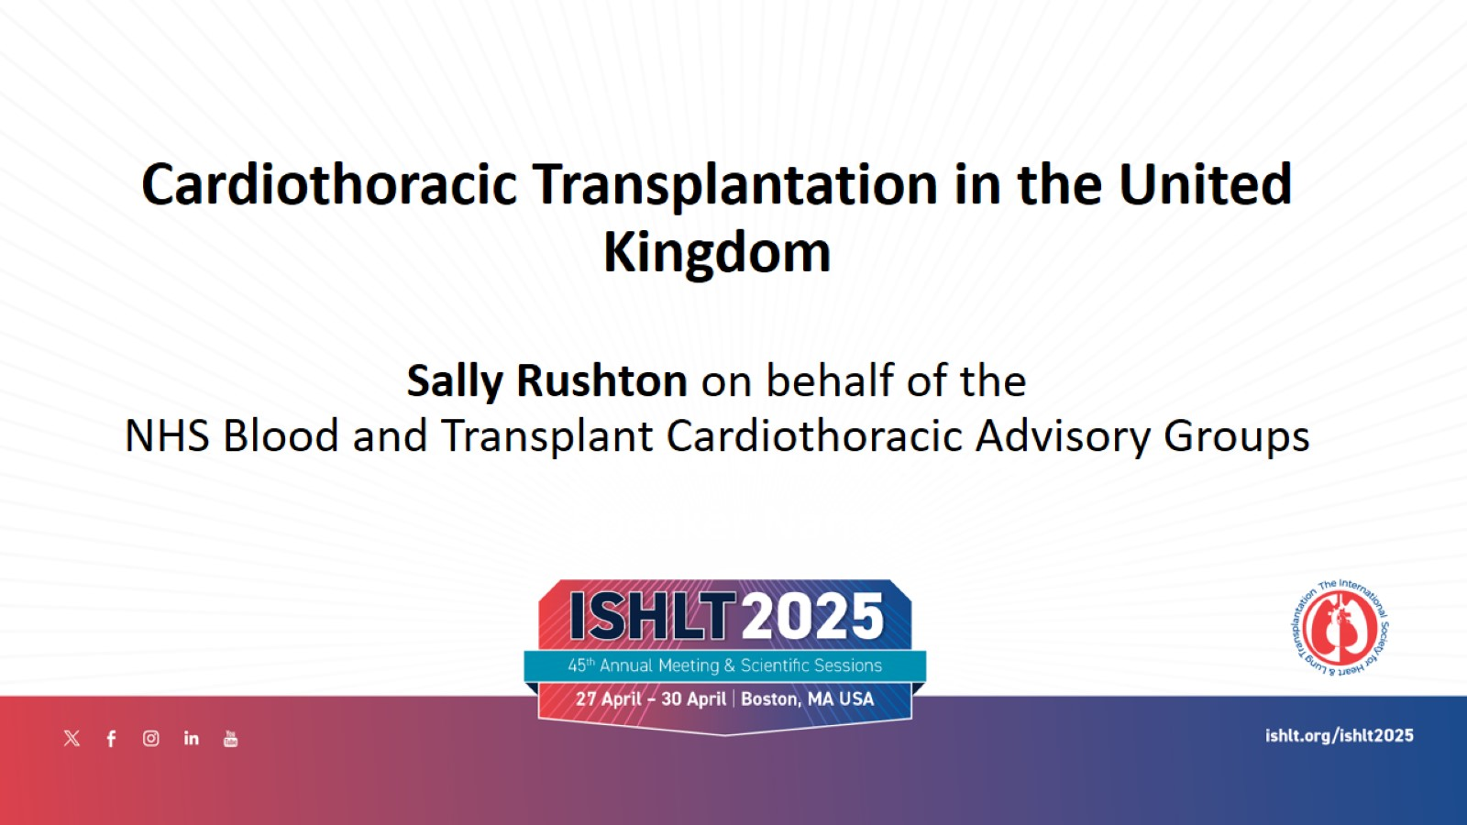

Slide 2


Slide 3
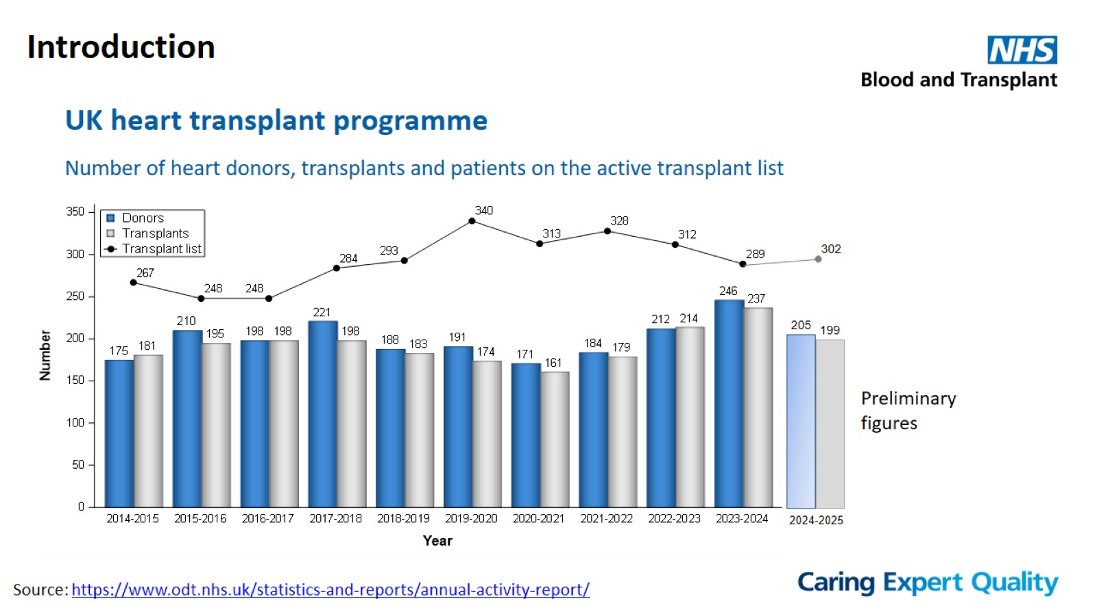
Introduction

Slide 4
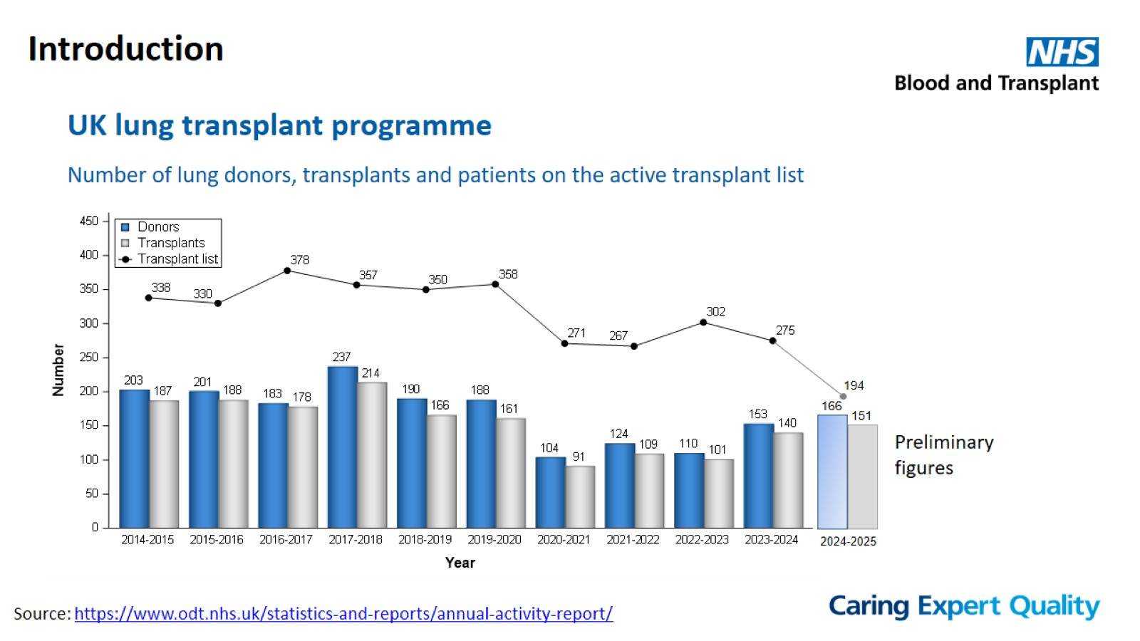
Introduction

Slide 5
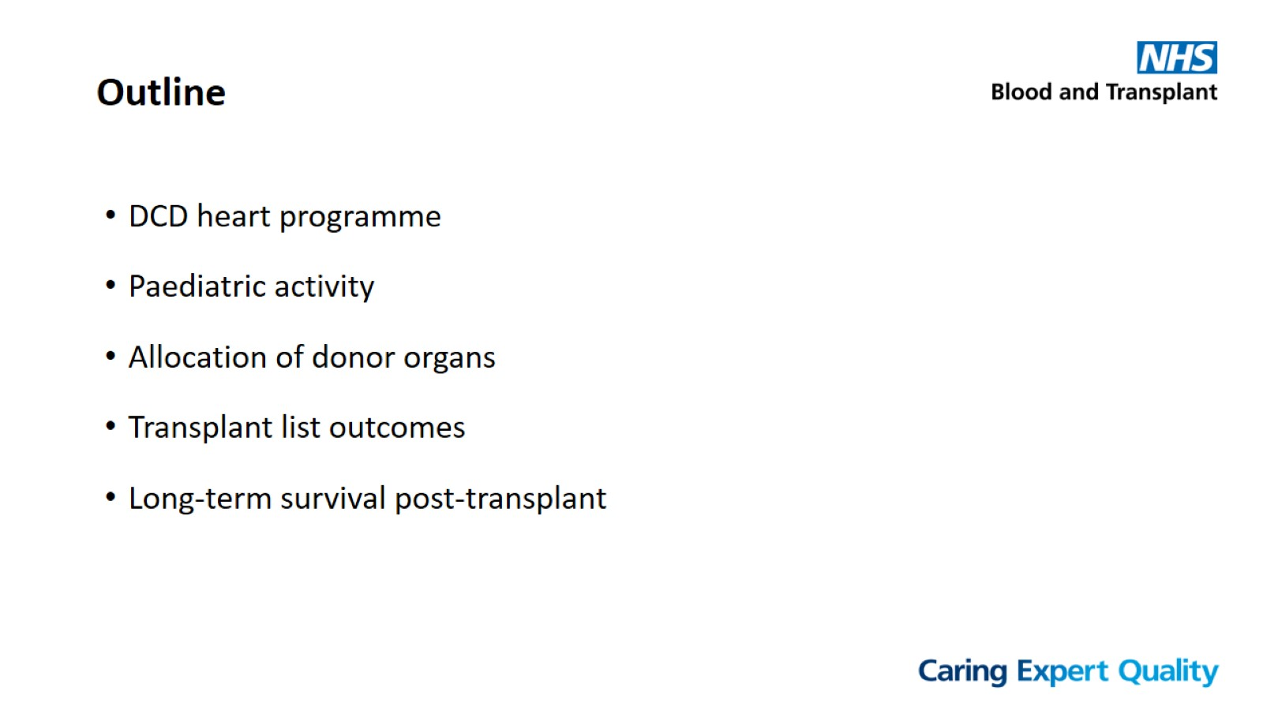
Outline

Slide 6
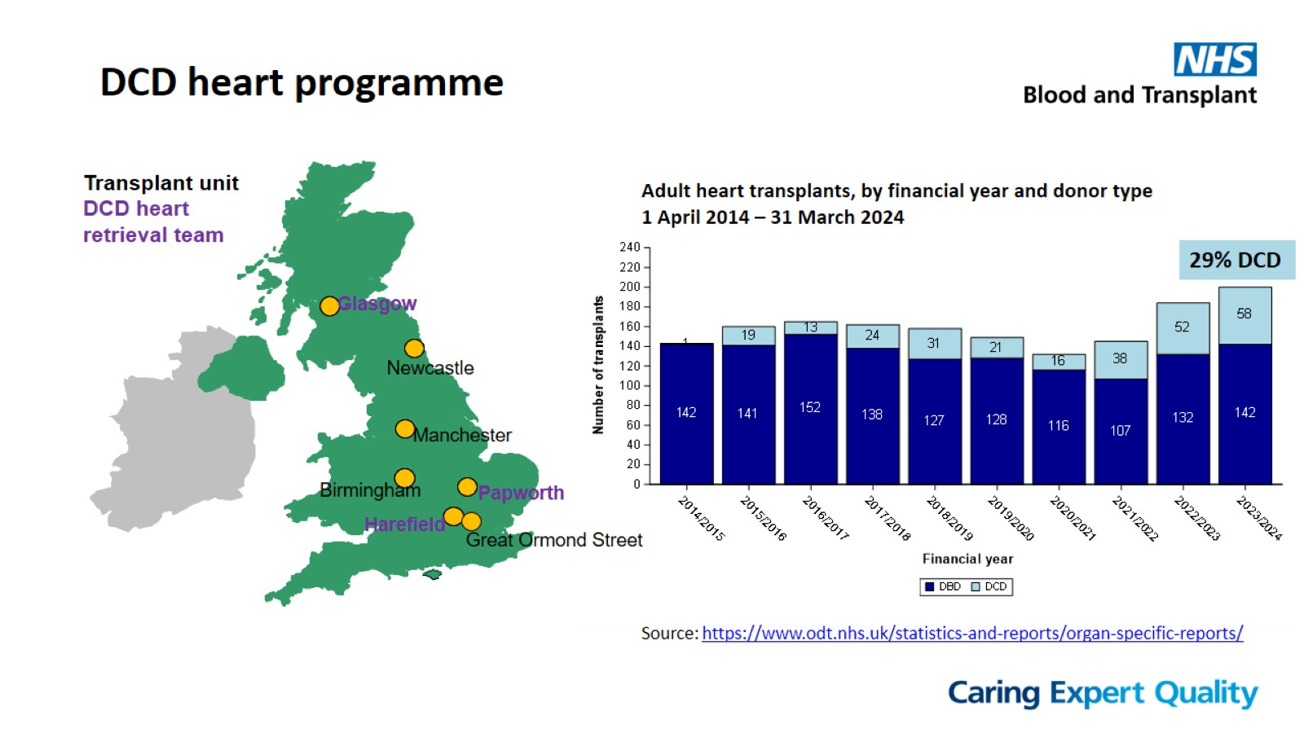
DCD heart programme

Slide 7
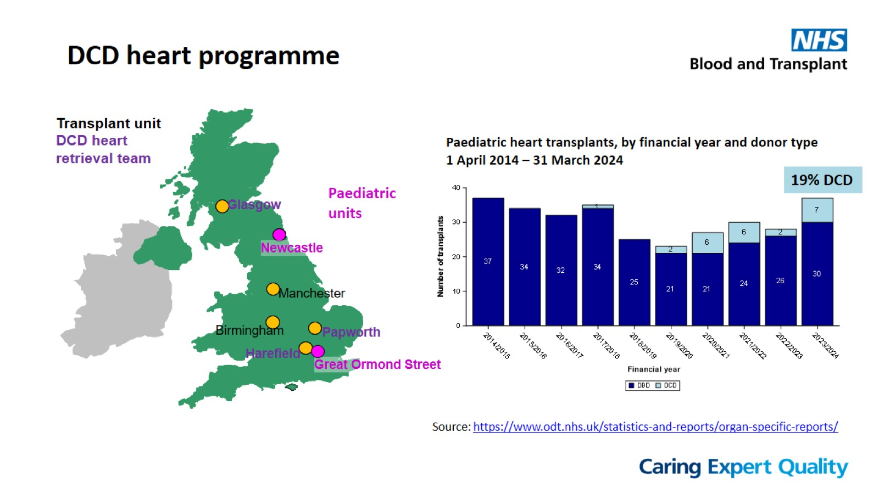
DCD heart programme

Slide 8
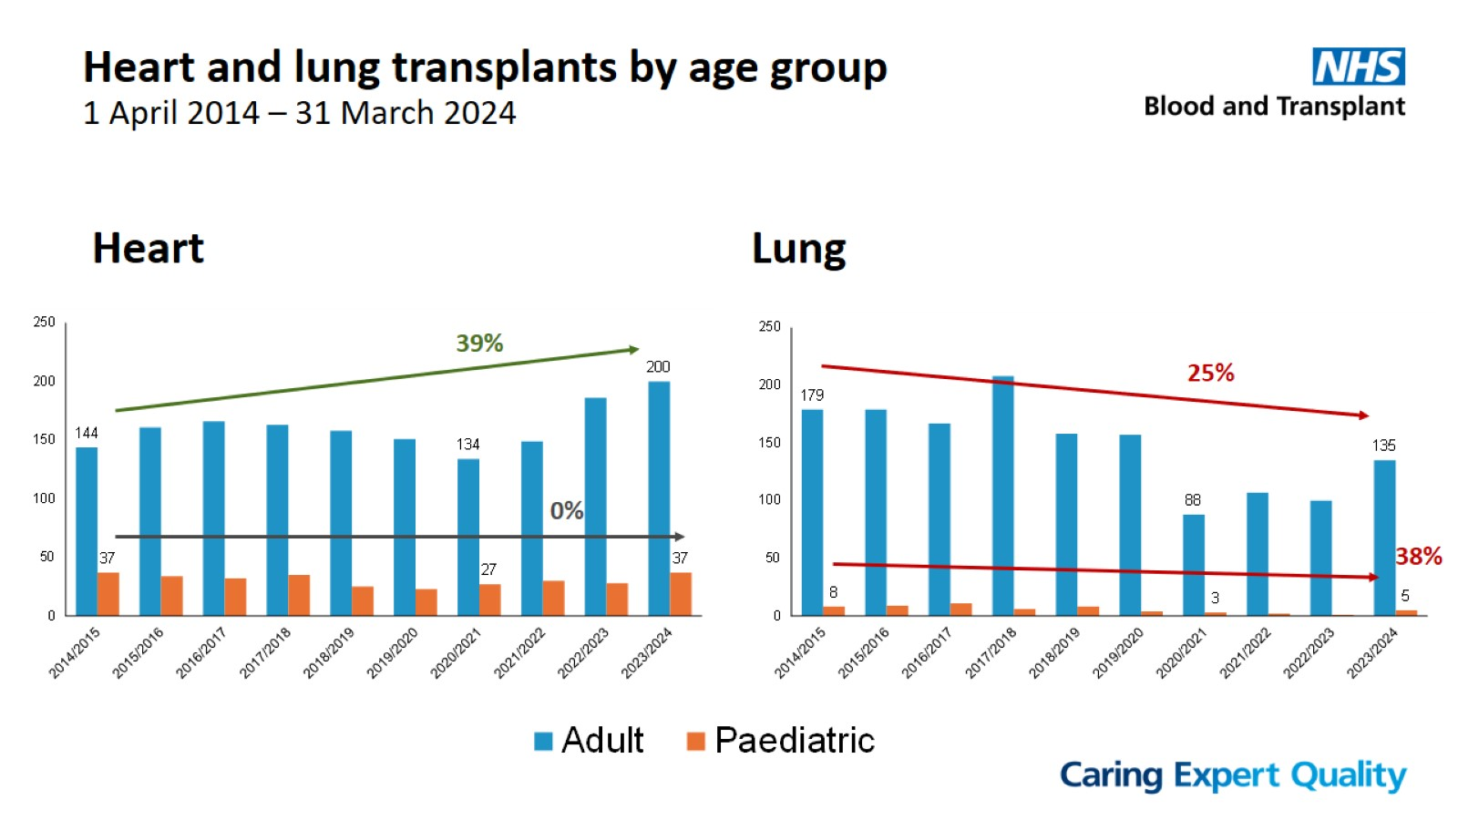
Heart and lung transplants by age group
1 April 2014 – 31 March 2024

Slide 9
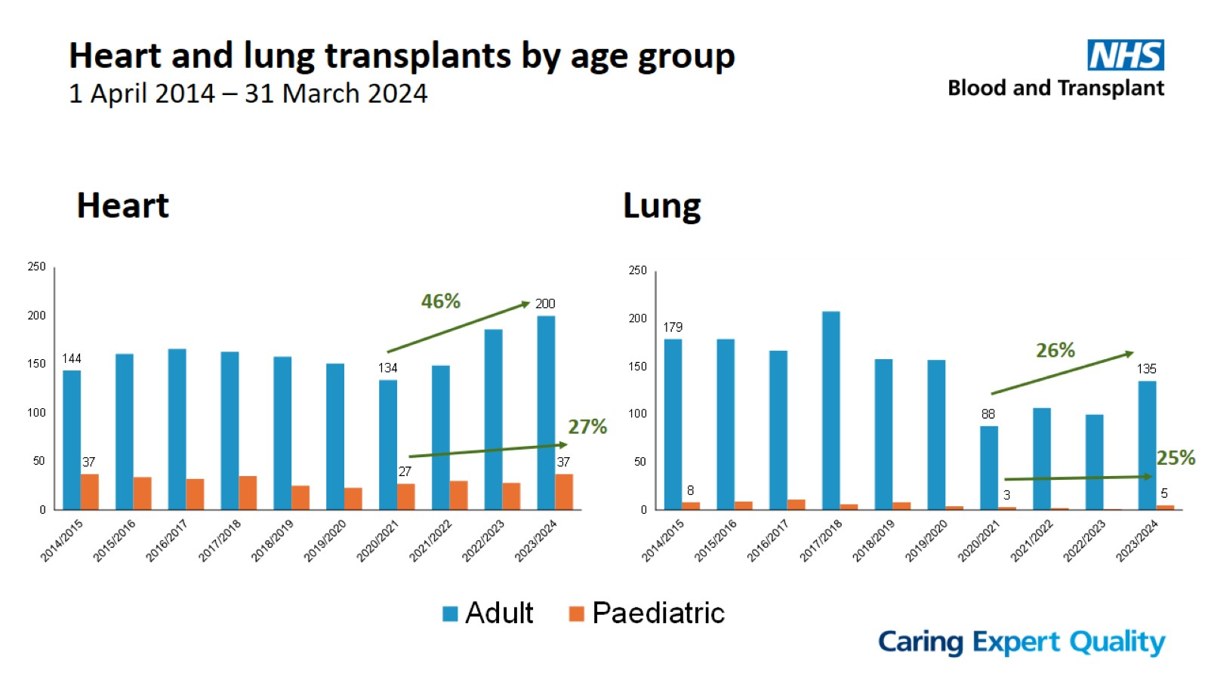
Heart and lung transplants by age group
1 April 2014 – 31 March 2024

Slide 10
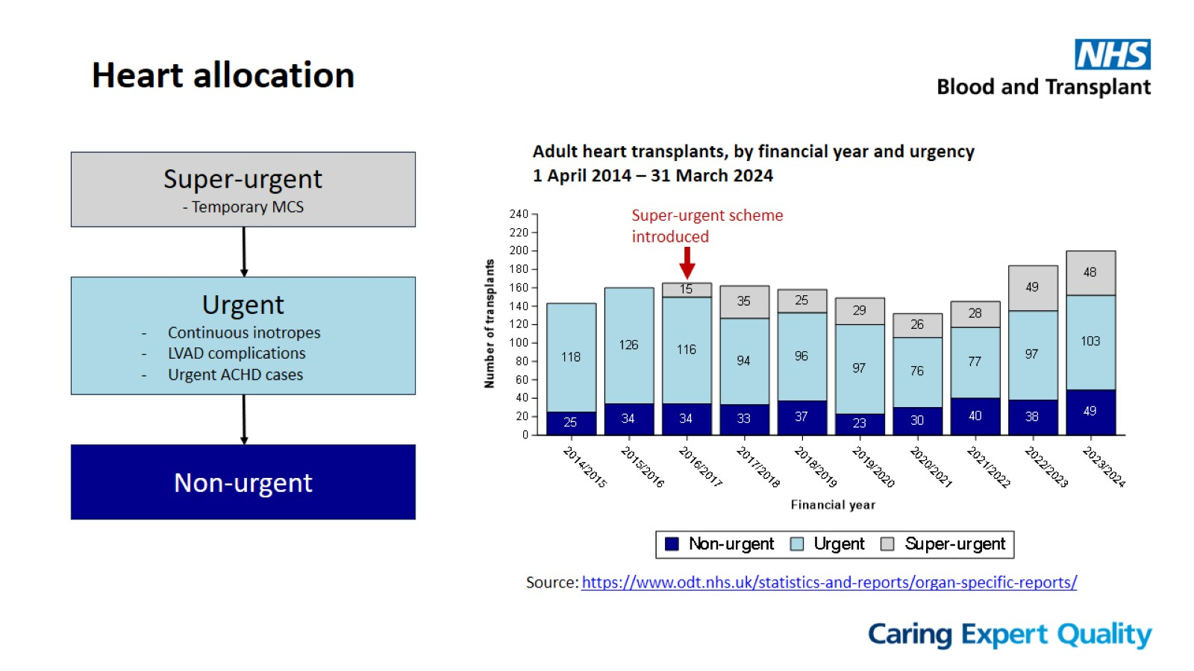
Heart allocation

Slide 11
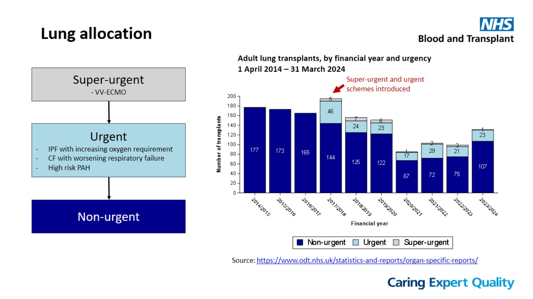
Lung allocation

Slide 12
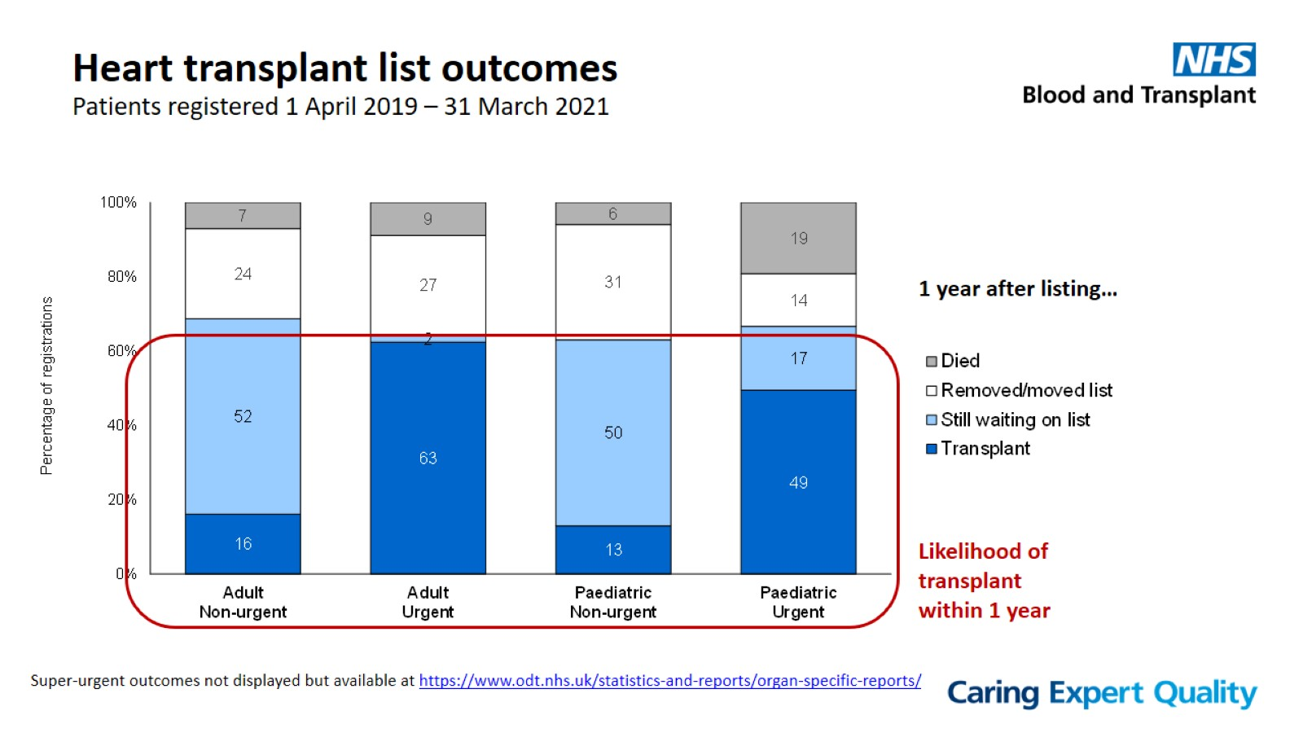
Heart transplant list outcomes
Patients registered 1 April 2019 – 31 March 2021

Slide 13
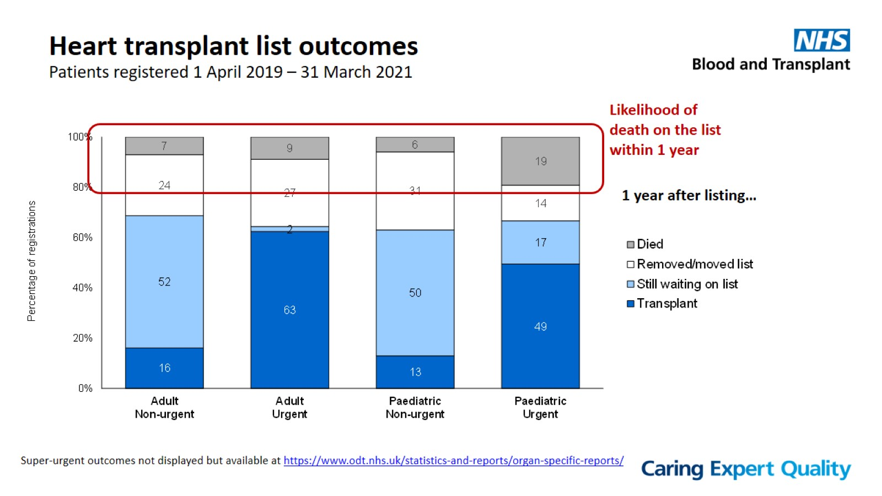
Heart transplant list outcomes
Patients registered 1 April 2019 – 31 March 2021

Slide 14
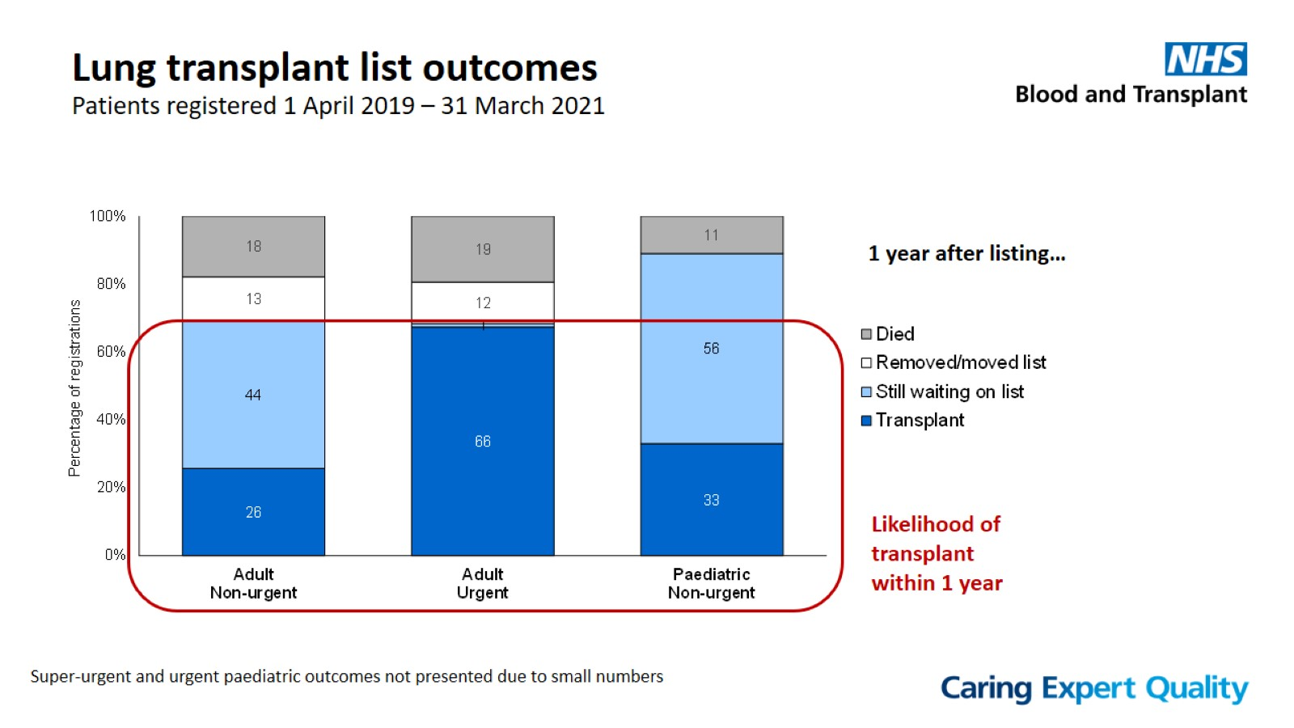
Lung transplant list outcomes
Patients registered 1 April 2019 – 31 March 2021

Slide 15
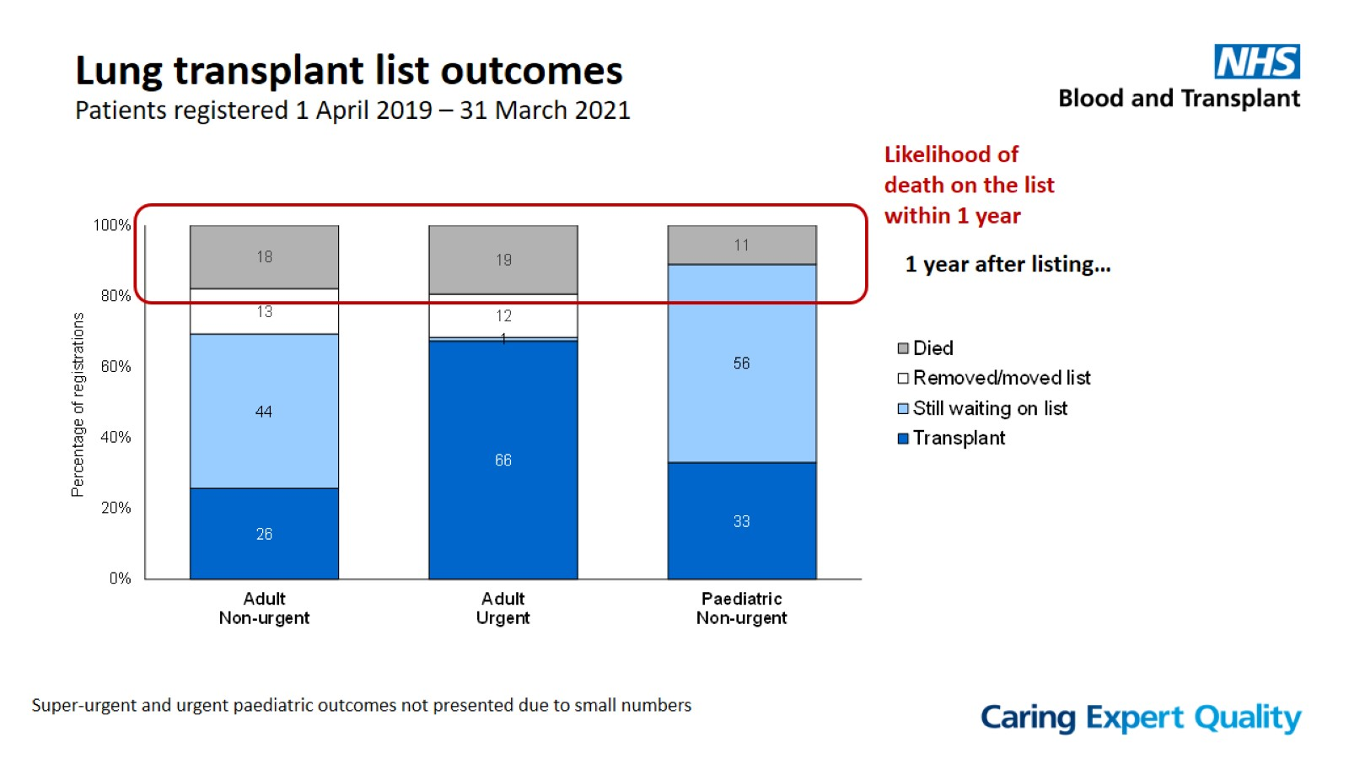
Lung transplant list outcomes
Patients registered 1 April 2019 – 31 March 2021

Slide 16
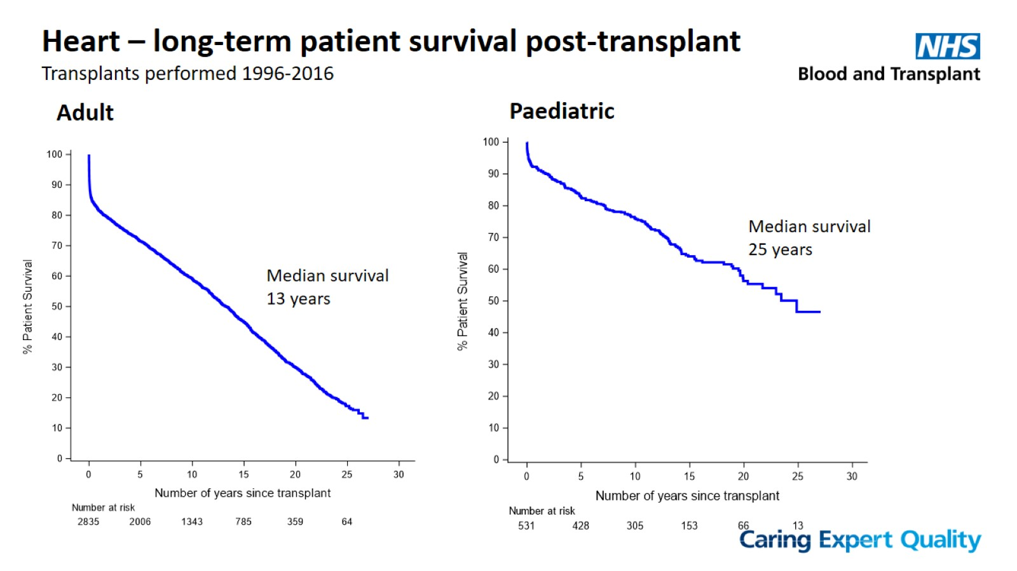

Slide 17
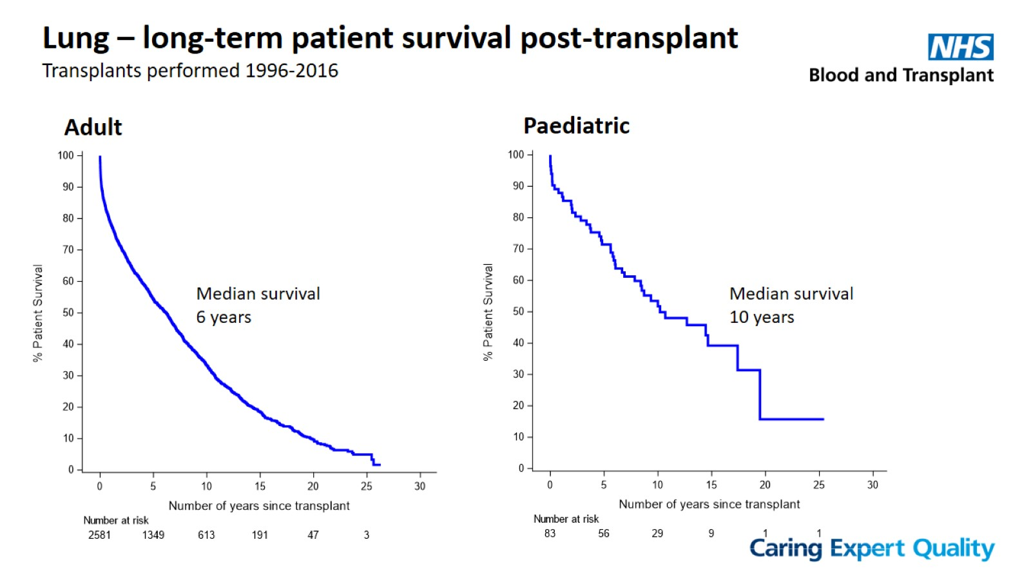

Slide 18
