Slide 1

@ODTEdandGov
#DDsim

Slide 2

Ethical, Legal and Professional The Law around Donation

Slide 3
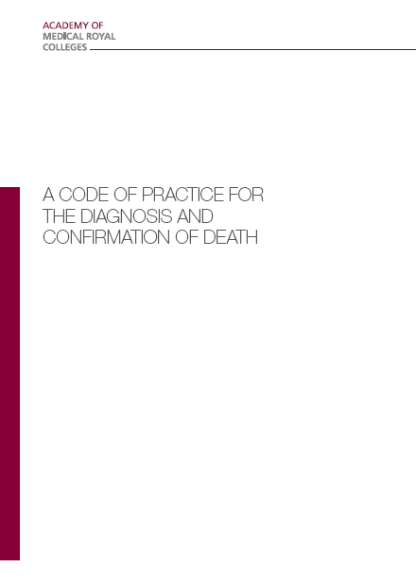
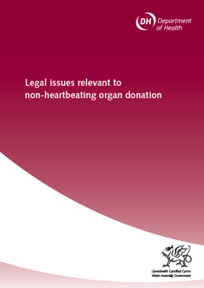
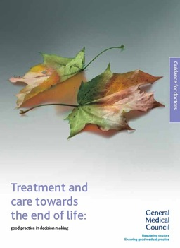
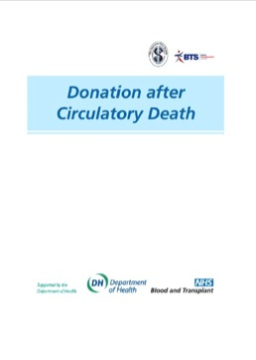
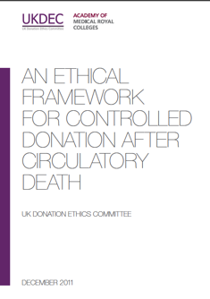
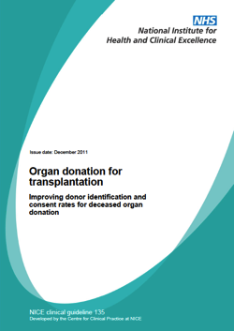
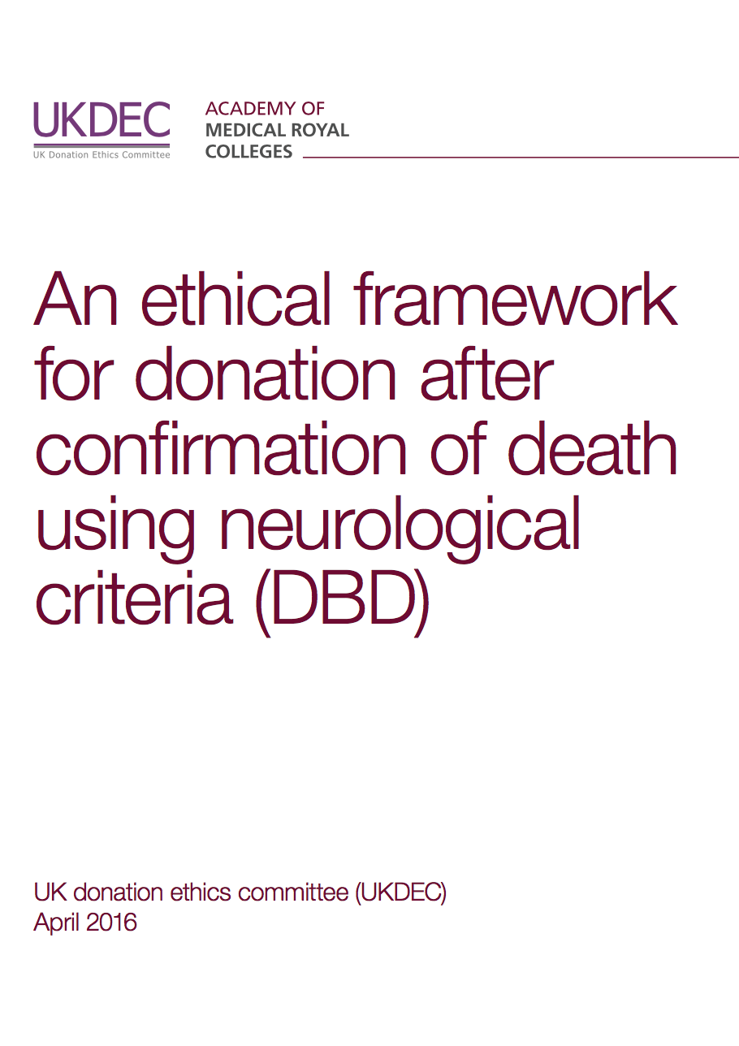

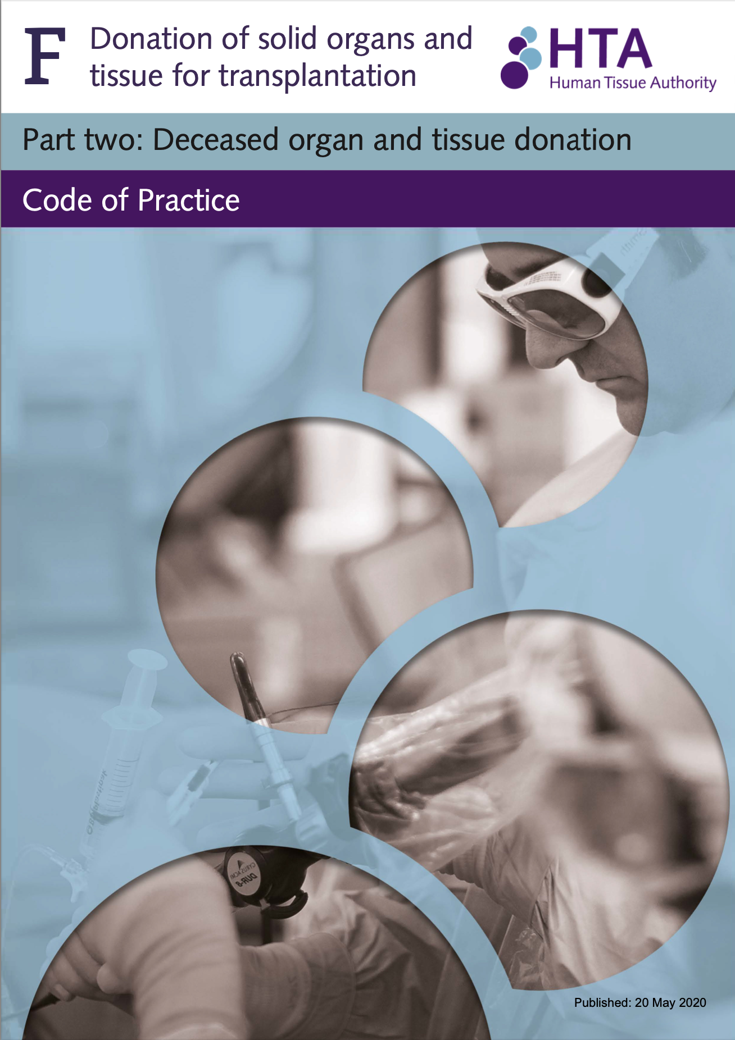
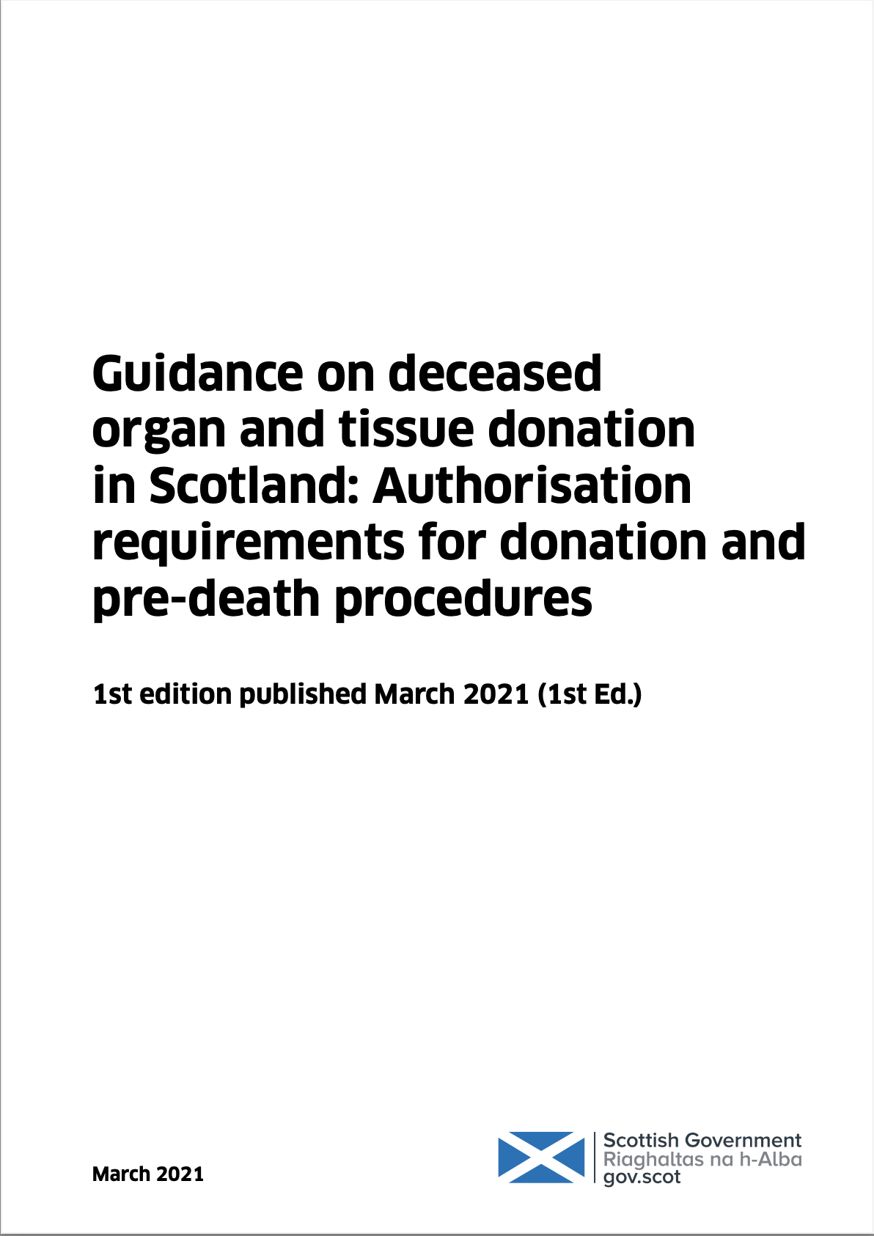
Framework of UK Practice
How the UK satisfies the Dead Donor Rule
How the UK satisfies the Consenting Donor Rule
The ethical, legal and professional framework that underpins the deceased organ donation programme in the UK is arguably, the strongest in the world.
Legal Codes of Practice
The Deceased Donation Course (ICM)

Slide 4




Deemed (Opt Out) Legislation in the UK
Commenced December 2015
Commenced
May
2020
Commenced
March
2021
Final Vote
Yes 43
No 8
Abstain 2
Private members bill
- No one formally objected!
Final Vote
Yes 116
No 3
Abstain 2

Slide 5

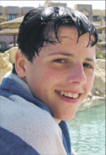
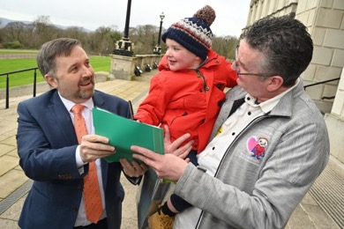
Deemed (Opt Out) Legislation in the UK
Northern Ireland
‘Dáithí’s Law’
Legislation
February 2022
Isle of Man
‘Daniel’s Law’
Royal Assent
July 2021
Jersey
Commenced July 2019
Guernsey
Royal Assent
May 2020

Slide 6


Deemed Legislation in the UK
‘Deemed Consent’
If you haven’t registered an organ or tissue donation decision, you will be considered to have no objection to becoming a donor.
‘Deemed Consent’
All adults are now considered to have agreed to be an organ donor when they die unless they have recorded a decision not to donate or are in one of the excluded groups.
‘Deemed Authorisation’
If you have not confirmed whether you want to be a donor or not, you will be considered to be willing to donate your organs and tissues when you die.
Duty to Inquire
Pre-Death Procedures

Slide 7

Steps for exploring consent
for organ donation
20 May 2020
100% referral is expected. As we observed in Wales families expect donation to be discussed. Additionally from public consultations there has emerged a societal expectation that donation will be discussed at the end of life – even if just to explain why donation can not go ahead or that we are aware they have ‘opted out’.
Step 1 - Unchanged
Referral
Breaking Bad News
Approach the family with a SNOD/SR
Follow GPICS2. The consultant leads on breaking bad news before handing over to the SNOD when it is clear that the family have accepted the inevitability of their loss AND are ready to consider what may happen next.
Notes:
Probably what most of you want to know is what changes.
Well these are the four steps for exploring consent for organ donation in England.
Step 1 remains completely unchanged – refer, break bad news, and approach the family with a SNOD / SR.
100% referral is expected.
As we observed in Wales families expect donation to be discussed and they are not surprised when we do. Our colleagues in Wales tell us that often families will bring up donation first, or when it is raised they say ‘We were expecting that, we have talked about this, and the answer is…”
Additionally from public consultations there has emerged a societal expectation that donation WILL be discussed at the end of life – even if just to explain why donation can not go ahead or that we are aware they have ‘opted out’. The last bit is very important. Some members of society have expressed concern that the ability to opt out is ‘fake’ or a ‘gimmick’. That we won’t really check the register and just take organs. Every time we go into a room and say “We have checked the register and we have seen that [name] has opted out. That’s what we will be following….” provides huge reassurance to these communities that Opting Out is real. That we do check. And peoples’ donation decision is respected.
In Guidelines for the Provision of Intensive Care Services Edition 2 (GPICS 2) it states what best practice for approaching families for organ donation involves - the consultant leads on breaking bad news before handing over to the SNOD when it is clear that the family have accepted the inevitability of their loss AND are ready to consider what may happen next.

Slide 8
Steps for exploring consent
for organ donation
20 May 2020
Check of the ODR
Opt in
Opt out
Nominated Representative (not Scotland)
Step 1 - Unchanged
Referral
Breaking Bad News
Approach the family with a SNOD/SR
Step 2
SNOD/SR will establish if expressed decision
SNOD/SR will lead a discussion with family to ascertain if a verbal decision was made in life.
Expressed decision can be:
Written
Verbal
And both are equally valid.
Last known decision is the one that carries legal weight.
Notes:
In Step 2 the SNOD / SR will establish if an expressed decision regarding donation has been made by the patient.
A prior expressed decision does not just have to be written, verbally – as in a conversation with a family – is equally valid.
A written expressed decision is discovered by checking the ODR.
To discover a verbal decision the SNOD will have to discuss with the family. This is not always as easy as it sounds.
It is the last known decision which is the one that carries legal weight.

Slide 9
Steps for exploring consent
for organ donation
20 May 2020
if no
Step 1 - Unchanged
Referral
Breaking Bad News
Approach the family with a SNOD/SR
Step 2
SNOD/SR will establish if expressed decision
Step 3
SNOD/SR will establish if consent can be deemed
Notes:
If that does not apply – there is no prior expressed decision – then deemed consent might apply.

Slide 10

Deemed Consent
Step 3
SNOD/SR will establish if consent can be deemed
DOES NOT apply to
If a donation decision is known.
Those under the age of 18
People who have lived in the country for less than 12 months or are not living here voluntarily.
Those who lack the capacity to understand the new arrangements and take necessary action.
There is no family / friend of long standing to consult.
Novel transplants.
Notes:
Deemed consent will not apply
If a donation decision has already been made as we saw on the previous slides
Those under 18
People who have lived in England for less than 12 months or are not living here voluntarily.
Those who lack the capacity to understand the new arrangements and take necessary action.
Novel transplants.
There is no family / friend of long standing to consult.
FAQ (great to have a SNOD/SR in the audience for this slide)
Not living here voluntarily means deemed consent does not apply to:
Tourists
Prisoners
Military Personnell
Asylum seekers (its complicated)
Those who live in Wales or Scotland and die in England
Those who lack the capacity to understand the new arrangements and take necessary action.
This is interpreted in the Code of Practice as for 12 calendar months prior to the admission.

Slide 11
Deemed Consent
Step 3
SNOD/SR will establish if consent can be deemed
There is no family / friend of long standing to consult.
Note - IMCA can not consent for OD
Soft Opt – OUT
Families must be consulted.
Family objection will be respected.
Wales - deemed consent in 2018/19 was 79%
ie not 100%
SNODs/SRs have received additional training to lead these conversations so they can:
Follow the law.
Follow the associated (and detailed) Human Tissue Authority Code of Practice.
Approach and support families.
Notes:
Note – IMCA can not consent for organ Donation
The legislation is a SOFT opt out.
Families must be consulted.
Family objection will be respected.
In Wales you can see this occurring. The deemed consent rate is not 100%, family objection is respected.
SNODs/SRs have received additional training to lead these conversations so they can:
Follow the law.
Follow the associated (and detailed) Human Tissue Authority Code of Practice. (It is complex, most doctors – including CLODs, probably have little interest in reading and remembering the HTA – that’s why bring your SNOD/SR in to talk to the families)
Approach and support families.
FAQ
More about IMCA or lasting power of attorney (LPA)
At death IMCA and LPA no longer have legal force (via Mental Capacity Act).
So in DBD, no legal role.
In DCD it is more complex. Because the patient is alive, even though the IMCA or LPA can not consent to donation (which occurs after death), they can change how the care in life is delivered. So in effect they could veto the necessary time and pre-mortem interventions required to allow DCD to occur.

Slide 12
Steps for exploring consent
for organ donation
20 May 2020
if no
if no
Step 1 - Unchanged
Referral
Breaking Bad News
Approach the family with a SNOD/SR
Step 2
SNOD/SR will establish if expressed decision
Step 3
SNOD/SR will establish if consent can be deemed
Step 4
SNOD/SR will establish if consent from family
Step 4 is anyone else
= exactly as we have been doing it
Notes:
Now if deemed consent doesn’t apply – then we are back to exactly as we have been doing it for years. And legal consent comes from the family.

Slide 13
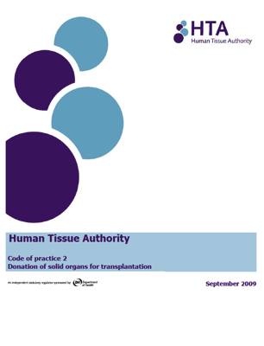

Hierarchy (England, Wales, NI)
1. spouse or partner (including civil or same sex partner)
2. parent or child (in this context a child can be any age and means a biological or adopted child)
3. brother or sister
4. grandparent or grandchild
5. niece or nephew
6. stepfather or stepmother
7. half-brother or half-sister
8. Friend of longstanding
2004
a) the adult’s spouse or civil partner; b) person living with the adult in a relationship which had the characteristics of the relationship between civil partners and had been so living for a period of not less than 6 months; c) the adult’s child; d) the adult’s parent; e) the adults brother or sister; f) the adult’s grandparent; g) the adult s grandchild; h) the adult’s uncle or aunt; i) the adult’s cousin; j) the adult’s niece or nephew; and
k) a friend of longstanding of the adult.
Notes:
The steps in the sequence of gaining consent have only changed with the addition of deemed consent.
Not on the ODR, first person consent: may have been a conversation the family recall during which the patient had expressed a wish to be a donor, or recorded their wish to donate in some other way.
Once it has been identified that the patient had neither made a decision nor appointed a representative then their consent may be deemed in Wales unless they are a child or excepted adult.
The family are involved in these discussions as they must be given the opportunity to produce evidence that the person did not want to be a donor.
If deemed consent does not apply to the patient then consent must be sought from those in the qualifying relationship – as outlined by the relevant Human Tissue Acts: HTA 2004 (England, Wales and Northern Ireland), HT(S)A 2006 (Scotland).

Slide 14
Challenges, worries and concerns
20 May 2020
What happened in Wales?
Consent Rate
49% 2014/15 (Eng 59%, Scot 54%, NI 60%)
77% 2018/19 (Eng 67%, Scot 64%, NI 63%)
Does it even work?
Why did it work?
Theories…
Greater Public Awareness
Greater Clinical Confidence
Statistical Analysis compared to England (Anaesthesia May 2020)
Welsh DBD consent 10% > England (p<0.05)
Risk-adjusted logistic regression analysis 2.1 times higher chance consent in Wales (95% CI 1.26 – 3.41)
Donors per million population
23.7 donors pmp 2014/15 (Eng 19.6, Scot 18.4, NI 26.2)
30.7 donors pmp 2018/19 (Eng 24.5, Scot 17.9, NI 23.0)
Notes:
Just as Paul Frost said at the beginning of this talk
Some clinicians, like Paul, have worries and concerns
One of these is, will it even work – is all this effort and money worth it.
Consent Rate in Wales 2014/15 – worst in UK. By 2019/20 – best.
We have carried out a statistical analysis comparing Wale to England.
DBD (but not DCD) reached statistical significance in Wales. 10% difference at 0.05 significance.
A risk adjusted logistic regression analysis revealed that there was a 2.1 times higher chance of gaining consent in Wales compared to England at the end of the study period.
This data has ben accepted for publication in an Anaesthesia special edition on organ donation timed for deemed consent coming out in May 2020.
Similarly
Donation numbers in Wales 2014/15 – weren’t too bad, 2nd best in UK. By 2019/20 – way out in front.
Why did it work?
Probably going to be arguing for years.
Here are 2 theories
Greater public awareness. As we said earlier ‘in Wales families expect donation to be discussed and they are not surprised when we do. Our colleagues in Wales tell us that often families will bring up donation first, or when it is raised they say ‘We were expecting that, we have talked about this, and the answer is…”
Greater clinical confidence. This one is a bit subtler. But with so much public and political support for donation there appears to be greater confidence in Wales – not just in the SNOD /SR but the Dr and bedside nurse – such that going into explore donation is the natural and right thing to do. It’s just expected and with that comes greater confidence – especially when more and more families keep saying yes.

Slide 15

Challenges, worries and concerns
20 May 2020
Marketing budget
= £11.7 million over two years
Does it even work?
It will work too well…
we don’t have enough beds.
Reach > 90% (exposed to)
Recorded Decision
Awareness = 62% (seen or heard)
People won’t know about the law.
Discussion = 54% (had a discussion)
Notes:
Some have a philosophical concern.
Will enough people know they need to opt out.
Marketing budget = £11.7 million over two years
In marketing terms they talk about
Reach – how many people could have been exposed to the marketing– this is running > 90% which is excellent.
Awareness – have people seen or heard something about the law change. The goal was 60% by the law implementation. This goal has been hit already with a few months to spare.
Our market research has shown that 54% of people have had a discussion regarding organ donation.
Many have gone onto record their decision.

Slide 16
Recorded Decision
ODR registrations by nation
Nation | OPT IN (%) | OPT OUT (%)
England | 22,910,987 (41) | 2,035,853 (4.0)
Northern Ireland | 991,327 (52) | 5,194 (0.3)
Wales | 1,384,296 (44) | 199,078 (6.2)
Scotland | 2,896,079 (53) | 172,547 (3.2)
Since 2015 anyone in the UK could opt out on ODR
Figures as of 31 September 2022, Source NHSBT
Notes:
Opt in continues to rise.
In Wales 6% of the population opted out.
We suspect a similar percent will opt out in England, perhaps a bit more.
FAQ
Population ONS 2018
England 55,977,000
Northern Ireland 1,882,000
Scotland 5,438,000
Wales 3,139,000

Slide 17
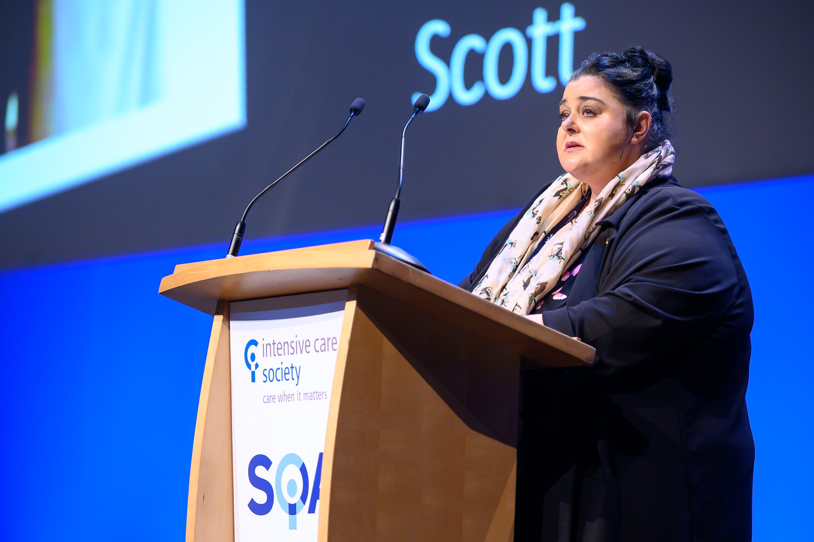
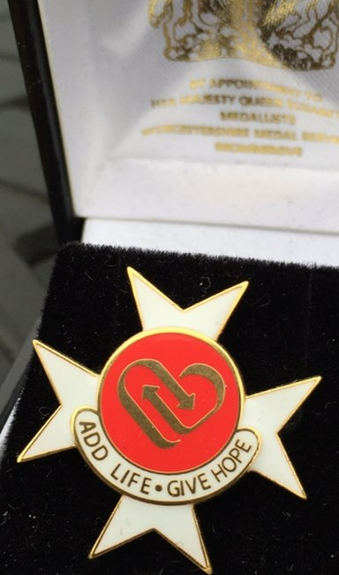
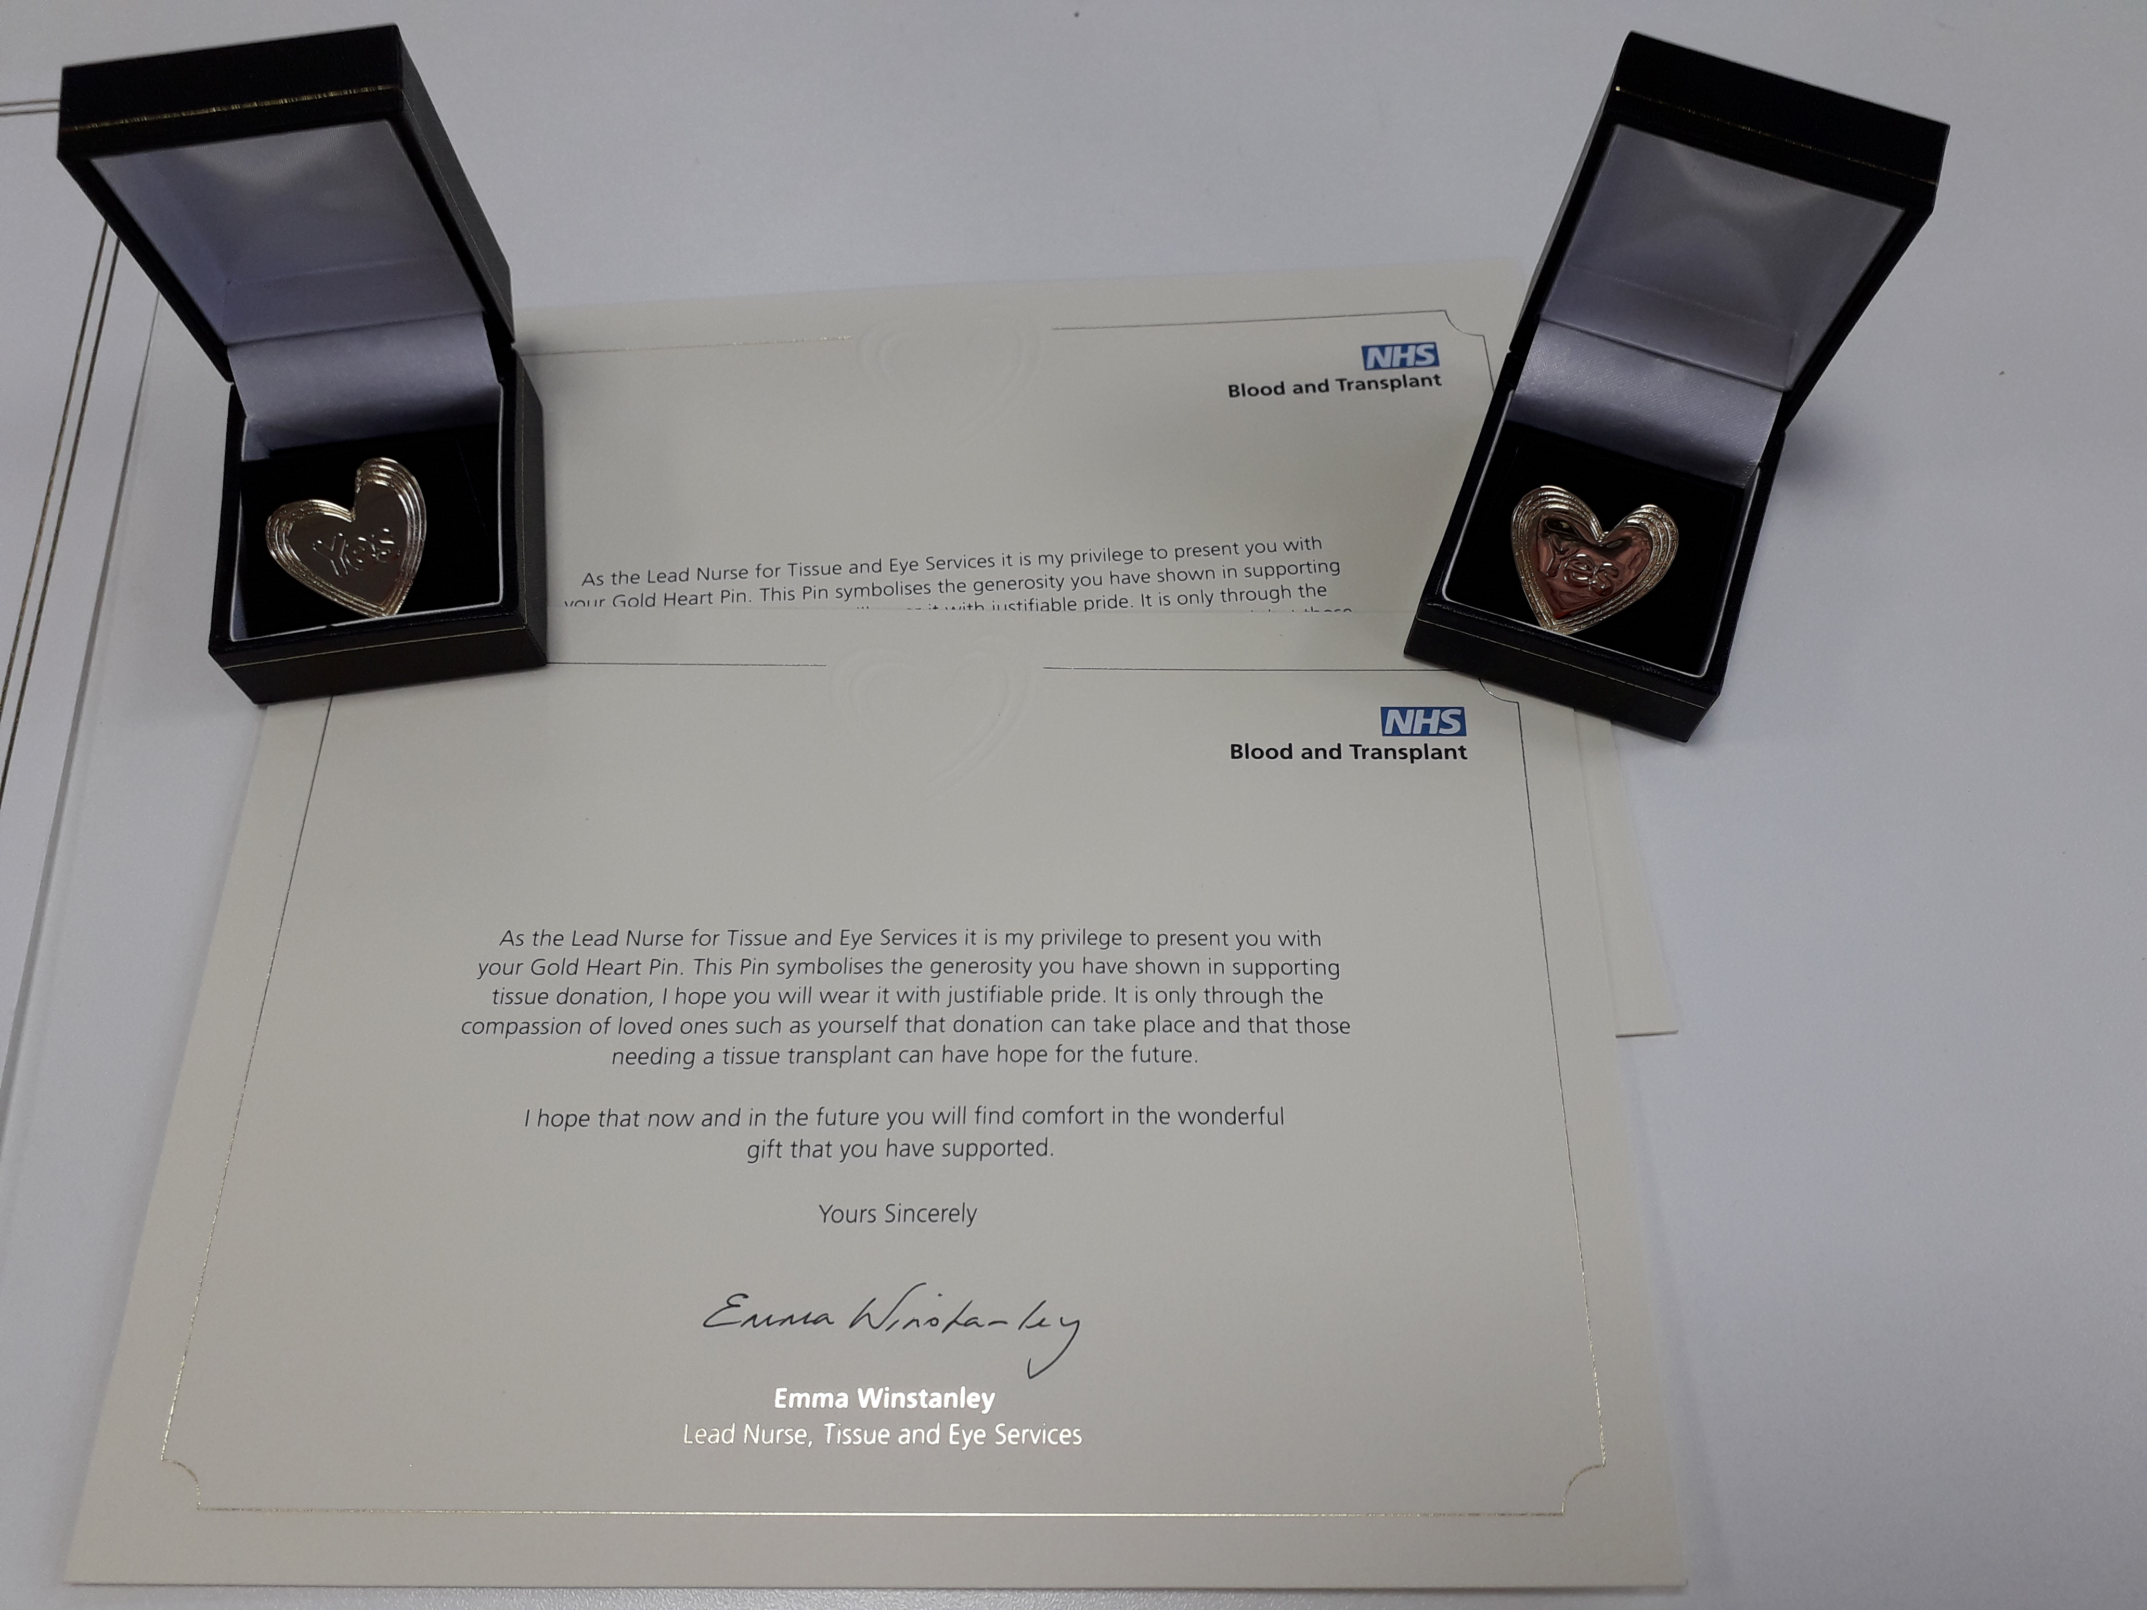
Challenges, worries and concerns
20 May 2020
Wales – no evidence.
Changes the GIFT
of donation?
Joanna Duckworth (one of the first deemed consent families in Wales),
speaking at ICS SOA 2019
Some families from Wales say that deemed consent took the pressure off their decision – and they all remain PROUD.
“I am so happy that Scott was able to donate as it brings me so much comfort that he has saved other peoples' lives.
His life has not been in vain.
His son knows he is a hero.”
NHSBT Gold Heart Pins and
Order of St John Award for Organ Donation
Notes:
One concern some people have, which we heard Paul talk about, is that deemed consent changes or devalues the gift of organ donation.
In Wales – we have absolutely no evidence of this.
Joanna Duckworth was one of the first deemed consent families in Wales.
This is her speaking in the opening plenary at the ICS SOA 2019 (just after Paul Frost)
“I am so happy that Scott was able to donate as it brings me so much comfort that he has saved other peoples' lives.
His life has not been in vain.
His son knows he is a hero.”
She received a standing ovation!
Some families from Wales have told us that deemed consent took the pressure off their decision – made it easier.
And they all remain PROUD.
We continue to recognise the gift of donation and say thank you through the NHSBT gold pins – available to donor families. Like the pink heart but gold for donor families.
And the Order of St John Award for Organ Donation – was established in 2013 as a national (and approved by HM The Queen) posthumous award for the donor.

Slide 18
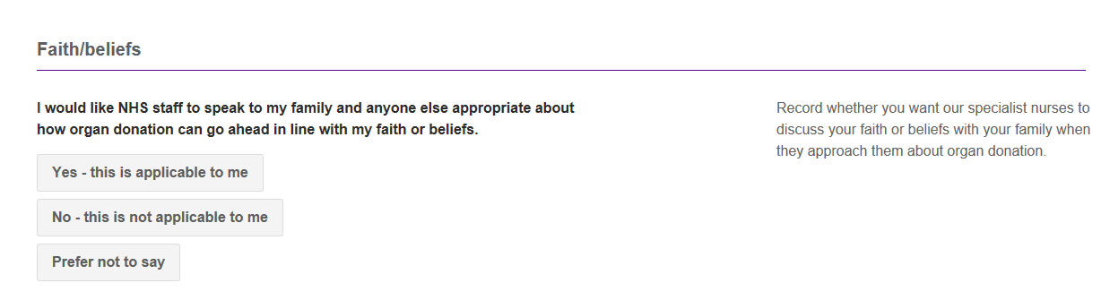
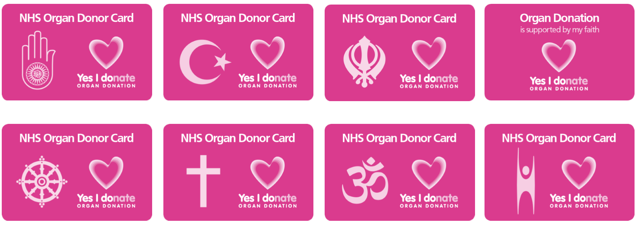
Faith/ Beliefs Declaration introduced in December 2018
The Deceased Donation Course (ICM)

Slide 19


Donation Actions Framework
Donation actions are activities or interventions carried out on a potential donor, either before or after death, for the purpose of exploring donation eligibility or facilitating deceased organ donation.
Donation actions can range in complexity from simple activities like checking the NHS Organ Donor Register or talking to family about a person’s willingness to be an organ donor after death, to more complex interventions such as investigations to ascertain suitability for donation or after death procedures to enhance organ function.
Notes:
Dale

Slide 20
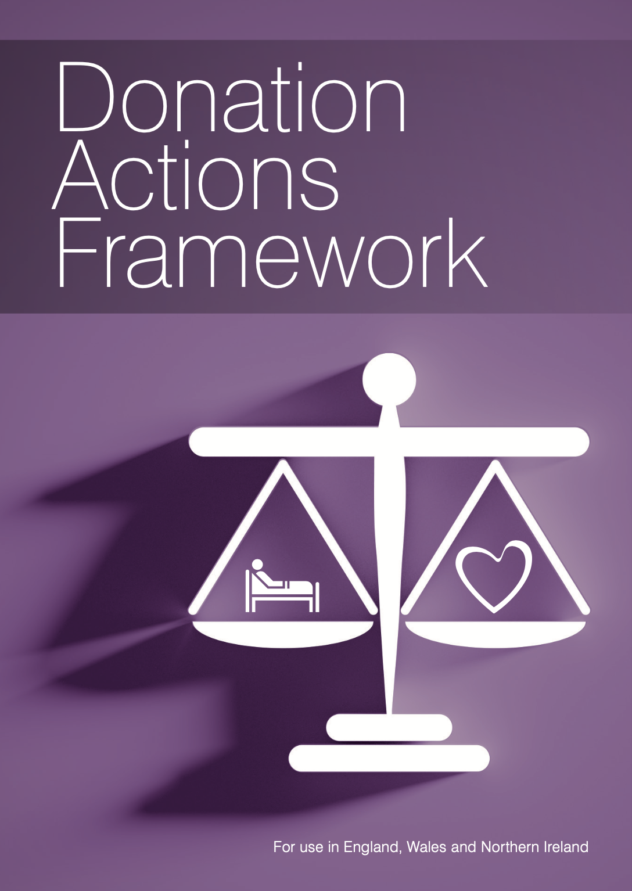

Slide 21
Four main time points:
Before death, before consent
Before death, after consent
After death, before consent
After death, after consent
Two key events:
Death
Consent

Slide 22
Categorisation of actions
Best interests (legal)
More than just physical
Do not all stop at the moment of death (2009)
Not restricted to self-interest (2010)
VERY LIKELY to be in best interests
LIKELY to be in best interests
UNLIKELY to be in best interests
AGAINST current legal or ethical guidance
BEST INTERESTS
require balancing
benefits vs harms of donation process
(weighted by the willingness to donate)

Slide 23
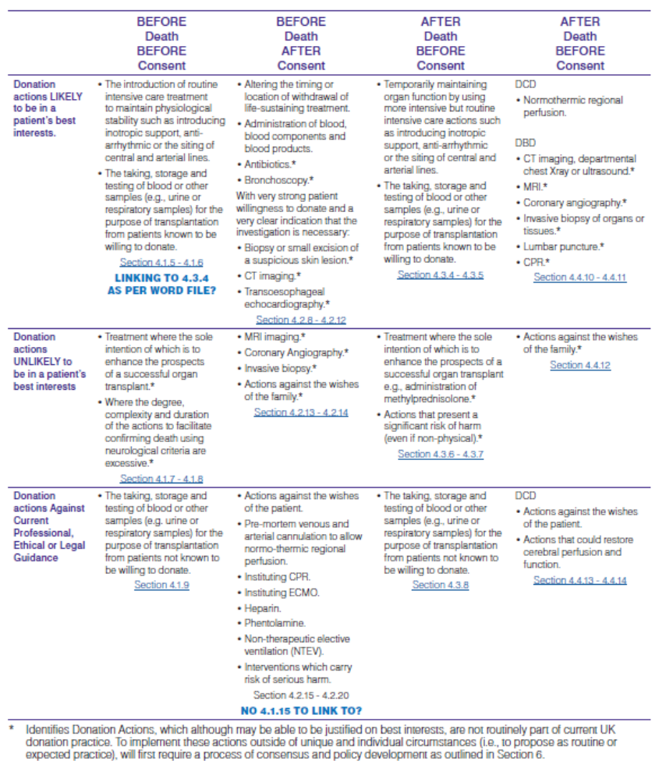

Slide 24
The stories of ‘Amina’ and ‘John’
2 donation stories
Decision points and audience participation
See how we use the DAF to aid decisions

Slide 25
Are we showing the ‘right’ answer?
Not necessarily – the DAF is a tool. Helps to form and justify decisions about the management of any potential organ donor.
Some scenarios have clear guidance in place – these are the easy ones!
Grey cases are where the DAF comes into its own.
Remember – this is all about Best Interests

Slide 26
Let’s meet our first patient…

Slide 27

Case 1 – DCD

Slide 28

Amina
Fit and well 32 year old lady presenting with perceived DBI secondary to SAH
No neurosurgical intervention – admitted for prognostication

Slide 29



Decision point 1
Inform the SNOD now?
Wait for decision to palliate?

Slide 30
Results of slido poll

Slide 31
What does the DAF say?
Remember - the patient is not dead (Before Death), and there is currently no consent for donation (Before Consent).
But - there is long established national guidance here

Slide 32

National Institute for Health and Care Excellence (NICE)
Triggered Notification
Plan to withdraw life-sustaining treatment
Plan to perform brain death testing
Early referral = Catastrophic brain injury
  + GCS of ≤ 4, not explained by sedation
  + Loss of 1 cranial reflex
2011
Notes:
We have NICE Guidance telling us WHO to refer.

Slide 33
General Medical Council
2010
Organ donation
81 If a patient is close to death and their views cannot be determined, you should be prepared to explore with those close to them whether they had expressed any views about organ or tissue donation, if donation is likely to be a possibility.
82 You should follow any national procedures for identifying potential organ donors and, in appropriate cases, for notifying the local transplant coordinator.
Establishes a duty on doctors to explore donation and follow national procedures.
Notes:
There is a GMC duty to refer.

Slide 34

Therefore…
Notification of the specialist nurse for organ donation is VERY LIKELY to be in the patient’s best interests

Slide 35
The Deceased Donation Course (ICM)
Notes:
These are the UK rates of donor referral – having shown great improvement.
Of those who met the referral criteria and were not referred, the reason given was that the patient was not identified as a potential donor or organ donation was not considered in 25% of cases.
The reason given for 43% of DCD was medical contraindications i.e. Clinical staff are deciding that the patient is not suitable without discussion. May be correct on many occasions but not necessarily always

Slide 36
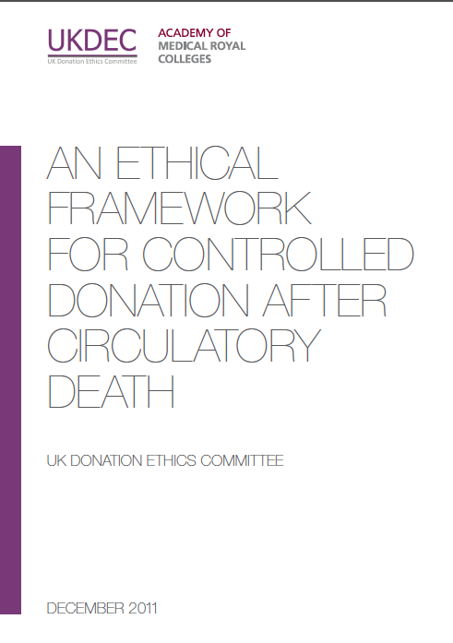
UK Donation Ethics Committee Advice
“There is no ethical dilemma if the treating clinician wishes to make contact with the SNOD at an early stage, while the patient is seriously ill and death is likely, but before a formal decision has been made to withdraw life-sustaining treatment.”
[“Benefits] include establishing whether there are contra-indications for organ donation……
Other practical and organisational factors might be relevant – if the SN-OD is based at a distant location then early contact can help to minimise distressing delays for the family.”
2011
Benefits of early notification accrue to the family and ICU.
The Deceased Donation Course (ICM)
Notes:
No ethical issue seen with early notification and many advantages.

Slide 37
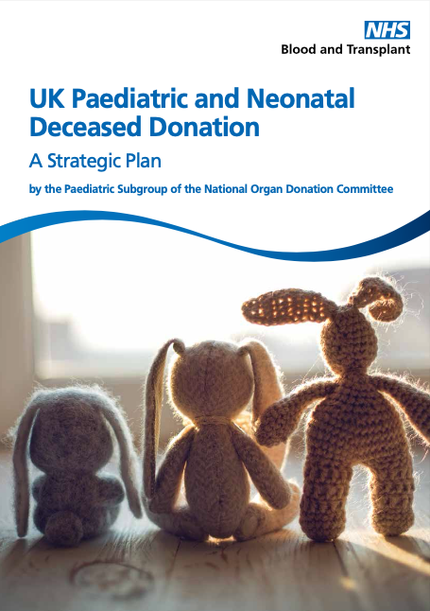
Is paediatrics different?
Notification Triggers
Plan to diagnose death using neurological criteria
Plan to withdraw life-sustaining treatment
Early planning for end of life care
Plan for MDT meeting to discuss appropriateness of care
The Deceased Donation Course (ICM)

Slide 38
Paediatric care planning often works in parallel.
Explicit consideration of donation prior to team/parental decision re futility may be required (unusual in adults)
The Deceased Donation Course (ICM)

Slide 39
Amina
Decision now taken for EOLC
Registered on ODR
Husband actively supportive
Cardiothoracic team have been in contact. They request
  Bronchoscopy
  Coronary angiogram

Slide 40
Decision point 2
Perform bronchoscopy only
Perform coronary angiography only
Perform BOTH bronchoscopy and coronary angiography
Perform neither

Slide 41
Results of poll

Slide 42
How can the DAF help you here?
Remember - this patient is not dead (Before Death), but consent for donation has been ascertained (After Consent).
Bronchoscopy – minimal risk of harm.
LIKELY to be in the patient’s best interests in most circumstances.
Coronary angiography – greater potential for harm.
UNLIKELY to be in the patient’s best interests unless compelling evidence of strong desire to donate.

Slide 43
Amina
Increasing physiological instability
Retrieval team setting up next door
Could we give some CPR to get her round to theatre?

Slide 44
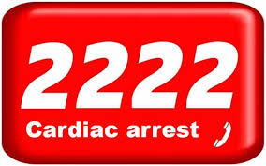
Decision point 3
Give CPR to get round to theatre
Allow cardiac arrest and lose donation potential

Slide 45
Poll result

Slide 46
How can the DAF help you here?
Remember - this patient is not dead (Before Death), but consent for donation has been ascertained (After Consent).
BUT decision for withdrawal of life-sustaining treatment includes decision not to perform CPR.
Performing CPR to facilitate organ donation is AGAINST current guidance – when WLST is the planned mode of death

Slide 47
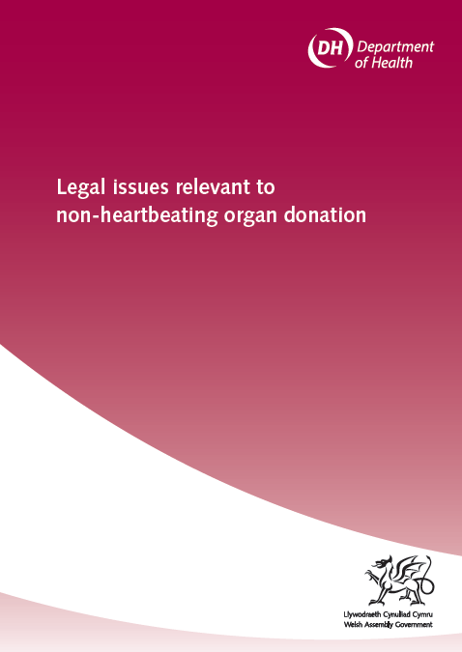
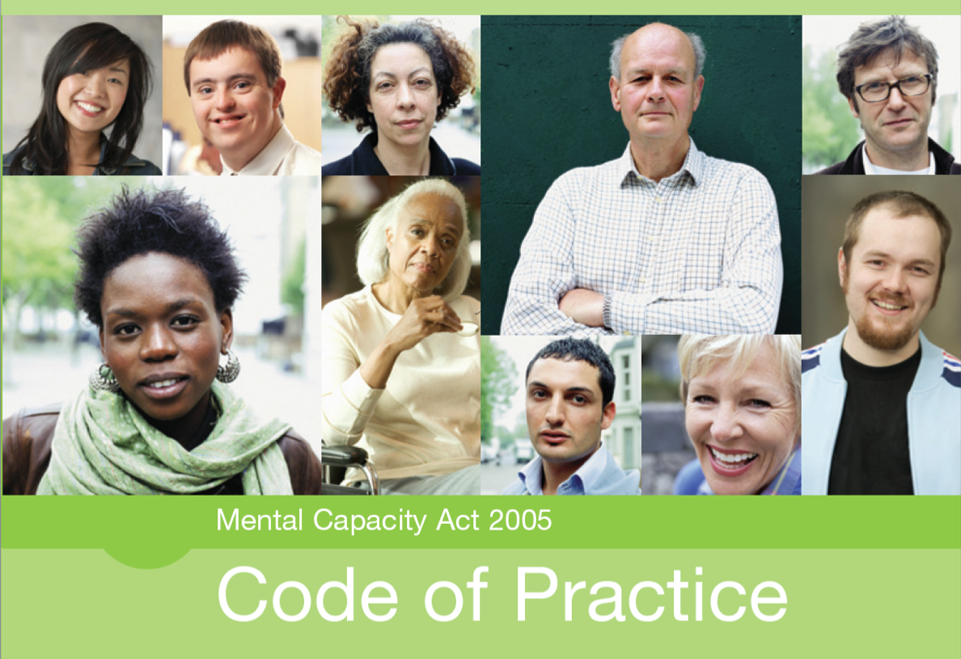
Deciding ‘best interests’ for incapacitated,
but alive patients.
Within guidance
Delay Withdrawal
Change patient's location
Maintain physiological stability
2009
Mental Capacity Act
Against Current Guidance
Systemic heparinisation
Resuscitation (CPR)
Femoral cannulation (ECMO / NRP)

Slide 48

Case 2 – DBD

Slide 49
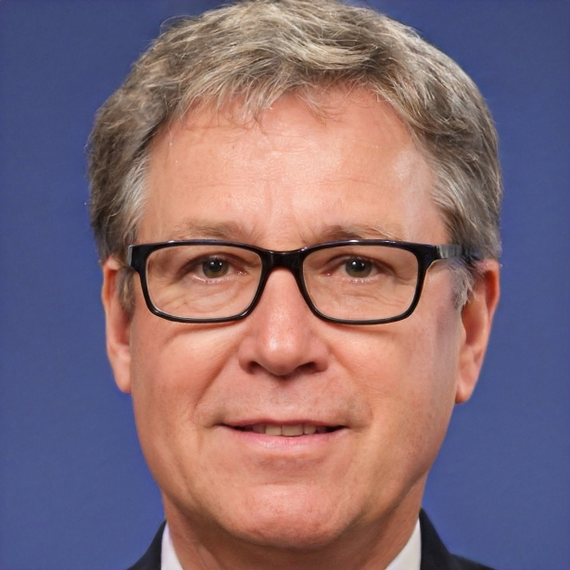
John
51 year old man
OOHCA yesterday
Clinically coned overnight
Referred to SNOD on admission – no registered decision
Nurses about to send routine bloods

Slide 50
John
Is it ok for the SNOD to be looking through the notes and contacting GP?
Should we send ‘donation specific’ bloods with the routines?

Slide 51
Decision point 1
SNOD to look through the notes and contact GP surgery but
NOT do donation specific bloods
SNOD to perform donation specific bloods but
NOT contact GP surgery or look through notes
SNOD to look through notes and contact GP surgery
AND perform donation specific bloods
SNOD NOT to do either

Slide 52
Result

Slide 53

How can the DAF help you here?
Remember - this patient is not dead (Before Death), and there is currently no consent for donation (Before Consent).
Gathering and sharing clinical information with the donation team or HM Coroner is VERY LIKELY to be in the patient’s best interests unless there is information to the contrary.
GDPR allows for sharing of information between health care providers (Article 6).
Without a known decision on donation – from Organ Donor Register or family – blood tests solely for purposes of donation is AGAINST current guidance (HTA).

Slide 54
John
Death confirmed using neurological criteria
Family not yet aware (declined observing tests)
Now on 15mls/hr metaraminol

Slide 55
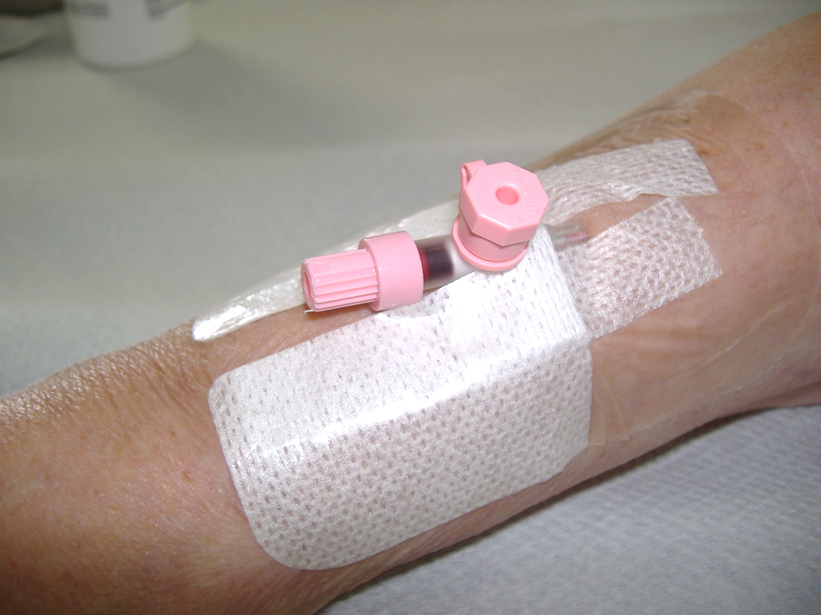
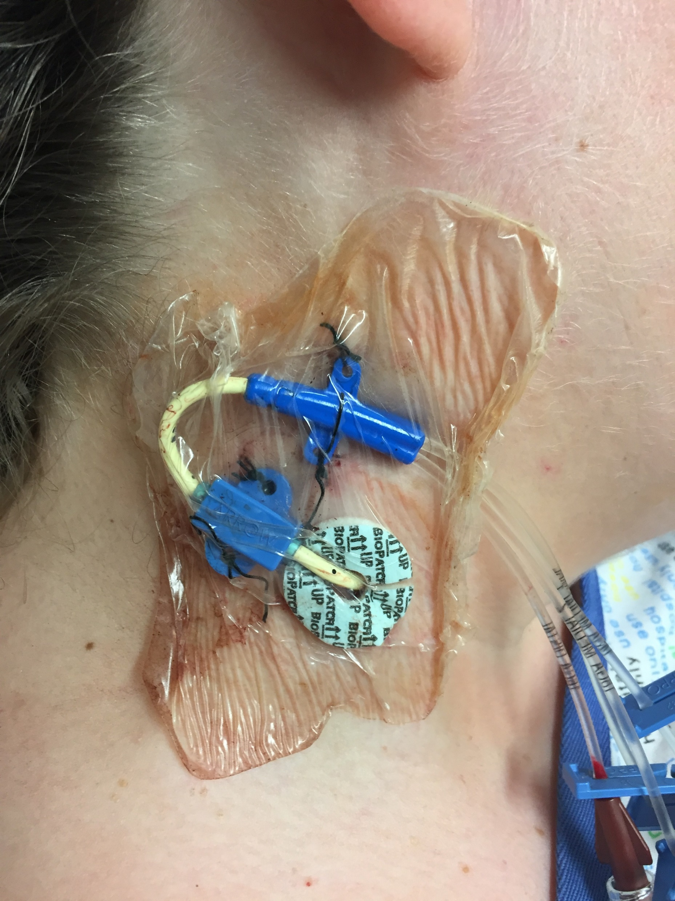
Decision point 2
Gain central access to start pressors before talking to family
Continue with peripheral pressors until family discussion can occur

Slide 56
Result

Slide 57
How can the DAF help you here?
Remember - this patient has died (After Death), and there is currently no consent for donation (Before Consent).
Maintaining physiological stability allows time for donation to be explored and was supported by the UK Donation Ethics Committee and NICE. Minimal risk of harm – especially after death!
Temporarily maintaining organ function by using more intensive but routine intensive care actions such as introducing inotropic support, anti-arrhythmic or the siting of central and arterial lines is LIKELY to be in the patient’s best interests in most circumstances.

Slide 58



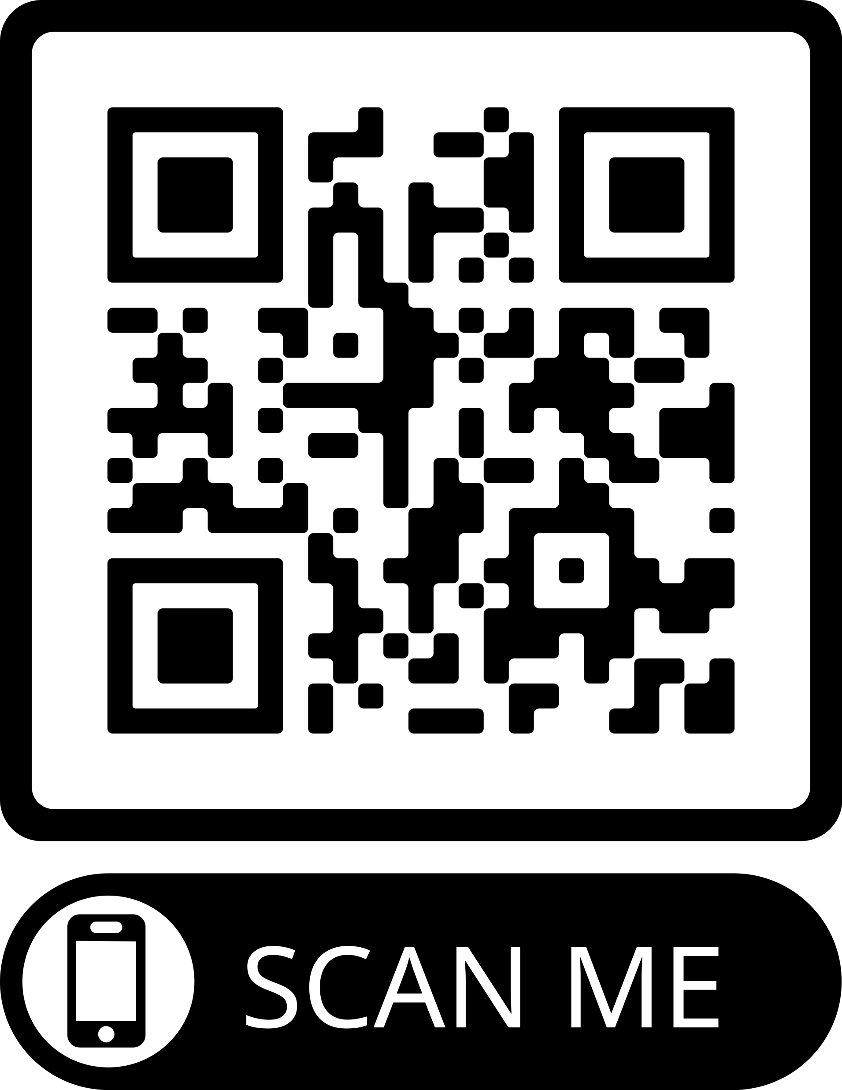






Slide 59
@ODTEdandGov
#DDsim

