Slide 1

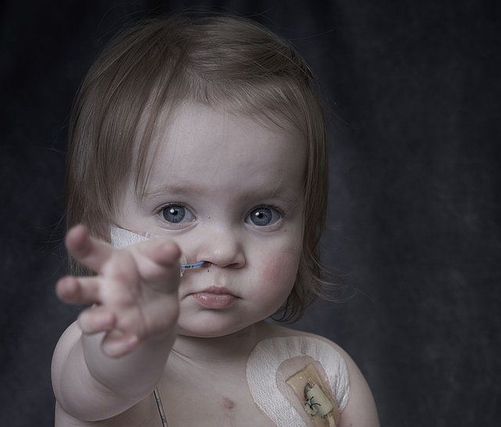
Paediatric Donation
CLOD
INDUCTION
April 2025
Omer Aziz
National Paediatric CLOD

Slide 2
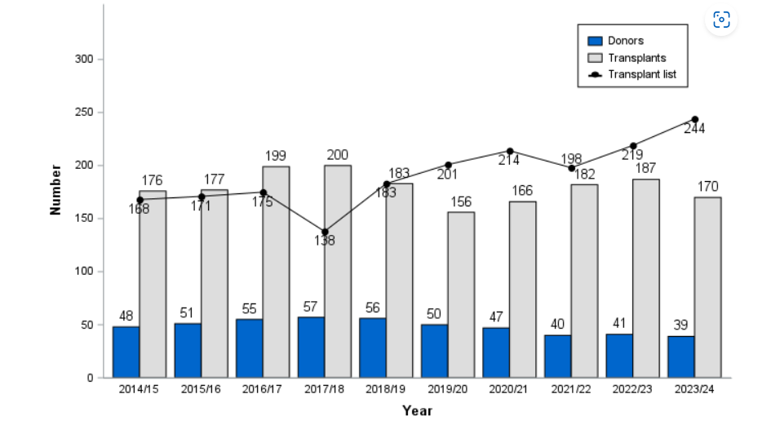
Paediatric Donation

Slide 3
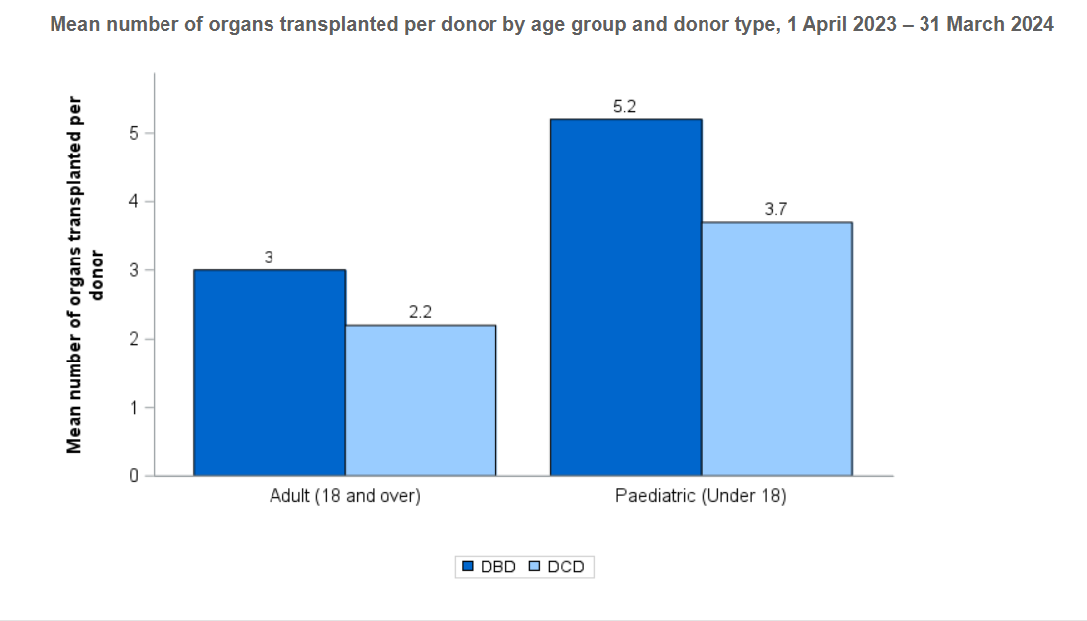
Organs per Donor

Slide 4
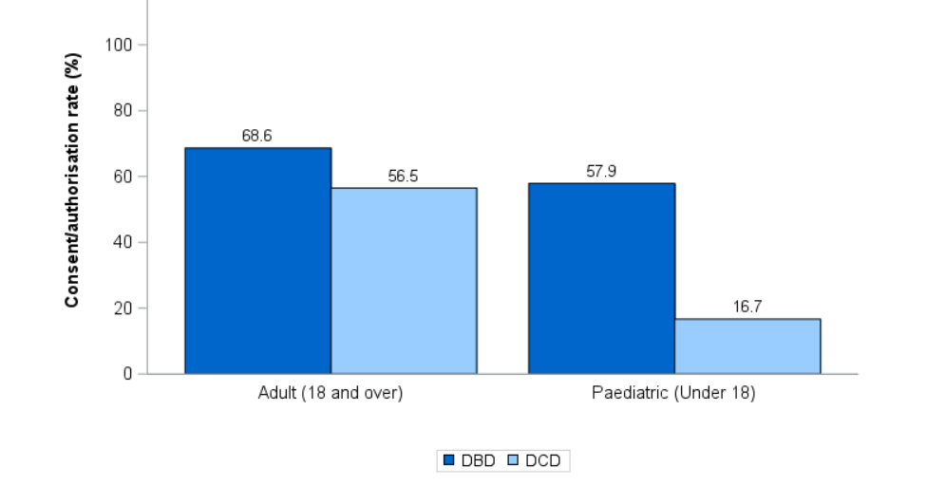
Consent Rate
2023-2024

Slide 5
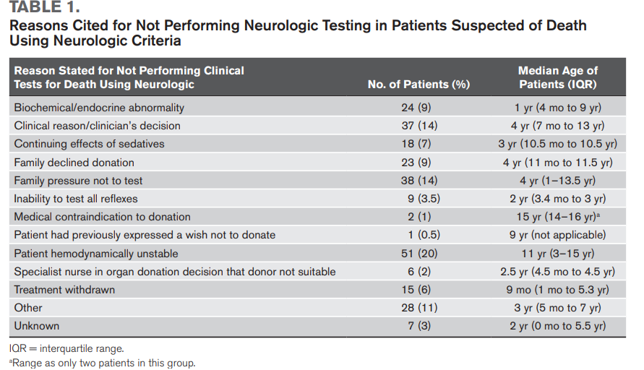
Reasons not to Test

Slide 6
Reasons families of medically suitable eligible donors were not approached, April 2023 – March 2024

Slide 7
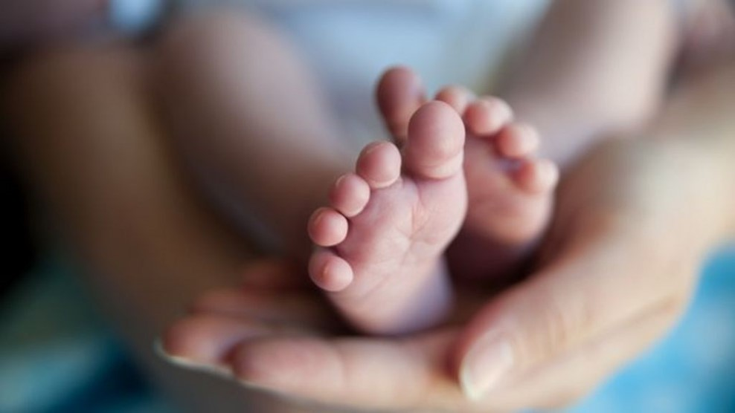
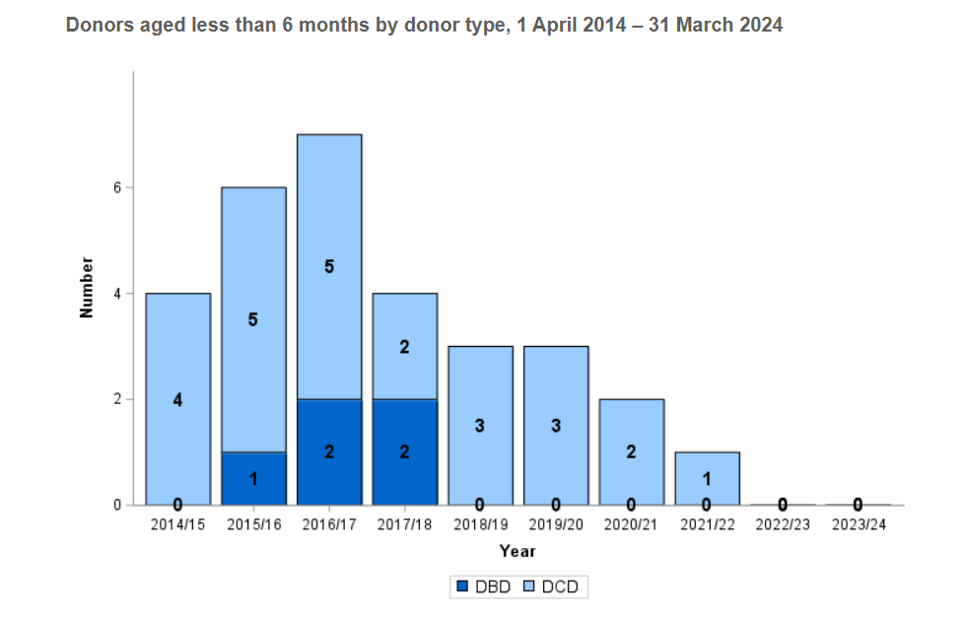
Neonatal Donation

Slide 8
Paediatric Donation Outside the PICU
2015-2020
  14 patients proceeded to donation from an adult ITU
  More than half teenagers
  Youngest 2 years old

