Slide 1
NORS and Perfusion Technologies
Cecelia McIntyre and Sarah Beale
OTDT Commissioning and Service Development Team

Slide 2
Tweaks for next time...
Update the 24/25 data –awaiting
Use case study re NORS deployment eg SCORE map slide
Use hexagons re number of people involved - in
Remove novel – perfusion tech – done

Slide 3
Overview
An introduction to the National Organ Retrieval Service (NORS)
Current activity
Perfusion Technologies in use
  DCD hearts
  Normothermic Regional Perfusion (NRP)

Slide 4
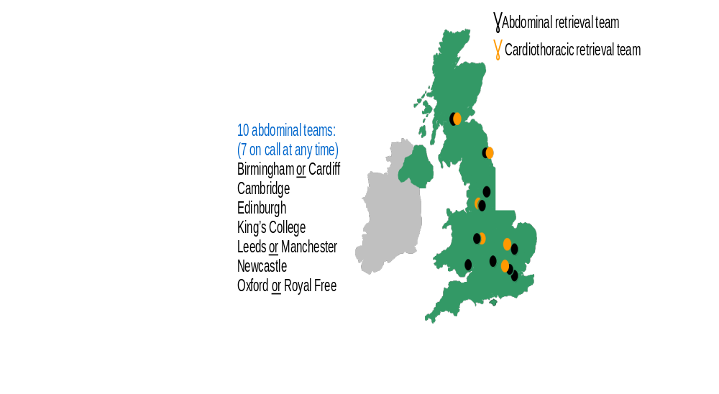
The National Organ Retrieval Service (NORS)
Introduced in 2010
Several reviews since introduction leading to current structure
At any given time, 8 abdominal and 3 cardiothoracic teams are on-call for retrieval
NHSBT commission 10 abdominal and 6 cardiothoracic surgical teams to retrieve organs from deceased donors in the UK
Teams are mobilised to donors when at least one organ has been accepted
Notes:
Commissioned service via a contract with the 16 NORS organisations
The NORS service cost £30million per year – that’s staffing, equipment, transport
NORS organisations employ staff and have full responsibility for those staff
10 Abdo and 6 CT
At any one time 8 abdominal teams available and 3 CT teams
3 CT teams cover a rota so are on call 50% of the time - A team covers DCD Hearts another EU cover, Newcastle and Papworth cover a 1 in 2 paediatric rota.
Abdo teams – there are 4 are on call 100% of the time the rest do a proportion.
Transport provided by IMT by means of a national contract – IMT know who is on call and when, so can prepare vehicles locally. IMT own 3 planes also
We do have some challenges with flights obviously limited availability as well as airport closures

Slide 5

NORS Commissioned Teams
Cardiothoracic Teams
  Lead Surgeon
  Assistant Surgeon
  Preservation Practitioner
  Scrub Practitioner
Abdominal Teams
  Lead Surgeon
  Assistant Surgeon
  Preservation Practitioner
  Scrub Practitioner
Notes:
So, who's on a NORS teams This is a standard commissioned team of 4
Additional staff may attend for training opportunities - obviously, we don’t want to overload the theatre with personnel
Lead surgeon fully signed off
Assistant surgeon – anything from a MS to a non-medically trained surgical assistant – SCPs
The scrub nurse and OPP are qualified Nurses or ODP
How do we train NORS staff – in house experiential learning
NORS Masterclass attendance for surgeon’s mandatory for sign off – that is VMC as well as a hands cadaveric course
The POP can attend and perioperative staff
Hoping to make the V MC mandatory for all POP
POP comprehensive competency document and e learning package completed prior to attendance.
Aim to standardise training for all teams.
Some are dual role practitioners, tend to focus on scrub role first.

Slide 6
Our ask of donor hospitals
For a DBD or DCD donor we may need
  Access to scans/Xrays
  An anaesthetist
  An anaesthetic assistant
  A runner
  Some basic equipment
    Diathermy
    Suction
    Surgical trolleys/drip stands
  Support for the SNOD with last offices
Information sheet for Donor Hospital theatres has been recently updated to include differences between DBD/DCD expectations and novel technologies
Notes:
Please be aware teams may have travelled for long distances
Cup of tea? Large theatre, place to handover – full team introduction and brief
What do we need in theatre – a basic set up – with additional suctions and set of scales
We ask for a local member of staff – familiar with local logistics and to support the NORS team – certainly in terms of the surgical count
Often overnight it’s the theatre nearest to where the local staff are working
Guide for Donor Hospitals recently updated – some hospitals have a laminated copy in theatre
The NORS perioperative community are working on a presentation to share with donor hospitals detailing the roles/tasks of the NORS team - very grateful for the collaboration with education CLOD

Slide 7
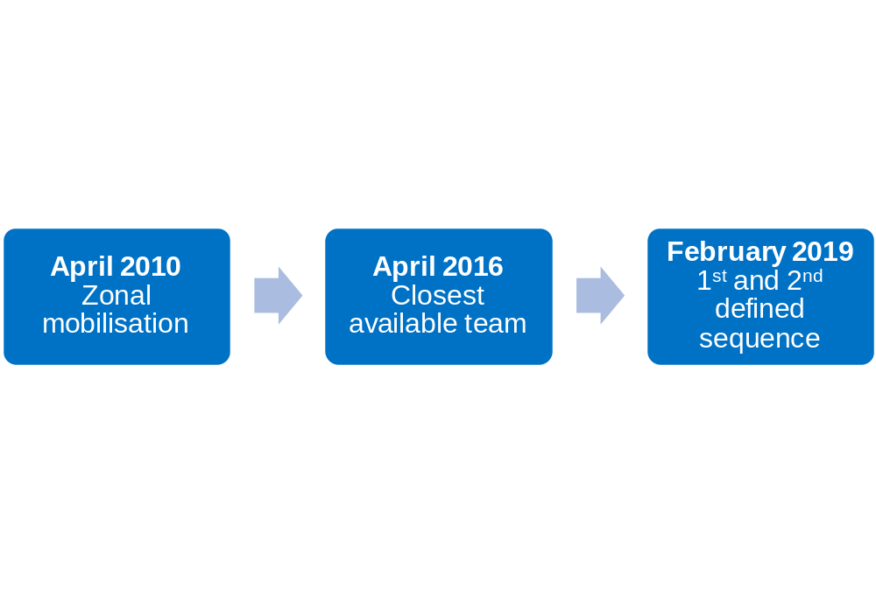
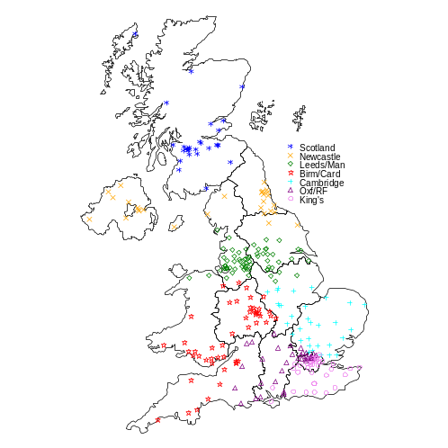
Mobilisation sequence
NORS teams mobilised to attend organ donors by the ODT Hub
Example:
 | 1st abdominal team in sequence | 2nd abdominal team in sequence
Royal Devon and Exeter Hospital | Oxford | Newcastle
Beyond this teams still mobilised based on a closest available system.
Notes:
NORS teams are mobilised to attend donors by the ODT Hub – who are based in Bristol and manage and coordinate all organ offering.
Teams are expected to be ready to mobilise within 90mins from call
When NORS was introduced in 2010 the mobilisation sequence was based on a zonal system, whereby each NORS team had a region of hospitals to which they would retrieve from
A review in 2016 moved to a system based solely on travel times and whether teams were available
Following the work of the group in February 2019 the sequence moved to a hybrid of these two. You can see an example here, where each hospital has a defined 1st and 2nd sequence which is not necessarily the closest in terms of travel time. Beyond this teams are still mobilised based on availability and travel times
Aim for teams to have similar levels of activity but hard to achieve in practice
Commissioning team monitor NORS activity in their monthly KPI’s.

Slide 8
Donors attended
Number of attendances
Year
Notes:
This slide really speaks for itself.
Attended donors
If we look at 18/19 & 20 numbers were increasing
2020 well we know what happen
Bit of a slow recovery
Into 22/23 activity on par with 2015/16
Then 23/24 we are seeing an increase = 1750 attendances = 4% increase on last year
We know there has been a decrease in 24/25 ? 1550

Slide 9
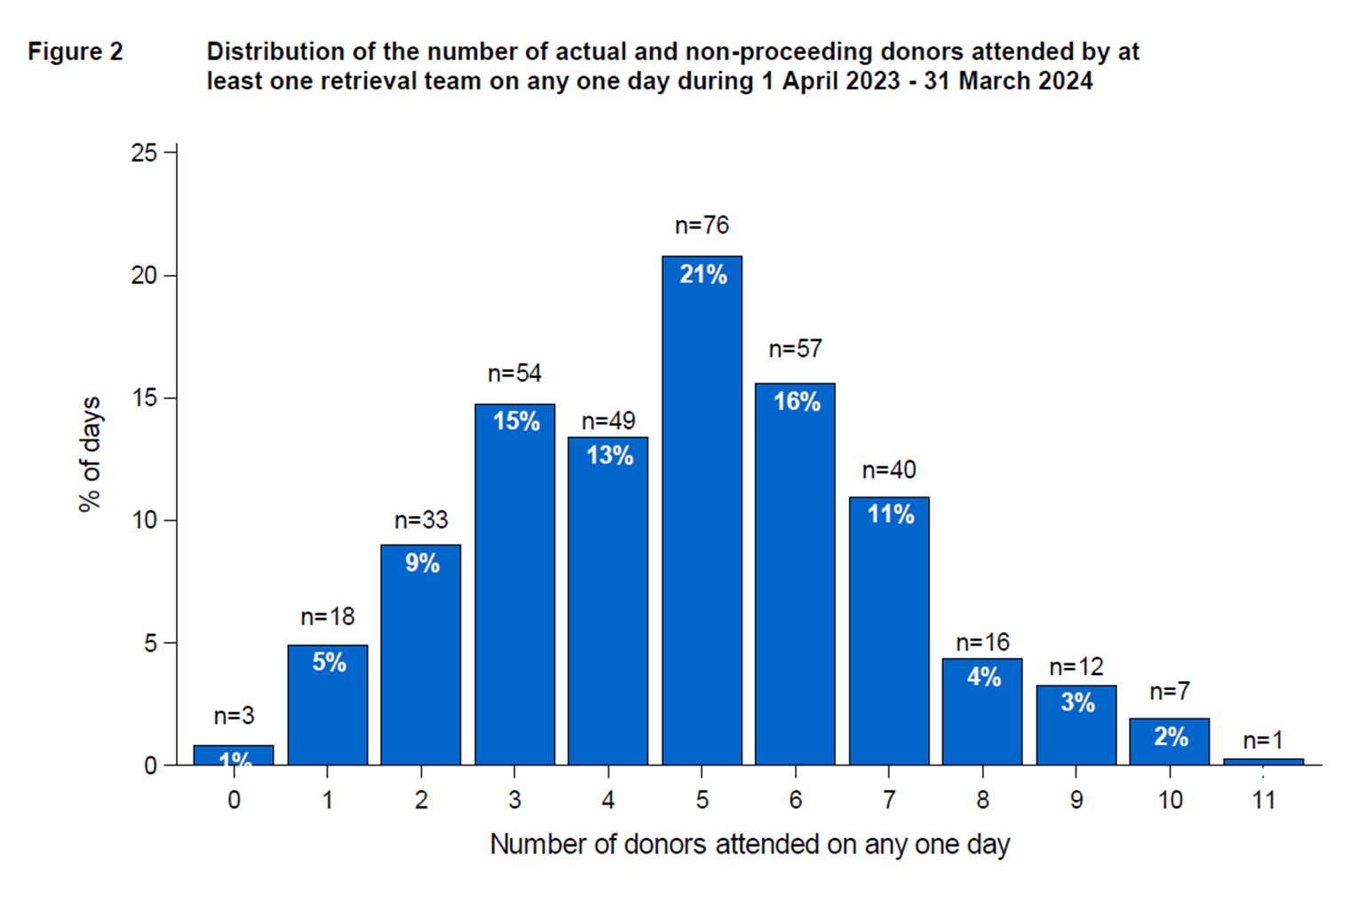
Notes:
In terms of activity, this shows the average number of attendances by NORS teams per day 2023/2024.
As you can see most often there were 5 attendances in a day, on one occasion there was 11 - We know activity is unpredictable
We try to avoid back-to-back retrievals, but they do happen, this means an extended work period can be more than 24hrs, if it is B2B then teams are mobilised to attend the closest, if possible
Hopefully in the future with the SCORE programme a Planned Arrival Window each team will attend one donor per day.

Slide 10
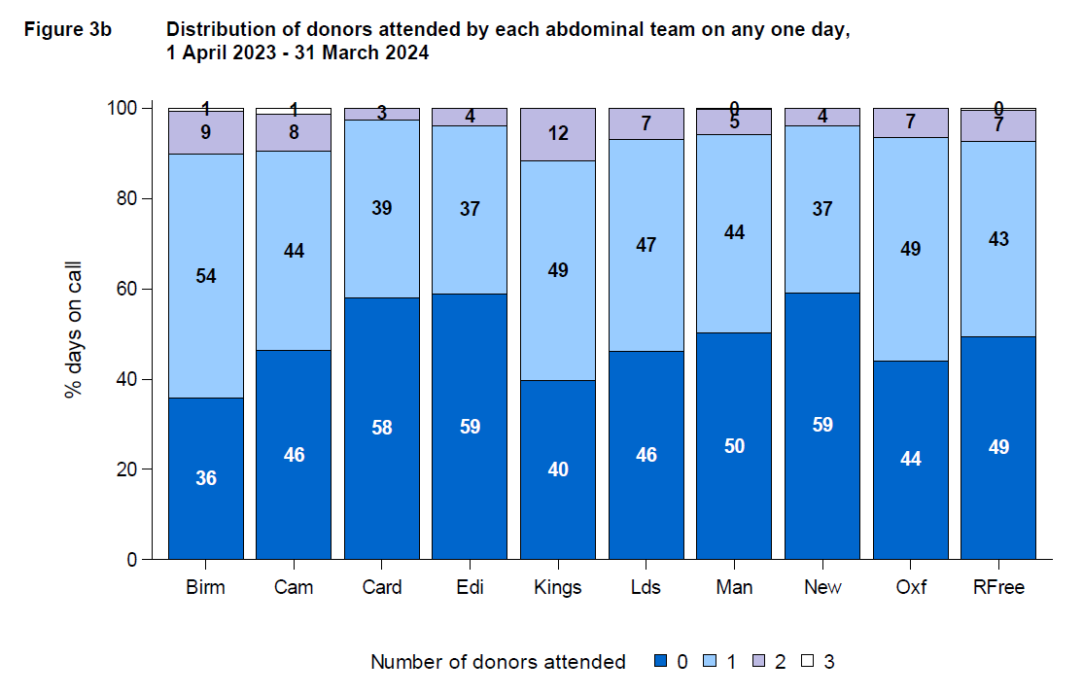
Notes:
Showing the 10 abdominal teams
Colours showing the % of times the teams are actually busy v % times the teams are not called out
Dark blue shows teams not call out
Light blue team busy
Lilac showing more than 2 donor in a day
White 3 donors
Teams are always surprised when they see this – because it always feels busier but remember this work is on top of the day job
There are clearly some teams who are busier than others, with Birmingham and Kings being the busiest.
We must remember we live in a long thin country – variable geography and population density

Slide 11
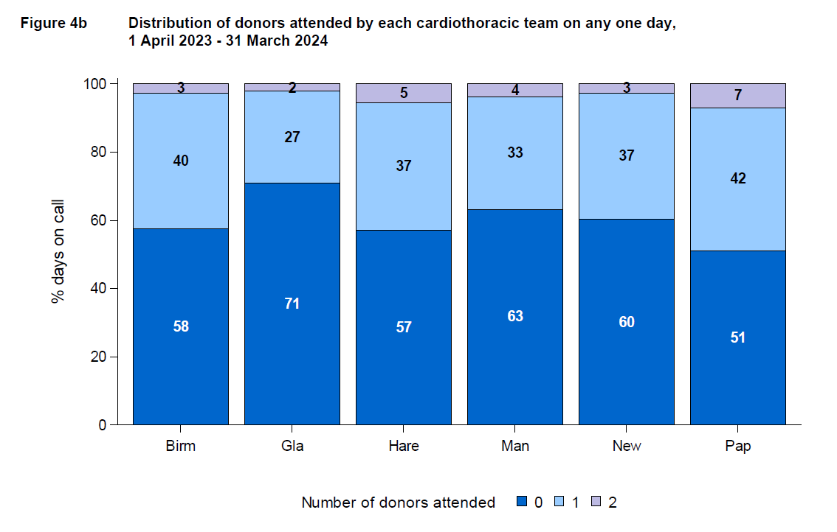
Notes:
Showing the 6 CT teams
As we know we have less multi organ - CT donors
More Lilac meaning more than one donor in 24 hours – we know that some of that additional activity is DCD hearts – it's important to note that this is an extended call out time if delivering DCD heart on OCS
As commissioners this is a really good measure it reassures us, we have enough capacity in the system

Slide 12
Governance and Support
NORS review meetings with NHSBT Commissioning team
  Contractual and clinical
Perioperative Forum
NORS management forum
Retrieval Advisory Group
Regularly monitors organ damage rates
  Looking across the pathway at timings and impact of daytime retrieval
  Supporting novel technologies
  Support process changes and monitoring – Super Urgent pathway, paediatric liver pathway, CUSUM development
  Reviews regular reports
Notes:
All teams have a yearly contract review meeting
As well as a 6monthly clinical review meeting – these are supportive, a 2-way discussion and acknowledgement meetings of the work done by the team
But also, an opportunity to highlight any concerns – often its staffing and covering the rota – attrition rates – in the past few years we've seen NORS surgeons leaving to go abroad – amongst the POP the Band 5 staff have the highest attrition rates
RAG
Key group – big event for the NORS community
Usually well attended
Representation from all teams
As well as representatives from donation, HUB, research

Slide 13
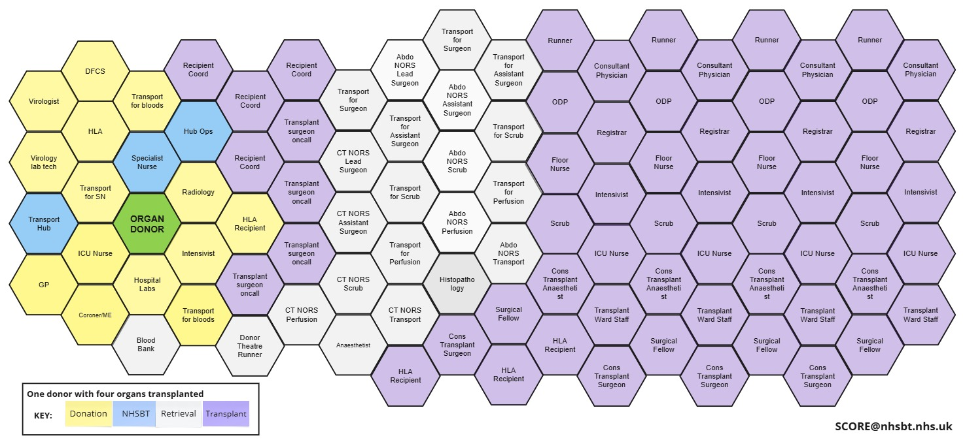
Notes:
Such an interesting slide!
Who's involved in one donor – staggering amount of staff from identification of donor through to transplantation of 4 organs

Slide 14
DCD Hearts

Slide 15
DCD heart attendances

Slide 16
Governance and Funding
SUBSTANTIVE FUNDING SECURED FROM APRIL 2025
National Pilot of DCD Hearts the Joint Innovation Fund (JIF)
  Comprised of key stakeholders from all CT transplant centres, NHSBT Commissioning, Governance, Operations and all devolved healthcare administrations.
  Provided a governance structure for teams to deliver DCD heart programme.
  Funding for teams to provide service and to reclaim the costs for consumables used during DCD Heart retrievals using the OCS machine.
  The JIF ended in September 2022
The DCD Heart Operational Group (DCD HOG)
  Confirmed funding for 2023/2024
  Confirmed funding for 2024/2025

Slide 17
Heart Transplant Activity
36% of heart transplants in 2023/24 from DCD donors

Slide 18
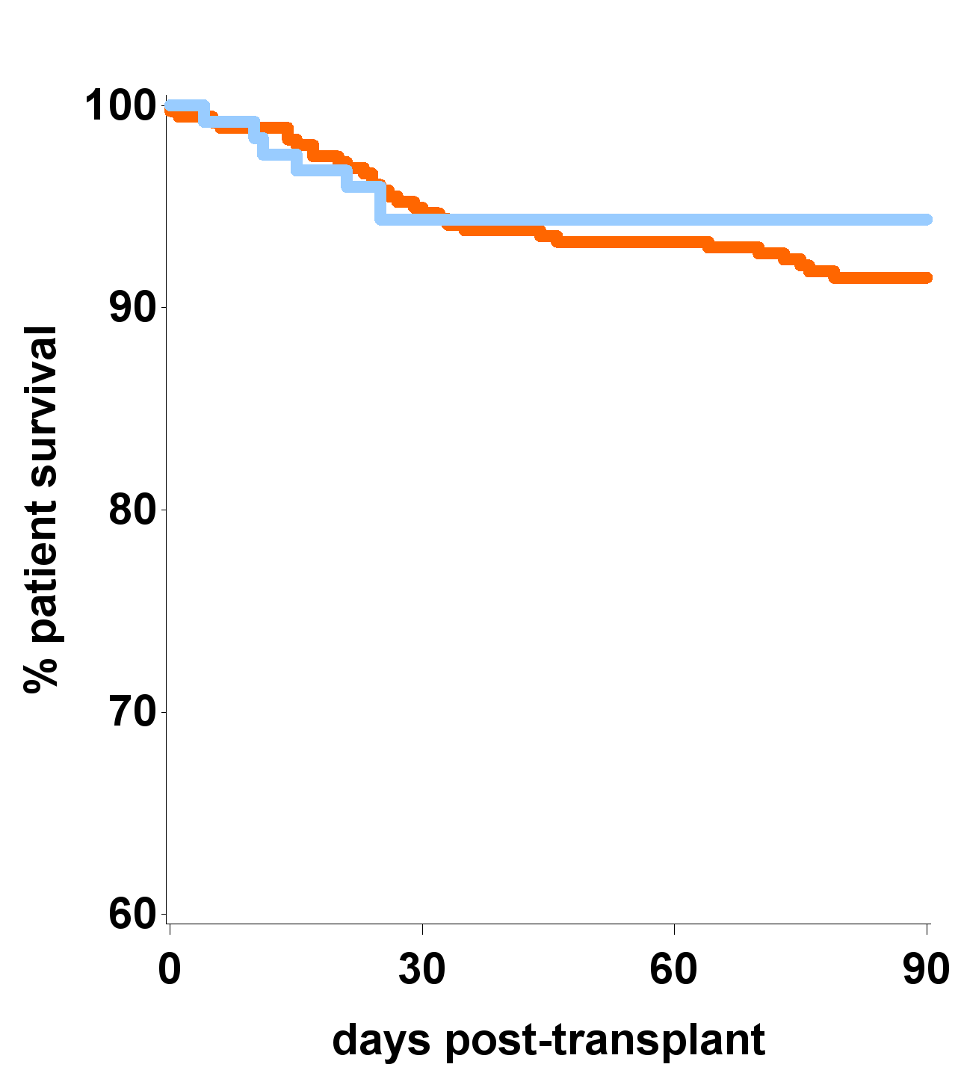
Survival – unadjusted
1st adult heart only transplant, 7 September 2020 – 30 September 2023
357 DBD, 124 DCD
DCD
94%
DBD
92%
p=0.33
Notes:
Comparable survival between the 2 groups

Slide 19
Normothermic Regional Perfusion (NRP)

Slide 20
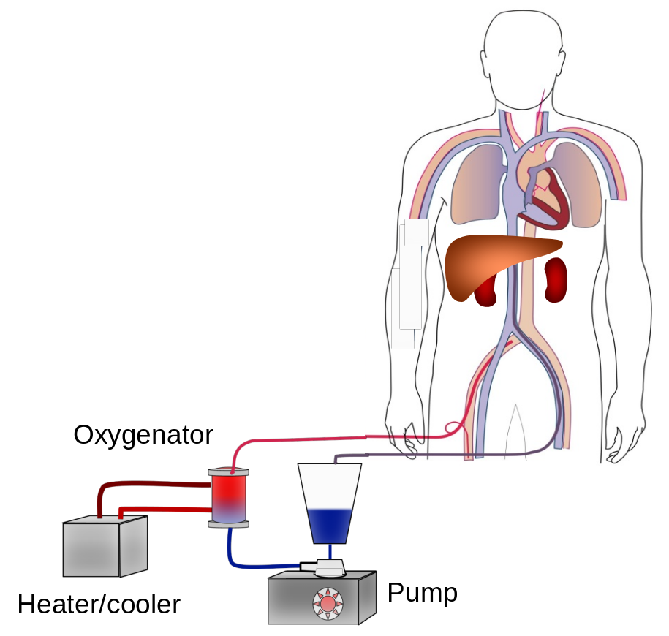
Normothermic Regional Perfusion (NRP)
Circulatory arrest on ITU / in theatre suite
Donor transferred into the operating theatre
Restoration of circulation of oxygenated blood at 37C to abdominal organs for 2 hours
Regional perfusion of the abdomen
cannula

Slide 21
Clinical benefits of NRP
Slows down retrieval process – more like a DBD retrieval
  Less retrieval damage than standard DCD
Allows biochemical assessment of liver
  Lactate, ALT, glucose
Removes uncertainty regarding subsequent function
Can allow utilisation of donors outside of the normal DCD criteria
  Donors with longer warm ischaemic times
  Older donors
Benefits to all abdominal organs
Notes:
Outside of normal DCD criteria – age/ length of wait post WLST

Slide 22
Governance and Funding
SUBSTANTIVE FUNDING SECURED FROM APRIL 2025
NRP pioneered in the UK by NORS teams in Edinburgh and Cambridge
NRP Steering Group established in 2019
  Governance
  Protocols
  Mentoring direct/indirect
  Education and shared practice
Interest from other teams has increased over the years
Now 7 teams in UK have NRP programmes running
  Edinburgh, Cambridge, Royal Free, Cardiff, Birmingham, Newcastle and Kings
Business case submitted to the DHSC
Notes:
Now have robust mentoring structure in place to support new teams develop their NRP programmes
Regular debrief sessions – shared learning invaluable

Slide 23
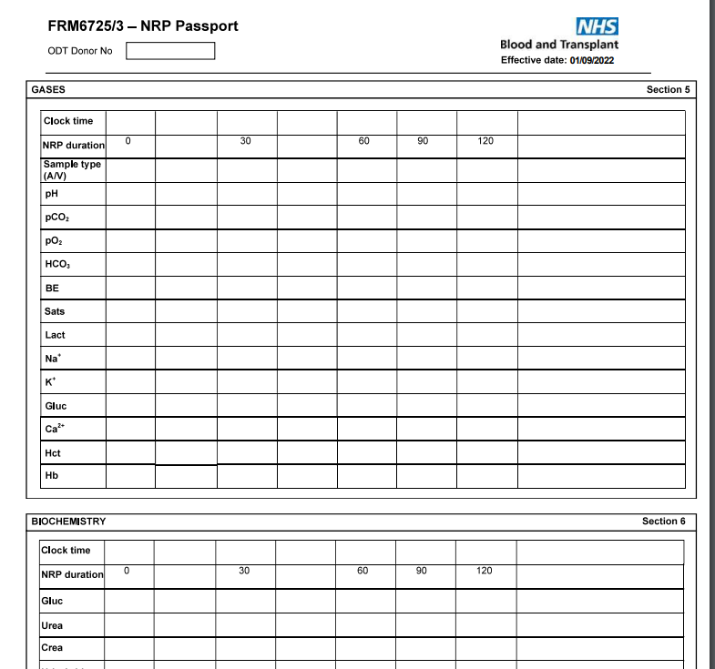
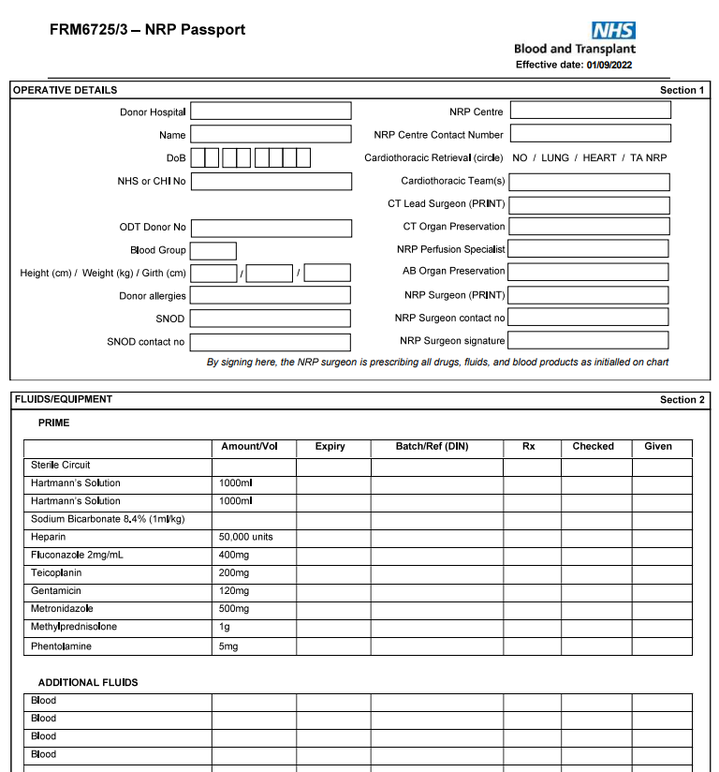
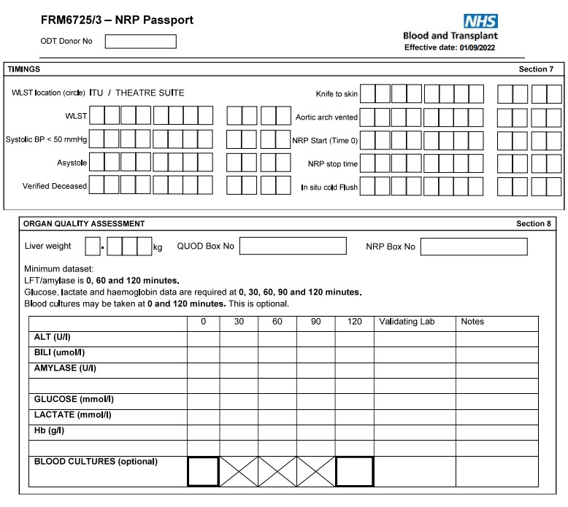
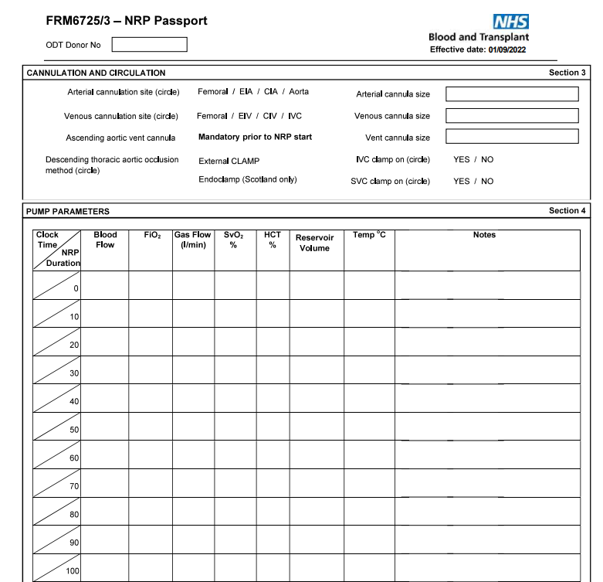
NRP Passport

Slide 24
NRP donor attendances
768 attendances over decade
8% increase last year
Number of donors
161 (87%) proceeded to donation in 2023/24

Slide 25
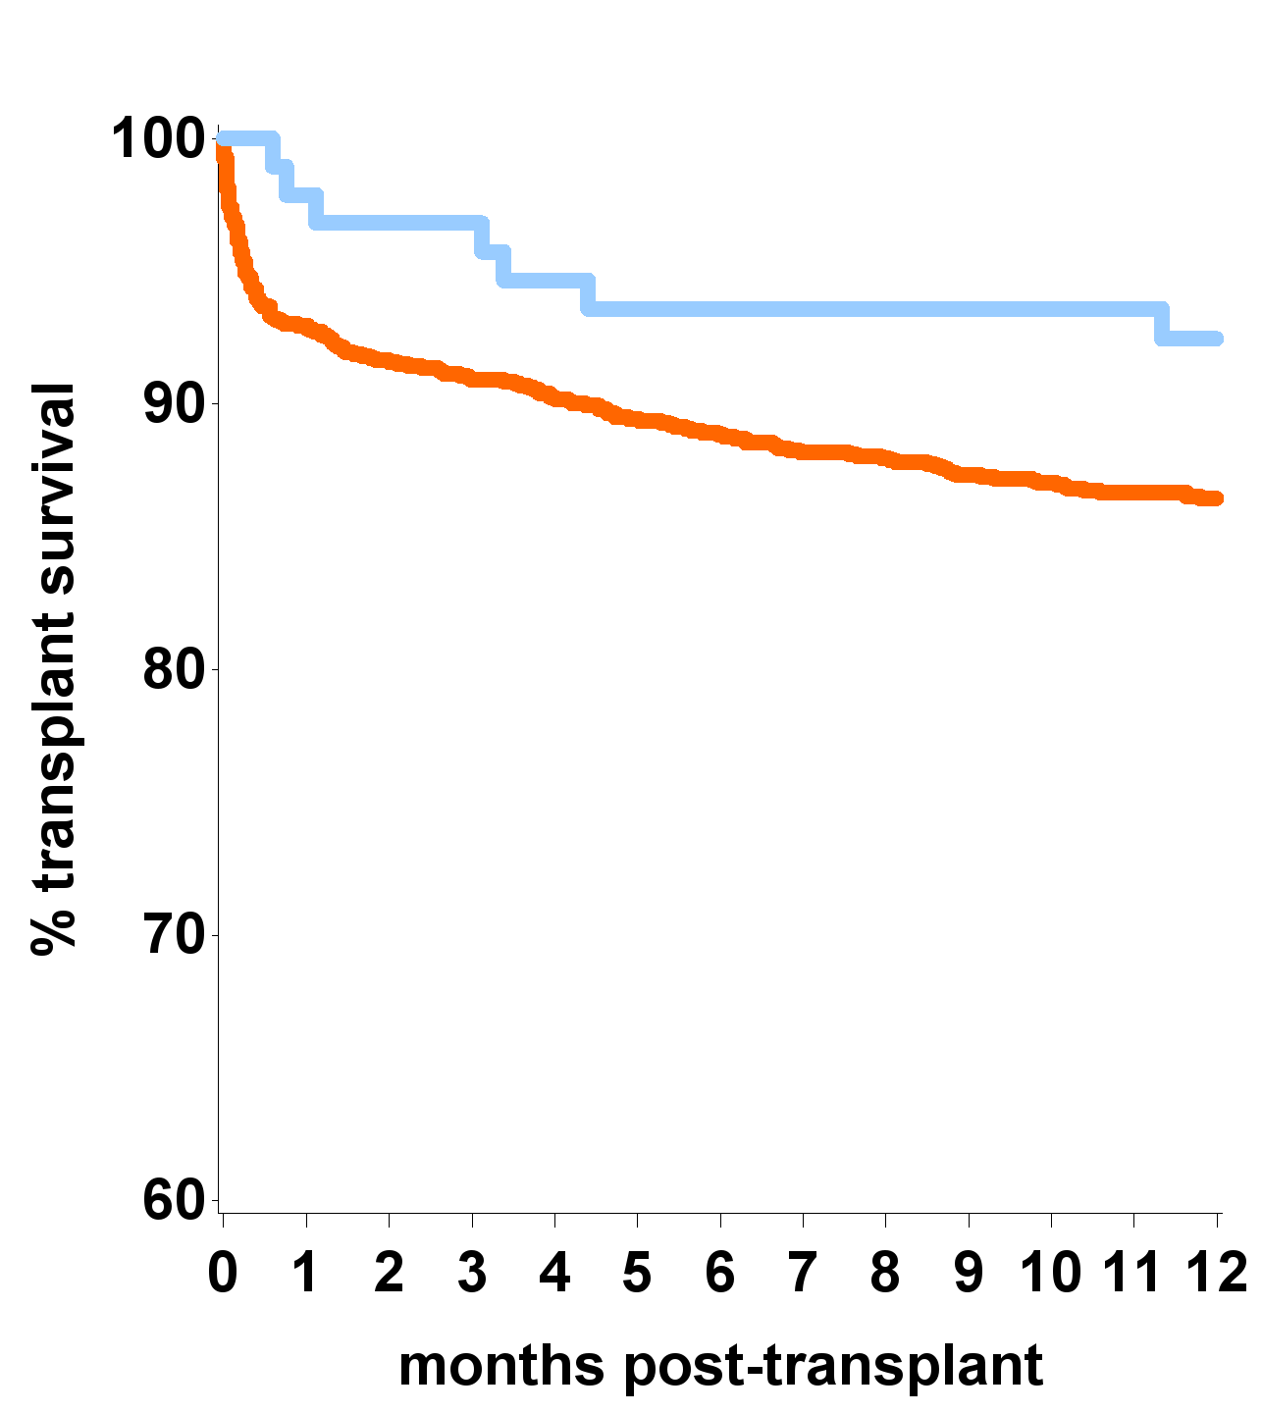
DCD liver outcomes
1st adult DCD liver only transplant, January 2011 – December 2019
94 NRP, 1,376 standard DCD
1 year unadjusted analysis
1 year risk-adjusted analysis
NRP
Significantly better outcomes for NRP – 50% reduced chance of transplant failure in NRP group – p=0.05
93%
Std DCD
86%
p=0.09
Ref: Oniscu GC et al. Transplantation 2022 in press
Notes:
HR 2.023 (0.922-4.439)
Transplant survival rate = patient and graft survival rate combination
Time from Tx to graft failure or death whichever happens first
Boarderline significance
Adjusting for the standard model see it is significantly better outcomes
This is significant.

Slide 26
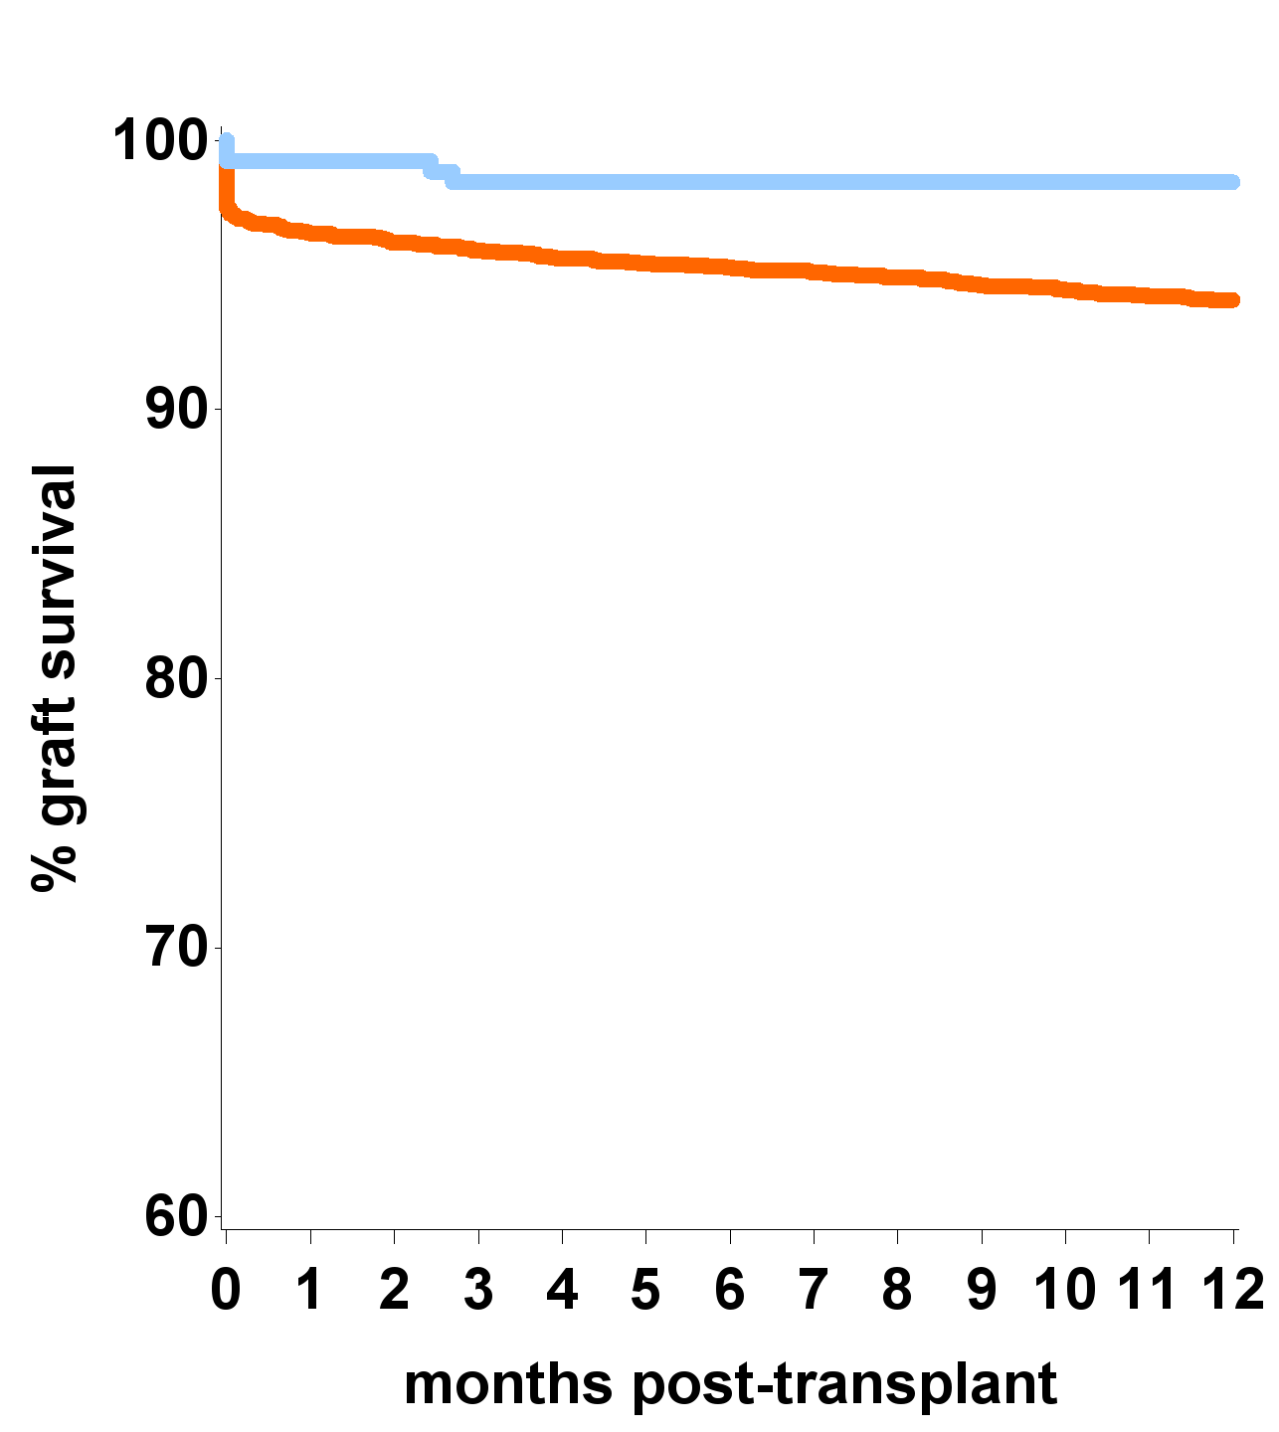
DCD kidney outcomes
1st adult DCD kidney only transplant, April 2016 – March 2021
258 NRP, 3,501 standard DCD
1 year unadjusted analysis
1 year risk-adjusted analysis
NRP
Significantly better outcomes for NRP
98%
94%
Std DCD
p=0.004
73% reduced chance of graft failure in NRP group – p=0.002
Mean eGFR:
NRP = 55.3
Std DCD = 46.2
eGFR – 7.6 ml/min/1.73m² higher if NRP used – p<0.001
Notes:
HR: 3.51 (1.30-9.44). eGFR p-value <0.0001
This is significant.
The increase in gfr equates to about 3.2 years extra dialysis free survival per transplant (about £33k saving for each year).

Slide 27
Impact of Novel Technologies on Donor Hospitals
DCD Hearts
  NORS team brings more kit – the OCS
NRP
  NORS teams brings more kit - cardiohelp
  Takes around an hour to set up the circuit
  Lengthens the DCD retrieval process
The benefit is more organs are able to be utilised for transplantation.

Slide 28
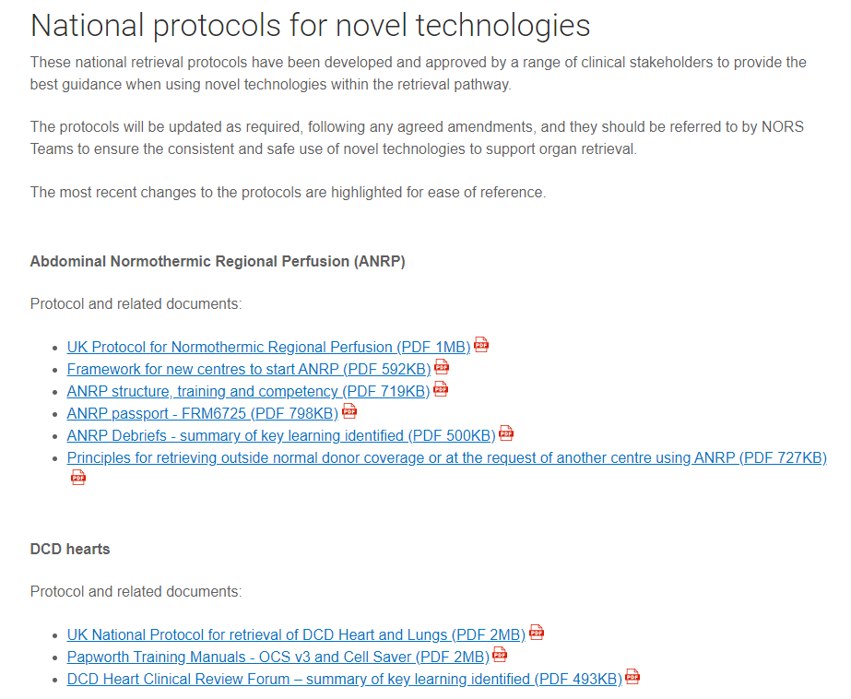
Resources available – ODT Microsite
https://www.odt.nhs.uk/retrieval/policies-and-nors-reports/

Slide 29
Any Questions?

