Slide 1

Influencing donation culture - the role of the CLOD
Clinical Lead Induction
1
Notes:
1

Slide 2
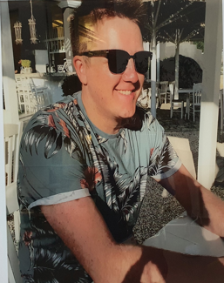
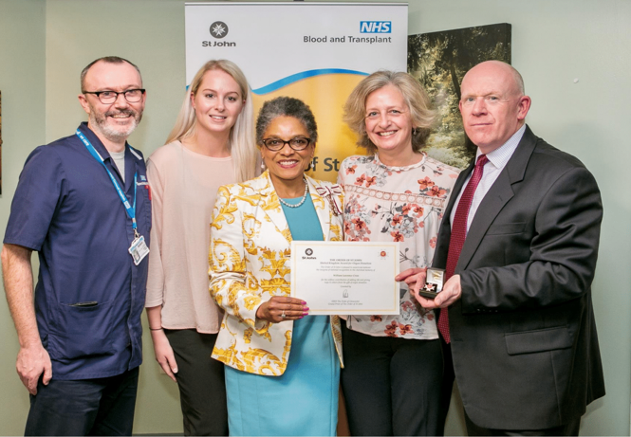
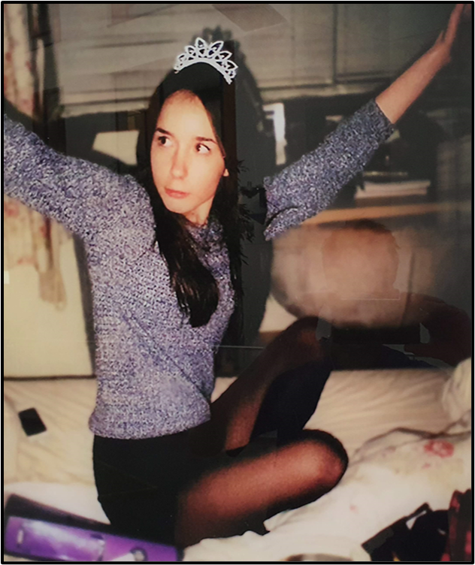
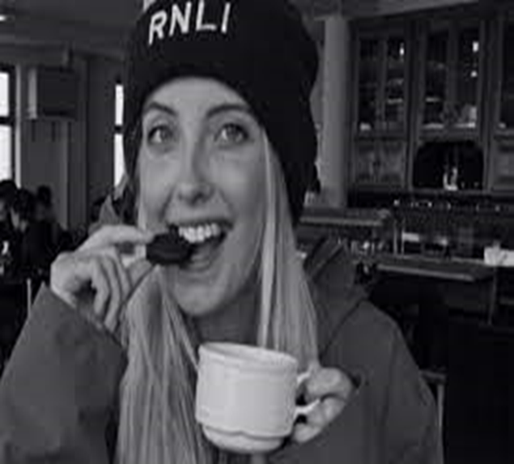
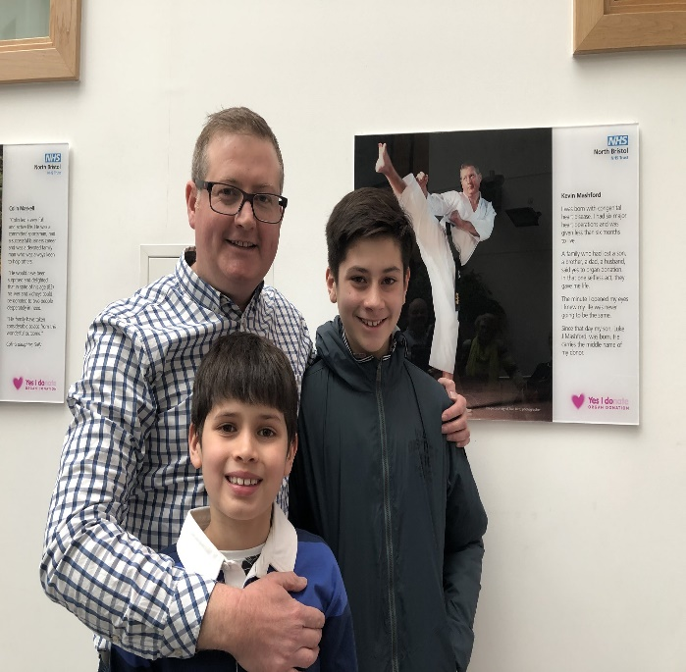


Out of tragedy
comes hope

Slide 3

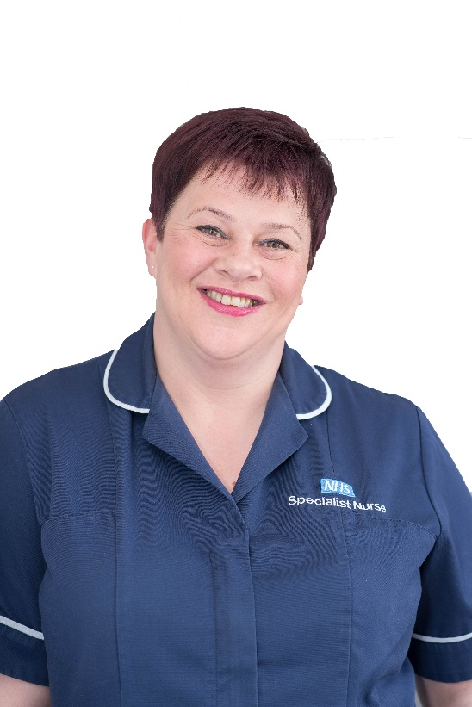

A UK Model for Donation: Local Donation Teams
Clinical Lead for Organ Donation (CLOD)
‘Embedded’ Specialist Nurse for Organ Donation (SN-OD)
Non-clinical Donation Committee Chair (Chair)
Notes:
Most important relationship is with the SNOD.

Slide 4
A UK Model for Donation: Local Donation Teams
Who are we?
95% Intensive Care
(including paediatric intensivists in appropriate hospitals)
Clinical Donation Champion
What do we do?
Provide clinical LEADERSHIP &
CHAMPION improvements
How are we funded?
Appointed by our hospitals but our time is reimbursed from national funds.
Funded 2-4 hours / week. Depending on local and regional need.
(NHSBT: £2.5 million)
What we don’t do?
Attend every donor
Clinical Lead for Organ Donation (CLOD)
Responsibilities
Identify and contribute to resolving local barriers to donation.
To develop a close working relationship with the specialist nurse for organ donation.
To be a source of knowledge regarding the ethical and legal aspects of organ donation and provide advice as required.

Slide 5
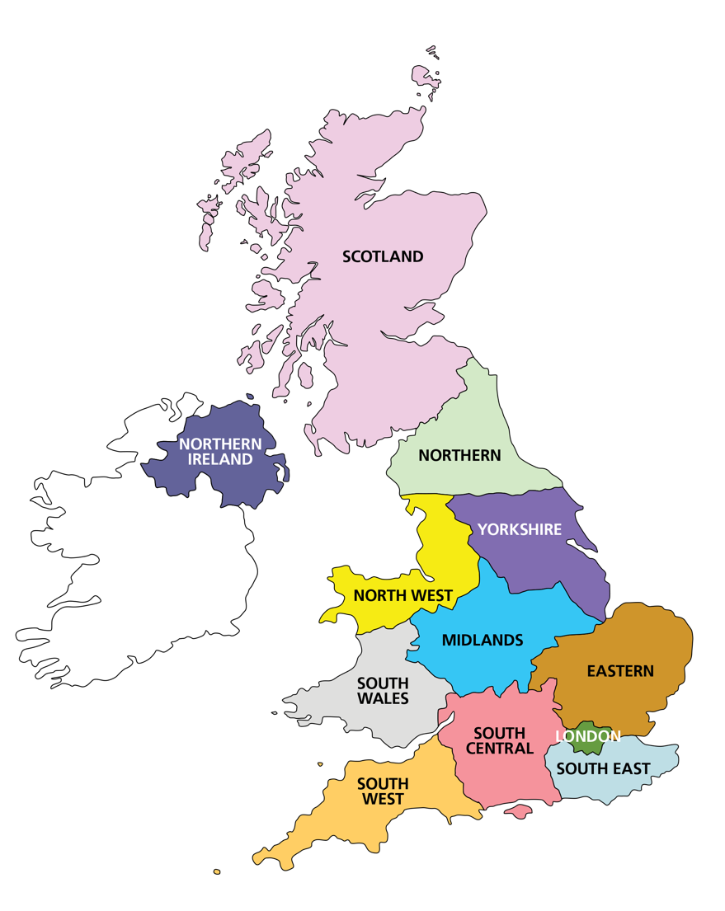
Local Donation Teams 2018
168 Committees (£2 million – includes donor recognition)
250 SNODs (£19 million - includes regional and national)
240 CLODs (£2.5 million - includes regional and national)
Regional
12 Regions
Regional Managers
Team Managers (2-3 per region)
18 Regional CLODs
Growing number of regional education CLODs
National
Medical Director – Derek Manas
National CLOD – Dale Gardiner
Innovation & Research CLOD: Dan Harvey
Medical Education CLOD: Ben Ivory
Paediatric CLOD: Omer Aziz
Director Organ Donation & Nursing
Director Education and Governance
SNOD Professional Development Team
Medical Education PDS – Jill Featherstone
Regional Education CLODs
CLOD Induction, 2024

Slide 6
Categorisation of Donation Activity by Level
Level 1 | 12 or more proceeding donors per year (averaged over two years) | 36
Level 2 | 6-12 (≥ 5 to < 12) proceeding donors per year (averaged over two years) | 51
Level 3 | 3-6 (>3 to <6) proceeding donors per year (averaged over two years) | 31
Level 4 | < 3 proceeding donors per year (averaged over two years) | 39
An additional descriptor is applied to each hospital, as appropriate.
N = Adult Neuro ICU
P = Paediatric ICU
MT = Major Trauma Centre
C = Cardiothoracic ICU
T = Transplant Centre
Trusts or Boards
CLOD Induction, 2024

Slide 7
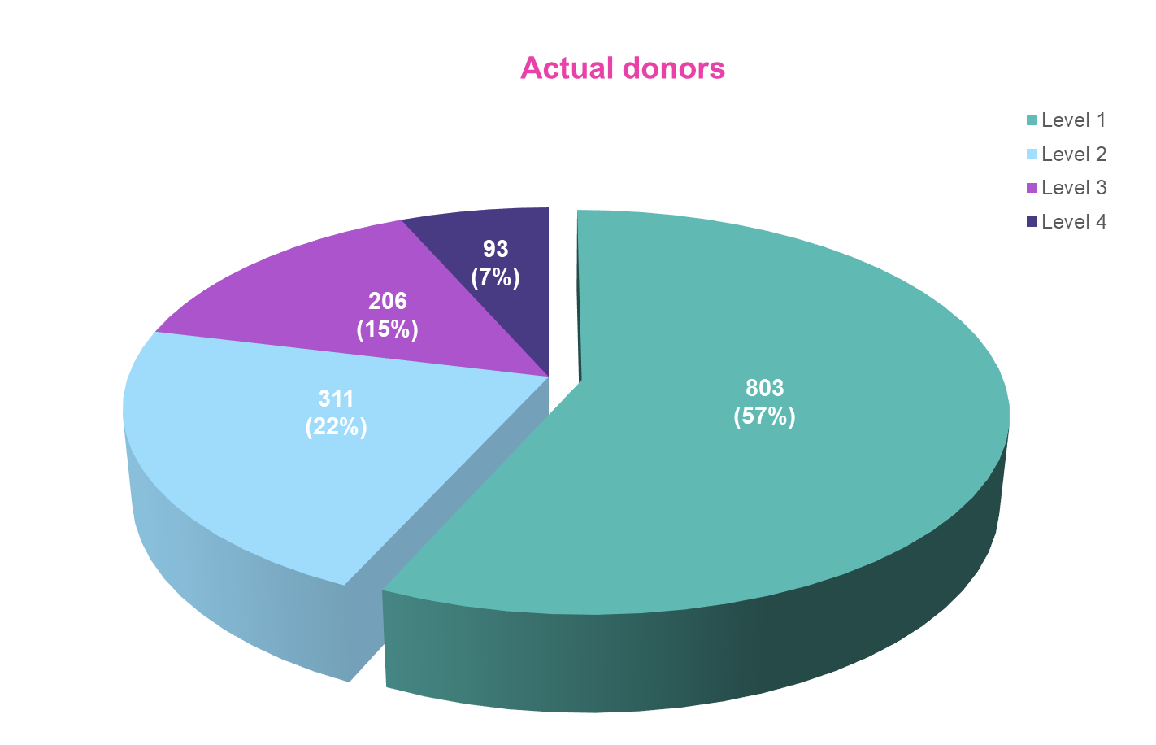
CLOD Induction, 2024
Notes:
Although a little over 50% of donors come from large, level 1 hospitals, nearly 50% come from smaller units. Arguably, the CLOD role is even more important where donation is less common

Slide 8
Who do we need to influence?
Clinical Lead Induction
Notes:
Hospital vs community

Slide 9
Clinical Lead Induction

Slide 10
What outcomes are we aiming for?
To make best practice standard practice:
100% timely referral
100% SNOD presence
100% DNC testing
Timing of WLST and retrieval
Clinical Lead Induction

Slide 11
What outcomes are we aiming for?
(Admitting appropriate DBI patients for prognostication/EOLC)
Clinical Lead Induction
Notes:
Not really an OD aim, more a good neuro-ICU aim, but we are often the ones who notice

Slide 12
Referral
Who?
When?
How?
By whom?
Clinical Lead Induction

Slide 13
Referral
Who?
When?
How?
By whom?
Clinical Lead Induction

Slide 14

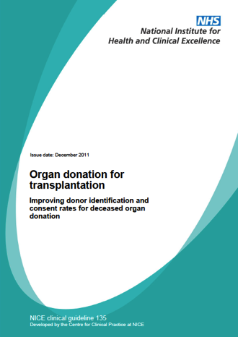
National Institute for Health and Care Excellence (NICE)
Triggered Referral
Plan to withdraw life-sustaining treatment
Plan to perform brain death testing
Early referral = Catastrophic brain injury
  + GCS of ≤ 4, not explained by sedation
  + Loss of 1 cranial reflex
2011
Clinical Lead Induction
Notes:
We have NICE Guidance telling us WHO to refer.

Slide 15
National Institute for Health and Care Excellence (NICE)
Refer EVERY mechanically ventilated patient where
you plan to withdraw life sustaining treatment.
2011
Clinical Lead Induction
Notes:
We have NICE Guidance telling us WHO to refer. Which boils down to a simple message – going to test, going to withdraw.

Slide 16
Referral
Who?
When?
How?
By whom?
Clinical Lead Induction

Slide 17
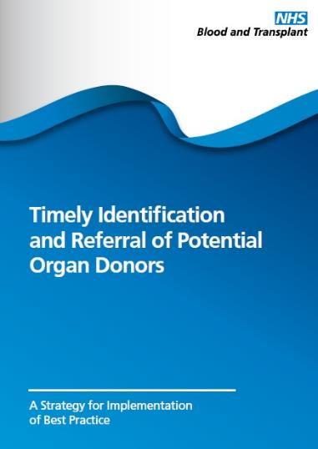
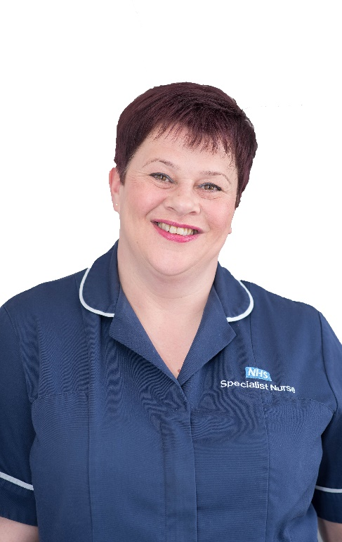
2012
Early referral will speed up process if donation does proceed and if donation is not possible, the answer can be known prior to any family approach.
TIMELY
Early referral can reduce the length of the whole process.
15% of families who decline DCD donation state it was due to the fact that they felt the process was too long.
Clinical Lead Induction
Notes:
Identification and referral of a potential donor is the first step in the donation pathway and it is fundamental that if potential donors are not identified and referred, then the potential for donation and transplantation are lost
But one of the important messages is that the timeliness of that referral is also crucial in bringing about benefits to the family and the hospital team
By timely we really mean 'early'
What concerns might some clinicians have about early referral?
1. Referring a patient without family knowledge
2. Referring a patient whilst active treatment continues
What are the potential benefits of early referral?
1. confirm whether a patient has the option of donation – no need to ask a family if not
2. If necessary, a SNOD can travel to the hospital without 'keeping a family waiting'
2. SNODs can support a family through neurological death testing
3. SNODs can help with coronial referral/discussion
4. early tissue typing and virology screening can minimise process delays

Slide 18
Referral
Who?
When?
How?
By whom?
Clinical Lead Induction

Slide 19
Will depend on your unit
Large units with constant SNOD presence – face to face may be straight forward
Smaller units with variable SNOD presence will usually need to make telephone referrals – far easier to miss
All units need a robust system for referral that is relevant to the local situation
Clinical Lead Induction

Slide 20
Referral
Who?
When?
How?
By whom?
Clinical Lead Induction

Slide 21
Essentially comes down to…
Nurse led referral
Clinical Lead Induction

Slide 22
Essentially comes down to…
vs
Nurse led referral
Doctor led referral
Clinical Lead Induction

Slide 23
Potential advantages to nurse led referral
Easy to protocolize (admitting GCS≤4 etc)
General feeling that nursing staff recognize futility before medics
Empowers nursing staff in the donation process
Bypasses potentially obstructive/forgetful medical staff…
Clinical Lead Induction

Slide 24
Potential barriers to 100% referral
Systemic – need to design systems to minimize inadvertent misses (daily SNOD call, inclusion in safety brief etc)
Lack of knowledge (eg consultant thinking pt has CI to OD and not referring)
Deliberate non-referral on ‘ethical’ grounds
Clinical Lead Induction
Notes:
More to come on difficult colleagues later

Slide 25

SNOD presence
Should be aiming for 100%
Ideally during BBN conversation
Not always achievable
Early referral is key
Still may be some resistance to early SNOD presence from some consultants
Clinical Lead Induction

Slide 26
Dealing with the ‘tricky’ colleague
Identify what the objection/problem is (eg omission vs commission)
Use evidence (better consent rates with SNODs, better outcomes for families)
Get the tide of practice going with you (get the low hanging fruit first)
Show them the letters that go to the chief exec/MD
Know when to give up…
Clinical Lead Induction
Notes:
No-one likes fighting against the prevailing practice in a dept. If everyone else is toeing the line, the stragglers will eventually catch up

Slide 27
Nursing staff
May have firmly held views based on previous experiences (in smaller units, OD experience will be extremely dilute)
SNOD relationships key
Establish link nurse roles
Consider invites to collaboratives
Regular unit education days
Clinical Lead Induction

Slide 28
ED Colleagues
Often problem of over-enthusiasm
Usually very keen to help OD
Worth establishing ED rep on ODC
Regular education sessions (ED strategy presentation available)
Clinical Lead Induction

Slide 29
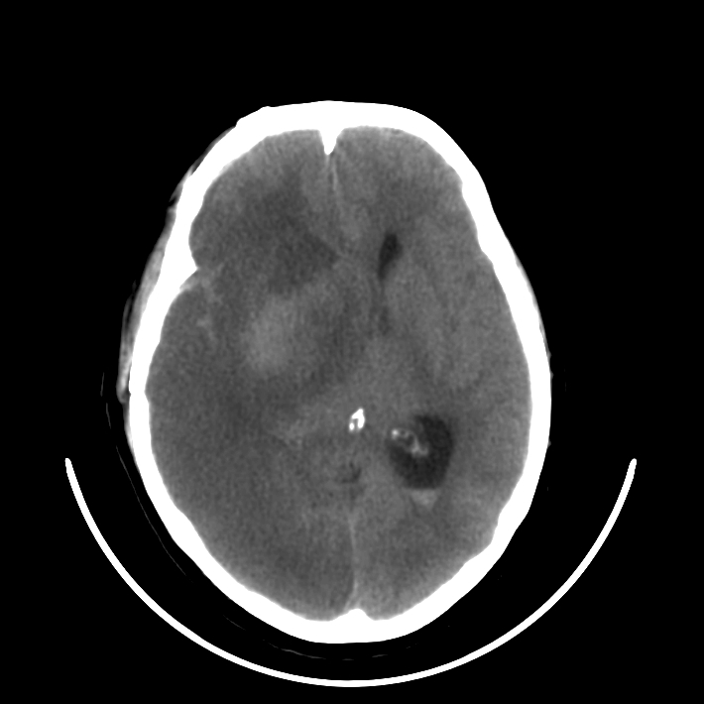
Neurological death testing
Trend down over recent months/years
Not a donation issue per se
Need to emphasise that testing is good medicine, not just good for donation
Clinical Lead Induction

Slide 30
Timing of WLST and retrieval
Ideally between
20:00 and 03:00
More on this tomorrow…

Slide 31
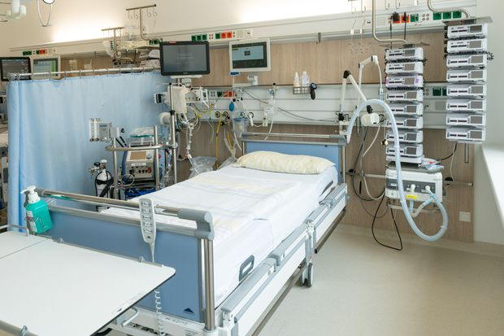
Location of WLST
Intensive care unit
Clinical Lead Induction

Slide 32
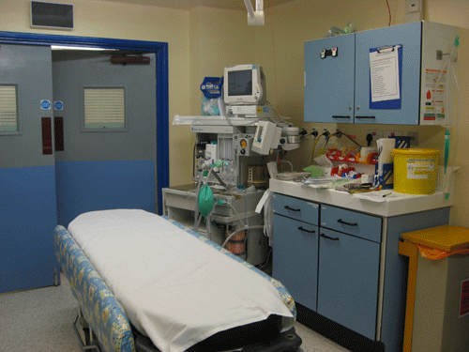
Location of WLST
Theatre suite
Intensive care unit
Clinical Lead Induction
Notes:
Ask where people currently withdraw. Trend UK wide towards WLST in theatre suite. Explore barriers and successes from audience

Slide 33
Management of DBI
Notes:
Worth mentioning this here. Often brought up as an ‘organ donation’ issue, despite the fact it is really a neuro-intensive care issue

Slide 34
Management of DBI
Hopefully less controversial than it was
Useful to detach from OD entirely – admission is about prognostication and good EOLC
Try to stop ‘admission for OD’ – it is rare that this is explicitly the sole reason for ICU admission
Clinical Lead Induction

Slide 35
Trust/board Culture
Stems from ICU culture
A strong ODC can make a huge difference
NED/executive presence on committee can help drive innovation
Visibility of OD in trust (memorial/lift wraps etc)
Clinical Lead Induction

Slide 36
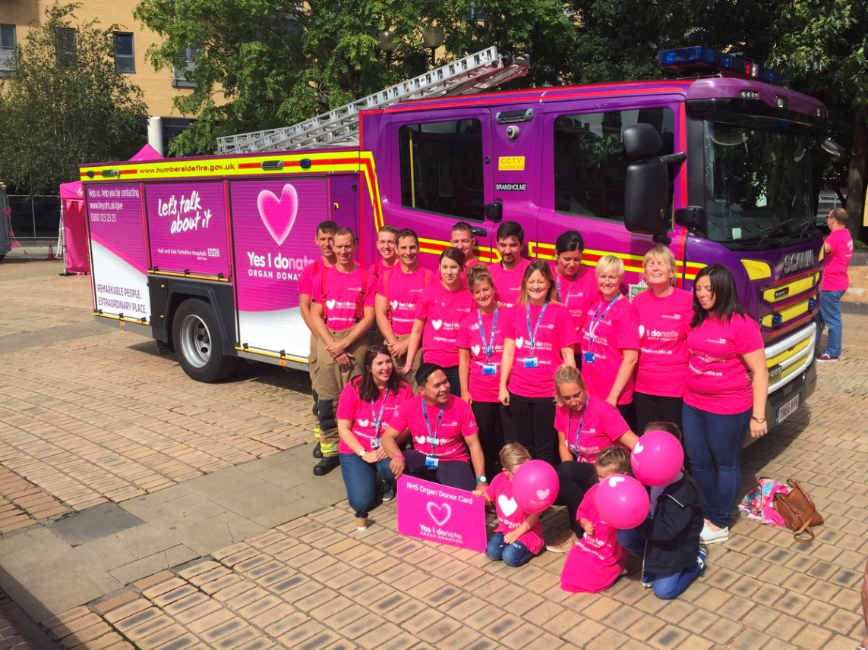
Local community engagement
Almost limitless opportunities
School involvement
Local press for special events
BAME/faith involvement
Play to your own (and your ODC’s) strengths and contacts
Visibility will likely feed back onto unit culture
Clinical Lead Induction

Slide 37
Expectations of the CLOD and appraisal
Clinical Lead Induction

Slide 38
Vision and Recommendations
Enhancing the Clinical Champion role
We recommend maintaining the presence of a CLOD at every Trust/Board but not necessarily in every hospital.
CLODs have been pivotal in establishing a donation culture in UK ICUs and Emergency Departments.
The ‘Meeting the Need’ and ‘Organ Utilisation’ strategies require a ‘whole hospital’ approach to organ and tissue donation and retrieval and a local community approach to promotion.
With the reduction of specialist nurse embedded time in hospitals with lower donation potential, CLODs are needed to have enhanced visibility.
The CLOD role should evolve to take on a wider, whole organisation approach, enabling more agile adoption of emerging policies and innovations in deceased donation and retrieval.
PICUs should have a CLOD on 0.5 PA.
In every region there should be a regional paediatric CLOD on 0.5 PA.

Slide 39
Vision and Recommendations
CLODs at the centre of a knowledge culture
Every region should have a Regional Education CLOD on 1 PA who will work closely with the PDS team, to disseminate knowledge to the wider CLOD network and satisfy local education needs.
Donation culture has changed in UK ICUs and EDs such that donation is ‘usual’. We need to evolve to ‘expected’.
Organ and tissue donation and retrieval will change significantly in the next 10 years.
We need a robust, capable and reliable system for disseminating and implementing new ways of working and adopting innovation going forward. The CLOD is central to this.
CLODs can perform a vital role in the acquisition, sharing, and application of new practice and key to engaging with wider hospital staff networks to support implementation.
Education CLODs will have access to set slides and educational material that can be shared with CLODs to enable teaching to hospital staff and in local promotion.
The national education CLOD role should be increased to 3 PA (from 2 PA).
A national paediatric education CLOD should be appointed on 1 PA.

Slide 40
Vision and Recommendations
Every region should be allocated a budget of CLOD PAs (based on size/complexity).
Building an engaged and sustainable CLOD network.
National guidance and role descriptions will advise on how to allocate CLOD PAs, but regional leadership teams will be encouraged to allocate flexibly, according to regional need.
The CLOD network has operational areas that can be improved to enhance engagement and sustainability.
The CLOD role needs to remain attractive.
We will establish a fair and consistent PA allocation system that better matches individual performance, local donation activity demands, and new hospital landscapes
CLOD role descriptions and the annual review process will be enhanced to be more effective, with clearer goals, more reliable performance markers, and to better promote engagement and commitment
While allowing for exceptions, 0.5 PA should be the typical allocation for any Level 3 or 4 Trust/Board and the minimum for any CLOD.
A clearer structural framework will be developed for CLOD role descriptions and individual CLOD annual reviews.
’Ownership’ of the CLOD database should be held by the AMD – Deceased Organ Donation, with administration and regional support.

Slide 41
Proposed Regional Budget Calculation
For England (devolved nations require individual negotiation with Govt.)
Regional Baseline
Level 1 = 1.5PA
Level 2 = 1PA
Level 3 = 0.5PA
Level 4 = 0.5PA
This does not mean a CLOD receives this amount – that is a regional decision.
Regional Roles
R-CLOD = 1-2 PA (2 PA if >10Trusts/Boards)
Per PICU = 0.5PA
Regional PICU Lead = 0.5PA
Education CLOD = 1PA
Complex Trust/Board Weighting
Possibility for additional PA allocation to the region.

Slide 42
CLOD annual 1:1
Checklist of core operational requirements
ACTIVITY | CHECK | Estimated time
Regular meetings with SNOD (expectation is monthly) |  | 2 hours / month = 24 hours / year = 6 PA = 3 days / year
Attendance at Organ Donation Committees (expectation is ODC should be meeting 3 or 4 times per year) |  | 2 hours x four times / year + 2 hours preparation for each meeting = 16 hours = 4 PA = 2 days
Attendance at regional collaboratives (expectation is 3 of 4 over 2 years) |  | 4 PA = 2 days / year
Annual 1:1 with R-CLOD |  | 4 hours / year = 1 PA = 0.5 day / year
Annual presentation of PDA data to Trust / Board executive or delegated governance structure. |  | 4 hours / year = 1 PA = 0.5 day / year
Up to date hospital organ donation policies |  | 4 PA = 2 days / year
Total Activities Checked Expectation is 5 or 6 checked activities. |  | 20 PA / Year = 10 days / year ½ PA ~ 11 days per year
Clinical Lead Induction

Slide 43
Opportunities from the CLOD role
Inbuilt network of ICU colleagues country wide
Opportunities for professional development within role (education, research, innovation)
Large degree of freedom in terms of day to day work
Loads of pink freebies….
Clinical Lead Induction

Slide 44
Opportunities from the CLOD role
Inbuilt network of ICU colleagues country wide
Opportunities for professional development within role (education, research, innovation)
Large degree of freedom in terms of day to day work
Loads of pink freebies….
Clinical Lead Induction

