Slide 1

Donation Committees and the role of the
Specialist Nurse
Jill Featherstone
National Professional Development Specialist
– Medical Education Lead
2024

Slide 2

An integrated local team
Benefits
Wider working
Your critical friend
Donation Committees
Notes:
Session aims to cover:
An integrated local team: start thinking of this triumvirate you’ll be working in like that –synergise with them
To encourage you to do that we’ll look at the benefits the committee can bring
We’ll cover their wider working and why that’s important
And
How, as your critical friend, the hospital’s critical friend together as you synergise you challenge each other to achieve more.

Slide 3
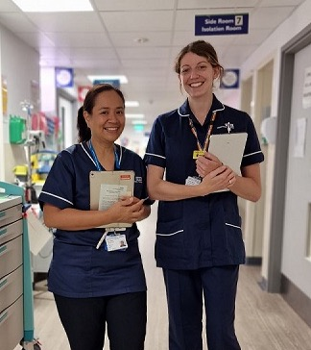
Specialist Nurse Role
Meeting challenges together
4 key areas of essential collaborative clinical working
Benefits of early notifications
Notes:
Specialist Nurse role –what’s their part in these achievements, where SN are most visible in the clinical areas as a donation is ongoing – the areas we concentrate on in the national course, and the benefits of making those notifications early (being proactive)

Slide 4

Committee Origins
Notes:
4
Origins in the 2008 task force document
Sets out what has become an enduring structure this was the ‘end in mind’

Slide 5
Origins
Recommendation 4
2008
Recommendation 9
Notes:
5
2 fundamental recommendations identified, from international experience, what we should have to make donation practice successful.

Slide 6
Origins
Recommendation 4
2008
All parts of the NHS must embrace organ donation as a usual, not an unusual event. … Each Trust should have an identified clinical [lead] and a Trust donation committee to help achieve this.
Recommendation 9
Notes:
6
CLODs and committees in each Trust or health board.

Slide 7
Origins
Recommendation 4
2008
All parts of the NHS must embrace organ donation as a usual, not an unusual event. … Each Trust should have an identified clinical [lead] and a Trust donation committee to help achieve this.
Recommendation 9
Additional [nurses], embedded within critical care areas, should be employed to ensure a comprehensive, highly skilled, specialised and robust service.
Notes:
7
And embedded nurses. Early identification that these relationships would be pivotal..
What we now know now as the triumvirate; 3 key roles, effective in bringing about and maintaining change, engage in excellence in practice, monitoring activity and being ambitious for good relationships and success.

Slide 8
‘There should be a close and defined collaboration between ODCs, clinical staff and clinical leads’
Notes:
The document’s call to action to collaborate as a local team. We know from performance reviews, time and time again that where this is demonstrated, the relationships worked at, as each challenge comes, success and break through follows because this local team is a powerful agent for growth.

Slide 9
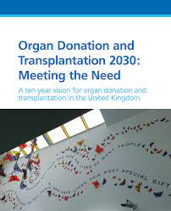
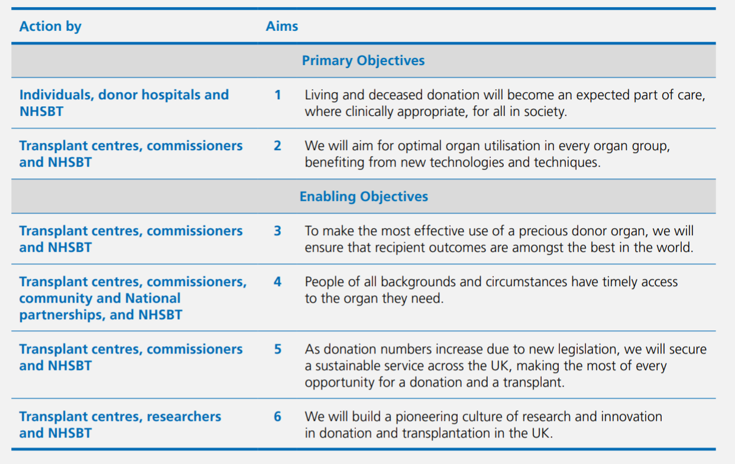
2030
Notes:
As we look to our latest strategy which combines all strategies previously separate to one goal, deceased, living and paeds
The vision to be realised will build on the success of the past –deliver further improvements – with a greater emphasis on holding all to account
Minority groups: Engage more & empower involvement and drive for improvements. You will be able to give feedback to chairs how that is impacting as they lead community engagement
Every organ safely transplanted –(optimisation, facilitating the use of the novel technologies - is everyone pulling together to enable these things to happen?) through your networking collaboratives etc you will again be able to report to chairs the improvements to utilisation & like-wise they can challenge you on why organs were not optimised.
Research & innovation seek out what the future could look like and lead it

Slide 10

Donation Committee Function
Notes:
In achieving all that is asked of us, the committee comes together to plan for that success, monitor effectiveness, meet the challenges and celebrate where successful.
What characterises a good functioning committee?
Chairs profiles are very different some NEDs some donor family members, every committee will be unique as it addresses unique settings

Slide 11
Donation Committee Function
Good working relationships
Notes:
A committee of all the talents; people, networking, influencing all important in energising a committee and taking progress forward.
Together evolve and revolutionise the work needed. Synergise
meet regularly with the chair

Slide 12
Donation Committee Function
Good working relationships
Good communication
Notes:
For that diversity of thought to take action takes good communication. COVID Opportunities working together differently to reduce the threats to deceased donation and no –one needs to be left behind. Attending to those 6 credit types helps here to help you deepen your communication

Slide 13
Donation Committee Function
Good working relationships
Good communication
Supportive to CLODs and SNs
Notes:
It requires that chairs too show leadership and support to CLODs and SNs be proactive

Slide 14
Donation Committee Function
Good working relationships
Good communication
Supportive to CLODs and SNODs
Knowledge of the key initiatives and issues
Notes:
It requires deep knowledge of the key initiatives and issues faced seeking first to understand

Slide 15
Donation Committee Function
Good working relationships
Good communication
Supportive to CLODs and SNODs
Knowledge of the key initiatives and issues
Promote donation in the wider community
Notes:
Will act to promote donation within the wider community, schools, community groups and the Trust /HB itself so that those arriving at the hospital know that there is support for donation, staff are supported and encouraged to be positive about it, and that there is active work within community groups to reduce barriers to donation.

Slide 16
Donation Committee Function
Good working relationships
Good communication
Supportive to CLODs and SNODs
Knowledge of the key initiatives and issues
Promote donation in the wider community
Wider Trust / H B links
Notes:
Will act to promote donation within the wider community, schools, community groups and the Trust /HB itself so that those arriving at the hospital know that there is support for donation, staff are supported and encouraged to be positive about it, and that there is active work within community groups to reduce barriers to donation.

Slide 17
Donation Committee Function
Good working relationships
Good communication
Supportive to CLODs and SNODs
Knowledge of the key initiatives and issues
Promote donation in the wider community
Wider Trust / H B links
Dynamic & diverse
Notes:
We ask for the diversity a committee reflets the area it presides over.
Diversity of thought as well as diversity of the community it serves.
Think about a donor family representative on the committee if not already

Slide 18


Monitoring & oversight
Board level representation
Donation funds management
A critical friend
Engage the community
Donation Committee Purpose
Notes:
Monitoring performance with PDA results and outcomes on power BI, ½ year and full year reports.
Represent donation at board level keeping the profile high with CEO and board level staff
Oversee donation funds and their distribution MOU allows for this.
A critical friend overcoming the challenges together
It’s a committee to work for you as much as you working to satisfy it.
Be ambitious reaching….evolving revolutionising
THIS IS RENEWAL

Slide 19
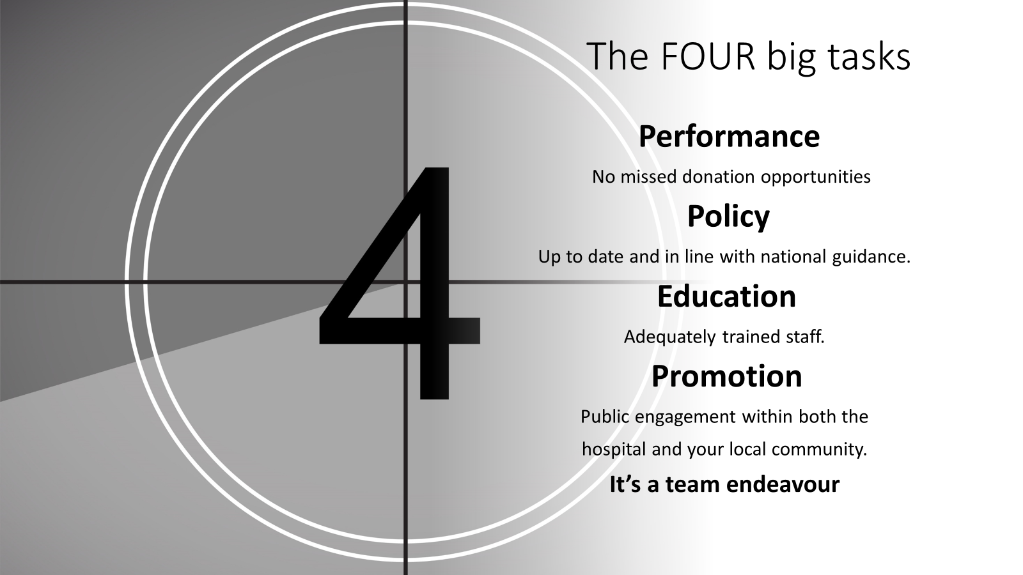

Slide 20

Overseeing performance
Notifications and missed opportunities
SNOD involvement
Neurological death testing
Coronial/ PF objections
Approaches particularly deemed
Non proceeding consented donors
Optimisation of organs retrieval / maximizing donation opportunity
Notes:
Details come from local data but also PDA six monthly and annual reports.
PDA data inputted by SNs
The same data fed up through Trust or HB to the exec board and up through NHSBT similarly.
SNs review performance monthly drill down into the data for each hospital and across the region.
Feeds and supports shared practice, education, development and operational goal setting also. Key points to enabling more successful conversations with families, confidence in the clinical support on the ground also reviewed might be relationships with faith groups, the units, theatres

Slide 21
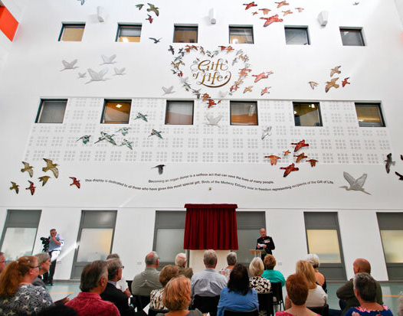

Notes:
Rewards like the memorials, family thank yous can bring a focus that can make all the hard work feel worthwhile

Slide 22


Slide 23
Specialist Nurse Role
Meeting challenges together
4 key areas of essential collaborative clinical working
Benefits of early notifications

Slide 24
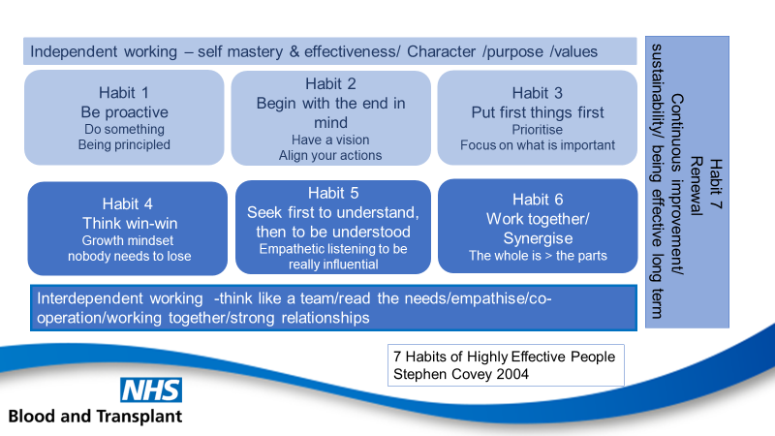
Specialist Nurse Role

Slide 25
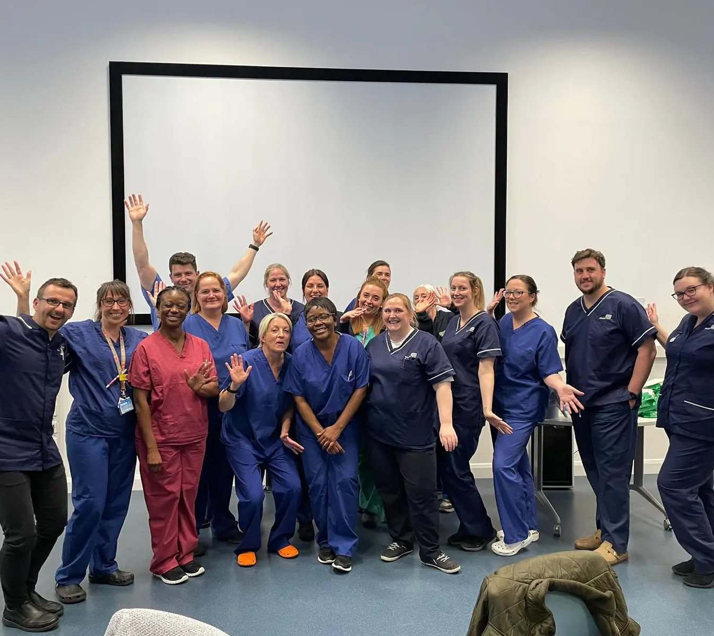
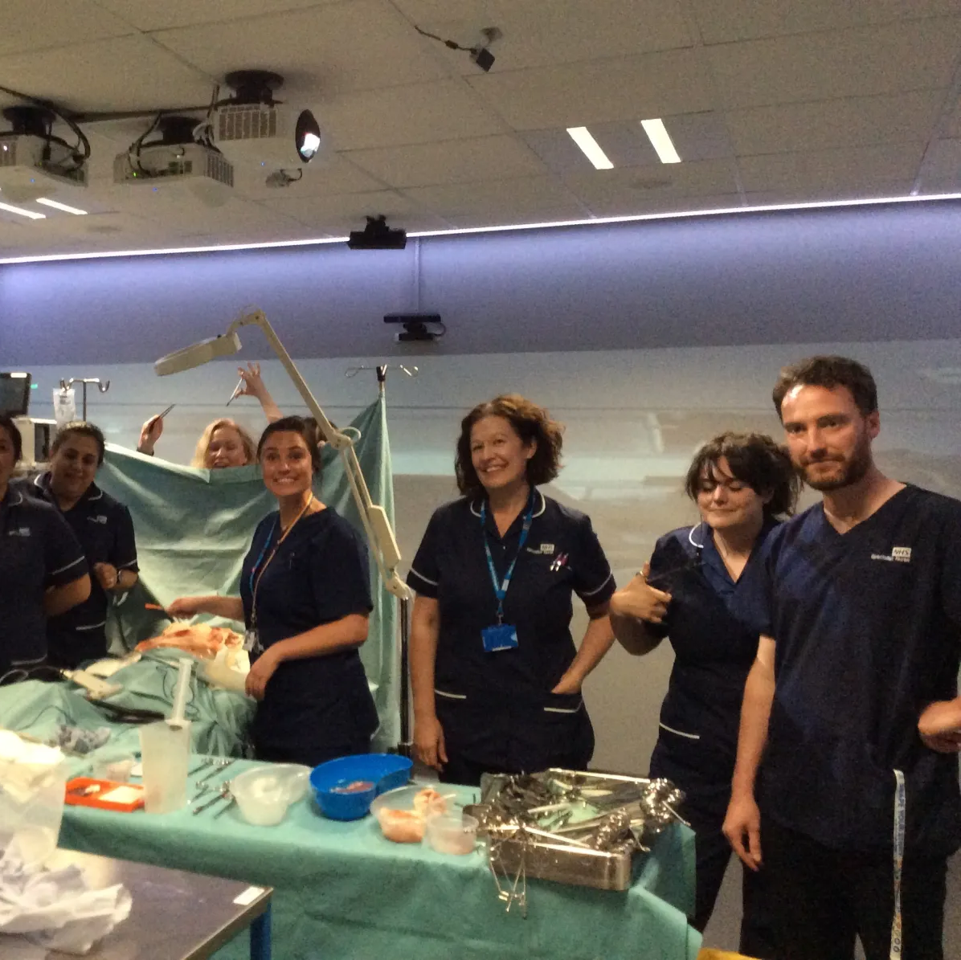

Foundation Training
Notes:
Powerful intensive training & award winning! Programme is evaluated and updated frequently.
understanding self – Insights and how we work with others to become effective. Leadership Framework foundations to their development.
Foundations of approaches and communication
Shadowing and mentorship, shared practice and using regional PDS to support confidence building in practice and process.
Periodic probationary monitoring
Appraisal

Slide 26

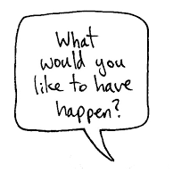
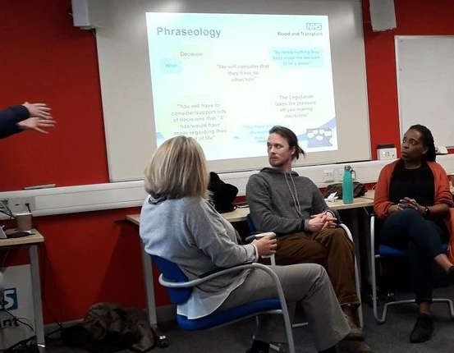
Ongoing training and development
Notes:
Networking, shared practice and performance allows teams to stretch, innovate and rapidly adopt excellence
Shared practice local and national
Performance reviews data numbers but also qualitative data.
Post approach debriefs
Clinical supervision
Deliberate practice
Annual practice day update and exploring communication techniques
Shared opportunities of level meetings congress etc.

Slide 27
SN Teams Structure Service:
what can you expect?
Notes:
The power linked teams enables peaks in activity to be planned and catered for but also to share good practice and innovation
SNOD, Specialist Requester now more frequently the generic SN

Slide 28
SNOD/SR Teams Structure Service: what can you expect?
24/7 regional service /inter-regional service on call
PDS in each region with national links
Embedded work support = donation activity
audit and reporting
education
hospital engagement focus
Parallel support structures: SN supported by Lead Nurse (LN) and Regional Head of Nursing (RHoN)
Notes:
The power of our team to link the regions, share good practice and innovation
24/7 regional service /inter-regional service
PDS in each region but a national team to bring consistency and cohesion
Embedded support: donation activity, education, audit and reporting - hospital engagement focus.
Notifications via national phone line
Triage & rapid assessment of donor potential
& identification of prior decisions
Specialist advice, communication skills & training that
guides approaches and donor care
Parallel structures SN CLOD and Chairs with regional leads

Slide 29
Notifications
Rapid
Decline
Age
Rapid Acceptance
SN mobilised
Exploring Donation Potential
More detailed PMH
Absolute contraindication
Instability
Known PMH
Plan palliation & offer tissue donation as advised
Blood results
Stability & plan of care explored
Police & coroner or PF considerations
-Plan SN attendance, a donation approach & plan palliation discussions collaboratively
Notes:
3 outcomes

Slide 30

consented donors
Exploring potential and prep work towards a consent.
Notes:
We work hard to enable every donor Around 25% of SN workload is consented donors
Around 75% is work exploring potential, screening, case history triage, coroner time, stabilisation, planning and preparing for the donation conversation
This is just in terms of response to notifications
Beyond this is another enormous amount of work, monitoring how we get there, studying performance data, analysing the qualitative experiences behind that that informs our practice, deliberate education and practice to improve both the service to families and for improved outcomes.

Slide 31
Donation Following Neurological Death: DBD
Stabilisation for testing & donor optimisation
Detailed assessment & planning
Gather whole health history
+ Physical examination
Prepare
for
theatre
Find recipients
Retrieval
Family discussions
Family Approach
Testing
Formal consent & medical social assessment
Register donor with national
hub team
Activate retrieval teams
Notification & Triage
Transfer to Theatre
Theatre
Post Retrieval Care and check in with units

Slide 32
Donation Following Circulatory Death: DCD
Stabilisation for ascertaining EOL decisions & donor optimisation
Detailed assessment & planning
Gather & present whole health history
+ Physical examination
Prepare
for
theatre
Find recipients
Retrieval
Family Approach
Preparation for & WLST
REINTUBATION
Formal consent & medical social assessment
Register donor with national
hub team
Activate retrieval teams
Notification & Triage
Theatre
Post Retrieval Care and check in with unit

Slide 33
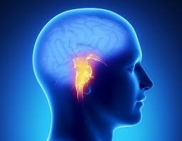
SN Involvement
The benefits
Neurological Death Testing
Efficient preparation towards testing
Reduction in delays for family & clinical teams
Detailed & expert advice access
Support family understanding
Family witnessing tests
Prompt introduction of the donor optimisation care bundle

Slide 34
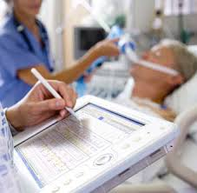
SN Involvement
The benefits
Guide donor optimisation care bundle use
Guide investigations & interventions when liaising with transplant teams
Support bedside nurse to the change of focus of care
Balances family requirements
Supports organ utilisation
Optimise

Slide 35
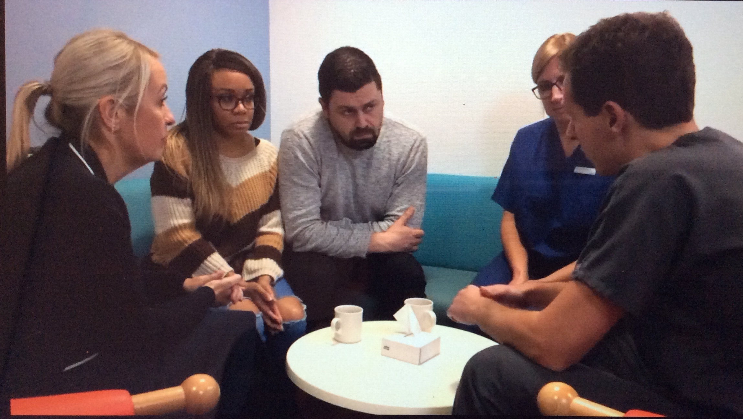
SN Involvement
The benefits
Supports clinical working
Co-ordination of support agencies
Planning the conversation
Supporting family understanding
Planning for & supporting family needs
Expert donation advice for families
Exploring deemed consent, declines & valuing decisions
Establishing post donation support
Donation Conversation

Slide 36
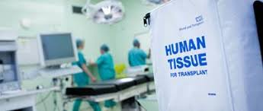
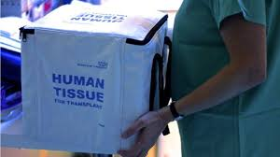
SN Involvement
The benefits
Collaboratively planned to optimise donation balanced with family wishes & patient need
Supervision of safe time scales
Co-ordinated to optimise for recipient outcomes
WoLST & Theatre

Slide 37

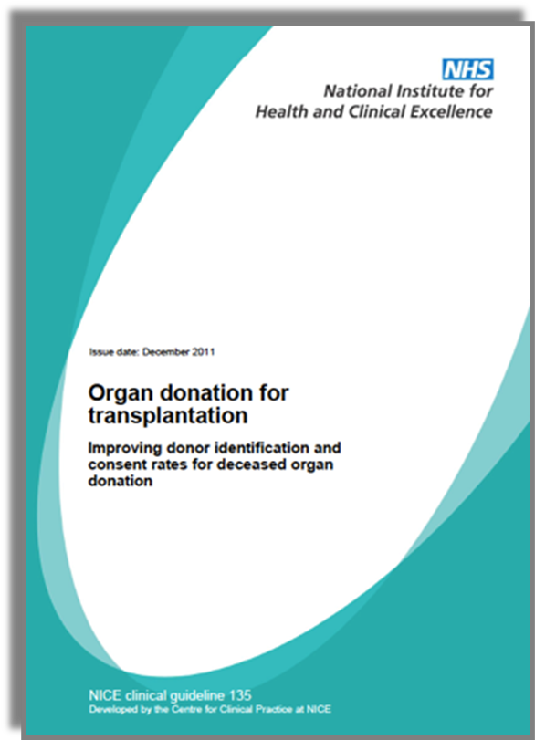

Why notify early?
Notes:
National Guidance advocates it
Stretched services
Performance data evidences that early notification has positive impact – PTA decisions, screening to include where possible, coroner involvement, family experiences,
Few patients can donate so we need to make each donation opportunity matter, the complex patients

Slide 38



ME/Coroner /PF & Police
Notes:
Coroner/ PF/ ME. It is important that donation proceeds with all the required authorisation or LACK OF OBJECTIONS required. An objection needs to be clearly understood but cooperation to complete the investigation can be supported.
They are seeking to complete investigations and understanding of the death. They must be satisfied that donation doesn't impede that understanding. Communication are now increasingly detailed and must be clearly documented including specific individual organs and tissues to be donated or where restrictions apply plus any likely retrieval process deviations (NRP and novel technologies) that may breach traditional instructions e.g. 'nothing above the diaphragm' and any research implications. Variations in how local processes work – work with those. In Scotland written conformation is required from the PF is required.
Recently all case referred to ME in first instance and this further layer has been both helpful and not. Either way the coroner appreciates time to fully consider the case and time to liaise with police colleagues.

Slide 39
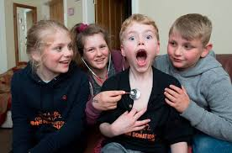
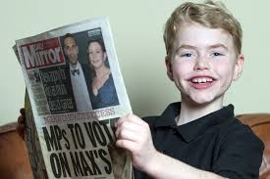
Positive outcome success from early notification
Improved family experiences
Greater coroner support
Efficiency for clinical areas
Safety & effectiveness in donation
& transplants
Notes:
Parallel planning adult or paediatrics.

Slide 40
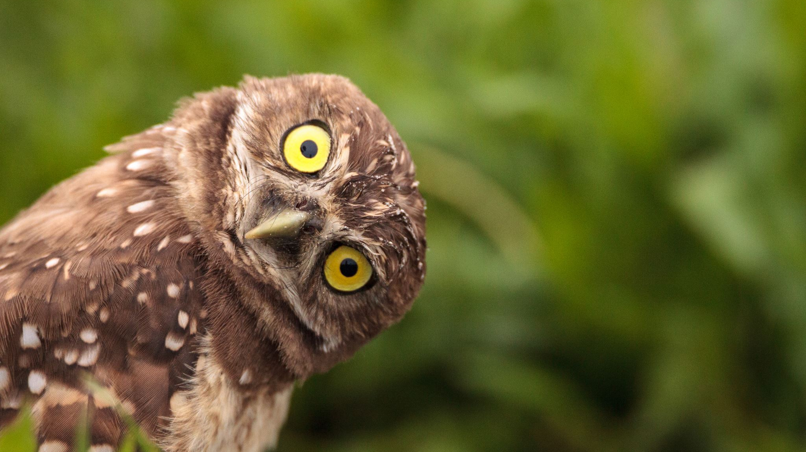
Notes:
Questions?

