Slide 1
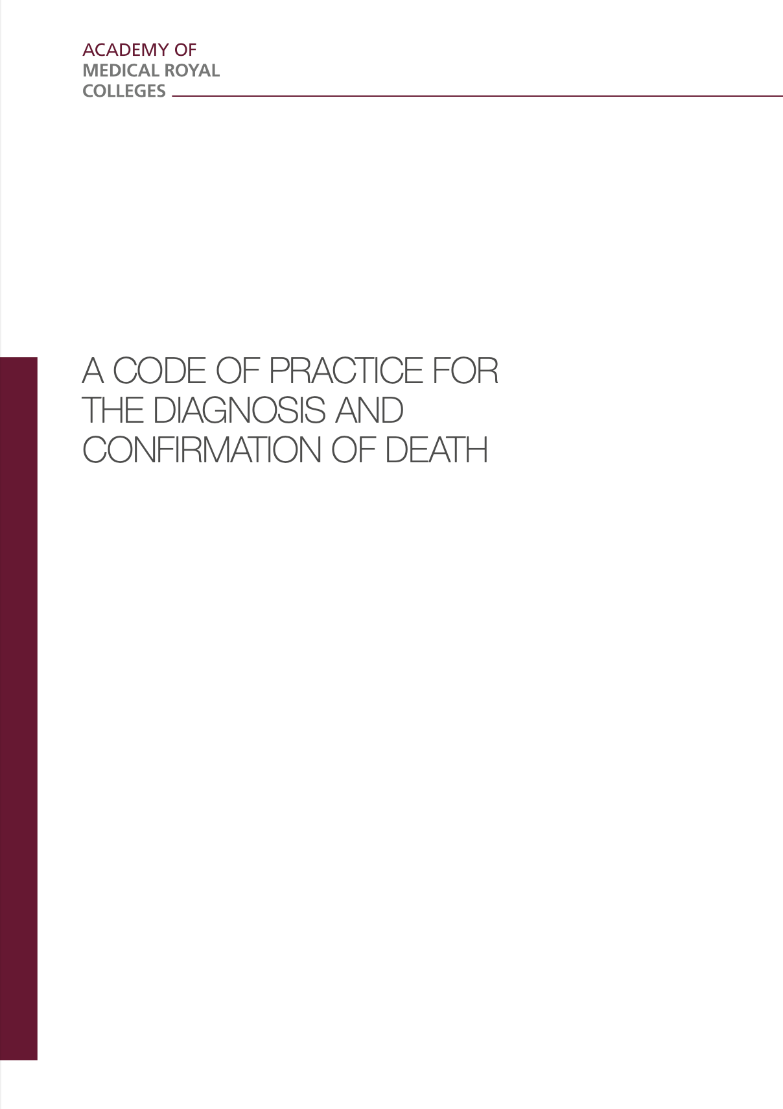
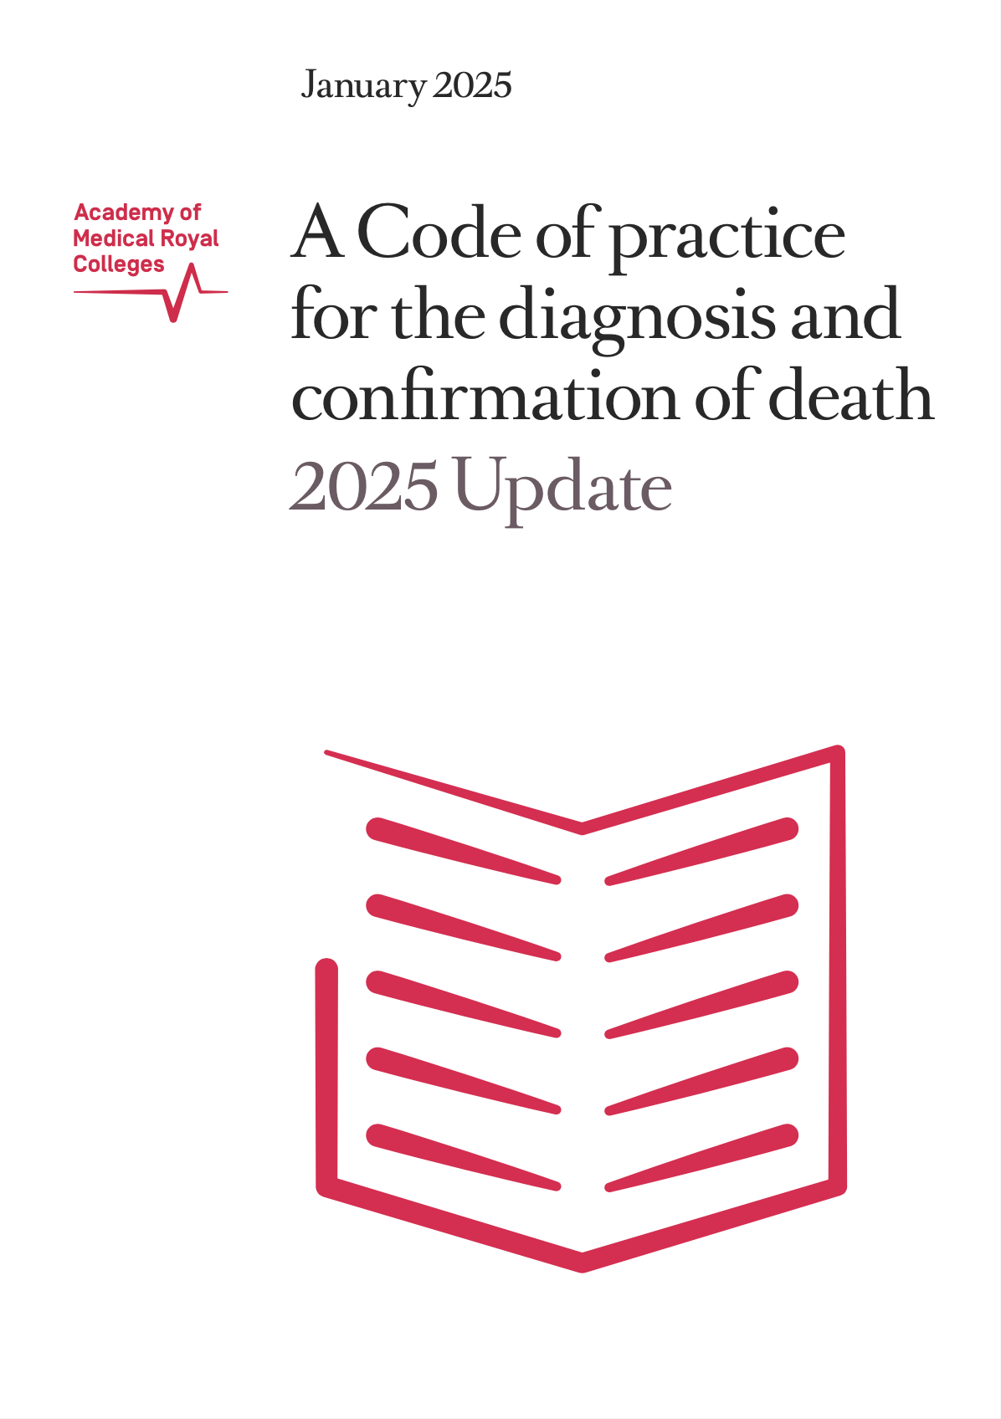
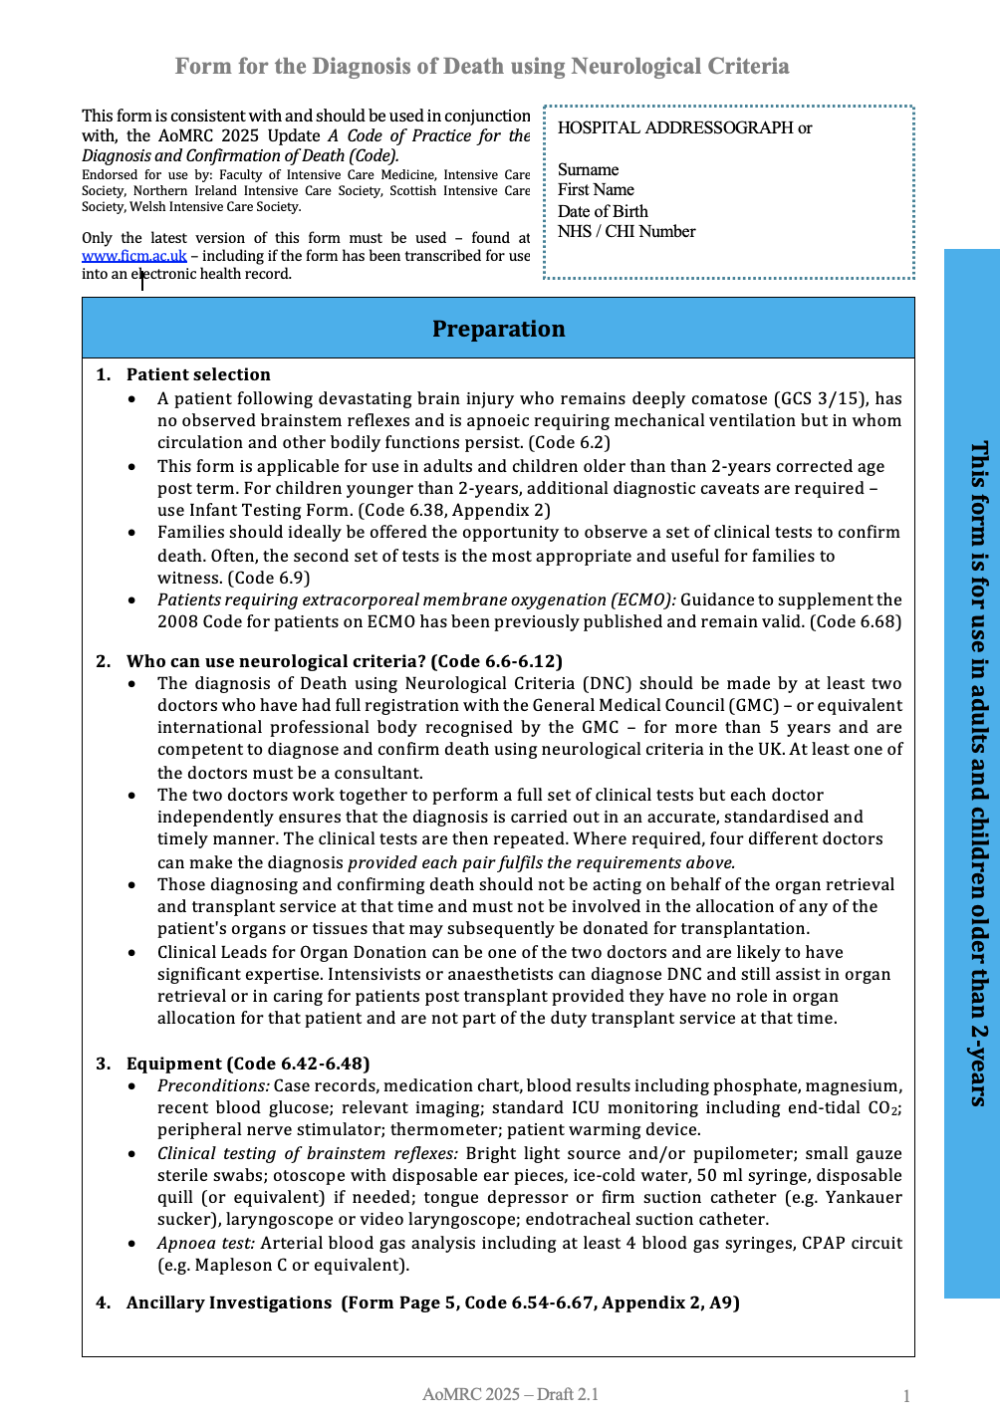
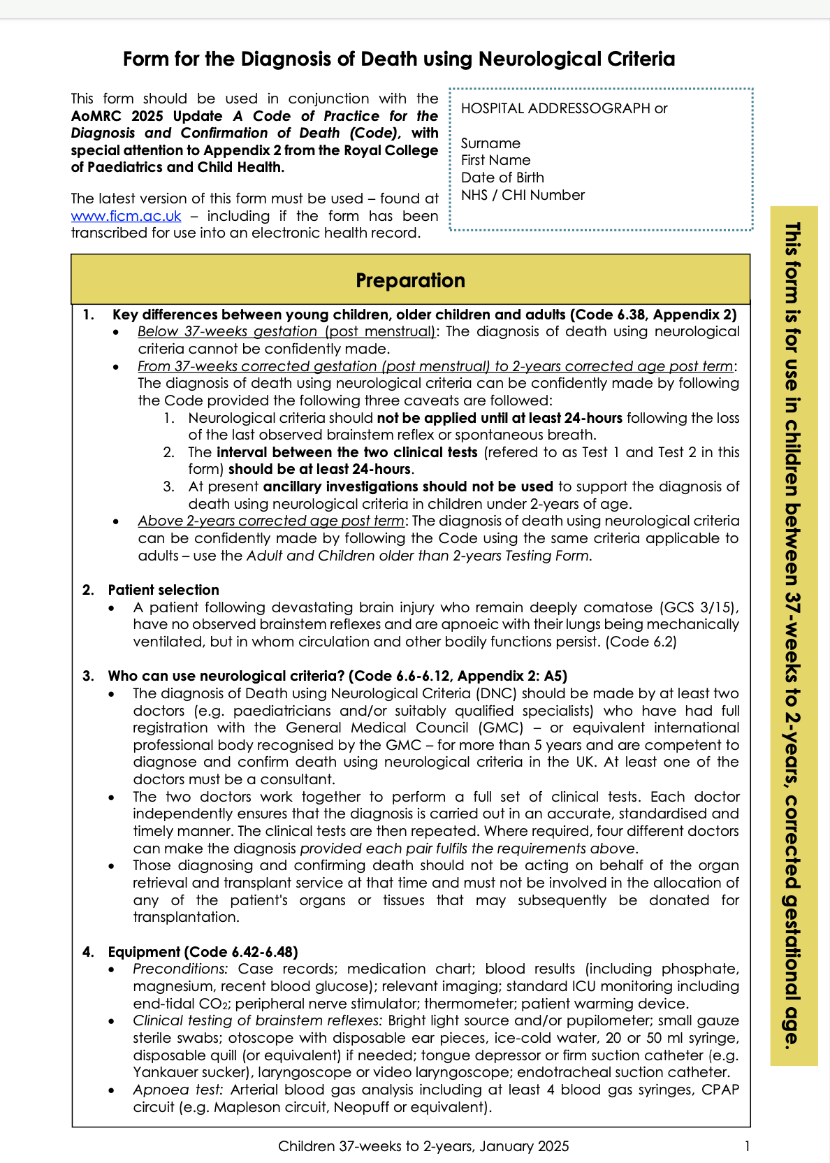
New Testing Forms
2008
1st January 2025

Slide 2


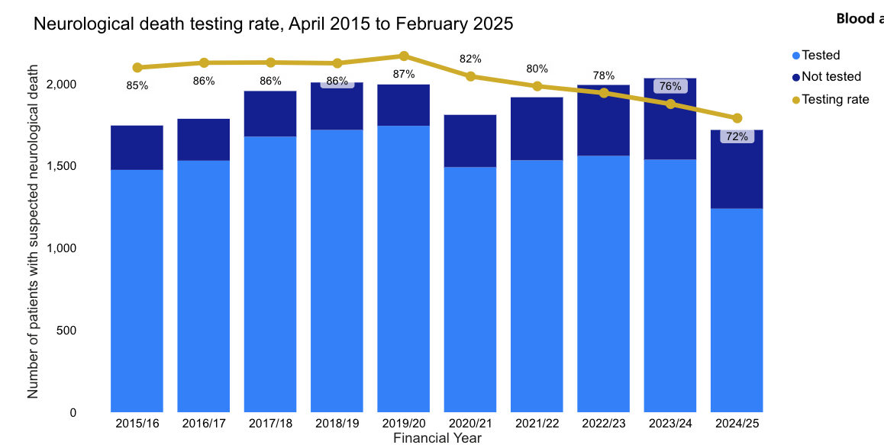
Progress (1)
Estimating
impact on donation
‘all else equal’
2023/24 testing rate 75% = est. +25 donors.
2019/20 testing rate 87% = +140 donors.
Jan
70%
Feb
67%
87%
72%
Increase
NDT rates
Level 1 73% (not tested 276)
Level 2 73% (not tested 117)
Level 3 68% (not tested 44)
Level 4 69% (not tested 42)
AICU 73% (not tested 454)
PICU 54% (not tested 25)
Paed. pt on AICU 63% (tested 15, not tested 9)
Less regional variation compared to ICU variation.
Level 1s 44% - 97% (Newcastle tested 34, not tested 1)

Slide 3
Progress (2)
Preconditions
37%
9+7+4+4+2 = 26
26 / 71 = 37%
Reason not tested (Jan & Feb 2025) | Total
 | N | Jan-Feb % | Apr-Dec %
Family pressure not to test | 13 | 18.3 | 9.2
Hypothermia | 9 | 12.7 | 0.3
Clinical reason/Clinician's decision | 9 | 12.7 | 15.8
Other | 9 | 12.7 | 9.7
Patient haemodynamically unstable | 7 | 9.9 | 31.8
Treatment withdrawn | 5 | 7.0 | 3.7
Family declined donation | 4 | 5.6 | 6.3
Biochemical/endocrine abnormality | 4 | 5.6 | 8.4
Inability to test all reflexes | 4 | 5.6 | 3.4
SN-OD advised that donor not suitable | 4 | 5.6 | 4.2
Continuing effects of sedatives | 2 | 2.8 | 2.1
Medical contraindication to donation | 1 | 1.4 | 2.1
Total | 71 | 100.0
Testing rate 69%
Hypothermia
Cases: 6 Jan, 3 Feb Adjusted testing rate 75% (3 active actions)
Link to donation
31%
13+4+4+1 = 22
22 / 71 = 31%
Increase
NDT rates
ICU Decision
20%
9+5 = 14
14 / 71 = 20%

Slide 4
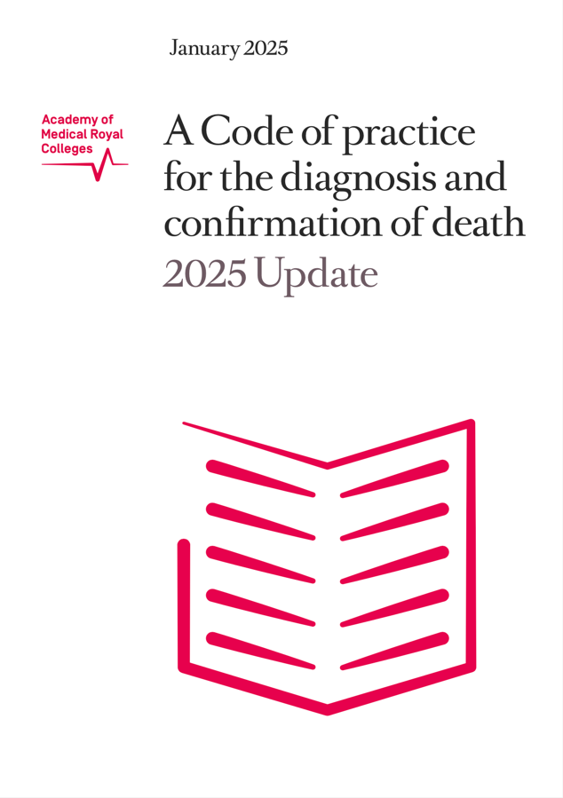
Neurological Criteria
Key Updating Principles
Provide authoritative guidance.
Maintain safety and confidence in the diagnosis of death. Where necessary, strengthen the Code.
Where possible complement and align across all ages and with other international guidelines.
Main Influences
2020, World Brain Death Project
2021, Australian and New Zealand Intensive Care Society's Statement on Death and Organ Donation
2023, Canadian Journal of Anesthesia Special Issue: Defining and Determining Death in Canada
2023, Pediatric and Adult Brain Death/Death by Neurologic Criteria Consensus Guideline from the American Academy of Neurology and the American Academy of Pediatrics.
1st January 2025
“No new science has altered the fundamentals to the criteria used to diagnose and confirm death as outlined in previous Codes…
The working group therefore considered their role to be one of updating and evolving the 2008 Code.”

Slide 5
Updated Code
Death using Neurological Criteria (DNC)
MAJOR UPDATES
Age Categories
< 37 weeks DNC cannot be confidently made.
37 weeks – 2 years Same as per adults with 3 caveats:
            24 hrs before testing
            24 hrs between testing
            No ancillary investigation.
2 years Criteria as per adults.
Apnoea Test
Start. PaCO₂ ≥ 5.3 KPa
End. PaCO₂ ≥ 8.0 kPa, pH < 7.3 + Rise PaCO₂ ≥ 2.7 kPa
Time. Minimum 5 minutes
Time of Death
Completion of the second set of clinical tests.
1st January 2025

Slide 6
Updated Code
Death using Neurological Criteria (DNC)
OTHER SIGNIFICANT UPDATES/CLARIFICATIONS
Greater alignment rest of the world
Temperature 36 ºC
Both eyes, both ears must be examinable
Other / Clarifications
Who
  Full registration GMC 5 years or equivalent
  Up to 4 doctors
Preconditions more specific and the 8 ‘red flags’ incorporated into preconditions.
Peripheral nerve stimulator use.
Minimum sodium concentration as a precondition for testing increased from 115 to 125 mmol/L.
Expanded ancillary investigation guidance.
1st January 2025

Slide 7
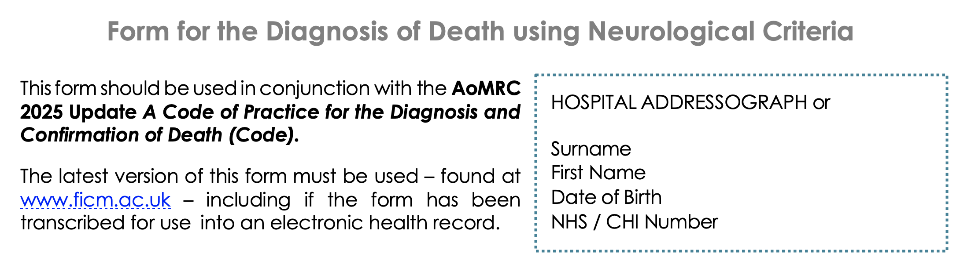
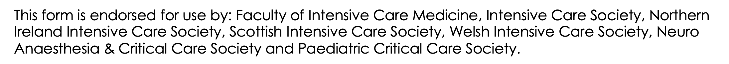
Page 1
Page 8

Slide 8
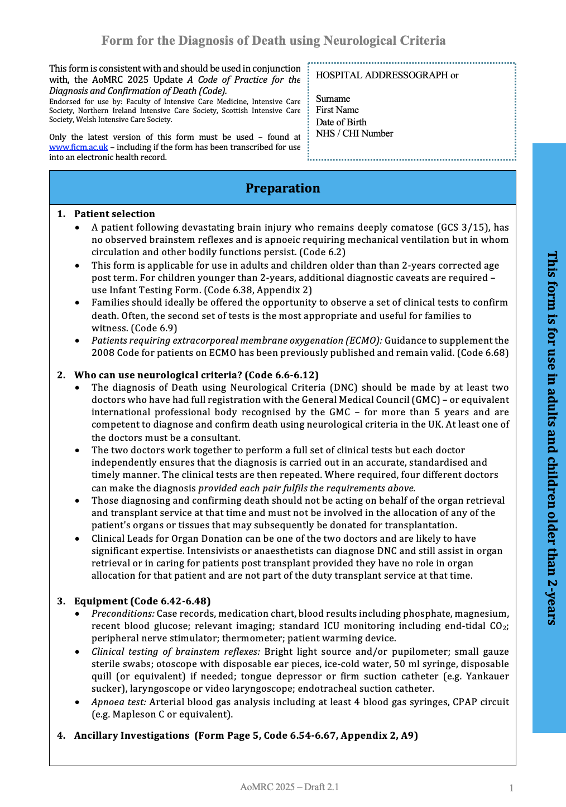
Page 1
Change
2008 Code
2 months of age was the transition to adult criteria

Slide 9
Page 1
Clarifications on who can test and conflicts of interests.

Slide 10

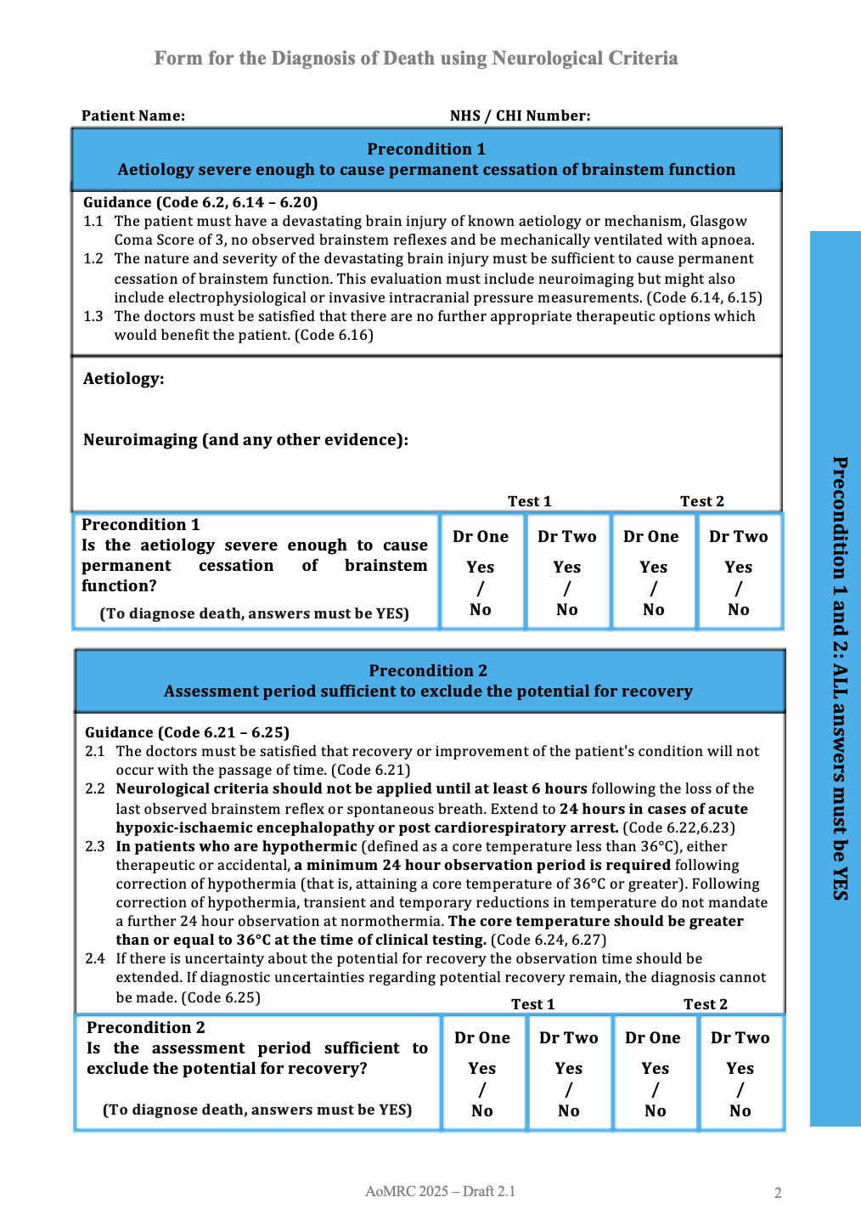
Page 2

Slide 11
Page 2

Slide 12
The requirements regarding hypothermia in the Code can be simplified to:
“Hypothermia can delay the return of brainstem function.
There should have been no significant periods of hypothermia (<36 °C) in the 24 hours before testing.
Temperature should be greater than or equal to 36°C at the time of clinical testing.”
Page 2

Slide 13

The requirements regarding hypothermia in the Code can be simplified to:
“Hypothermia can delay the return of brainstem function.
There should have been no significant periods of hypothermia (<36 °C) in the 24 hours before testing.
Temperature should be greater than or equal to 36°C at the time of clinical testing.”
Page 2
Clinical judgment is still required to judge
‘significant’
or as the Code says
‘transient and temporary reductions’.

Slide 14
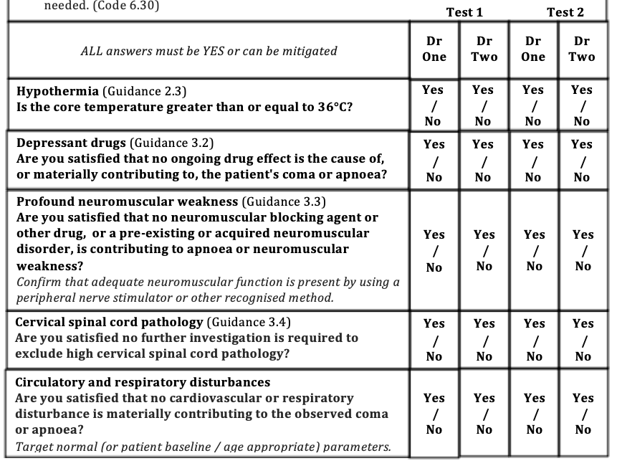
Change
2008 Code
34ºC
Page 3

Slide 15
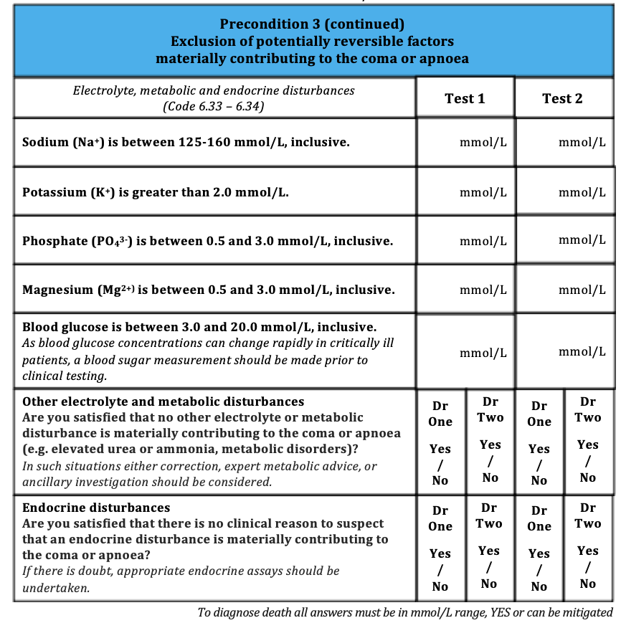
Page 4
Change
2008 Code
Sodium 115 mmol/L

Slide 16

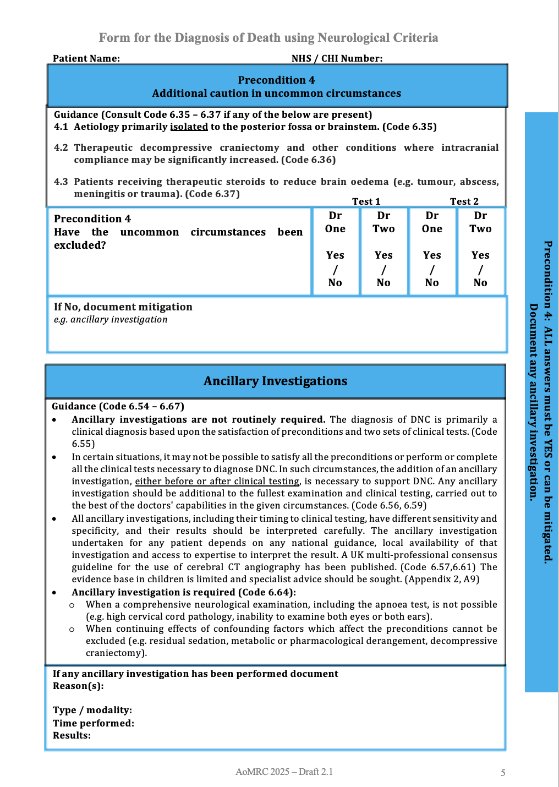
Page 5

Slide 17
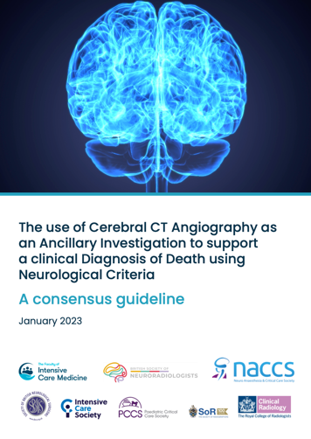
Page 5
2025 Code supportive of professional national guidance.

Slide 18
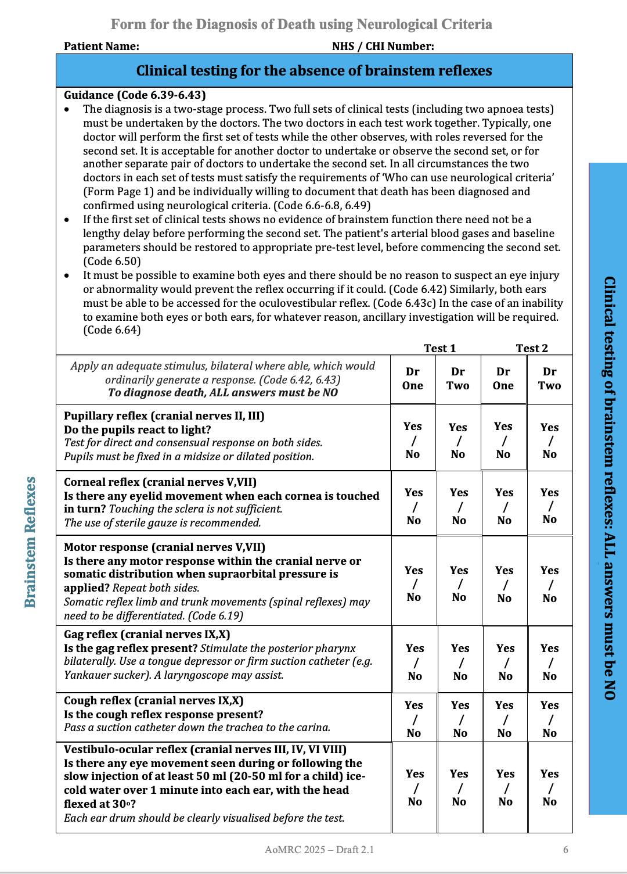
Page 6

Slide 19
Page 6

Slide 20
Page 7

Slide 21
 | AoMRC 2008 | RCPCH 2015 | WBDP 2020 | ANZICS 2021 | Canada 2023 | USA 2023 | AoMRC 2025
Start PaCO₂ | ≥ 6.0 pH < 7.4 | ≥ 5.3 | 4.7 - 6.0 | - | - | 4.7-6.0 pH 7.35-7.45 | ≥ 5.3
Rise PaCO₂ | 0.5 | > 2.7 | - | - | ≥ 2.7 | ≥ 2.7 | ≥ 2.7
End PaCO₂ | - | > 8.0 | ≥ 8.0 pH <7.30 | > 8.0 pH <7.30 | ≥ 8.0 pH ≤ 7.28 | ≥ 8.0 pH <7.30 | ≥ 8.0 pH <7.30
Time | Minimum 5 minutes |  | Check at 10 minutes | Check after 10 minutes or shorter if start PaCO₂ is 6 (advice given this can shorten the time) |  | Check 8-10 mins | Minimum 5 minutes
Apnoea Test
AoMRC 2025
International alignment
Use all ages
2.7 kPa
= 20 mmHg
Main worldwide alignment is for an End PaCO₂ & pH
PaCO₂
rises approx. 0.5 kPA per minute
5 x 0.5 = 2.5
5 minutes is a minimum
Notes:
AoMRC 2008. Academy of Medical Royal Colleges. (2008) A code of practice for the diagnosis and confirmation of death.
RCPCH 2015. Royal College of Paediatrics and Child Health. (2015) The diagnosis of death by neurological criteria in infants less than two months old.
WBDP 2020. Greer DM, Shemie SD, Lewis A, et al. Determination of Brain Death/Death by Neurologic Criteria: The World Brain Death Project. JAMA 2020; 324(11):1078–97.
ANZICS 2021. Australian and New Zealand Intensive Care Society. (ANZICS) (2021) The Statement on Death and Organ Donation. Edition 4.1
Canada 2023. Shemie SD, Wilson LC, Hornby L et al. A brain-based definition of death and criteria for its determination after arrest of circulation or neurologic function in Canada: a 2023 clinical practice guideline. Can J Anesth 2023; 70(4):483-557.
USA 2023. Greer DM, Kirschen MP, Lewis A et al. Pediatric and Adult Brain Death/Death by Neurologic Criteria Consensus Guideline: Report of the AAN Guidelines Subcommittee, AAP, CNS, and SCCM. Neurology 2023; 101:1-21.

Slide 22
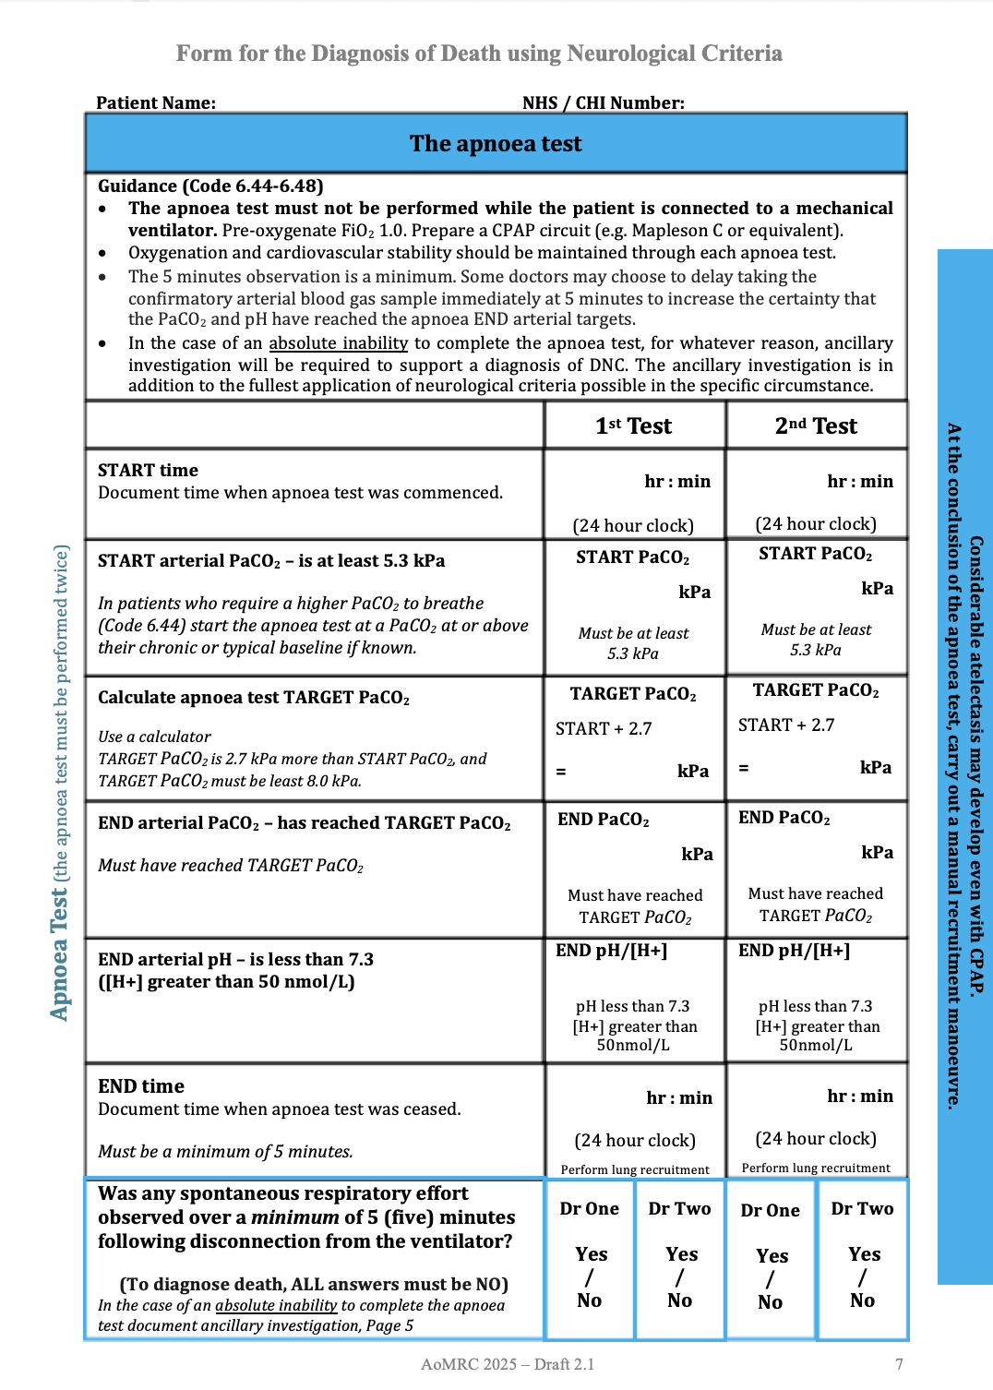
Page 7
Must not be performed on mechanical ventilation.
Absolute inability = absolute inability.
While was theoretically allowed in 2008, very rare.
Even though now more explicitly allowed, still need to keep very rare e.g. cervical spinal cord pathology.

Slide 23
Page 7

Slide 24
Page 7
PaCO₂
START ≥ 5.3 kPa
TARGET
= START PaCO₂ + 2.7
Use a calculator.
Why 2.7 kPA = 20mmHg
END ≥ TARGET
End ≥ 8 kPa
Rise ≥ 2.7 kPa

Slide 25
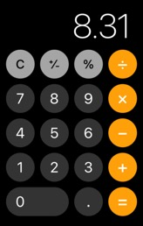
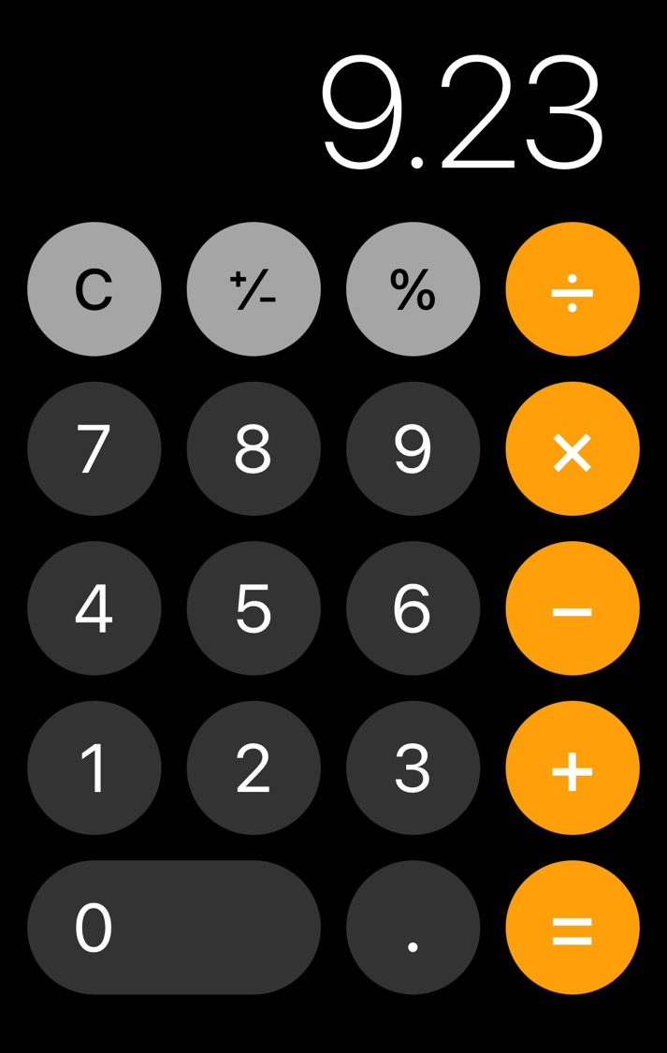
Page 7 (example)
PaCO₂
5.61
6.53
START ≥ 5.3 kPa
TARGET
= START PaCO₂ + 2.7
Use a calculator.
Why 2.7 kPA = 20mmHg
8.31
9.23
8.85
9.25
END ≥ TARGET
End ≥ 8 kPa
Rise ≥ 2.7 kPa

Slide 26
Page 7
pH / [H⁺]
END pH < 7.3
=
END [H⁺] > 50 nmol/L
7.18
7.16

Slide 27
Page 7
Time
MINIMUM
5 minutes
PaCO₂
rises approximately
0.5 kPA per minute
5 x 0.5 = 2.5
Some doctors may choose to delay taking the confirmatory arterial blood gas sample immediately at
5 minutes, to increase the certainty that the PaCO₂ and pH have reached the apnoea end arterial blood targets.
Options
Take a sample at 5 minutes but expect to repeat when ABG is back. Gives a guide to the rate of rise.
Take a sample at around 7-8 minutes. More likely risen ≥ 2.7 kPa.

Slide 28
Page 7

Slide 29

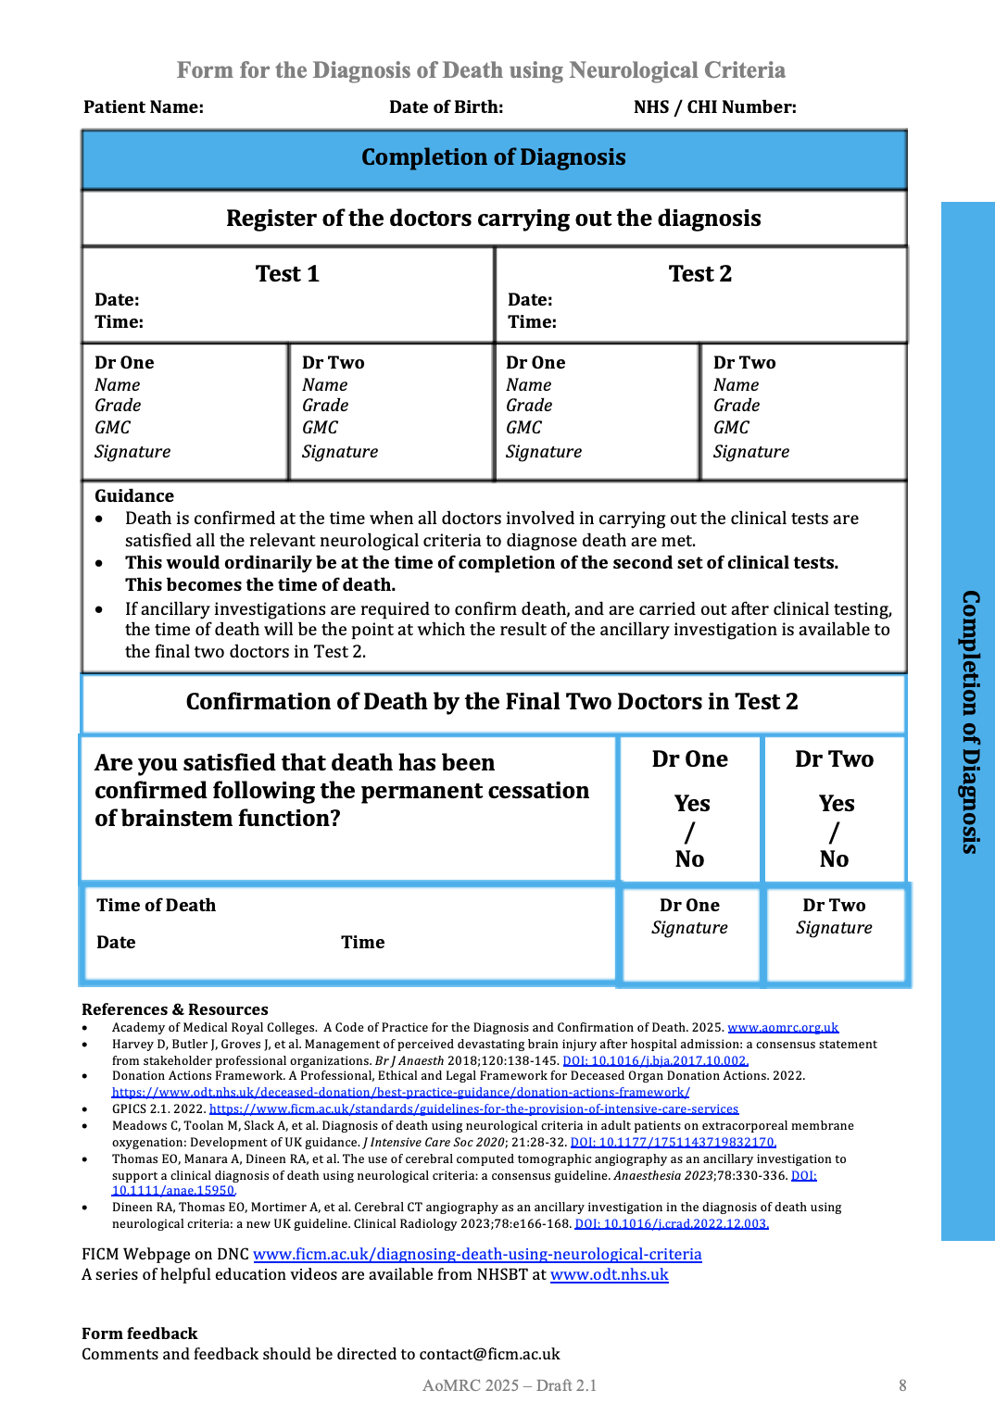
Page 8

Slide 30
Page 8

Slide 31
New Testing Forms
2008
1st January 2025

Slide 32
Progress (1)
Estimating
impact on donation
‘all else equal’
2023/24 testing rate 75% = est. +25 donors.
2019/20 testing rate 87% = +140 donors.
Jan
70%
Feb
67%
87%
72%
Increase
NDT rates
Level 1 73% (not tested 276)
Level 2 73% (not tested 117)
Level 3 68% (not tested 44)
Level 4 69% (not tested 42)
AICU 73% (not tested 454)
PICU 54% (not tested 25)
Paed. pt on AICU 63% (tested 15, not tested 9)
Less regional variation compared to ICU variation.
Level 1s 44% - 97% (Newcastle tested 34, not tested 1)

Slide 33
Progress (2)
Preconditions
37%
9+7+4+4+2 = 26
26 / 71 = 37%
Reason not tested (Jan & Feb 2025) | Total
 | N | Jan-Feb % | Apr-Dec %
Family pressure not to test | 13 | 18.3 | 9.2
Hypothermia | 9 | 12.7 | 0.3
Clinical reason/Clinician's decision | 9 | 12.7 | 15.8
Other | 9 | 12.7 | 9.7
Patient haemodynamically unstable | 7 | 9.9 | 31.8
Treatment withdrawn | 5 | 7.0 | 3.7
Family declined donation | 4 | 5.6 | 6.3
Biochemical/endocrine abnormality | 4 | 5.6 | 8.4
Inability to test all reflexes | 4 | 5.6 | 3.4
SN-OD advised that donor not suitable | 4 | 5.6 | 4.2
Continuing effects of sedatives | 2 | 2.8 | 2.1
Medical contraindication to donation | 1 | 1.4 | 2.1
Total | 71 | 100.0
Testing rate 69%
Hypothermia
Cases: 6 Jan, 3 Feb Adjusted testing rate 75% (3 active actions)
Link to donation
31%
13+4+4+1 = 22
22 / 71 = 31%
Increase
NDT rates
ICU Decision
20%
9+5 = 14
14 / 71 = 20%

Slide 34
