Slide 1


Slide 2
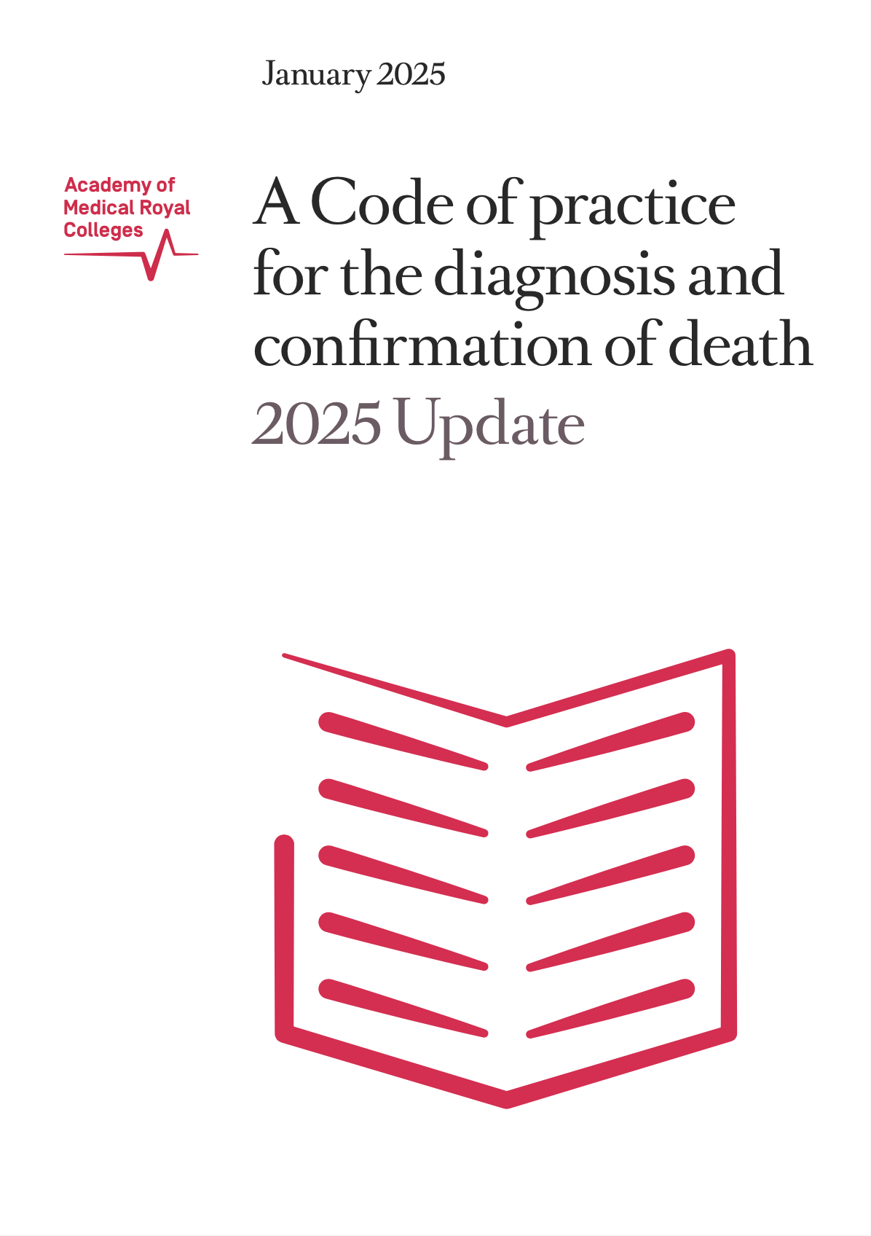
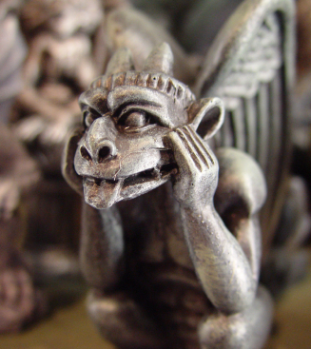
Updated 2025
Pitfalls in Diagnosing Death using Neurological Criteria
Dead or Not Dead Quiz

Slide 3
Question Types
Type 1 – asks if it is safe to proceed with clinical testing (without ancillary investigations).
Clinical testing can proceed? (Dead)
Clinical testing can not proceed? (Not Dead)
Type 2 – asks if neurological criteria can be conceptually true in this circumstance.
Is a diagnosis of DNC still possible? (Dead)
Is a diagnosis of DNC NOT possible? (Not Dead)

Slide 4
Example Question
During clinical testing, the patient blinks to command.
Is a diagnosis of DNC still possible? (Dead)
Is a diagnosis of DNC NOT possible? (Not Dead)

Slide 5
Example Question
During clinical testing, the patient blinks to command.
Is a diagnosis of DNC still possible? (Dead)
Is a diagnosis of DNC NOT possible? (Not Dead)
  Not Dead
  Patient may be locked in.

Slide 6
Preconditions

Slide 7
Precondition 1
Aetiology severe enough to cause permanent cessation of brainstem function
Question 1
CT demonstrates overwhelming cerebral oedema and coning. The clinical diagnosis is meningo-encephalitis but the exact microbiological organism is not known.
Clinical testing can proceed? (Dead)
Clinical testing can not proceed? (Not Dead)

Slide 8
Precondition 1
Aetiology severe enough to cause permanent cessation of brainstem function
Question 1
CT demonstrates overwhelming cerebral oedema and coning. The clinical diagnosis is meningo-encephalitis but the exact microbiological organism is not known.
Neurological death testing can proceed? (Dead)
Neurological death testing can not proceed? (Not Dead)
  Dead
  This is a safe diagnosis provided both doctors are satisfied that the mechanism of cerebral oedema is consistent with the permanent cessation of brainstem function.
  There should be no doubt that the patient's condition is due to devastating brain injury of known aetiology or mechanism. (Code 6.14)
  Specifically, the diagnosis of death using neurological criteria requires that the patient has an established devastating brain injury, the nature and severity of which is recognised to result in the permanent cessation of brainstem function. (Code 6.15)

Slide 9
Precondition 2
Assessment period sufficient to exclude the potential for recovery
Question 2
A patient with hypoxic brain injury was admitted to ICU at midnight with no observed brainstem reflexes or spontaneous breathing.
It is now the next day at 1400.
Neurological death testing can proceed? (Dead)
Neurological death testing can not proceed? (Not Dead)

Slide 10
Precondition 2
Assessment period sufficient to exclude the potential for recovery
Question 2
A patient with hypoxic brain injury was admitted to ICU at midnight with no observed brainstem reflexes or spontaneous breathing.
It is now the next day at 1400.
Neurological death testing can proceed? (Dead)
Neurological death testing can not proceed? (Not Dead)
  Not Dead
  Hypoxic brain injury requires 24 hours observation.
  Neurological criteria should not be applied until at least 6-hours following the loss of the last observed brainstem reflex or spontaneous breath. (Code 6.22)
  Extend to 24-hours in cases of acute hypoxic-ischaemic encephalopathy or post cardiorespiratory arrest. (Code 6.23)

Slide 11
Precondition 2
Assessment period sufficient to exclude the potential for recovery
Question 3
A patient with intracranial haemorrhage has a temperature of 36.2°C.
Over the last 24 hours there has been two periods of two hours each where the temperature was less than 36°C.
Neurological death testing can proceed? (Dead)
Neurological death testing can not proceed? (Not Dead)

Slide 12
Precondition 2
Assessment period sufficient to exclude the potential for recovery
Question 3
A patient with intracranial haemorrhage has a temperature of 36.2°C.
Over the last 24 hours there has been two periods of two hours each where the temperature was less than 36°C.
Neurological death testing can proceed? (Dead)
Neurological death testing can not proceed? (Not Dead)
  Dead
  There has been no significant periods of hypothermia over the preceeding 24 hours.
  Hypothermia can delay the return of brainstem function. (Code 6.24)
  In patients who are hypothermic, either therapeutic or accidental, a minimum 24-hour observation period is required following correction of hypothermia (that is, attaining a core temperature of 36°C or greater). Following correction of hypothermia, transient and temporary reductions in temperature do not mandate a further 24-hour observation at normothermia. (Code 6.24)
  The core temperature should be greater than or equal to 36°C at the time of clinical testing. (Code 6.27)

Slide 13
Precondition 3
Exclusion of potentially reversible factors materially contributing to the coma or apnoea
Question 4
The patient has cervical spinal cord injury.
Neurological death testing can proceed? (Dead)
Neurological death testing can not proceed? (Not Dead)

Slide 14
Precondition 3
Exclusion of potentially reversible factors materially contributing to the coma or apnoea
Question 4
The patient has cervical spinal cord injury.
Neurological death testing can proceed? (Dead)
Neurological death testing can not proceed? (Not Dead)
  Not Dead
  Cer
  Neurological criteria should not be applied until at least 6-hours following the loss of the last observed brainstem reflex or spontaneous breath. (Code 6.22)
  Extend to 24-hours in cases of acute hypoxic-ischaemic encephalopathy or post cardiorespiratory arrest. (Code 6.23)

Slide 15
Question 13
The patient has cervical spinal cord injury?
Ancillary investigation is NOT required? (Dead)
Ancillary investigation is required? (Not Dead)
The Deceased Donation Course (ICM)

Slide 16

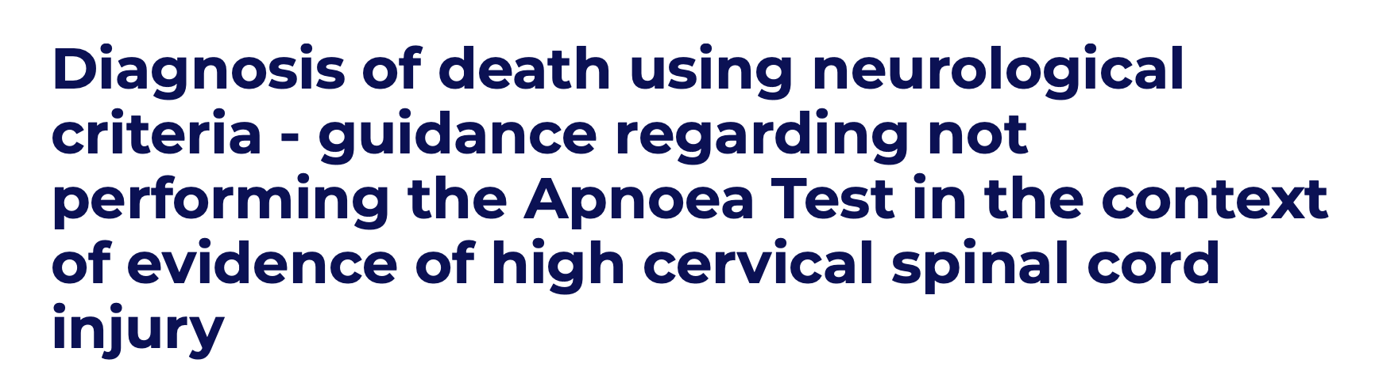
Question 13
The patient has cervical spinal cord injury?
Ancillary investigation is NOT required? (Dead)
Ancillary investigation is required? (Not Dead)
Not Dead – apnoea test is invalid!
If spinal cord injury = ancillary investigation.
Recent RCPCH safety alert.
If cervical spine injury 3 options
MRI to show no cord damage.
Ancillary investigation.
Don’t diagnose DNC.
The Deceased Donation Course (ICM)

Slide 17
Precondition 4
Additional caution in uncommon circumstances
Question 2
A patient was admitted to ICU with no observed brainstem reflexes or spontaneous breathing and a temperature 36.2°C.
For most of the night the temperature was less than 36°C.
The temperature is now 36°C in preparation for testing.
Is a diagnosis of DNC still possible? (Dead)
Is a diagnosis of DNC NOT possible? (Not Dead)
  Dead
  Temperature is greater than or equal to 36°C at the time of clinical testing.
  “In patients who are hypothermic (defined as a core temperature less than 36°C), either therapeutic or accidental [at admission], a minimum 24-hour observation period is required following correction of hypothermia (that is, attaining a core temperature of 36°C or greater). Following correction of hypothermia, transient and temporary reductions in temperature do not mandate a further 24-hour observation at normothermia. The core temperature should be greater than or equal to 36°C at the time of clinical testing. (Code 6.24, 6.27)
The Deceased Donation Course (ICM)

Slide 18
Ancillary investigations
Question 2
A patient was admitted to ICU with no observed brainstem reflexes or spontaneous breathing and a temperature 36.2°C.
For most of the night the temperature was less than 36°C.
The temperature is now 36°C in preparation for testing.
Is a diagnosis of DNC still possible? (Dead)
Is a diagnosis of DNC NOT possible? (Not Dead)
  Dead
  Temperature is greater than or equal to 36°C at the time of clinical testing.
  “In patients who are hypothermic (defined as a core temperature less than 36°C), either therapeutic or accidental [at admission], a minimum 24-hour observation period is required following correction of hypothermia (that is, attaining a core temperature of 36°C or greater). Following correction of hypothermia, transient and temporary reductions in temperature do not mandate a further 24-hour observation at normothermia. The core temperature should be greater than or equal to 36°C at the time of clinical testing. (Code 6.24, 6.27)
The Deceased Donation Course (ICM)

Slide 19
Clinical testing for the absence of brainstem reflexes
Question 2
A patient was admitted to ICU with no observed brainstem reflexes or spontaneous breathing and a temperature 36.2°C.
For most of the night the temperature was less than 36°C.
The temperature is now 36°C in preparation for testing.
Is a diagnosis of DNC still possible? (Dead)
Is a diagnosis of DNC NOT possible? (Not Dead)
  Dead
  Temperature is greater than or equal to 36°C at the time of clinical testing.
  “In patients who are hypothermic (defined as a core temperature less than 36°C), either therapeutic or accidental [at admission], a minimum 24-hour observation period is required following correction of hypothermia (that is, attaining a core temperature of 36°C or greater). Following correction of hypothermia, transient and temporary reductions in temperature do not mandate a further 24-hour observation at normothermia. The core temperature should be greater than or equal to 36°C at the time of clinical testing. (Code 6.24, 6.27)
The Deceased Donation Course (ICM)

Slide 20
The apnoea test
Question 2
A patient was admitted to ICU with no observed brainstem reflexes or spontaneous breathing and a temperature 36.2°C.
For most of the night the temperature was less than 36°C.
The temperature is now 36°C in preparation for testing.
Is a diagnosis of DNC still possible? (Dead)
Is a diagnosis of DNC NOT possible? (Not Dead)
  Dead
  Temperature is greater than or equal to 36°C at the time of clinical testing.
  “In patients who are hypothermic (defined as a core temperature less than 36°C), either therapeutic or accidental [at admission], a minimum 24-hour observation period is required following correction of hypothermia (that is, attaining a core temperature of 36°C or greater). Following correction of hypothermia, transient and temporary reductions in temperature do not mandate a further 24-hour observation at normothermia. The core temperature should be greater than or equal to 36°C at the time of clinical testing. (Code 6.24, 6.27)
The Deceased Donation Course (ICM)

Slide 21
Completion of diagnosis
Question 2
A patient was admitted to ICU with no observed brainstem reflexes or spontaneous breathing and a temperature 36.2°C.
For most of the night the temperature was less than 36°C.
The temperature is now 36°C in preparation for testing.
Is a diagnosis of DNC still possible? (Dead)
Is a diagnosis of DNC NOT possible? (Not Dead)
  Dead
  Temperature is greater than or equal to 36°C at the time of clinical testing.
  “In patients who are hypothermic (defined as a core temperature less than 36°C), either therapeutic or accidental [at admission], a minimum 24-hour observation period is required following correction of hypothermia (that is, attaining a core temperature of 36°C or greater). Following correction of hypothermia, transient and temporary reductions in temperature do not mandate a further 24-hour observation at normothermia. The core temperature should be greater than or equal to 36°C at the time of clinical testing. (Code 6.24, 6.27)
The Deceased Donation Course (ICM)

Slide 22
Precondition 1
Aetiology severe enough to cause permanent cessation of brainstem function
Question 1
CT demonstrates overwhelming cerebral oedema and coning. The clinical diagnosis is meningo-encephalitis but the exact microbiological organism is not known?
Answer: still ok if both doctors are satisfied that the mechanism of cerebral oedema is consistent with the permanent cessation of brainstem function.
Is a diagnosis of DNC still possible? (Dead)
Is a diagnosis of DNC NOT possible? (Not Dead)
The Deceased Donation Course (ICM)

Slide 23
Question 1
The patient flexes their arm at the elbow following imposition of a painful stimulus to the nail bed on that side?
Is a diagnosis of DNC still possible? (Dead)
Is a diagnosis of DNC NOT possible? (Not Dead)
The Deceased Donation Course (ICM)

Slide 24
Question 1
The patient flexes their arm at the elbow following imposition of a painful stimulus to the nail bed on that side?
Is a diagnosis of DNC still possible? (Dead)
Is a diagnosis of DNC NOT possible? (Not Dead)
  Dead - May represent a spinal reflex
The Deceased Donation Course (ICM)

Slide 25
Question 2
The ventilator registers the patient as making spontaneous respirations?
Is a diagnosis of DNC still possible? (Dead)
Is a diagnosis of DNC NOT possible? (Not Dead)
The Deceased Donation Course (ICM)

Slide 26
Question 2
The ventilator registers the patient as making spontaneous respirations?
Is a diagnosis of DNC still possible? (Dead)
Is a diagnosis of DNC NOT possible? (Not Dead)
  Dead
  May represent the heart beat creating flow that is triggering ventilation.
The Deceased Donation Course (ICM)

Slide 27
Question 3
The patient has a generalised tonic clonic seizure?
Is a diagnosis of DNC still possible? (Dead)
Is a diagnosis of DNC NOT possible? (Not Dead)
The Deceased Donation Course (ICM)

Slide 28
Question 3
The patient has a generalised tonic clonic seizure?
Is a diagnosis of DNC still possible? (Dead)
Is a diagnosis of DNC NOT possible? (Not Dead)
  Not Dead – the patient must have intact neural connections to have a grand mal fit.
The Deceased Donation Course (ICM)

Slide 29
Question 4
The patient’s pulse increases from 70bpm to 110 bpm during apnoea testing?
Is a diagnosis of DNC still possible? (Dead)
Is a diagnosis of DNC NOT possible? (Not Dead)
The Deceased Donation Course (ICM)

Slide 30
Question 4
The patient’s pulse increases from 70bpm to 110 bpm during apnoea testing?
Is a diagnosis of DNC still possible? (Dead)
Is a diagnosis of DNC NOT possible? (Not Dead)
  Dead - Hypercarbia (which occurs during apnoea testing) results in endogenous adrenaline release.
The Deceased Donation Course (ICM)

Slide 31
Bonus Question 4a
The patient’s pulse increases from 70bpm to 110 bpm after injection of 2mg atropine?
Is a diagnosis of DNC still possible? (Dead)
Is a diagnosis of DNC NOT possible? (Not Dead)
The Deceased Donation Course (ICM)

Slide 32
Bonus Question 4a
The patient’s pulse increases from 70bpm to 110 bpm after injection of 2mg atropine?
Is a diagnosis of DNC still possible? (Dead)
Is a diagnosis of DNC NOT possible? (Not Dead)
  Not Dead - the tachycardia is vagally mediated (Cranial Nerve X). Up to 3% increase may be seen secondary to limited local effects and is acceptable.
The Deceased Donation Course (ICM)

Slide 33
Question 5
There is slow drift of one eye away from the ear in which cold water is injected?
Is a diagnosis of DNC still possible? (Dead)
Is a diagnosis of DNC NOT possible? (Not Dead)
The Deceased Donation Course (ICM)

Slide 34
Question 5
There is slow drift of one eye away from the ear in which cold water is injected?
Is a diagnosis of DNC still possible? (Dead)
Is a diagnosis of DNC NOT possible? (Not Dead)
  Not Dead – any eye movements in response to caloric testing signifies the presence of some reflex brain stem arc function.
The Deceased Donation Course (ICM)

Slide 35
Question 6
The patient sits up during apnoea testing?
Is a diagnosis of DNC still possible? (Dead)
Is a diagnosis of DNC NOT possible? (Not Dead)
The Deceased Donation Course (ICM)

Slide 36
Question 6
The patient sits up during apnoea testing?
Is a diagnosis of DNC still possible? (Dead)
Is a diagnosis of DNC NOT possible? (Not Dead)
  Dead – The Lazarus Sign.
  A spinal reaction to the acidosis which follows hypercarbia. Very unsettling and disturbing!
The Deceased Donation Course (ICM)

Slide 37
How are you going?
These six questions were asked in the Australian JFICM exam 2008 and the pass rate was only 65%!
The Deceased Donation Course (ICM)

Slide 38
Preconditions
The Deceased Donation Course (ICM)

Slide 39
Question 7
During an apnoea test on a mechanical ventilator after 20 seconds the patient starts to breathe and then continues to breathe steadily at 16 breaths per minute without variation over the next five minutes?
Is a diagnosis of DNC still possible? (Dead)
Is a diagnosis of DNC NOT possible? (Not Dead)
The Deceased Donation Course (ICM)

Slide 40
Question 7
During an apnoea test on a mechanical ventilator after 20 seconds the patient starts to breathe and then continues to breathe steadily at 16 breaths per minute without variation over the next five minutes?
Is a diagnosis of DNC still possible? (Dead)
Is a diagnosis of DNC NOT possible? (Not Dead)
  Dead – ventilator apnoea ventilation has kicked in. Are you convinced not to do your apnoea tests still connected to the ventilator?
The Deceased Donation Course (ICM)

Slide 41
Question 8
Supra-orbital painful stimulus leads to movement in one of the arms?
Is a diagnosis of DNC still possible? (Dead)
Is a diagnosis of DNC NOT possible? (Not Dead)
The Deceased Donation Course (ICM)

Slide 42
Question 8
Supra-orbital painful stimulus leads to movement in one of the arms?
Is a diagnosis of DNC still possible? (Dead)
Is a diagnosis of DNC NOT possible? (Not Dead)
  Not Dead (debateable) – although one primarily looks for movement in the cranial nerve distribution one must actively ensure (by repetition) that this was a coincidental spinal reflex but until proven this may represent the patient is not dead.
The Deceased Donation Course (ICM)

Slide 43
Question 9
The patient is seen to shrug the shoulder when the arm is touched or when the head is rotated?
Is a diagnosis of DNC still possible? (Dead)
Is a diagnosis of DNC NOT possible? (Not Dead)
The Deceased Donation Course (ICM)

Slide 44
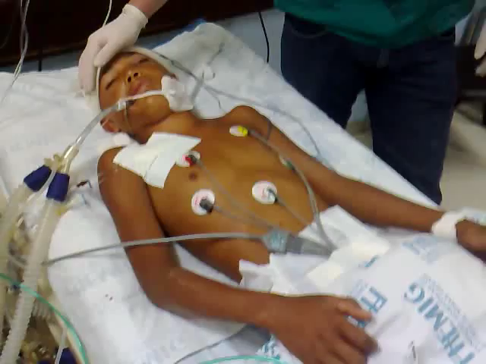
Question 9
The patient is seen to shrug the shoulder when the arm is touched or when the head is rotated?
Is a diagnosis of DNC still possible? (Dead)
Is a diagnosis of DNC NOT possible? (Not Dead)
Dead (with care) – spinal roots also supply the neck muscles and the anatomical course of motor CN N XI is complicated arising in the spinal cord traversing up the foramen magnum (outside the brain stem) and then exiting as Cn N XI to supply the neck muscles.
The Deceased Donation Course (ICM)

Slide 45
The next 4 questions are on the need for ancillary investigation.
Ancillary investigation is NOT required? (Dead)
Ancillary investigation is required? (Not Dead)
The Deceased Donation Course (ICM)

Slide 46
Question 10
The patient has had a therapeutic decompressive craniectomy?
Ancillary investigation is NOT required? (Dead)
Ancillary investigation is required? (Not Dead)
The Deceased Donation Course (ICM)

Slide 47
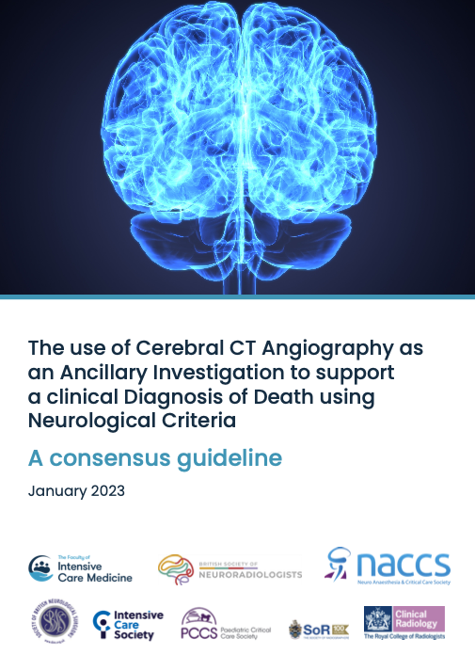
Question 10
The patient has had a therapeutic decompressive craniectomy?
Ancillary investigation is NOT required? (Dead)
Ancillary investigation is required? (Not Dead)
Not Dead – therapeutic decompressive craniectomy is a Red Flag and ancillary investigation (CT angiography) is advised.
Note 1. The quoted sensitivity of CTA is 85% for demonstrating absent cerebral blood in DNC. Sensitivity may well prove lower in patients who have had therapeutic decompressive craniectomy.
Note 2. The diagnosis of death in the UK is by concept FUNCTIONAL - the irreversible loss of the capacity to breathe combined with the irreversible loss of the capacity for consciousness.
Theoretically absent flow isn’t mandated – seek expert advice.
But if Concern on Precondition / Red Flag situation FLOW = NO.
The Deceased Donation Course (ICM)

Slide 48
Question 11
Due to left orbital trauma you can't visualise or observe the left eye?
Ancillary investigation is NOT required? (Dead)
Ancillary investigation is required? (Not Dead)
The Deceased Donation Course (ICM)

Slide 49
Question 11
Due to left orbital trauma you can't visualise or observe the left eye?
Ancillary investigation is NOT required? (Dead)
Ancillary investigation is required? (Not Dead)
  Not dead (but only from 01/01/2025)
  2008 code - If both eyes were not visible clinical criteria alone would generally be considered inadequate.
  2025 code – Need both eyes/ears
The Deceased Donation Course (ICM)

Slide 50
Question 12
The patient is on ECMO?
Ancillary investigation is NOT required? (Dead)
Ancillary investigation is required? (Not Dead)
The Deceased Donation Course (ICM)

Slide 51
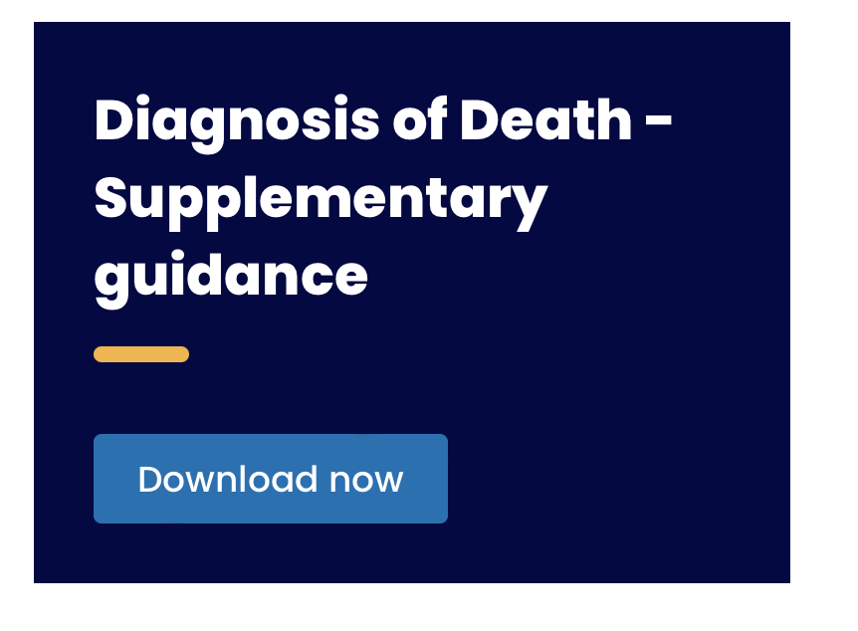
Question 12
The patient is on ECMO?
Ancillary investigation is NOT required? (Dead)
Ancillary investigation is required? (Not Dead)
Dead – supplementary consensus guidance has been published. Apnoea Test needs adaption.
“Apnoea testing on ECMO requires maintenance of the extracorporeal blood flow with a membrane sweep gas FiO2 100% in order to preserve systemic oxygenation. The sweep gas flow rate can then be manipulated to achieve the starting PaCO2 and pH requirements. During testing, it is important to titrate the sweep gas flow downwards in small decrements to prevent rapid changes in PaCO2 and potential precipitation of further neurological injury.”
FICM
ICS Standards Committee NHS England Severe Respiratory Failure Network
For adults and children older than 16 years.
The Deceased Donation Course (ICM)

Slide 52
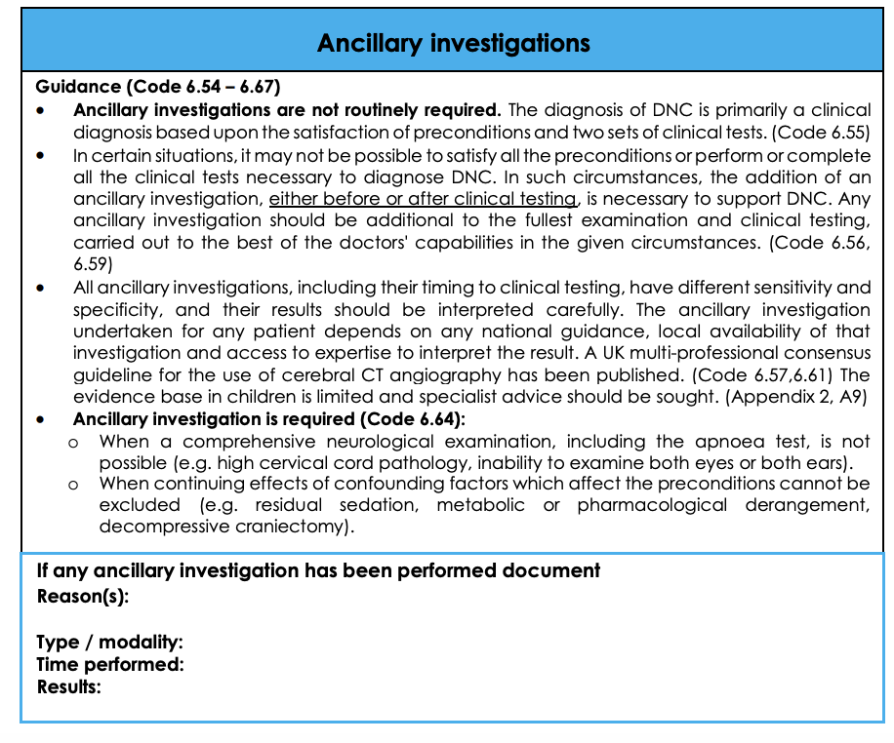

Slide 53
The final 3 questions are on the validity of a diagnosis of DNC.
The diagnosis remains valid? (Dead)
The diagnosis is NOT valid? (Not Dead)
The Deceased Donation Course (ICM)

Slide 54
Question 14
During the second set of brain stem testing the second clinician finds the ears full of wax and can't visualise the drum?
The diagnosis remains valid? (Dead)
The diagnosis is NOT valid? (Not Dead)
The Deceased Donation Course (ICM)

Slide 55
Question 14
During the second set of brain stem testing the second clinician finds the ears full of wax and can't visualise the drum?
The diagnosis remains valid? (Dead)
The diagnosis is NOT valid? (Not Dead)
  Not Dead – this finding may invalidate the first oculovestibular test and thus the first test may not be valid.
The Deceased Donation Course (ICM)

Slide 56
Question 15
After confirming death using neurological criteria the doctors remember that the patient suffered from myotonic dystrophy?
The diagnosis remains valid? (Dead)
The diagnosis is NOT valid? (Not Dead)
The Deceased Donation Course (ICM)

Slide 57
Question 15
After confirming death using neurological criteria the doctors remember that the patient suffered from myotonic dystrophy?
The diagnosis remains valid? (Dead)
The diagnosis is NOT valid? (Not Dead)
Not Dead – may represent a confounder for having profound neuromuscular weakness.
True case from the UK.
‘Patients with any neuromuscular disorders’ is a Red Flag.
A Red Flag means: consider the need to delay testing and/or perform ancillary investigations. Or seek advice.
The Deceased Donation Course (ICM)

Slide 58
Question 16
The 1st set of tests are carried out and are in keeping with a diagnosis of death. However on the 2nd set of tests the ABG for apnoea testing Sodium is 165, which sits outside the range for AoMRC guidance - upper limit of 160.
The diagnosis remains valid? (Dead)
The diagnosis is NOT valid? (Not Dead)
The Deceased Donation Course (ICM)

Slide 59
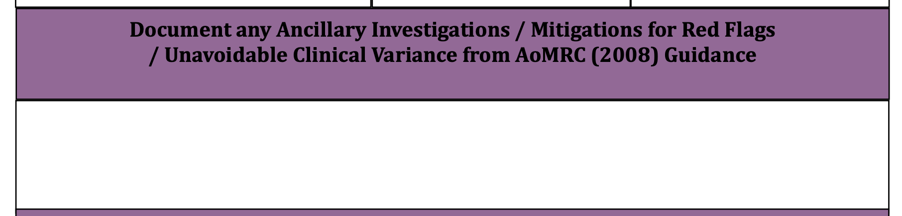
Question 16
The 1st set of tests are carried out and are in keeping with a diagnosis of death. However on the 2nd set of tests the ABG for apnoea testing Sodium is 165, which sits outside the range for AoMRC guidance - upper limit of 160.
The diagnosis remains valid? (Dead)
The diagnosis is NOT valid? (Not Dead)
Dead (but….)– hypernatremia secondary to DI, secondary to raised ICP, secondary to massive SAH, is consequence of neurological death rather than the proximate cause.
Variance from Code.
Tension in Code of Practice between guidance, but also legally accepted and represents the standard of care.
The Deceased Donation Course (ICM)

Slide 60
Question 17
A high quadriplegic (C2 level) man who is unable breathe spontaneously suffers a cardiorespiratory arrest and is left in a persistent vegetative state.
Is he Dead
Is he Not Dead
The Deceased Donation Course (ICM)

Slide 61
Question 17
A high quadriplegic (C2 level) man who is unable breathe spontaneously suffers a cardiorespiratory arrest and is left in a persistent vegetative state.
Is a brain stem death diagnosis still possible? (Dead)
Is a brain stem death diagnosis NOT possible? (Not Dead)
Not dead - consciousness is manifested by two physiological components: arousal (wakefulness) and awareness. PVS patients have brain stem reflexes and show arousal. Arousal comes from the brain stem.
Critics of the British criteria claim we would consider them dead. They are incorrect in their understanding.
The Deceased Donation Course (ICM)

Slide 62
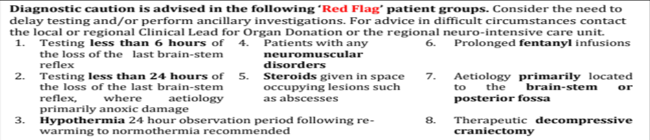

Slide 63


Slide 64
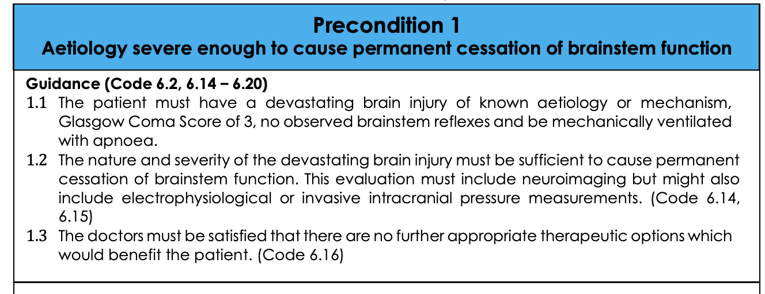

Slide 65
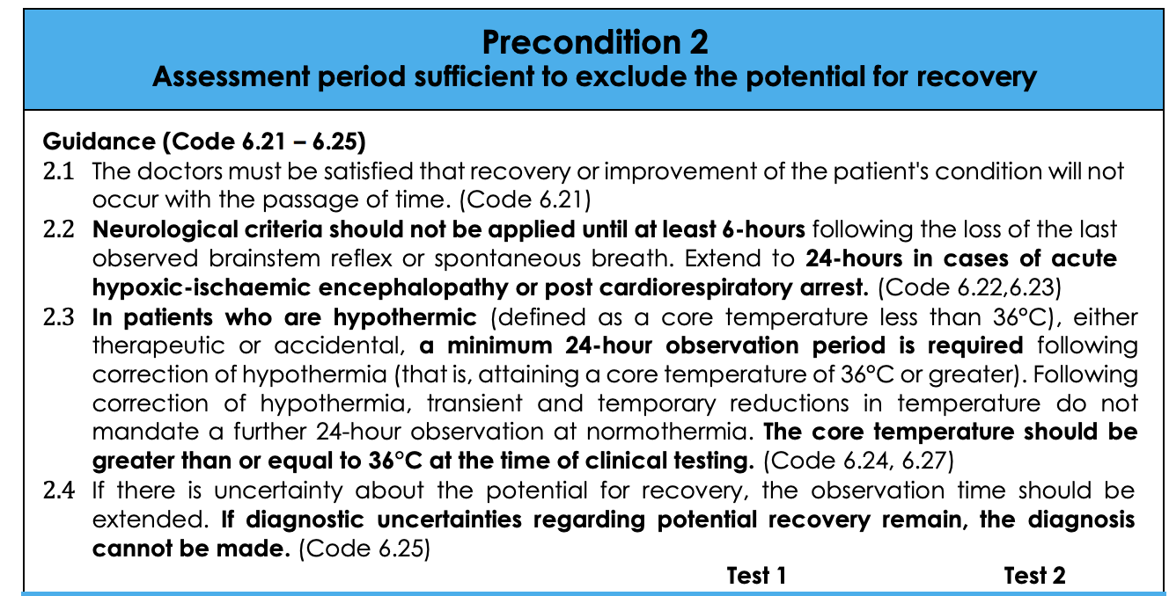

Slide 66
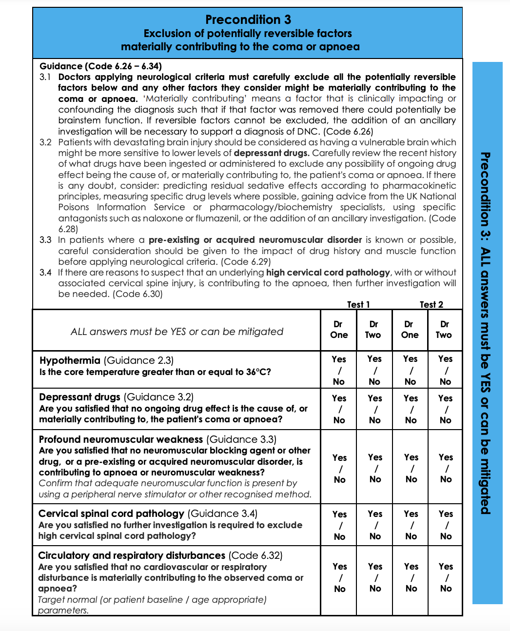
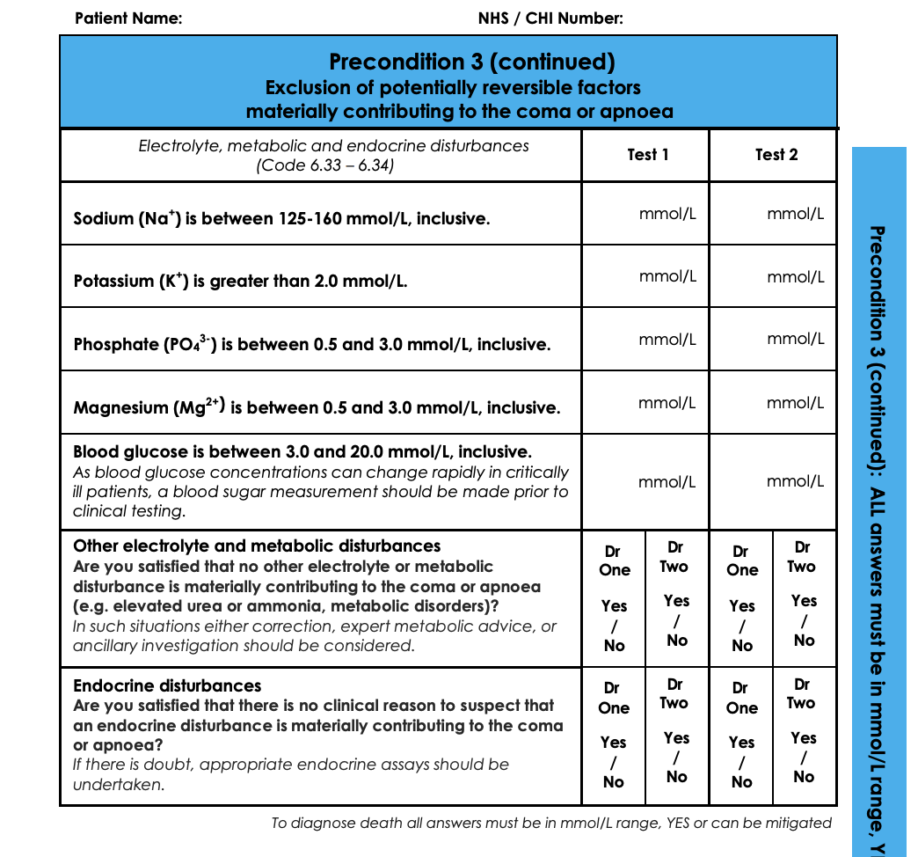

Slide 67
