Slide 1
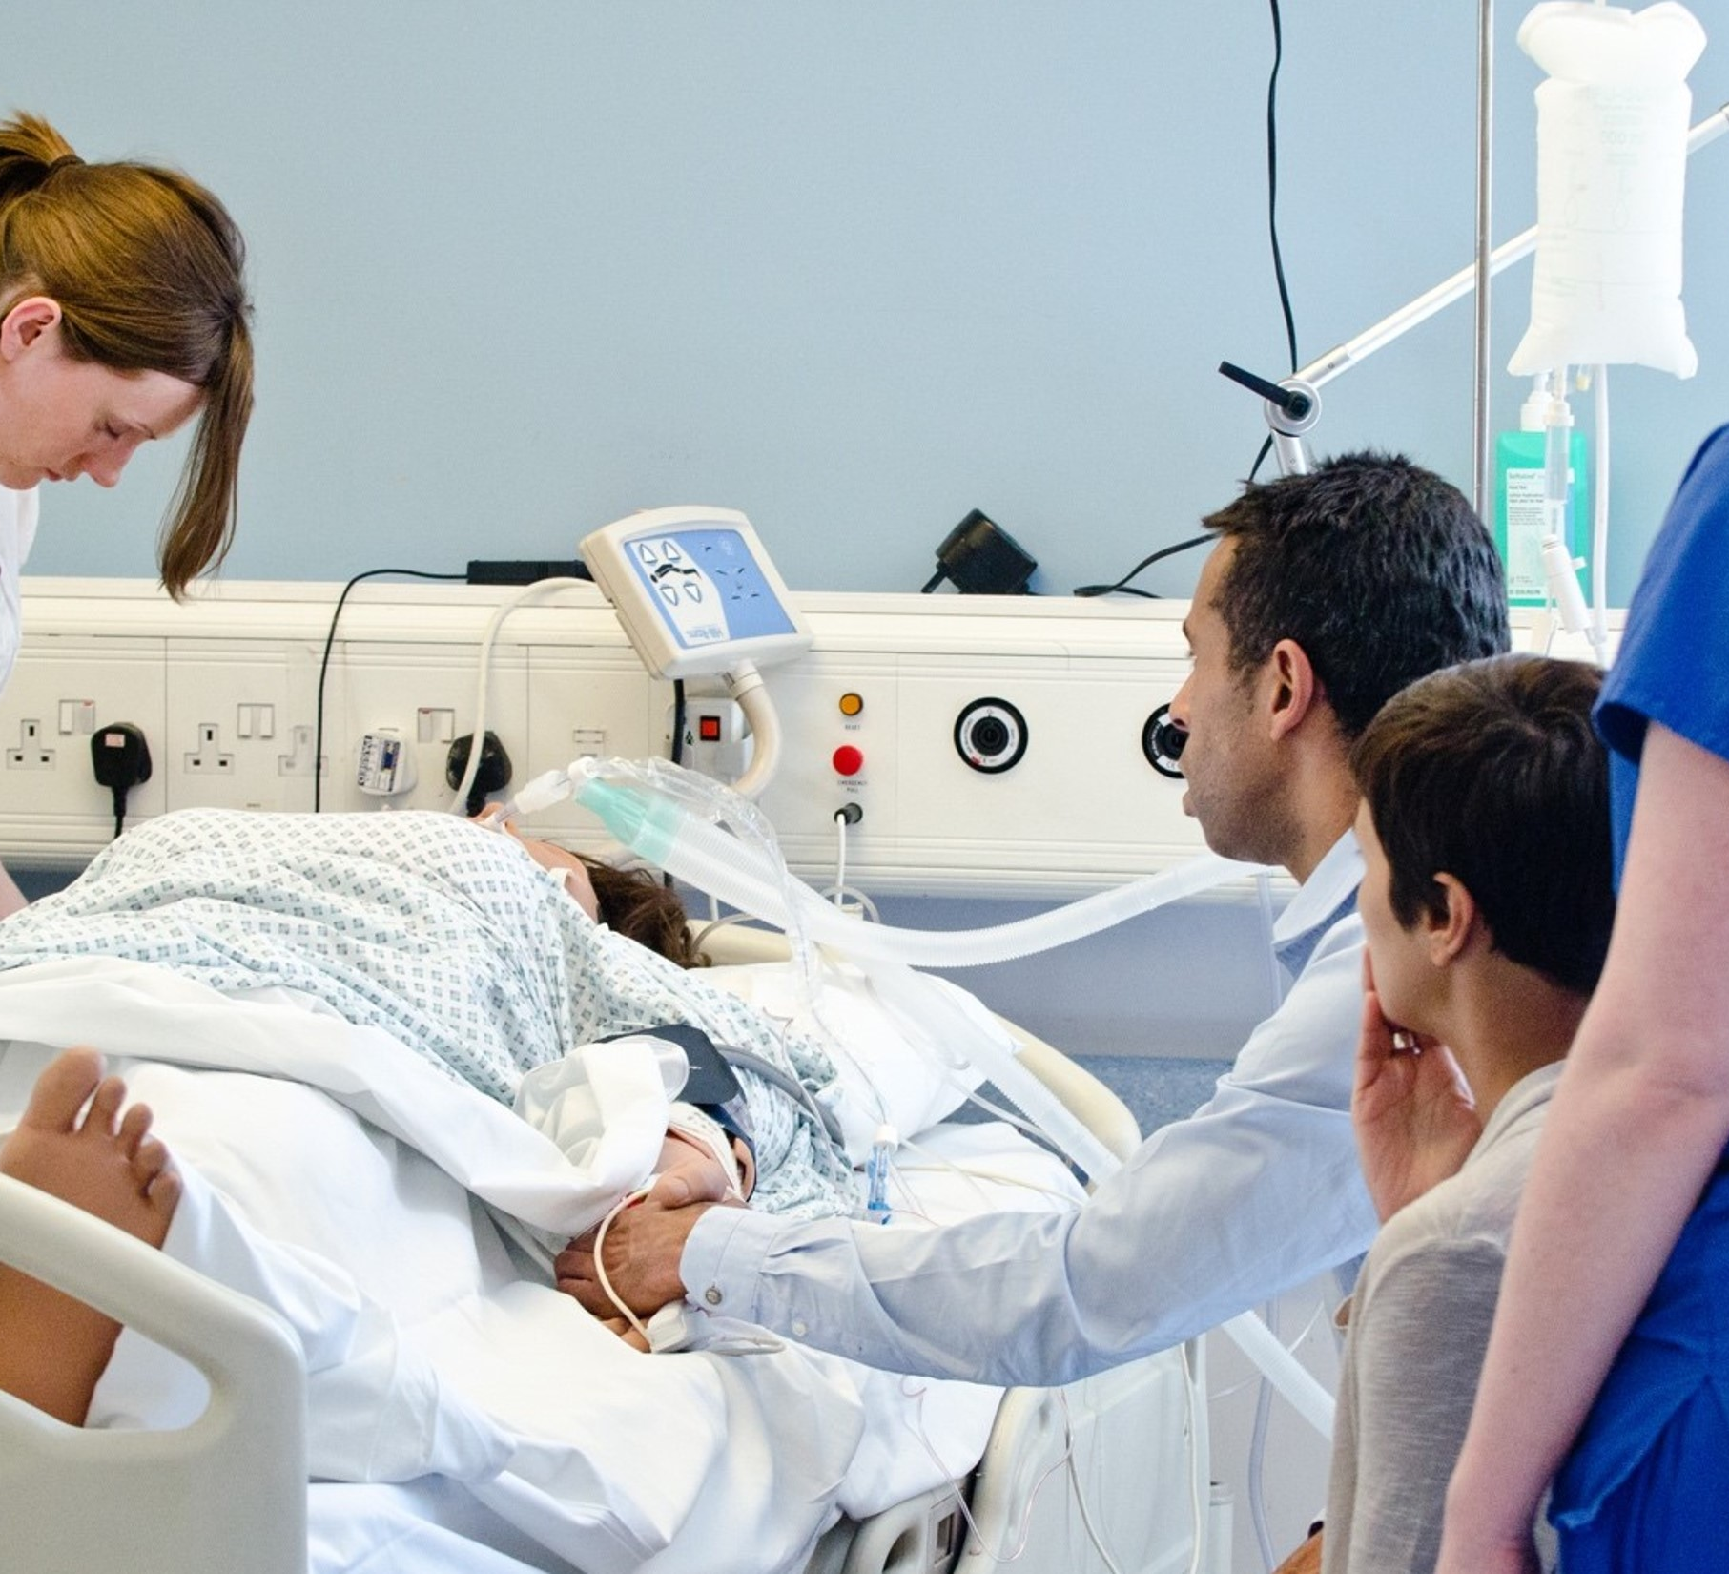


The
National Deceased Donation
Course
2025

Slide 2

Welcome!
Take a seat….
Relax…
We start at 10:30

Slide 3
Please sign in

Slide 4
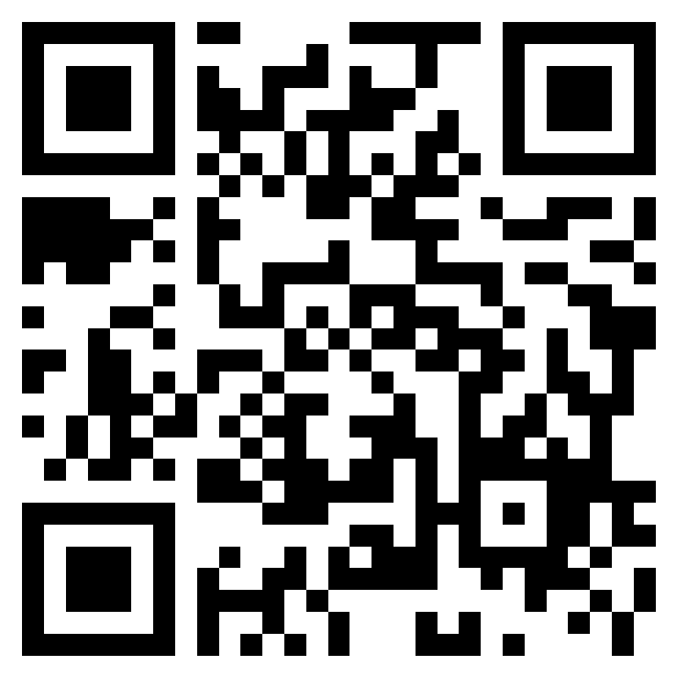
Is your pre-course survey complete?

Slide 5

Different learning needs?
Does this setting suit your learning?
How can we help?

