Slide 1

Jill Featherstone
National Professional Development Specialist Nurse
Medical Education

Slide 2

SNOD service overview – what you can expect
Early Notifications -Why? What happens next?
4 Key focus areas of collaborative working
SNOD involvement: the benefits
Outcome success

Slide 3
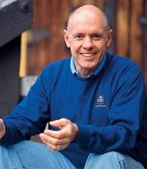
7 Habits of Highly Effective People Stephen Covey
Think Win-Win
Seek first to understand before being understood
Notes:
Reflection on own grieving experiences impact and awareness of SN skills in dealing with colleagues and family and in expressing leadership skills

Slide 4
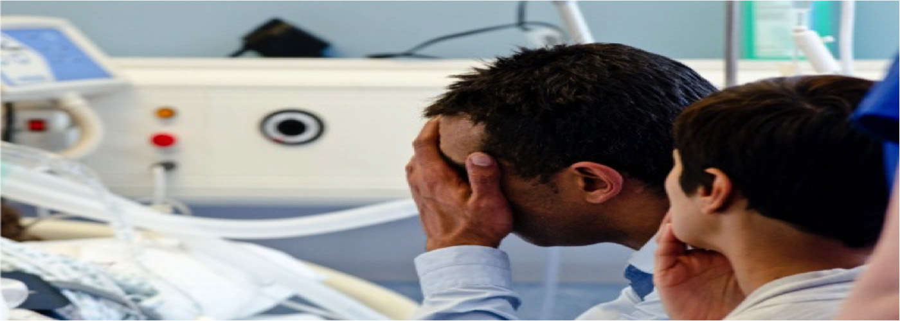
Family Focussed
Safe
Effective
Efficient
Communication
The Deceased Donation Course (ICM)
Notes:
Family focussed _ this is a grieving family we ned them to feel we have their interests at heart – we do. It’s their experience
Safe: safe donation, safe transplantation and safely working within your clinical areas BUT in addition to all of that enabling a family to feel safe to support a decision/ indication to donate
Effective: complex process, demands thoroughness and attention to detail for safe, donation, transplantation and family care skill comes from study and experience of donation practice
Efficient: a complex process like this, involving many stakeholders needs to be efficient to keep the process timely for those affected by it – including other patients and families
ALL based on good communication of which SN have an abundance of foundation and ongoing training! This is a craft!

Slide 5
SNOD Service: what can you expect?
The Deceased Donation Course (ICM)
Notes:
Extensive investment in training. 6 months to establish a SNOD in the complexities of process. Once established and on the rota the real growth begins as they explore practice more extensively.
Awareness of NHSBT structure regional and cluster working

Slide 6
SNOD Service: what can you expect?
24/7 regional service /inter-regional service
The Deceased Donation Course (ICM)
Notes:
Extensive investment in training. 6 months to establish a SNOD in the complexities of process. Once established and on the rota the real growth begins as they explore practice more extensively. Awareness of NHSBT structure regional and cluster working = dynamic responsive service.

Slide 7
SNOD Service: what can you expect?
24/7 regional service /inter-regional service
Embedded support = donation activity, audit, education, follow up services and promotion,
The Deceased Donation Course (ICM)
Notes:
Extensive investment in training. 6 months to establish a SNOD in the complexities of process. Once established and on the rota the real growth begins as they explore practice more extensively.
Audit awareness – data helps us improve and understand how to do that and data shared both with NHSBT and each hospital structures for transparency
Education vital to keeping people ‘with us’ = effectiveness and efficiency
Follow up services mean families don’t feel isolated or ignored following a donation

Slide 8
SNOD Service: what can you expect?
24/7 regional service /inter-regional service
Embedded support = donation activity, audit, education, follow up services and promotion,
SN-OD/SR or Specialist Nurse?
The Deceased Donation Course (ICM)
Notes:
SR requesters with highly tuned skills in discussing donation with families – SNOD continue the process but both omni-competent and support each other to achieve effective efficient donations. Work remotely to support too. Our systems now talk across the donation and transplant pathways

Slide 9
SNOD Service: what can you expect?
24/7 regional service /inter-regional service
Embedded support = donation activity, audit, education, follow up services and promotion,
SN-OD/SR or Specialist Nurse?
Specialist advice, communication skills & training that guides approaches, donor care, prep work, coroner/PF relationships
The Deceased Donation Course (ICM)
Notes:
Specialist advice with regional and national experts for neurological testing, virology understanding transplant risks – important for safety, efficiency and family care.

Slide 10

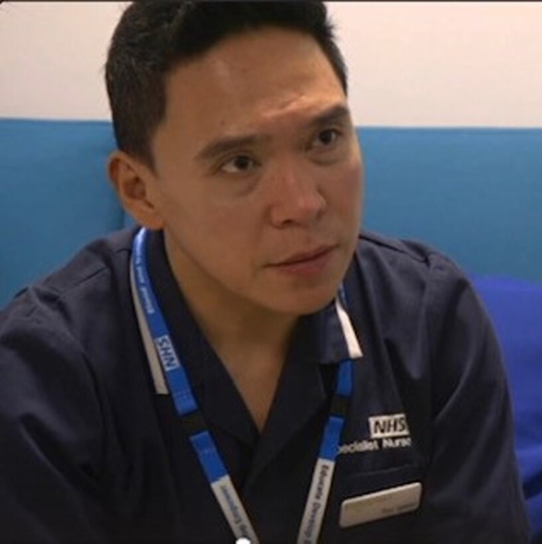
Notes:
What we hope you encounter is a work force that demonstrate our principles of caring expert and quality.

Slide 11

Why notify early?

Slide 12
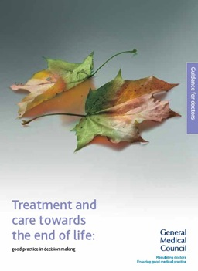
2010
Organ donation
81 If a patient is close to death and their views cannot be determined, you should be prepared to explore with those close to them whether they had expressed any views about organ or tissue donation, if donation is likely to be a possibility.
82 You should follow any national procedures for identifying potential organ donors and, in appropriate cases, for notifying the local transplant coordinator.
GMC established a duty on doctors to explore donation and follow national procedures.
The Deceased Donation Course (ICM)
Notes:
GMC gives clear guidance that Drs have a duty to make the notification. This is patient focus and considering their end of life decisions.

Slide 13
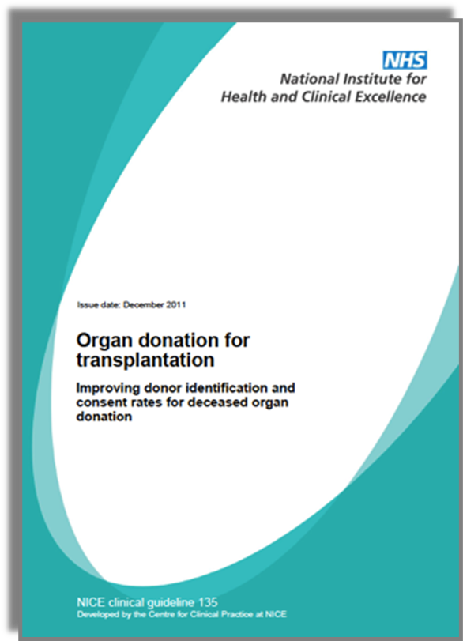
Notification Triggers
Plan to withdraw life-sustaining treatment
Plan to perform brain death testing
Early referral = Devastating brain injury
  + GCS of ≤ 4, not explained by sedation
  + Loss of 1 cranial reflex
2011
The Deceased Donation Course (ICM)
Notes:
Further supported by the NICE national guidance which outlines the criteria of when to trigger that notification. Thinking ahead means plans can be in place to support your decisions and discussions.
What if the family mentions it? Positive or negative?

Slide 14
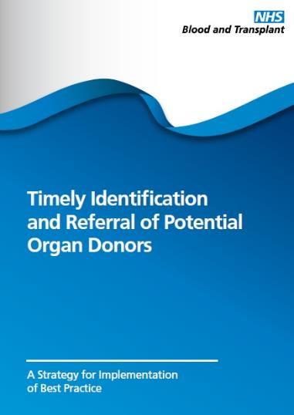
Makes the process timely
Reduces length of process
Helps prepare for family conversations
Prevents missed opportunities
2011
The Deceased Donation Course (ICM)
Notes:
NHSBT guide to support you further and brings that guidance together.

Slide 15
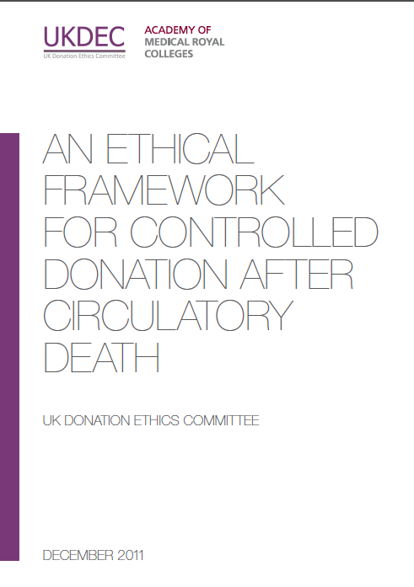
UK Donation Ethics Committee
“There is no ethical dilemma if the treating clinician wishes to make contact with the SNOD at an early stage, while the patient is seriously ill and death is likely, but before a formal decision has been made to withdraw life-sustaining treatment.”
2011
The Deceased Donation Course (ICM)
Notes:
NHSBT guide to support you
Reasons to support
Ethical support for doing so beneficence= many e.g. getting a SNOD there in a timely way, assessing suitability etc Family experience

Slide 16
Why notify early?
National guidance advocates it
Stretched NHSBT service
Performance data evidences that it has positive impact
Few patients can be donors – make each matter
Chance to explore fully
Families are exploring EOL earlier and get a better experience
Notes:
SEED Trial but rule of thumb refer early

Slide 17
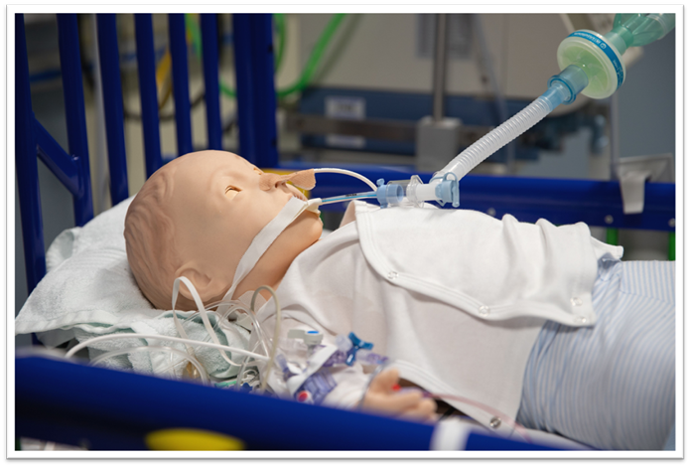
Paediatric and Infant Notifications triggers 2023
Death is likely within in the next 48 hours either neurological determination of death through testing criteria OR by withdrawal of life sustaining treatment
Family have raised organ donation
Discussions regarding re-orientation of care- including palliative care discussions
Early end of life care planning
The Deceased Donation Course (ICM)
Notes:
Are paediatrics different?

Slide 18
Notifications
Rapid
Decline
Age
Absolute contraindication
Instability
Known PMH
Plan palliation & offer tissue donation as advised
The Deceased Donation Course (ICM)
Notes:
1 of 3 outcomes with the notifications
Rapid decline = most notifications

Slide 19
Notifications
Rapid
Decline
Age
Rapid Acceptance
SNOD mobilised
Absolute contraindication
Instability
Known PMH
Plan palliation & offer tissue donation as advised
Plan SNOD attendance, a donation approach & palliation plan
The Deceased Donation Course (ICM)
Notes:
Clear donation potential will trigger arranging attendance to take a closer look at the patient’s background and firm up whether donation is actually a potential.

Slide 20
Notifications
Rapid
Decline
Age
Rapid Acceptance
SNOD mobilised
Exploring Donation Potential
More detailed PMH
Absolute contraindication
Instability
Known PMH
Plan palliation & offer tissue donation as advised
Blood results
Stability & plan of care explored
Police & coroner or PF considerations
Plan SNOD attendance, a donation approach & palliation plan
The Deceased Donation Course (ICM)
Notes:
3rd outcome, takes time to do so well & accurately and can take sensitivity. It supports a good family experience when valuable clarity over uncertainties and greater certainty can be given.
Some of this is enormously complex and lengthy

Slide 21

consented donors
Exploring potential and prep work towards a consent.
Notes:
We work hard to enable every donor Around 25% of SN workload is consented donors
Around 75% is work exploring potential, screening, case history triage, coroner PF time, stabilisation, planning and preparing for the donation conversation
This is just in terms of response to notifications
Beyond this is another enormous amount of work, monitoring how we get there, studying performance data, analysing the qualitative experiences behind that that informs our practice, deliberate education and practice to improve both the service to families and for improved outcomes.

Slide 22



Coroner/ME /PF
Police
Notes:
Coroner/ PF/ ME. It is important that donation proceeds with all the required authorisation or LACK OF OBJECTIONS required. An objection needs to be clearly understood but cooperation to complete the investigation can be supported.
They are seeking to complete investigations and understanding of the death. They must be satisfied that donation doesn't impede that understanding. Communication are now increasingly detailed and must be clearly documented including specific individual organs and tissues to be donated or where restrictions apply plus any likely retrieval process deviations (NRP and novel technologies) that may breach traditional instructions e.g. 'nothing above the diaphragm' and any research implications. Variations in how local processes work – work with those. In Scotland written conformation is required from the PF is required.
Recently all case referred to ME in first instance and this further layer has been both helpful and not. Either way the coroner appreciates time to fully consider the case and time to liaise with police colleagues.

Slide 23

The Deceased Donation Course (ICM)
Notes:
SNODs looking to collaborate, support the discussions but our request is that involvement is early in the day where possible to ensure time to establish the detail required. Work is ongoing with coroner/PF and ME services to develop those relationships, understanding and to stream line the process so the everyone achieves the level of satisfactory understanding they need.

Slide 24
consented donors
Exploring potential and prep work towards a consent.
Notes:
We work hard to enable every donor Around 25% of SN workload is consented donors
Around 75% is work exploring potential, screening, case history triage, coroner time, stabilisation, planning and preparing for the donation conversation
This is just in terms of response to notifications
Beyond this is another enormous amount of work, monitoring how we get there, studying performance data, analysing the qualitative experiences behind that that informs our practice, deliberate education and practice to improve both the service to families and for improved outcomes.

Slide 25
Early Notifications
The Deceased Donation Course (ICM)
Notes:
What do we want from you?
Notification 100% of the time -why?

Slide 26
Early Notifications
Recognise
Identify and plan
Notify
100%
The Deceased Donation Course (ICM)
Notes:
What do we want from you?
Notification 100% of the time -why?

Slide 27
Donation Following Neurological Death: DBD
Stabilisation for testing & donor optimisation
Detailed assessment & planning
Gather whole health history
Physical examination
Prepare
for
theatre
Find recipients
Retrieval
Family discussions
Testing
Family Approach
Formal consent & medical social assessment
Register donor with national
hub team
Activate retrieval teams
Theatre
Transfer to Theatre
Notification & Triage
Post Retrieval Care
The Deceased Donation Course (ICM)
Notes:
After death testing.
Highlight ‘pink’ points of joint collaborative working that we will explore in simuation
The most complicated process in the NHS
Note: simultaneous processes all whilst supporting the family’s needs and supporting their understanding may include keeping their confidence in the process

Slide 28
Donation Following Circulatory Death: DCD
Stabilisation for ascertaining EOL decisions & donor optimisation
Detailed assessment & planning
Gather & present whole health history
Physical examination
Prepare
for
theatre
Find recipients
Retrieval
Family Approach
Preparation for & WLST
REINTUBATION
Formal consent & medical social assessment
Register donor with national
hub team
Activate retrieval teams
Theatre
Notification & Triage
Post Retrieval Care
The Deceased Donation Course (ICM)
Notes:
Compares to DCD the principles are the same but often DCD discussions need layering, time between realization of impending death and a discussion around end of life is shorter.

Slide 29
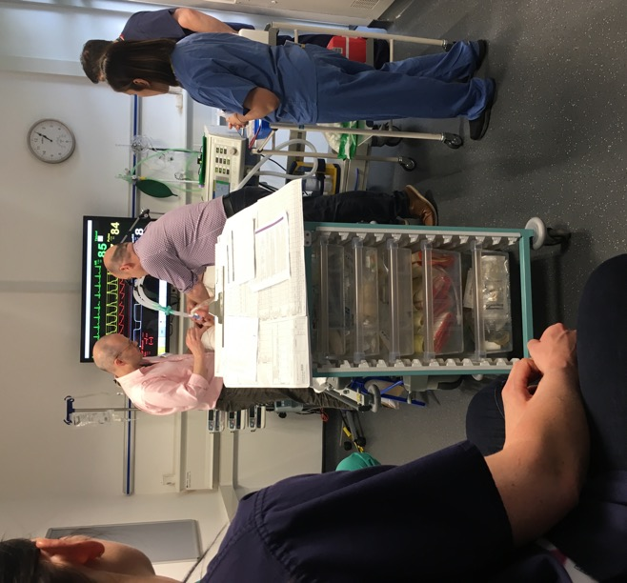
SNOD Involvement
The benefits
Supports recognition to enable a diagnosis of death
Efficient preparation towards testing
Reduction in delays for family & clinical teams
Detailed & expert advice from regional and national experts
Support family understanding
Family witnessing tests
Prompt introduction of the donor optimisation care bundle
Neurological Death Testing
The Deceased Donation Course (ICM)
Notes:
3 main benefits – given recent reduced confidence in testing.
Around effective efficient set up of testing, support for clinical staff to achieve that, bring clarity to the intention to test
Family focussed support around testing
Prompt after testing care to ensure a fully and promptly optimised donor

Slide 30
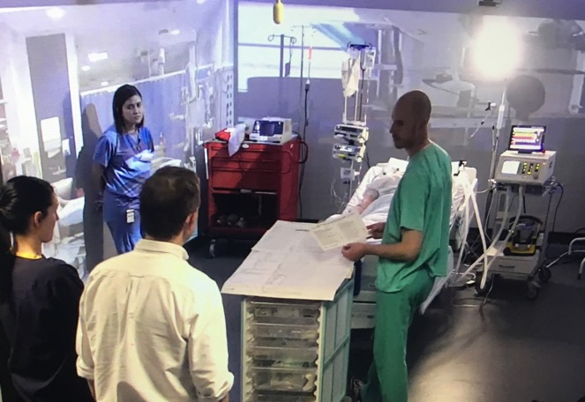
SNOD Involvement
The benefits
Guide donor optimisation care bundle use
Training supports a collaborative approach
Guide investigations & interventions when liaising with transplant teams
Support bedside nurse to the change of focus of care
Balances family requirements
Supports organ utilisation
Optimisation
The Deceased Donation Course (ICM)
Notes:
Refer to later lecture on optimisation DBD and DCD patients. Focus on how each individual patient can give optimally.
SN training has been focussed around awareness and deepening knowledge around how best to optimise. Families want a positive outcome. we want to ensure the best possible donation is achieved (aiming for gold – never silver)
2030 strategy is challenging us to make each donation count to the max – SNODs reduced offering time allows us to use time to ensure optimisation together we can make that happen. Too often lungs are not optimised.
Balances family needs of spending time with the patient. They want to see their support for this not go to waste.

Slide 31
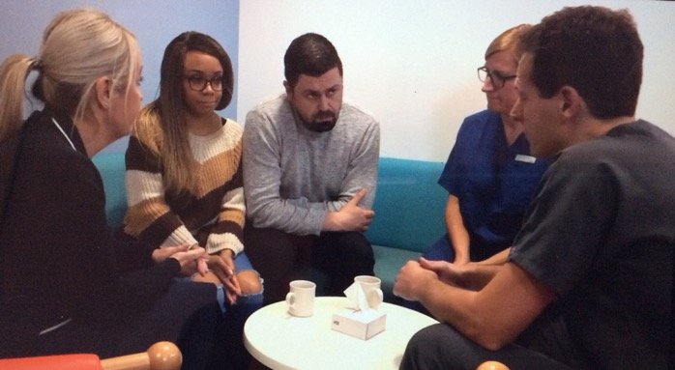
SNOD Involvement
The benefits
Supports clinical working
Co-ordination of support agencies
Planning the conversation
Supporting family understanding
Planning for & supporting family needs
Expert donation advice for families
Exploring declines, unwillingness to support
Valuing choice
Establishing post donation support
Approach for Donation
The Deceased Donation Course (ICM)
Notes:
Bread and butter of SN working
Takes time to explore family’s feelings and support or otherwise of donation . Families need to feel safe in their decision making and feel cared for in this process. An investment to support a positive support to donation and sustaining that through the process.
Conversations and preparation for donation needs to be layered. At the family’s pace.

Slide 32
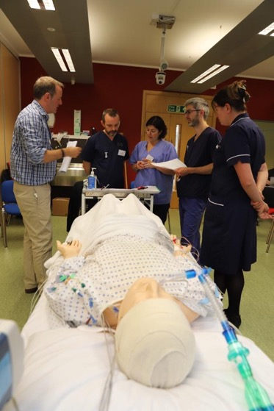
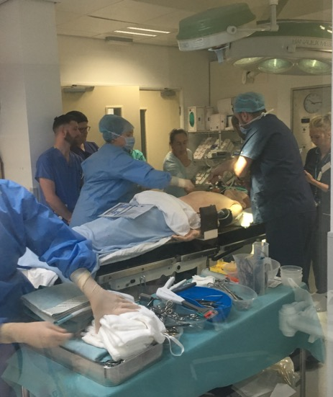
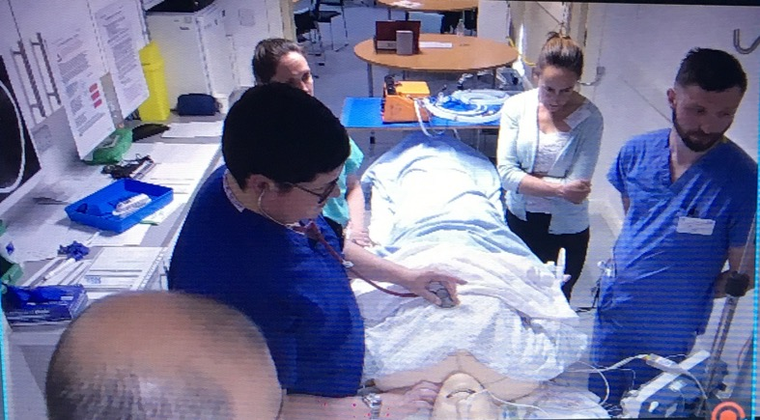
SNOD Involvement
The benefits
Collaboratively planned and co-ordinated to optimise donation balanced with family wishes and patient need
Supervision of time scales to ensure legal framework is met
Co-ordinated to optimise for recipient outcomes and donor dignity
WLST & Theatre
The Deceased Donation Course (ICM)
Notes:
Theatre is getting increasingly complicated SN is trained to co-ordinate and ensure all competing needs are met.
Novel technologies mean a need for close collaboration and accurate detailed planning.

Slide 33
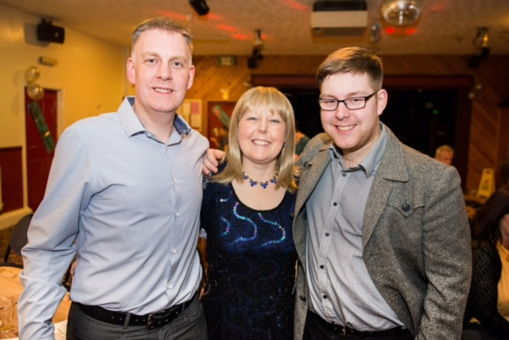
Outcome Success by Early Notification
Good donor family experiences
Efficiency for clinical areas
Safety & effective donation & transplants
Happy recipients in good health
Notes:
Vicky had a double lung transplant, received hers as a younger woman for CF. Her son was just 5 yrs old, she didn’t expect to see him grow up. Her son has now graduated, and is now a daddy. SN will be thinking of the donor families but also those they are supporting back to health.

Slide 34
References:
Covey, S R (2004) The Seven Habits Of Highly Effective People. London: Simon and Schuster UK Ltd
NHS Blood and Transplant (2020) Taking Organ Transplantation to 2020 A Detailed Strategy London: Crown Publications
NHS Blood and Transplant (2023) Organ Donation and Transplantation 2030: Meeting the Need London: Crown Publications
NHS National Institute for Clinical Excellence (NICE)(2011) The Organ Donation For Transplantation: Improving Donor Identification and Consent Rates For Deceased Organ Donation guidance 135 London: Crown Publications

Slide 35

This Photo by Unknown Author is licensed under CC BY-SA

