Slide 1
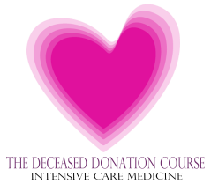
Donor Optimisation

Slide 2
The reason for optimisation
“Not everybody wants to be an organ donor”
“No-one wants to be a poor organ donor”
Notes:
Optimisation vs stabilisation

Slide 3
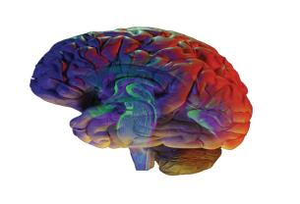
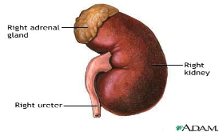
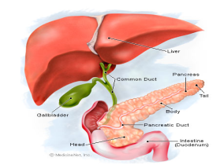
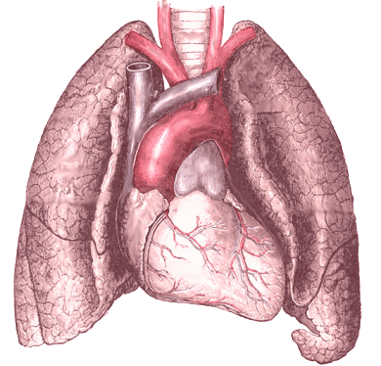

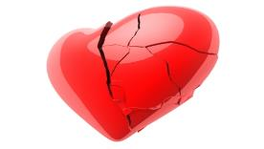
The organ consequence of dying
DBD
Squashed brain = severe organ response to dying
DCD
Prolonged time where organs have no circulation (warm ischaemia)

Slide 4




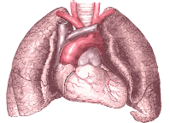
The organ consequence following ‘coning’
Good liver, pancreas & kidneys
Squashed brain = severe organ response to dying
Damaged heart
DBD
Damaged lungs
Challenge in DBD: confirm death, minimise organ dysfunction

Slide 5
Physiological changes
Hypotension 81%
Diabetes insipidus 65%
DIC 28%
Cardiac dysrhythmias 25%
Pulmonary oedema 18%
Metabolic Acidosis 11%
J Heart Lung Transplantation 2004 (suppl)
Hypothermia
Loss of hypothalamic control
Fall in metabolic rate
Loss of muscular activity
Peripheral dilatation
The Deceased Donation Course (ICM)

Slide 6


Where do I.......
(DBD)
The Deceased Donation Course (ICM)

Slide 7
Respiratory Management
Lung recovery rates are disappointing ~16%
Recruitment manoeuvers
Protective ventilation: benefits demonstrated by Mascia et al (JAMA 2010) 27% to 54%
Continue physiotherapy
Consider bronchoscopy
Actively manage oxygen therapy (PEEP/FiO2)
Be careful with fluids
30 degree head up tilt
Check cuff pressure
The Deceased Donation Course (ICM)
Notes:
Beneficial effect of Lung Protective Strategy demonstrated by Mascia et al (JAMA 2010)
Randomised for duration of 6 hour observation period
Lung donor eligibility : 54% in conventional group, compared to 95% following protective strategy
Lung recovery increased from 27% to 54%

Slide 8
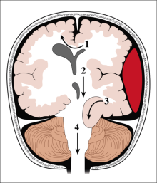

During coning - CVS
Sympathetic surge
  high SVR
  hypertension
  LV dysfunction
  arrhythmias
  cardiac stunning
The Deceased Donation Course (ICM)

Slide 9
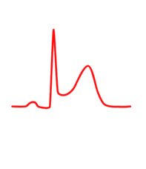
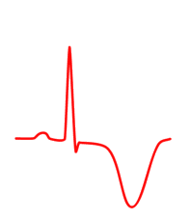
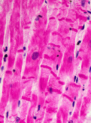
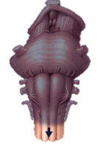



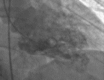
Myocardial aftermath
contraction band necrosis
apical ballooning
Normal
troponin release
The Deceased Donation Course (ICM)
Slide courtesy of Giuseppe Citerio, Monza

Slide 10
After coning - CVS
Herniation and spinal cord infarction leads to loss of sympathetic tone and hypotension
Heart failure following sympathetic surge
The Deceased Donation Course (ICM)

Slide 11
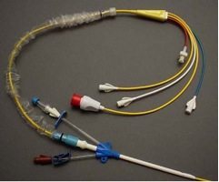
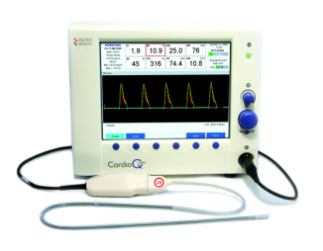
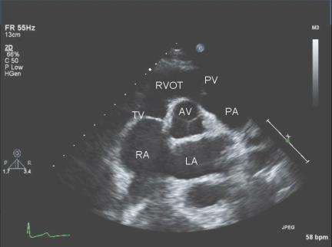
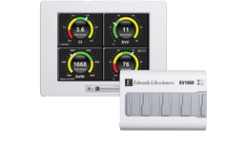
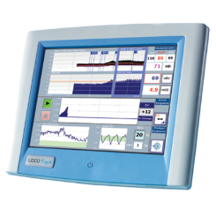
Cardiovascular Management
Monitor
  Invasive monitoring
Prevent hypotension or hypertension
  MAP 60-80 mmHg
Ensure good cardiac output
  CI > 2.1 l/min/m2
Avoid fluid overload
The Deceased Donation Course (ICM)

Slide 12
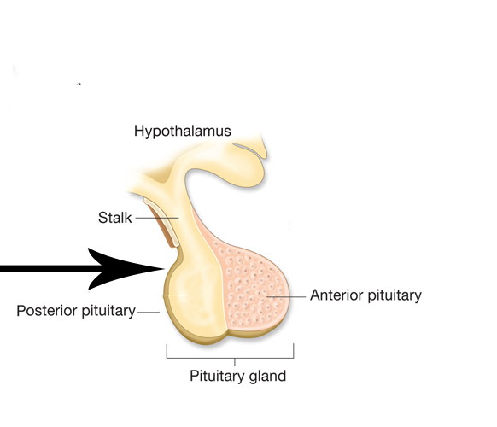

Endocrine failure
LH
FSH
GH
ACTH
TSH
Prolactin
ADH
The Deceased Donation Course (ICM)

Slide 13
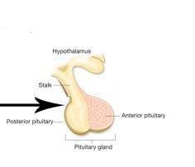

Endocrine failure
Early depletion of ADH
  -Diabetes Insipidus
+
The Deceased Donation Course (ICM)
Notes:
This is characterized by inappropriate diuresis, severe hypovolemia, hyperosmolality, and hypernatremia. These changes may exacerbate neurogenic pulmonary edema and lead to tissue hypoperfusion. Diabetes insipidus-associated hypernatremia is often aggravated by the infusion of large volumes of sodium-containing colloid solutions during cardiovascular resuscitation.

Slide 14

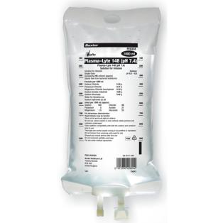
Diabetes insipidus
Endocrine Management
DDAVP
Caution with sodium containing fluids
Consider 5% dextrose
Target Na <150
The Deceased Donation Course (ICM)

Slide 15
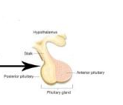
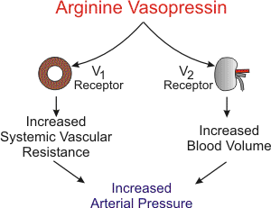
ADH* deficit
* AKA Arginine Vasopressin
Treat vasodilatory hypotension with vasopressin
The Deceased Donation Course (ICM)

Slide 16
ACTH + TSH
⬇ACTH
  Significant decreases in cortisol level
  Unopposed inflammation
  Disrupted glucose metabolism
  Vasodilation
⬇TSH
  Decline in free T3
  Reduced peripheral conversion of T4
The Deceased Donation Course (ICM)
Notes:
Insulin levels fall after brain stem death, leading to a decrease in intracellular glucose concentration, the development of an energy deficit, and a shift toward anaerobic metabolism and acidosis.
Systemic hyperglycemia may be exacerbated by the administration of large volumes of glucose-containing fluids (to treat hypernatremia) and increased catecholamine levels. A high-dose insulin infusion is often required to prevent the development of a hyperosmolar state, a severe osmotic diuresis, and profound hypovolemia.
Significant decreases in cortisol levels occur after brain stem death and may impair the donor stress response. These changes, in association with decreasesin T3, contribute to the cardiovascular instability.
The decrease in plasma cortisol may be associated with a decrease in the release of its stimulating factor adrenocorticotropic hormone (ACTH) from the anterior lobe of the pituitary gland. The administration of exogenous corticosteroids has been associated with stabilization of organ function.
As a result of impaired thyroidstimulating hormone (TSH) secretion and peripheral conversion of tetraiodothyronine (T4), but attempts to study thyroid disturbances in organ donors have produced confl icting data. Reduced T3 has been implicated in the progressive loss of cardiac contractility associated with the depletion of high-energy phosphates, increased anaerobic metabolism, and accumulation of lactate after brain stem death.

Slide 17
ACTH + TSH
Methylprednisolone
  15mg/kg (maximum dose 1000mg)
  Prevents inflammatory response
  Reduction in vasopressor requirements
  Increases organ retrieval
  Give immediately following consent for donation
Tri-iodthryonine (T3)
  Conflicting data – no longer used
The Deceased Donation Course (ICM)
Notes:
Insulin levels fall after brain stem death, leading to a decrease in intracellular glucose concentration, the development of an energy deficit, and a shift toward anaerobic metabolism and acidosis. Systemic hyperglycemia
may be exacerbated by the administration of large volumes of glucose-containing fluids (to treat hypernatremia) and increased catecholamine levels. A high-dose insulin infusion is often required to prevent the development of a hyperosmolar state, a severe
osmotic diuresis, and profound hypovolemia.
Significant decreases in cortisol levels occur after brain stem death and may impair the donor stress response. These changes, in association with decreasesin T3, contribute to the cardiovascular instability.
The decrease in plasma cortisol may be associated with a
decrease in the release of its stimulating factor adrenocorticotropic hormone (ACTH) from the anterior lobe of the pituitary gland. The administration of exogenous corticosteroids has been associated with stabilization of organ function.
as a result of impaired thyroidstimulating hormone (TSH) secretion and peripheral conversion of tetraiodothyronine (T4), but attempts to study thyroid disturbances in organ donors have produced confl icting data. Reduced T3 has been implicated in the progressive loss of cardiac contractility associated with the depletion of high-energy phosphates, increased anaerobic metabolism, and accumulation of lactate after brain stem death.

Slide 18
“Hormonal resuscitation”
Insulin
Methylprednisolone
DDAVP
Vasopressin
The Deceased Donation Course (ICM)

Slide 19
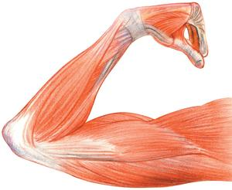
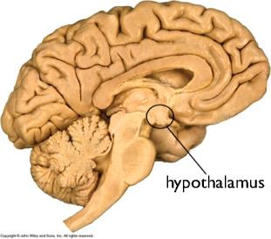
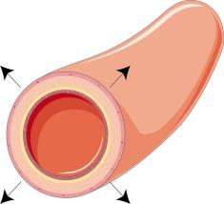
Hypothermia
The Deceased Donation Course (ICM)
Notes:
Loss of central control
Loss of muscle activity
Fall in metabolic rate
Increased heat loss (vasodilation)

Slide 20
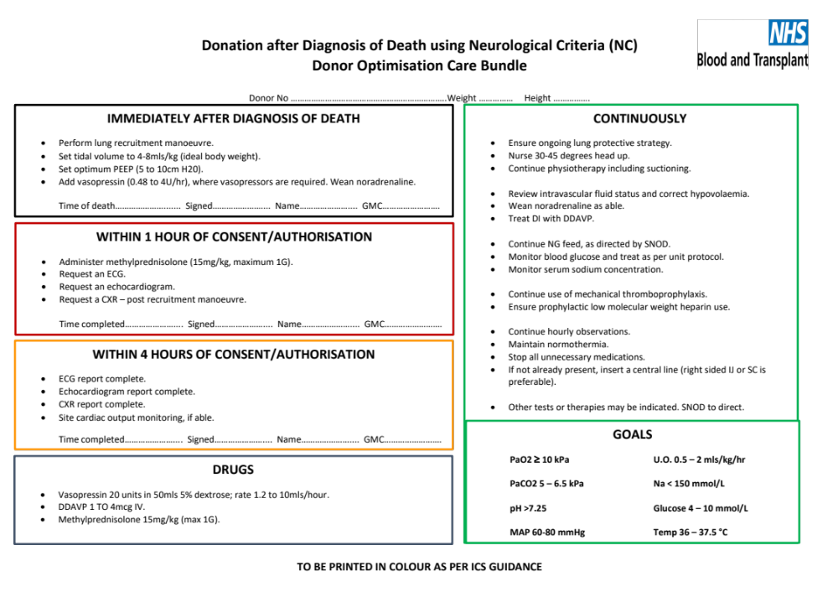

Slide 21
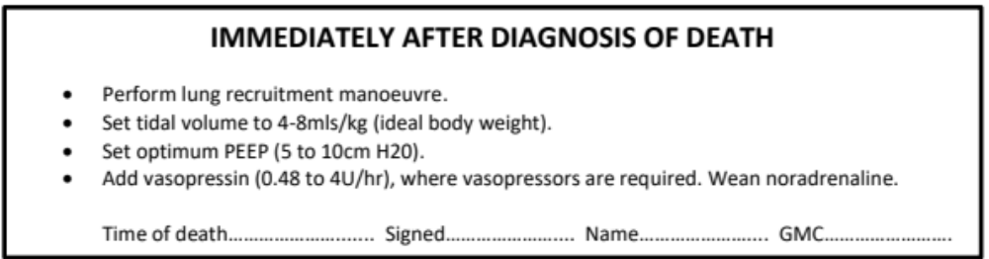

Slide 22
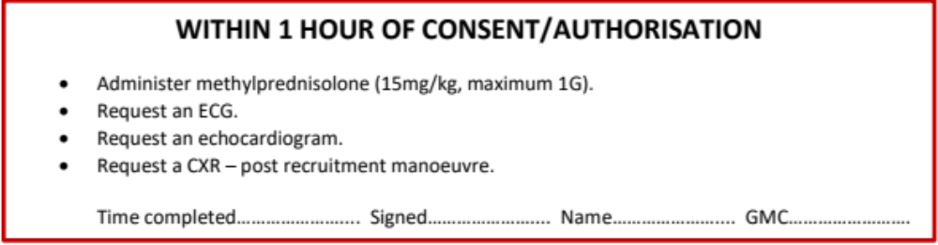

Slide 23
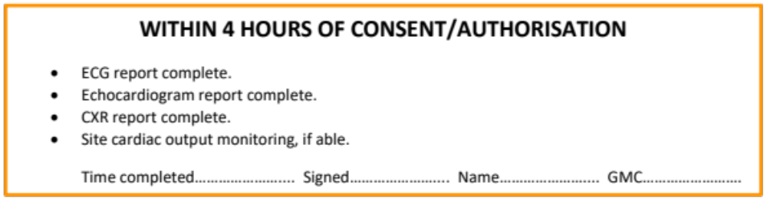

Slide 24
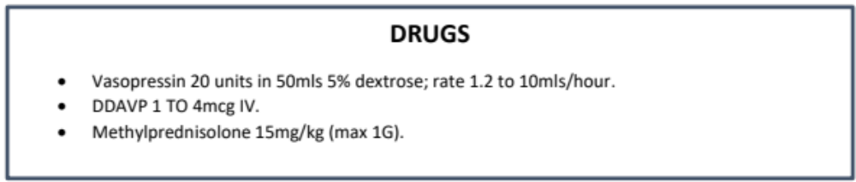

Slide 25
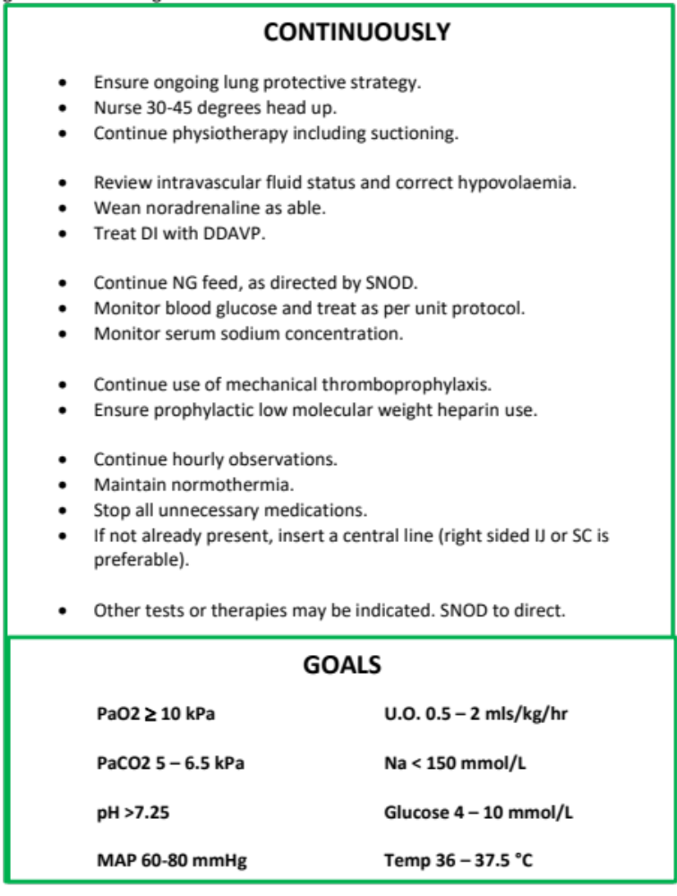

Slide 26
The organ consequence following circulatory cessation
Good long term kidneys
Borderline liver & pancreas
Prolonged warm ischaemic time
Heart ?
UK (100+), Sydney, Denver; Cape Town 1967
DCD
Good lungs?
Challenge in DCD: minimise / overcome warm ischaemic damage

Slide 27

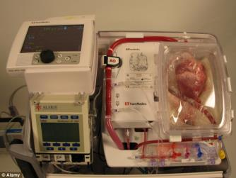
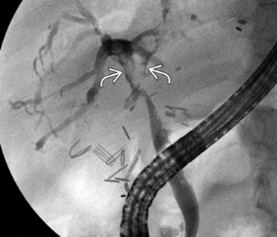
Reduce warm ischaemic injury in DCD donation
Withdrawal in theatre?
  Liver
  Heart
Expedient diagnosis of death and transfer to theatre.
The Deceased Donation Course (ICM)
Notes:
And so second ask
Prepare for UK-wide DCD heart retrieval programme
Improve outcomes from DCD liver retrieval.
If you were asked tomorrow to facilitate organ donation from your theatre complex (DCD Heart, marginal liver) could you. Are you ready?

Slide 28


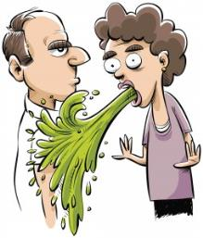
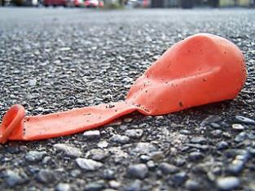
Problems with DCD lungs
The Deceased Donation Course (ICM)

Slide 29
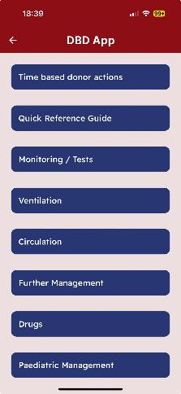
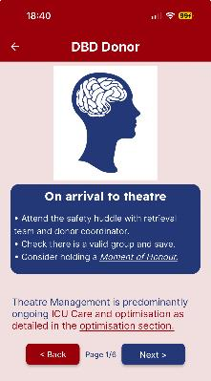
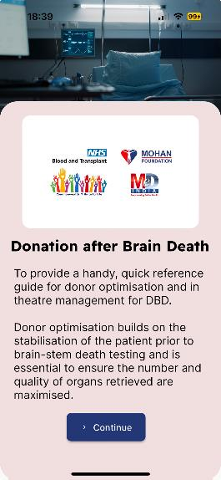
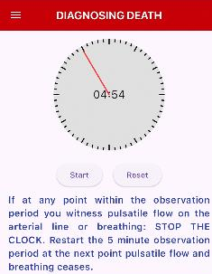
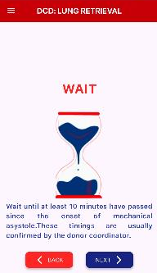


DBD App
(Donor Optimisation)
optimisation
theatre
DCD App
No Lung DCD
Lung DCD
The Deceased Donation Course (ICM)

Slide 30
Ethical justification for donation is a set of usable organs.
Leaving the heart behind or a donor hepatectomy
≠ successful transplantation
≠ patients decision
“Not everybody wants to be an organ donor”
“No-one wants to be a poor organ donor”
The Deceased Donation Course (ICM)

Slide 31

The most important part of optimisation
The Deceased Donation Course (ICM)

