Slide 1
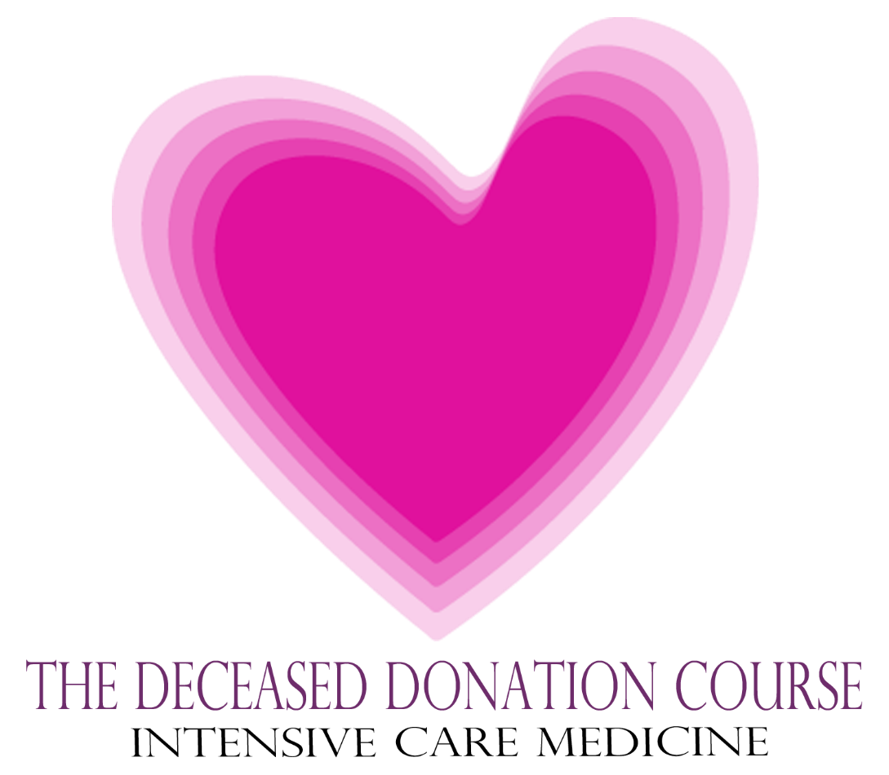
@ODTEdandGov #DDsim

Slide 2


The Diagnosis and Confirmation of Death

Slide 3


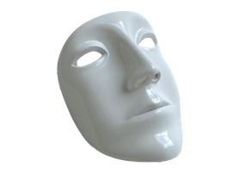
Conceptually
Diagnosis
The application of criteria against the history, examination and investigation of a patient.
Expectation
Legally and socially there must be a clear line.
ALIVE
DEAD
ALIVE
DEAD
Examination
History
Investigation

Slide 4


Conceptually
 |  | TRUTH
 |  | Dead | Not Dead
Diagnostic Criteria | Dead | True Positive | False Positive
 | Not Dead | False Negative | True Negative
Diagnosis
The application of criteria against the history, examination and investigation of a patient.
ALIVE
DEAD
Sensitivity
= TP/(TP+FN)
Specificity
= TN/(TN+FP)
Examination
History
Investigation

Slide 5
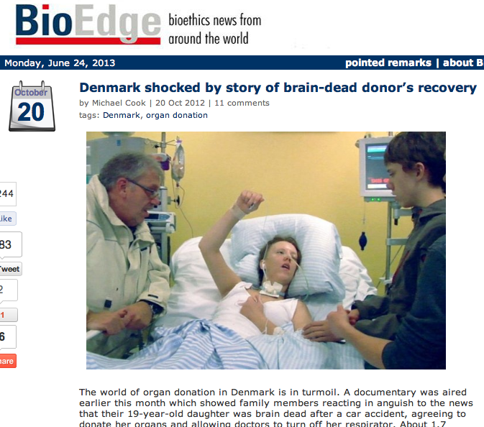
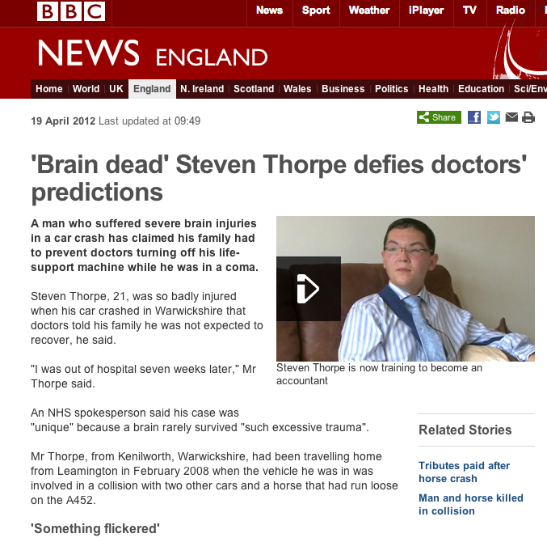
False Reporting

Slide 6
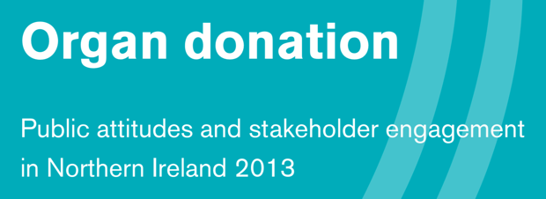

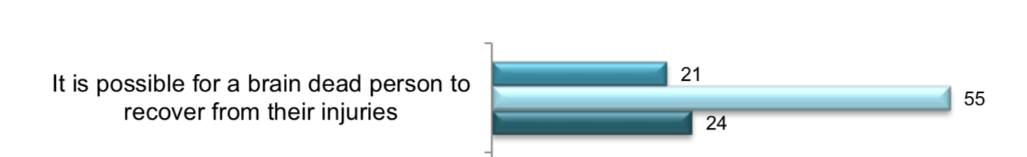


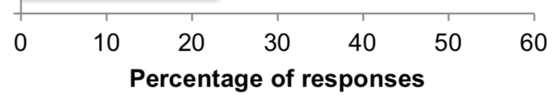
Poor Understanding
Nearly 50% of the public thought you could or don’t know if you could recover from brain death!

Slide 7
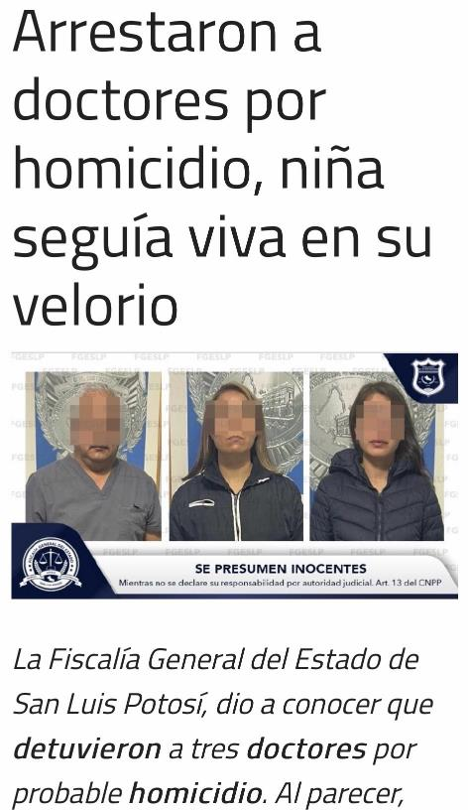
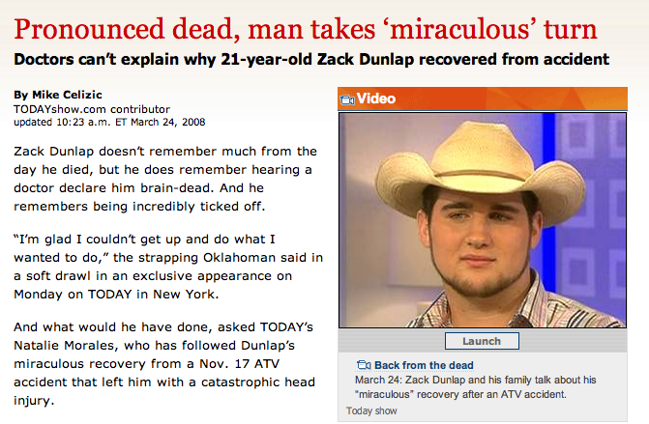
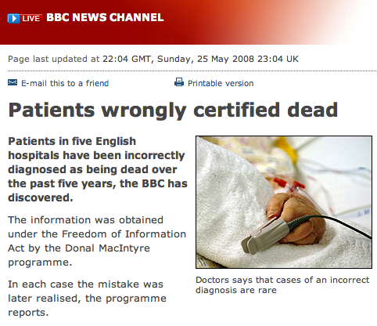
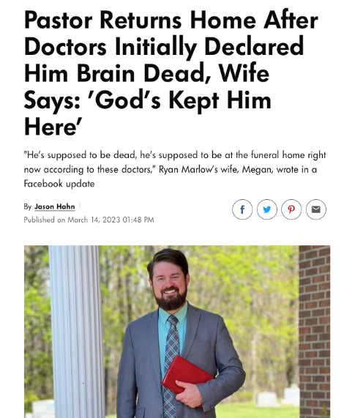
Medical Error
Neurological Criteria
Circulatory Criteria

Slide 8
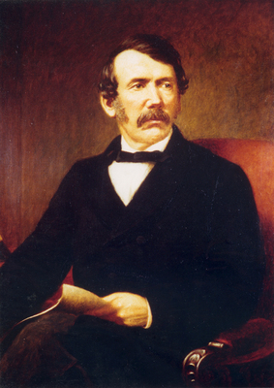
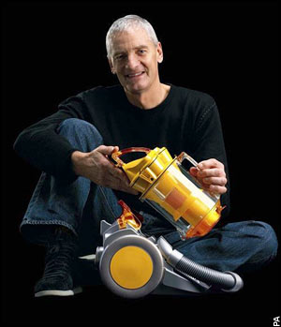
Diagnosis of Death Discovered not Invented
History of Diagnosing Death
not inventors…
We are explorers
The Deceased Donation Course (ICM)

Slide 9
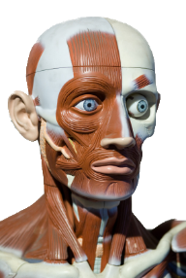
Elisha 800BC ‘mouth to mouth’
History of Diagnosing Death
Ancient
History
Ancient
History
Somatic Criteria recognised
Both Genesis and the Qur’an recognise ‘breath as life’

Slide 10
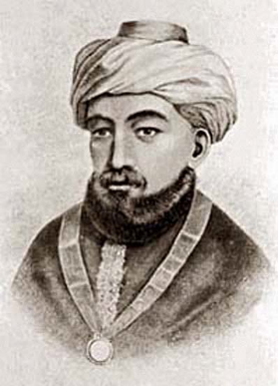
History of Diagnosing Death
12th
Century
Moses Maimonides -
a decapitated person was immediately dead despite the presence of residual movement in the body

Slide 11
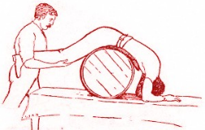

William Harvey describes the circulation of blood and the function of the heart as a pump
1666
1st successful animal to animal blood transfusion
Interest grows in resuscitation techniques after drowning
History of Diagnosing Death
17th Century
18th Century
1603
Feathers, mirrors and candles used to detect the breath of life
Circulatory Criteria
Death is when the heart has stopped
1740
‘Putrefaction is the only sure sign of death’

Slide 12
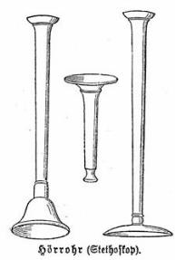
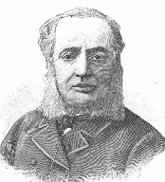

1818
First transfusion in haemorrhage after childbirth.
1819
Rene´ Laennec invents the stethoscope.
History of Diagnosing Death
19th
Century
1846 Paris, Dr Eugene Bouchut wins the Academy of Sciences prize for ‘the best work on the signs of death and the means of preventing premature burials’. He advocates the use of the stethoscope, as a technological aid to diagnose death. Bouchut believed that if a heartbeat was absent for 5 minutes, a person could be considered dead.

Slide 13
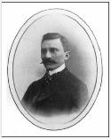
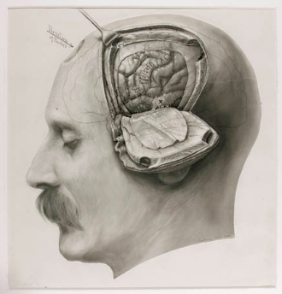
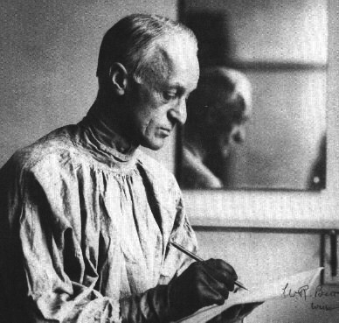
1902
1st renal autotransplant in a dog
1902
1st xeno Tx in
a human
(unsuccessful)
1918
Human blood transfusion a reality
1905
1st cornea Tx
History of Diagnosing Death
Early
20th
Century
Harvey Cushing describes increased brain pressure provoking respiratory arrest with preserved heartbeat.

Slide 14
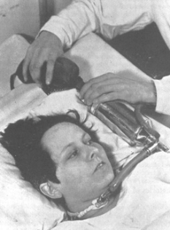
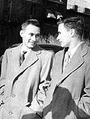
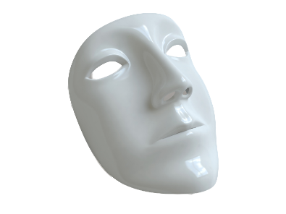
1940s
Danish medical students hand ventilate polio victims
Mouth to Mouth Resuscitation gains prominence & Mechanical Ventilation becomes possible
1954
1st successful kidney transplant between identical twins
History of Diagnosing Death
1940s
1950s
1950s
1950s
Cerebral circulatory arrest is demonstrated in comatose patients by angiography
Neurological Criteria
1959, doctors discover empirical proof by the identification of mechanically ventilated patients in coma dépassé.

Slide 15
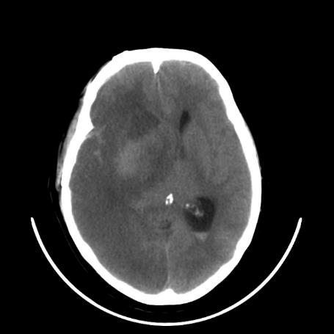
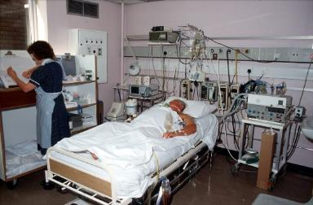
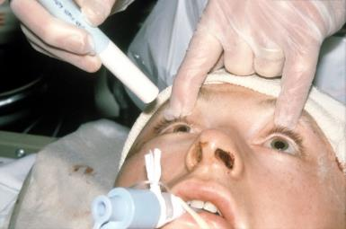
Lethal Neurological Injury
Effect of ICU Care
intracranial catastrophe
brain(stem) ischaemia
respiratory arrest
cardiac arrest

Slide 16
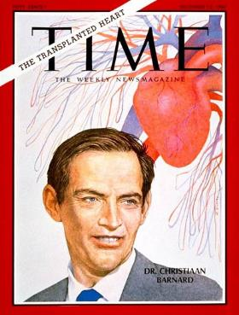
1963
1st successful deceased donor liver & lung Tx
1962
1st successful deceased donor kidney Tx
1966
1st successful deceased donor pancreas Tx
1967
1st successful deceased donor heart Tx
History of Diagnosing Death
1960s
1960s
1960s
1960s
Proposed that the EEG can demonstrate death of the Central Nervous System.
1964, Keith Simpson “there is life so long as circulation of oxygenated blood is maintained to live brainstem centres”
1968
Ad Hoc Committee of the Harvard Medical School define irreversible coma as a new criterion for death.
Notes:
Keith Simpson did the post-mortem on Ruth Ellis, last woman judicial execution in UK.

Slide 17
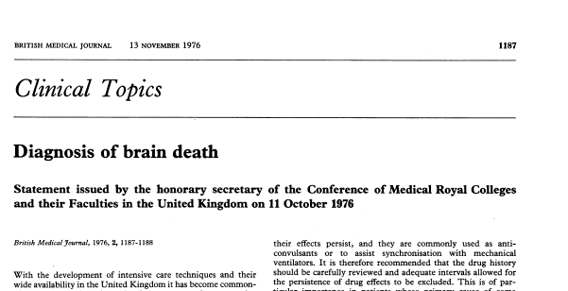
Modern intensive care practice grows.
Organ Donation from Brain Dead donors increases worldwide.
History of Diagnosing Death
Late
20th
Century
1976 (clarified 1979)
UK Criteria for Diagnosing Death using Neurological Criteria Published.
“Whatever the mode of its production, brain death represents the stage at which a patient becomes truly dead.”

Slide 18
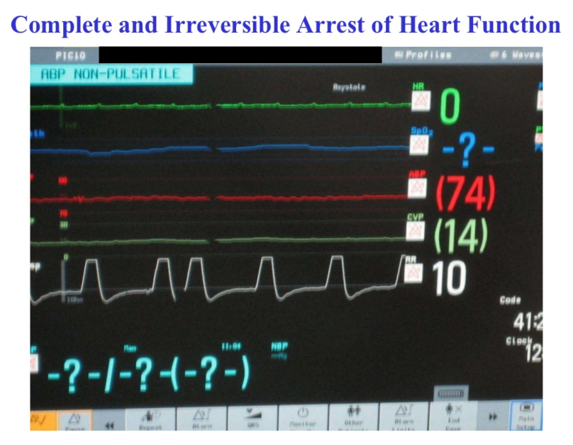
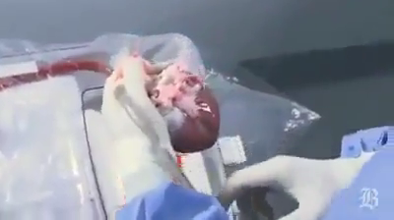
Still discovering…
Growing use of ECMO and other techniques to support the circulation, establish that it is possible to be alive, without a heart-beat.
History of Diagnosing Death
21st
Century
Image courtesy of Dr Sam Shemie

Slide 19


Still discovering…
Growing use of ECMO and other techniques to support the circulation, establish that it is possible to be alive, without a heart-beat.
Growing gap between the number of donors and those on the transplant waiting list leads to the reintroduction of donation from those declared dead after cardio-respiratory arrest.
History of Diagnosing Death
21st
Century
2008
UK Criteria for Circulatory Criteria published for the 1st time. 5 minutes.
2021
Canadian led observational trial upholds the 5 minute standard. n=631

Slide 20
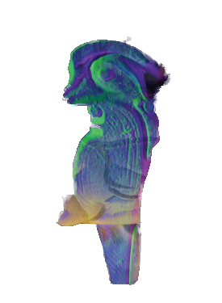
UK Definition of Death
Academy of Medical Royal Colleges, 2024
“… permanent loss of the capacity for consciousness, combined with irreversible loss of the capacity to breathe…
therefore permanent cessation of the integrative function of the brain-stem equates with the death of the individual.”
All human death is anatomically located to the brain(stem)
The Deceased Donation Course (ICM)

Slide 21
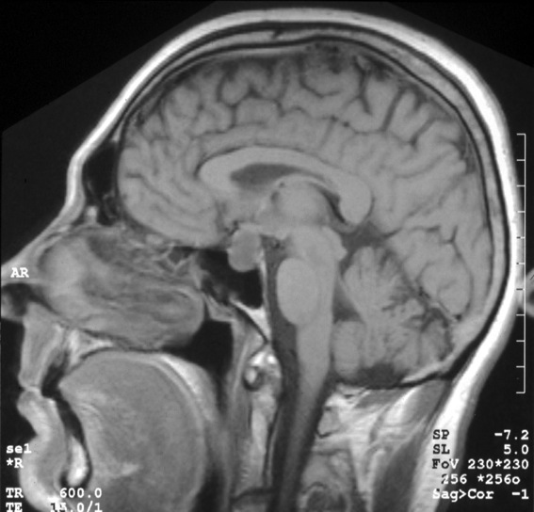
Functions of the brainstem
Reticular activating system (consciousness)
Conduit for sensory and motor tracts
Cranial nerve nuclei
Medulla Oblongata
(respiratory control)
Permanent loss of brainstem function is sufficient to satisfy the
UK Code for the Diagnosis and Confirmation of Death
The Deceased Donation Course (ICM)

Slide 22

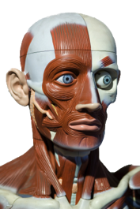
1 death : 3 sets of criteria
Neurological Criteria
DEATH
Circulatory Criteria
Permanent loss of the
capacity for consciousness
Permanent loss of the
capacity to breathe
Somatic Criteria
The Deceased Donation Course (ICM)

Slide 23
Who can diagnose death?
Any doctor.
RNVoEAD Guidance (5th Edition) allows for verification of expected death by a registered nurse.
ACCPs can diagnose for DCD (with extra training).
In Scotland, if organ and tissue donation must be a doctor.
Somatic criteria, some prolonged resuscitation scenarios paramedics.
DNC requires 2 doctors, both registered for >5 years and ‘competent to perform the tests’
One must be a consultant.
Not part of the transplant team.
The Deceased Donation Course (ICM)

Slide 24
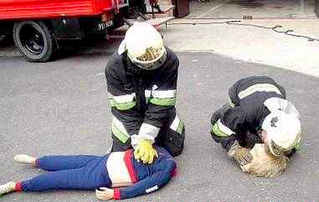
SOMATIC CRITERIA
The Deceased Donation Course (ICM)

Slide 25
SOMATIC CRITERIA
CONDITIONS UNEQUIVOCALLY ASSOCIATED WITH DEATH
The Association of Ambulance Chief Executives (AACE) and Joint Royal Colleges Ambulance Liaison Committee (JRCALC)
Physical trauma
Decapitation.
Massive cranial and cerebral destruction.
Hemicorporectomy or similar massive injury.
Incineration. The presence of full-thickness burns with charring of greater than 95% of the body surface.
Time based signs
Decomposition/putrefaction. Where tissue damage indicates that the patient has been dead for some hours, days or longer.
Hypostasis. The pooling of blood in congested vessels in the dependent part of the body in the position in which it lies after death.
Rigor Mortis. The stiffness occurring after death from the post-mortem breakdown of enzymes in the muscle fibres.
Foetal maceration in a newborn. Autolytic changes which follow in-utero death.
The Deceased Donation Course (ICM)

Slide 26
1 death : 3 sets of criteria
An examination and an observation period to confirm continuous apnoea, absent circulation and unconsciousness; after which the likelihood of spontaneous resumption of cardiac function will have passed. 5 minutes. Validated NEJM 2021
A clear intention not to attempt / continue cardiopulmonary resuscitation (CPR).
DEATH
Circulatory Criteria
Permanent loss of the
capacity for consciousness
Permanent loss of the
capacity to breathe
The Deceased Donation Course (ICM)

Slide 27
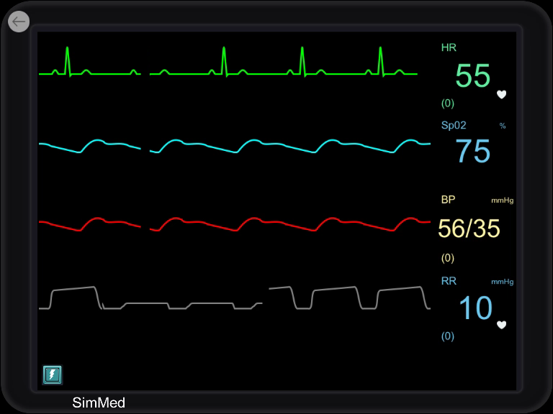
Declaration of death
“Permanence”
Decision to abandon CPR
T0
T5
5 minutes
Continuous observation ensuring
Ongoing Apnoea
Mechanical asystole (Arterial line or Echo)
---------------------------------------------
ECG – electrical asystole (not required, used if no arterial line)
---------------------------------------------
Neurological examination at the end of five minutes: pupil, cornea, supraorbital pressure.
Withdrawal of life-sustaining treatment
Loss of circulation
Apnoea
Unresponsiveness
The Deceased Donation Course (ICM)

Slide 28

9,250 DCD Cases in the UK
– no cases of auto-resuscitation
UK (and international)
criteria of five minutes is SAFE

Slide 29
Question
After five minutes of cardiorespiratory arrest, without any ongoing resuscitation, a patient can be safely confirmed dead because?
The patient’s brain will have been destroyed
The patient’s heart will not restart spontaneously
The patient will not be able to be resuscitated
All of the above
The Deceased Donation Course (ICM)

Slide 30
1 death : 3 sets of criteria
An examination and an observation period to confirm continuous apnoea, absent circulation and unconsciousness; after which the likelihood of spontaneous resumption of cardiac function will have passed. 5 minutes. Validated NEJM 2021
A clear intention not to attempt / continue cardiopulmonary resuscitation (CPR).
The prohibition at any time of any intervention that might restore cerebral blood flow by any means.
DEATH
Circulatory Criteria
Permanent loss of the
capacity for consciousness
Permanent loss of the
capacity to breathe
The Deceased Donation Course (ICM)

Slide 31
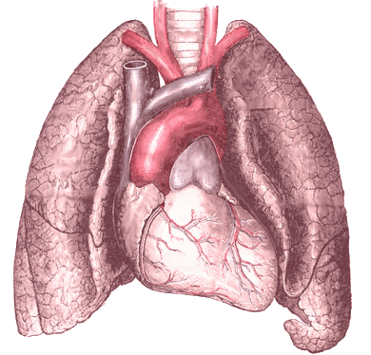
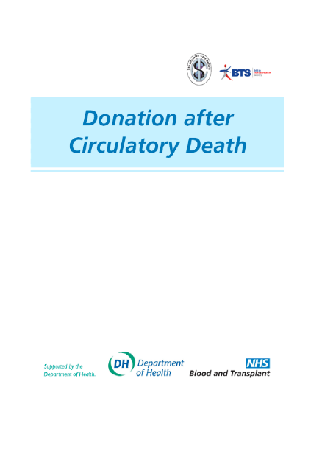
What is required for successful lung donation after circulatory death?
Usual practice of five minutes observation.
Confirmation of Death
Protection of the airway to prevent aspiration of stomach contents
Early inflation of the lungs with oxygen
A cuffed breathing tube can be placed in the airway any time after death has been confirmed.
Inflation of the lungs
Minimum wait of 10 minutes after the onset of asystole
Single recruitment maneuver
Followed by CPAP 5cm H₂O
the safe way
The Deceased Donation Course (ICM)

Slide 32
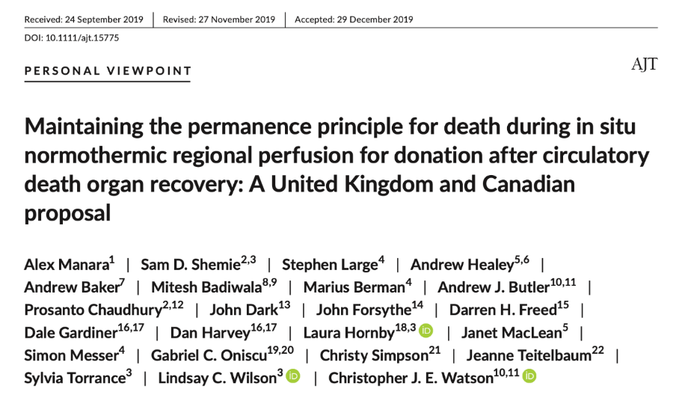


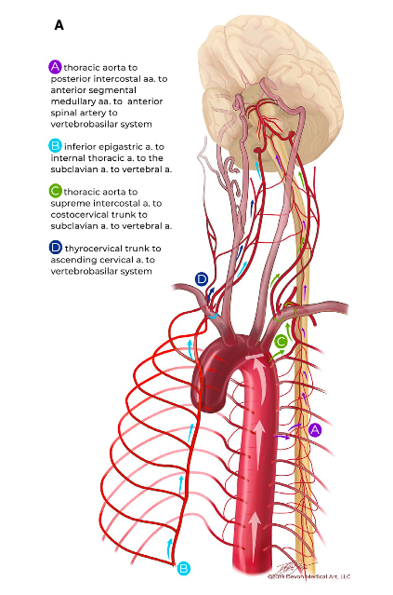
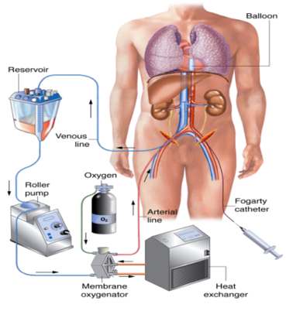
Normothermic Regional Perfusion
Organ
RECOVERY
in situ
Ultimately, the heart is just a pump for the brain and all human death is anatomically located to the brain.

Slide 33
Dx Death using Neurological Criteria
An established aetiology capable of causing structural damage to the brain which has led to the irreversible loss of the capacity for consciousness combined with the irreversible loss of the capacity to breathe.
DEATH
Permanent loss of the
capacity for consciousness
Permanent loss of the
capacity to breathe
The Deceased Donation Course (ICM)

Slide 34
Dx Death using Neurological Criteria
An exclusion of reversible conditions capable of mimicking or confounding the diagnosis of death using neurological criteria.
An established aetiology capable of causing structural damage to the brain which has led to the irreversible loss of the capacity for consciousness combined with the irreversible loss of the capacity to breathe.
DEATH
Permanent loss of the
capacity for consciousness
Permanent loss of the
capacity to breathe
The Deceased Donation Course (ICM)

Slide 35
Dx Death using Neurological Criteria
No reversible causes / confounding factors
Temperature > 36º C
Na+ between 125 and 160 mmmol/L
K+ > 2 mmol/L
Glucose > 3 mmol/L < 20mmol/L
Phosphate > 0.5 mmol/L < 3 mmol/L
Magnesium > 0.5 mmol/L < 3 mmol/L
Primary hypothermia
Metabolic disturbances
The Deceased Donation Course (ICM)

Slide 36
Dx Death using Neurological Criteria
No reversible causes / confounding factors
Primary hypothermia
Metabolic disturbances
Depressant drugs
Muscle relaxants
Clinical judgement essential
Impossible to create rules for every situation
Difficulties mainly thiopentone and midazolam
Plasma concentrations poor predictors of effect
Use of antagonists may help
Ideally use non cumulative drugs – propofol, remifentanil
The Deceased Donation Course (ICM)

Slide 37
Dx Death using Neurological Criteria
An exclusion of reversible conditions capable of mimicking or confounding the diagnosis of death using neurological criteria.
An established aetiology capable of causing structural damage to the brain which has led to the permanent loss of the capacity for consciousness combined with the permanent loss of the capacity to breathe.
DEATH
A clinical examination of the patient, which demonstrates profound coma, apnoea and absent brainstem reflexes.
Permanent loss of the
capacity for consciousness
Permanent loss of the
capacity to breathe
In 2023/24, 1534 tests performed, death confirmed in 1496 = 97.5%

Slide 38
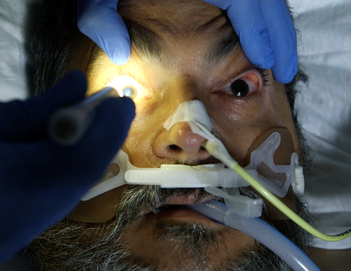
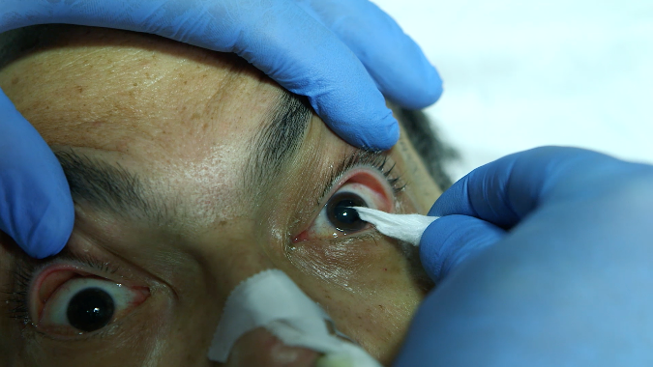
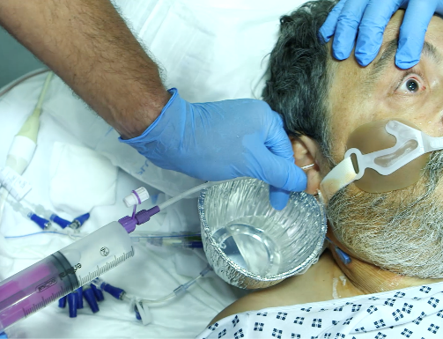
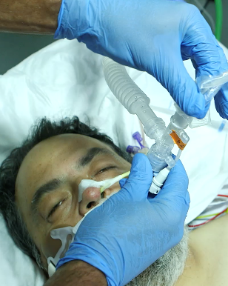
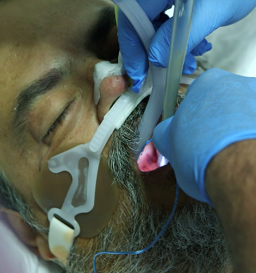
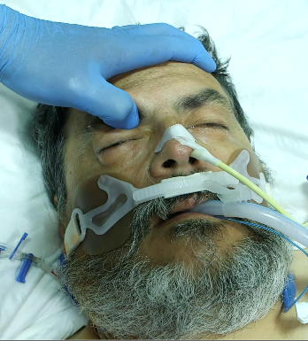
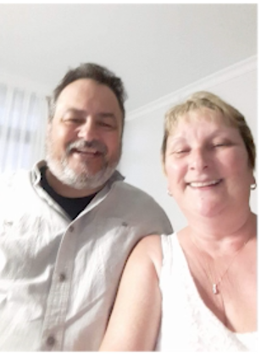
Examination of brainstem reflexes
Pupillary (II, III)
Corneal (V, VII)
Vestibuo-ocular (III, VI, VIII)
Motor (supraorbital) (V, VII)
Cough
(IX, X)
Gag
(IX, X)
The Deceased Donation Course (ICM)
In honour and memory of
Mr Robert Williams (1962-2017)

Slide 39
Examination of brainstem reflexes
Permanent absence of the brainstem reflexes is the clinical justification for concluding there is permanent loss of consciousness.
As the reticular activating system (required for consciousness) runs through the brainstem, interwoven with its nuclei.
Pupillary (II, III)
Corneal (V, VII)
Vestibuo-ocular (III, VI, VIII)
Motor (supraorbital) (V, VII)
Cough
(IX, X)
Gag
(IX, X)
The Deceased Donation Course (ICM)
In honour and memory of
Mr Robert Williams (1962-2017)

Slide 40
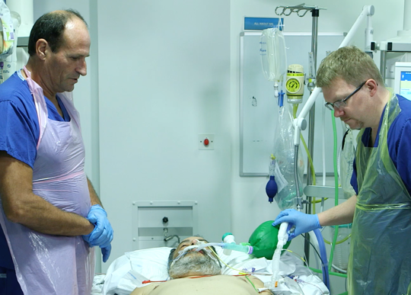
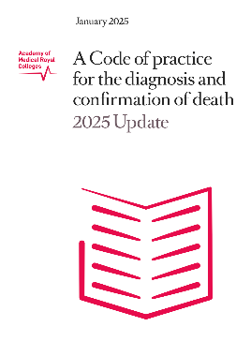
Apnoea Test
Start: PaCO₂ ≥ 5.3 Kpa
40 mmHg
Stop: PaCO₂ rise ≥ 2.7 Kpa
PaCO₂ ≥ 8.0 Kpa
Minimum time: 5 mins
20 mmHg
60 mmHg
Recommended method in adults
After pre-oxygenation, disconnect the ventilator and administer oxygen via a Waters circuit (Mapleson C).
Performed twice as the last clinical examination in each set of tests.
The Deceased Donation Course (ICM)

Slide 41
Challenges to DNC
Legal
Philosophical
Self Fulfilling Prophecy
What functions count
Spinal and Autonomic Reflexes
To test or not to test
Clinical
Time of Death
Preconditions & ‘Red Flags’
Lessons learnt from recent cases
Ancillary Investigations
Communicating to Relatives
The Deceased Donation Course (ICM)

Slide 42

UK Legal Position
Mr JUSTICE PEEL
May 2024
“There is nothing before me to suggest that the brain stem tests were not conducted rigorously in accordance with the Code of Practice... The brain stem tests were carried out in accordance with the Code of Practice and there is nothing to suggest that any further inquiry would reach a different conclusion."
Airedale NHS Trust v. Bland [1993]
House of Lord’s recognised Tony Bland as alive because brainstem not destroyed.
Court of Appeal. [2023]
“…a widely accepted consensus in this country for almost 50 years that brain stem death, correctly diagnosed, is the proper indicator of death in the legal sense.
The contrary is not reasonably arguable at any level of court.”

Slide 43
UK Legal Position
LORD JUSTICE PETER JACKSON
September 2023
“Finally, every human endeavour involves the possibility of error.
The fact that the conclusions from testing may have proved incorrect in one or more other cases underlines the need for the greatest care to be exercised.
It does not lead to the conclusion that the basis upon which death is to be established is unsound."
Airedale NHS Trust v. Bland [1993]
House of Lord’s recognised Tony Bland as alive because brainstem not destroyed.
Court of Appeal. [2023]
“…a widely accepted consensus in this country for almost 50 years that brain stem death, correctly diagnosed, is the proper indicator of death in the legal sense.
The contrary is not reasonably arguable at any level of court.”

Slide 44


UK and International Case Law
Judges wear black robes not white coats
The Deceased Donation Course (ICM)

Slide 45



Self-fulfilling
prophecy
‘Although we were unable to restore his consciousness or spontaneous breathing, the boy lived several more years.’ (page 195)
D. Alan Shewmon, MD
The Deceased Donation Course (ICM)

Slide 46



Death
= loss of function
Image taken with family permission in the late 1980s
What functions count?
examples from the animal world
The Deceased Donation Course (ICM)

Slide 47




The Deceased Donation Course (ICM)

Slide 48



Spinal Reflexes
40 years of practice
Jorgensen (1973),
  63 patients – clinical, EEG, angiogram
  80% spinal reflexes (if not = periods profound hypotension)
  Autopsy – liquefaction of the brain
Autonomic
Reflexes
The Deceased Donation Course (ICM)

Slide 49


To TEST or NOT to TEST
diagnosis decision
The Deceased Donation Course (ICM)

Slide 50
To TEST or NOT to TEST
Establishing unequivocally whether a patient is alive or dead.
Allows all medical support to be withdrawn as it cannot benefit the patient in any way.
Protects medical staff in cases subject to medico-legal scrutiny where national guidance has been followed.
Maintains the safety of the diagnostic criteria by providing an opportunity for education.
Where organ donation is a possibility the test results clarify the clinical context in which discussions about donation can take place.
diagnosis decision
The Deceased Donation Course (ICM)

Slide 51
Time of Death
Re A (A Minor) [1992]
1976 ‘customary to repeat the tests’
‘should nevertheless be repeated’
‘two sets of tests should always be performed’
2008 ‘must always be performed on two occasions.’
2025 ‘Death is confirmed at the time when an authorised healthcare professional is satisfied all the relevant criteria to diagnose and confirm death are met.’
ALIVE
Test 1
ALIVE
Test 2
DECEASED
Time of Death
The Deceased Donation Course (ICM)

Slide 52



Supports for you, so you can be safe and confident
In honour and memory of
Mr Robert Williams (1962-2017)
Educational videos www.odt.nhs.uk
search ‘Neurological Criteria’

Slide 53
Lessons Learnt from Recent UK Cases
Decompressive Craniectomy
Added as a Red Flag
Red Flags made more prominent on testing forms
AoMRC asked to look at updating Code (work ongoing)
Professional organisations and societies to look at ancillary investigations.
Archie Battersbea
Testing found to be ‘best interests’
Prolonged ventilation = use nerve stimulator
Child A
Safety alert on spinal cord injury
Improvements to form design planned
The Deceased Donation Course (ICM)

Slide 54

Ancillary Investigations
Required when:
Comprehensive neurological examination not possible.
Where confounding conditions (e.g., red flags) cannot be excluded.
Considered when:
Uncertainty regarding the interpretation of possible spinally mediated movements.
To promote understanding to families who are uncertain or unaccepting of such a diagnosis.
Loss of Bioelectrical Activity
EEG
Evoked Potentials
Loss of Cerebral Circulation
Four-vessel intra-arterial catheter angiography
CT angiogram
Transcranial Doppler
MRA
SPECT
PET
The Deceased Donation Course (ICM)

Slide 55

Communicating to Relatives
Essential message
Death is suspected
Tests to confirm death
“The scan of her brain is very abnormal and devastating. My fear is that the damage Margaret has sustained to her brain, is so severe, that she may have already died.”
“Another senior doctor and I are planning to carry out some tests on Margaret to see if she will ever regain any consciousness or ever breathe again. If the tests confirm that these essential brain functions are permanently lost, this will confirm to us, that she has died.”
The Deceased Donation Course (ICM)

Slide 56
A doctors’ duty
Resuscitate – save those you can
Diagnose the dead – declare death
Safe – no coming back to life after death declared
Timely – no unnecessary delay
Death is a process, which effects different functions and cells of the body at different rates of decay.
Doctors identify the point in the process where death can be diagnosed and confirmed in an accurate (safe), standardised (safe) and timely manner.
The Deceased Donation Course (ICM)

