Slide 1

@ODTEdandGov
#DDsim

Slide 2
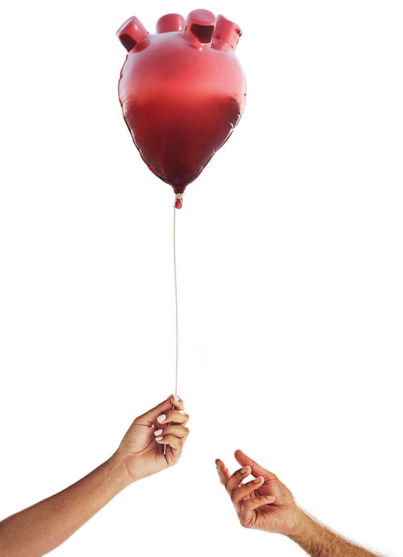


Deceased Donation in Context past, present and future
Dr Dale Gardiner
Associate Medical Director – Deceased Organ Donation
(National CLOD)
DDSIM 2025

Slide 3
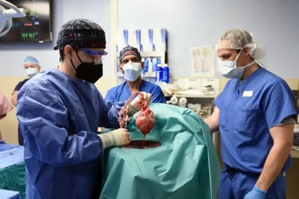
Organs for Transplant
solid organ transplantation
xeno-
transplants
stem cell
research
living
donation
deceased
donation
DCD
(donation after circulatory death)
controlled
un-controlled
DBD
(donation after brainstem death)
DD SIM 2025
Notes:
These are your options if you have end stage organ failure
We hope for solutions – unlimited solutions – from xenotransplantation or stem cell research
Well dream on, because for the time being we will have to rely on second hand organs used and abused by a previous owner and given up either in life or in death.
In turn, we recognise three kinds of donation after death.
Firstly, donation after death that is confirmed using neurological criteria – your kind of death
Then, donation after a death diagnosed using circulatory criteria, a death that is either anticipated because it follows a decision to limit or withdraw life sustaining treatments, or unexpected – or uncontrolled – because it follows an unexpected cardiac arrest

Slide 4
Donation in UK, 2023/24
662,000 deaths
290,000 hospital deaths
Corneal Donors
2,154 cornea only
215 DBD
220 DCD
6,794 potential organ donors
56% of deceased organ donors on the opt-in ODR
6,421 referred
3,107 family requests
1,880 yes
62% of deceased organ donors
50 years or older.
1,510
donors
DBD 772 DCD 738
DD SIM 2025
DD SIM 2024
Notes:
Activity Report 2023/24
Figure 2.3
Figure 2.2
Organ Donor Register Summary Page
Figure 3.1 – age
Cornea Activity Summary Page
Cornea DBD and DCD # find under Figure 10.1

Slide 5
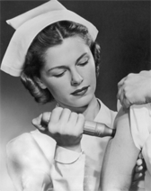

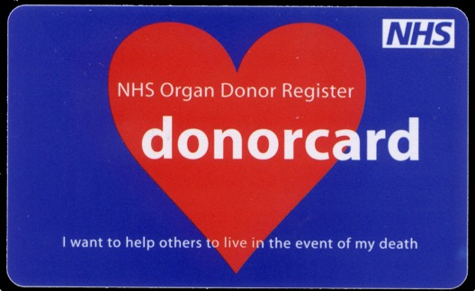
the past
Our UK journey

Slide 6
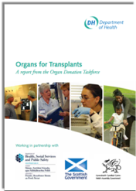
Our journey
Our UK journey
Transplant waiting list
50% increase in donors over 5 years
Deceased donors
2008
2008 Taskforce “Donation should be a usual part of end of life care.”

Slide 7



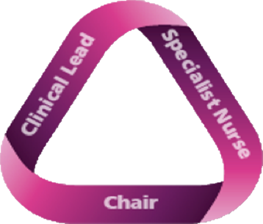
Invest in People
People - the building block of our improvement
2-4 hours / week
240 CLODs
Local, regional, national
Budget £2.3 million / year
Recommendation 4
All parts of the NHS must embrace organ donation as a usual, not an unusual event. … Each Trust should have an identified clinical [lead] and a Trust donation committee to help achieve this.
Clinical Lead for Organ Donation (CLOD)
Non-clinical Donation Committee Chair
Recommendation 9
Additional [nurses], embedded within critical care areas, should be employed to ensure a comprehensive, highly skilled, specialised and robust service.
people
Specialist Nurse for Organ Donation (SN-OD)

Slide 8
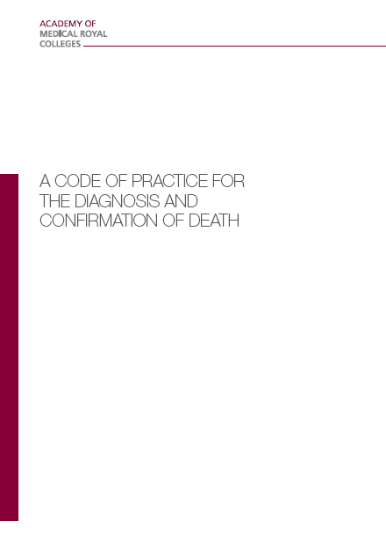
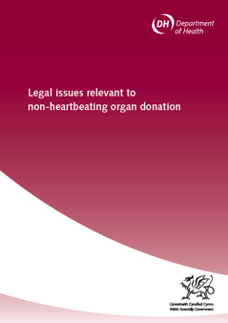

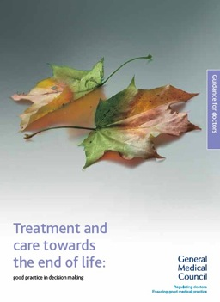
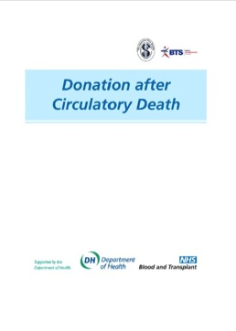
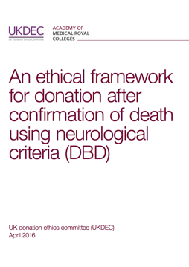
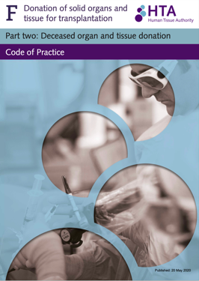
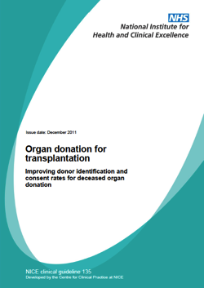
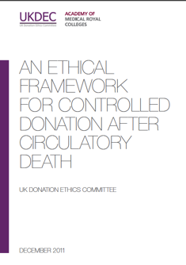
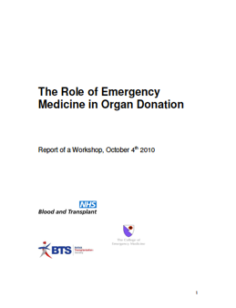
Framework of UK Practice
2008
The ethical, legal and professional framework that underpins the deceased organ donation programme in the UK.
2020
A Professional, Ethical and Legal Framework
Available www.odt.nhs.uk
Notes:
Dale

Slide 9
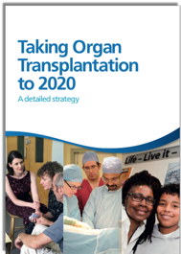
Our journey
Our UK journey
Transplant waiting list
Collaborative Approach
Training
Deceased donors
2013
Marketing
and Media
2008 Taskforce “Donation should be a usual part of end of life care.”
2008
To 2020 Strategy
“A revolution in consent.”
People
Frameworks

Slide 10


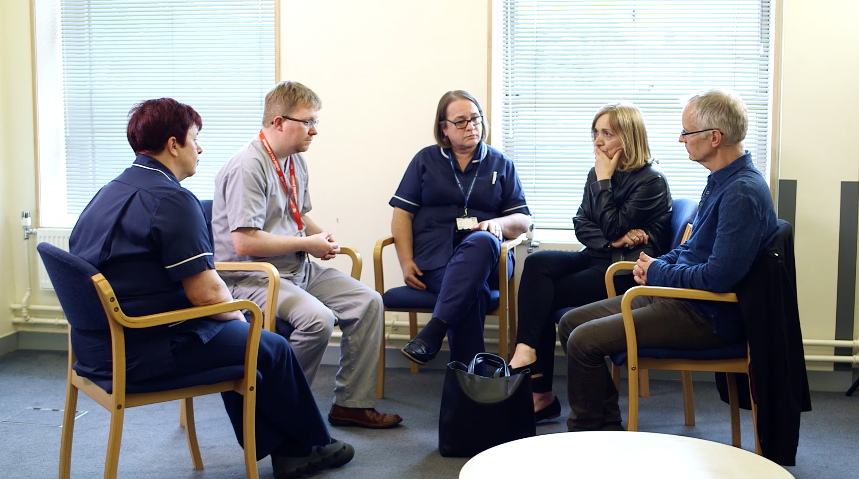
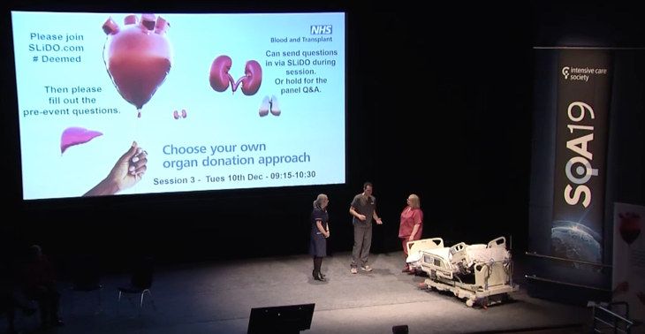

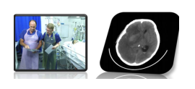

Collaborative Approach and Training
Specialist Nurse Training
National Deceased Donation Course for Intensive Care medicine Trainees (#DDSIM)
CLOD / Chair Induction
UK Organ Retrieval Masterclass
Child and Infant Deceased Donation Course
World Leading Education Videos
Death using Neurological Criteria (awaiting update)

Slide 11

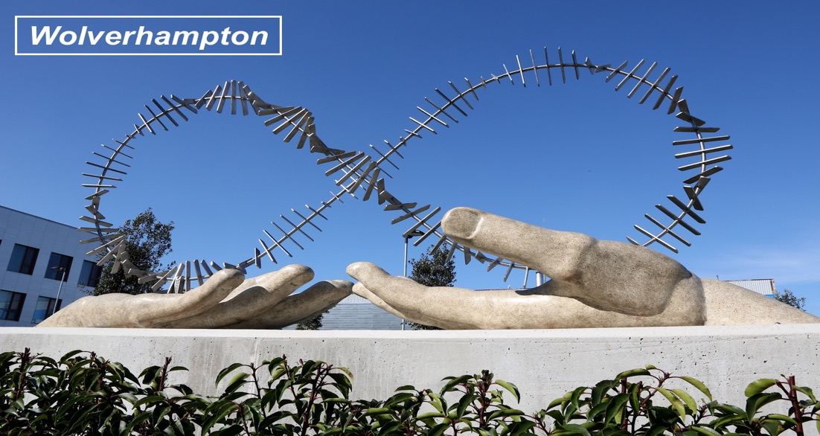
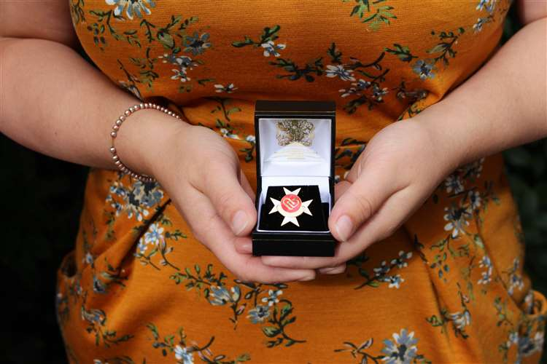
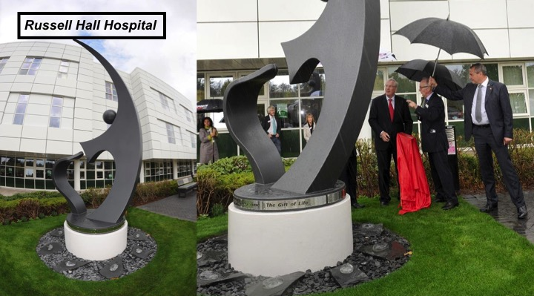
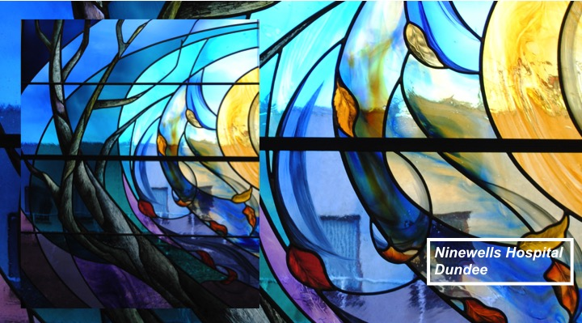
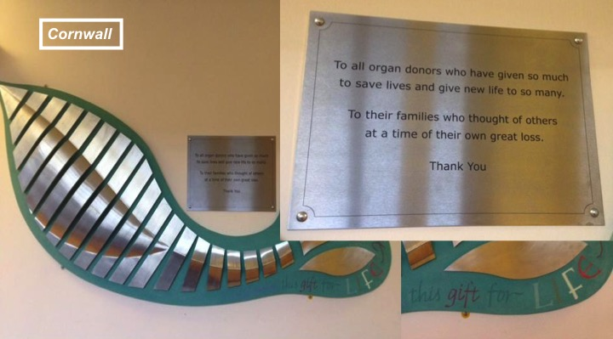
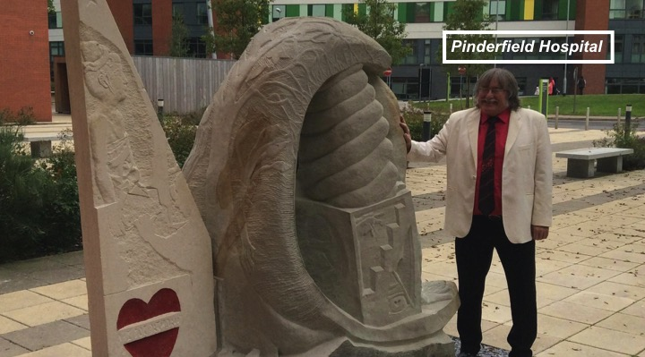
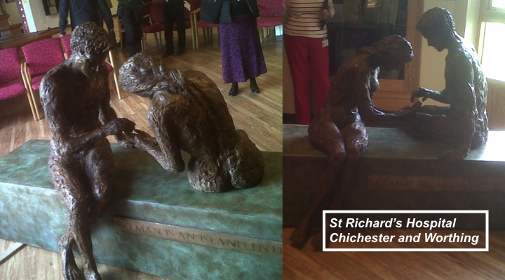
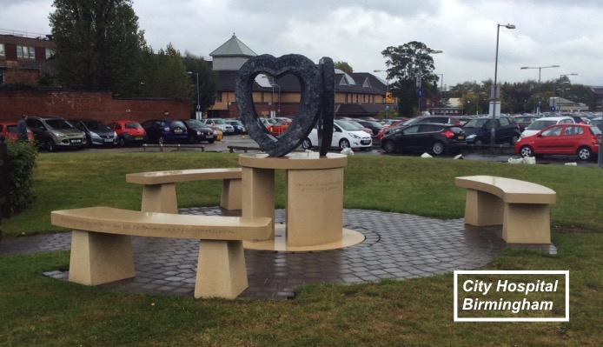
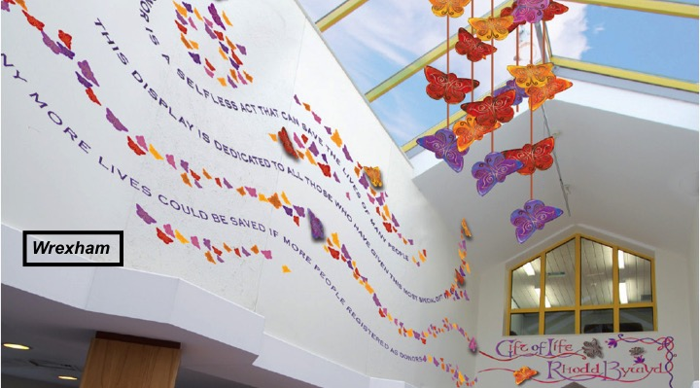
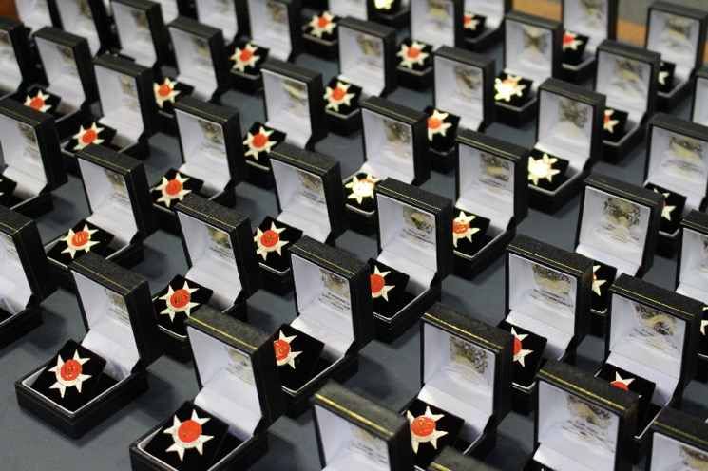
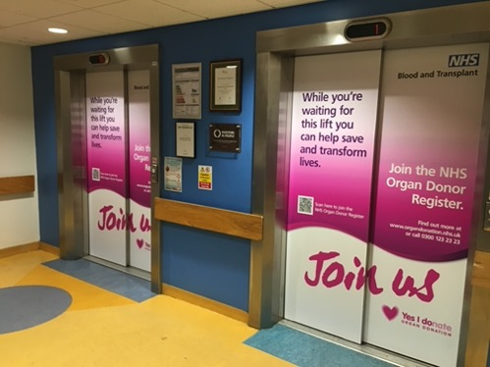
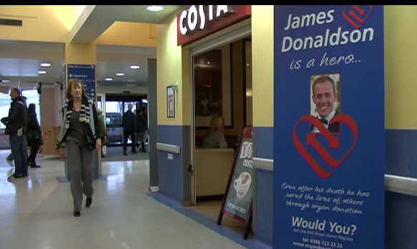
Hospital & Public Promotion
Order of St John Award for Organ Donation

Slide 12
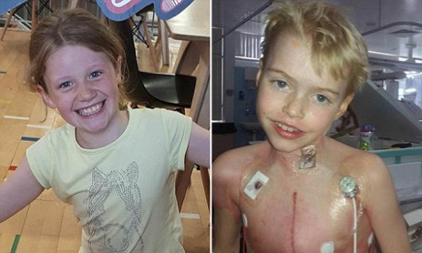
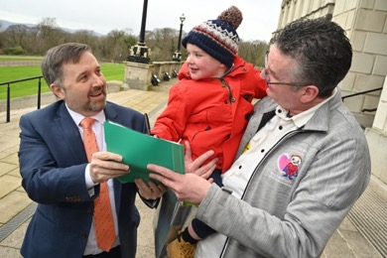
Deemed (Opt Out) Legislation in the UK
Wales
Commenced December 2015
Final Vote
Yes 43
No 8
Abstain 2
England
‘Max and Keira’s Law’
Commenced May 2020
Private members bill
- No one formally objected!
Scotland
Commenced
March 2021
Final Vote
Yes 116
No 3
Abstain 2
Northern Ireland
‘Dáithí’s Law’
Commenced June 2023
No verbal dissent.

Slide 13
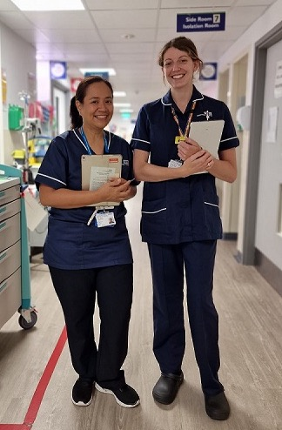
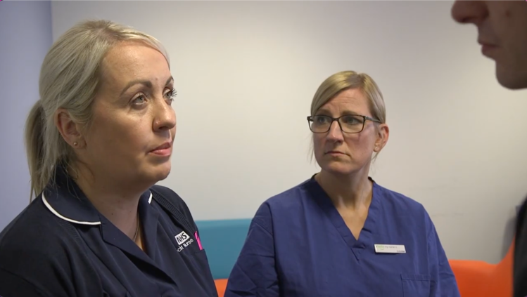

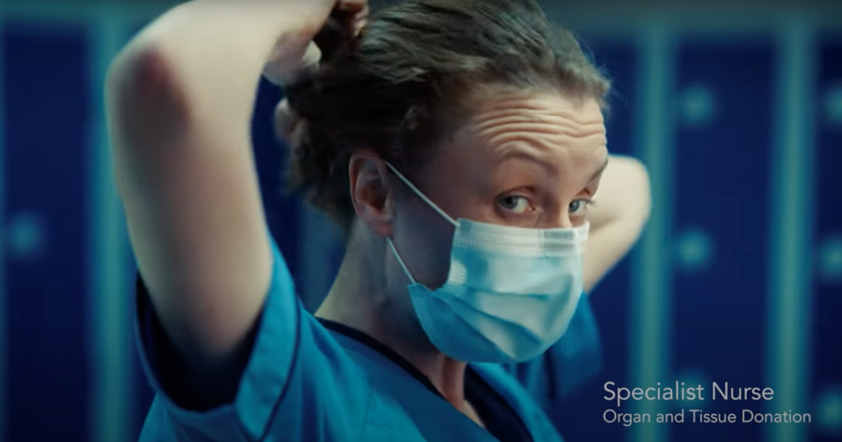
Our UK journey
the present

Slide 14
Renal Registry Data

Slide 15
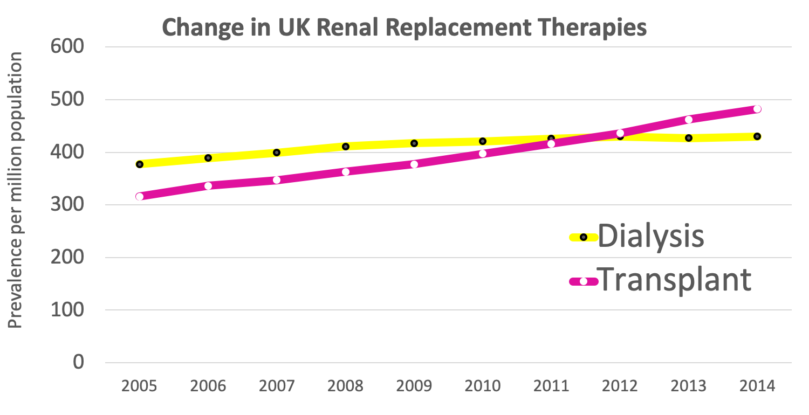
NICE identified a potential net monetary benefit of £62,983 from kidney transplantation compared to dialysis.
Welsh government financial analysis concluded that an increase of one additional donor each year will, over a ten year period, have an estimated net present value of £3-5 million.
The lifesaving impact of transplantation Renal Registry Data
Notes:
More work to be done.

Slide 16
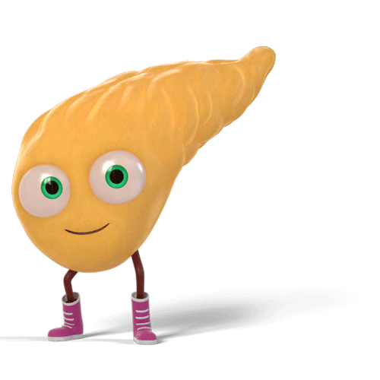
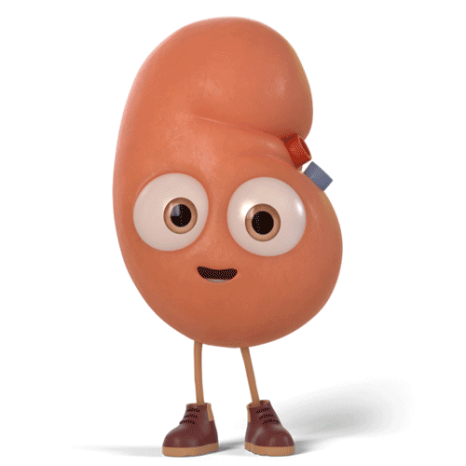
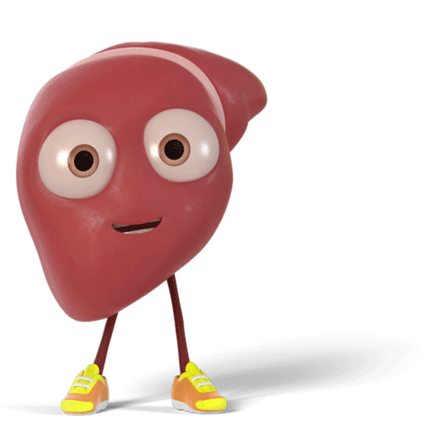
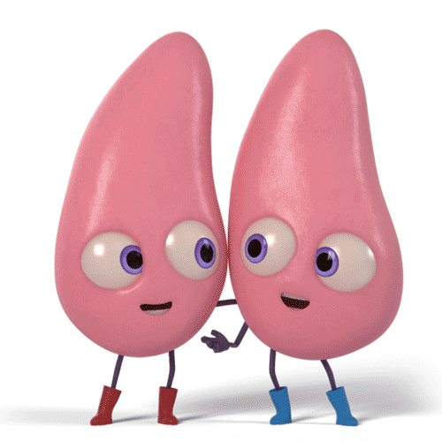
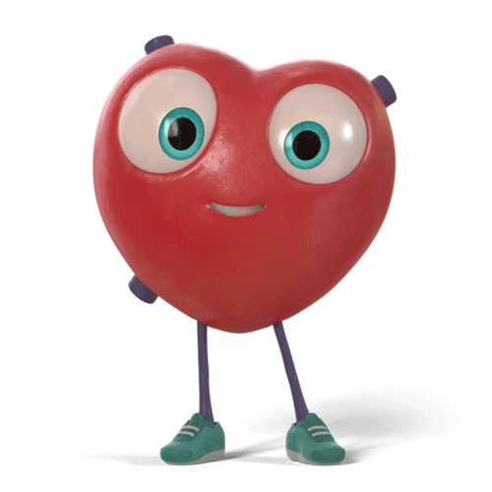
5 Yr Graft Survival
5 Yr Patient Survival
DBD 55%
DCD 51% (3 Yr)
Liver
5 Yr Patient Survival
DBD 84%
DCD 81%
Living ?
Pancreas only
5 Yr Graft Survival
DBD 64%
DCD 64%
5 Yr Graft Survival
DBD 87%
DCD 84%
Living 94%
5 Yr Patient Survival
DBD 87%
DCD 83%
Living 94%
5 Yr Patient Survival
DBD 75%
DCD 77% (3 Yr)
28%
2.4%
49%
31% 38%
24%
27%
DCD
Deceased Transplants
(2023/24 data)
(2015/16 data)
www.orgamites.com
UK Transplant Outcomes
Notes:
DCD Tx %
Kidneys
Table 5.7 Kidney only transplant rates per million population (pmp), in the UK, 1 April 2017 - 31 March 2018, by country and English Strategic Health Authority
Pancreas
Table 6.7 Pancreas transplant rates per million population (pmp), in the UK, 1 April 2017 - 31 March 2018, by country and English Strategic Health Authority
Lungs
Table 7.9 Cardiothoracic transplant rates per million population (pmp) in the UK, 1 April 2017 - 31 March 2018, by country/ Strategic Health Authority
Heart
Table 7.9 Cardiothoracic transplant rates per million population (pmp) in the UK, 1 April 2017 - 31 March 2018, by country/ Strategic Health Authority
Liver
Table 8.8 Liver transplant rates per million population (pmp) in the UK, 1 April 2017 - 31 March 2018, by Country/ Strategic Health Authority
Tx Survival
Kidney
Table 11.1 Graft survival after first adult kidney only transplant from a DBD
Table 11.2 Patient survival after first adult kidney only transplant from a DBD
Table 11.3 Graft survival after first adult kidney only transplant from a DCD
Table 11.4 Patient survival after first adult kidney only transplant from a DCD
Table 11.5 Graft survival after first adult living donor kidney transplant
Table 11.6 Patient survival after first adult living donor kidney transplant
Pancreas
Table 11.15 Graft survival after first pancreas only transplant from a DBD
Table 11.17 Graft survival after first pancreas only transplant from a DCD
Liver
Table 11.26 Patient survival after first elective adult liver only transplant from a DBD
Table 11.26 Patient survival after first elective adult liver only transplant from a DCD
Heart
Table 11.19 Patient survival after first adult heart only transplant from a DBD
Table 11.20 Patient survival after first adult heart only transplant from a DCD
Lung
Table 11.22 Patient survival after first adult lung only transplant from a DBD
Table 11.23 Patient survival after first adult lung only transplant from a DCD

Slide 17

Our journey

Slide 18

Our UK journey
the future

Slide 19
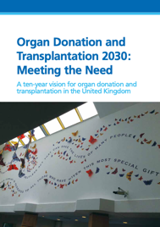
Our journey
Our UK journey
- 25%
Transplant waiting list
2013
DEEMED
Deceased donors
2008 Taskforce “Donation should be a usual part of end of life care.”
2008
To 2020 Strategy
“A revolution in consent.”
Meeting the Need, 2030
“Transplants and donation.”

Slide 20
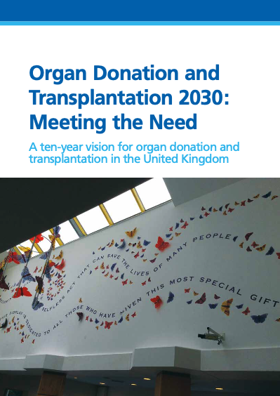



future
Utilisation
Expected

Slide 21


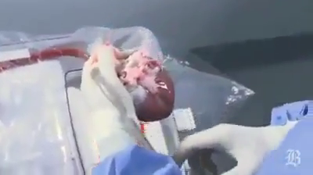

DCD heart retrieval
Organ
RECOVERY
Technology
ex situ
Utilisation
Ex-situ machine perfusion for extracorporeal preservation of livers for transplantation
Interventional procedures guidance
Published: 16 January 2019
nice.org.uk/guidance/ipg636
UK, Australia, Belgium Netherlands, Spain, USA
Cape Town (1967)
Image from YouTube
DCD →27% UK Heart Tx
Challenge in DCD: minimise / overcome warm ischaemic damage

Slide 22
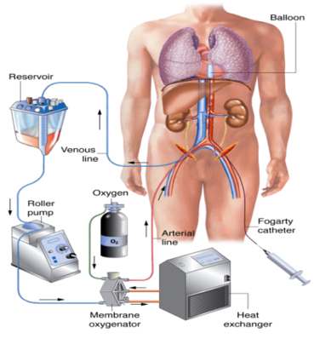
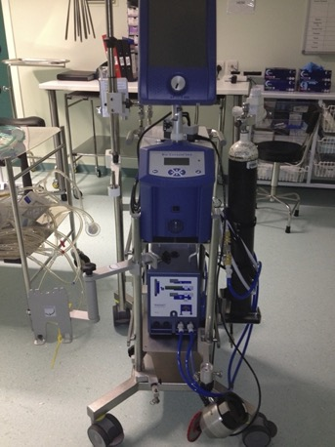
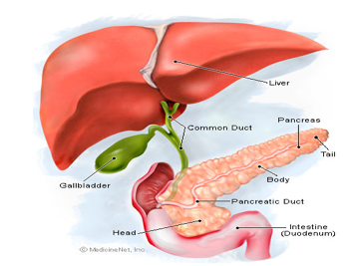
Normothermic Regional Perfusion (NRP)
Organ
RECOVERY
in situ
DCD 31% UK Liver Tx
(> 40% with NRP)
Utilisation
Borderline liver & pancreas
~ 16% increased risk ischaemic cholangiopathy
for every 1 additional minute warm ischaemia
Challenge in DCD: minimise / overcome warm ischaemic damage

Slide 23



Expected
“Living and deceased donation will become an expected part of care, where clinically appropriate, for all in society.”
In our intensive care and emergency departments, the consideration of organ donation is now a usual part of end of life care.
We need to take the next step.
From usual to expected.
Organ donation becomes a
societal norm

Slide 24

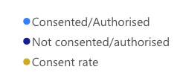
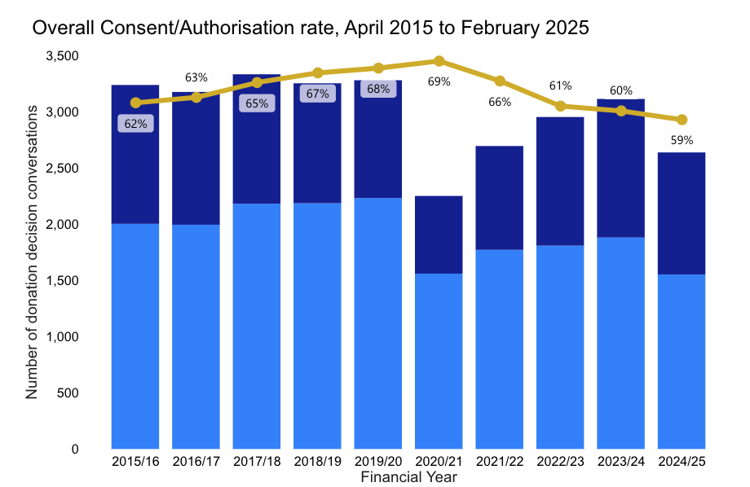
UK Consent/Authorisation
year to date
DCD 15% lower than DBD
157 families overruled expressed opt-in
29 DBD
128 DCD
Deemed Consent / Authorisation
= 48%
Before deemed legislation, was 50:50 families agreeing if didn’t know what the person wanted.

Slide 25



Ethnicity Differences Report

Slide 26


Paediatrics (<18yrs)
1 April 2014 – 31 March 2024
The average age of deaths in PICU is 1 years old.
The average age of proceeding donors is 12 years old.
UK PICU mortality (< 16 years)
2004 – 5.5 %
2021 – 3.5 %
Paediatrics

Slide 27

Our future
A world leading
organ donation and transplantation system
=
www.nhsbt.nhs.uk/commonwealth

Slide 28




4 initiatives you can help with
(apart from putting into practice what you learn over the next two days)
LEADER
2025
Trainee Representatives in Organ Donation
TRODs
Leadership in holding
a Moment of Honour
https://www.odt.nhs.uk/deceased-donation/best-practice-guidance/end-of-life-care/

Slide 29






